Slide 1
M2 Chapter 7: Application of Forces Static Particles

Slide 2
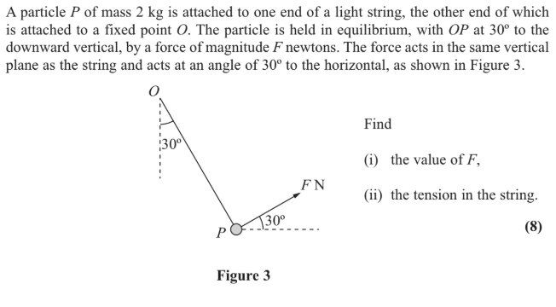
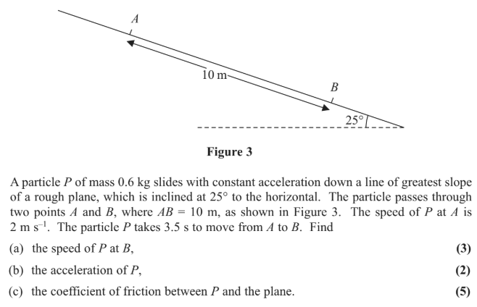
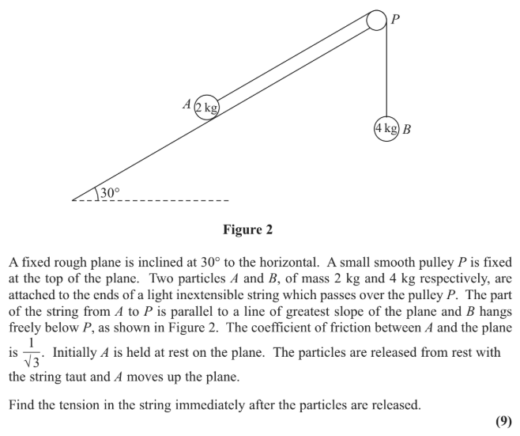

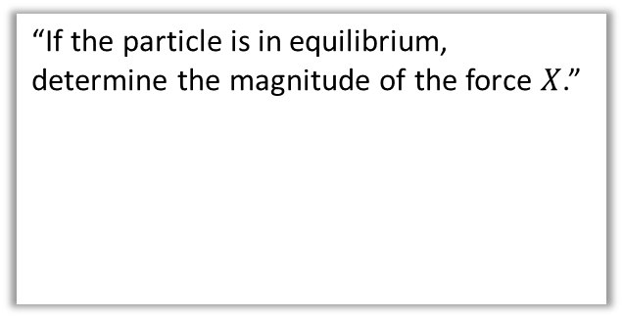

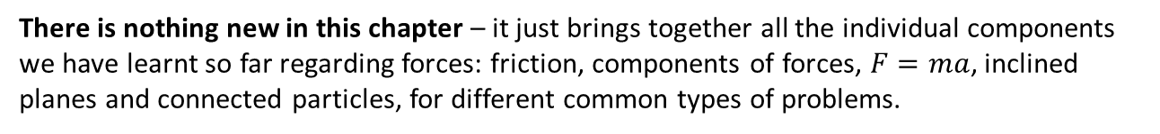

Overview
There is nothing new in this chapter – it just brings together all the individual components we have learnt so far regarding forces: friction, components of forces, $F=ma$, inclined planes and connected particles, for different common types of problems.
1:: Unknown forces for bodies in equilibrium.
2:: Static problem involving weight, tension and pulleys
“If the particle is in equilibrium, determine the magnitude of the force $X$.”
$$X$$
$$20 N$$
$$60°$$
$$30°$$
$$10g N$$
3:: Objects in motion on inclined planes
4:: Connected particles requiring resolution of forces.

Slide 3


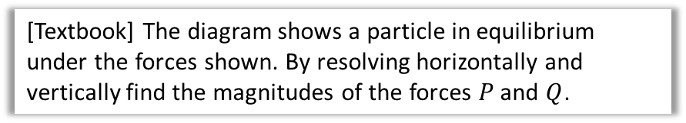




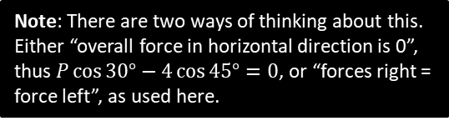
Finding unknown forces by resolving forces
$$4 N$$
[Textbook] The diagram shows a particle in equilibrium under the forces shown. By resolving horizontally and vertically find the magnitudes of the forces $P$ and $Q$.
$$P N$$
$$45°$$
$$30°$$
Just resolve separately in the horizontal and vertical directions, as before.
$$Q N$$
?
Note: There are two ways of thinking about this. Either “overall force in horizontal direction is 0”, thus $P\cos{30°−4}\cos{45°}=0$, or “forces right = force left”, as used here.
$$R\left(→\right): P\cos{30°}=4\cos{45°} \\ R\left(↑\right): P\sin{30°}+4\sin{45°}=Q$$
$$P=\frac{4\cos{45}}{\cos{30}}=3.27 \left(3sf\right) \\ Q=\left(\frac{4\cos{45}}{\cos{30}}\right)\sin{30}+4\sin{45}=4.46 (3sf)$$

Slide 4











Unknown forces on inclined planes
[Textbook] The diagram shows a particle in equilibrium on an inclined plane under the forces shown. Find the magnitude of the force $P$ and the size of the angle $α$.
?
$$R\left(↗\right): P\cos{α}=8+5\sin{30°} \\ R\left(↖\right): P\sin{α}+2=5\cos{30°}$$
When we have $P\sin{α}$ and $P\cos{α}$, a good strategy is to divide them so we get just $\tan{α}$. You may have seen this in Year 2 trigonometry when expressing trig sums in the form $R sin⁡(x+α)$.
$$P\sin{α}=5\cos{30°}−2 \\ P\cos{α}=8+5\sin{30°} \\ ∴\tan{α}=\frac{5\cos{30°}−2}{8+5\sin{30°}}=0.222… \\ α=12.5° (3sf)$$
$$P\sin{12.5…}=5\cos{30°}−2 \\ P=10.8 (3sf)$$
$$2 N$$
$$P N$$
?
$$P\sin{α}$$
$$α$$
$$P\cos{α}$$
?
$$8 N$$
$$5\cos{30}$$
$$5 N$$
$$30°$$
?
$$30°$$
$$5\sin{30}$$
?
Recall the recommendation to use dotted labelled arrow for the components of forces in diagrams.

Slide 5






Test Your Understanding
The diagram shows a particle in equilibrium on an inclined plane under the forces shown. Find the magnitude of the force $Q$ and the size of the angle $β$.
?
$$R\left(↗\right): Q\cos{β}=5+6\sin{30°} \\ R\left(↖\right): Q\sin{β}+6\cos{30°}=14$$
$$Q\sin{β}=14−6\cos{30°} \\ Q\cos{β}=5+6\sin{30°} \\ ∴\tan{β}=\frac{14−6\cos{30°}}{5+6\sin{30°}} \\ β=47.7° (3sf)$$
$$Q\cos{47.7…}=5+6\sin{30°} \\ Q=11.9 N (3sf)$$
$$14 N$$
$$Q N$$
$$β$$
?
$$5 N$$
$$6 N$$
$$30°$$

Slide 6
Exercise 7.1
Pearson Stats/Mechanics Year 2
Pages 56-57

Slide 7
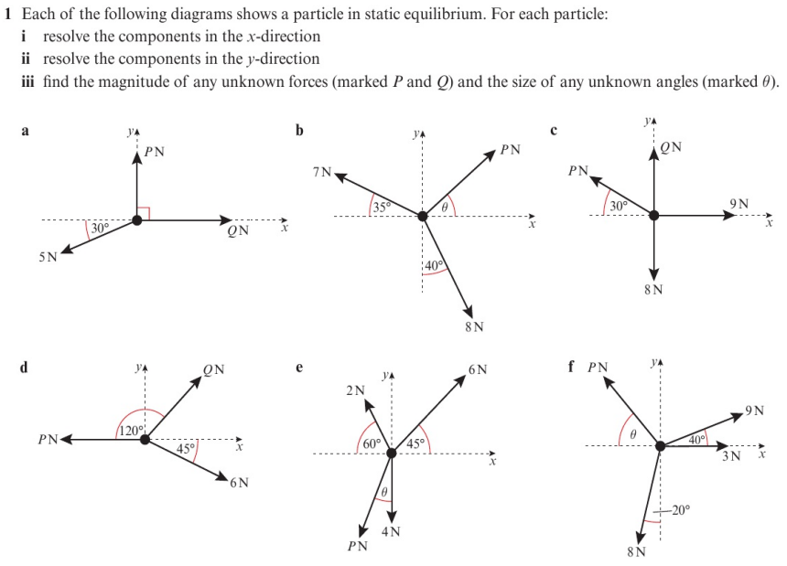
Homework Exercise

Slide 8
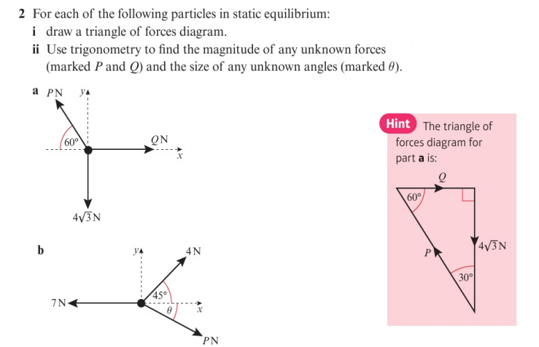
Homework Exercise

Slide 9
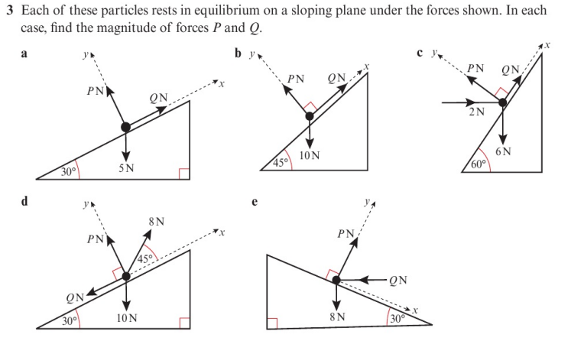
Homework Exercise

Slide 10
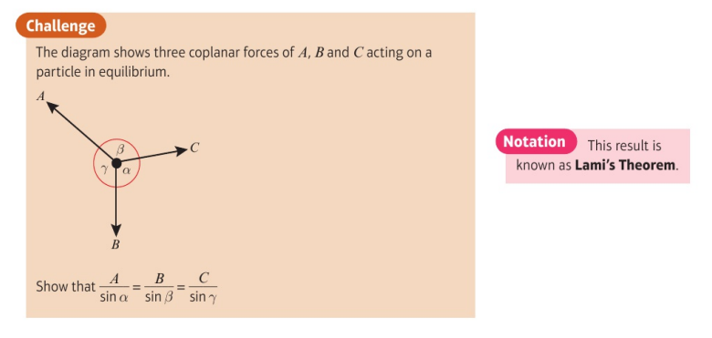
Homework Exercise

Slide 11
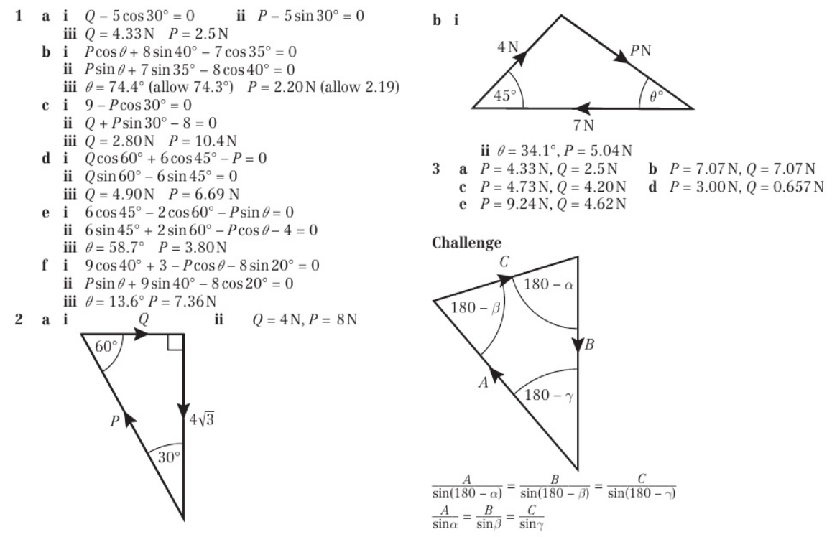
Homework Answers

