Slide 1
P1 Chapter 14: Logarithms Non-Linear Data

Slide 2
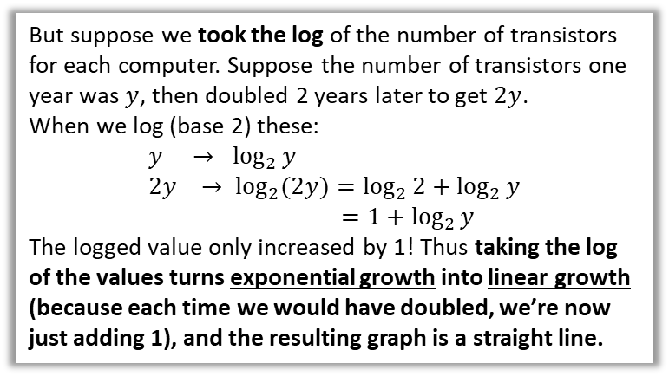
Graphs for Exponential Data
In Science and Economics, experimental data often has exponential growth, e.g. bacteria in a sample, rabbit populations, energy produced by earthquakes, my Twitter followers over time, etc.
Because exponential functions increase rapidly, it tends to look a bit rubbish if we tried to draw a suitable graph:
But suppose we took the log of the number of transistors for each computer. Suppose the number of transistors one year was $y$, then doubled 2 years later to get $2y$.
When we log (base 2) these:
$$y → \log_{2}{y} \\ 2y → \log_{2}{(2y)}=\log_{2}{2}+\log_{2}{y} \\ =1+\log_{2}{y}$$
The logged value only increased by 1! Thus taking the log of the values turns exponential growth into linear growth (because each time we would have doubled, we’re now just adding 1), and the resulting graph is a straight line.
Take for example “Moore’s Law”, which hypothesised that the processing power of computers would double every 2 years. Suppose we tried to plot this for computers we sampled over time:
If we tried to force all the data onto the graph, we would end up making most of the data close to the horizontal axis. This is not ideal.
Number of transistors
log(transistors)
2000
Year
Year
1970
1980
1990
1970
1980
1990
2000

Slide 3
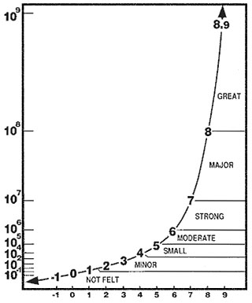
Graphs for Exponential Data
Because the energy involved in earthquakes decreases exponentially from the epicentre of the earthquake, such energy values recorded from different earthquakes would vary wildly.
The Richter Scale is a logarithmic scale, and takes the log (base 10) of the amplitude of the waves, giving a more even spread of values in a more sensible range.
(The largest recorded value on the Richter Scale is 9.5 in Chile in 1960, and 15 would destroy the Earth completely – evil scientists take note)
The result is that an earthquake just 1 greater on the Richter scale would in fact be 10 times as powerful.
Richter Scale

Slide 4



Other Non-Linear Growth
$$y$$
We would also have similar graphing problems if we tried to plot data that followed some polynomial function such as a quadratic or cubic.
We will therefore look at the process to convert a polynomial graph into a linear one, as well as a exponential graph into a linear one…
$$y=2x^{3}$$
$$x$$

Slide 5






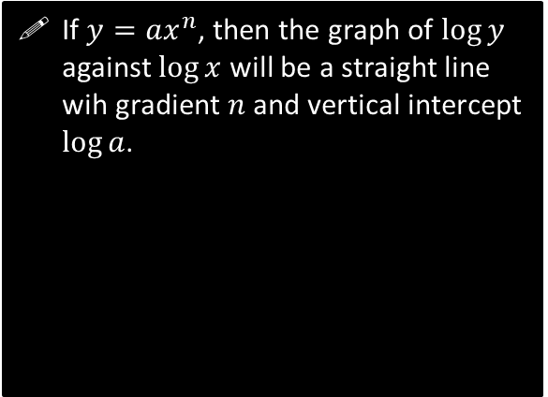
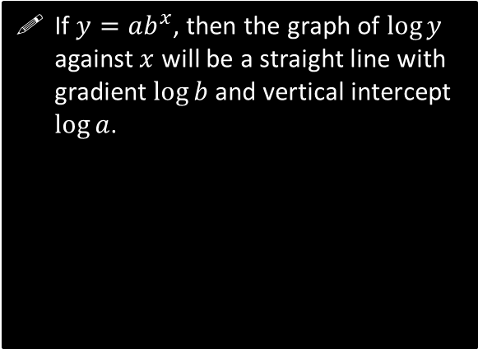


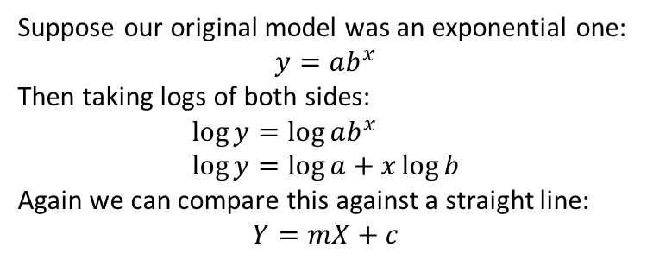
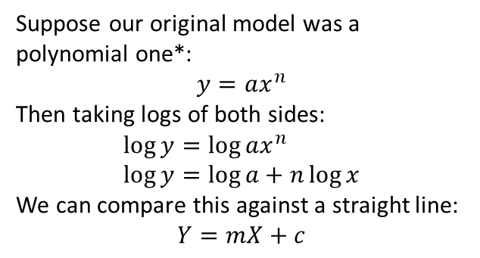


Turning non-linear graphs into linear ones
Case 1: Polynomial $→$ Linear
Case 2: Exponential $→$ Linear
Suppose our original model was a polynomial one*:
$$y=ax^{n}$$
Then taking logs of both sides:
$$\log{y}=\log{ax^{n}} \\ \log{y}=\log{a}+n\log{x}$$
We can compare this against a straight line:
$$Y=mX+c$$
Suppose our original model was an exponential one:
$$y=ab^{x}$$
Then taking logs of both sides:
$$\log{y}=\log{ab^{x}} \\ \log{y}=\log{a}+x\log{b}$$
Again we can compare this against a straight line:
$$Y=mX+c$$
If $y=ax^{n}$, then the graph of $\log{y}$ against $\log{x}$ will be a straight line wih gradient $n$ and vertical intercept $\log{a}$.
If $y=ab^{x}$, then the graph of $\log{y}$ against $x$ will be a straight line with gradient $\log{b}$ and vertical intercept $\log{a}$.
$$\log{y}$$
$$\log{y}$$
$$\log{a}$$
$$\log{a}$$
$$\log{x}$$
$$x$$
* We could also allow non-integer $n$; the term would then not strictly be polynomial, but we’d still say the function had “polynomial growth”.
The key difference compared to Case 1 is that we’re only logging the $y$ values (e.g. number of transistors), not the $x$ values (e.g. years elapsed). Note that you do not need to memorise the contents of these boxes and we will work out from scratch each time…
In summary, logging the $y$-axis turns an exponential graph into a linear one. Logging both the $x$ and $y$-axis turns a polynomial graph into a linear one.

Slide 6
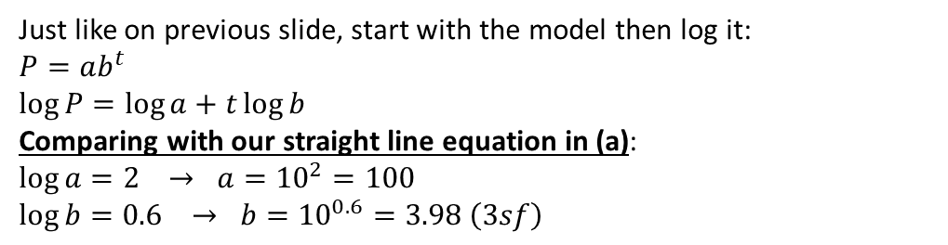


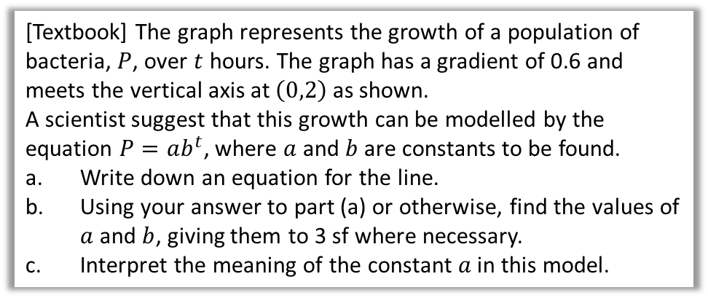




Example
[Textbook] The graph represents the growth of a population of bacteria, $P$, over $t$ hours. The graph has a gradient of 0.6 and meets the vertical axis at $\left(0,2\right)$ as shown.
A scientist suggest that this growth can be modelled by the equation $P=ab^{t}$, where $a$ and $b$ are constants to be found.
Write down an equation for the line.
Using your answer to part (a) or otherwise, find the values of $a$ and $b$, giving them to 3 sf where necessary.
Interpret the meaning of the constant $a$ in this model.
$$log⁡(P)$$
$$2$$
$$t$$
?
a
$$\log{P}=0.6t+2$$
Equation of straight line is $y=mx+c$ where here:
$$y=\log{P}, m=0.6, c=2, x=t$$
b
Just like on previous slide, start with the model then log it:
$$P=ab^{t} \\ \log{P}=\log{a}+t\log{b}$$
Comparing with our straight line equation in (a):
$$\log{a}=2 → a={10}^{2}=100 \\ \log{b}=0.6 → b={10}^{0.6}=3.98 \left(3sf\right)$$
?
Recall that $\log{a}$ means $\log_{10}{a}$
?
c
$a$ gives the initial size of the bacteria population.
Recall that the coefficient of an exponential term gives the ‘initial value’.

Slide 7

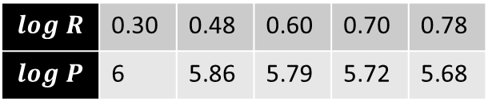





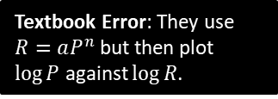
Example
[Textbook] The table below gives the rank (by size) and population of the UK’s largest cities and districts (London is number 1 but has been excluded as an outlier).
City B’ham Leeds Glasgow Sheffield Bradford
Rank, $R$ 2 3 4 5 6
Population, $P$ 1 000 000 730 000 620 000 530 000 480 000
The relationship between the rank and population can be modelled by the formula:
$P=aR^{n}$ where $a$ and $n$ are constants.
Draw a table giving values of $\log{R}$ and $\log{P}$ to 2dp.
Plot a graph of $\log{R}$ against $\log{P}$ using the values from your table and draw the line of best fit.
Use your graph to estimate the values of $a$ and $n$ to two significant figures.
Textbook Error: They use $R=aP^{n}$ but then plot $\log{P}$ against $\log{R}$.
c
First get equation of straight line:
$$m=\frac{Δy}{Δx}=\frac{5.68−6.16}{0.77−0.05}=−0.67$$
$c=6.2$ (reading from the graph)
$$∴\log\left(P\right)=−0.67\log\left(R\right)+6.2$$
As with previous example, let’s log the original model so we can compare against our straight line:
$$P=aR^{n} \\ \log{P}=\log{a}+n\log{R}$$ Comparing this with our straight line:
$$\log{a}=6.2 → a={10}^{6.2}=1600000 \left(2sf\right) \\ n=−0.67$$
$$log R$$ | 0.30 | 0.48 | 0.60 | 0.70 | 0.78
$$log P$$ | 6 | 5.86 | 5.79 | 5.72 | 5.68
?
a
?
b
?
$$log⁡(P)$$
Let’s use these points on the line of best fit to determine the gradient.
6.4
6.0
5.6
5.2
$$\left(0.05, 6.16\right)$$
$$\left(0.77, 5.68\right)$$
$$\log{R}$$
0.2 0.4 0.6 0.8

Slide 8
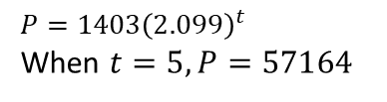
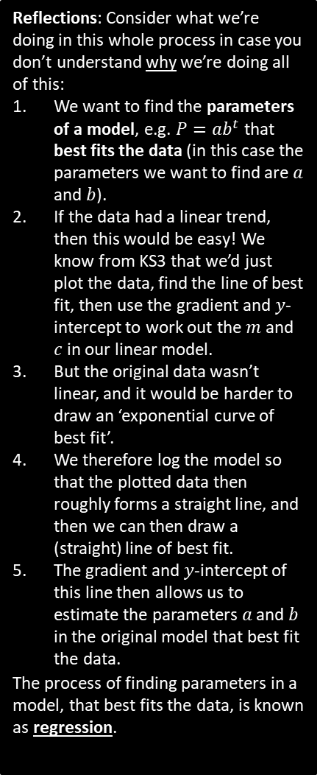
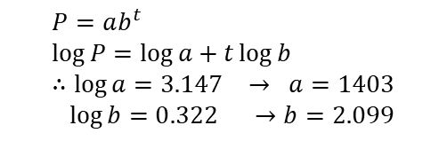
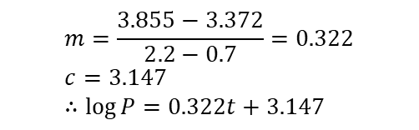
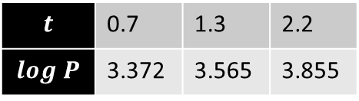
Test Your Understanding
Reflections: Consider what we’re doing in this whole process in case you don’t understand why we’re doing all of this:
We want to find the parameters of a model, e.g. $P=ab^{t}$ that best fits the data (in this case the parameters we want to find are $a$ and $b$).
If the data had a linear trend, then this would be easy! We know from KS3 that we’d just plot the data, find the line of best fit, then use the gradient and $y$-intercept to work out the $m$ and $c$ in our linear model.
But the original data wasn’t linear, and it would be harder to draw an ‘exponential curve of best fit’.
We therefore log the model so that the plotted data then roughly forms a straight line, and then we can then draw a (straight) line of best fit.
The gradient and $y$-intercept of this line then allows us to estimate the parameters $a$ and $b$ in the original model that best fit the data.
The process of finding parameters in a model, that best fits the data, is known as regression.
TheRealSanta wants to predict his number of Twitter followers $P$ (@ TheRealSanta) $t$ years from the start 2015. He predicts that his followers will increase exponentially according to the model $P=ab^{t}$, where $a,b$ are constants that he wishes to find.
He records his followers at certain times. Here is the data:
Years $t$ after 2015: 0.7 1.3 2.2
Followers $P$: 2353 3673 7162
Draw a table giving values of $t$ and $\log{P}$ (to 3dp).
A line of best fit is drawn for the data in your new table, and it happens to go through the first data point above (where $t=0.7$) and last (where $t=2.2$). Determine the equation of this line of best fit. (The $y$-intercept is 3.147)
Hence, determine the values of $a$ and $b$ in the model.
Estimate how many followers TheRealSanta will have at the start of 2020 (when $t=5$).
a
$$m=\frac{3.855−3.372}{2.2−0.7}=0.322 \\ c=3.147 \\ ∴\log{P}=0.322t+3.147$$
?
b
?
$$t$$ | 0.7 | 1.3 | 2.2
$$log P$$ | 3.372 | 3.565 | 3.855
c
?
d
?
$$P=ab^{t} \\ \log{P}=\log{a}+t\log{b} \\ ∴\log{a}=3.147 → a=1403 \\ \log{b}=0.322 →b=2.099$$
$$P=1403{\left(2.099\right)}^{t}$$
When $t=5, P=57164$

Slide 9
Exercise 14.8
Pearson Pure Mathematics Year 1/AS
Page 120

Slide 10
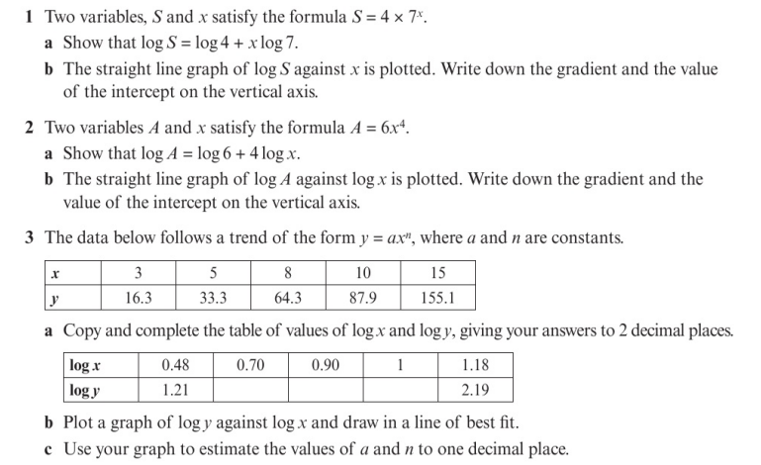
Homework Exercise

Slide 11
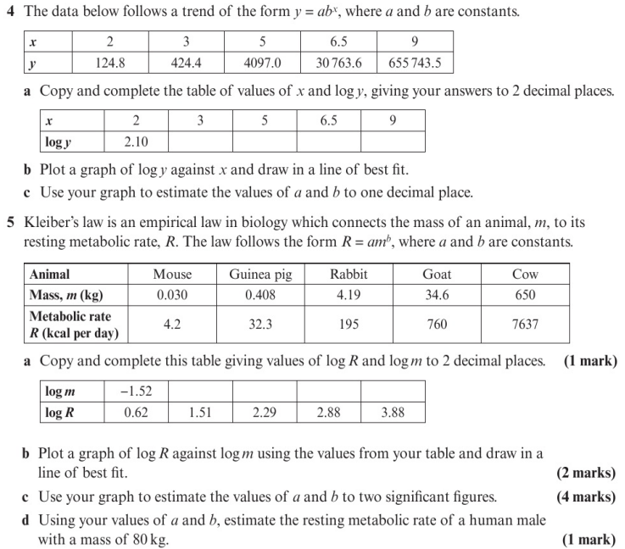
Homework Exercise

Slide 12
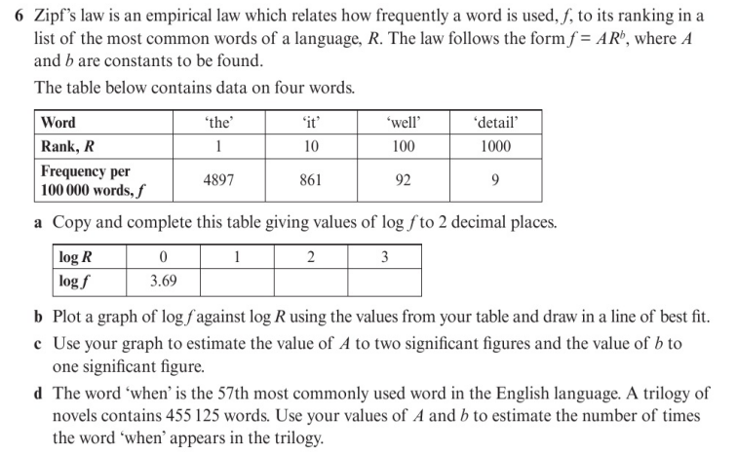
Homework Exercise

Slide 13
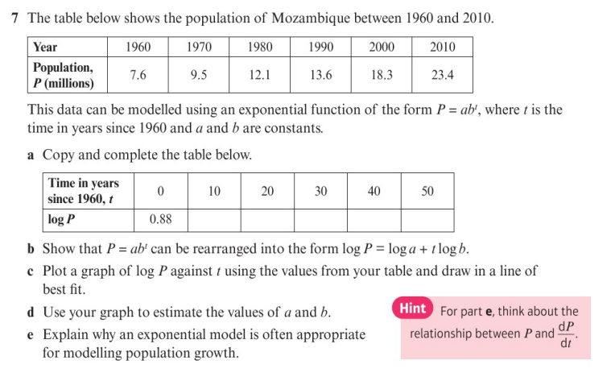
Homework Exercise

Slide 14
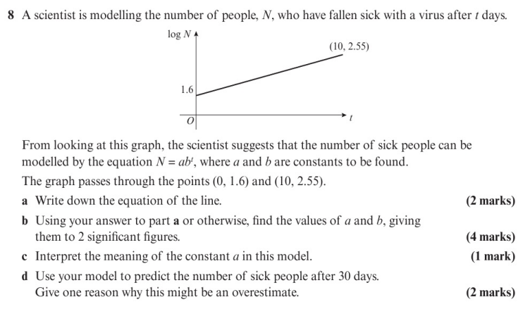
Homework Exercise

Slide 15
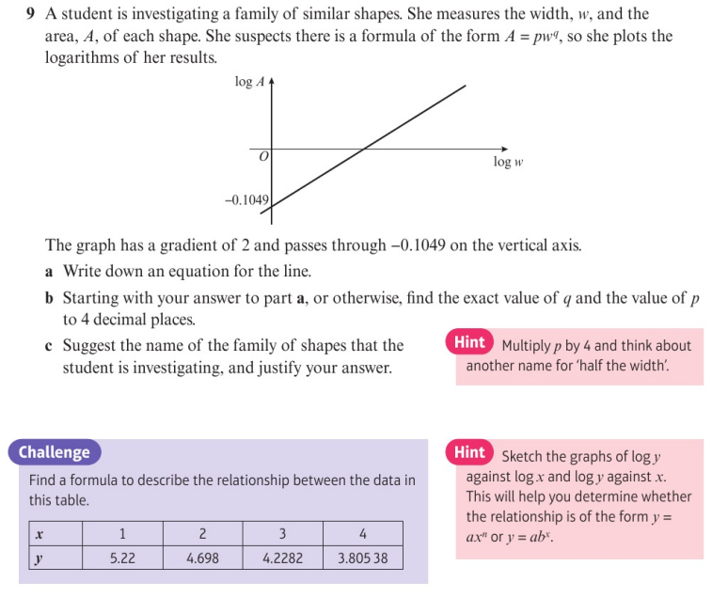
Homework Exercise

Slide 16
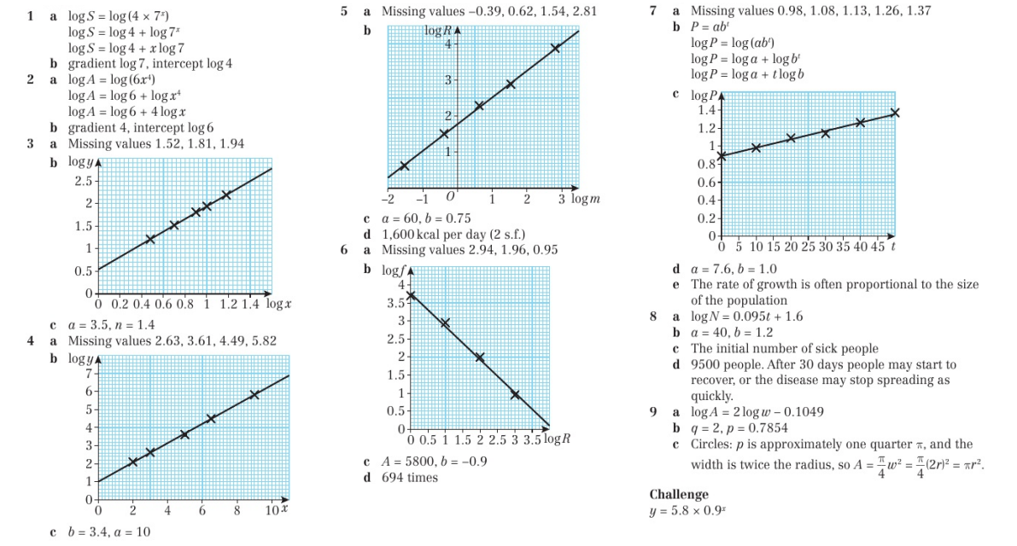
Homework Answers

