Slide 1
P1 Chapter 10: Trigonometry Equations Simple Trig Equations

Slide 2
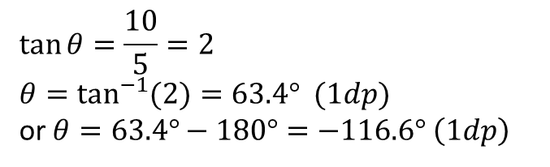
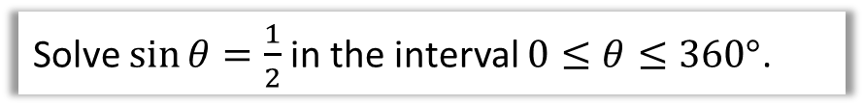
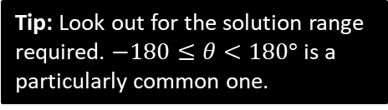
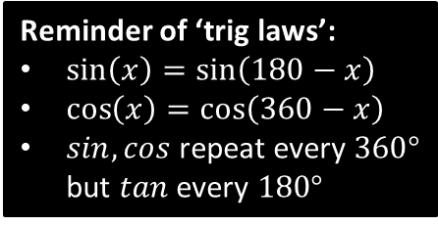
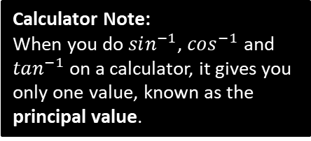
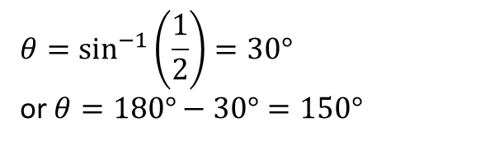

Solving Trigonometric Equations
Remember those trigonometric angle laws (on the right) earlier this chapter? They’re about to become super freakin’ useful!
Reminder of ‘trig laws’:
$\sin\left(x\right)=\sin\left(180−x\right)$
$\cos\left(x\right)=\cos\left(360−x\right)$
$sin,cos$ repeat every $360°$ but $tan$ every $180°$
Solve $\sin{θ}=\frac{1}{2}$ in the interval $0≤θ≤360°$.
?
Calculator Note:
When you do $sin^{−1}$, $cos^{−1}$ and $tan^{−1}$ on a calculator, it gives you only one value, known as the principal value.
$$θ=\sin^{−1}\left(\frac{1}{2}\right)=30°$$ or $θ=180°−30°=150°$
Solve $5\tan{θ}=10$ in the interval $−180°≤θ<180°$
$$\tan{θ}=\frac{10}{5}=2 \\ θ=\tan^{−1}{(2})=63.4° (1dp)$$
or $θ=63.4°−180°=−116.6° \left(1dp\right)$
Tip: Look out for the solution range required. $−180≤θ<180°$ is a particularly common one.
?
$tan$ repeats every $180°$, so can add/subtract $180°$ as we please.

Slide 3
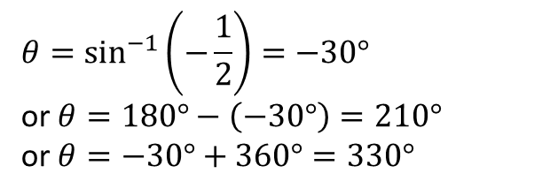

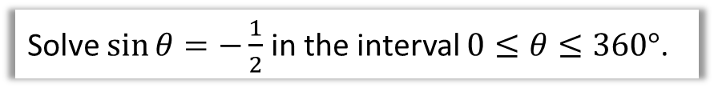

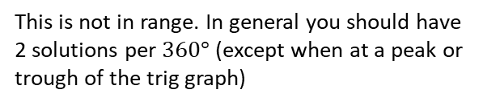
Slightly Harder Ones…
Solve $\sin{θ}=−\frac{1}{2}$ in the interval $0≤θ≤360°$.
?
$$θ=\sin^{−1}\left(−\frac{1}{2}\right)=−30°$$ or $θ=180°−\left(−30°\right)=210°$
or $θ=−30°+360°=330°$
This is not in range. In general you should have 2 solutions per $360°$ (except when at a peak or trough of the trig graph)
Note that we’ve had to use a second law, i.e. that $sin$ repeats every $360°$.
Solve $\sin{θ}=\sqrt{3}\cos{θ}$ in the interval $0≤θ≤360°$.
?
$$\frac{\sin{θ}}{\cos{θ}}=\sqrt{3}$$
$$\tan{θ}=\sqrt{3}$$
$$θ=\tan^{−1}\left(\sqrt{3}\right)=60°$$
or $θ=60°+180°=240°$
Hint: The problem here is that we have two different trig functions. Is there anything we can divide both sides by so we only have one trig function?

Slide 4
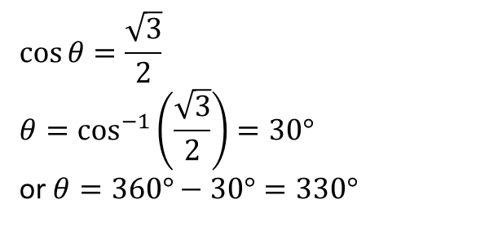
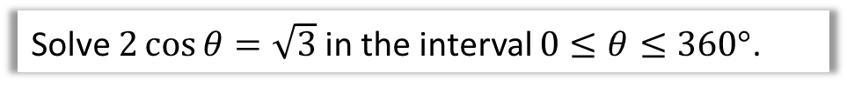

Test Your Understanding
Solve $2\cos{θ}=\sqrt{3}$ in the interval $0≤θ≤360°$.
?
$$\cos{θ=\frac{\sqrt{3}}{2}}$$
$$θ=\cos^{−1}\left(\frac{\sqrt{3}}{2}\right)=30°$$
or $θ=360°−30°=330°$
Solve $\sqrt{3}\sin{θ}=\cos{θ}$ in the interval $−180°≤θ≤180°$.
$$\tan{θ=\frac{1}{\sqrt{3}}} \\ θ=\tan^{−1}\left(\frac{1}{\sqrt{3}}\right)=30°$$
or $θ=30°−180°=−150°$
?

Slide 5
Exercise 10.4
Pearson Pure Mathematics Year 1/AS
Page 81

Slide 6
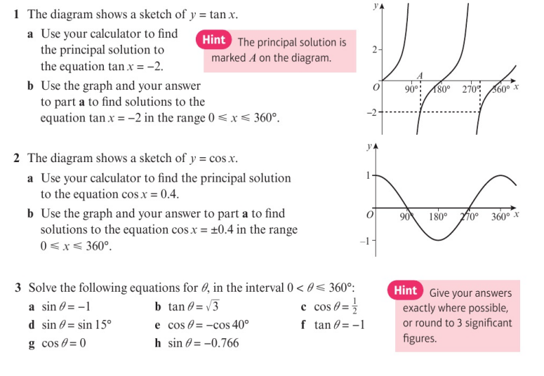
Homework Exercise

Slide 7
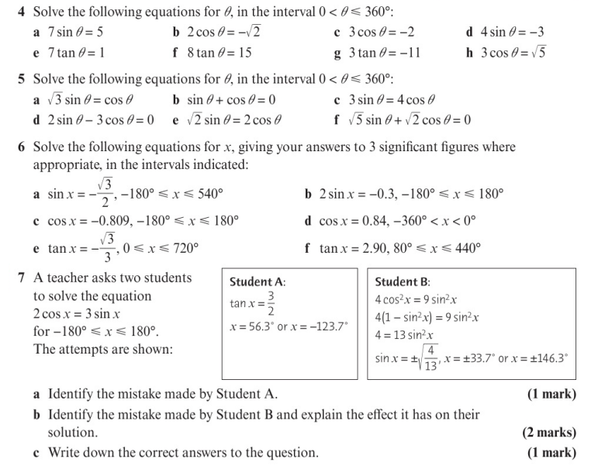
Homework Exercise

Slide 8
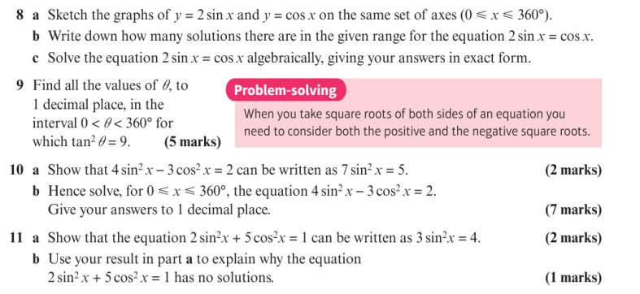
Homework Exercise

Slide 9
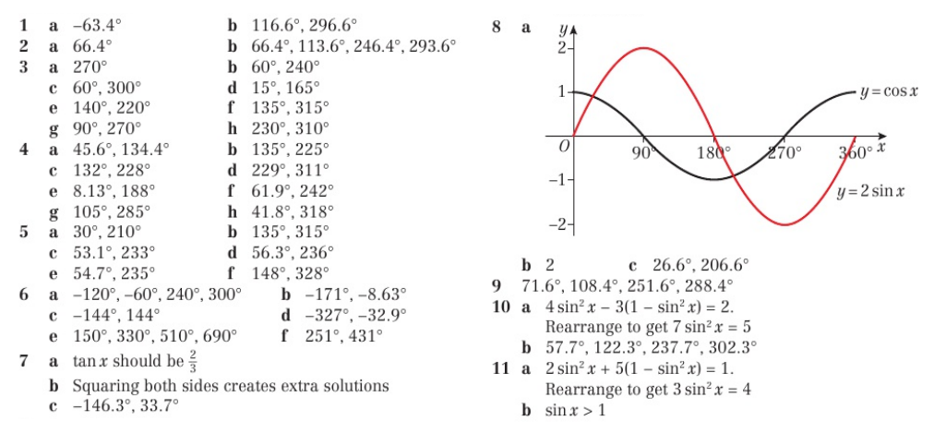
Homework Answers

