Slide 1
Pre-training Summarization Models of Structured Datasets for Cardinality Estimation
Yao Lu, Srikanth Kandula, Arnd Christian König, Surajit Chaudhuri
Microsoft
project-iris@microsoft.com

Slide 2
Introduction
Cardinality estimation (CE) is critical for query optimization.
Existing methods:
Histograms & sketches (state-of-the-art)
Learned models (dataset-specific, costly to train/retrain).
Challenges:
High training cost (thousands of (predicate, cardinality) pairs per dataset).
No incremental updates—full retraining needed on data changes.
Slow inference (milliseconds per CE call, often GPU-dependent).
Our Goal:
Fast, accurate CE without per-dataset training.
Sub-millisecond latency without GPUs.
Pre-trained models (inspired by ResNet/BERT) for unseen datasets.

Slide 3
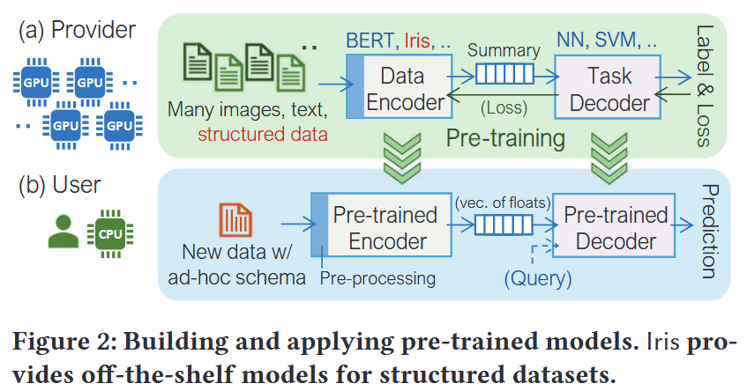
Introduction
Iris consists of:
an encoder
a summary
a decoder
Contributions:
Pre-trained summarization models:
Encoders generate summaries incrementally.
Decoders answer CE efficiently (CPU-only, SIMD-optimized).
Pre-processor:
Selects column subsets & summary methods per relation.
Reduces storage/computation costs.
Evaluation:
Outperforms sampling, histograms, and learned models.
Comparable/better accuracy and faster build time at low storage.

Slide 4

Iris System Overview
Scope: Iris supports queries which can be represented as:
where T is a table and column Coli can be of numeric or categorical types.
This scope is largely similar to prior ML-based CE but we note some key aspects:
does not support joins
supports categorical columns
group-by and other relational operations are not supported (not supported by any of these works).
Requirements:
Storage: Comparable to production histograms (~4KB/column)
Latency: Sub-millisecond CE without GPUs
Reduce the costs to build summaries by using models that are pre-trained offline
Incremental updates for data changes

Slide 5
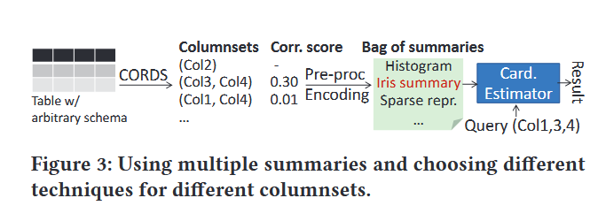
Iris System Overview
Summarization challenges and solutions:
Challenge | Iris Solution
Row-order invariance | Linear per-row aggregation (ψ)
Schema diversity | Fixed-bit quantization + Reorder
High-dimensional correlations | Multiple summaries per columnset
Storage-accuracy tradeoff | Model selection (Hist/Sparse/Iris)
Overview of summarizing a new dataset:

Slide 6
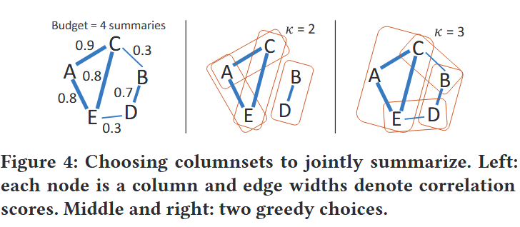
Data Summarization
Column Subset Selection
Goal: Capture multi-column correlations within storage budget
Method:
CORDS analysis on sample data (pairwise correlation scores)
Greedy clique selection (max edge weight, size ≤κ=2)
Fallback: 1D histograms for unpicked columns
Model Selection:
model | condition
Sparse | #DV_k < ε₀
AVI | s_k < ε₁
Hist | s_k ∈ [ε₁, ε₂]
Iris | s_k > ε₂

Slide 7
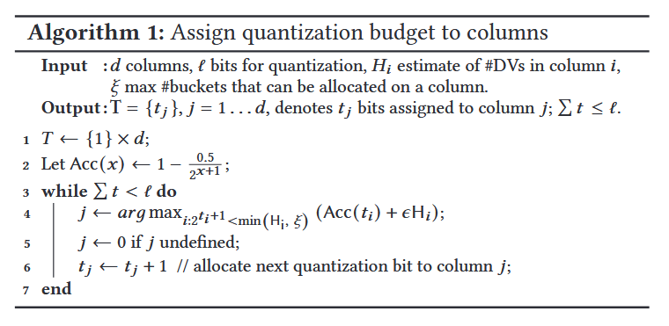
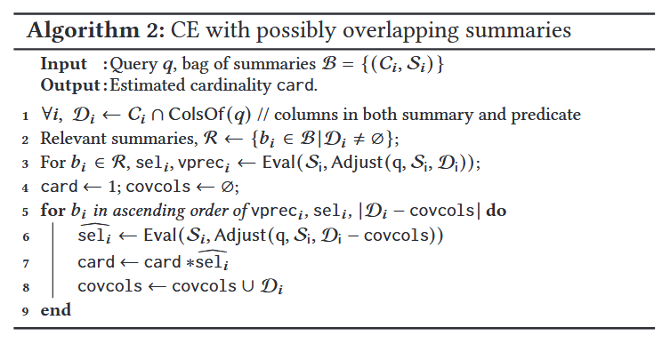
Data Summarization
Quantization for rows
For models to generalize, we must quantize inputs into fixed-size vectors. Our quantization method assigns to each column a certain number of buckets and then replaces column values with the index of the bucket that contains the value.
CE using a bag of summaries

Slide 8
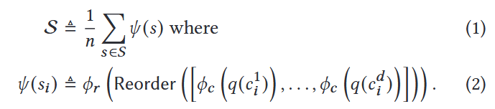
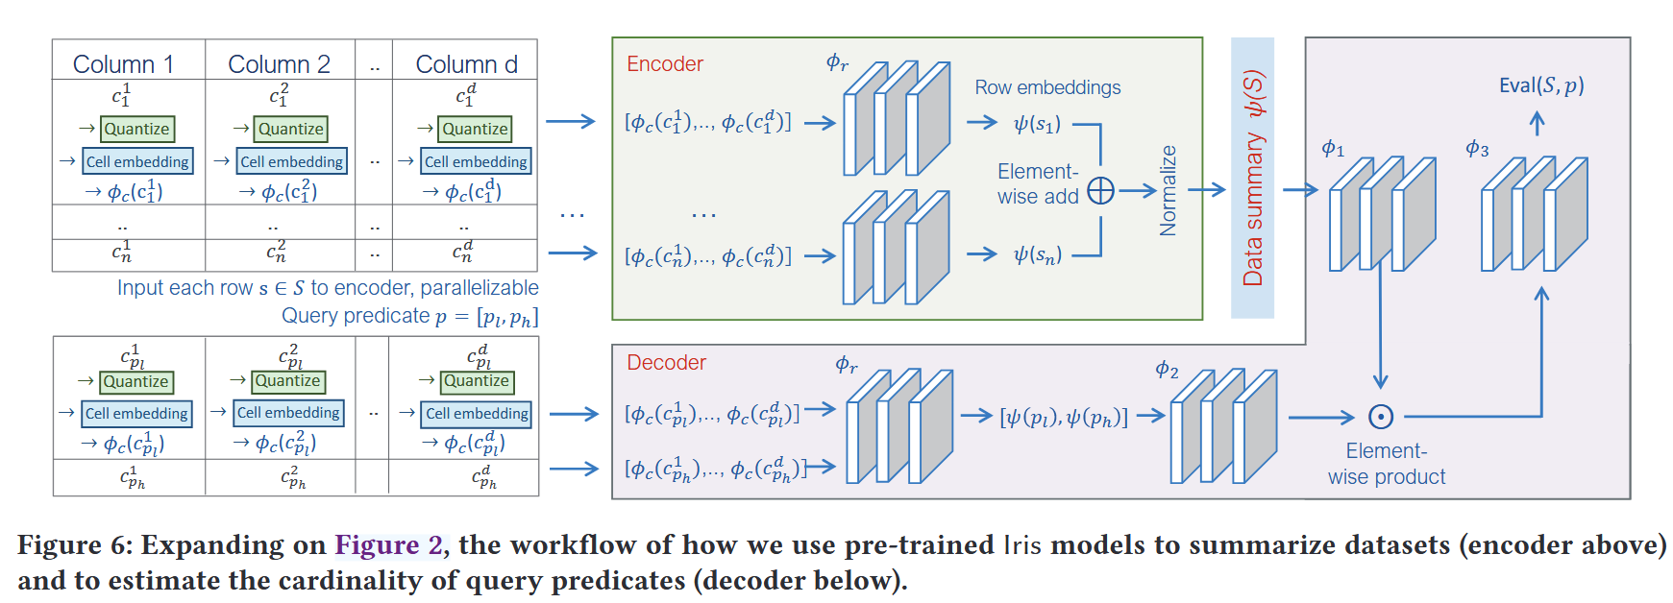
Training And Using Iris Models
Using Iris models to summarize a rowset:
q(): Quantization (Algorithm 1)
ϕ꜀: Column embedding (64-dim)
ϕᵣ: Row embedding (η-dim output)

Slide 9
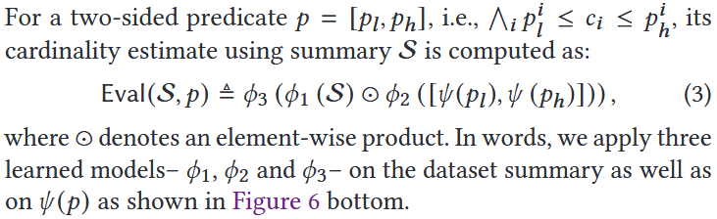
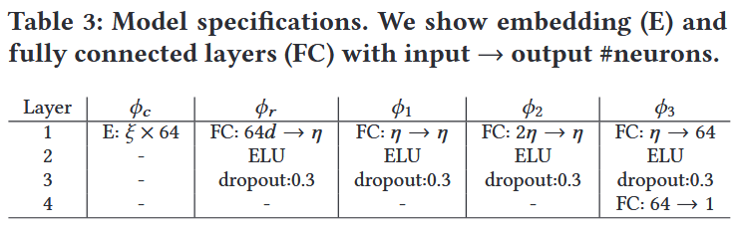
Training And Using Iris Models
Answering queries over Iris summaries:

Slide 10

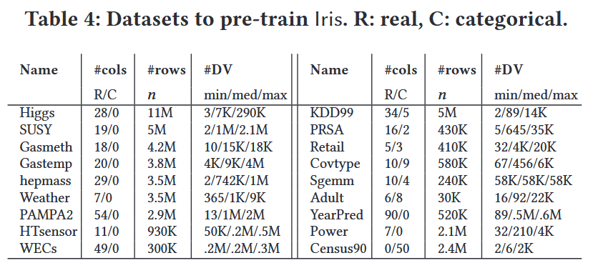
Training And Using Iris Models
Incrementally handling dataset changes
if multi-set S with n rows has a learned summary S, adding or deleting a row s_i or changing s_i to a new value s_j leads to the following summaries:
Pre-training Iris models
Data Preparation:
Corpus: 30K column pairs (Table 4)
Augmentations:
✓ Value shifting/mirroring
✓ Frequency noise injection
✓ Synthetic dataset mixing
Model Training: Architecture: Shallow NN (Table 3)

Slide 11
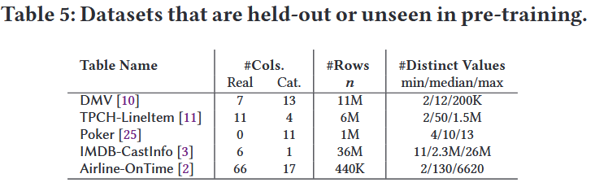
Experiment Setup
Datasets
Use the datasets in Table 5 that are unseen during pre-training to test cardinality estimation.
Pick 16 columnpairs at random to evaluate some aspects in more detail.
Predicates
Pick 1K queries per full dataset and 300 for each of the 16 columnpairs.
Metrics
Storage used, Query latency, Accuracy, Building costs,
Baselines
Sampling
Histograms from DBMS-x
Learned Models (LM, LM-, MSCN, Naru, DeepDB)
Multi-dimensional histograms (STHoles, K-d trees)

Slide 12
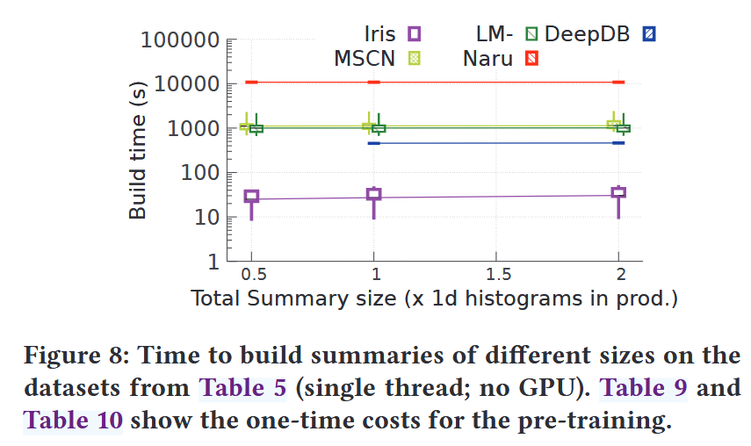
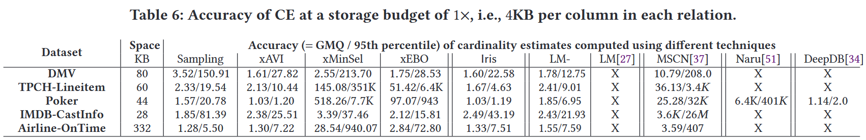
Efficacy Of CE On Entire Datasets
Time to build summaries.
Using pre-trained summarization models significantly reduces the computation needed before cardinality estimates are available.
Accuracy of cardinality estimates.
More selective predicates have lower accuracy to the estimates. Iris is competitive across the cardinality range.

Slide 13
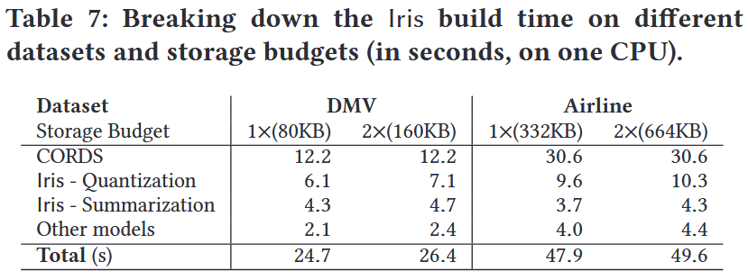
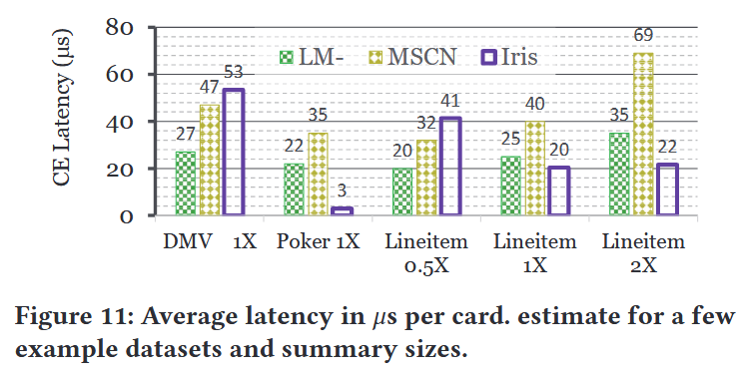
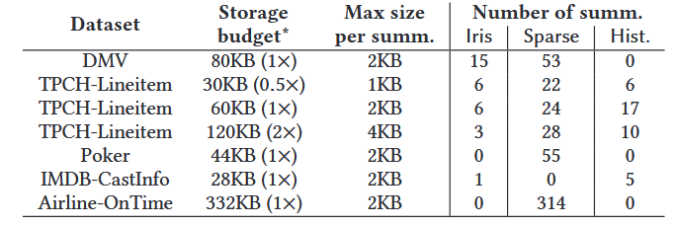
Efficacy Of CE On Entire Datasets
Breaking down buildtime and parallelization.
CORDS can run in parallel per column pair
different threads can summarize different data partitions.
Cardinality estimation latency.
Iris and some alternatives offer comparable latency.
The CE latency can depend on the number of Iris summaries used - each decoder inference takes 32μs with SIMD which is 1-2 orders of magnitude slower than evaluating Hist or Sparse;

Slide 14
Efficacy Of CE On Entire Datasets
Memory footprint.
Memory Efficiency of Iris：
Low Memory Footprint for Summary Construction
Only a few hundred KBs (CORDS samples + φr/φc dictionaries)
Comparable Memory Usage for Estimation
~Tens of KBs per dataset (optimized summary space)
High Memory Costs in Prior Learned Models
Require storing entire training corpora (hundreds of MBs)
Naru/DeepDB additionally cache large dataset samples for ground-truth labels

Slide 15
Understanding The Components Of Iris
Model Selection Intelligence
On Lineitem (1× storage):
57% chance matching optimal summary (vs. 32% random)
82% choices have ΔGMQ < 0.1
Global insights:
Learned summaries optimal for 19% column pairs
39% pairs can use AVI without accuracy loss
Quantization vs. Summarization
Key findings:
Higher bits (l) reduce qGMQ error (diminishing returns)
Final GMQ < qGMQ due to histogram clipping
Space efficiency:
Compresses 2^l floats → η floats (η≪2^l)

Slide 16
Understanding The Components Of Iris
Training Corpus Effects
Critical observations:
More relations + augmentations reduce tail errors
Stable training time (fixed-size batch sampling)
Typical config:
Optimal at l=11, η=128
Micro-benchmark Validation
At same storage budget:
Iris outperforms sampling/STholes/K-d trees
Proves value of learned summaries for compact storage

