Slide 1
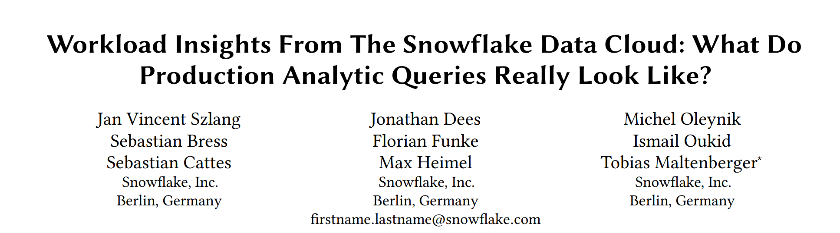

Slide 2
Introduction
🔍 The Core Challenge in Database Research
Understanding real-world problems is a cornerstone of database research.
However, gaining visibility into relevant production workloads remains a significant challenge.
Most real-world query patterns are locked away in proprietary applications or on-premises infrastructure.
Cloud data platforms offers unprecedented visibility into true workload patterns.
📊 The Limitations of Synthetic Benchmarks
The community relies on synthetic benchmarks (TPC-H, TPC-DS, Clickbench) to evaluate systems.
They fall short of capturing the full diversity and dynamics of actual workloads, leaving many critical patterns unexplored

Slide 3
Introduction
🎯 Our Two-Fold Contribution
Detailed Analysis of SQL Patterns
We provide an in-depth examination of query properties (filters, joins, aggregations).
We focus on previously underexplored aspects and real-world SQL query texts/plans.
2. Identification of Benchmark Gaps
By comparing our findings with the TPC-DS benchmark, we highlight opportunities to broaden its scope.
We uncover unique, practically relevant query patterns absent from standard benchmarks.

Slide 4
Methodology
📅 Data Source
Source: Snowflake's internal warehouse, Snowhouse.
Duration: 7 days (October 21 to 27, 2024).
Scale: 667 million production queries from a single cloud region.
🎯 Workload Filtering
Focused exclusively on queries from the most popular BI tools.
Accounted for >60% of all BI queries during the week, ensuring representativeness.
Deliberately excluded other use cases (e.g., ETL, data engineering) to maintain workload consistency.
🔬 Analysis Approach
Draws on occurrence-based metrics (e.g., distribution of query types).
Query attributes (e.g., number of joins) extracted directly from optimized query plans.
Excluded: Memory/CPU consumption & detailed execution times.

Slide 5
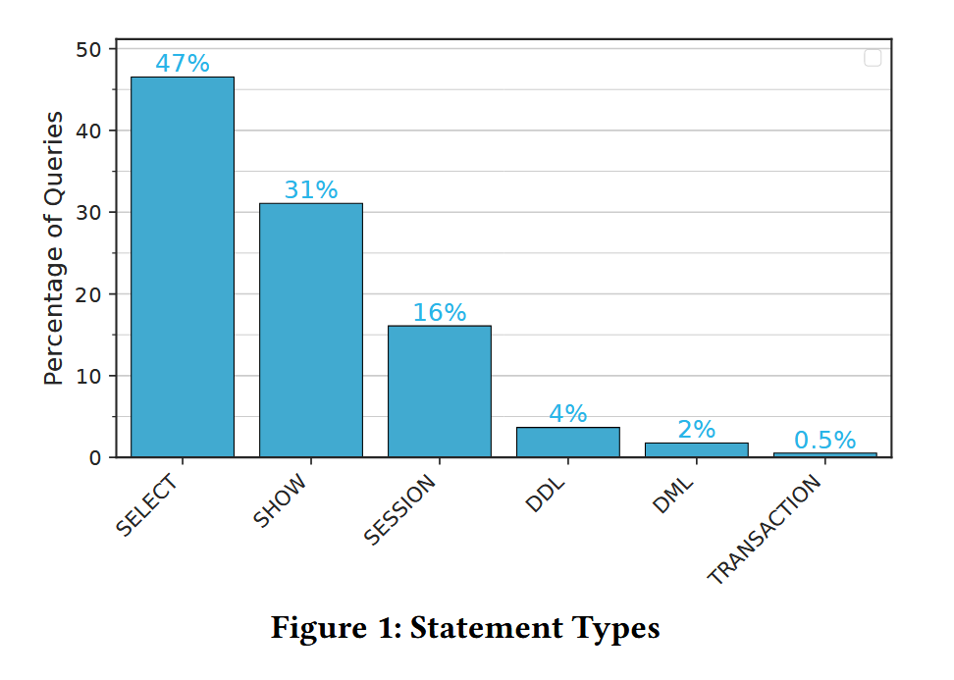
General Workload Patterns
1. Statement Types.
Key Observations:
Metadata Query Prevalence: High proportion of SHOW commands underscores critical role of catalog performance for BI tools.
DDL Queries Outnumber DML Queries: Data is often restructured for analysis.
Read-Heavy Nature of BI Workloads: This trend reflects the BI-centric nature of our workload.

Slide 6
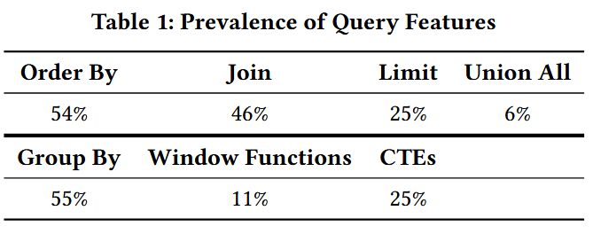
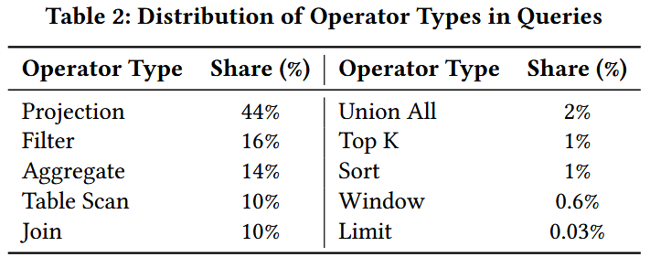
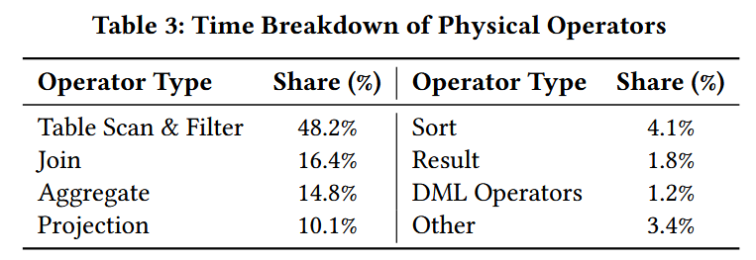
General Workload Patterns
2. SQL Features.
3. Physical Operators.

Slide 7
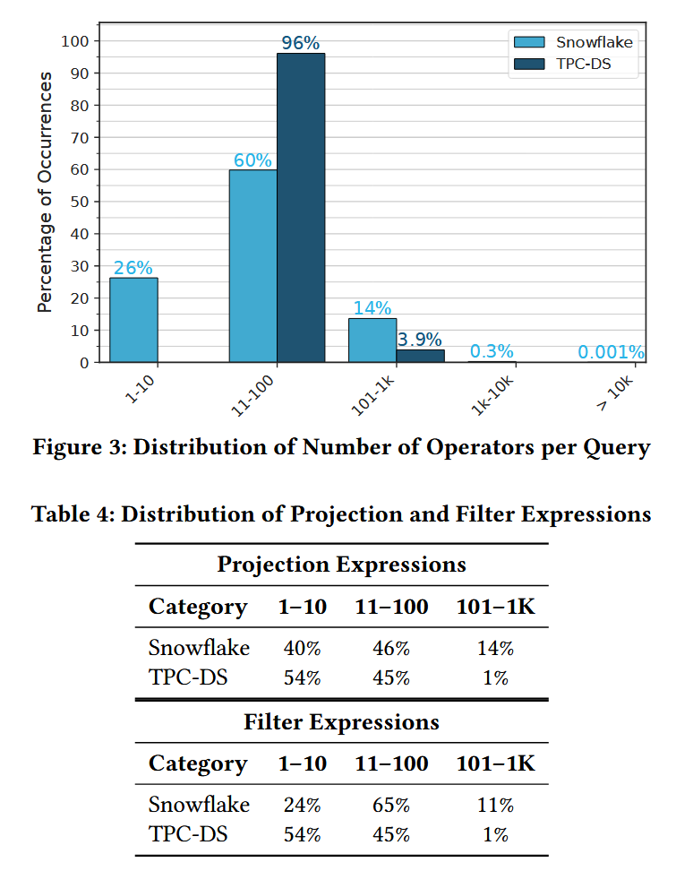
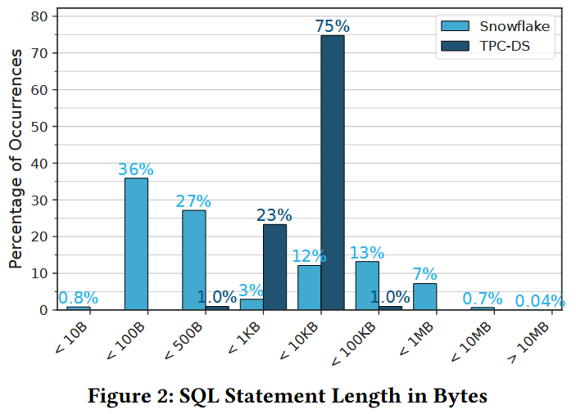
Understanding Query Complexity
To quantify query complexity, we analyze two metrics:
SQL statement length
the number of physical operators and expressions in the execution plan.

Slide 8
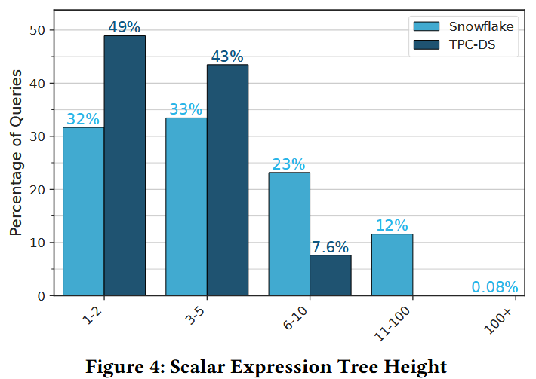
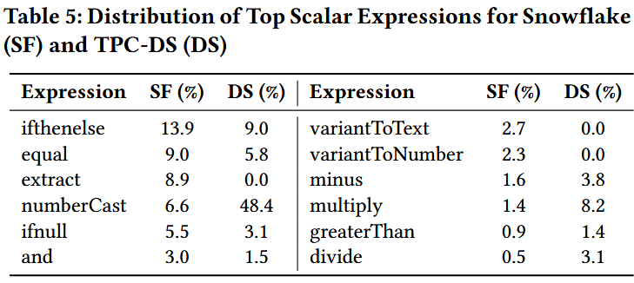
Query Patterns: SELECT Clause
Scalar Expressions.
These functions reflect the application-driven nature of modern workloads, where logic and transformation are frequently pushed into the database.
Such deeply nested expressions highlight the challenges posed by hierarchical conditions and complex transformations, which place increased demands on query planners and execution engines.

Slide 9
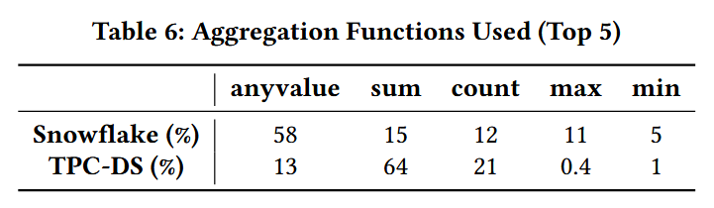
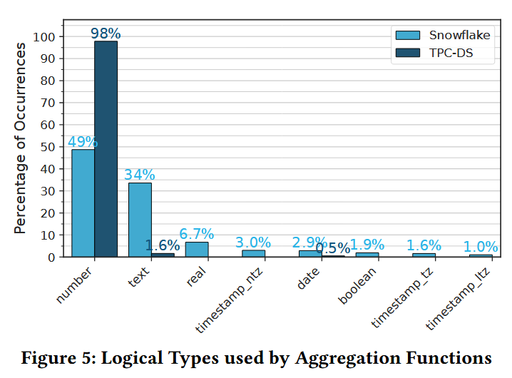
Query Patterns: SELECT Clause
Aggregate Expressions.
These differences highlight the limitations of TPC-DS in representing the functional and data type diversity of real-world workloads, where non-numeric data and less conventional functions like anyvalue play a critical role.

Slide 10
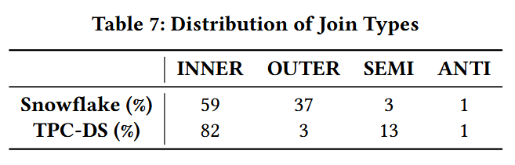
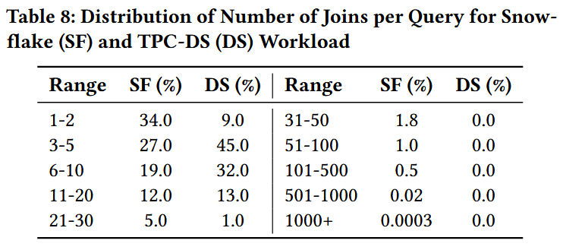
Query Patterns: FROM Clause
Join Types.
Efficient implementations of all join types, particularly outer and semi joins, are essential to handle the diverse and complex scenarios found in real-world queries.
Number of Joins per Query.
TPC-DS queries rarely exceed ten joins, underrepresenting the occasional complexity of real-world workloads.

Slide 11
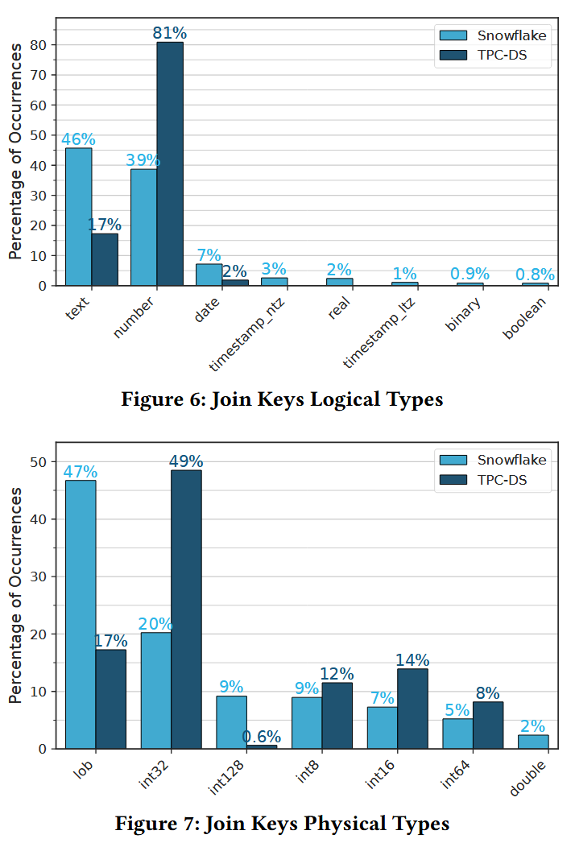
Query Patterns: FROM Clause
3. Join Key Types.
Expanding benchmarks like TPC-DS to include a broader variety of key types, particularly text keys, would enhance their ability to model the complexities of real-world analytical workloads and provide a more comprehensive foundation for evaluating join algorithms.

Slide 12
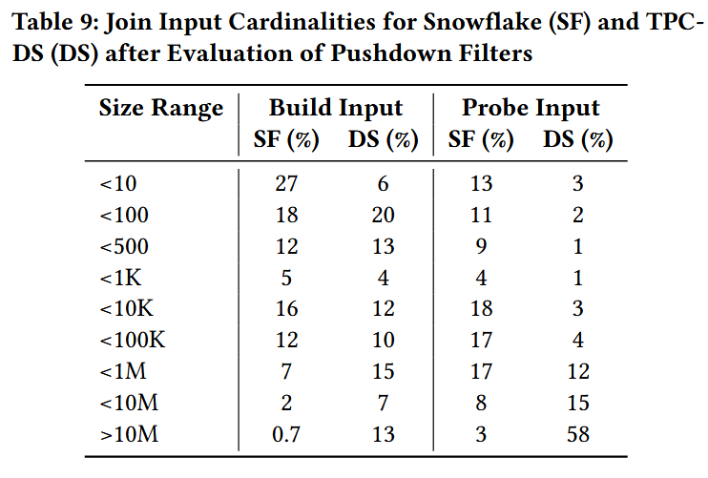
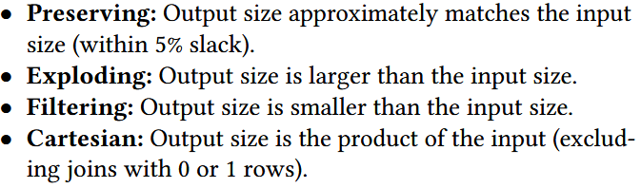
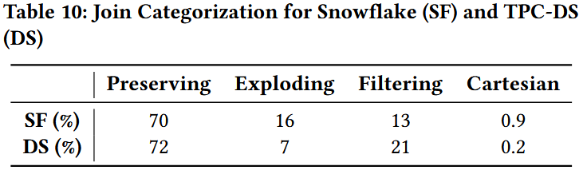
Query Patterns: FROM Clause
4. Join Input Cardinalities.
5. Join Selectivities.
TPC-DS queries tend to focus on large inputs exceeding 10 million rows but underrepresent smaller and mid-sized joins.
Real-world workloads, in contrast, demand join algorithms capable of handling diverse input sizes.
Reflecting an underrepresentation of scenarios where join outputs expand significantly.

Slide 13
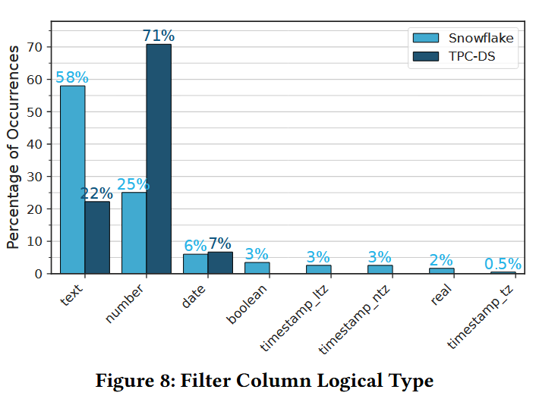
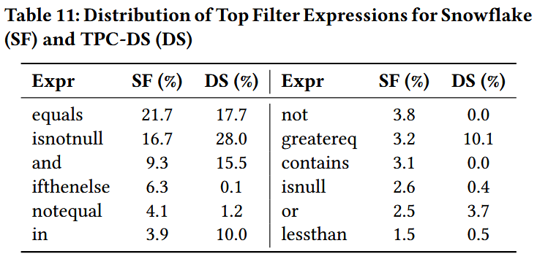
Query Patterns: WHERE Clause
1. Filtered Column Types.
2. Common Predicate Functions.
Future optimizations could explore hardware-accelerated techniques (e.g., SIMD) or algorithms tailored for text filtering to address the unique challenges posed by real-world workloads.
Reliance on flexible, domain-specific text representations challenges optimizers.

Slide 14
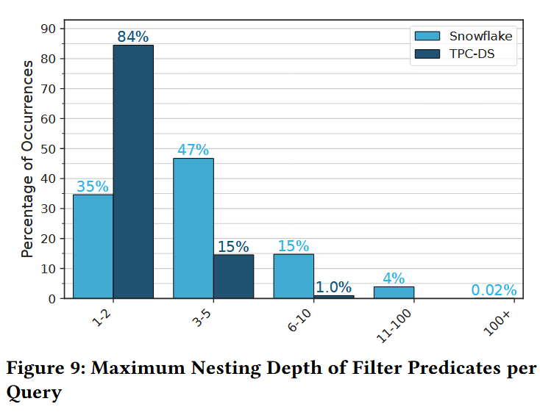
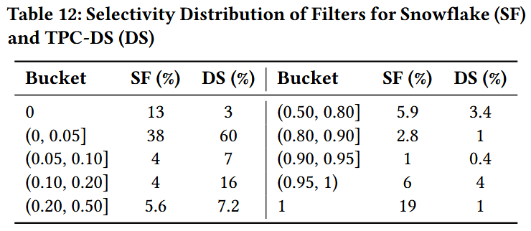
Query Patterns: WHERE Clause
3. Nesting Depth of Filters.
4. Selectivity Distribution.
The broader selectivity patterns in real-world workloads highlight the need for adaptive query optimization strategies.
The presence of deeply nested filters in real-world workloads highlights opportunities for advanced optimization.

Slide 15
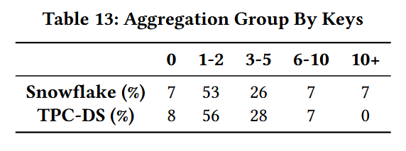
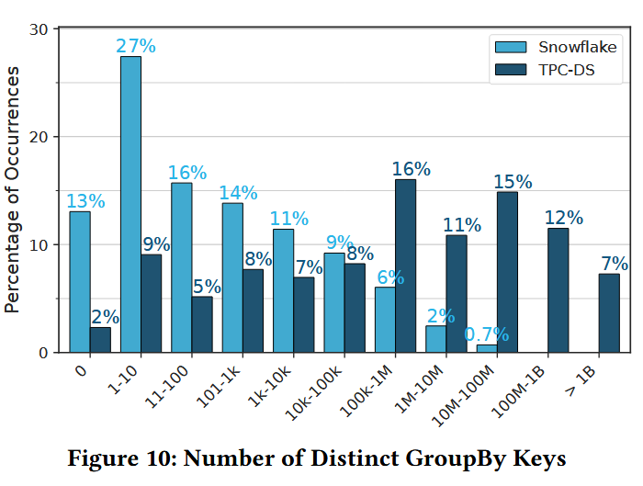
Query Patterns: GROUP BY Clause
1. Distribution of Number of Grouping Keys.
Aside from its lack of queries with a large number of grouping keys, TPC-DS captures the distribution of smaller groupings reasonably well.
2. Grouping Key Cardinalities.
This difference highlights how TPC-DS skews toward large cardinality scenarios, underrepresenting the more common smallto-medium cardinalities seen in real-world workloads.

Slide 16
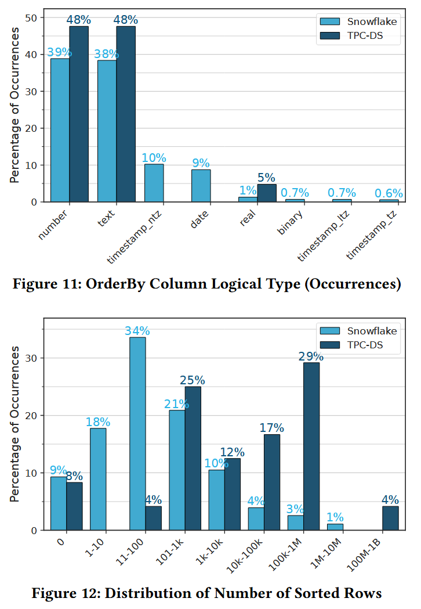
Query Patterns: ORDER BY Clause
While our workload is largely aligned with TPC-DS, it includes sorting on timestamp columns, which TPC-DS lacks.
Reflecting a focus on small-scale sorting.

Slide 17
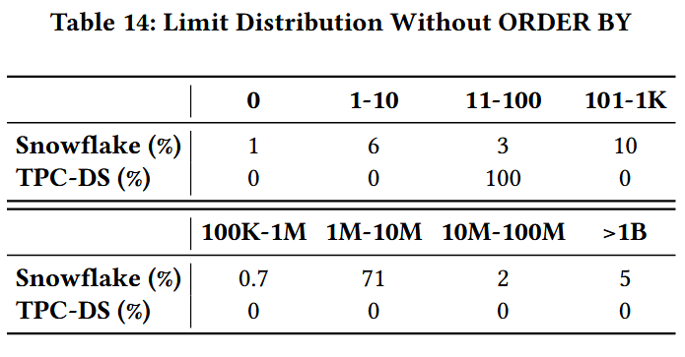
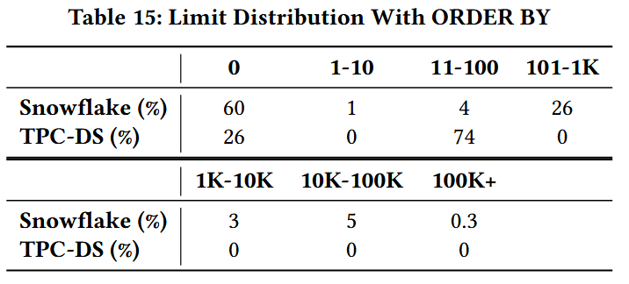
Query Patterns: LIMIT Clause
1. Limit Without Order By.
Further investigation revealed that some business intelligence (BI) tools set large default limits to ensure that desktop data visualization applications receive a sufficient amount of data.
2. Limit With Order By (TopK Queries).
This indicates that top-k queries, often considered lightweight operations, must also adapt to a range of scenarios from returning no data at all to delivering extensive result sets.

Slide 18
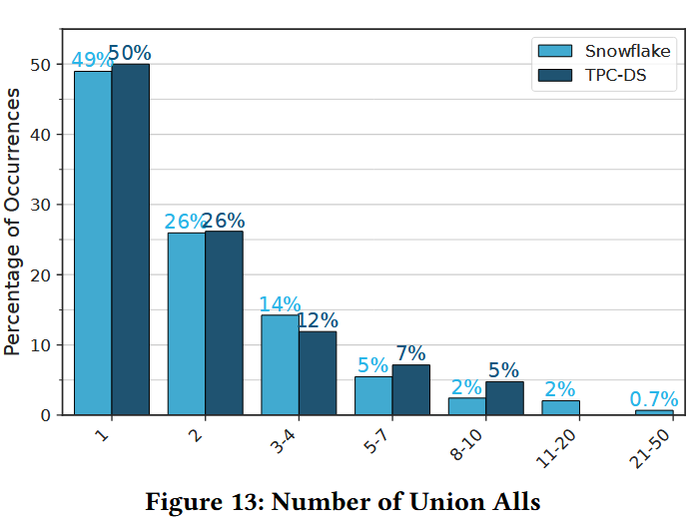
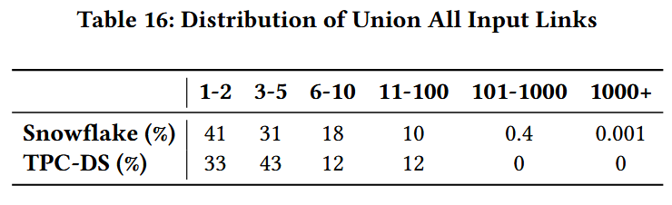
Query Patterns: UNION ALL Clause
1. Distribution of Union All Operators.
2. Distribution of Number of Input Links.
This one-percent tail of highly complex operators indicates that systems must efficiently handle cases where numerous input streams merge into a single result set.
Emphasizing the importance of ensuring efficient plan execution even for queries with extensive query blocks.

Slide 19
DISCUSSION AND OUTLOOK
Extending TPC-DS
1. Metadata Queries
Finding: Metadata queries (e.g., SHOW) are a critical component (31% of all statements).
Gap: Completely absent in TPC-DS.
Recommendation: Incorporate metadata-heavy queries to evaluate catalog performance, caching, and indexing.
2. Expressions
Finding: Production workloads frequently feature deeply nested expressions (some >100 depth).
Gap: TPC-DS does not account for such deep nesting, limiting its ability to stress-test query optimizers.
Recommendation: Expand benchmarks to include complex, deeply nested expression patterns.

Slide 20
DISCUSSION AND OUTLOOK
Extending TPC-DS
3. Joins
Finding: A long tail of join complexity exists (e.g., >500 joins), with heavy use of outer joins (37%) and text-based keys (~50%).
Gap: TPC-DS underrepresents large join graphs, focuses on inner joins, and uses primarily integer keys.
Recommendation: Include diverse join types, exploding joins, and text-key joins.
4. Aggregations
Finding: Aggregations like ANY_VALUE (58%) and those involving text-based columns (34%) are common.
Gap: TPC-DS is dominated by SUM/COUNT on numeric data, with minimal use of ANY_VALUE.
Recommendation: Add queries with ANY_VALUE and aggregations on non-numeric data types.

Slide 21
DISCUSSION AND OUTLOOK
Extending TPC-DS
5. Limit and Top-K
Finding: LIMIT often requests large result sets (78% return >1M rows). Top-K queries show high variability.
Gap: TPC-DS does not account for these large-result scenarios.
Recommendation: Include large-result LIMIT queries to test performance under high-output conditions.
6. Union All
Finding: Production workloads exceed TPC-DS limits, with 2.7% of queries containing >10 operators and 0.4% exceeding 100 input links.
Gap: TPC-DS has a much lower upper bound for UNION ALL complexity.
Recommendation: Incorporate queries with extensive UNION ALL usage to test inter-operator parallelism.

Slide 22
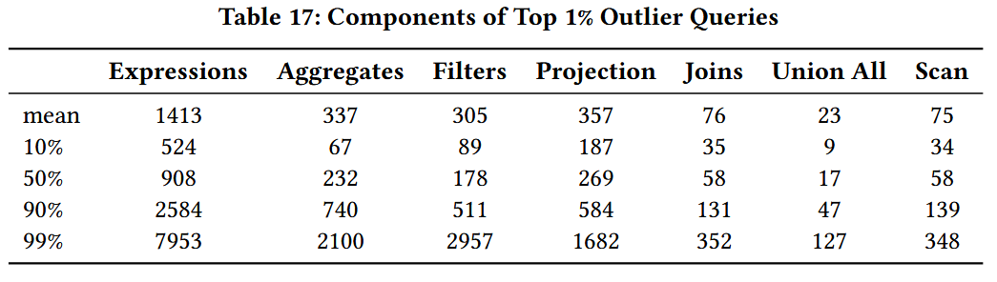
DISCUSSION AND OUTLOOK
Unusual but Not Uncommon Queries
Identifying Significant Outliers:
Employed Isolation Forests to identify the top 1% of outlier queries.
Even at cloud scale, 1% represents a substantial number of queries that can influence system design.
These findings reinforce the need for robust query processing and resource management strategies capable of efficiently handling diverse and challenging workloads.

Slide 23
RELATED WORK
Workload Analysis
Snowset (Vuppalapati et al.)
Focus: Published statistics for 70M queries from Snowflake.
Contribution: Identified research opportunities based on query characteristics, workload patterns, and system performance.
Our Complement: We focus on core relational operators and explicit comparison with TPC-DS.
Redset (van Renen et al.)
Focus: Extensive analysis of Amazon Redshift fleet; addressed data characteristics (table properties, data skew, value distributions).
Contribution: Published an anonymized query log dataset.
Our Complement: We investigate how queries are structured (e.g., 31% metadata queries, 78% LIMITs >1M rows), providing query-level insights absent from Redset.
TracEx (Durner et al.)
Focus: A workload exploration tool for detailed analysis of query traces.
Finding: Compared Snowset with TPC-DS and concluded TPC-DS lacks comprehensive coverage.
Alignment: This conclusion is consistent with our findings.

Slide 24
RELATED WORK
Benchmarks
Benchmarks for Cloud Databases (Binnig et al.)
Argument: Cloud benchmarks must account for scalability, elasticity, fault tolerance, and pay-as-you-go pricing.
The Elasticity Test (Poggi et al.)
Contribution: An extension to TPC benchmarks for cloud environments, emphasizing elasticity and SLA-based metrics.
Cloud Analytics Benchmark - CAB (van Renen et al.)
Motivation: Proposed to address shortcomings of TPC-DS and TPC-H when compared to real-world cloud workloads (using Snowset).
Goal: Enable more accurate evaluation of performance and cost-effectiveness in the cloud.

Slide 25
CONCLUSION
📈 Workload Insights
A long tail of complex queries challenges systems at scale.
Even rare patterns are frequent enough to impact design.
🔍 Key Query Patterns
Prevalent use of conditional logic, text processing, and deep nesting.
Enables algorithm evaluation against real-world patterns.
⚠️ TPC-DS Gaps
Missing Metadata Queries (31% of workload).
Underrepresented Complexities (expressions, joins).
Lack of Diversity in operators and selectivities.
🚀 Benchmark Evolution
Evolve benchmarks to reflect modern workload diversity.
Incorporate metadata, complex joins, and mixed filters.
🎯 Contribution
Guides the development of robust and scalable systems for real-world analytics.

