Slide 1
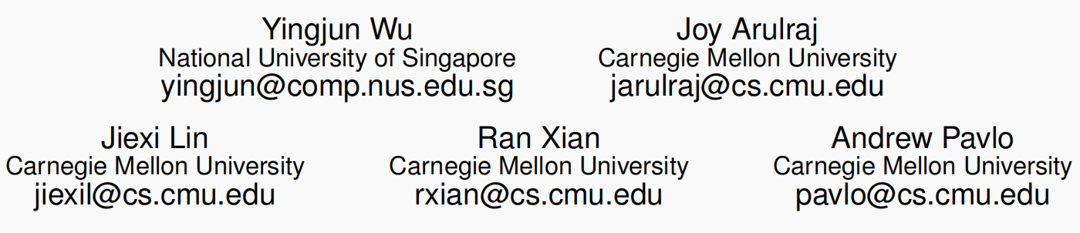
An Empirical Evaluation of In-Memory Multi-Version Concurrency Control
Proceedings of the VLDB Endowment, 2017

Slide 2
MVCC
DBMS maintains multiple physical versions of a single logical object in the database:
When a txn writes to an object, DBMS creates a new version of that object.
When a txn reads an object, it reads the newest version that existed when the txn started.
First proposed in 1978 MIT PhD dissertation.
First implementation was InterBase (Firebird).
Used in almost every new DBMS in last 10 years.

Slide 3
Benefits
Allow for greater concurrency than a single-version system.
Allow a transaction to read an older version of an object at the same time that another transaction updates that same object.
Support time-travel operations to query a consistent snapshot of the database at some point of time in the past.

Slide 4
Motivation
Several design choices have different trade-offs and performance behaviors, as well as bottlenecks.
Previous work(1980s) does not reflect recent trends in latch free, serializable concurrency control, in memory storage and hybrid workloads.
Notes:
performance characteristics have changed drastically in a multi-core and main-memory setting due to the absence of disk operations
there are newer high-performance variants that remove locks/latches and centralized data structures, and are optimized for byte-addressable storage

Slide 5
Topics
MVCC design decisions:
Concurrency control protocol (MVTO, MVOCC, MV2PL)
Version storage (Append-only, Time-Travel, Delta)
Garbage Collection (Tuple-level, Transaction-level)
Index management (Logical Pointer, Physical Pointer)
Implement all of the approaches in the Peloton (in-memory MVCC DBMS) and conduct comprehensive comparative study.
Notes:
Concurrency control protocol:
1. whether to allow a transaction to access or modify a particular tuple version in the database at runtime
2. whether to allow a transaction to commit its modifications

Slide 6
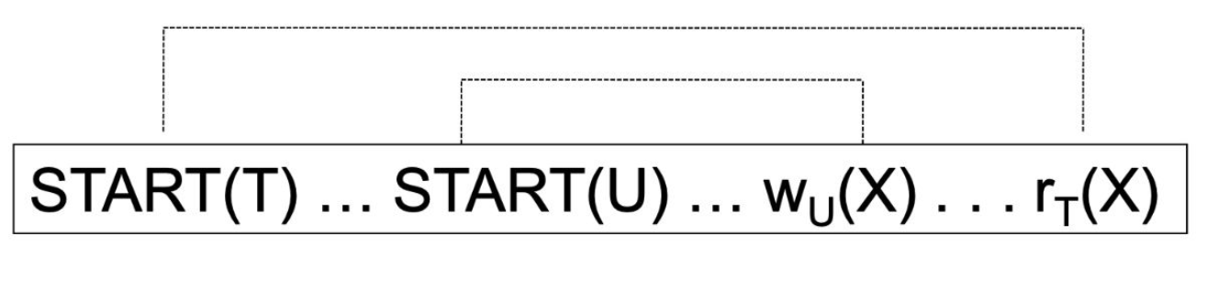
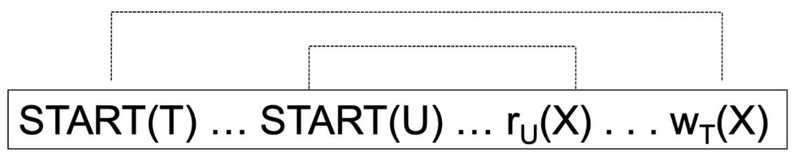
Read Write Conflicts
Read-Write Conflict (Read Uncommitted Data)
Write-Read Conflict (Unrepeatable Read)
Notes:
Basic read-write concurrency for operating on only one item
When operating on several items, still suffer from write skew

Slide 7
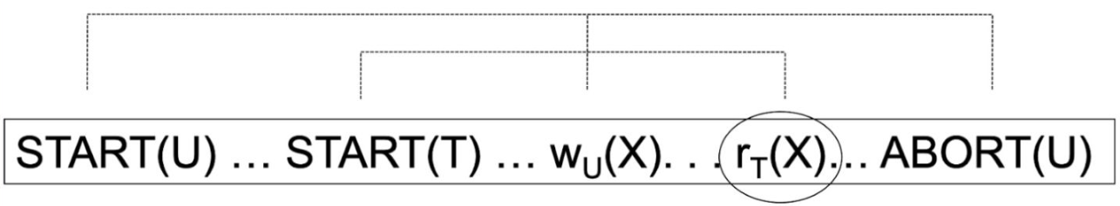
Read Write Conflicts
Dirty Read
Write-Write Conflict

Slide 8

Metadata
Unique Txn
Identifier
Version Lifetime
Next/Prev Version
Additional Meta-data
Notes:
use tuple-level locking as this is sufficient to ensure serializable execution
txn-id:
1. mark tuple versions that a transaction accesses
2. use for the serialization order of transactions
3. serves as the version’s write lock

Slide 9
Concurrency Control Protocol
Approach #1: Timestamp Ordering
Assign txns timestamps that determine serial order.
Considered to be original MVCC protocol.
Approach #2: Two-Phase Locking
Txns acquire appropriate lock on physical version before they can read/write a logical tuple.
Approach #3: Optimistic Concurrency Control
Three-phase protocol from last class.
Use private workspace for new versions.

Slide 10
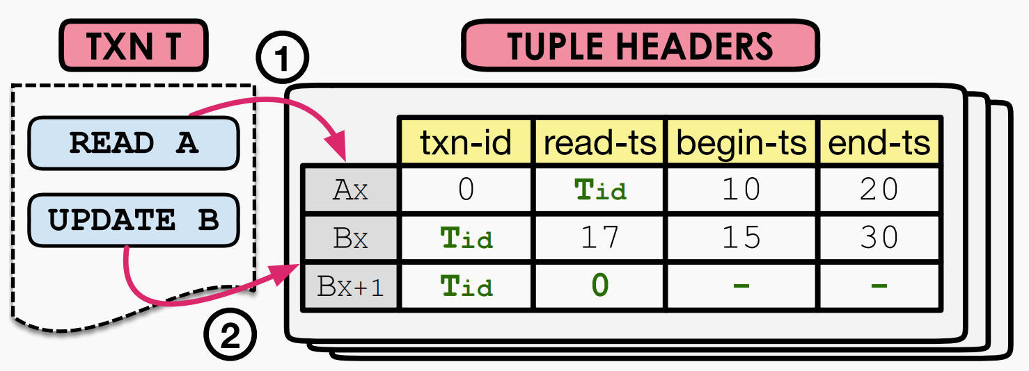
Timestamp Ordering (MVTO)
Txns use READ-TS to track the timestamp of the last txn that read it.
#1 Read
Txn can read version if latch is unset and Txn-ID between BEGIN-TS and END-TS.
Txn set READ-TS to Txn_ID if current value is smaller.
#2 Update
Txn creates a new version if no other txn holds latch and Txn-ID is greater than READ-TS.
Txn set END-TS to Txn-ID in old version and set BEGIN-TS, END-TS to INF in new version.
#3 Commit
Set BEGIN-TS to Txn-ID for all writes in writeset.
Notes:
#1 MVTO never allows a transaction to read uncommitted versions and allow the transaction to read an older version without updating read

Slide 11
Timestamp Ordering (MVTO)
#1 Read-Write Conflict
Read cannot get the new version created by write.
#2 Write-Read Conflict
Read updates READ-TS, write find its timestamp less than READ-TS.
#3 Dirty Read
Read timestamp is less than write timestamp, read cannot get the new version created by write.
#4 Write-Write Conflict
Lock ensure mutual exclusion access of writes.
Notes:
#1 MVTO never allows a transaction to read uncommitted versions and allow the transaction to read an older version without updating read

Slide 12
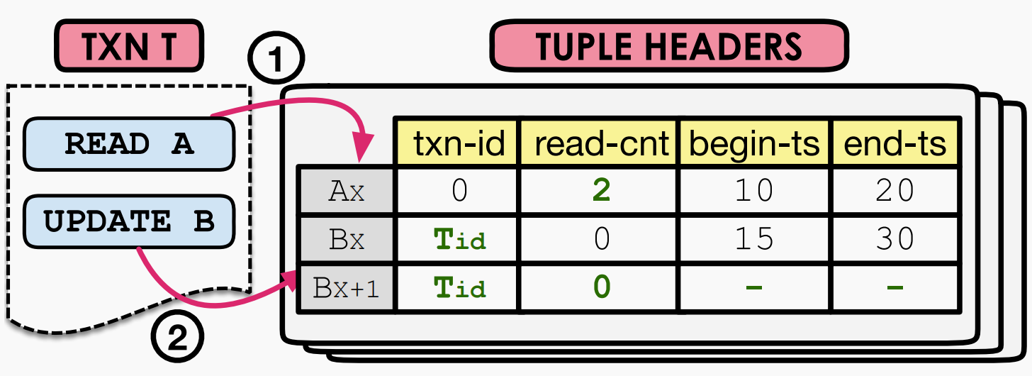
Two-Phase Locking (MV2PL)
Txn use READ-CNT as SHARD lock and use TXN-ID as EXCLUSIVE lock.
#1 Read
Txn can acquire SHARD lock by incrementing the READ-CNT field if Txn-ID is zero.
#2 Update
Txn can acquire EXCLUSIVE lock by setting Txn-ID if it is zero.
#3 Commit
Txn update BEGIN-TS field with T-Commit for the versions created by that txn and release locks.

Slide 13
Two-Phase Locking (MV2PL)
#1 Read-Write Conflict
Write gets EXCLUSIVE lock first.
#2 Write-Read Conflict
Read gets SHARD lock first.
#3 Dirty Read
Read can only get committed data.
#4 Write-Write Conflict
Lock ensure mutual exclusion access of writes.
Notes:
#1 MVTO never allows a transaction to read uncommitted versions and allow the transaction to read an older version without updating read

Slide 14
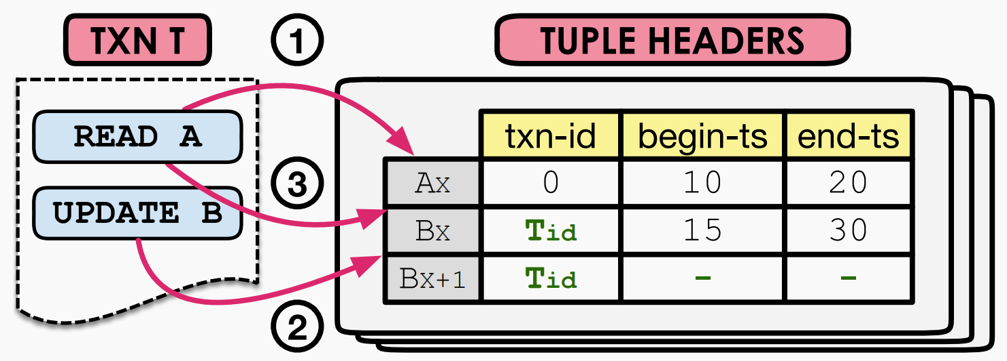
Optimistic Concurrency Control (MVOCC)
DBMS does not maintain a private workspace for transactions, since tuples versioning information already prevents txn from reading/updating versions not visible to them.
#1 Read-Phase
Read: Txn perform read operation for a visible version based on BEGIN-TS and END-TS fields.
Write: Txn create new version with Txn-ID if write lock is not acquired.
#2 Validation-Phase
Assign txn another timestamp T-Commit to determine serialization order, check if read set updated by committed txns.
#3 Write-Phase
Set BEGIN-TS to T-Commit and END-TS to INF.

Slide 15
Optimistic Concurrency Control (MVOCC)
#1 Read-Write Conflict
New Version created by write is not visible to read.
#2 Write-Read Conflict
Read that get old data will abort in validation stage.
#3 Dirty Read
Read can only get committed data.
#4 Write-Write Conflict
Lock ensure mutual exclusion access of writes.
Notes:
#1 MVTO never allows a transaction to read uncommitted versions and allow the transaction to read an older version without updating read

Slide 16
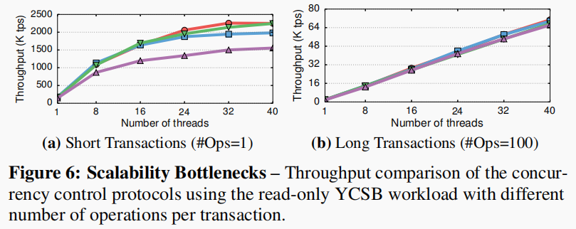
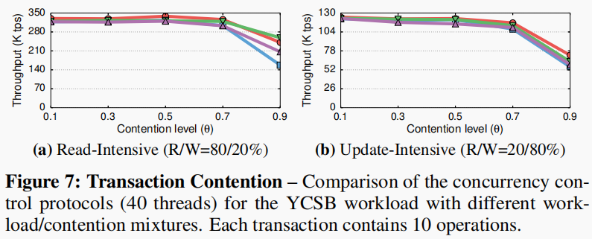
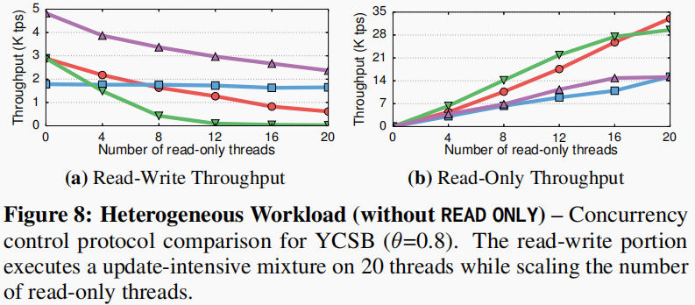
Concurrency Control Protocol
Notes:
#1 MVTO never allows a transaction to read uncommitted versions and allow the transaction to read an older version without updating read

Slide 17
Version Storage
Approach #1: Append-Only Storage
New versions are appended to the same table space.
Approach #2: Time-Travel Storage
Old versions are copied to separate table space.
Approach #3: Delta Storage
The original values of the modified attributes are copied into a separate delta record space.

Slide 18
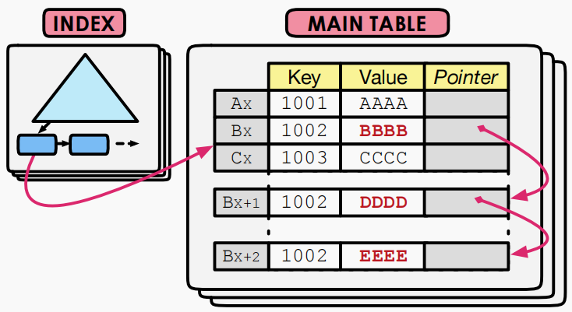
Append-Only Storage (Oldest-to-Newest)
Advantage: DBMS need not update indexes to point to newer version whenever modified.
Drawback: Traverse a long version chain to find the latest version during query processing.
Notes:
The append-only scheme is better for analytical queries that perform large scans because versions are stored contiguously in memory, which minimizes CPU cache misses and is ideal for hardware prefetching.
But queries that access an older version of a tuple suffer from higher overhead be cause the DBMS follows the tuple’s chain to fifind the proper version.
The append-only scheme also exposes physical versions to the index structures, which enables additional index management options.

Slide 19
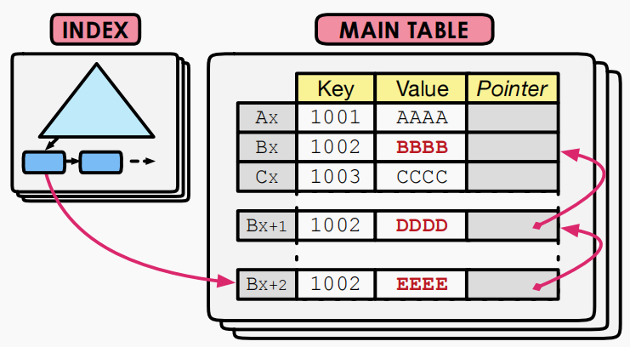
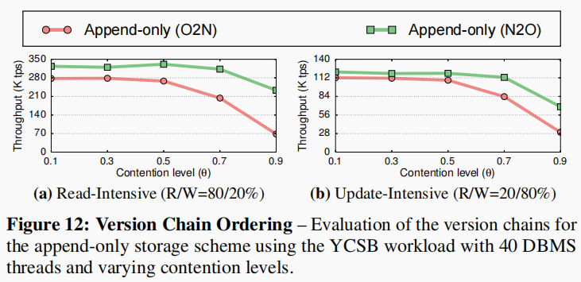
Append-Only Storage (Newest-to-Oldest)
Advantage: DBMS need not traverse the chain, since most txn access the latest version.
Drawback: Chain’s head changes whenever a tuple is modified, DBMS update all indexes(primary/secondary) to point to the new version.

Slide 20
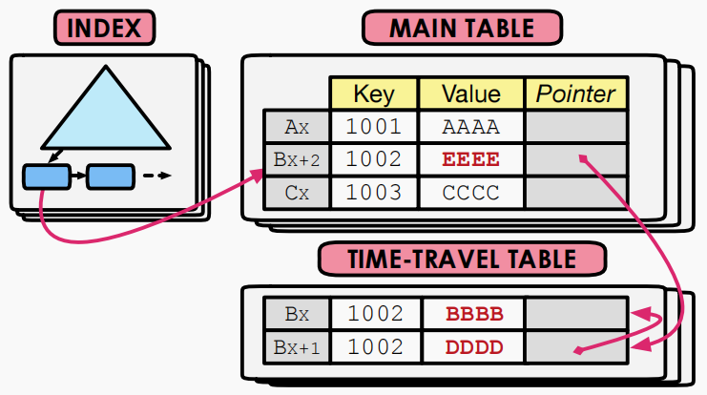
Time-Travel Storage
Advantage: Indexes are not affected by version chain updates because they always point to the master version, old version data can use column-store.
Drawback: Suffer from non-inline attributes(e.g., BLOBs, Variable-Length Data).

Slide 21
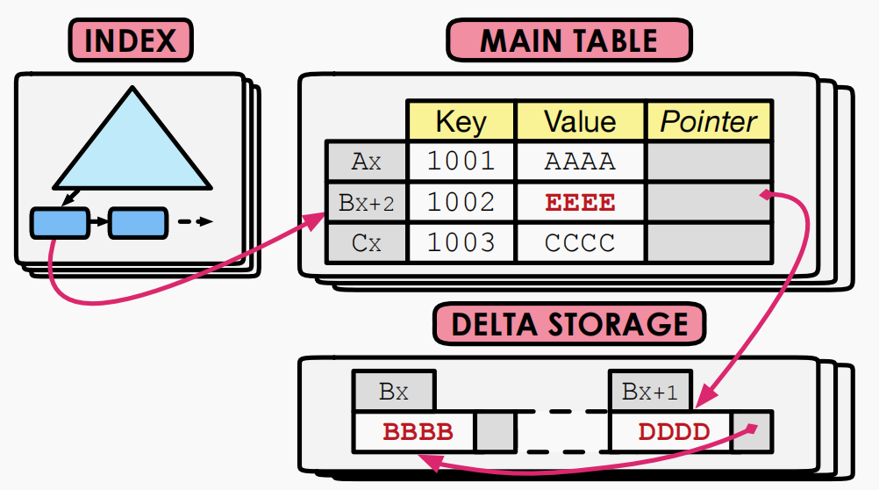
Delta Storage
Advantage: Reduce memory allocations for update operations that modify a subset of tuple’s attributes.
Drawback: Lead to higher overhead for read-intensive workloads, since DBMS has to traverse the version chain to fetch data for each attribute.
Notes:
Maintain the master versions of tuples in the main table and a sequence of delta versions in a separate delta storage.
All of the storage schemes require the DBMS to allocate memory for each transaction from centralized data structures (i.e., tables, delta storage).
Multiple threads will access and update this centralized storage at the same time, thereby causing access contention.
To avoid this problem, the DBMS can maintain separate memory spaces for each centralized structure (i.e., tables, delta storage) and expand them in fixed-size increments.

Slide 22
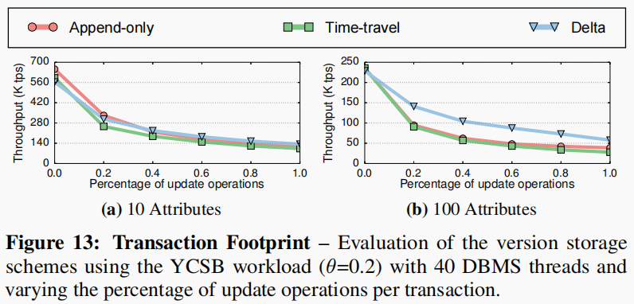
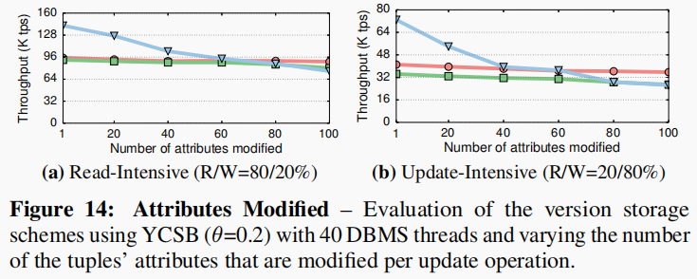
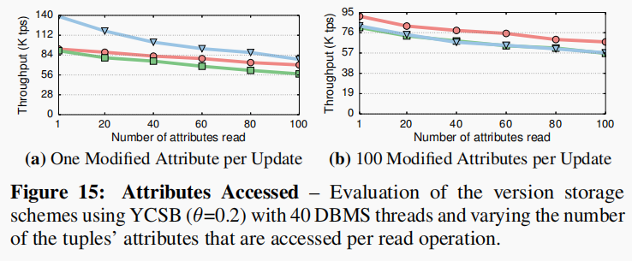
Version Storage
Notes:
Maintain the master versions of tuples in the main table and a sequence of delta versions in a separate delta storage.
All of the storage schemes require the DBMS to allocate memory for each transaction from centralized data structures (i.e., tables, delta storage).
Multiple threads will access and update this centralized storage at the same time, thereby causing access contention.
To avoid this problem, the DBMS can maintain separate memory spaces for each centralized structure (i.e., tables, delta storage) and expand them in fixed-size increments.

Slide 23
Garbage Collection
Detect expired versions, Unlink those versions from their associated chains and indexes, Reclaim their storage space.
The version was created by an aborted txn.
No active txn in the DBMS can see that version.
Approach #1: Tuple-Level
Find old versions by examining tuples directly.
Background Vacuuming vs. Cooperative Cleaning.
Approach #2: Transaction-Level
Txns keep track of their old versions so the DBMS does not have to scan tuples to determine visibility.

Slide 24
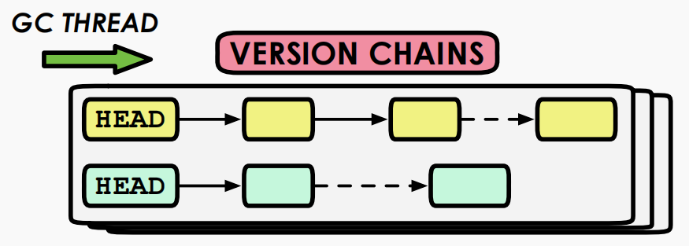
Tuple-Level Garbage Collection (Background Vacumming)
Advantage: Easy to implement and works with all version storage schemas.
Drawback: Hard to scale for large databases.
Optimization: Maintain a bitmap of dirty blocks so that vacumm threads do not examine blocks that were not modified since last GC.
Notes:
Separate threads periodically scan the table and look for reclaimable versions.

Slide 25
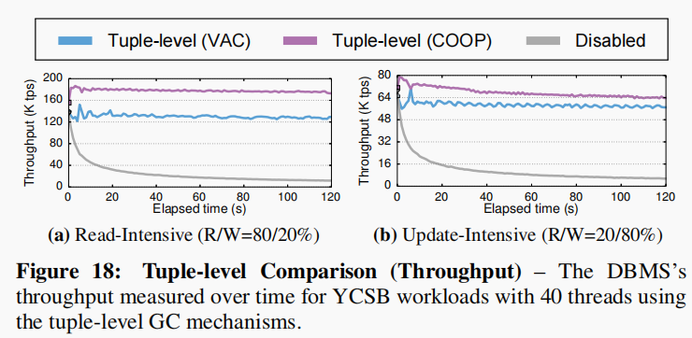
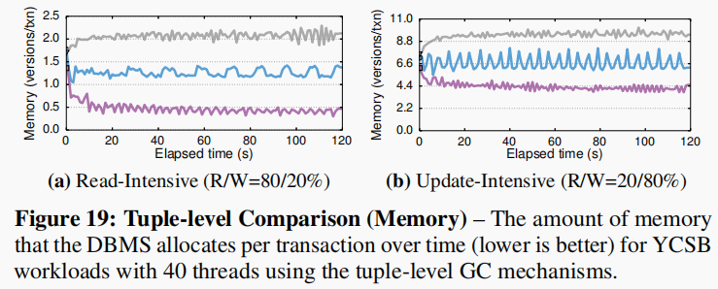
Tuple-Level Garbage Collection (Cooperative Cleaning)
Advantage: Scalable and lower cost.
Drawback: Only work with O2N Append-Only Storage, higher query latency and never remove expired version if a version chain is not traversed.
Notes:
Worker threads identify reclaimable versions as they traverse version chain.

Slide 26
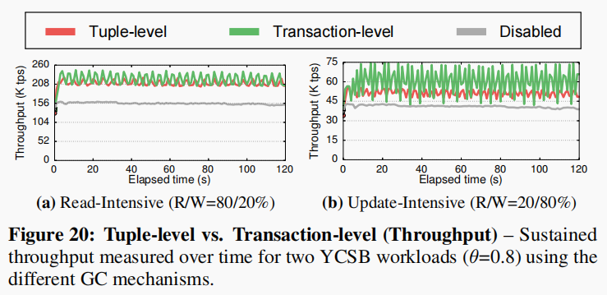
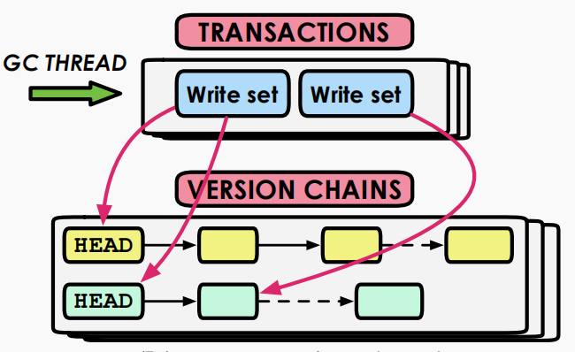
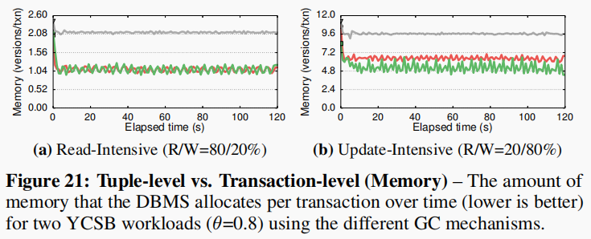
Transaction-Level Garbage Collection
#1 Txn are grouped into epochs.
#2 DBMS tracks the read/write sets of txn for each epoch.
#3 DBMS considers a txn as expired when the version it generated are not visible to any active transaction.
Notes:
DBMS reclaims storage space at transaction-level granularity.

Slide 27
Index Management (Primary Index)
Primary key indexes always point to the current version of a tuple.
How often the DBMS updates a primary key index depends on whether or not its version storage schema creates new versions when a tuple is updated.
DBMS never incur false negative from an index, but may get false positive matches because the index can point to a key version that may not be visible to a particular txn.
Notes:
e.g. delta storage need not, O2N append-only storage need

Slide 28
Index Management (Secondary Index)
Approach #1: Logical Pointers
Use a fixed identifier per tuple that does not change.
Requires an extra indirection layer.
Primary Keys vs. Tuple Id
Approach #2: Physical Pointers
Use the physical address to the version chain head.

Slide 29
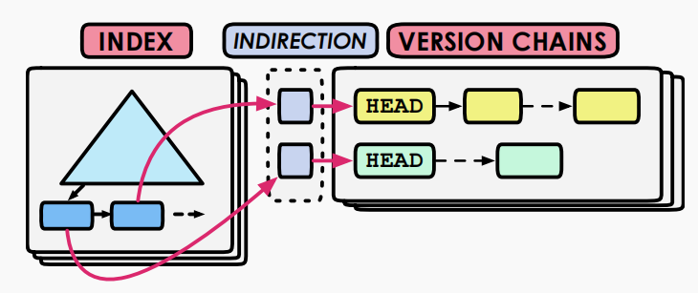
Logical Pointers
Avoid the problem of having to update all of a table’s indexes to point to a new physical location whenever a tuple is modified
Primary Key: Retrieve an entry from a secondary index and perform another look-up by primary key to locate version chain head.
Tuple Id: Storage overhead increases as the size of a tuple’s primary key increases, use a unique 64-bit tuple identifier and a separate hash table instead.
Notes:
DBMS uses a fixed identifier that does not change for each tuple in its index entry.

Slide 30
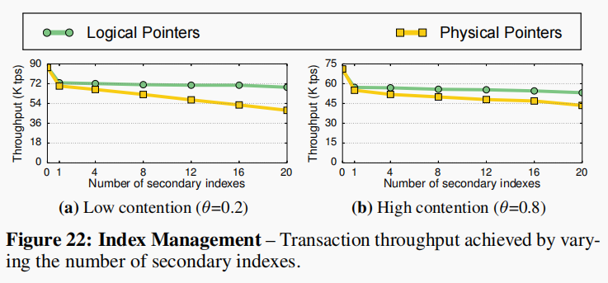
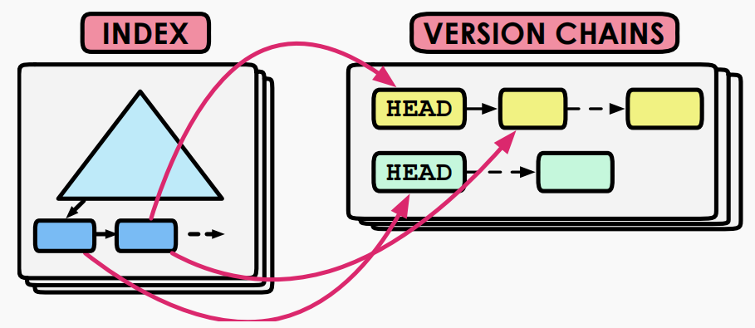
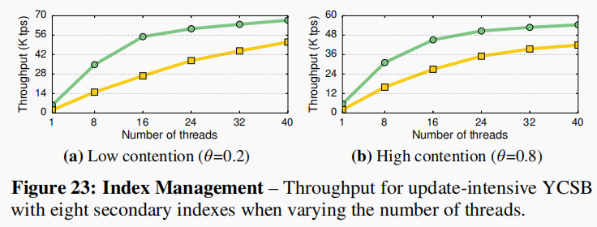
Physical Pointers
Notes:
DBMS uses a fixed identifier that does not change for each tuple in its index entry.

