Slide 1

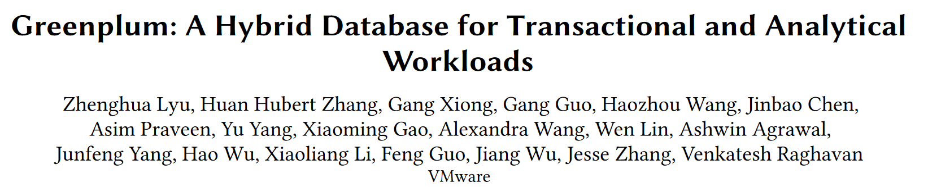

Slide 2
INTRODUCTION
Background
Greenplum database is traditionally known as an OLAP data warehouse system with limited ability to process OLTP workloads.
QUESTION
How to serve both OLTP and OLAP workloads while maintaining the ACID properties with minimal performance overhead?

Slide 3
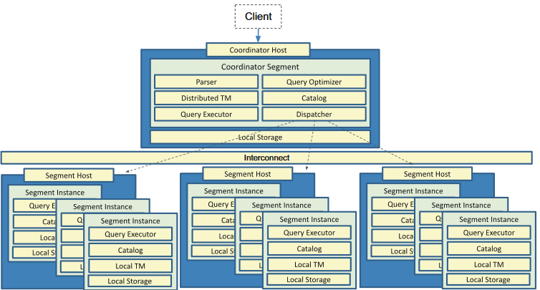
INTRODUCTION
Greenplum was designed with OLAP queries as the first class citizen while OLTP workloads were not the primary focus.
A running Greenplum cluster consists of multiple running worker segments which can be viewed as an enhanced PostgreSQL.
The massively parallel processing (MPP) architecture of Greenplum splits the data into disjoint parts stored across individual segments.

Slide 4
INTRODUCTION
The coordinator segment receives commands or queries from user clients, manages distributed transactions, and finally sends results back.
Segments serve as the primary storage of user data and execute a specific part of the distributed plan from coordinator.
Mirrors (and standbys) will not participate in computing directly but receive WAL logs from their corresponding primary segments continuously and replay the logs on the fly.

Slide 5
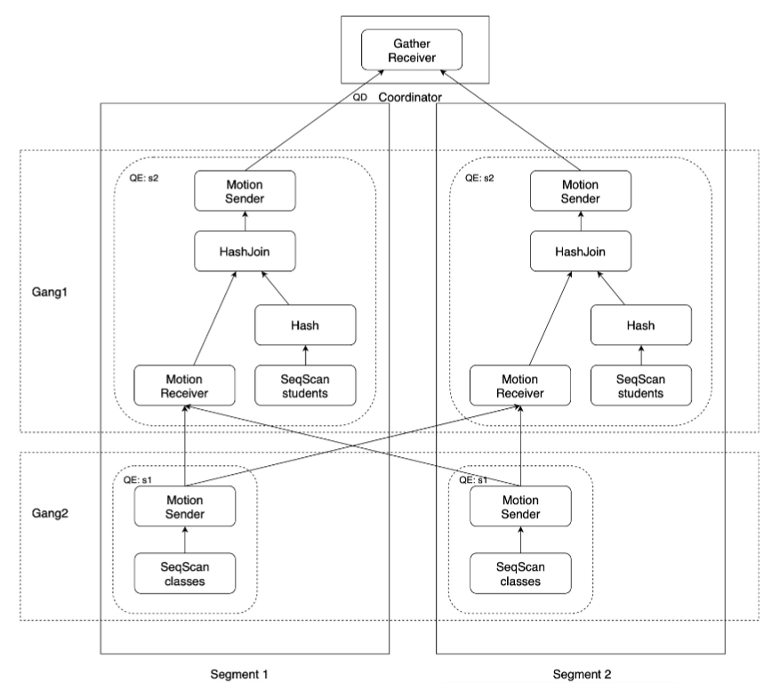
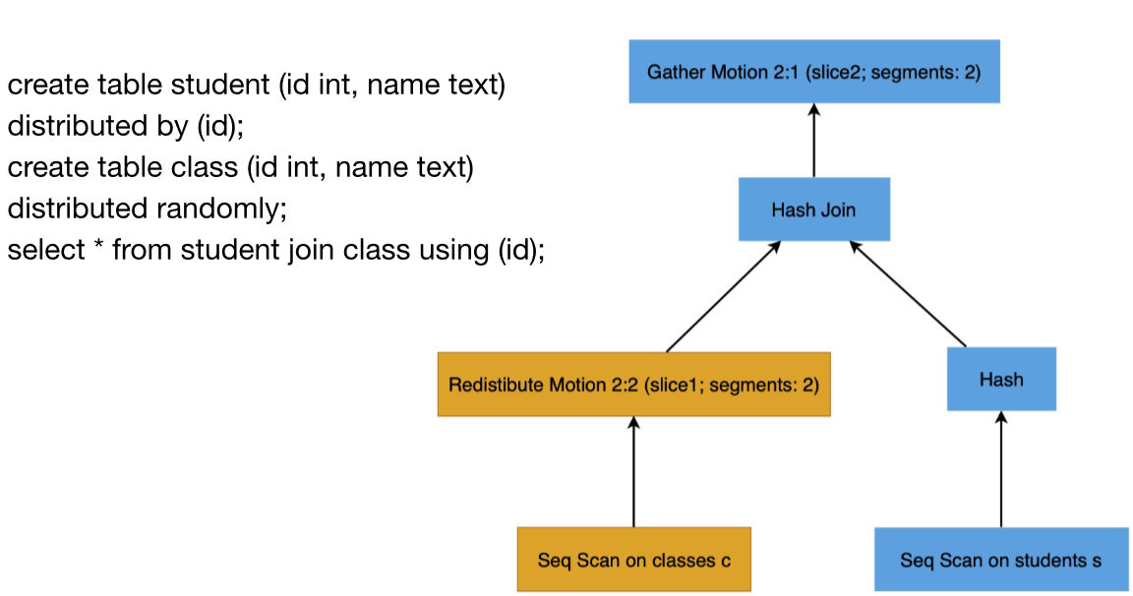
INTRODUCTION
Distributed query
Motion plan nodes cut the plan into pieces, each piece is executed by a group of distributed processes.

Slide 6
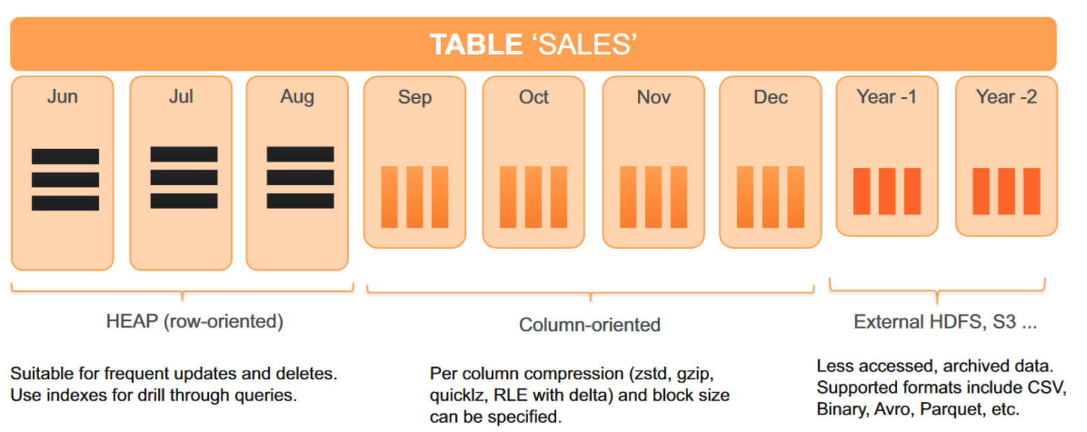
INTRODUCTION
Storage
Greenplum creating a hierarchy of tables underneath a root table.
AO-row, AO-column and heap tables can be joined in the same query.
*AO: append-optimized

Slide 7
CONTRIBUTION
identify challenges in transforming an OLAP database system into an HTAP database system
propose a global deadlock detector to reduce the locking overhead and increase the OLTP response time
speedup transactions by switching to a one-phase commit protocol
develop a new resource isolation component to manage OLTP and OLAP workloads

Slide 8
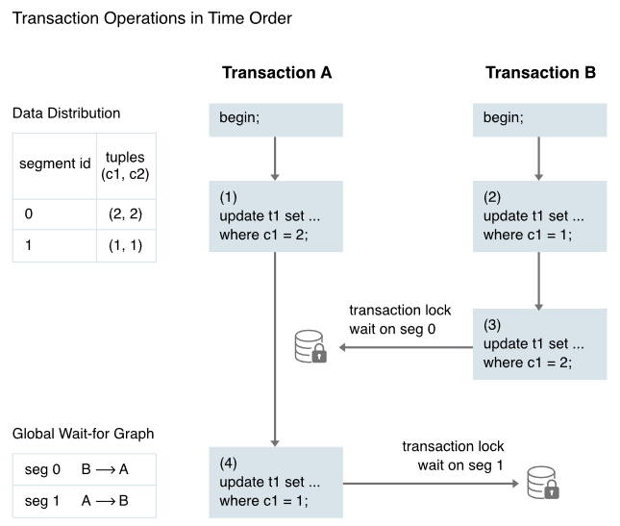
ARCHITECTURE
Lock Optimization
Even if each segment has a local deadlock handler, it cannot avoid a global deadlock across different segments.

Slide 9
ARCHITECTURE
Lock Optimization
The GDD daemon collects each segment’s local wait-for graph and builds a global wait-for graph.
Solid edge: the waiting disappears only after the lock-holding transaction ends.
Dotted edge: denotes a lock can release without ending the transaction.

Slide 10
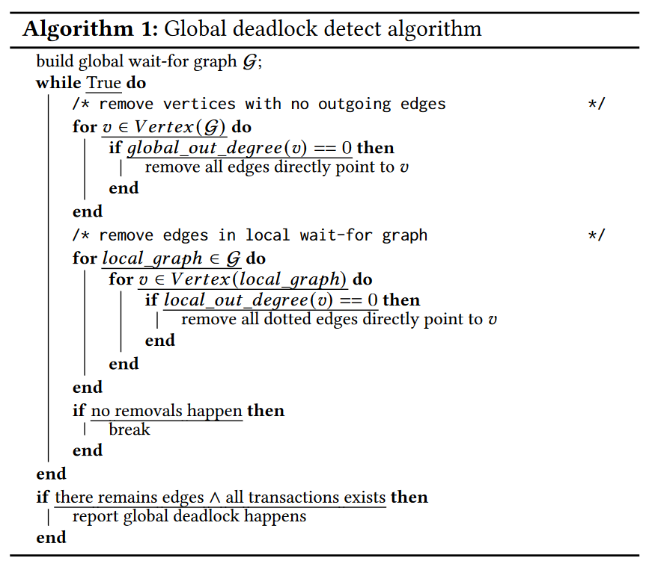
ARCHITECTURE
Lock Optimization
Removes all vertices with zero global out degree in global wait-for graph.
Scans each local wait-for graph to remove all dotted edges that are pointing to a vertex with zero local out-degree.
Check if edges or all transactions exist.

Slide 11
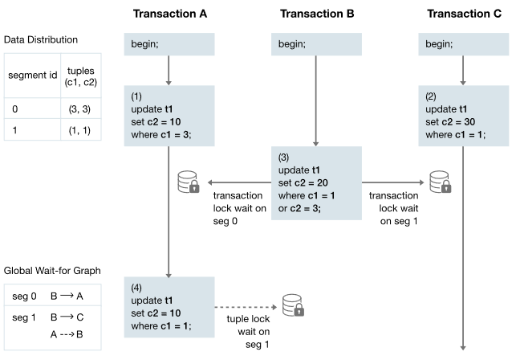
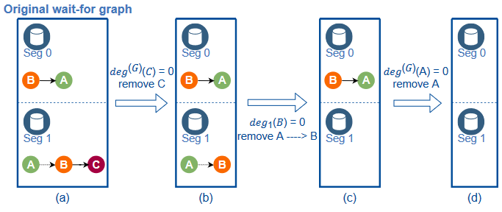
ARCHITECTURE
Lock Optimization

Slide 12
ARCHITECTURE
Transaction Isolation
A segment uses native PostgreSQL transaction mechanism to generate local transaction identifiers.
Distributed transaction identifier uniquely identifies a transaction at global level.
Tuple visibility is determined by combining local and distributed snapshot information.
During a scan operation, we extract the distributed transaction identifier of a tuple and using it in conjunction with the distributed snapshot to determines the tuple visibility.

Slide 13
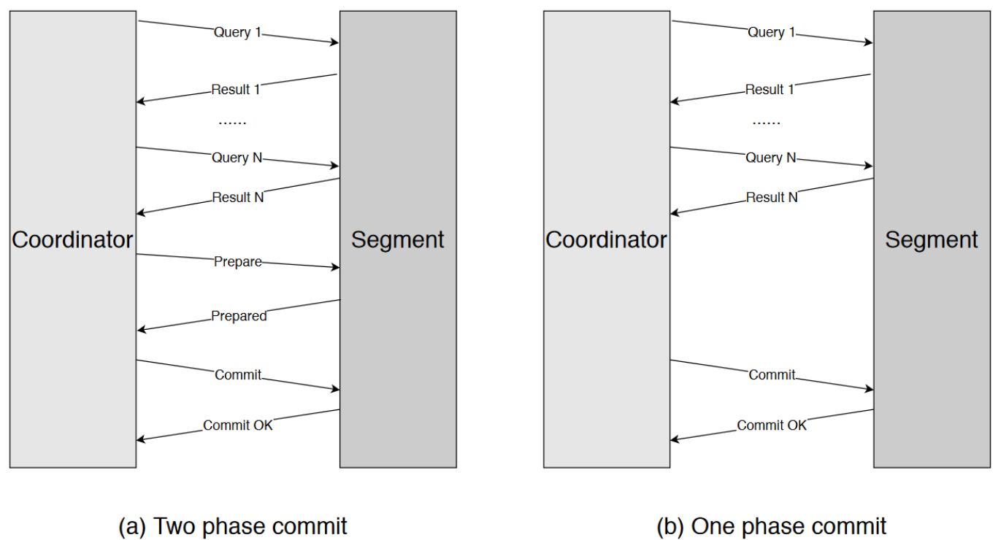
ARCHITECTURE
One-Phase Commit
The coordinator can determine whether a write operation happens only on one segment. If so, the coordinator skips the PREPARE phase and dispatches the commit command to the participating segment.

Slide 14
ARCHITECTURE
Resource Isolation
Greenplum introduces Resource Group to isolate the resource among different kinds of workloads or user groups.
CPU isolation is implemented based on the control group (cgroup) technology.
Cgroup is a Linux kernel feature that limits and isolates the resource usage of a collection of processes.
From the perspective of cgroup tree structure, a resource group is implemented as an interior node and all the processes belong to this resource group are the children of it.

Slide 15
ARCHITECTURE
Resource Isolation
Memory isolation is implemented based on the memory management module Vmemtracker.
Vmemtracker is responsible for tracking all memory usages in the Greenplum database kernel.
memory usage of a single query in a group;
group shared memory;
memory usage among different groups.

Slide 16
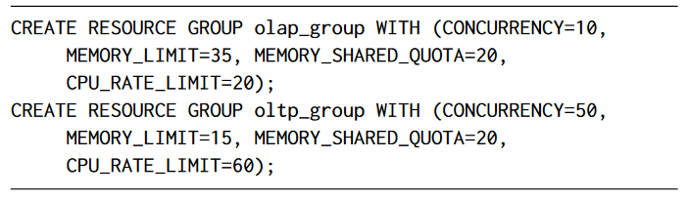
ARCHITECTURE
Resource Isolation
For memory resources, we assign higher memory limit to the analytical resource group to allow analytical queries to use more memory and to avoid spilling to disk excessively.
For CPU resources, we assign more CPU rate limit to the transactional resource group, since transactional queries are short and sensitive to query latency.
Notes:
CONCURRENCY和MEMORY_SHARED_QUOTA都是描述内存隔离如何分配的参数
The calculation formula of slot memory is the group non-shared memory divided by the number of concurrency.
Group shared memory could be set by parameter MEMORY_SHARED_QUOTA for each resource group.

Slide 17
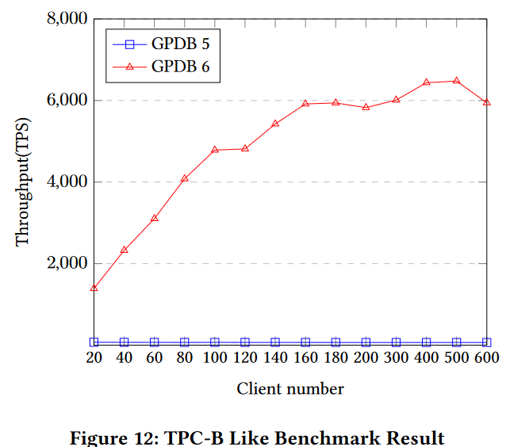
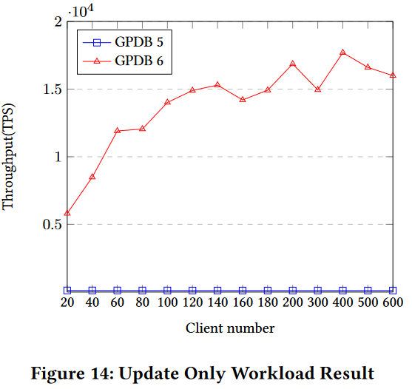
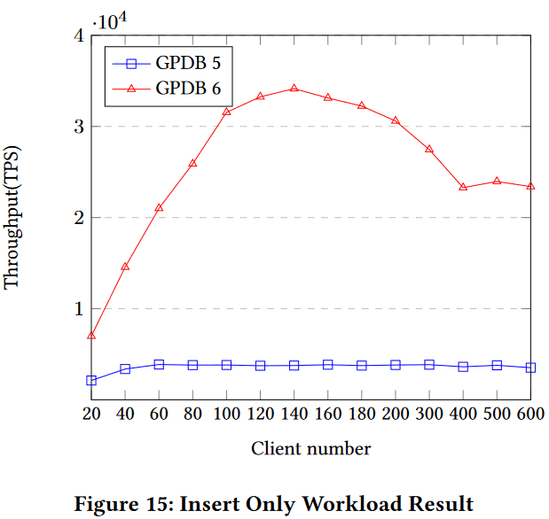
EVALUATION
OLTP
Performance increases because the one-parse commit and global deadlock detection.
Notes:
Pgbench是pg提供的一款测试工具，内置tpcb，tpcb比较简单，包含一个读写case（没有delete）和一个纯读case
the one-phase commit protocol not only reduces the overhead of communication between the coordinator and segments, which exists in two-phase commit protocol, but also could eliminate unnecessary CPU cost on segments which in fact does not insert any tuple.

Slide 18
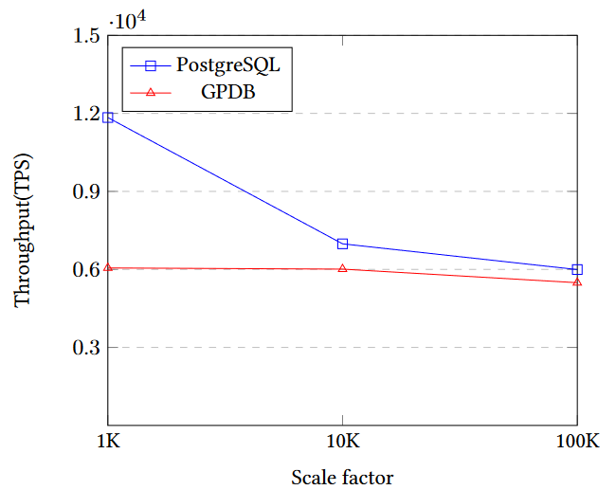
EVALUATION
OLTP
As the data size increases, PostgreSQL throughput sharply declines whereas Greenplum throughput remains steady.
Notes:
the one-phase commit protocol not only reduces the overhead of communication between the coordinator and segments, which exists in two-phase commit protocol, but also could eliminate unnecessary CPU cost on segments which in fact does not insert any tuple.

Slide 19
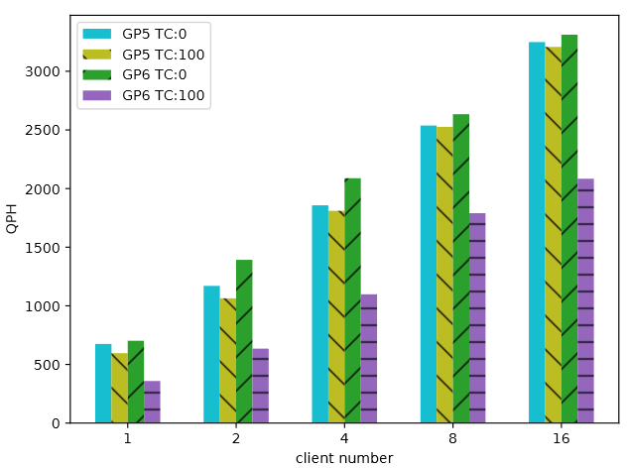
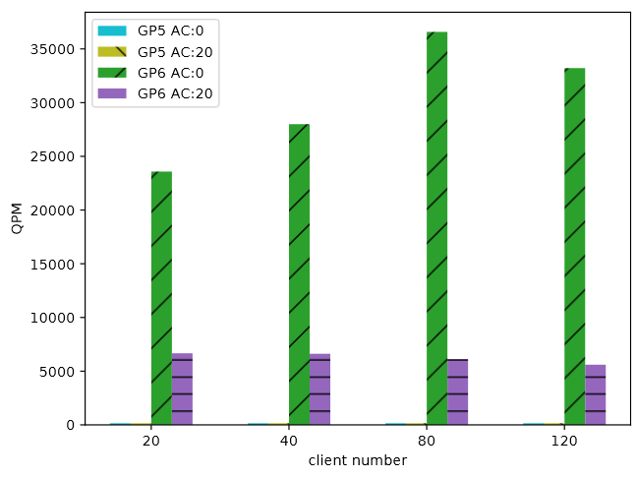
EVALUATION
HTAP:CH-benCHmark
GP6’s decreased QPH is due to the fact that the OLTP queries per minute (QPM) in GPDB 5 is too small to preempt the resource of OLAP workloads.
*TC: TP client AC: AP client

Slide 20
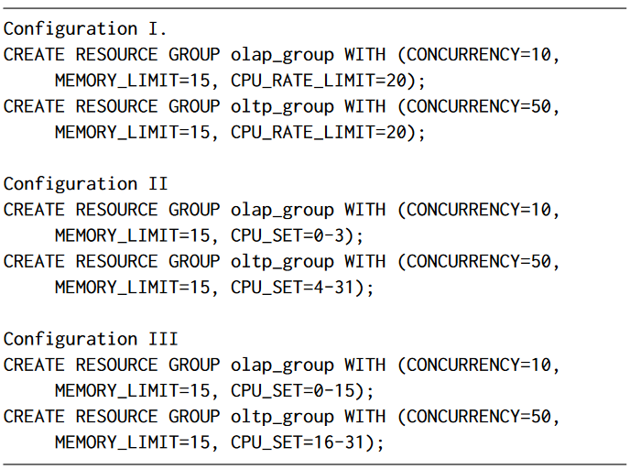
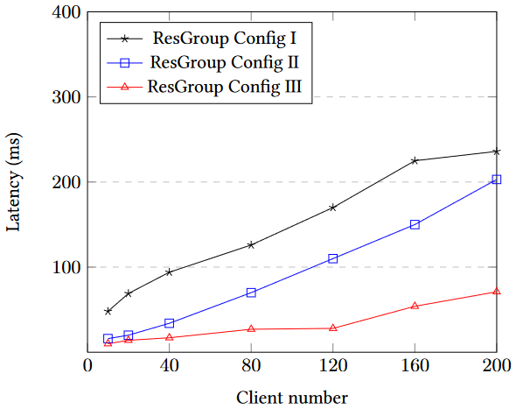
EVALUATION
Resource
Resource group is able to tune the resource allocation and query performance of HTAP workloads in a flexible way.
Notes:
HTAP负载

