Slide 1


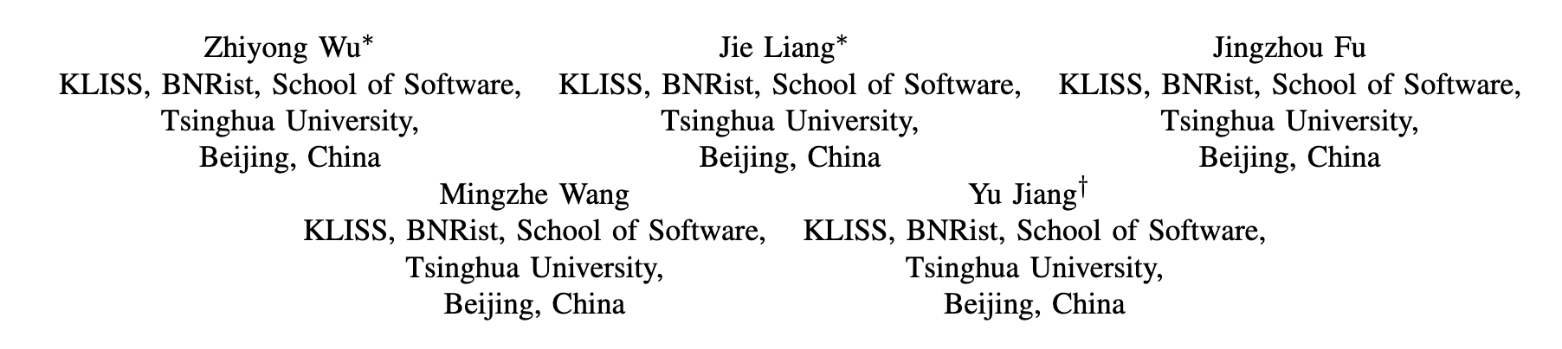
ICSE 2025
PUPPY: Finding Performance Degradation Bugs in
DBMSs via Limited-Optimization Plan Construction

Slide 2
Background
Query Optimizer
the most crucial component in the database system that determines the most efficient execution plan for a given query.
Optimization Operation
It refers to a predefined algorithm or technique used by the DBMS optimizer to enhance SQL clause performance;
A query plan consists of a sequence of optimization operations, which indicates the execution way.

Slide 3
What is performance degradation bug (PDB)？
Performance Degradation Bugs (PDB)
It refers to the performance of the plan provided by the optimizer with all optimizations enabled is significantly inferior to the plan generated when the partial optimization operation is disabled;
Executing the plan by combining some optimizations on specific data will cause performance degradation compared to not using optimizations.

Slide 4
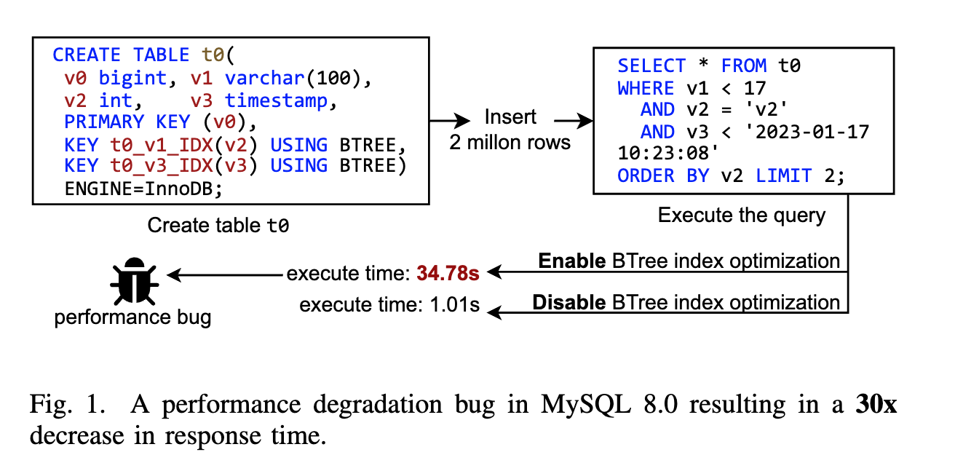
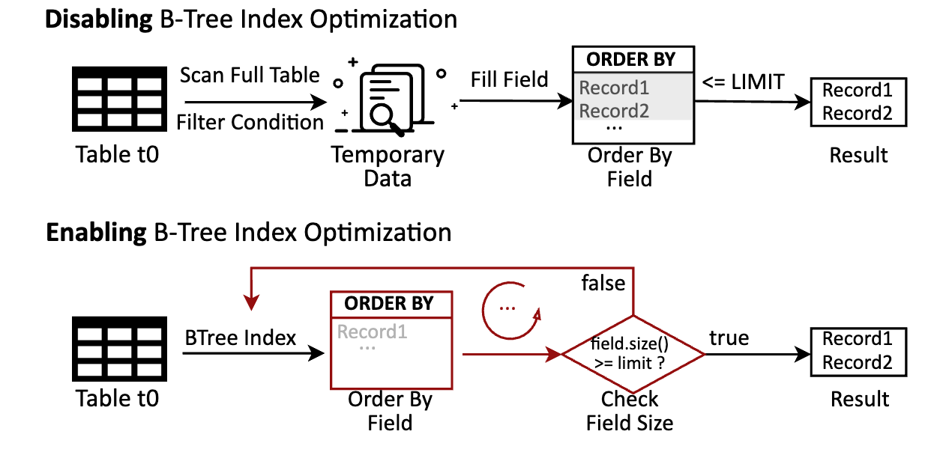
A Simple Example

Slide 5
Basic Methodology
The core idea is to limit the optimization operations enabled within a plan by modifying certain optimization options. When a “limited-optimization” plan outperforms the plan with all available optimizations enabled, it indicates a potential PDB.

Slide 6
Challenges
C1: Huge Optimization Operator Space Coverage
To effectively trigger performance degradation bugs in DBMSs, the generated SQL queries need to include a multitude of optimization operation sequences. However, in the absence of specific guidance, the generated queries may inadvertently contain similar optimization operation sequences.
C2: Huge Disabling Options Space Enumeration
Due to the extensive number of optimization options present in the DBMS, identifying and disabling specific options to construct a limited optimization plan can be a challenging task.

Slide 7
Contribution
S1: Optimization-guided Query Synthesis
It designs the optimization operation sequence coverage to steer the SQL query synthesis, thereby enhancing the diversity of the optimization operation sequence in one SQL query.
S2: Execution-driven Limited-optimization Plan Construction
It examines the query plan for the SQL query, gather the options that can impact the utilized optimization operations within the query plan, and subsequently deactivate specific optimizer options based on the information from the execution process analysis.
Experiments:
PUPPY evaluates on five widely-used DBMSs: MySQL, Percona, TiDB, PolarDB, and PostgreSQL. PUPPY reports a total of 62 PDBs, with 54 performance anomalies have been confirmed as previously unknown bugs. Besides, PUPPY also finds 20 crash bugs, and 16 of them are confirmed.

Slide 8
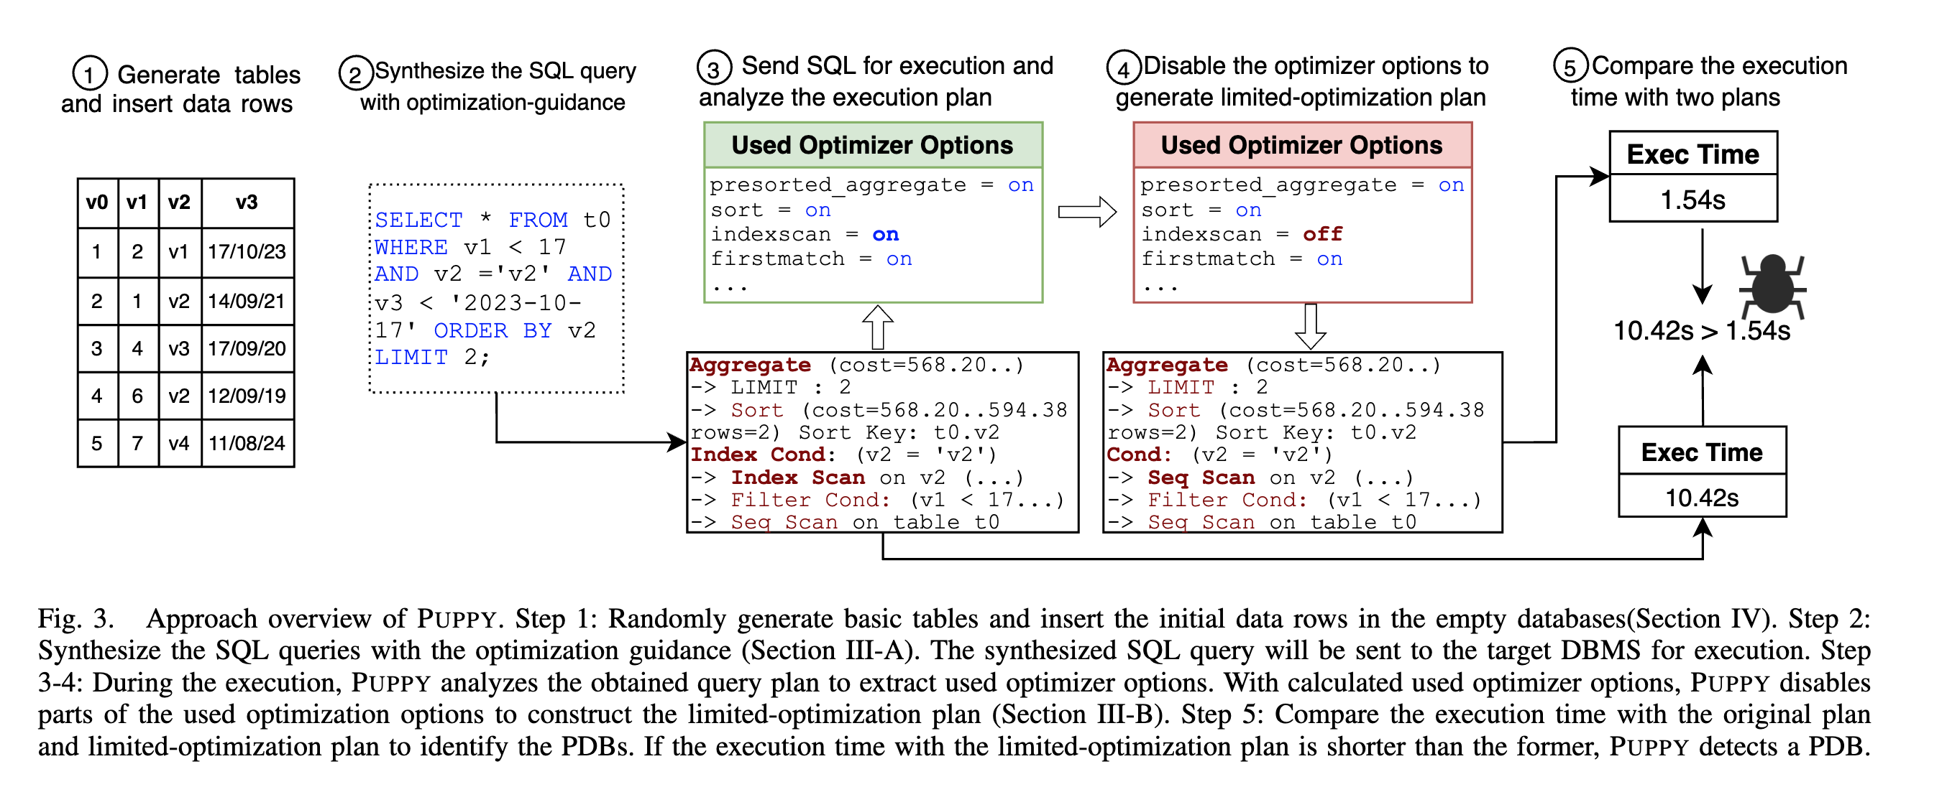
Framework

Slide 9
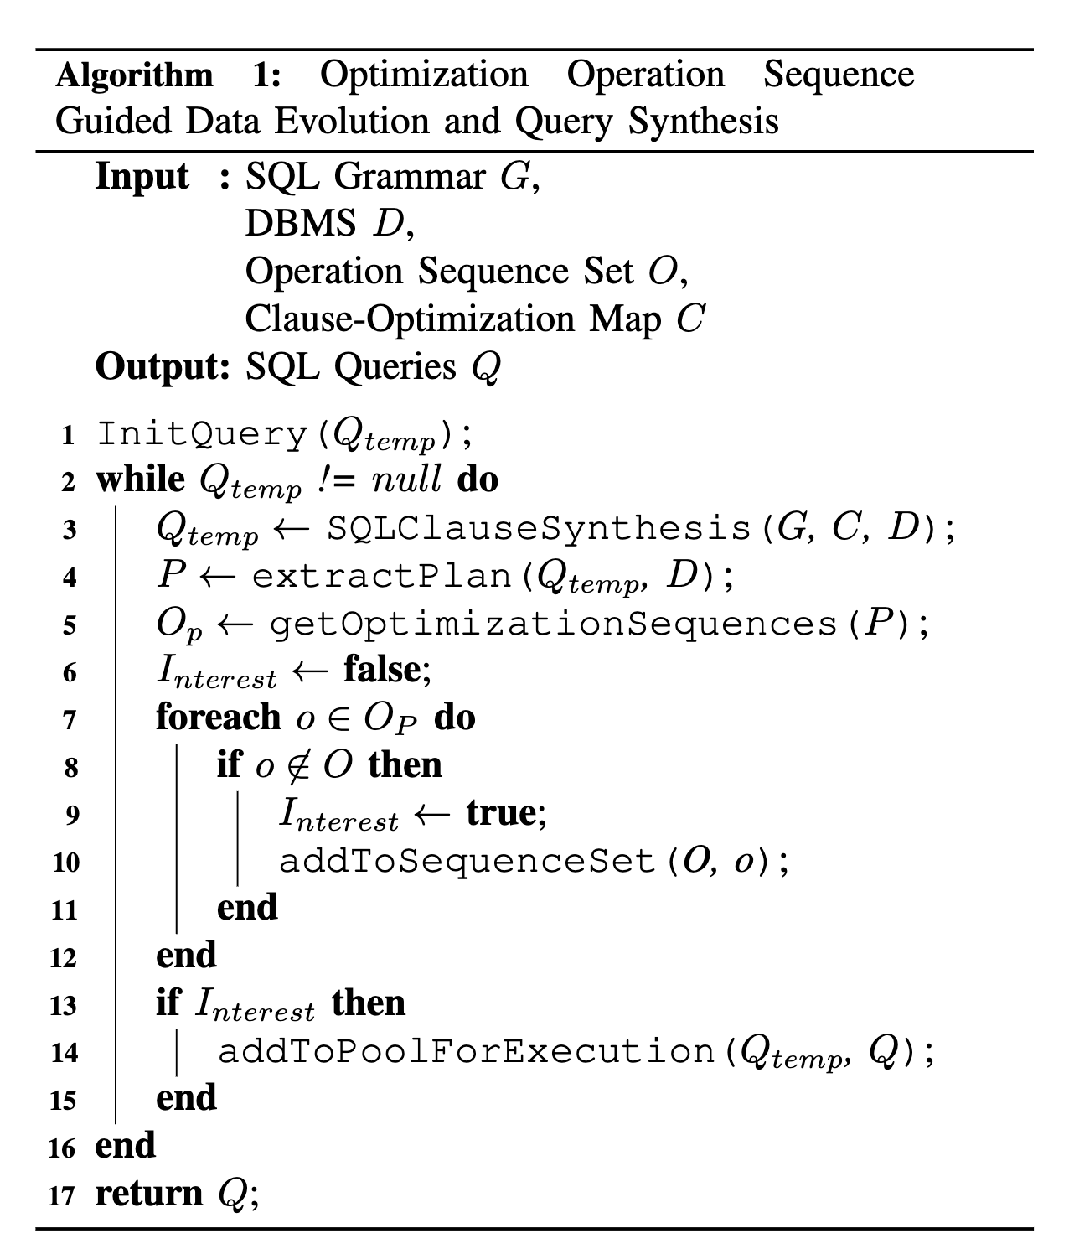
S1: Optimization-Guided SQL Synthesis
Step1: PUPPY selects some tables from the DBMS and initializes and synthesizes a SQL query with stored data and the clause-optimization map following the SQL grammar;
Step2: Then, PUPPY analyzes the optimized execution plan and extracts the optimization operation sequences;
Step3: The Optimization Operation Sequence Set maintains a record of all previously discovered sequences. By checking whether the sequences of this plan exist in this set, it can ascertain the significance of the corresponding query. If it discovers new optimization operation sequences, PUPPY thinks the synthesized SQL query is interesting and adds it to the SQL query pool for execution.
Notes:
clause-optimization map: hint (index / join order)

Slide 10
S2: Execution-Driven Limited Optimization Plan Construction
Design Goal: Disabling Specific Optimization Options
After synthesizing amounts of SQL queries, PUPPY then dispatches these queries to the DBMS for execution. During the execution, PUPPY analyzes the default optimization execution plan and constructs limited optimization query plans by disabling some specific optimization options of the DBMS optimizer.
Selecting Appropriate Optimization Options to Disable is Challenging!
Typically, a DBMS optimizer offers an extensive array of optimization options, which determine the utilization of various optimization operations. A single SQL query usually triggers only a subset of these optimization operations. If we randomly deactivate DBMS optimization options, it might become difficult to create a limited optimization execution plan that is customized to the needs of that particular query.

Slide 11
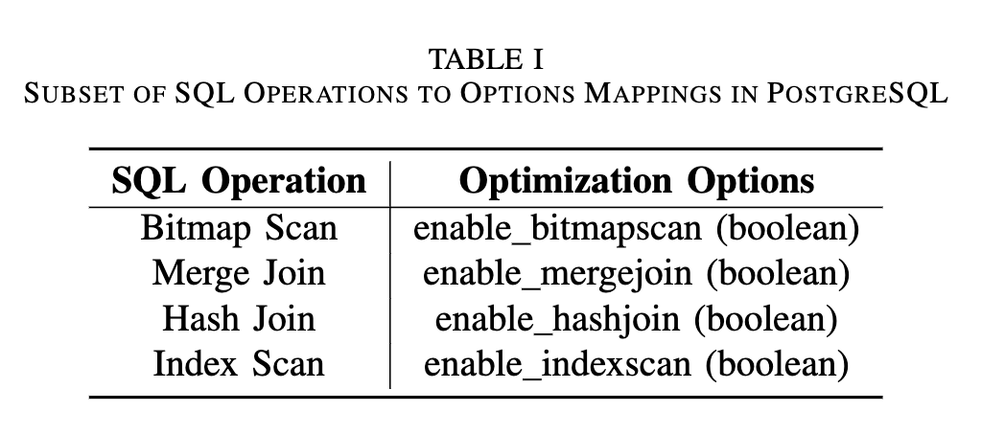
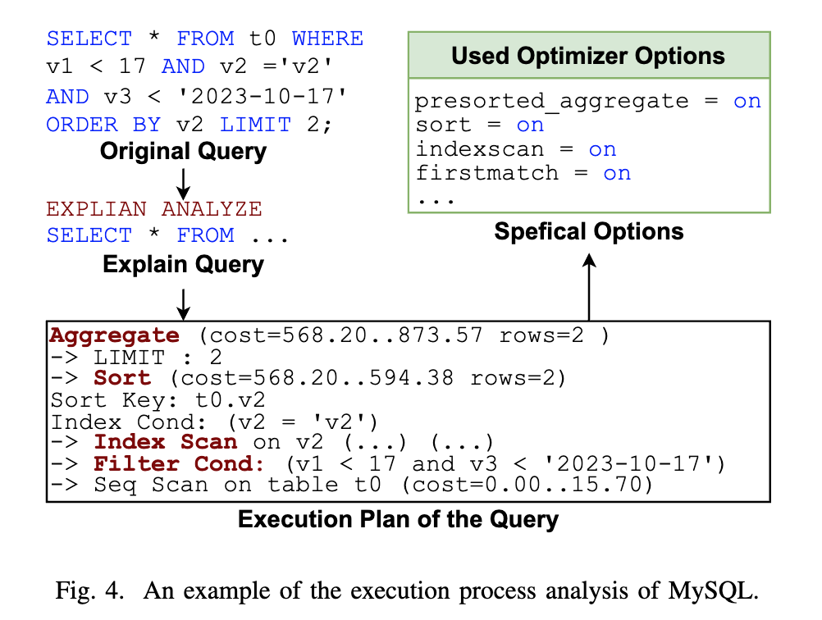
Three Steps
STEP1: Execution Process Analysis
First, it acquires query plans by instrumenting queries with the EXPLAIN statements;
Second, PUPPY analyzes the acquired query plan to extract optimization options sequence using the Operations-Options Mappings. These mappings document the SQL optimization options that have the potential to influence the utilization of corresponding optimization operations within the optimizer.

Slide 12
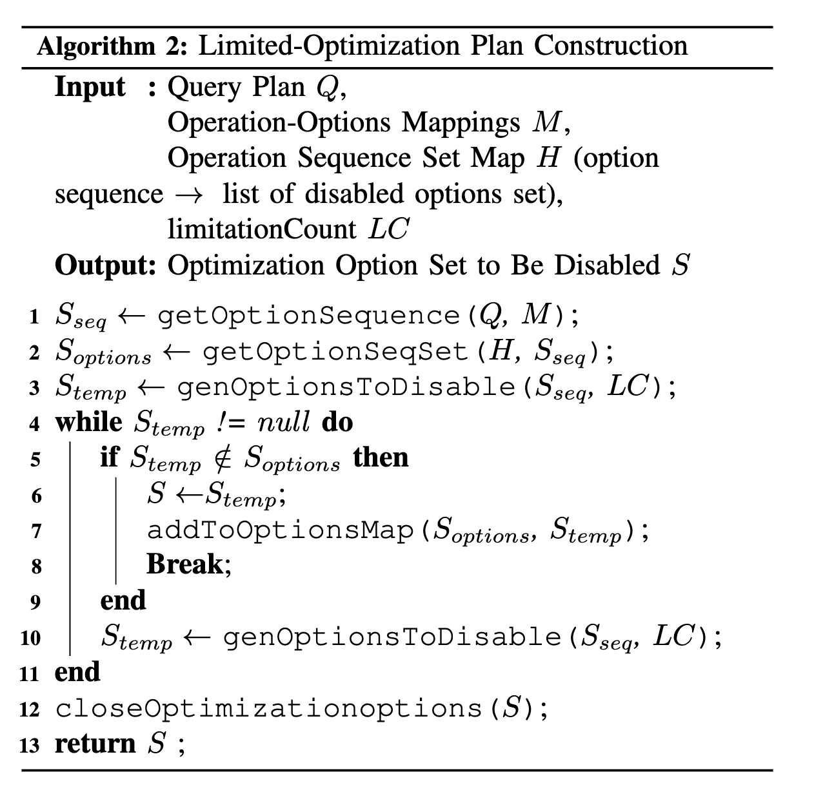
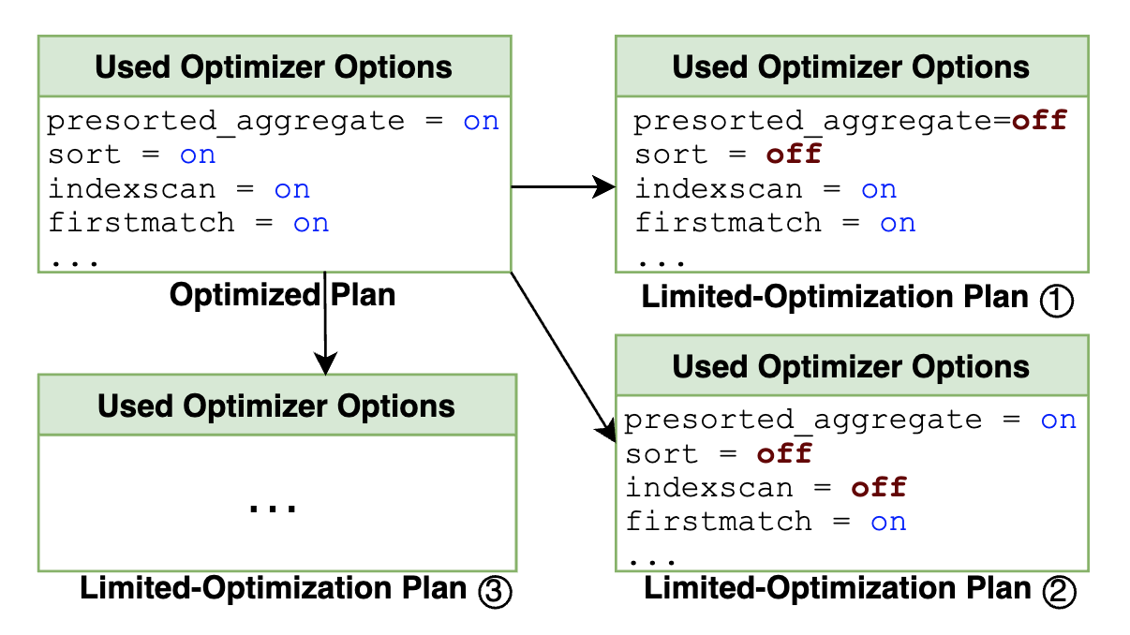
Three Steps
STEP2: Limited-Optimization Plan Construction
Algorithm 2 outlines the complete procedure for constructing a limited-optimization plan with memorized operation sequence set.

Slide 13
Three Steps
STEP3: PDB Detection
Each limited-optimization plan is methodically crafted and executed, and their respective response times are recorded. The objective here is to observe how these limited-optimization plans perform in terms of query execution time when compared to the plan without limitations;
If it finds that the response time of a limited optimization plan is notably less than the response time of the unlimited one, it signals a potential PDB;
In other words, it suggests that the limited-optimization plan is executing faster than the meticulously optimized plan.

Slide 14
Experiment
Target DBMS: MySQL, Percona, TiDB, PolarDB, and PostgreSQL
Three Questions:
RQ1: Can PUPPY discover performance degradation bugs in widely-used DBMSs?
RQ2: How does PUPPY’s performance compare to other DBMS testing techniques?
RQ3: How important is the optimization guided algorithms in identifying PDB?

Slide 15
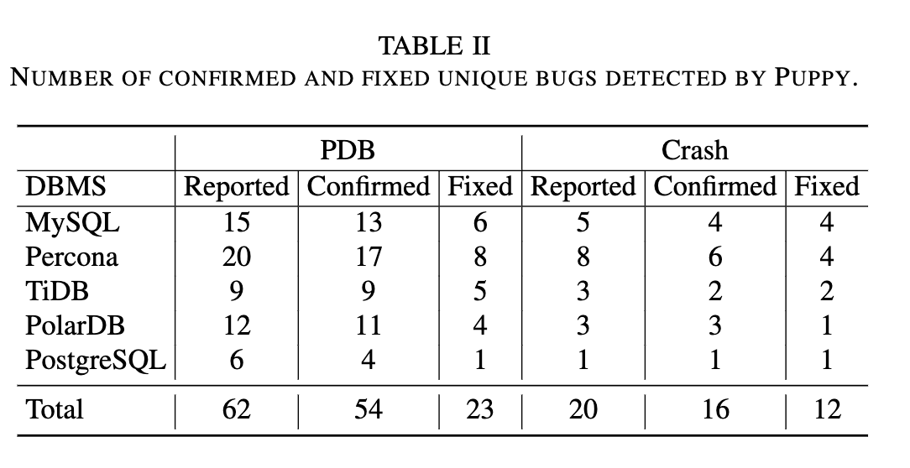
Unique Bugs

Slide 16
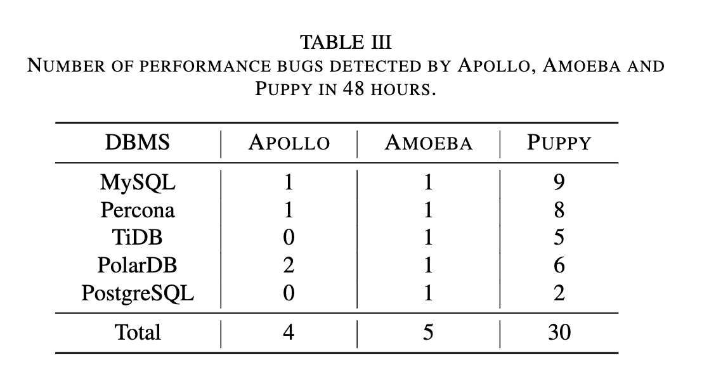
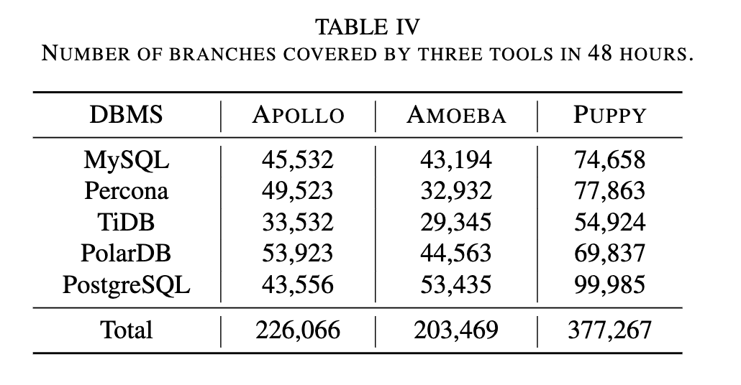
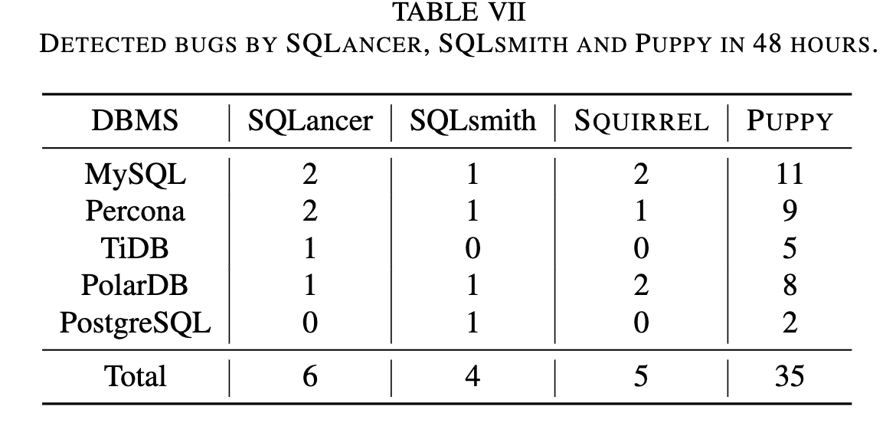
Compare with Other Techniques

Slide 17
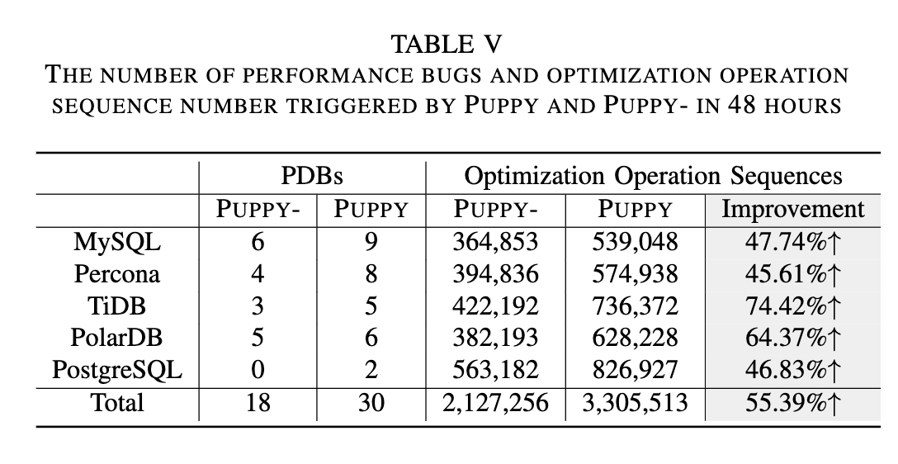
Efficiency of the Optimization Guided Algorithm
Notes:
如果是空，就返回后一个，否则返回自己

Slide 18
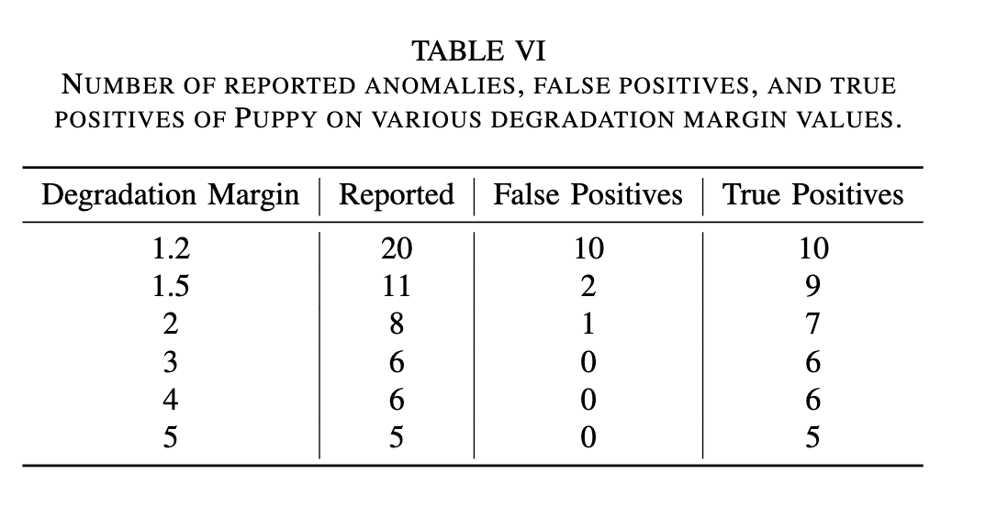
False Positives

Slide 19
Thank You Guys!

