Slide 1



VLDB 2023
Lero: A Learning-to-Rank Query Optimizer

Slide 2
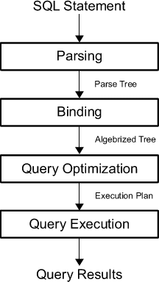
Background - Query Optimization
Query optimizer plays one of the most significant roles in databases. It aims to select an efficient execution plan for each query. Improving its performance has been a longstanding problem.
Notes:
https://www.red-gate.com/simple-talk/databases/sql-server/performance-sql-server/the-sql-server-query-optimizer/

Slide 3
Major Components for Optimizer
Cardinality Estimator
Estimate the number of tuples in the output for each sub-query of 𝑄
Cost Model
The cost of a plan 𝑃 (with physical operators) for the query 𝑄 is a proxy of latency or other user-specified metrics regarding the efficiency of executing 𝑃.
The cost model PlanCost(𝑃) estimates 𝑃’s cost and is usually a function of estimated cardinalities of 𝑄’s sub-queries.
Plan Enumerator
The plan enumerator considers valid plans of 𝑄 in its search space and returns the one with the minimum estimated cost for execution.

Slide 4
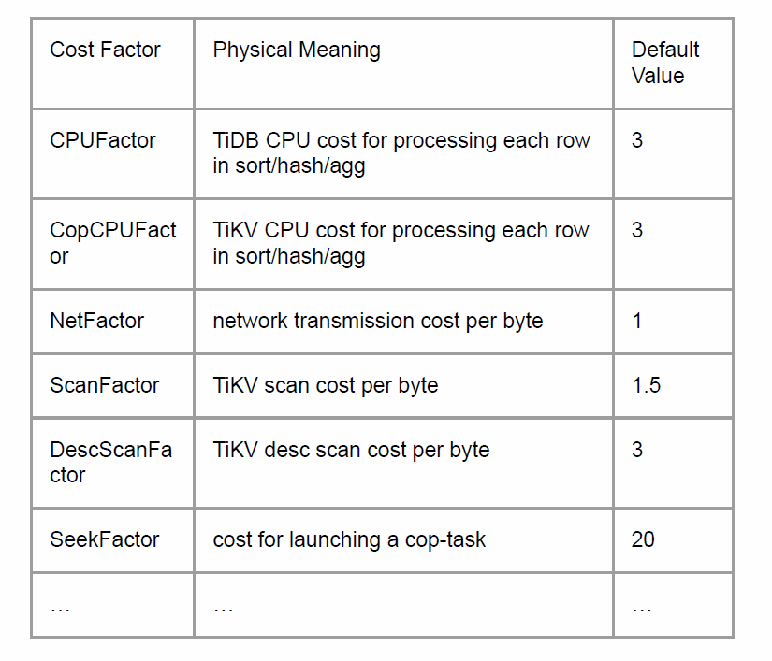
Heuristic-Based Costing Models
The cost model is a function mapping the (sub)plan with annotated information to a scalar (cost).
Uses a combination of CPU and I/O costs that are weighted by magic constant factors
Disadvantages:
Cost factors are decided by experience and may deviate from reality.
Cardinality Estimation Errors affect the quality.
Complexity increase tremendously in a distributed or parallel database, the cloud environment, or cross-platform query engines.

Slide 5
Machine Learning Models
Aim：Develop machine learning models to replace traditional cost models
learn from different datasets and workloads to enable finer-grained characterization of various data distributions and system configurations.
Related works:
Neo and Balsa：use deep reinforcement learning to find the best plan with the minimum estimated latency. (end-to-end)
Bao：use a machine learning model to estimate the (e.g., latency) of each candidate plan 𝑃 and select the best candidate for execution. (steer a native query optimizer with different sets of hints.)
Notes:
Each hint set forces/disables some operations, e.g., index scan or hash join, so the query optimizer may output a different, and possibly better, execution plan.

Slide 6
Major Deficiencies
Unstable performance
Can be worse than PostgreSQL’s native query optimizer on TPC-H benchmark
High learning cost
For complex datasets, this method can consume several days or weeks
Slow model updating
model updating in this case requires huge efforts (training data and cost), and easily leads to performance regression
New question：Is it really necessary to predict the latency?
With the goal of finding the best execution plan, training a machine learning model to predict the exact latency (cost) is an overkill

Slide 7
New Method
A Learning-to-Rank Query Optimizer
Train a learned oracle that is able to rank a set of candidate query plans with respect to their execution efficiency
Continuously explores different query plans, observes their performance, and learns to rank them accurately.

Slide 8
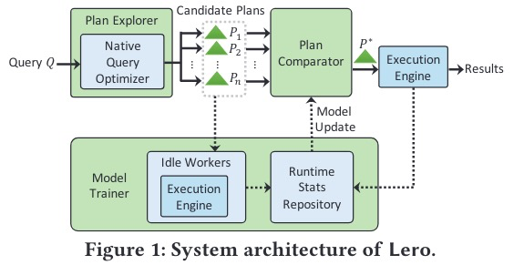
Overall Architecture
Plan Explorer
Generate potentially good and diversified candidate plans
Plan comparator model
select the best plan from the candidates for answering 𝑄
Model trainer
Using idle workers to collect the runtime latency information and continuously trains the model

Slide 9
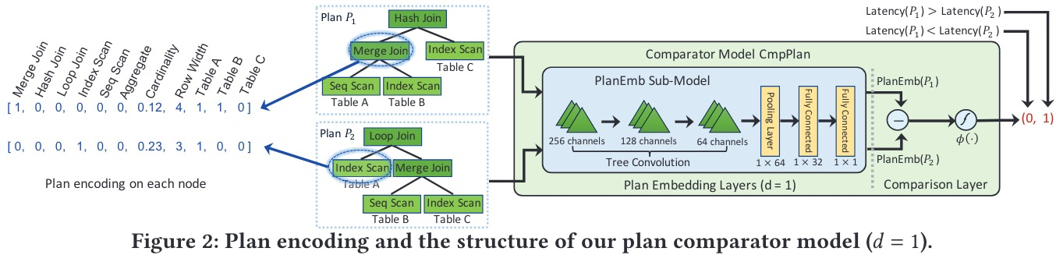
Plan Comparator Model
Plan Embedding Layers
PlanEmb：Map plan from the original feature space to a one-dimensional embedding space
Comparison Layer
CmpPlan：learn via pairwise comparisons of plans with binary labels indicating which one is better for each pair
Loss Function
maximize the likelihood of outputting the right order between any two plans

Slide 10
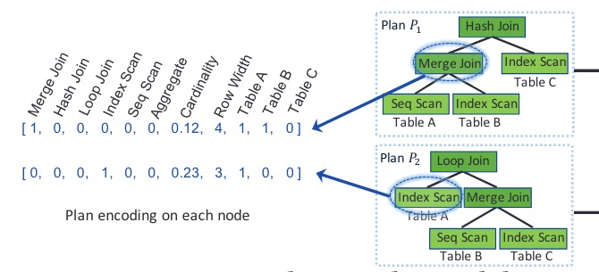
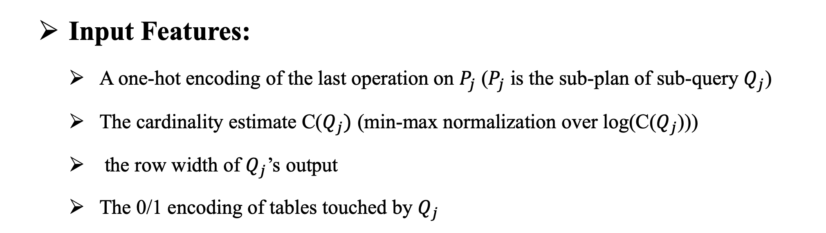
Plan Embedding Layers
Input Features:
A one-hot encoding of the last operation on $P_{j}$ ($P_{j}$ is the sub-plan of sub-query $Q_{j}$)
The cardinality estimate C($Q_{j})$ (min-max normalization over log(C($Q_{j}$)))
the row width of $Q_{j}$’s output
The 0/1 encoding of tables touched by $Q_{j}$

Slide 11

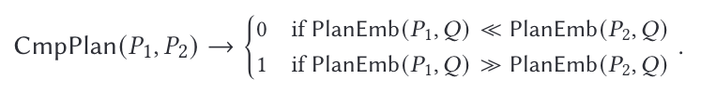
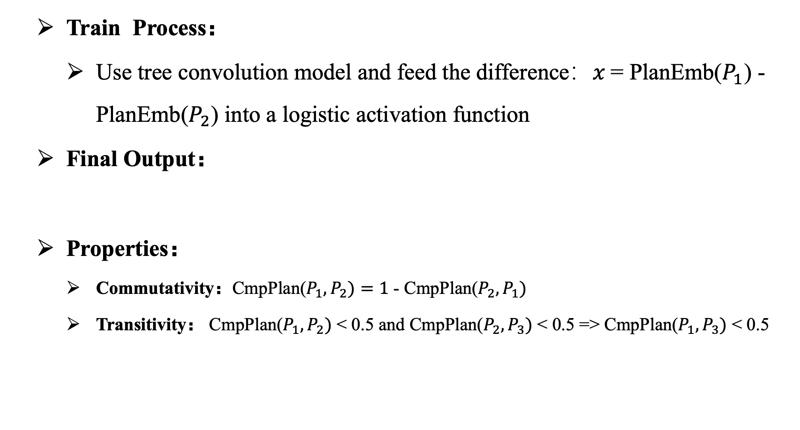
Comparison Layers
Train Process：
Use tree convolution model and feed the difference：𝑥 = PlanEmb($P_{1}$) - PlanEmb($P_{2}$) into a logistic activation function
Final Output：
Properties：
Commutativity：CmpPlan($P_{1},P_{2})=1$ - CmpPlan($P_{2},P_{1})$
Transitivity： CmpPlan($P_{1},P_{2})$ < 0.5 and CmpPlan($P_{2},P_{3})$ < 0.5 => CmpPlan($P_{1},P_{3})$ < 0.5

Slide 12
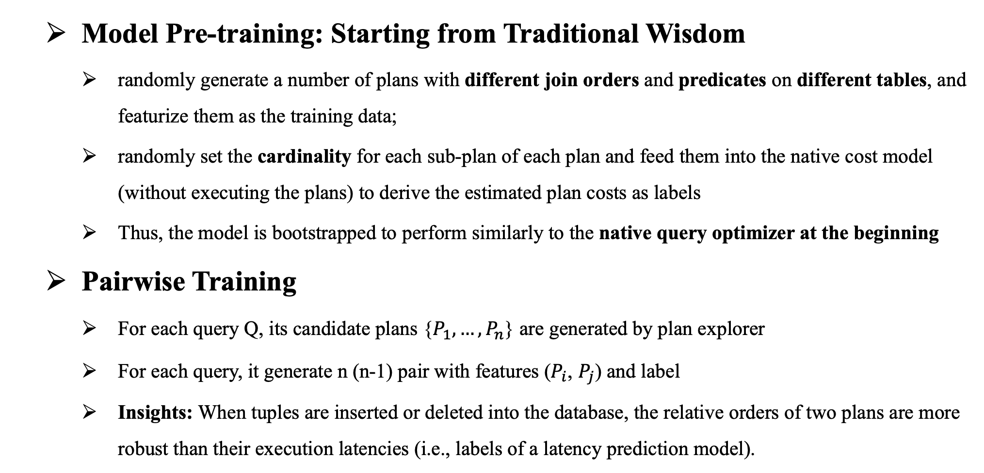
Model Training
Model Pre-training: Starting from Traditional Wisdom
randomly generate a number of plans with different join orders and predicates on different tables, and featurize them as the training data;
randomly set the cardinality for each sub-plan of each plan and feed them into the native cost model (without executing the plans) to derive the estimated plan costs as labels
Thus, the model is bootstrapped to perform similarly to the native query optimizer at the beginning
Pairwise Training
For each query Q, its candidate plans {$P_{1},…, P_{n}$} are generated by plan explorer
For each query, it generate n (n-1) pair with features ($P_{i}$, $P_{j}$) and label
Insights: When tuples are inserted or deleted into the database, the relative orders of two plans are more robust than their execution latencies (i.e., labels of a latency prediction model).

Slide 13
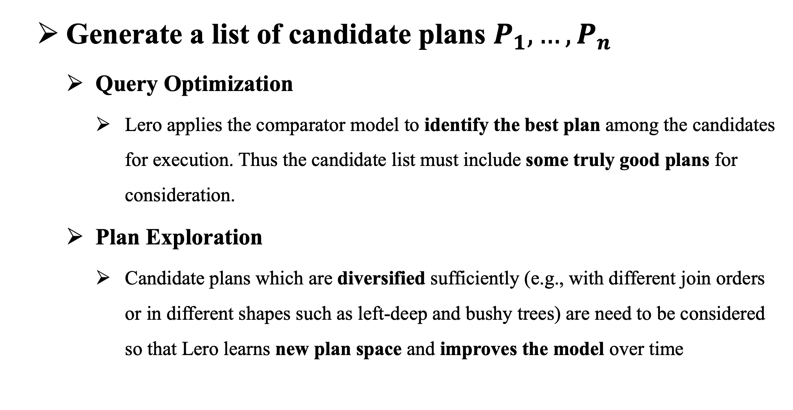
Plan Explorer
Generate a list of candidate plans $P_{1},…,P_{n}$
Query Optimization
Lero applies the comparator model to identify the best plan among the candidates for execution. Thus the candidate list must include some truly good plans for consideration.
Plan Exploration
Candidate plans which are diversified sufficiently (e.g., with different join orders or in different shapes such as left-deep and bushy trees) are need to be considered so that Lero learns new plan space and improves the model over time

Slide 14
Existing Plan Exploration Methods
Method1：Explore a random sample of valid plans
High-quality plans could be missing in a random sample
Sample size has to be large that executing would be costly for training
Method2：Tuning a set of hints to disable/force certain types of optimization rules
If different parts of a query have different optimal choices, tuning a flag at a query level may miss opportunities for finding high-quality plans
Enumerating all kinds of combinations is infeasible in practice
Notes:
the set of available hints is system specific. An optimizer usually contains hundreds of flags to enable/disable certain optimization rule

Slide 15
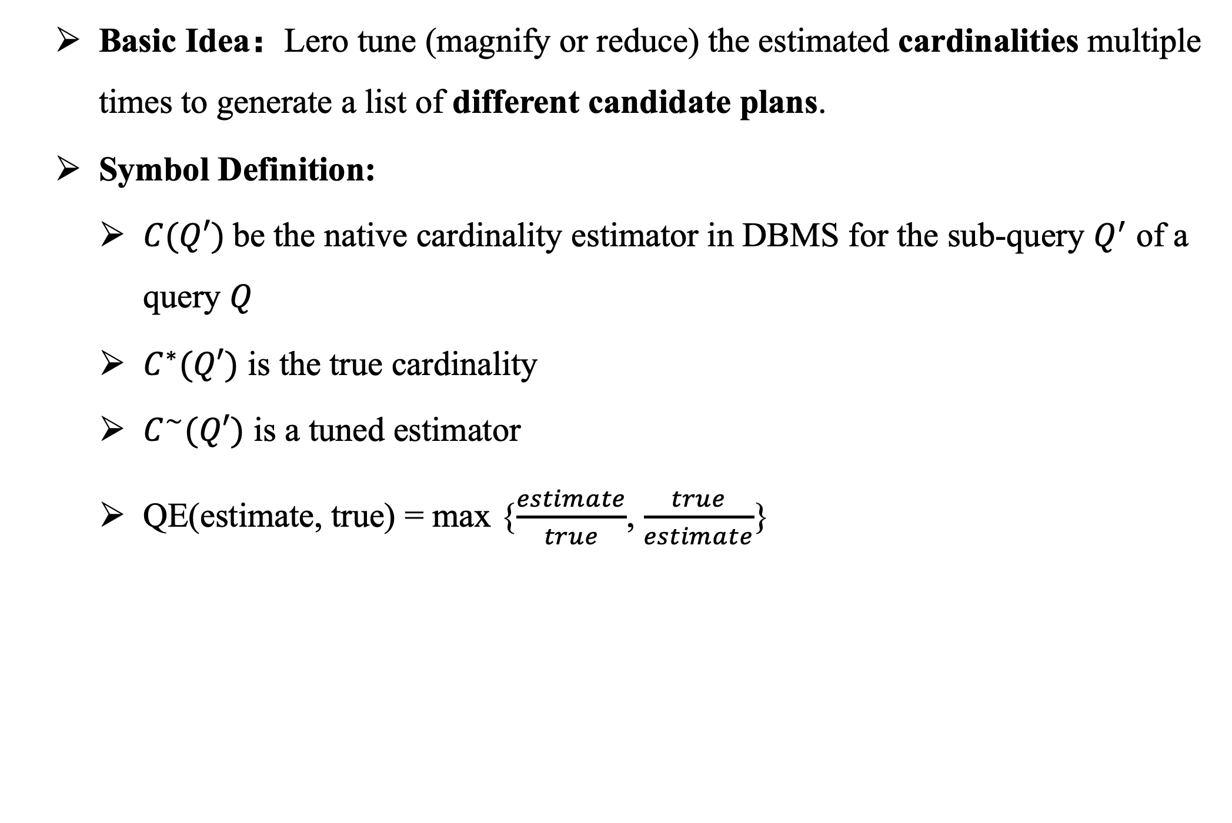
Cardinality as Knob
Basic Idea：Lero tune (magnify or reduce) the estimated cardinalities multiple times to generate a list of different candidate plans.
Symbol Definition:
$C(Q′)$be the native cardinality estimator in DBMS for the sub-query $Q^{′}$ of a query $Q$
$C^{∗}(Q′)$ is the true cardinality
$C^{\sim }(Q′)$ is a tuned estimator
QE(estimate, true) = max {$\frac{estimate}{true}$, $\frac{true}{estimate}$}

Slide 16

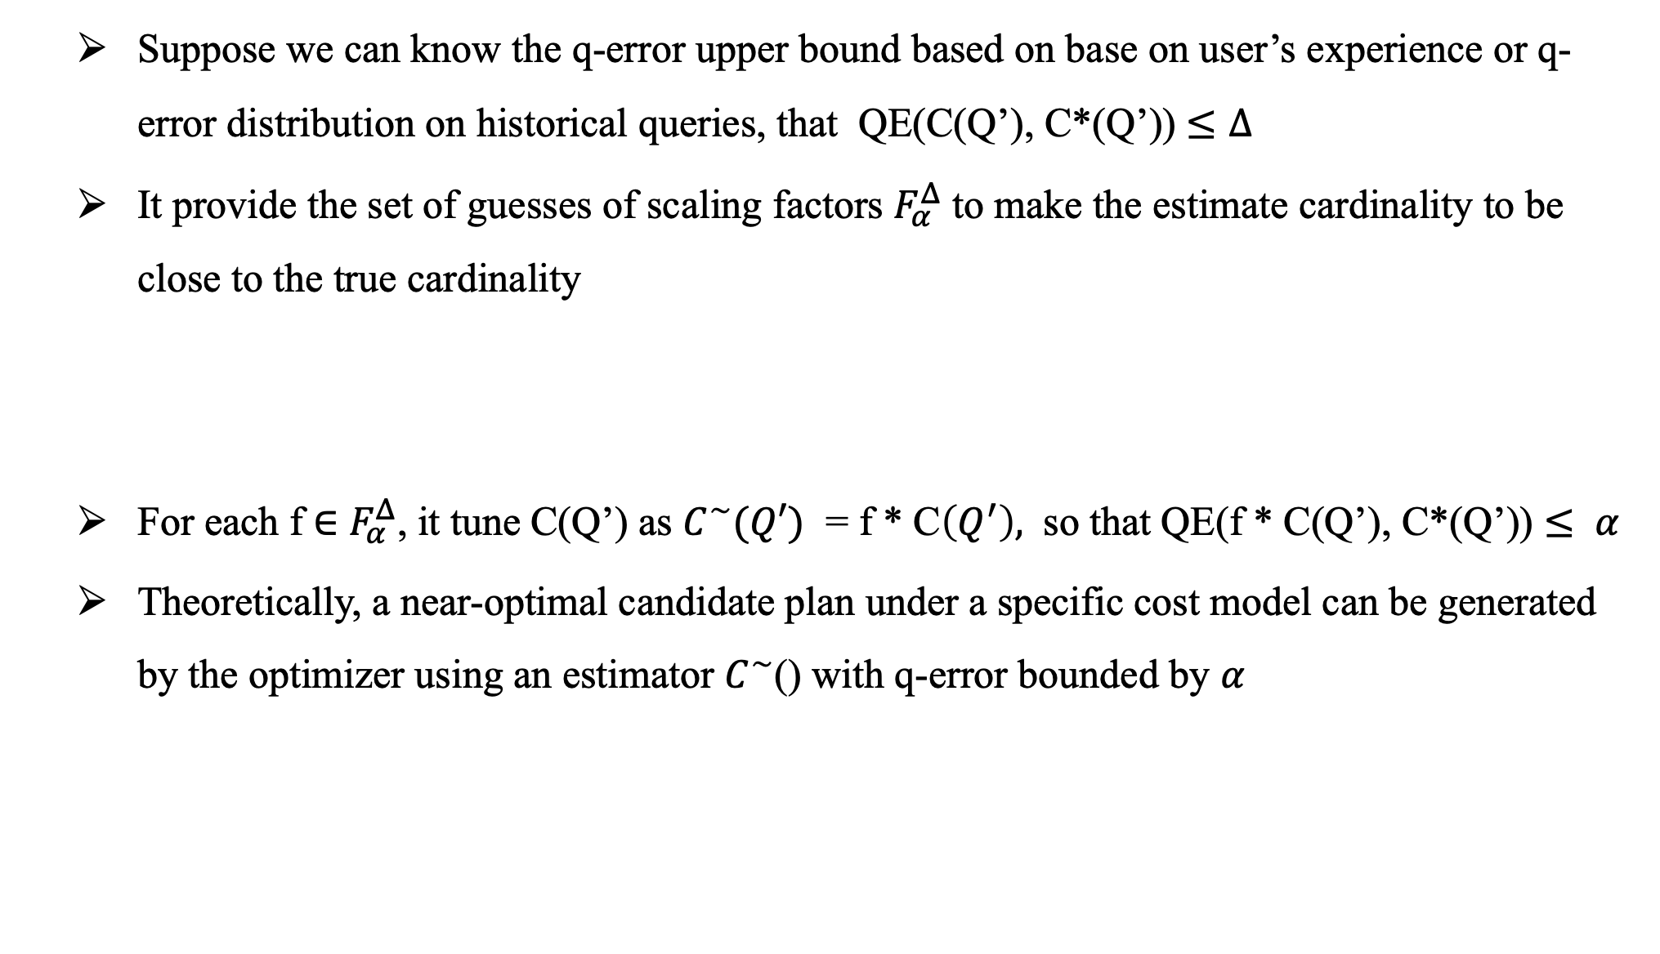
Cardinality as Knob
Suppose we can know the q-error upper bound based on base on user’s experience or q-error distribution on historical queries, that QE(C(Q’), C*(Q’)) $≤∆$
It provide the set of guesses of scaling factors $F_{α}^{Δ}$ to make the estimate cardinality to be close to the true cardinality
For each f $∈$ $F_{α}^{Δ}$, it tune C(Q’) as $C^{\sim }(Q′)$ = f * C$\left(Q^{′}\right),$ so that QE(f * C(Q’), C*(Q’)) $≤ α$
Theoretically, a near-optimal candidate plan under a specific cost model can be generated by the optimizer using an estimator $C^{\sim }$() with q-error bounded by 𝛼

Slide 17
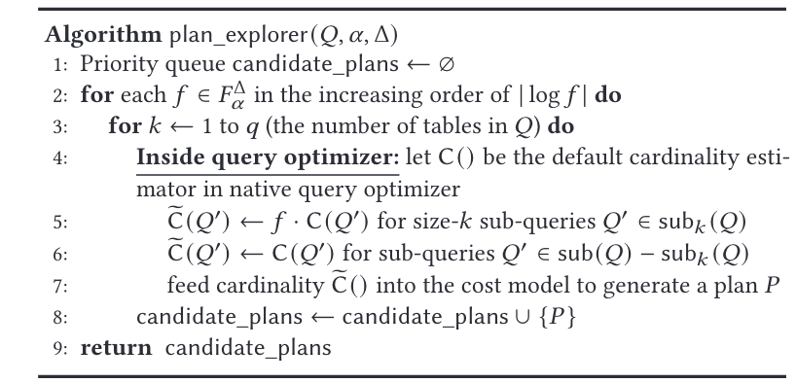
Priority-Based Heuristic Methods
Instead of exploring all possibilities and tuning cardinality estimates for all sub-queries, it introduce a heuristic which focuses on mistakes in estimating cardinalities for size-𝑘 sub-queries on 𝑘 tables (for each different 𝑘 ≥ 1 at one time).

Slide 18
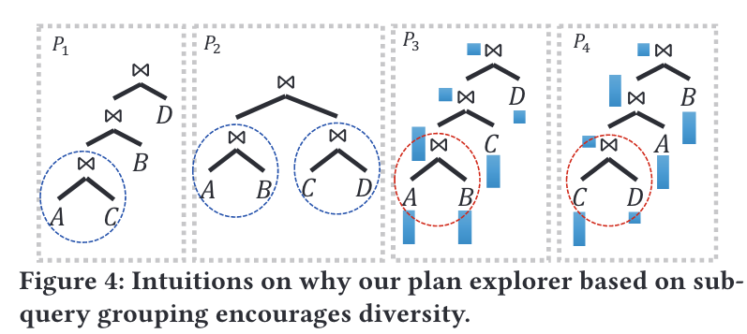
Encouraging Diversity in Candidates
Diversity of plan shapes
Diversity of join orders

Slide 19
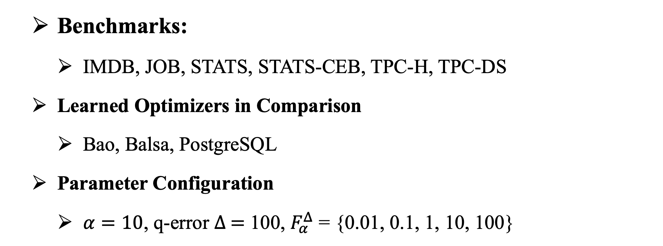
Experiment Configuration
Benchmarks:
IMDB, JOB, STATS, STATS-CEB, TPC-H, TPC-DS
Learned Optimizers in Comparison
Bao, Balsa, PostgreSQL
Parameter Configuration
$α=10$, q-error $∆ =$ 100, $F_{α}^{Δ}$ = {0.01, 0.1, 1, 10, 100}

Slide 20
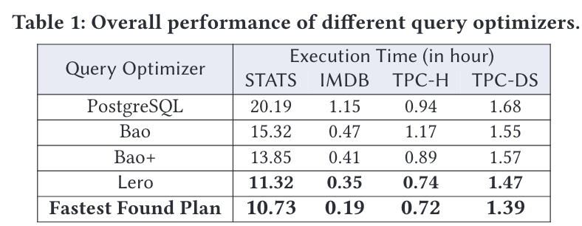
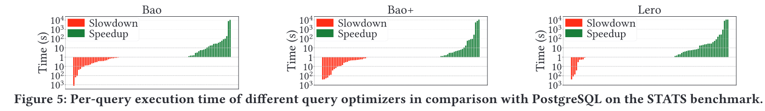
Performance with Stable Models

Slide 21
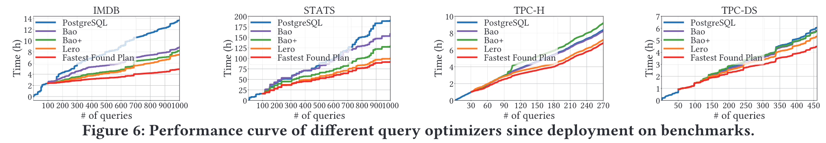
Performance Curves since Deployment

Slide 22
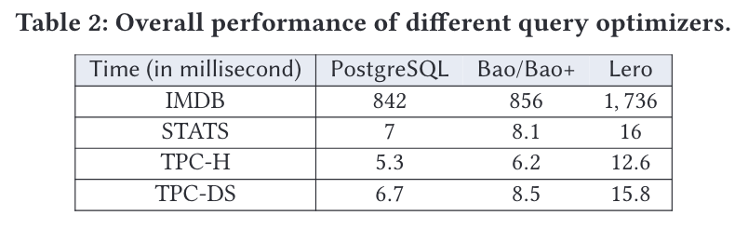
Query Optimization Cost
Notes:
We observe that this extra cost in query optimization is very low. In particular, the total extra cost is only at most 2.4% of the total query execution time on IMDB and less than 0.1% on STATS, TPC-H and TPC-DS. Whereas, Lero saves 13% to 70% execution time in comparison with PostgreSQL on these benchmarks

Slide 23
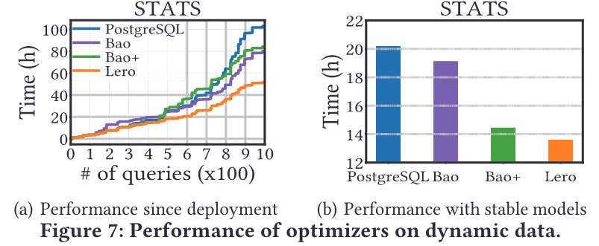
Adapting to Dynamic Data

Slide 24
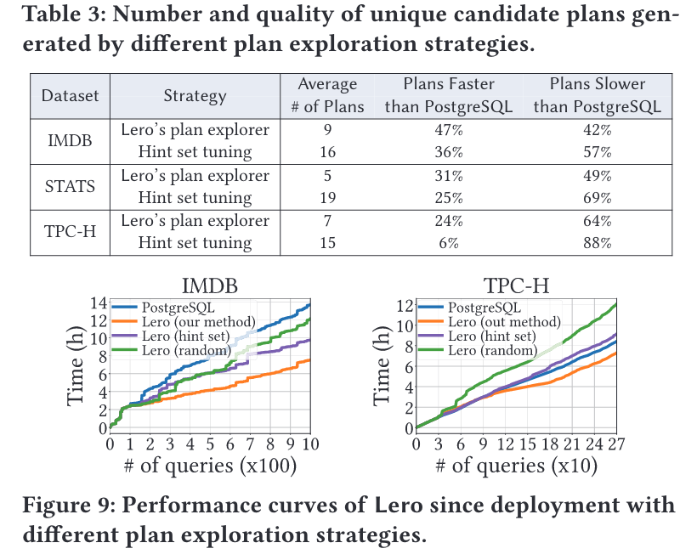
Plan Exploration Strategies

Slide 25
Thank You Guys!

