Slide 1

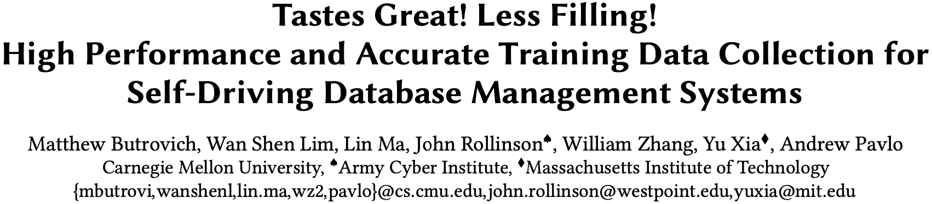
SIGMOD ’22

Slide 2

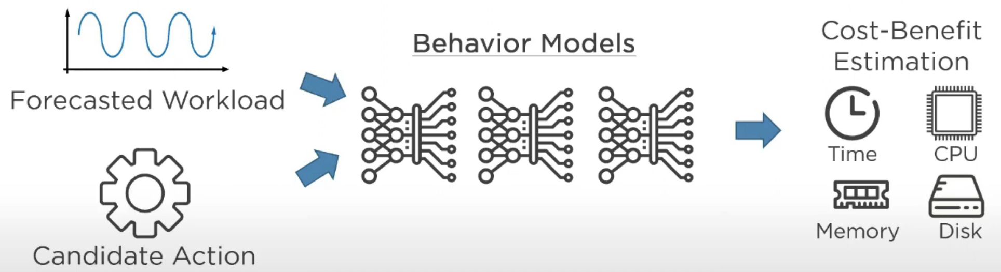
Behavior Modeling
Generate behavior models that predict the cost and benefit for self-driving actions.

Slide 3
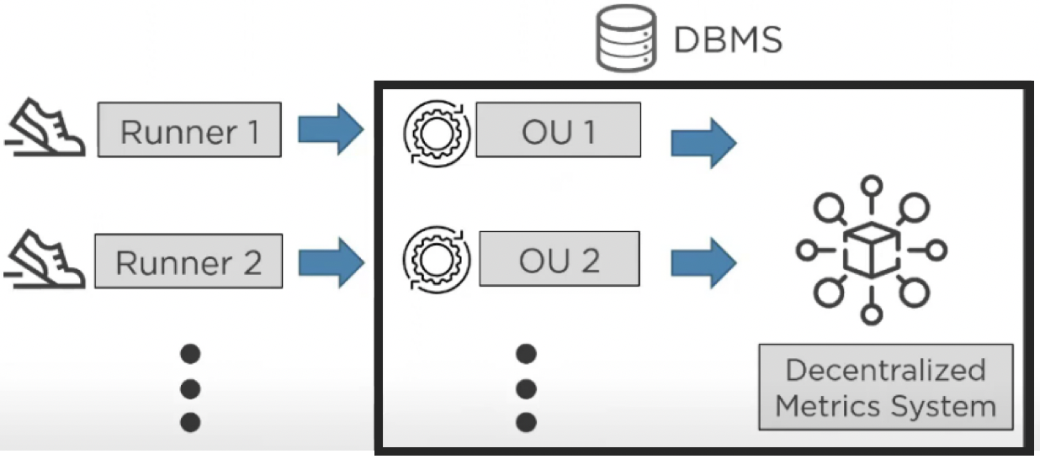
Model Training in MB2
MB2 trains multiple models per OU and then automatically selects the one with the best accuracy for each OU.

Slide 4
Input Features in MB2
Singular OUs
(1) rows of input tuples, (2) columns of input tuples, (3) average input tuple size, (4) estimated key cardinality , (5) payload size , (6) number of loops, (7) execution mode flag
Batch OUs
(1) the total number of bytes, (2) the total number of log buffers, (3) the log flush interval
Contending OUs
(1) number of tuples, (2) number of keys, (3) size of keys, (4) estimated cardinality of the keys, and (5) the number of parallel threads

Slide 5
Output Labels in MB2
A vector of commonly available hardware metrics:
Elapsed time
CPU
CPU time
CPU cycles
CPU instructions
CPU cache references
Disk
Disk block reads
Disk block writes (for logging)
Memory
Memory consumption

Slide 6

Training Data Wishlist
Features:
Workload
Online environment
DBMS configuration
Metrics:
DBMS-level
Hardware-level

Slide 7
Challenges
1
Performance degradations.
2
Measurement degradations.
3
Granularity that the DBMS does not support.

Slide 8
TScout(TS)
Use internal approach:
Developers annotate a DBMS’s source code with hooks to monitor the system’s behavior.
Extract these hooks and generates a kernel-level program that efficiently captures metrics from multiple sources.
Combine these metrics with internal DBMS state observations, generating training data for behavior models.

Slide 9
Offline vs. Online Training
Offline:
Deploy a clone of the production instance and replay a workload trace.
(Drawback: prohibitively expensive.)
Create targeted microbenchmarks (i.e., runners) that simulate different execution scenarios.
(Drawback: training data does not provide additional information.)
Online:
Collect the training data as it executes the application’s queries.
(Advantage: exactly reflects the DBMS’s current workload, database
and environment.)

Slide 10
Input Sources
The inputs to an OU behavior model describe the DBMS’s task when executing that OU.
Source of features:
External method:
Execute SQL queries (e.g. EXPLAIN) or other public APIs.
(Drawbacks: 1. not feasible in high-performance scenarios. 2. cannot capture a query’s interactions with DBMS background tasks. )
Internal method:
Modify DBMS source code to capture state.
(Drawbacks: higher software engineering costs. )

Slide 11
Output Sources
The output of an OU behavior model is the DBMS’s estimated metrics.
Source of metrics:
User-space metrics:
Operating system APIs (e.g., perf).
(Drawbacks: 1. incurs significant overhead. 2. OS may not expose all the metrics.)
Kernel-space metrics:
Kernel data structures and privileged APIs.
(Drawbacks: 1.OS kernel modules are notoriously difficult to write. 2. could potentially pose several safety issues.)

Slide 12
BPF
A kernel-embedded VM that runs in kernel mode to trace the behavior of other processes.
Allow developers to write event-driven programs in C-like dialect.
Advantages:
Save round trips on sys-calls.
Yields more predictable performance for the DBMS.

Slide 13
Resource Probes
Probes are reusable code that run at OU boundaries defined by the markers in the DBMS.
Categories:
User-level
Resource: Memory.
Measurement: TS bundles metrics at the FEATURES marker before sending them to TS’s Collector.
Kernel-level
Resource: CPU, network, and disk.
Measurement: TS provides kernel-level probes written in BPF for measuring.

Slide 14
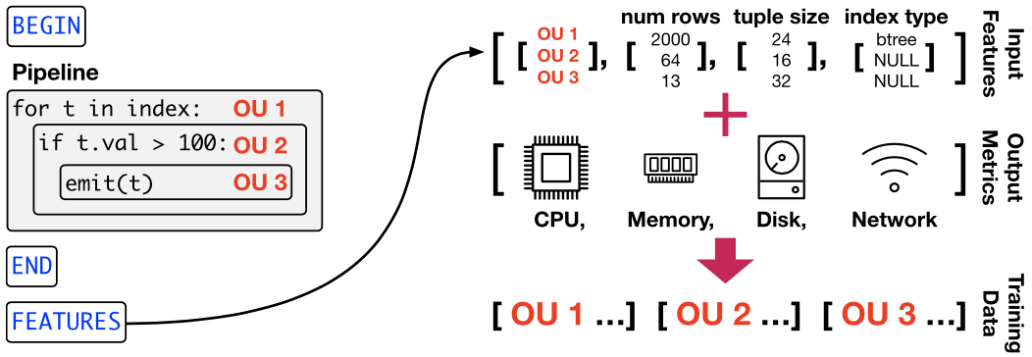
Query Engine Integration
JIT Query Compilation: the DBMS converts a query plan into executable code that it then compiles and links into its address space.

Slide 15
Adjustable Sampling
TS groups the OU models by DBMS subsystem because they share the same input features.
TS maintains a 100-bit field for each subsystem to represent its sampling rate.
e.g. a rate of 20%: have 20 random bits set to one.
Each thread in NoisePage maintains offsets to index into the bit fields.

Slide 16
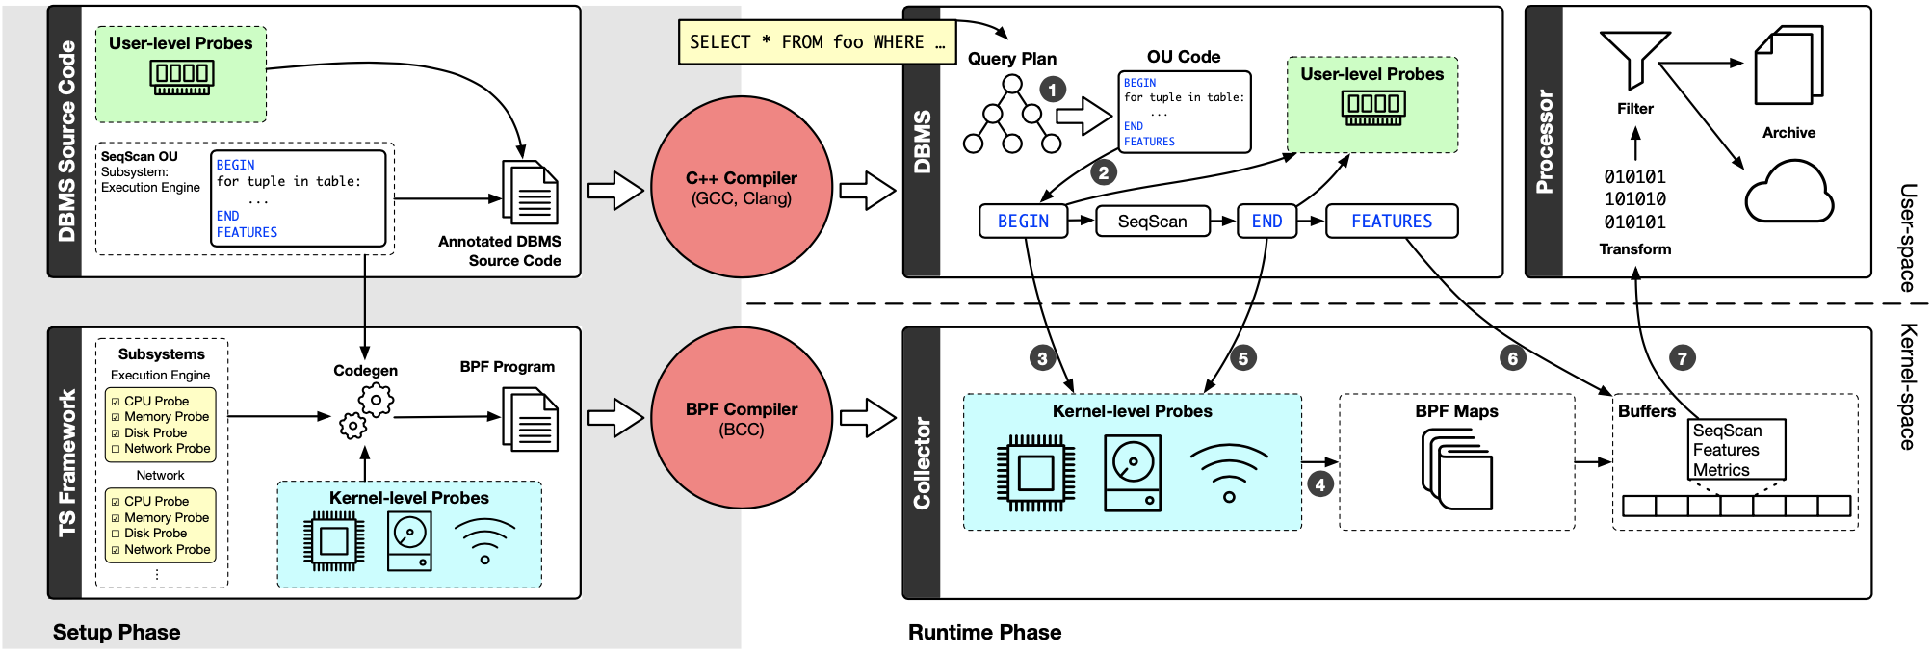
TScout Workflow

Slide 17
EXPERIMENTAL EVALUATION

Slide 18
Preparation
DBMS
NoisePage (https://github.com/cmu-db/noisepage)
Data Collector
Single-threaded Processor to extract training data and write it to a file on the server’s local disk.
Evaluation Metrics
|𝐴𝑐𝑡𝑢𝑎𝑙 − 𝑃𝑟𝑒𝑑𝑖𝑐𝑡| / 𝐴𝑐𝑡𝑢𝑎𝑙

Slide 19
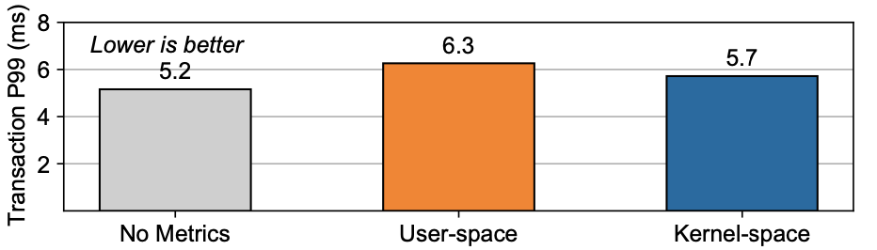
Metrics Collection Overhead
Run TPC-C transactions with a single client to evaluate the average p99 latency.

Slide 20
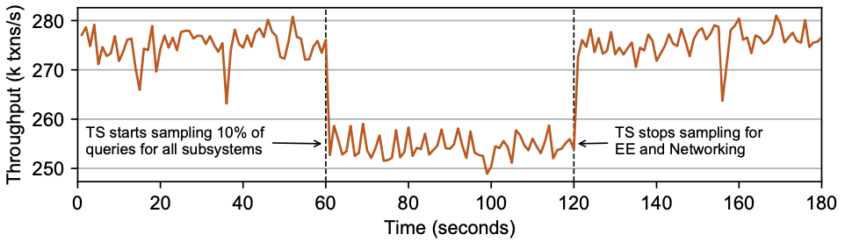
Sampling Overhead
Run YCSB and then dynamically adjust TS’s subsystem sampling rates at runtime.

Slide 21
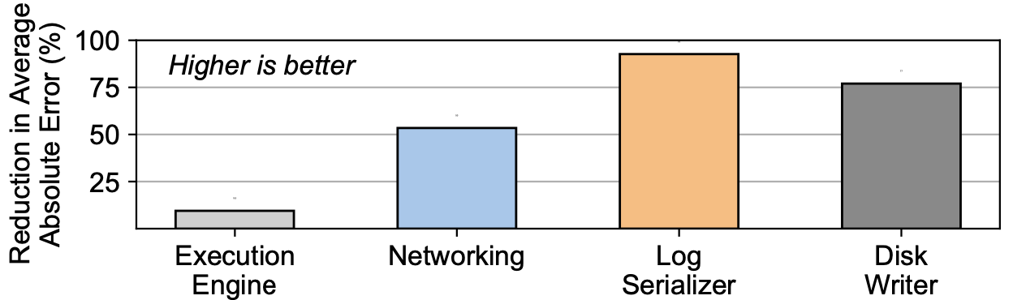
Offline vs. Online Training Accuracy
Accuracy measurements of behavior models trained with offline and online data when predicting the execution time of TPC-C queries.
Offline models use training data collected from NoisePage’s built-in runners.
Online models use training data collected from running the TPC-C.

