Slide 1
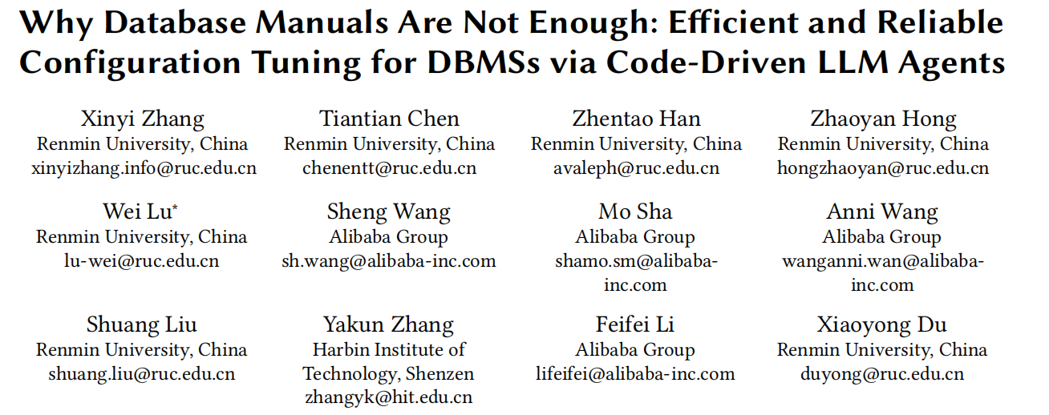
PVLDB 2026
2026-08

Slide 2
Background: DBMS Configuration Tuning
· Hundreds of knobs
MySQL exposes 400+ knobs that jointly shape system behavior
· Huge performance impact
θ* = argmax f(c, θ)
Good vs. bad configurations can differ by orders of magnitude
· Context-dependent optimum
θ: configuration (Θ = Θ₁ × ··· × Θₘ)
c: runtime metrics + workload characteristics
No global best — only the best under the current workload & hardware
· NP-hard search
Exploding combinatorial space forces strategic search, not enumeration

Slide 3
Paradigm ① Data-Driven: DBMS as a Black Box
BO / RL / transfer learning: pure search without looking inside, trial-and-error toward the optimum
Configuration
→
Workload Replay
→
Performance
→
Update Model
⟳
✗ Costly sampling every observation requires a full workload replay — minutes per iteration
✗ Unsafe exploration without priors, early iterations evaluate many bad configs, even hurting performance
✗ Poor transferability Transfer can degrade when source and target workloads differ

Slide 4
Paradigm ② Manual-Driven: Knowledgeable, but Coarse
DB-BERT / GPTuner: LLMs extract tuning heuristics from manuals & blogs to prune the search space
What manuals offer
What is missing
✓ Value ranges / recommended / special values
✗ Incomplete coverage: <50% knobs have valid ranges
✓ Narrow an infinite space into searchable intervals
✗ Context-agnostic: blind to current workload & bottleneck
e.g., buffer pool suggested at 70~80% of memory
✗ No context-specific trigger, direction, or step size
A broad legal range ≠ the right value under the current bottleneck

Slide 5
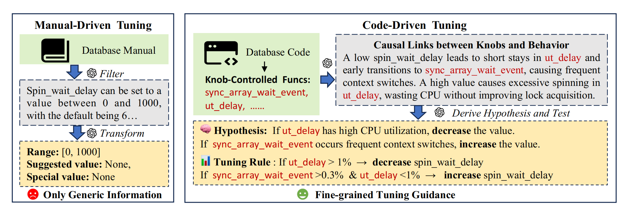
Motivating Example: innodb_spin_wait_delay
Manual view
Code view (this paper)
range [0,1000] · default 6 · qualitative trade-off only
The knob trades off ut_delay vs. sync_array_wait_event; the runtime state decides whether to increase or decrease

Slide 6
Three Challenges → Three Designs
C1 · Code Understanding
Challenge: locate knob-controlled execution paths in millions of LOC — feeding everything to an LLM drowns the context
→ Design: static taint analysis scopes the region; dual LLM agents read code on demand
C2 · Quantitative Guidance
Challenge: semantic insights give direction only — they must become executable triggers, directions, and step sizes
→ Design: semantic sampling experiments + customized association rule mining (ARM)
C3 · Reliability
Challenge: LLMs hallucinate, and tuning is high-stakes — bad configs can crash throughput
→ Design: rule-level confidence maintenance, continuously validated by real feedback

Slide 7
Preliminaries: Problem Formulation
θ* = argmax f(c, θ)
Given context c, search for the configuration θ* that maximizes performance f
Decision ① Knob Selection
Decision ② Value Recommendation
Among hundreds of knobs, which few are worth tuning?
For the chosen knobs — which direction, and by how much?
SysInsight answers both with "code knowledge"

Slide 8
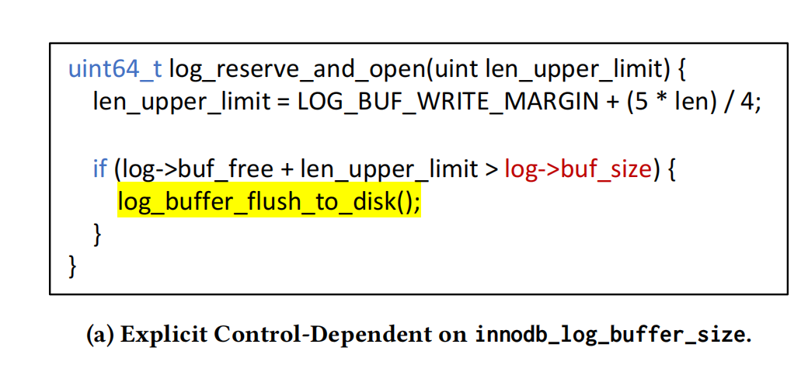
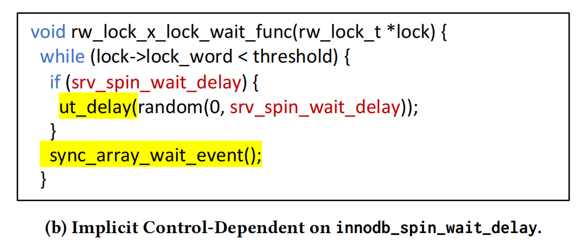
Preliminaries: How Knobs Affect Behavior
Explicit Control · Branch Switch
Implicit Control · Frequency / Timing

Slide 9
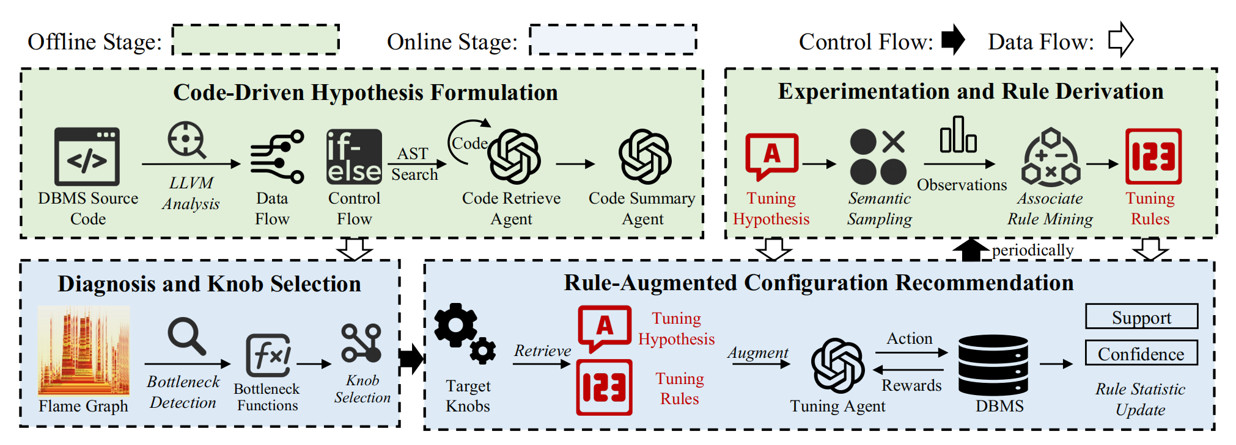
SysInsight Overview

Slide 10
C1 · From Source Code to Hypotheses (Overview)
DBMS Source Code
millions of LOC → cannot fit in one prompt
↓
① ConfMapper
map each knob to its internal variable
Two deliverables
↓
Mapping: bottleneck function ↔ controllable knobs
② Static Taint Analysis
trace data + control dependencies
↓
Hypothesis: condition → tuning direction
③ Dual LLM Agents
retrieve context → summarize causal links
↓
Output: Hypothesis
directional advice → C2

Slide 11
C1 · Static Mapping Output: Real JSON Example
Actual JSON excerpt: static mapping record
{
"knob_name": "innodb_spin_wait_delay",
"data_flow_functions_num": 10,
"control_flow_functions": [
"ut::random_from_interval_fast",
"ut_delay"
],
"control_flow_functions_num": 2,
"total_functions_num": 12
}
knob
innodb_spin_wait_delay
↓
ConfMapper
finds its Sys_var_* definition
↓
Data flow
srv_spin_wait_delay → rw_lock_x_lock_func()
↓
Control flow
ut_delay() + ut::random_from_interval_fast()
One JSON record per knob → later invert to f → K_f

Slide 12
C1 · Dual Agents: From Code to Tuning Advice
1. Retrieval Agent
2. Summarization Agent
START knob-controlled parent function
INPUT retrieved code context
ASK Which code do I still need?
EXPLAIN knob → function → performance
FETCH requested function bodies
retrieved code
→
LOOP append code until context is enough
OUTPUT condition → tune knob ↑ / ↓
Output: a directional hypothesis — thresholds and step sizes are learned later in C2

Slide 13
C1 Output Example: innodb_spin_wait_delay
Retrieved code context
rw_lock_x_lock_wait_func(...)
if (srv_spin_wait_delay) {
ut_delay(random(...));
}
sync_array_wait_event();
LLM analysis: causal mechanism
Higher delay -> fewer switches, but more CPU spinning
Lower delay -> less spinning, but more wake-ups
Actual hypothesis output
ut_delay() high -> decrease
sync_array_wait_event() dominates -> increase
No numeric threshold or step size - C2 learns both from trials

Slide 14
C2 · From Hypotheses to Verifiable Rules
Tuning Hypothesis
C1 output: direction only, no threshold or step size
① Semantic Sampling
try configurations along the hypothesized direction, collect real feedback
each = runtime context + adjustment action + performance change
② Observations
③ Customized ARM
generalize what successful observations share into quantified rules
Output: Tuning Rule
conditions ⇒ adjustment (direction + magnitude), with confidence

Slide 15
C2 · Concrete Rule: Context -> Adjustment
Runtime context (function ratios) -> recommended knob adjustment
Example input: current perf profile satisfies the left-hand condition
r(sync_array_wait_event) > 0.3% AND r(ut_delay) < 1% -> increase innodb_spin_wait_delay by (0, 10]
Output format: function-state thresholds + an executable knob range
Coverage
Confidence
How often the runtime context occurs
Success rate when this action is applied

Slide 16
C2 · Example: Observation Pair -> Rule
① Pairwise Augmentation
② Encoding
③ LSQM Discretization
④ Target-Constrained FP-Growth
Pair lower h_j with better h_i; keep only large gains
Encode function ratios + normalized knob adjustment
Group values with similar performance effects
Mine frequent context + knob-action patterns
→
→
→
Record = context of h_j + knob change in h_i
Example: memory knobs are expressed as % of RAM
Paper example: 1%, 12%, 30% may share one interval
Rule output: r(f) in [l,u] -> knob adjustment
Illustrative pattern from the paper
A at 2.5%, 3%, 4% + decrease x by ~10% => infer a broader context interval [2%,4%]

Slide 17
C2 · What Real Rules Look Like
Antecedent (workload + function-state predicates) ⇒ Consequent (knob adjustments)
Rule quality is measured by coverage and confidence; performance improvement validates each application
Workload predicate
Function-state predicate
Knob-adjustment item
e.g., OLTP workload, thread count, or arrival-rate condition
a sampled function ratio constrained to an interval — the runtime context
increase / decrease a knob by a recommended range
Performance improvement is used to estimate confidence; it is not part of the rule consequent

Slide 18
C3 · Online Tuning: One Iteration
① perf Sampling
run the workload on the current config; collect function-level CPU shares
② Diagnose Bottleneck
differential profiling (with baseline) or SHAP (without) locates bottlenecks
③ Reverse Lookup
use C1's function–knob mapping to find the knobs to tune
④ Retrieval + Prompt
top-k rules by EI, assembled with hypotheses into the prompt
⑤ Execute & Evaluate
apply the LLM-suggested configuration and observe the change
⑥ Feedback Update
update hit rules' confidence; periodically re-run ARM

Slide 19
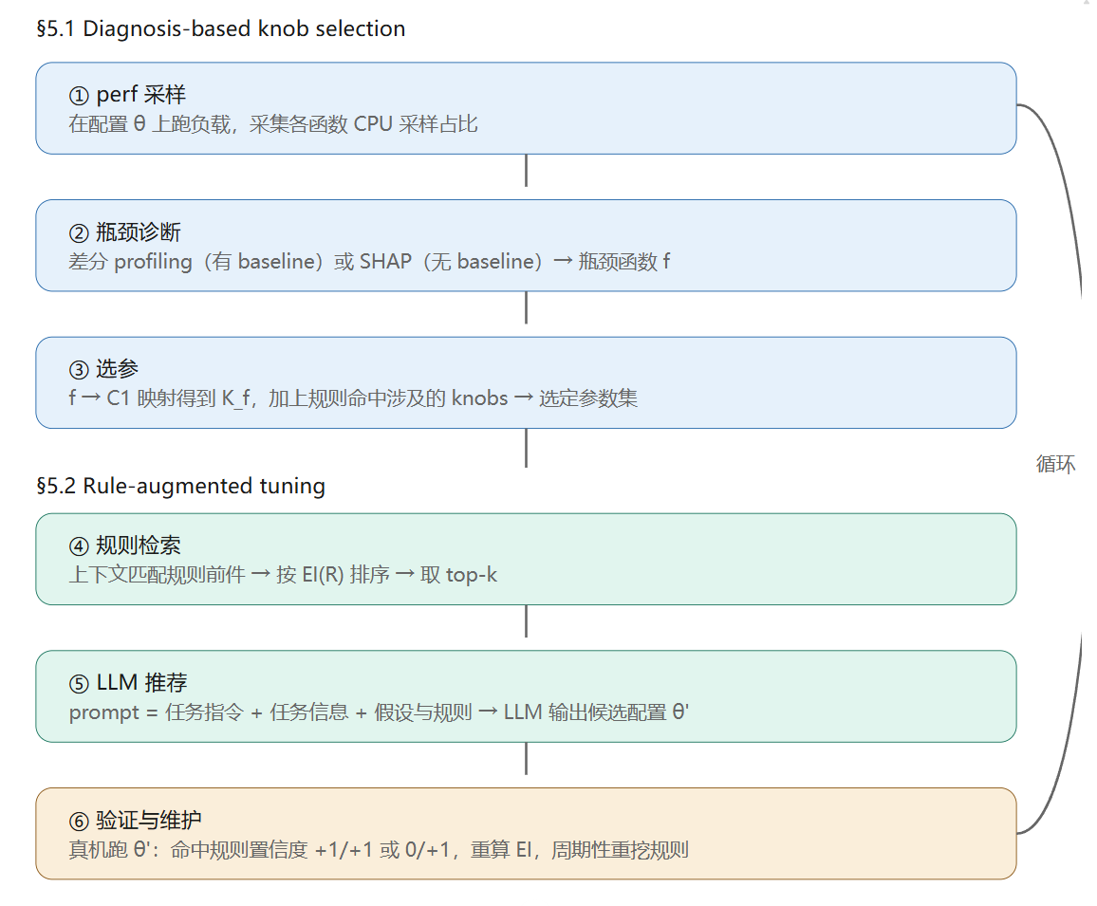
C3 · Online Tuning: One Iteration

Slide 20
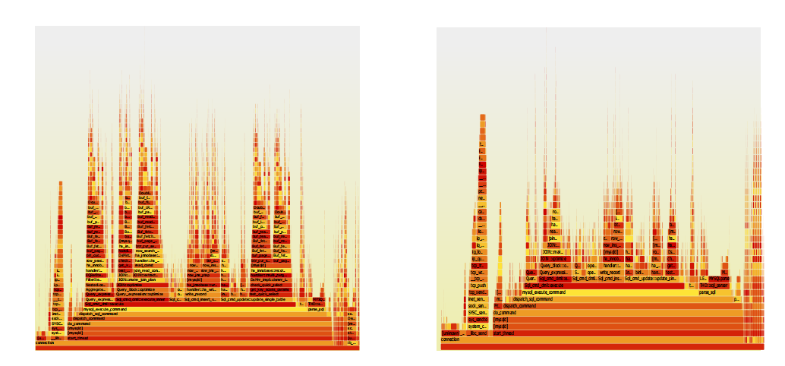

Slide 21
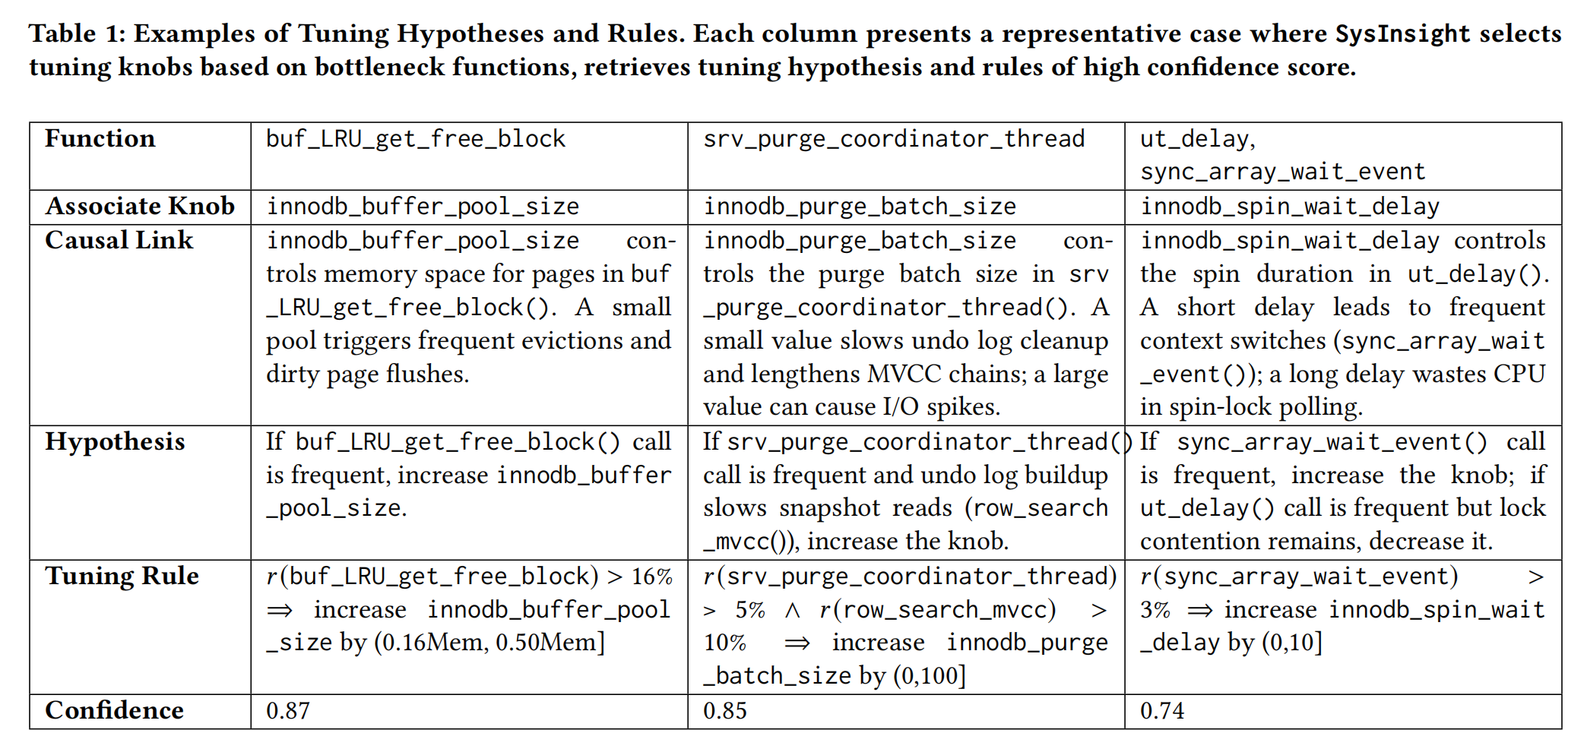
Case Study · What Mined Knowledge Looks Like

Slide 22
Experimental Setup
DBMS
Workloads
Hardware
MySQL 8.0.36
TPC-C · SYSBENCH · TPC-H
4 cores / 16 GB and 16 cores / 64 GB
44 44 knobs · default configuration as the starting point
SF 200 · read-write · SF 1
two cloud-instance configurations
Baselines
Protocol
Backend LLM
GPTuner · DB-BERT · SMAC
3 sessions × 20 iterations
GPT-4o-mini
DDPG++ · ResTune · OtterTune
target-workload historical data excluded
used for SysInsight + and GPTuner

Slide 23
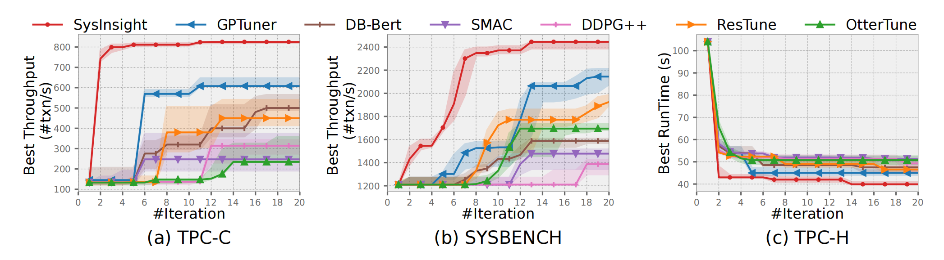
Results · Faster Convergence, Better Configurations

Slide 24
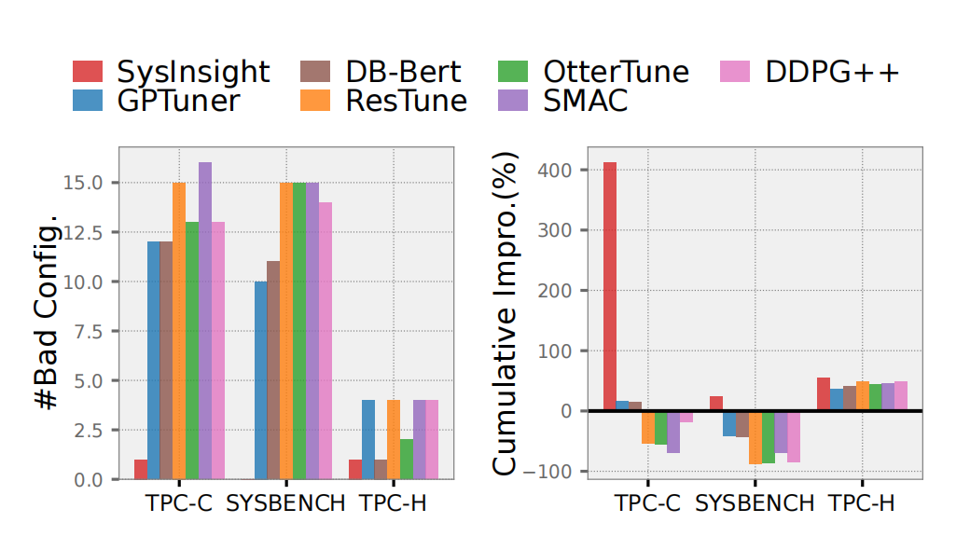
Results · Fewer Harmful Configurations

Slide 25
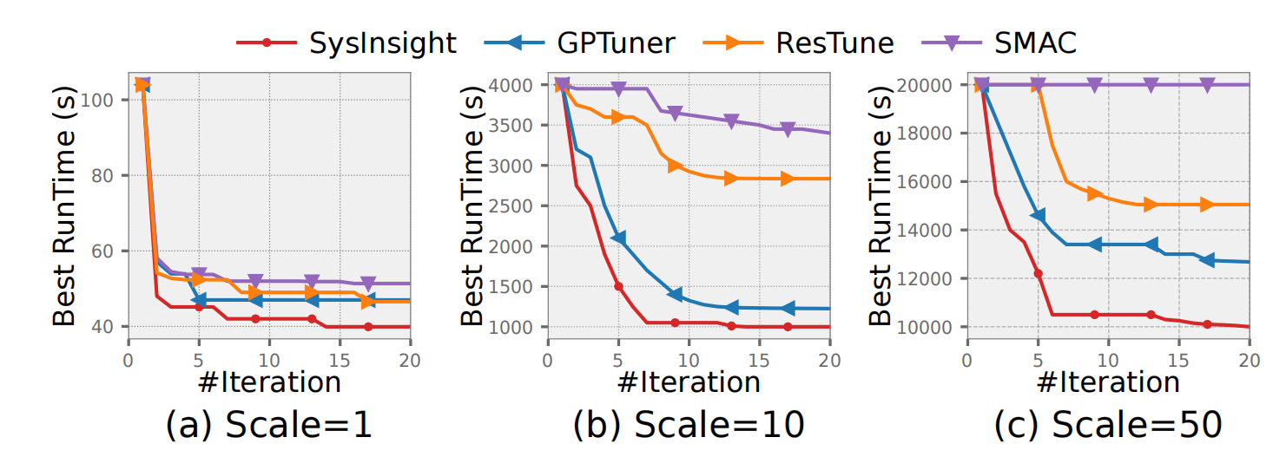
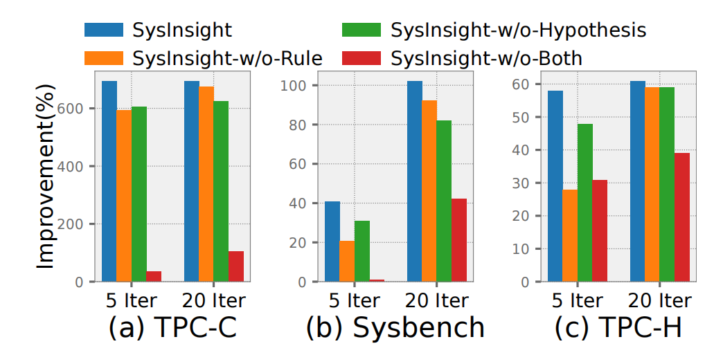
Results · Scalability and Ablation

