Slide 1

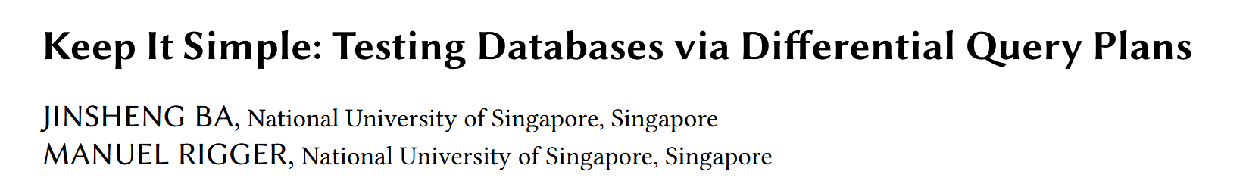

Slide 2
INTRODUCTION
BACKGROUND
A key feature of relational Database Management Systems (DBMSs) is to join data in multiple tables using a JOIN.
Given the complexity of such optimizations, query optimizers might apply a semantically incorrect optimization, which could result in incorrect results being produced.

Slide 3
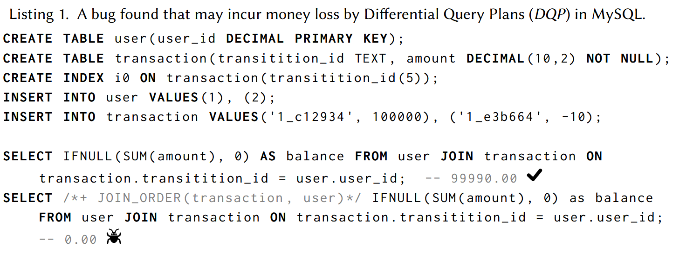
INTRODUCTION
BACKGROUND
2 Rows
0 Row

Slide 4
INTRODUCTION
State of The Art
TQS is the state-of-the-art approach for testing join optimizations.
Case Generation: generates a JOIN cross several sub-tables from a split table.
Oracle Generation: derives ground-truth results of a query that joins these sub-tables by retrieving the given table.
Enhance diversity: randomly injects noise, such as NULL and 0; models database schemas as a graph to evaluate the similarity of JOINs.

Slide 5
INTRODUCTION
LIMITATION OF TQS
TQS suffers from two major challenges.
This method is complex to understand and implement.
It is hard to decide whether two graphs are isomorphic for evaluating the similarity of queries.
The testing scope is small.
TQS applies only to equijoins.
Though it can be extended to non-equijoins, this method cannot test other SQL features.

Slide 6
TQS STUDY
RQ.1 Join-related Bugs. How many bugs reported by TQS are related to join optimizations?
RQ.2 Bug Justifications. How were the bugs reported by TQS? Convincing developers that their DBMS, and not TQS, is computing an incorrect result might be challenging.

Slide 7
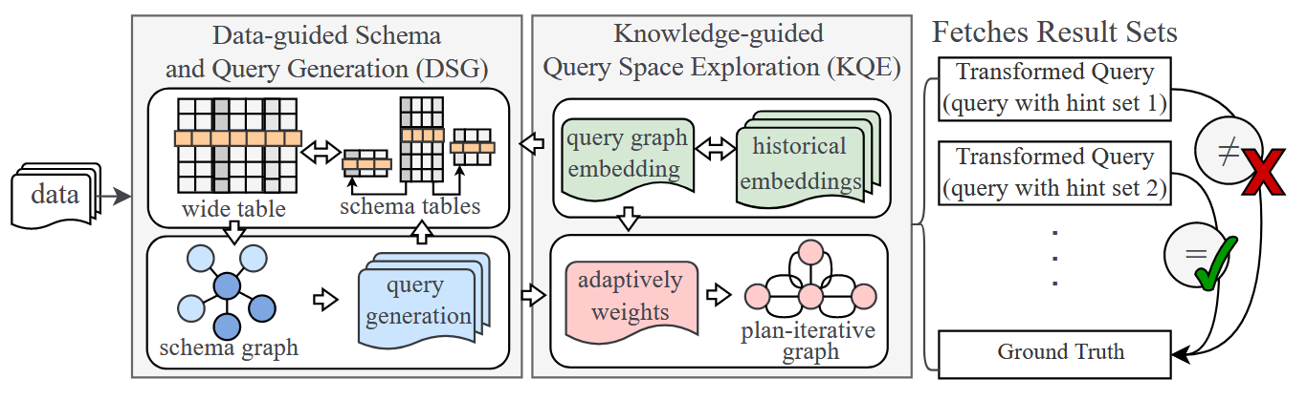
TQS STUDY
Summary
TQS claims that 115 bugs were found by this approach within 24 hours including 7, 5, 5, and 3 types of bugs in MySQL, MariaDB, TiDB, and PolarDB.

Slide 8
TQS STUDY
Data Preprocessing
We observed that the public bug list does not include the bug reports of PolarDB.
As a result, we studied the bug reports of MySQL, MariaDB, and TiDB, whose actual bug number is 21, namely 11 bug reports in MySQL, 5 in MariaDB, and 5 in TiDB.

Slide 9
TQS STUDY
Data Preprocessing
$$115 Bugs≠21 Bug reports≃17 Bug types$$
We further searched the submission history of the first author in the corresponding issue trackers, to avoid that we missed any bug reports.
Based on our observation and investigation, we infer that the 92 bugs in the paper refer to bug-inducing test cases, a large portion of which are duplicates, instead of unique, valid bugs.

Slide 10
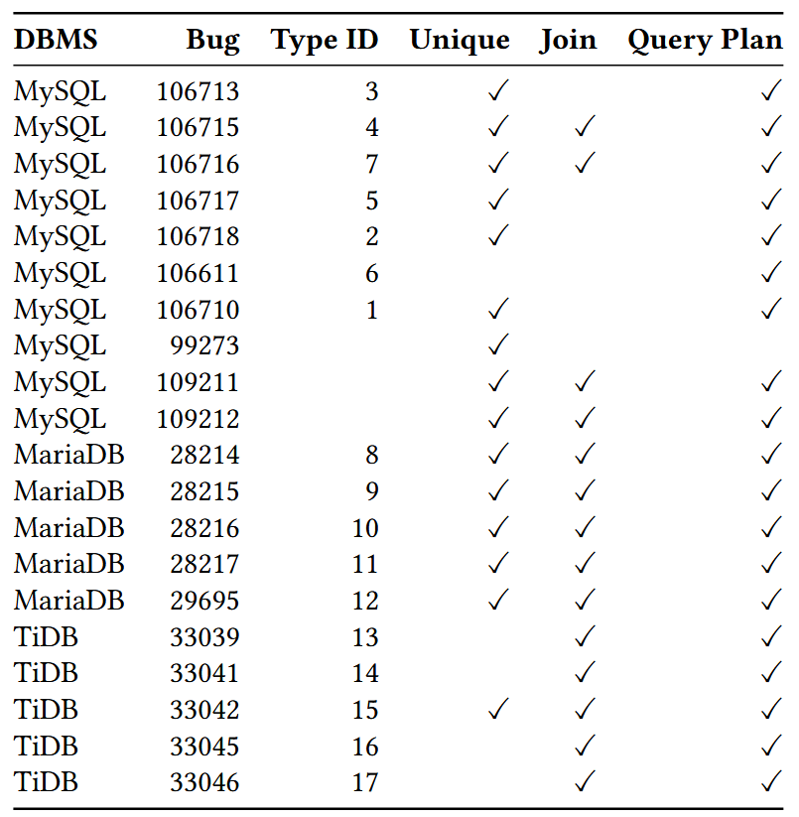
TQS STUDY
Data Preprocessing
A matching analysis is done to examine the correlation between the public bug list and the 17 bug types.
Three bug reports have no matched bug types, and a possible explanation is that they were submitted after paper submission.

Slide 11
TQS STUDY
Data Preprocessing
RQ.1 Join-related Bugs
10 of 15 unique bugs (67%), are related to join optimizations.
The rest of 5 bugs include at least one SUBQUERY clause. It is unclear how TQS constructs the ground-truth results for these cases.

Slide 12
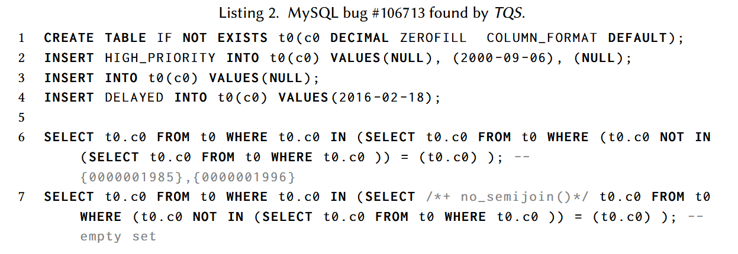
TQS STUDY
Data Preprocessing
RQ.2 Bug Justifications
All 10 join-related bugs and 14 of 15 unique bugs were reported in the same manner, by demonstrating that different query plans of the same query compute inconsistent results.

Slide 13
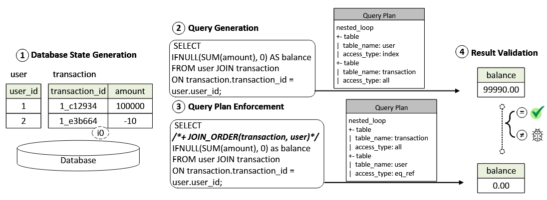
APPROACH
We term Differential Query Plans (DQP) testing, to find bugs in join optimizations
Our core idea is to find bugs by comparing the results of the same query while enforcing different query plans for it.

Slide 14
APPROACH
Database State Generation: DQP can be paired with any database state generation method. (implemented in SQLancer)
Query Generation: DQP can, in principle, be paired with any of query generation methods. (implemented in SQLancer)
Query Plan Enforcement: DQP attempts to force the DBMS to derive an alternative query plan P′ for the same query with query hints and system variables.
Result Validation: DQP compares the results of different plans.

Slide 15
IMPLEMENTATION
Query Plan Enforcement
Query hints. For the query hints that require table or column names, we randomly generate such names based on the query.
System variables. DQP executes a SET statement with the query to configure the system variable to enforce a different query plan.
Efficiency consideration. For testing efficiency, we enforce multiple query plans {P′, P′′, ...} by enumerating all possible query hints and values of the system variable in an iteration.
Hints and values are finite and small in number, e.g. 32 hints and 26 options in MySQL.

Slide 16
EVALUATION
Questions
Q.1 Bug Reproduction. Can DQP find the bugs found by TQS?
Q.2 New Bugs. Can DQP find previously unknown bugs?
Q.3 Bug-finding Efficiency. How efficiently can DQP find bugs?
Q.4 Bug-finding Effectiveness. How effective is DQP compared to other test oracles for finding logic bugs?
Q.5 Coverage. To what extent does DQP cover query optimizers?
Tested DBMS
Q.3 MySQL: 8.0.28, MariaDB: 10.8.2, TiDB: 5.4.0(as TQS)
Others. MySQL: 8.1.0, MariaDB: 11.1.2, TiDB: 7.4.0(latest)

Slide 17
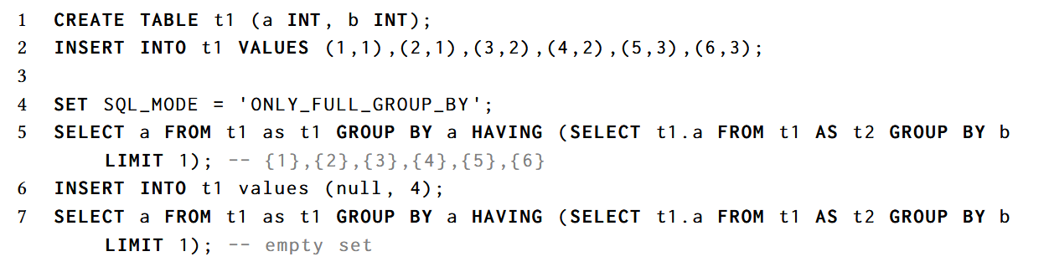
EVALUATION
Bug Reproduction
14 of 15 unique bugs, and all 10 join-related bugs found by TQS can be detected by DQP.
The only one bug TQS found but DQP not found.

Slide 18
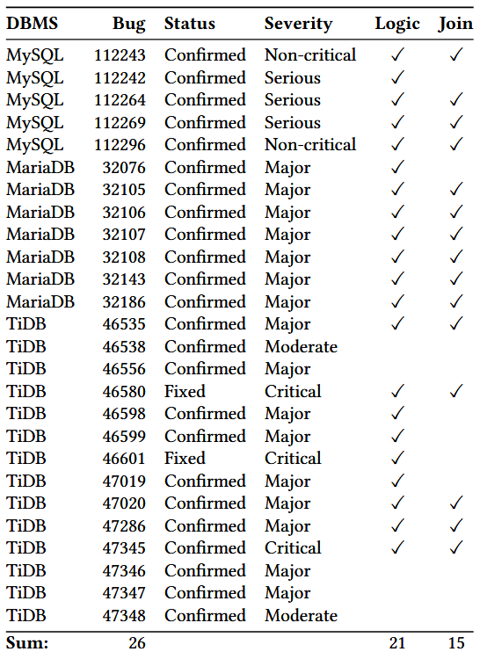
EVALUATION
New Bugs
The results show that join optimizations are more buggy than other query optimizations, and TQS overlooked our found bugs in join optimizations.
10/21 logic bugs are found by setting system variables, while others are found by hints.

Slide 19
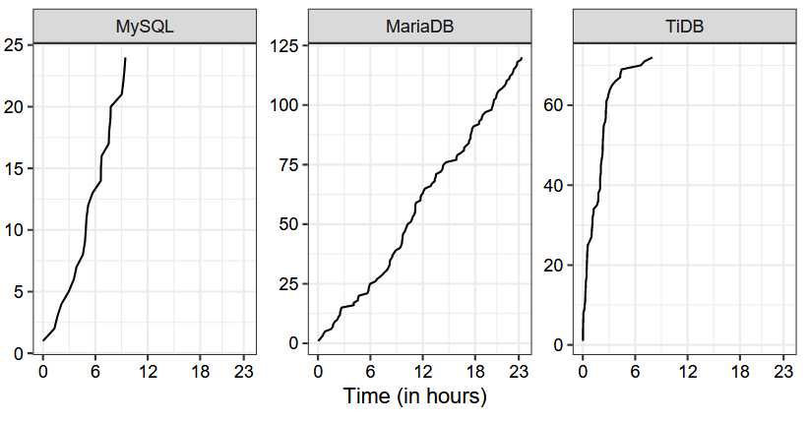
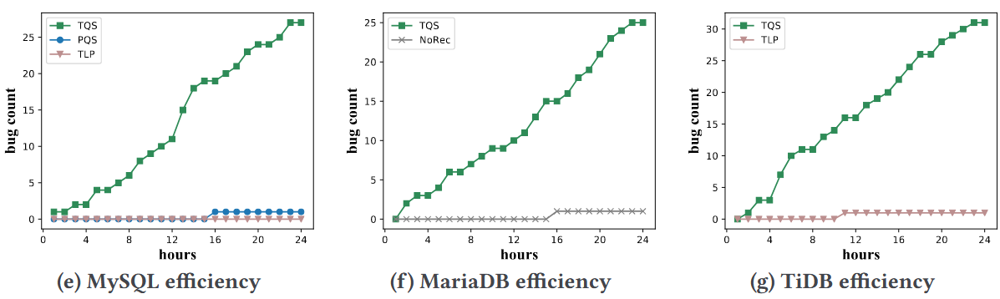
EVALUATION
Bug-finding Efficiency
SQLancer+DQP found 216 bug-inducing test cases in 24 hours in MySQL, MariaDB, and TiDB.
It is challenging to make a fair comparison with TQS, due to the aforementioned unavailability of its source code, and because some experimental configurations are unclear.

Slide 20
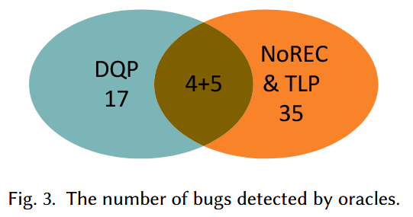
EVALUATION
Bug-finding Effectiveness
Other SOTA methods, NoREC and TLP, cannot find 17 of 21 logic bugs found by DQP.
10/17 are caused by different plans these methods cannot generate.(System variables)
7/17 are caused by the clauses these methods cannot generate.

Slide 21
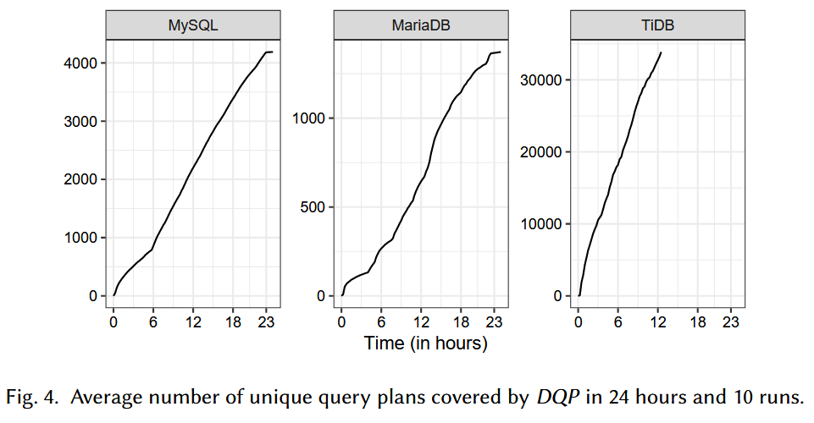
EVALUATION
Coverage
Join coverage: The join operator is not fully covered by DQP, since it requires specific expressions in queries. We have not found any hint or variable that directly enforces the other three join operators.
Code coverage: We measured only the code coverage of query optimization, which is 22.2%, 27.7% and 36.1% for three DBMSs. The coverage appears to be low because we cannot enumerate all possible query plans.

Slide 22
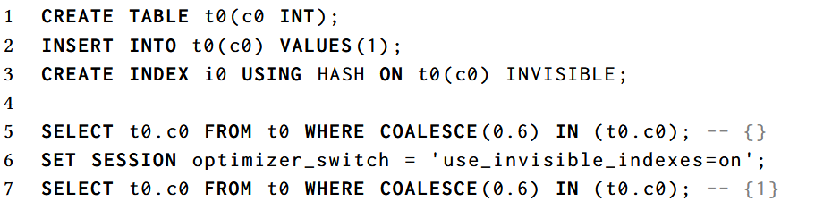
DISCUSSION
Bug diversity
The found bugs can affect a variety of different queries. The bugs were typically due to incorrect optimizations, such as the incorrect index optimization.
Notes:
COALESCE, 返回函数中出现的第一个非空值。这个bug的原因不在invisible而在index（类型转换0.6->1），invisible只是使得在不用hint的时候不会触发bug。

Slide 23
DISCUSSION
Path to adoption
A simple testing approach has the potential for wide adoption.
easy to understand.
no need for internal execution information or understand the result.
in less than 100 lines of Java code per DBMS.
can be paired with existing databases and query generators.
Contribution and novelty
Our core contribution is the insight that , in a testing context, simple, practical approaches provide significant benefits over complex, but conceptually appealing ones.

Slide 24
DISCUSSION – ABOUT TQS
Inconsistent bug number
We suspect that the authors confused terminology by referring to bug-inducing test cases as “bugs” and unique bugs as “bug kinds”.
We acknowledge that bug deduplication is an open problem, and we also observed duplicate issues being counted as bugs in other work.

Slide 25
DISCUSSION – ABOUT TQS
Unavailable TQS source code
The authors of TQS have not released its source code.
The authors replied that the source code was not ready for release.
The repository of demonstration tool lacks the core approach implementation of TQS
It is challenging to re-implement TQS as it consists of complex steps.
It is not clear what concrete method they used.
While it is understandable that these are not described in the paper, it prevented us from reimplementing the approach for comparison.

Slide 26
LIMITATION
Threats to Validity
TQS source code and TQS’s bug reports on PolarDB are not available.
The correctness of our implementation.
We built DQP on a popular DBMS testing framework, SQLancer, and made the source code publicly available.
The reliability of the results we presented.
We reported each found bug to the DBMSs’ developers and annotated the bug status according to developers’ replies. We also made all bug reports public.

