Slide 1
PVLDB 2026 | VOL. 19
ArceKV: Towards Workload-driven
LSM-compactions for Key-Value Store
Under Dynamic Workloads
Junfeng Liu, Haoxuan Xie, Siqiang Luo
Nanyang Technological University, Singapore

Slide 2
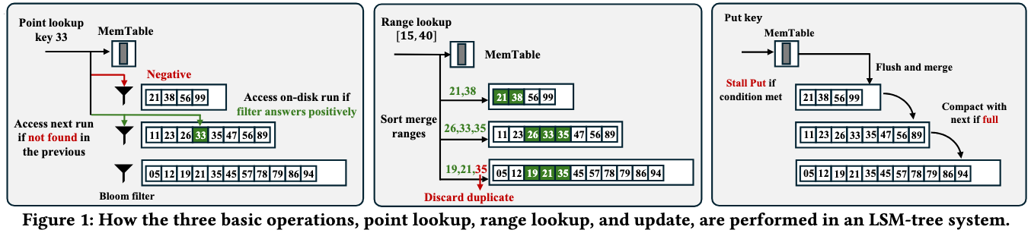
BACKGROUND
ARCEKV DESIGN
EVALUATION
CONCLUSION
Background: LSM-tree & Write Stall
LSM-tree (Log-Structured Merge Trees)
Basic Operations
• Core data structure for KV stores; converts in-place updates to sequential updates
• Multi-level structure with exponentially growing capacities
• Data organized as Sorted Runs / SSTables
Point Lookup: Top-down scan, relies on Bloom filter to reduce I/O
Range Lookup: Retrieves entries across sorted runs, merge-sorts
Update: Insert into MemTable → flush to L0 → trigger Compaction
LSM-tree Structure Overview
2

Slide 3
BACKGROUND
ARCEKV DESIGN
EVALUATION
CONCLUSION
Challenge: Dynamic Workload Adaptivity
In LSM-tree-based key-value stores, a major challenge lies in online handling dynamically changing workloads. For example, Meta analyzed access patterns from five distinct applications and found that each exhibits highly diverse workload behaviors, with substantial variation occurring even within a single day.
Limitations of Existing Workload-Aware Methods
Static Optimal (Moose, Wacky)
Greedy Transition
Compute optimal structure for static workloads but lack transition mechanisms when workloads change
Adapts quickly but requires aggressive write stall → severe latency spikes
Lazy Transition (Dostoevsky)
Compromise (Ruskey's FLSM)
Avoids high reorganization cost but responds slowly → prolonged performance degradation
Accelerates response but relies on sufficient updates → slow under read-intensive workloads
Key Insight: Existing methods focus on finding the optimal target structure, but neglect the transition procedure itself — causing severe performance degradation during adaptation.
3

Slide 4
BACKGROUND
ARCEKV DESIGN
EVALUATION
CONCLUSION
Our Vision & Contributions
CORE VISION
Focus on the transition procedure, not on the final structure.
Instead of blindly morphing toward a predefined structure, consistently optimize performance throughout the transition.
Key Contributions
01
02
03
ElasticLSM
ARCE Engine
ArceKV
An enhanced LSM-tree design that enables the system to compact runs selected across levels and initiate compactions at workload-dependent timing.
• Flexible Run Selection
• Workload Dependent Timing
Adaptive Runtime Compaction Engine
A score-based lightweight compaction evaluation engine that dynamically balances read/write performance.
Full-featured KV store implementation on RocksDB.
Achieves ~3x speedup over state-of-the-art under dynamic scenarios
4

Slide 5
BACKGROUND
ARCEKV DESIGN
EVALUATION
CONCLUSION
ElasticLSM: Expanded Action Space
Design Philosophy: Remove fixed structural parameters. Treat LSM-tree as a flexible collection of sorted runs tagged with timestamps, sizes, and key ranges.
Two Core Management Actions
1
Write Stall
2
Compaction
Only when total sorted runs exceed adjustable threshold c, limit updates at rate k.
Pick runs between any levels, as long as timestamp ordering is strictly preserved.
Three Valid Compaction Patterns
Pattern 1: Intra-level
Pattern 2: Adjacent-level
Pattern 3: Multi-level
Multiple Runs
Same Level → Merged
Level i + Level i+1
→ Merged
Multiple Levels
Joint Compaction →
Compact multiple sorted runs within the same level. Reduces runs without cross-level I/O.
Traditional adjacent-level compaction. Standard approach used in most LSM-tree systems.
Joint compaction across multiple levels. Greatly accelerates response under read-intensive loads.
5

Slide 6
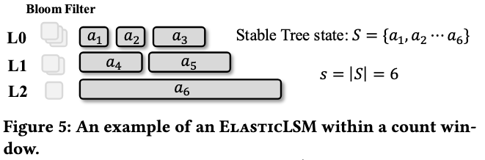
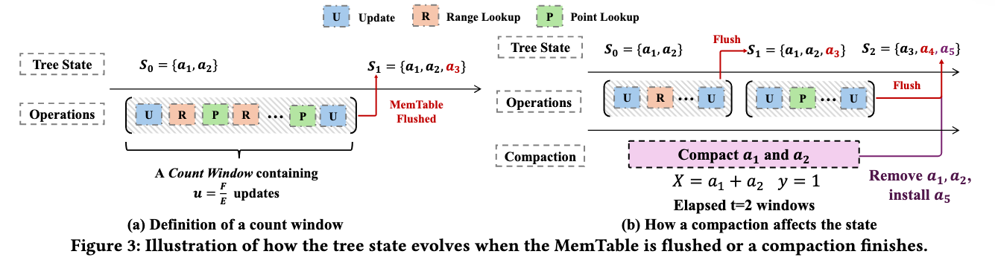
BACKGROUND
ARCEKV DESIGN
EVALUATION
CONCLUSION
System Cost Modeling
Challenge: ElasticLSM's flexible operations lead to highly unpredictable tree states — traditional amortized cost calculations fail.
Windowed-State Cost Modeling
• Divide operation sequence into count windows
• Each window: u = F/E updates
(F = MemTable size, E = entry size)
• Within a window, tree state S remains stable
6

Slide 7






BACKGROUND
ARCEKV DESIGN
EVALUATION
CONCLUSION
System Cost Modeling
Challenge: ElasticLSM's flexible operations lead to highly unpredictable tree states — traditional amortized cost calculations fail.
Cost Formulas (Per Window)
Point Lookup Cost
Range Lookup Cost
Update Cost
$$P(s)=(s⋅α+1)⋅I_{r}$$
$$R(s)=s⋅I_{r}$$
$$U(s)=\frac{F}{B}⋅I_{w}+k⋅I(s>c)$$
The Foreground I/O Time In t Windows (without other concurrent compactions)
The number of sorted runs of windows
Notation Legend
s = number of sorted runs | α = Bloom filter false positive rate
I_{r}, I_{w} = I/O read/write time
B = block size | c = stall threshold | k = stall rate
I(·) = indicator function
t = number of time windows used for a compaction
7

Slide 8


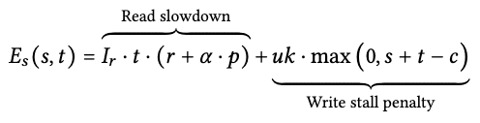
BACKGROUND
ARCEKV DESIGN
EVALUATION
CONCLUSION
ARCE: Deciding Intermediate Compactions
Objective: Find compaction sequence minimizing average operation cost — proven NP-hard (Lemma 3.2).
Key Insight: By evaluating only the immediate trade-off between short-term penalty and long-term benefit for each candidate compaction, it achieves near-optimal decisions with minimal computational overhead.
Pick the compaction with largest score
Short-Term Effect E_{s}
Long-Term Effect E_{l}
Compaction occupies background threads → L0 data accumulation → increased read latency and potential write stall
Compaction reduces y sorted runs → all future reads in current decision window benefit from reduced lookup cost
$$E_{l}(y)=(r+α⋅p)⋅I_{r}⋅y$$
t = compaction time | r = read ops | p = point lookups
s = current runs | u = updates per window
y = number of runs reduced by compaction
Benefit scales linearly with run reduction
8

Slide 9
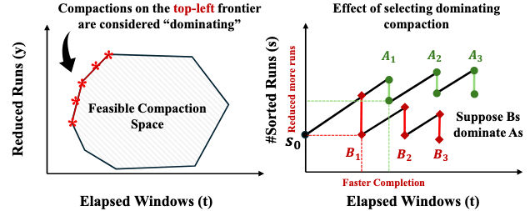
BACKGROUND
ARCEKV DESIGN
EVALUATION
CONCLUSION
Effectiveness Score & Optimality
EFFECTIVENESS SCORE
$$E(s,t,y)=M⋅E_{l}(y)−E_{s}(s,t)$$
M = weight for long-term benefit (determined by tree state, workload, stall threshold)
Optimality Analysis: Domination
Domination Definition
Domination Frontier Visualization
Compaction A dominates B (A ≺ B) if:
• A requires less compaction time
• A reduces more sorted runs
i.e., A is strictly better in both dimensions
ARCE Guarantee
Under any parameter configuration, ARCE only selects non-dominated candidates.
These form the left frontier in the time-reduction 2D space.
9

Slide 10
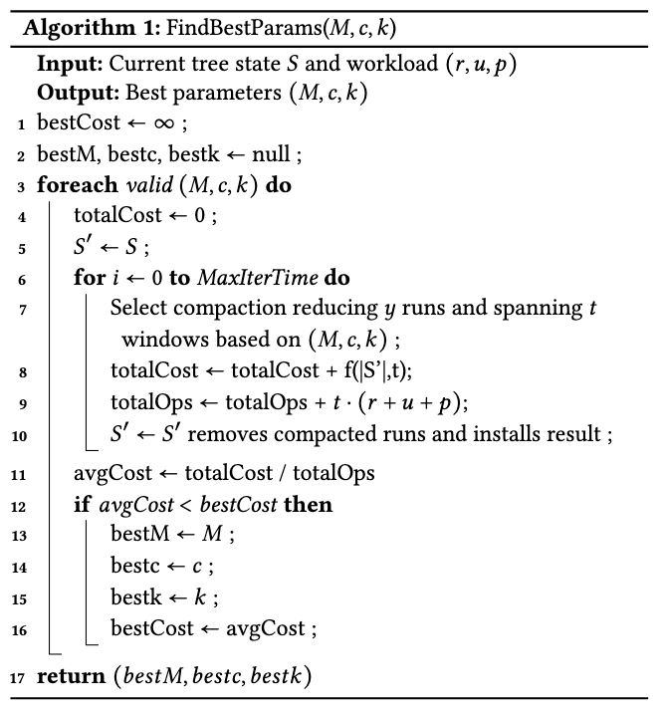
BACKGROUND
ARCEKV DESIGN
EVALUATION
CONCLUSION
Parameter Selection & Adaptivity
PARAMETER SPACE
M Long-term benefit weight
Balances future reads vs. current stall penalty
Challenge: Determining optimal (M, c, k) over time is also NP-hard.
Solution: Simulation-based tuning triggered only on significant changes.
c Stall threshold
Max sorted runs before write stall triggers
k Stall rate
Update limitation rate when stall active
Algorithm 1: FindBestParams
1
Trigger Check: Only recompute when tree state or workload changes significantly (exceeds threshold d = 0.1)
2
Explore: Iteratively test candidate (M, c, k) combinations from parameter space
3
Simulate: For each candidate, run MaxIterTime consecutive compaction decisions in memory to estimate average cost
4
Select: Choose parameter set with lowest estimated cost and apply to system
5
Adapt: Continuously monitor; re-trigger from Step 1 when drift exceeds d
Multi-threading Extension
Uses Amdahl's Law to model the accelerating effect of concurrent foreground threads on background compaction windows
10

Slide 11
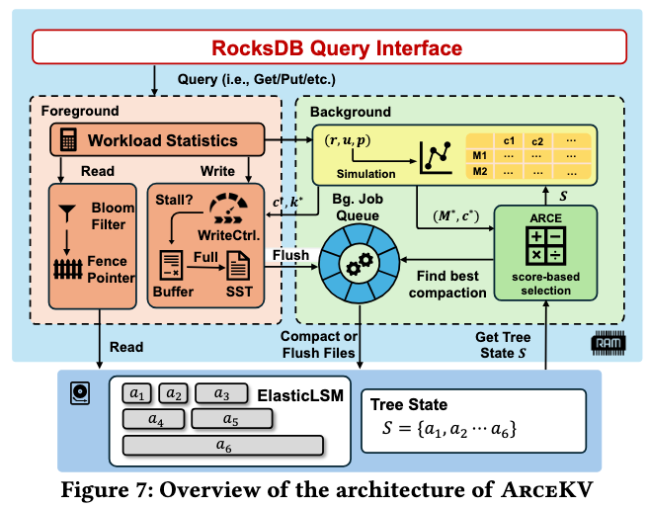
BACKGROUND
ARCEKV DESIGN
EVALUATION
CONCLUSION
Architecture of ArceKV
Built on industrial-grade LSM-tree storage engine: RocksDB
Engineering Optimizations
Parallel Simulation (SIMD)
Uses Eigen library and SIMD instructions for vectorized computation
Decision in <30 microseconds
Parameter Pruning
Coarse-grained search for M and c with upper bounds
Reduces computation overhead significantly
11

Slide 12
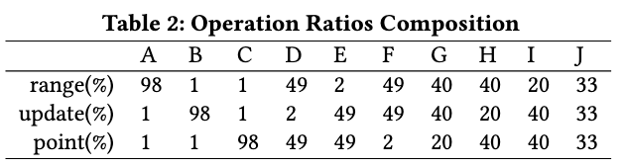
BACKGROUND
ARCEKV DESIGN
EVALUATION
CONCLUSION
Evaluation Setup
Comparison Baselines
Category | System | Description
Traditional | Leveling, Tiering, 1-Leveling | Read-optimal, write-optimal, RocksDB default
SOTA Academic | LazyLeveling, Moose, Ruskey, CAMAL | DP static optimal, RL-based, hybrid approaches
Industrial | Pebble, WiredTiger, Cassandra | Production-grade KV stores
ArceKV (Ours) | ElasticLSM + ARCE on RocksDB
Dynamic Workload Generation
Composite Workload I & II
• Combine sub-workloads with extreme read/write ratios:
98% read ↔ 98% write
• Test abrupt shifts and gradual transitions
12

Slide 13
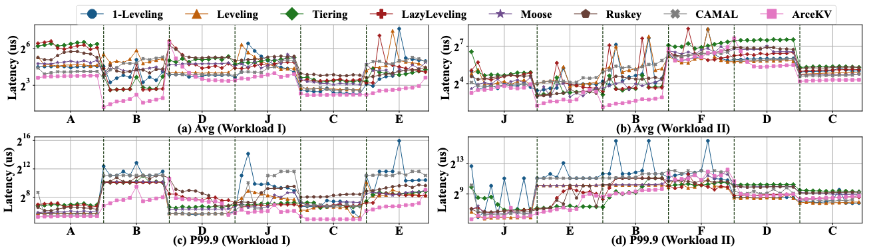
BACKGROUND
ARCEKV DESIGN
EVALUATION
CONCLUSION
Experimental Results: System Performance
3x
2.17-2.92x
1.41-2.00x
Speedup over SOTA under dynamic scenarios
Improvement over Tiering & LazyLeveling
Improvement over adaptive 1-Leveling
13

Slide 14
BACKGROUND
ARCEKV DESIGN
EVALUATION
CONCLUSION
Experimental Results: System Performance
3x
2.17-2.92x
1.41-2.00x
Speedup over SOTA under dynamic scenarios
Improvement over Tiering & LazyLeveling
Improvement over adaptive 1-Leveling
Key Findings
Top-Tier Throughput
Fast Adaptation
ArceKV maintains top-tier throughput across almost all sub-workloads in both Workload I and II
Even extreme write-to-read mutations (B→D), ArceKV adjusts rapidly without latency spikes
Superior to SOTA Methods
Low Tail Latency
2.17-2.92x over Tiering & LazyLeveling; 1.41-2.00x over most adaptive 1-Leveling
ArceKV consistently maintains extremely low P99.9 latency across all workload transitions
Note: Figures 8 & 9 from the original paper show detailed throughput comparisons. ArceKV's performance remains consistently at the top.
14

Slide 15
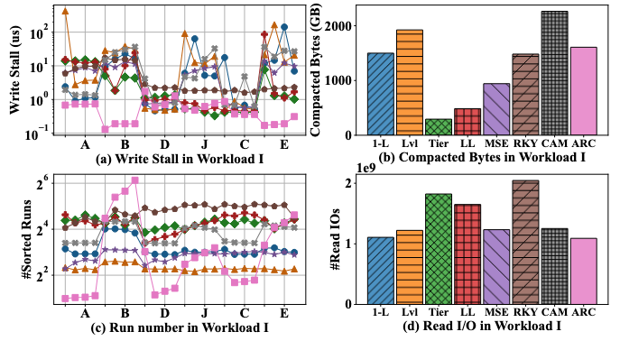
BACKGROUND
ARCEKV DESIGN
EVALUATION
CONCLUSION
Action Analysis
ElasticLSM Action Advantages (Fig. 9)
Read-Intensive Phases
Write-Intensive Phases
• Executes multi-level compactions
• Reduces sorted runs faster than Leveling
• Rapidly improves read performance
• Boldly defers compaction
• Allows accumulation, low write stall
• Maximizes write throughput
Conclusion: Dynamic perfect balance between compaction aggressiveness and write stall control
15

Slide 16
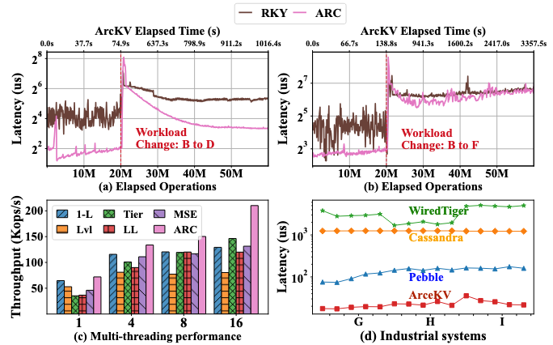
BACKGROUND
ARCEKV DESIGN
EVALUATION
CONCLUSION
Scalability & Industrial Comparison
Concurrent Scalability
Scalability Insights
1-Leveling: Rigid stall thresholds cause frequent stalls as threads increase → throughput plateaus
ArceKV: Dynamically adjusts stall thresholds and compaction scheduling with thread count
Best concurrent scalability
vs. Industrial KV Stores
Key Results
ArceKV is >10x faster than Cassandra and WiredTiger
ArceKV is ~3x better than Pebble
Pebble limited by Go GC, syscall overhead, and lacks fine-grained dynamic tuning
16

Slide 17
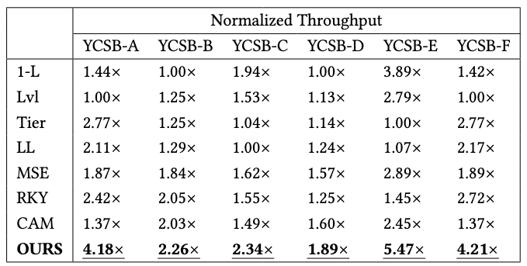
BACKGROUND
ARCEKV DESIGN
EVALUATION
CONCLUSION
YCSB Workloads
Tested Zipfian and Latest distributions across YCSB workloads A-F:
• By avoiding re-simulation of parameter configurations when workload shifts, ArceKV expands compaction search space
ArceKV achieves consistently highest performance across all YCSB workloads (A through F), demonstrating robust adaptivity under diverse access patterns and skew distributions.
17

Slide 18
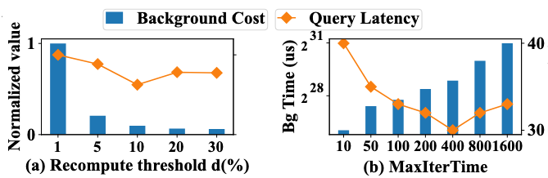
BACKGROUND
ARCEKV DESIGN
EVALUATION
CONCLUSION
Parameter Studies
Parameter Sensitivity
• Recompute threshold d = 0.1: Best balance between minimizing recompute cost and maintaining responsiveness
• Background simulation overhead: <2% CPU time (SIMD acceleration)
18

Slide 19
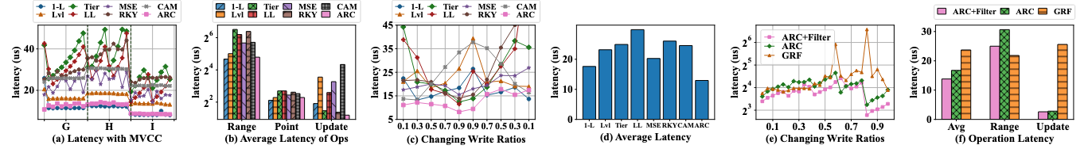
BACKGROUND
ARCEKV DESIGN
EVALUATION
CONCLUSION
Case Studies
MVCC Read Amplification
Smooth Workload Changes
+ Range Filters (Grafite)
• Identifies long version chains from massive updates
• Assigns low compaction penalty
• Converges to Leveling-like behavior
• Effectively reduces read latency
• Write ratio: 10% → 90% → 10%
• Gradual transition test
• ArceKV maintains most stable adaptive performance
• Smoothest adaptation curve
• Grafite range filter integrated into ArceKV
• vs. SOTA range filter system GRF:
• ~20% throughput ↑
• Latency halved
19

Slide 20
CONCLUSION
ArceKV: Data-Driven, Workload-Aware KV Storage
Problem
Solution
Results
Static compaction and write-stall strategies cause severe performance degradation under dynamic workloads
ElasticLSM breaks structural constraints + ARCE dynamically adapts compaction and stall thresholds
Consistently outperforms SOTA and industrial databases under evolving dynamic workloads
~3x faster than SOTA | >10x faster than industrial KV stores
Thank You
Junfeng Liu, Haoxuan Xie, Siqiang Luo | NTU Singapore | PVLDB 2026

