Slide 1


SIGMOD 2025
Constant Optimization Driven Database System Testing
CHI ZHANG, Nanjing University, China
MANUEL RIGGER, National University of Singapore, Singapore

Slide 2
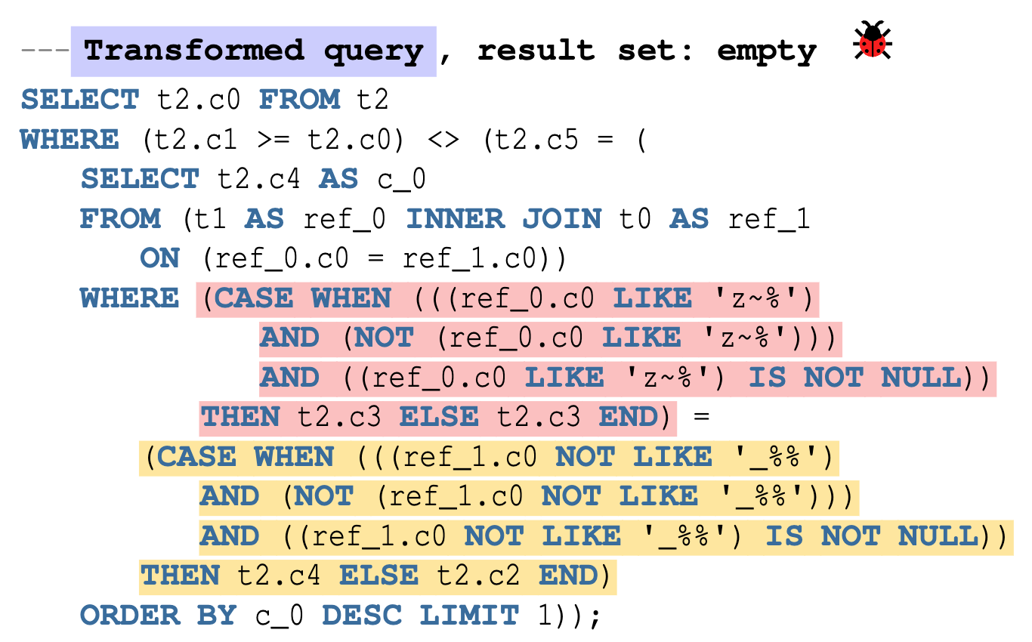
Motivation
Logical Bug Detection Attracts Attention
NoREC and DQE: Place the same predicate in different clauses;
TLP: Decompose a query into three parts (p, not p, p is null);
TQS: Provide a test oracle for join operators using database schema normalization;
PQS: Random join hints should have identical result;
EET: Adding Boolean expression.
Limitations:
None of these approaches support testing subqueries, an important feature that allows query nesting.
Fig.1 EET Example

Slide 3
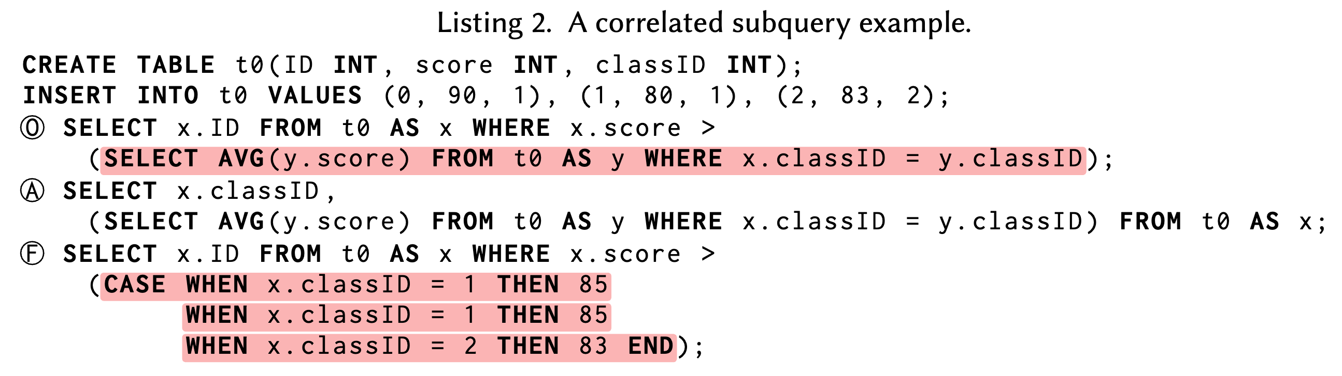
Background
Predicate
A predicate is a Boolean expression that evaluates to TRUE, FALSE, or NULL when applied to given values or rows.
Predicates are used in various clauses of SQL, such as the WHERE clauses of SELECT, UPDATE, and DELETE, as well as the JOIN ON, HAVING, GROUP BY, and ORDER BY clauses of SELECT.
Subqueries
Correlated subqueries are SELECT queries nested within outer queries, referencing columns from the outer queries to construct their predicate.
Non-correlated subqueries do not reference columns in the outer query and are evaluated once in execution.
非相关子查询：
获取所有员工中工资大于平均工资的员工信息
SELECT * FROM employees WHERE salary > (SELECT AVG(salary) FROM employees);

Slide 4
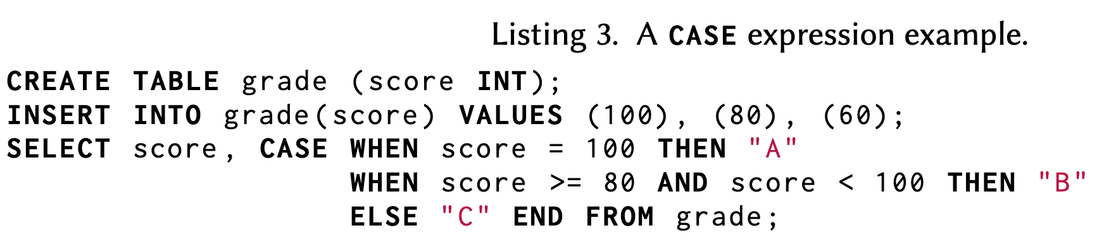
Background
SQL CASE expression
The CASE expression is a feature of SQL to process if / then logic.
Metamorphic testing
Formally, given an input 𝐼 and 𝑃 (𝐼) = 𝑂, where 𝑃 is the program under test, a follow-up input 𝐼′ is derived, so that a known relationship between 𝑂 and 𝑃 (𝐼′) = 𝑂′ is validated.
The core challenge is to identify a so-called metamorphic relation that derives the follow-up input 𝐼′ and relates the outputs 𝑂 and 𝑂′.
Notes:
of realizing a metamorphic testing approach

Slide 5
Observations
Constant folding
It is a well-known compiler optimization that evaluates constant expressions at compile time, rather than computing them at run time.
For example, it evaluates the statement i = 1 + 2 + 3; to i = 6; at compile time.
Constant propagation
Through reachability analysis, it determines constant values for variables by assessing their reachability at specific program points.
For example, the statement sequence a = 1; i = a + 2 + 3; can be optimized to i = 6;.
Key Insights
Within an SQL query, by assuming a constant database state and given query, we can apply constant folding and constant propagation to a specific expression in a predicate, assuming that the query’s result remains unchanged.
Any discrepancy in the results of these two queries indicates a potential bug.
Notes:
of realizing a metamorphic testing approach

Slide 6
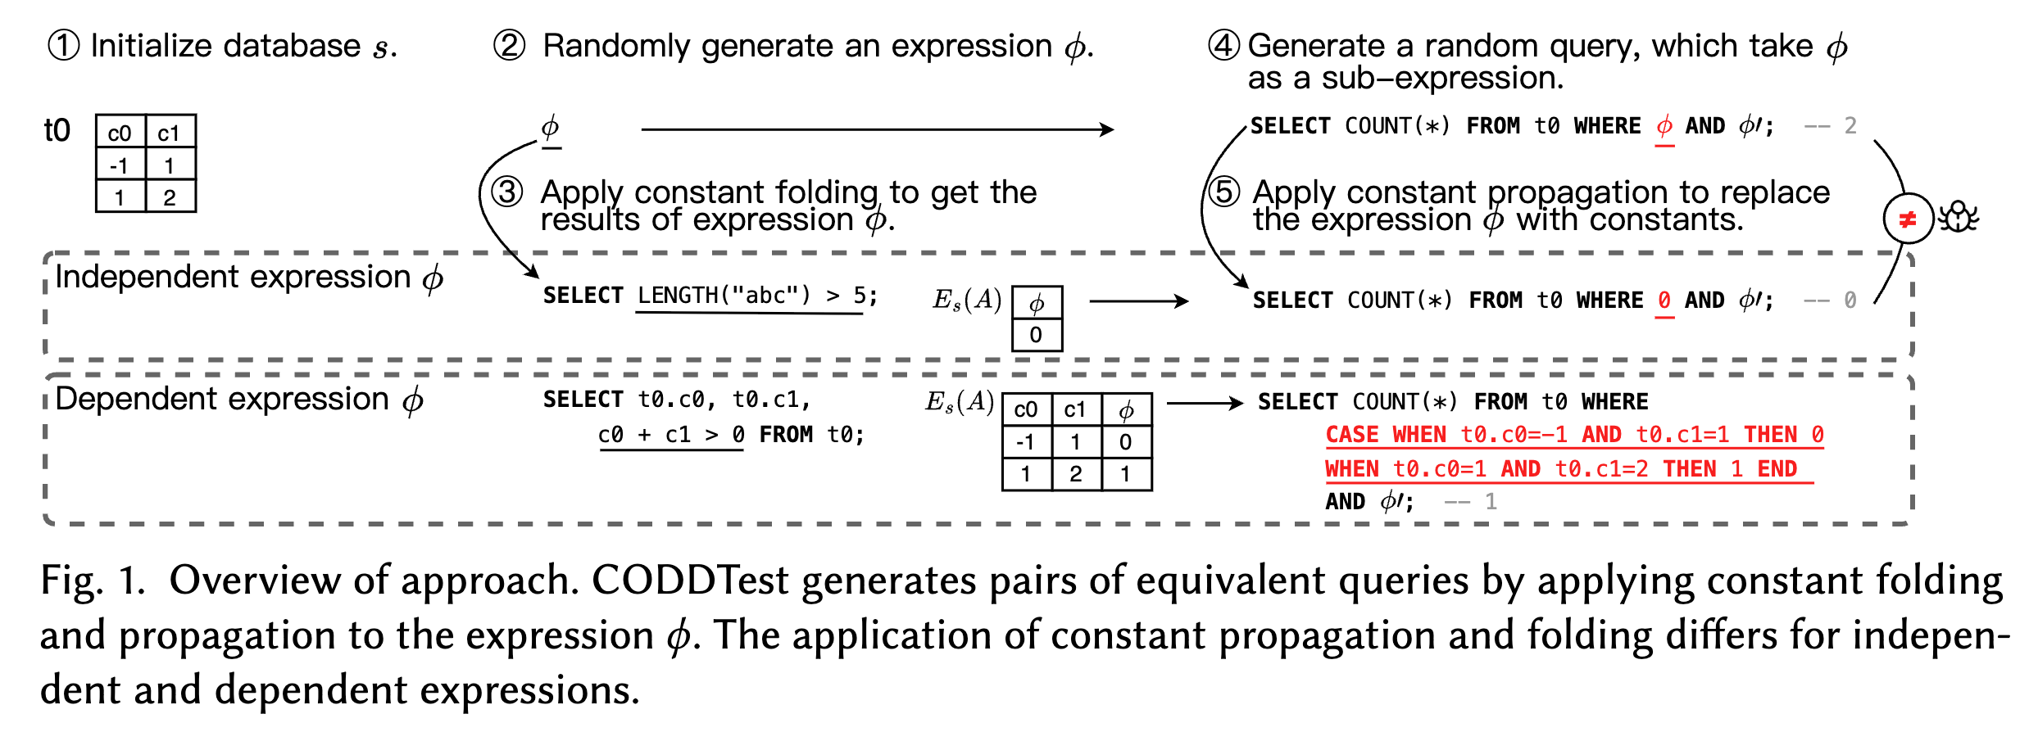
Overview
The original query includes the randomly generated predicate.
The folded query is derived by substituting the predicate in the original query with the corresponding constant-folded predicate.
Notes:
of realizing a metamorphic testing approach

Slide 7
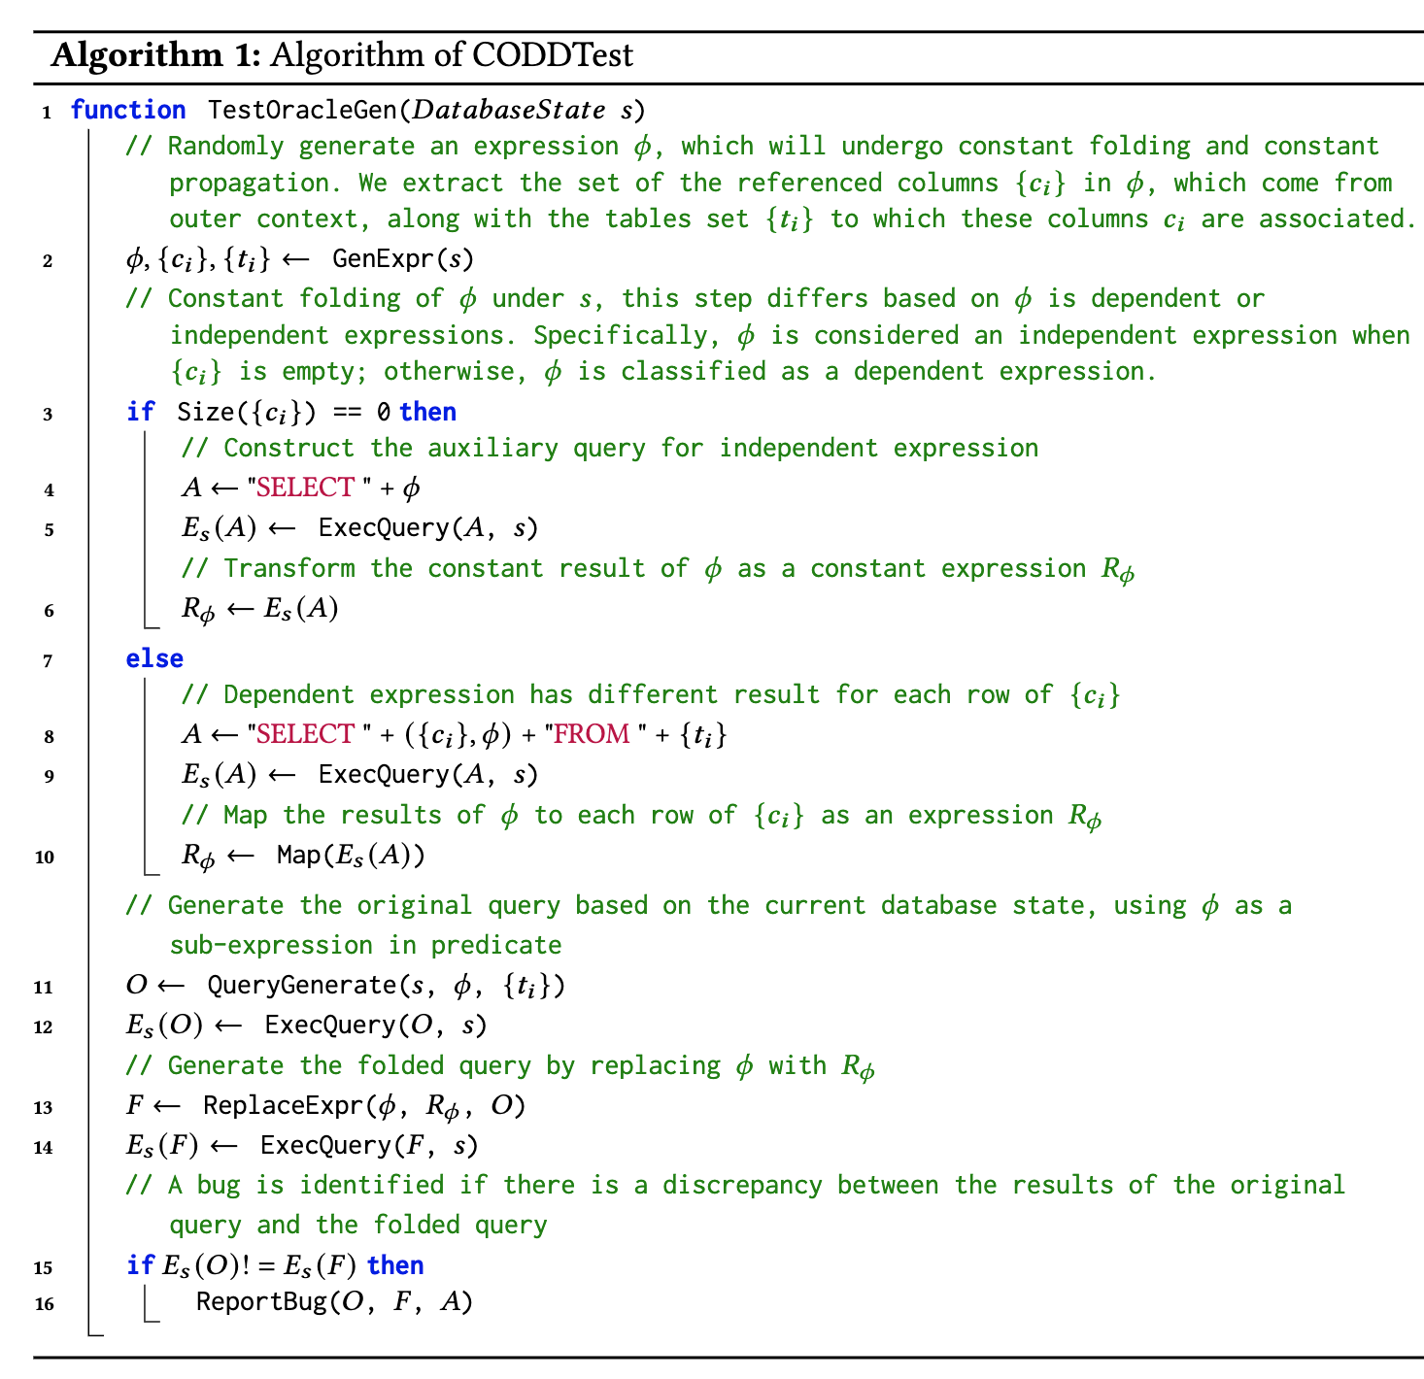
Algorithm Sketch
Notes:
of realizing a metamorphic testing approach

Slide 8
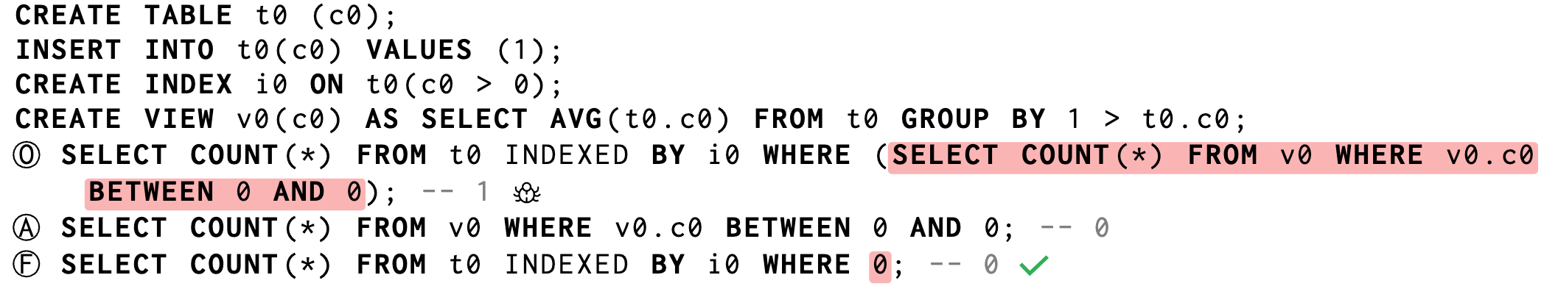
Folding Independent Expressions
Case1：The expression 𝜙 has no column references
It is a constant expression that always yields a constant value.
For example, the independent expression LENGTH ( "abc" ) > 5 shown is used in a SELECT statement to derive its results.
Case2：The expression 𝜙 is a non-correlated subquery
It computes a constant result assuming a fixed database state.
The subquery of query returns the same result regardless of the outer query’s result.

Slide 9
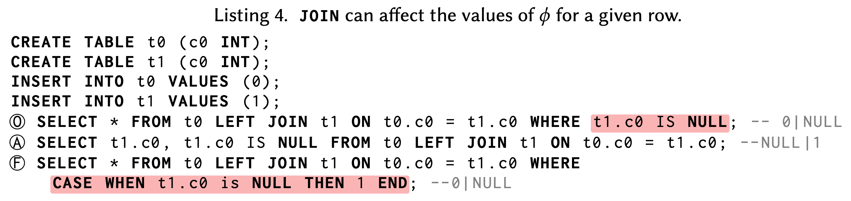
Folding Dependent Expressions
Constant folding:
It first obtains the results of the expression on each row (i.e., step 3 for dependent expression).
It then represents them using a mapping (i.e., step 5 for dependent expression).
Supporting Join:
The auxiliary queries must use the same JOIN clauses as the original query, except in cases where 𝜙 serves as the predicate within the JOIN clause.
Although it generates non-empty tables, an empty result can still occur, for example, when using an INNER JOIN with a false predicate. In such scenarios, it discards the test.

Slide 10
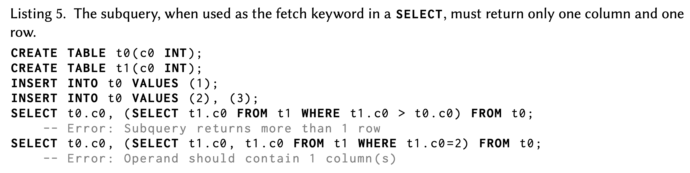
Construction of Original Query
Predicate construction
It randomly generate predicates that contain or correspond to 𝜙 based on SQLancer.
Subqueries can evaluate to three different result types: (1) a scalar value, which is a single value; (2) a row value, which is an ordered list of two or more scalar values; (3) multiple row values.
Query construction
It supports placing these predicates not only in the WHERE, JOIN, HAVING, GROUP BY, and ORDER BY clauses of SELECT, but also in other statements that require predicates, such as CREATE INDEX, CREATE VIEW, UPDATE, INSERT, and DELETE.
Notes:
To this end, for correlated subqueries, we either use an aggregate function without using a GROUP BY clause, or use a LIMIT clause.

Slide 11
Experiment
Target DBMS: SQLite, MySQL, CockroachDB, DuckDB, and TiDB.
Baselines: NoREC, TLP, DQE, and EET.
Environment: A server with a 64-Core AMD EPYC 7763 Processor at 2.45GHz and 512GB of memory running Ubuntu 22.04.

Slide 12
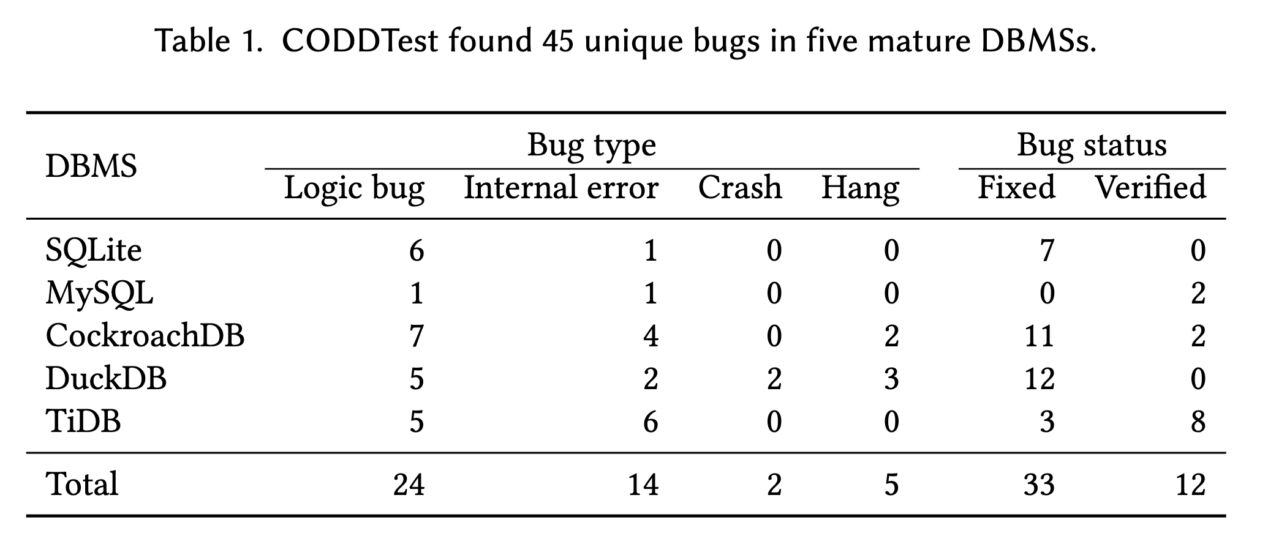
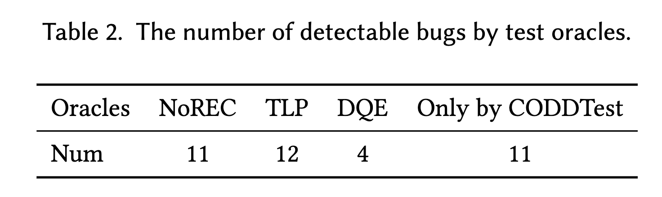
Bug Number

Slide 13
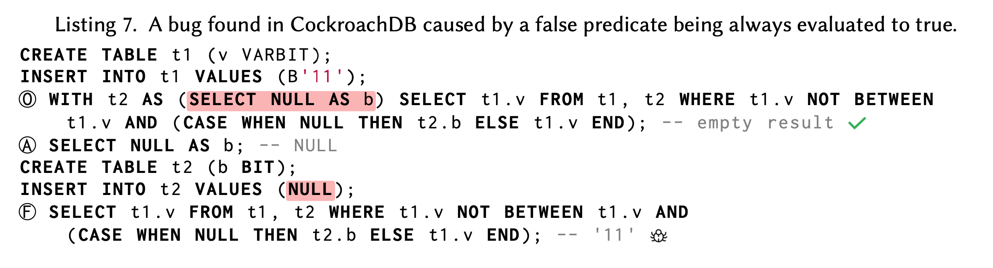
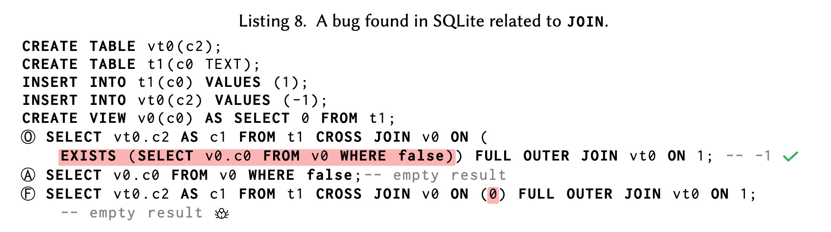
Case Study

Slide 14
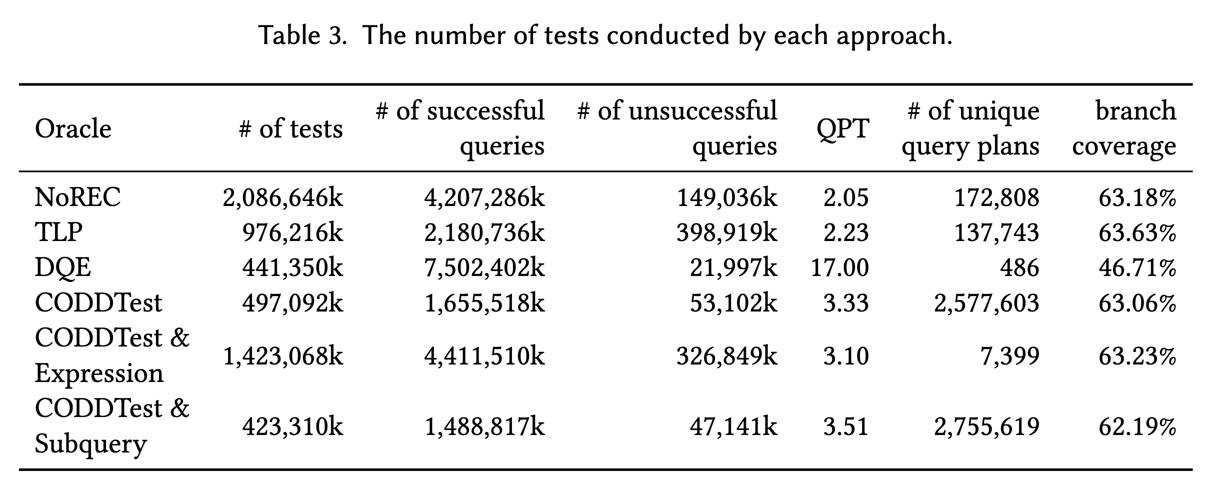
Efficiency
24-hour Test Over SQLite
Notes:
SQLiteHowever, in our evaluation, we found that most of the bugs we found by the bug-inducing
test cases use only shallow expressions after reduction. Therefore, during testing, there is no need
to generate expressions with great depth.

Slide 15
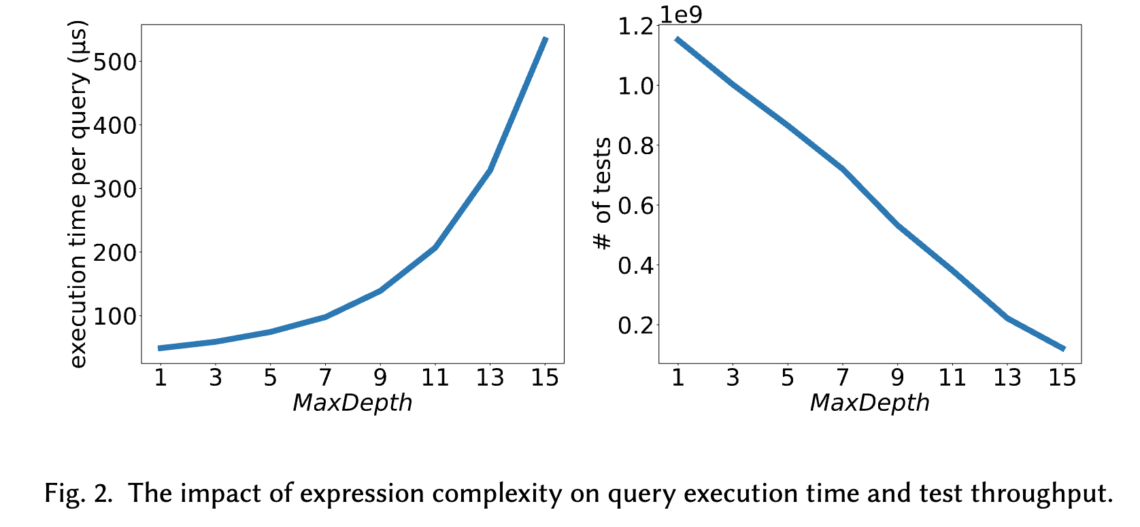
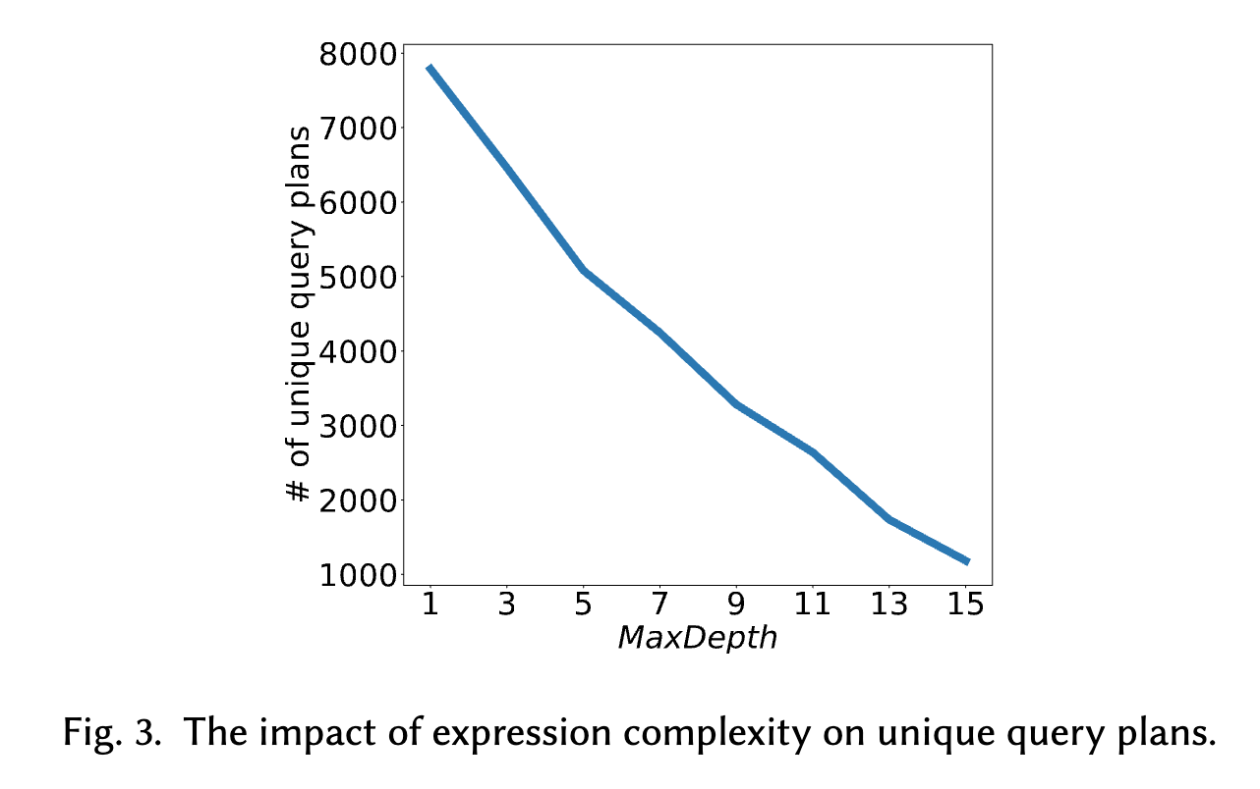
Expression Complexity
Notes:
However, in our evaluation, we found that most of the bugs we found by the bug-inducing
test cases use only shallow expressions after reduction. Therefore, during testing, there is no need
to generate expressions with great depth.

Slide 16
Thank You Guys!

