Slide 1


OSDI 2021
Retrofitting High Availability Mechanism
to Tame Hybrid Transaction/Analytical
Processing
Sijie Shen, Rong Chen, Haibo Chen, and Binyu Zang, Institute of Parallel and Distributed Systems, Shanghai Jiao Tong University; Shanghai Artificial Intelligence Laboratory; Engineering Research Center for Domain-specific Operating Systems, Ministry of Education, China
Notes:
IPADS
2021 OSDI USENIX

Slide 2

Background
Typical Workloads Of Databases
OLTP
(OnLine Transaction Processing)
Short-term read-write transactions
Online order processing
Stock exchange
E-commerce
OLAP
(OnLine Analytical Processing)
Long-term read-only queries
Business intelligence
Financial reporting
Data mining
Notes:
Some concept:

Slide 3
Background
HTAP：New type of workloads
HTAP
(Hybrid Transaction/Analytical Processing)
OLTP
OLAP
Real-time queries on data generated by transactions
IOT
Healthcare
Fraud detection
Personalized recommendation
Notes:
Banks use various techniques to detect fraud strategies and other vulnerabilities, including running multiple machine learning (ML) models, but these strategies are effective only if the data being used is as up to date as possible and detection can take place in real time.

Slide 4
Introduction
Information is most valuable when it first appears, and diminishes over time.
Some enterprise, such as Alibaba, want to master the real-time data and some immediate information to monitor system in Double 11 Festival.
It’s beneficial to personal consumption and fraud detection as well.

Slide 5
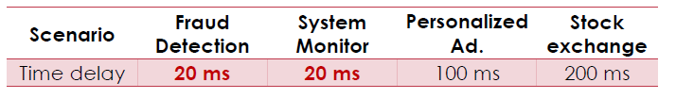
Requirements
Two core problems
Performance
Minimizing performance degradation (e.g., < 10%) when transactions and analytical queries being executed concurrently.
Freshness
the maximum time delay between TP and AP (e.g., < 20ms).
Notes:
HTAP系统的两个总体目标：
（1）Freshness：在无故障的情况下，事务的元组值写入和分析查询的读取之间的最大时间延迟应该接近实时，例如几十毫秒。
（2）Performance：与专用系统相比，事务和分析查询应该同时执行，性能下降很少（例如，低于 10%）

Slide 6
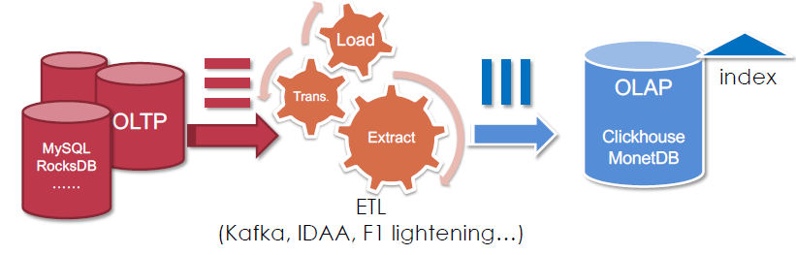
Traditional Data Analysis Solution
TP + ETL + AP
Data generation, row store
(update, delete, insert)
Data analysis, column store
(SUM, AVG, GROUP)

Slide 7
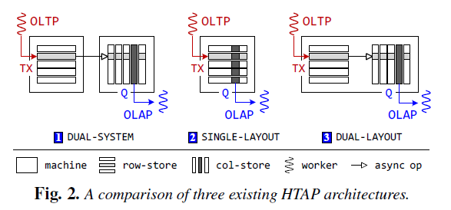
Three HTAP Alternatives
Alternative#1: DUAL-SYSTEM
Good performance
Large time delay
Alternative#2: SINGLE-LAYOUT
Short time delay
Huge performance degradation
Alternative#3: DUAL-LAYOUT
Lightweight data sync (a tradeoff)
Notes:
Data access requires locality

Slide 8
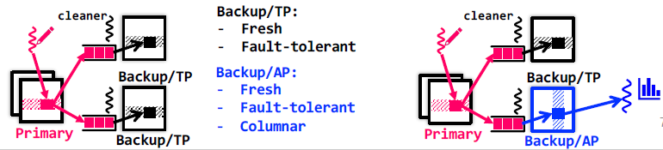
Overview : VEGITO
A distributed in-memory HTAP system
Opportunity of High Availability for fast in-memory OLTP
Replication-based HA mechanism is common
Synchronous log shipping during transaction committing
Reuse HA for HTAP
For performance: OLTP on primary, OLAP on backup/AP
For freshness: synchronous logs

Slide 9
Opportunity Of Reuse HA
For Freshness, high availability guarantees strong consistency between primary and backups by synchronous log shipping.
For Performance, running different workloads on different replicas can avoid interference naturally and deploy optimizations individually.
Notes:
更为详细地来说

Slide 10
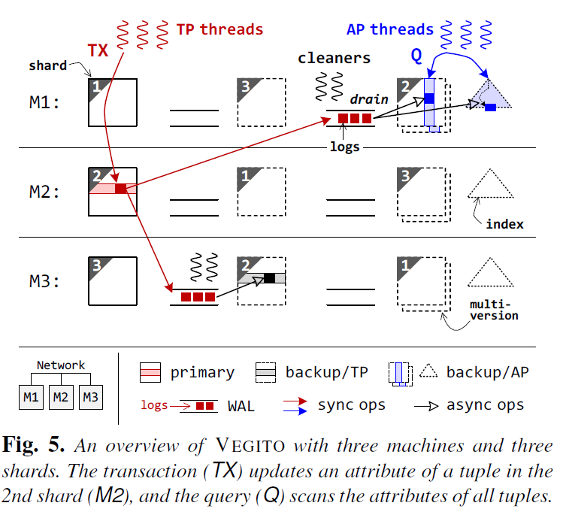
System Architecture
Keep 3-way primary-backup replication, one for primary, and the rest for TP and AP.
Transactions (synchronously) append updates to the WAL of backups involved before committing on the primary.
Some cleaner threads drain the logs in a lazy and batched manner (asyn).
Key-Value store

Slide 11
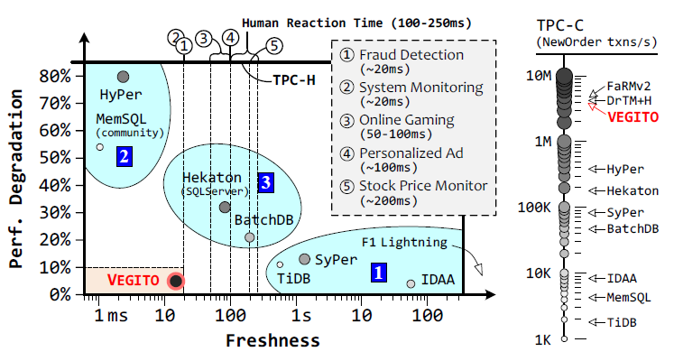
Effects of VEGITO

Slide 12
Challenges
Instead of using a snapshot of transactional data to support AP
Use synchronous log shipping to keep backups consistent and fresh
Performance degradation

Slide 13
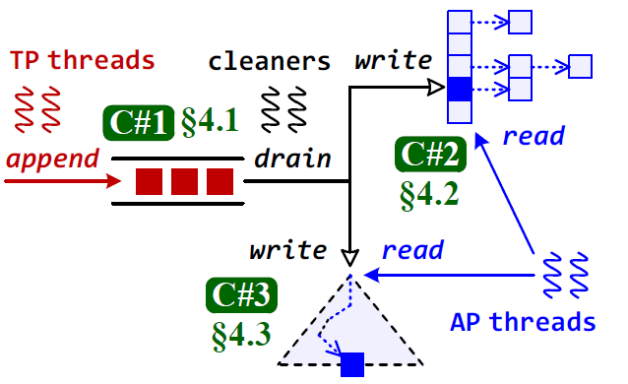
Challenge#1：Log Cleaning
Log shipping
TP threads always append logs to queue
Cleaner threads drain logs to apply
For HA
Drain logs in parallel
Without consistency until recovery
For AP Quires
Should be consistency

Slide 14
Consistency Requirement
Transactions dependency
Due to AP workloads needs consistent backups, cleaner threads should drain logs following the dependency in transactions.
All logs of one transaction should be applied atomically
All logs from different transactions should be applied in order

Slide 15
Traditional Approach
Significant throughput loss
To keep consistent, a common solution is to record a global timestamp in each log and drain logs in sequence which causes significant loss(70%) in throughput.
Assigning timestamp causes high contention in a cluster of 16 machines.
Sequentially draining logs limits the clean throughput and further limit TP throughput.
New approach
In a consistent and parallel way.

Slide 16
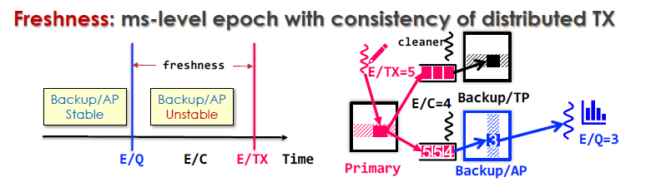
Solution#1：Epoch-based Design
Epoch is the granularity at which VEGITO guarantees the consistency and visibility of backup/AP replicas to analytical queries .
Partitioning time into non-overlapping epochs to reach time isolation between OLTP and OLAP.
Each machine has
E/TX: epoch of TX logs (increase periodically)
E/C : epoch of logs being drained
E/Q : epoch of stable versions on backup/AP

Slide 17
Consistent Epoch Assign
Gossip-style epoch assign
Epoch oracle :
update epoch periodically and broadcast epoch number.
This broadcast only aims to all machines in the cluster, instead of transactions or queries involved.
It always waits for ACKs from all machines such that the epoch gap among machines must not bigger than 1.
Gossip epoch during commit if violate dependence
Consistency: previous TX must within an equal or smaller epoch

Slide 18
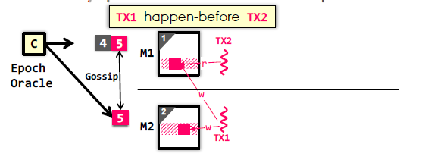
Consistent Epoch Assign
Detailed scheme

Slide 19
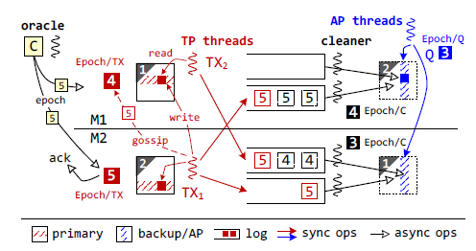
Parallel Log Cleaning
Clean and apply logs matching TX dependence
Each machine maintains a cleaner epoch number(E/C), meaning that all txs at this epoch as been drained.

Slide 20
Parallel Log Cleaning
Clean and apply logs matching TX dependence
Each machine maintains a cleaner epoch number(E/C), meaning that all txs at this epoch as been drained.
Parallelism: Logs within an epoch drained in parallel.
Consistency: each machine update E/C when all logs of an epoch drained individually.

Slide 21
Parallel Log Cleaning
Reduce waiting time among cleaner threads
Refrain from synchronization among the cleaner threads among different machines to accelerate, while may lead to data inconsistency
Make AP Quires read consistent backups at a stable query epoch(E/Q), which is the minimum value of cleaner epochs on machines involved.

Slide 22
Challenge#2：MVCS
To avoid contention between cleaner threads (write) and AP threads (read), backup/AP replicas require to adopt a multiversion column store (MVCS) at the epoch level
the cleaner threads will generate a new version of column store for each epoch by applying logs in parallel.
Meanwhile, AP threads will run analytical queries over the latest stable version of the column store to retrieve fresh results.

Slide 23
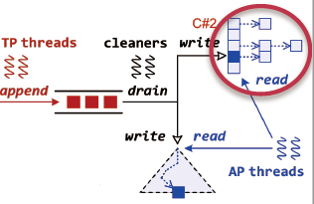
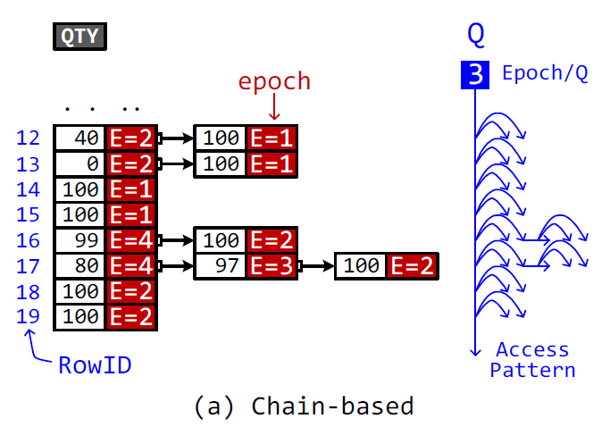
Chain-based Design
Column store maintains an array for each attribute to store the latest value of tuples with its version, Each entry also maintains a backward chain for values in the earlier versions
Can update efficiently
Because analytical queries commonly access the latest consistent data, so AP thread has to traverse the chains of updated entries and check the versions.
Scan performance drop 90%

Slide 24
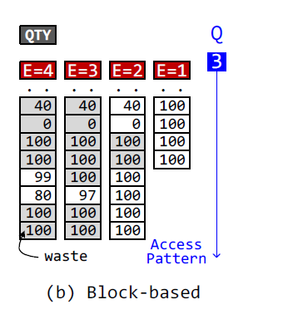
Solution#2 : Block-based MVCS
This design maintains an array for each epoch. When starting a new epoch, the cleaner thread copies the original array and applies logs to it. (Cow in the unit of blocks)
Can scan efficiently (Perfect locality without interference from cleaner threads) .
Data copying waste lots of CPU and memory resources, especially for append-only attributes.

Slide 25
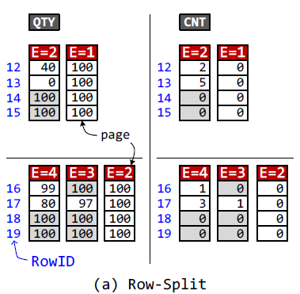
Optimizations: Row-Split
Split a column into several pages (unit of Cow)
Features : txs may focus on updating tuples in a small scope for a while.
VEGITO first splits values into multiple pages, and each page enables a copy-on-write mechanism independently to implement fine-grained on-demand data copying.
4KB page size is enough to exploit the cache locality.

Slide 26
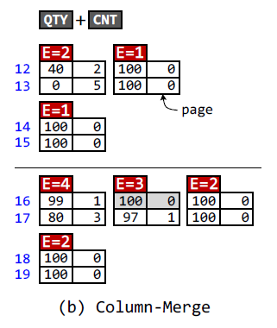
Optimizations: Column merge
Merge high-related columns together
Features : A certain type of txs usually update a fixed set of attributes at a time.
VEGITO will merge related attributes for the same tuple into a single page
“We collect the statistics on the column family to decide how to merge columns with conflicting requirements” (automatically discover correlations from tx logs)
Notes:
ML

Slide 27
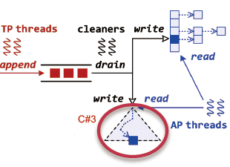
Challenge#3：Tree-based index
Interference from heavy inserts
Write-optimized tree index
At the expense of read performance
Read-optimized tree index
Write performance is limited

Slide 28
Traditional Approach
The Insert operation consists of three steps.
Locate leaf node:
Search a leaf node to store the value by traversing from the root.
Split/Insert leaf node
Split the leaf node if it is full, and then insert the value into the sorted leaf node.
Split/Insert inner node.
(Recursively) Split the upper level inner node if it is full, and then insert a value and a link into the sorted inner node.
Throughput of insert operation drops with the increase of threads due to the second step may block other concurrent insert operations (lock)

Slide 29
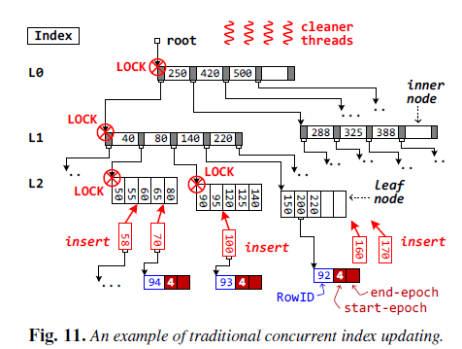
Traditional Approach
Leaf nodes
The sorted value
A link to the row ID
Its start/end epochs
(end epoch used to delete)

Slide 30
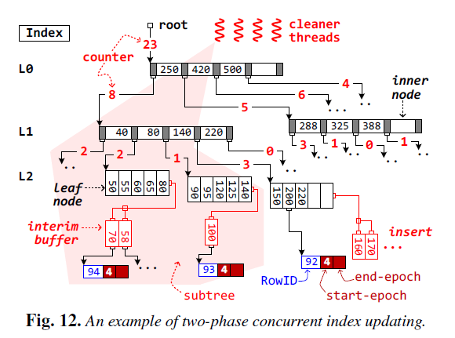
Solution#3: Two-phase concurrent updating
Insert in buffer of each leaf, balance in batch
Location phase
Search a leaf node to append the value into its interim buffer.
Update phase,
top-down greedy strategy to partition the tree into non-overlapping subtrees according the counters at each level, so that each subtree has a similar amount of tasks.

Slide 31
Fault Tolerance
VEGITO perseveres the same availability guarantees
No need for extra replicas
Prefers to recovers the primary from backup/TP
Special cases (rare)
Both primary and backup/TP fail: rebuild primary from backup/AP and migrate to another machine
Backup/AP fail: rebuild to the next epoch

Slide 32
Evaluation Setup
16 machines, each has
2x12 intel Xeon E5-2650 processors, 128GB RAM
2x ConnectX-4 100Gbos InfiniBand NIC
Benchmark
CH-BenCHmark ≈ TPC-C + TPC-H
Workload Settings
OLTP-only
OLAP-only
HTAP

Slide 33
Compare to Specific Systems
Compared with OLTP-specific systems
Peak throughput: 3.7M txns/s
1% lower than DrTM+H (OLTP-specific)
Compared with OLAP-specific systems
Geo-mean latency : 57.2ms
2.8x faster than MonetDB (OLAP specific)
Notes:
一个关键基础就是搭建在了之前团队DrTM+H上，一个分布式（基于RDMA）的in-memory TP系统

Slide 34
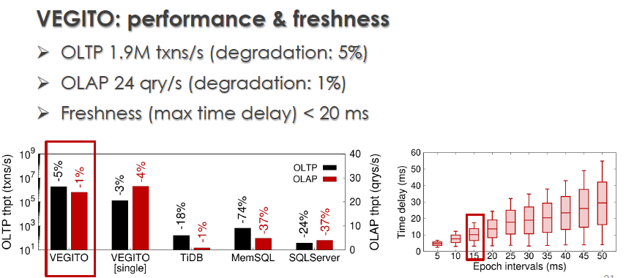
HTAP Workloads

Slide 35
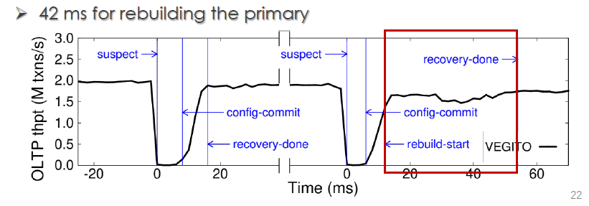
Recovery
Kill one of the primary for twice
Recovery from Backup/AP

Slide 36
Contributions
A new distributed in-memory HTAP architecture that retrofits fault-tolerant backups to support hybrid transaction/analytical processing without compromising high availability.
Three key techniques with epoch scheme to collectively make a fresh, multi-version columnar backup with tree-based indexes for analytical queries.
A set of evaluations that confirm the efficacy of VEGITO for HTAP workloads even facing millions of transactions per second.

Slide 37
Personal views
Writing
Ample background introduction
A self-critical writing style
Sufficient comparisons between different design approaches and systems
Vivid and clear graphs
Good at emphasizing important ideas
Tech
Integrate many old but valuable ideas

Slide 38
References
https://www.usenix.org/system/files/osdi21_slides_shen.pdf
https://www.youtube.com/watch?v=ZFIhs5fhBBo
https://www.usenix.org/conference/osdi21/presentation/shen
https://github.com/SJTU-IPADS/vegito

Slide 39
Thank You Guys!

