Slide 1
Automated Performance Anomaly Diagnosis and Root Cause Analysis for Database Systems
曹品善 2026.3.30

Slide 2
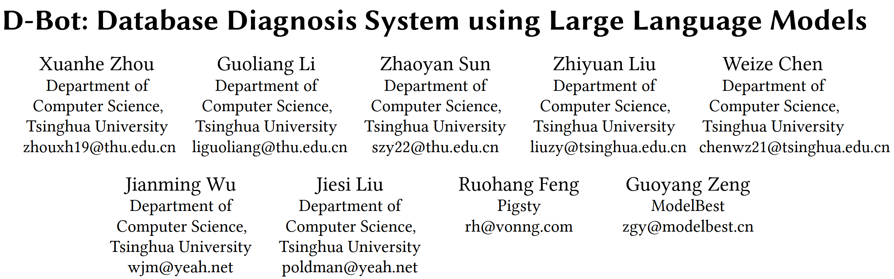
Notes:
异常诊断和根因分析的介绍主要依托 D-Bot 介绍，这篇论文由 周煊赫，李国良等发表在 VLDB 2024。

Slide 3
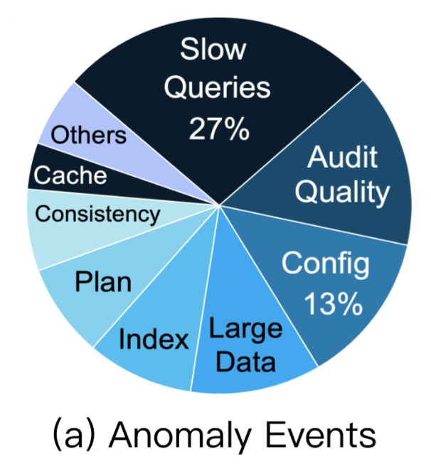
Introduction
Database diagnosis detects, analyzes and resolves database anomalies to ensure high data availability and workload performance.
Database anomalies are diverse with complex module correlations, making predefined rule-based diagnosis infeasible and the task highly challenging.
A database vendor recorded over 900 multi-facet anomaly events in 3 months (e.g., slow queries, improper configurations).
Notes:
这篇文章的 Introduction 逻辑很清晰，下面对 introduction 的每一部分逐步介绍。
首先简单几句话引入，数据库诊断是检测，分析，解决数据库异常。数据库异常种类繁多并伴随复杂的关联关系，使得简单规则难以实施。
数据库厂商记录了九百多起异常事件，有慢查询，配置不合理，内部统计质量问题，插入大量数据等问题。

Slide 4
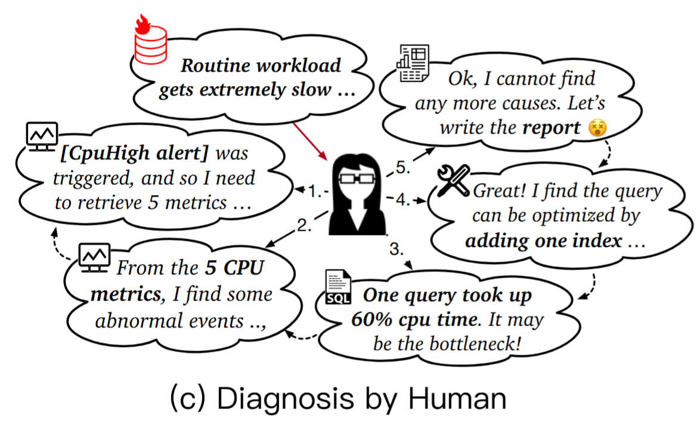
Introduction
Anomaly Notification:
Users report abnormal database performance (e.g., routine queries 120% slower than normal).
Alert Detection:
DBAs check triggered alerts (e.g., a "CPU High" alert with total CPU usage exceeding 90% for 2 minutes).
Metric Analysis:
DBAs analyze relevant metrics (e.g., running/blocked processes, query calls).
Event Analysis:
DBAs retrieve top-k slow query statistics and find a single query consuming nearly 60% of CPU time.
Optimization Advice:
DBAs propose optimizations (e.g., index update, SQL rewrite) based on experience/tools.
Report Writing:
DBAs need to write diagnosis reports including root causes and detailed diagnosis.
Notes:
下面举了一个DBA进行异常诊断的例子。
当客户报告一个数据库性能异常，DBA检查触发的报警，例如CPU利用率过高，然后DBA分析相关的指标，例如执行的查询。然后对该异常事件进行分析，找到TOP-k个慢SQL。
针对慢SQL进行优化。最后将该案例写成一个报告。

Slide 5
Introduction
Limited capabilities of human DBAs
Training a qualified DBA requires months to years of learning relevant documents and hands-on practice, with high time costs.
It is nearly impossible to deploy enough DBAs to manage massive database instances (e.g., millions of cloud instances).
Human DBAs cannot provide timely responses for urgent/cross-module correlated anomalies, potentially leading to huge financial losses.
Semi-automatic diagnosis tools
Built on empirical rules or small-scale ML models (e.g., classifiers), lacking scenario understanding and the ability to utilize professional diagnosis knowledge.
Poor generalization to scenario changes: manual rule update/verification for new database versions is tedious; ML models need redesign of input metrics/labels and retraining for new scenarios.
No human-like inference ability (e.g., recursively exploring system views based on initial results to infer root causes).
Notes:
人工异常分析的局限性：1 培养一个资深DBA时间成本高，2 人力难以管理海量数据库实例，3 可能无法对紧急或者跨模块事件及时响应。
半自动诊断工具：缺乏领域知识，泛化能力较差，没有推理能力。

Slide 6
Introduction
Target
Precise Diagnosis: Utilize tools to gather scenario information/derive optimization advice, and conduct logical reasoning to make diagnosis plans (unsupported by traditional methods).
Expense and Time Saving: Alleviate human DBAs’ on-call duties by automatically resolving typical anomalies that empirical rules cannot handle.
High Generalizability: Flexibly analyze unseen anomalies based on diagnosis documents (new metrics/views/logs) and past experience.
Challenge
C1 (Enhance LLM’s diagnosis problem understanding): Extract useful knowledge from long documents, match knowledge with anomaly context, and retrieve applicable database tools effectively.
C2 (Improve single-cause anomaly diagnosis performance): Address LLM’s early stop problem in interactive diagnosis and hallucination issue to ensure in-depth, reasonable analysis.
C3 (Enhance multi-cause anomaly diagnosis capability): Design an efficient mechanism for multiple LLMs to collaborate, improving accuracy and efficiency for complex anomalies with fine-grained critical metrics.
Notes:
诊断系统目标：准确的逻辑推理，自动分析解决异常，高泛化性。
使用LLM搭建诊断系统需要面临的挑战：从长文档中提取知识并与异常场景匹配。解决推理过早终止和幻觉问题。设计多智能体协同机制。

Slide 7
Introduction
Contributions
Designed an LLM-based database diagnosis framework to achieve precise, efficient and generalizable database anomaly diagnosis.
Proposed a context-aware diagnosis prompting method, empowering LLMs with document knowledge matching and fine-tuned tool retrieval.
Propose a tree-search-based root cause analysis method to guide LLMs in multi-step analysis, significantly improving diagnosis performance.
Designed a collaborative diagnosis mechanism for multiple LLMs to analyze complex anomalies asynchronously (cross review, result sharing), boosting diagnosis efficiency.
Conducted extensive experiments on real benchmarks, verifying D-Bot’s ability to identify root causes of unseen anomalies and its outperformance over traditional methods and vanilla LLMs (e.g., GPT-4).
Notes:
贡献是，一个诊断框架，框架中三个点，prompt设计，树状推理链路，多智能体协作机制。最后是 D-bot 性能优于其他方法。

Slide 8
Preliminaries
Database Performance Anomalies
Slow Query Execution
Longer-than-expected response time. Slow queries sharply increase CPU usage and query duration, while the number of active processes remains low.
Full Resource Usage
System resources (CPU, memory) are exhausted, blocking new requests or causing failures (e.g., insert errors due to OOM). High concurrency drives high resource usage and a large rise in active processes.
Database Hanging
Database becomes unresponsive, typically caused by long-running queries, deadlocks, or resource contention. High CPU consumption occurs with frequent process interrupts and context switching.
Database Crashing
Unexpected shutdown making data inaccessible. A common cause is full disk space, which prevents writes and essential operations, leading to database failure.
Notes:
首先总结了数据库异常，例如查询执行慢，资源耗尽，数据库失去响应（长时查询，死锁，资源争用，频繁上下文切换），数据库崩溃（如磁盘空间已满）。

Slide 9
Preliminaries
Root Causes
Concurrency Workloads
Severe resource contention among concurrent operations leads to system performance degradation.
Query Operator Issues
Large-scale inserts, massive data fetching, and complex predicates overload database processing.
Planning & Execution Inefficiencies
Abnormally long query planning and extended database wait times indicate suboptimal execution logic.
Data-Specific Issues
Data corruption, dead tuples, and stale physical storage data cause performance anomalies.
Schema & Configuration Issues
Missing indexes, improper database settings (e.g., small shared buffers) affect optimization and memory management.
Harmful Background Tasks
Over-frequent maintenance jobs (e.g., vacuum) compete for resources with user queries and hurt performance.
Notes:
论文也总结了许多根因：负载并发过高，查询算子问题（复杂的查询条件），查询计划低效，数据陈旧，索引缺失和配置不当，后台任务争抢资源。

Slide 10
Preliminaries
Optimization actions
Query Rewrite Tools
Optimize slow queries via external logical transformation rules (e.g., ~120 rules in Calcite), compensating for weak database internal optimization on complex predicates.
Knob Tuning Tools
Fix configuration-related failures and poor performance using rule-based suggestions. Example: increase MySQL innodb_buffer_pool_size by 5% if memory usage < 60%.
Index Tuning Tools
Generate high-potential indexes based on tuning rules, such as building composite indexes for columns in the same query predicate.
Notes:
一些解决方法有：SQL重写，参数调优，索引调优

Slide 11
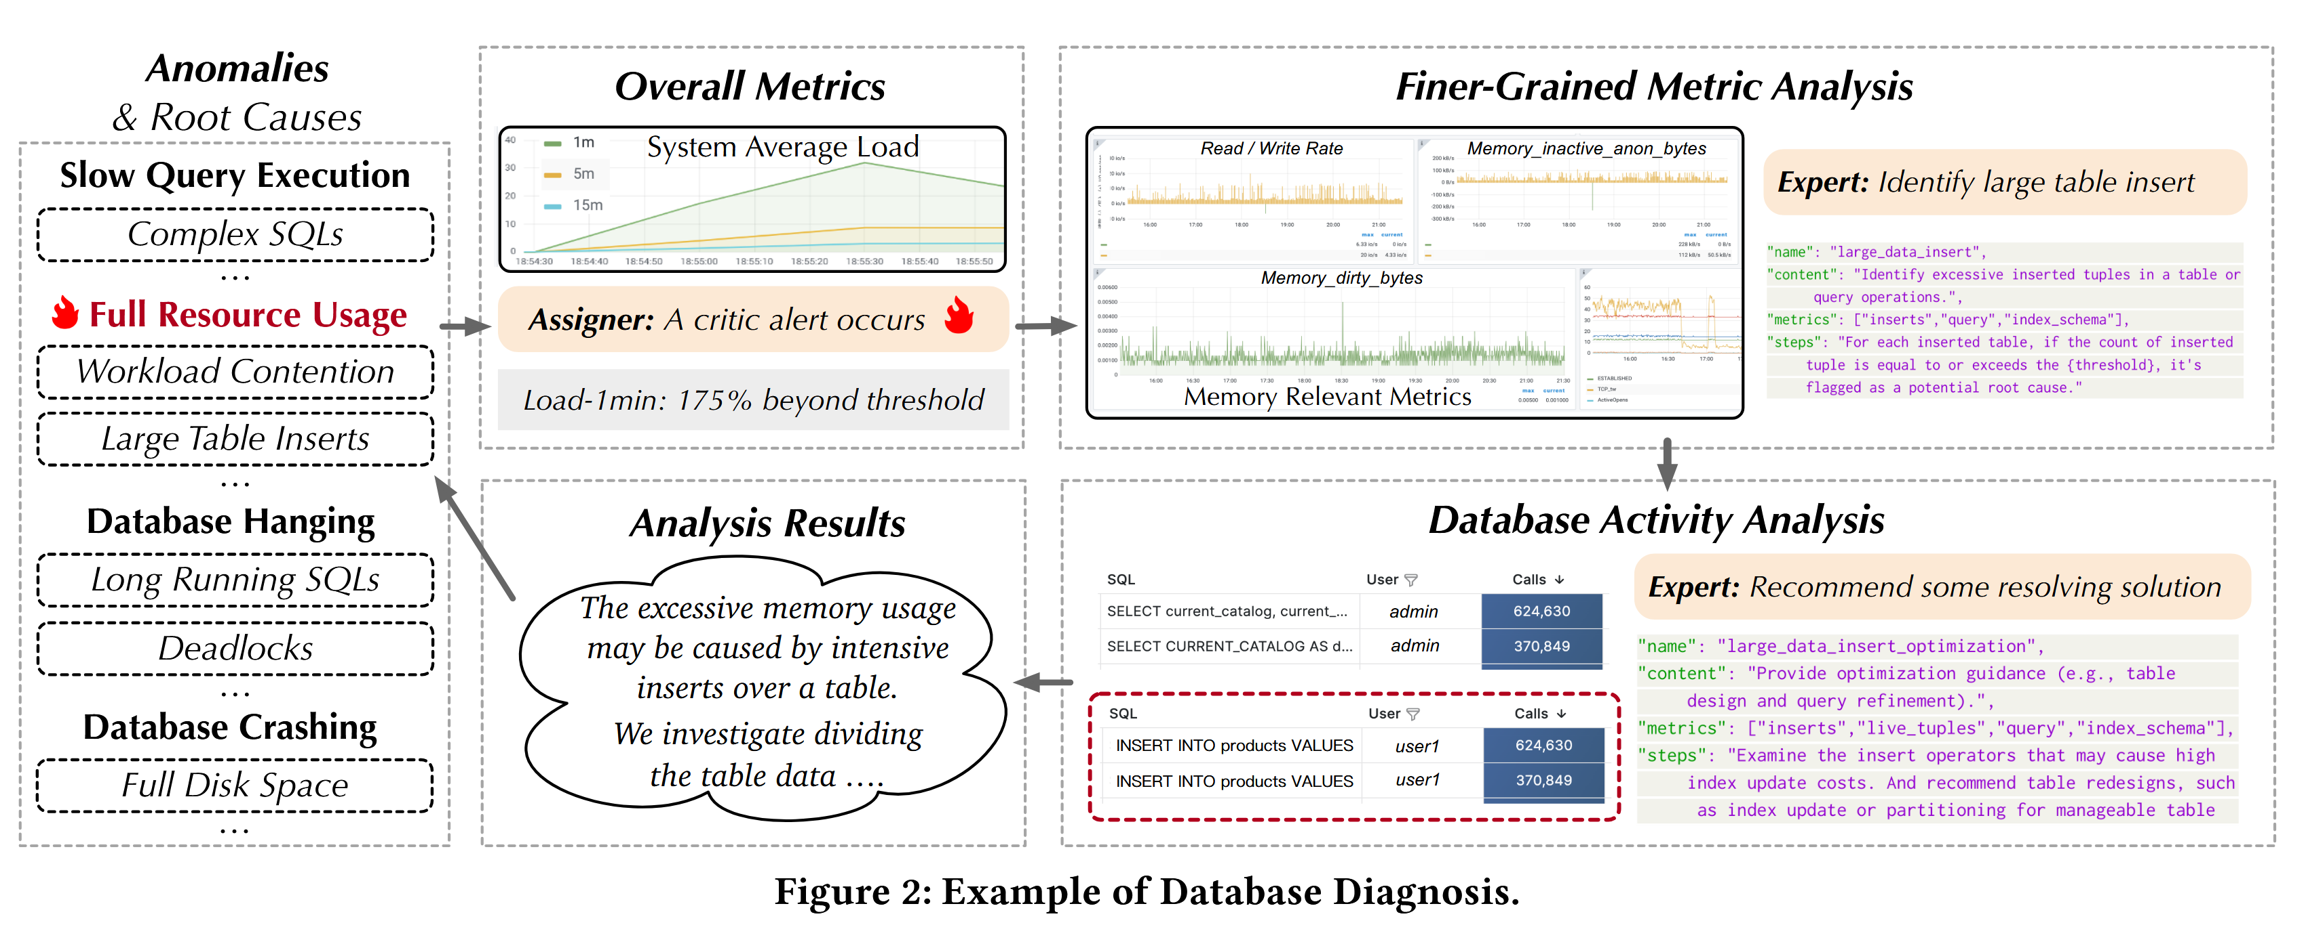
Preliminaries
Notes:
当收到内存使用率过高的异常告警时，
首先检查异常发生时的系统负载（例如，内存使用量指标 node_memory_total）。数据证实存在异常的内存占用（超过 90%）。
为了理解这一现象，我们进一步获取相关内存指标（例如 node_memory_inactive_anon_bytes）。
对这些指标的分析表明，过高的内存使用可能是由向表中插入数据的密集工作负载引起的。
为了解决这个问题，我们研究是否可以采用优化策略来帮助降低内存消耗（例如，将表数据划分为分区）。

Slide 12
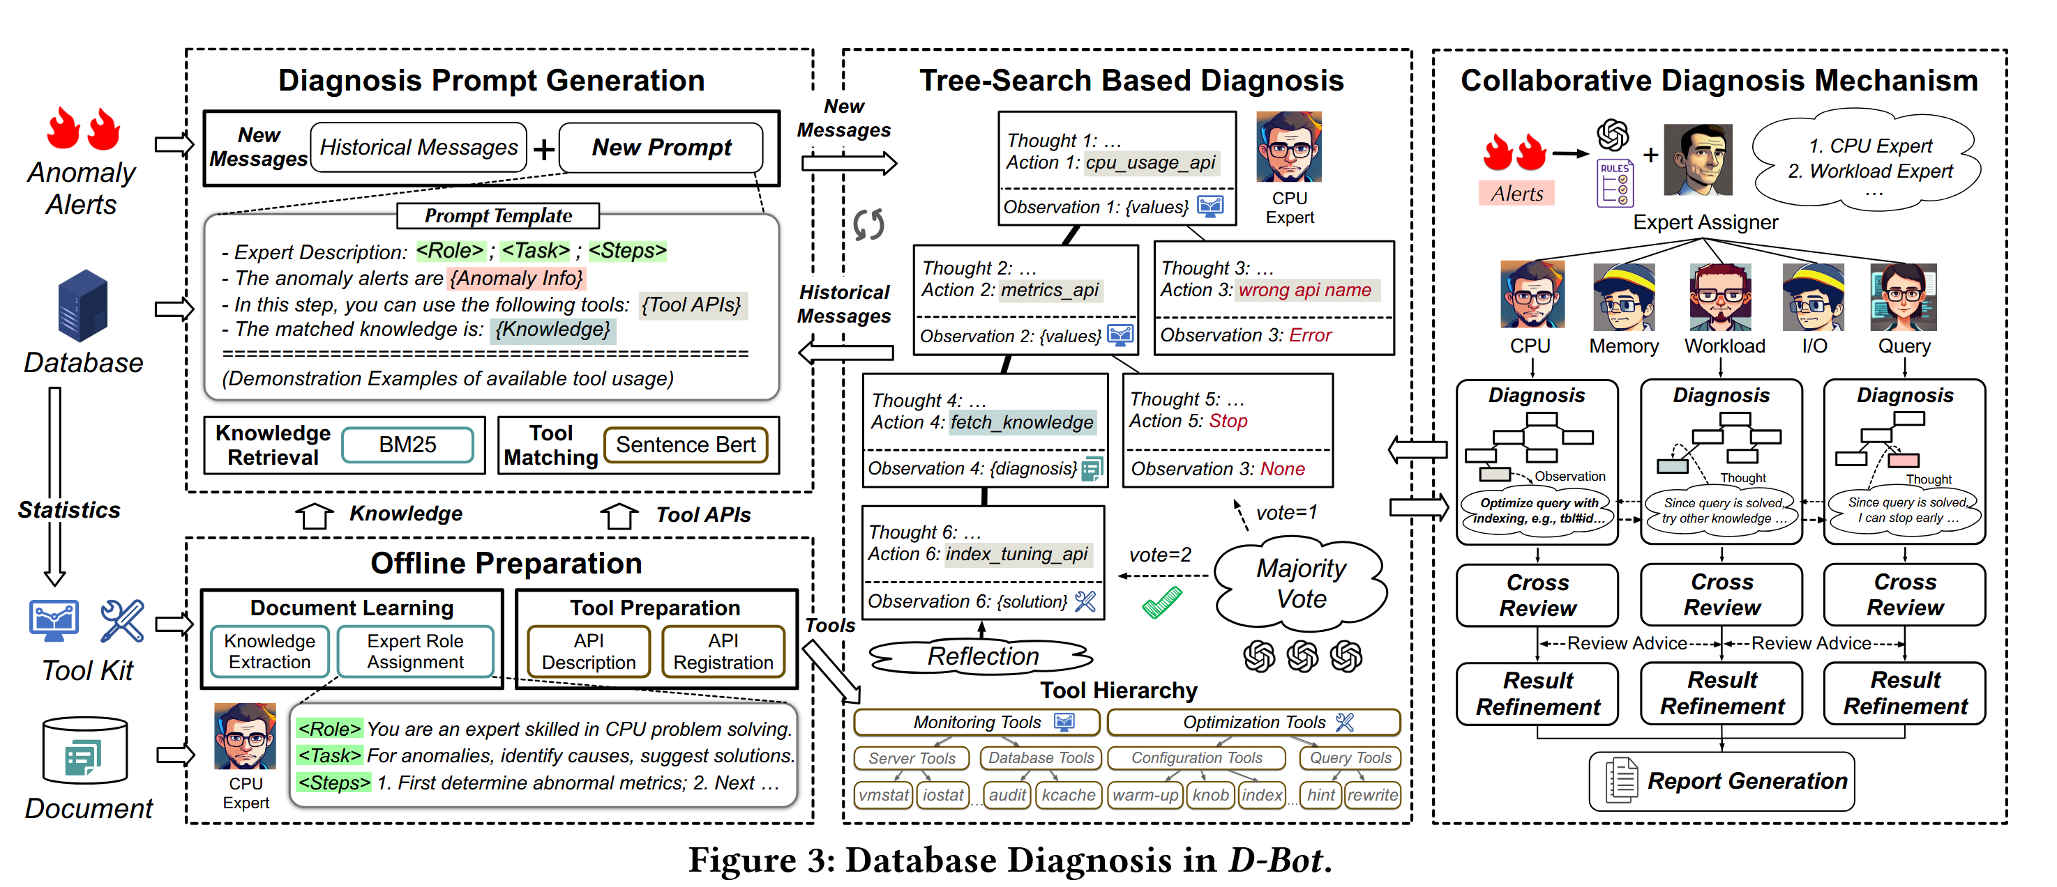
Overview
Offline Preparation.
Diagnosis Prompt Generation.
Tree-Search Based Diagnosis.
Collaborative Diagnosis Mechanism.
Notes:
离线准备
提示词构建
树状搜索诊断
多智能体协作

Slide 13
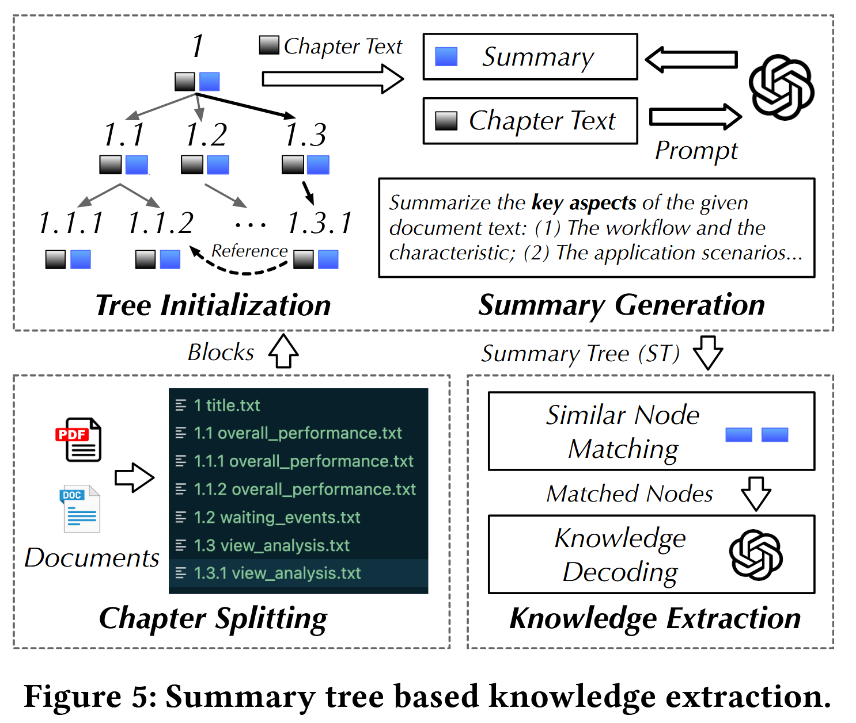
Offline Preparation
Document Learning
Knowledge Format: Name, Content, Metrics, Steps.
Knowledge Extraction: 1) Chapter Splitting, 2) Summary Tree Construction, 3) Knowledge Extraction.
p_summarize = “Summarize the provided chunk briefly · · · Your summary will serve as an index for others to find technical details related to database maintenance · · · Pay attention to examples even if the chunks cover other topics.”
Tools Preparation
Structured hierarchy - “categories-tools-APIs”
Utilization specification
Notes:
规定了知识的格式：异常名字，异常描述，相关度量指标，分析步骤。
对文档知识的抽取，首先按照章节拆分，然后对每一个章节建立一个索引，最后对相似章节进行合并。
工具这边是对工具进行分级，检测工具这边更多的是查询统计信息。

Slide 14
Diagnosis Prompt Generation
Each prompt integrates five main parts:
(i) Role description, which outlines the expertise and duties of the LLM.
(ii) Anomaly description that provides the details of triggered alerts (e.g., occurring time, anomaly summary, severity level).
(iii) Diagnosis tools (e.g., monitoring, indexing, query optimization) matched to the diagnosis context through a fine-tuned Sentence-BERT model.
(iv) Knowledge chunks pinpointed with keyword search methods (e.g., BM25).
(v) Historical message that supply essential background information (e.g., previous tool calling results) to aid the following tree-search-based diagnosis.
Notes:
Prompt 包括五个部分：
LLM的角色任务推理过程，对异常的描述，相关的诊断工具（由一个微调的模型推荐），相关的知识（由相似性算法搜索），历史信息。

Slide 15
Tree Search for LLM Diagnosis
Step 1: Tree Initialization
Build a search tree with an Action Input root node, including task objectives, domain knowledge (e.g., diagnosis steps), and available tool APIs.
Guides the LLM to explore actions and expand tree nodes.
Step 2: Tree Node Scoring
Evaluate leaf node benefit scores based on three metrics:
Instant Benefit: Derived from workload cost reduction after applying solutions in the database; zero if no solution exists.
Long-term Benefit: Assessed by knowledge-augmented LLM via voting, considering task proximity, performance, and efficiency.
Selection Frequency: Calculated as the maximum ancestor selection count + 1.
Overall scores are computed using the UCT formula.
Notes:
构建树状的思考链，首先构建异常状况的提示词给到LLM，生成初步分析结果，作为思考的起点。
对于不同的叶节点，从三个维度打分，
带有解决方案的根据解决方案的提升效果打分，否则为0，
其他智能体投票打分，
祖先节点选择频次。

Slide 16
Tree Search for LLM Diagnosis
Step 3: Tree Node Generation
Expand child nodes from the highest-scoring leaf node via four sub-steps:
Action Generation: LLM generates a new action message.
Action Validation: Check format (Thought / Action / Action Input); retry up to 3 times if invalid.
Node Creation: New node stores parent state, LLM message, and execution/knowledge result.
Tree Expansion: Attach the new node as a child and update the search tree.
Step 4: Existing Node Reflection
LLM re-evaluates action benefits along the root-to-selected path.
Useless nodes are marked for pruning to improve efficiency.
Step 5: Terminal Condition
Repeat Steps 2–4.Terminate after a fixed number of non-improving iterations (e.g., 20 steps).
Output root causes and solutions from the highest-scoring leaf node.
Notes:
从得分最高的叶结点中扩展子节点：大模型根据携带历史信息的 prompt 产生输出，验证输出是否符合格式，建立节点，保存结果。
利用大语言模型（LLM）重新评估执行该输出的收益。
被判定为不包含有效信息的节点将被标记为 “待剪枝”。
重复上面的步骤，输出得分最高的节点内容。

Slide 17
Collaborative Database Diagnosis
Step 1: Expert Preparation
Initialize 7 LLM experts based on knowledge clustering.
Each expert is assigned specialized knowledge and corresponding tools.
Step 2: Expert Assignment
Generate a structured anomaly description (time, alert type, severity).
An LLM-based assigner selects the most relevant experts (e.g., CPU Expert for high load, Memory Expert for OOM).
Step 3: Asynchronous Diagnosis
Selected experts perform diagnosis in parallel.
A publish-subscribe asynchronous mechanism enables efficient, non-blocking information sharing (metrics, tool outputs, findings).
Event-driven notifications allow experts to react to others’ analysis in real time.
Notes:
7个不同的专家，具备不同的领域知识。
将异常转化为结构化的描述，由LLM将异常分配给相关专家。
不同专家可以同步诊断，非阻塞式的信息共享，不同专家可以接收到其他专家的分析结果。

Slide 18
Collaborative Database Diagnosis
Step 4: Cross Review & Summarization
Incremental Message Summarization: LLM progressively condenses long diagnostic records into compact summaries to retain key information.
Review Advice: Experts review peers’ results and provide correction or improvement suggestions.
Diagnosis Refinement: Each expert revises conclusions, adds new inferences, and calls additional tools based on feedback.
Step 5: Report Generation
Generate a complete anomaly diagnosis report including:
Anomaly title, time, and description
Identified root causes
Recommended solutions
Summarized diagnosis process
Notes:
信息总结，同行评审，诊断反馈。
报告生成。

Slide 19
Experiment Results
Environment Setup
PostgreSQL 12.5
(i) the pg_stat_statements plugin for tracking frequent queries,
(ii) the hypopg plugin for creating hypothetical indexes.
LLM (temperature = 0)
GPT-4-0613
gpt-3.5-turbo16k
Ablation Methods
No Knowledge
No Tree Search
Single Agent

Slide 20
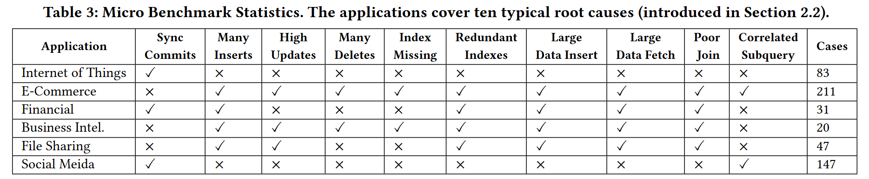
Experiment Results
Anomaly Distribution
There are 254 anomalies with single causes and 285 with multiple causes.
Single-cause anomalies mainly result from “Missing Indexes”. Other common causes include “Many Updates” and “Redundant Indexes”, pointing to widespread inefficiencies in database operations and data schemas.
Multi-cause anomalies are more diverse. The combination of “Sync Commits” and “Many Inserts” is the most frequent, occurring twice as often as any other combination like “Poor Join + Many Updates”.

Slide 21
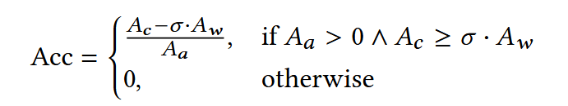
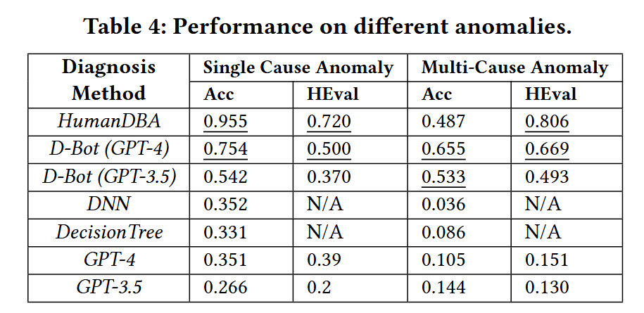
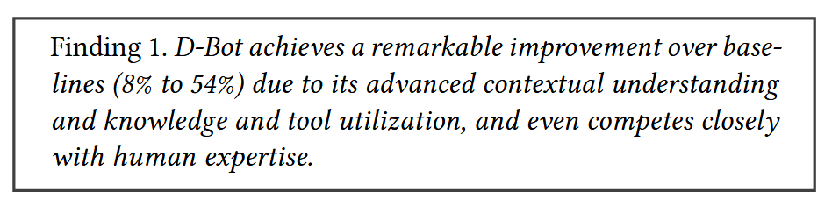
Experiment Results
Evaluation Metrics
Result Accuracy (Acc)
Ac denotes the number of correct causes, Aa denotes the total number of causes, Aw denotes the number of wrongly detected causes, and σ is a hyper-parameter with 0.1 as the default value
Human Evaluated Accuracy (HEval)
Ac’ in HEval denotes number of causes that (i) are correctly detected and (ii) the analysis process also makes sense (human evaluation).

Slide 22
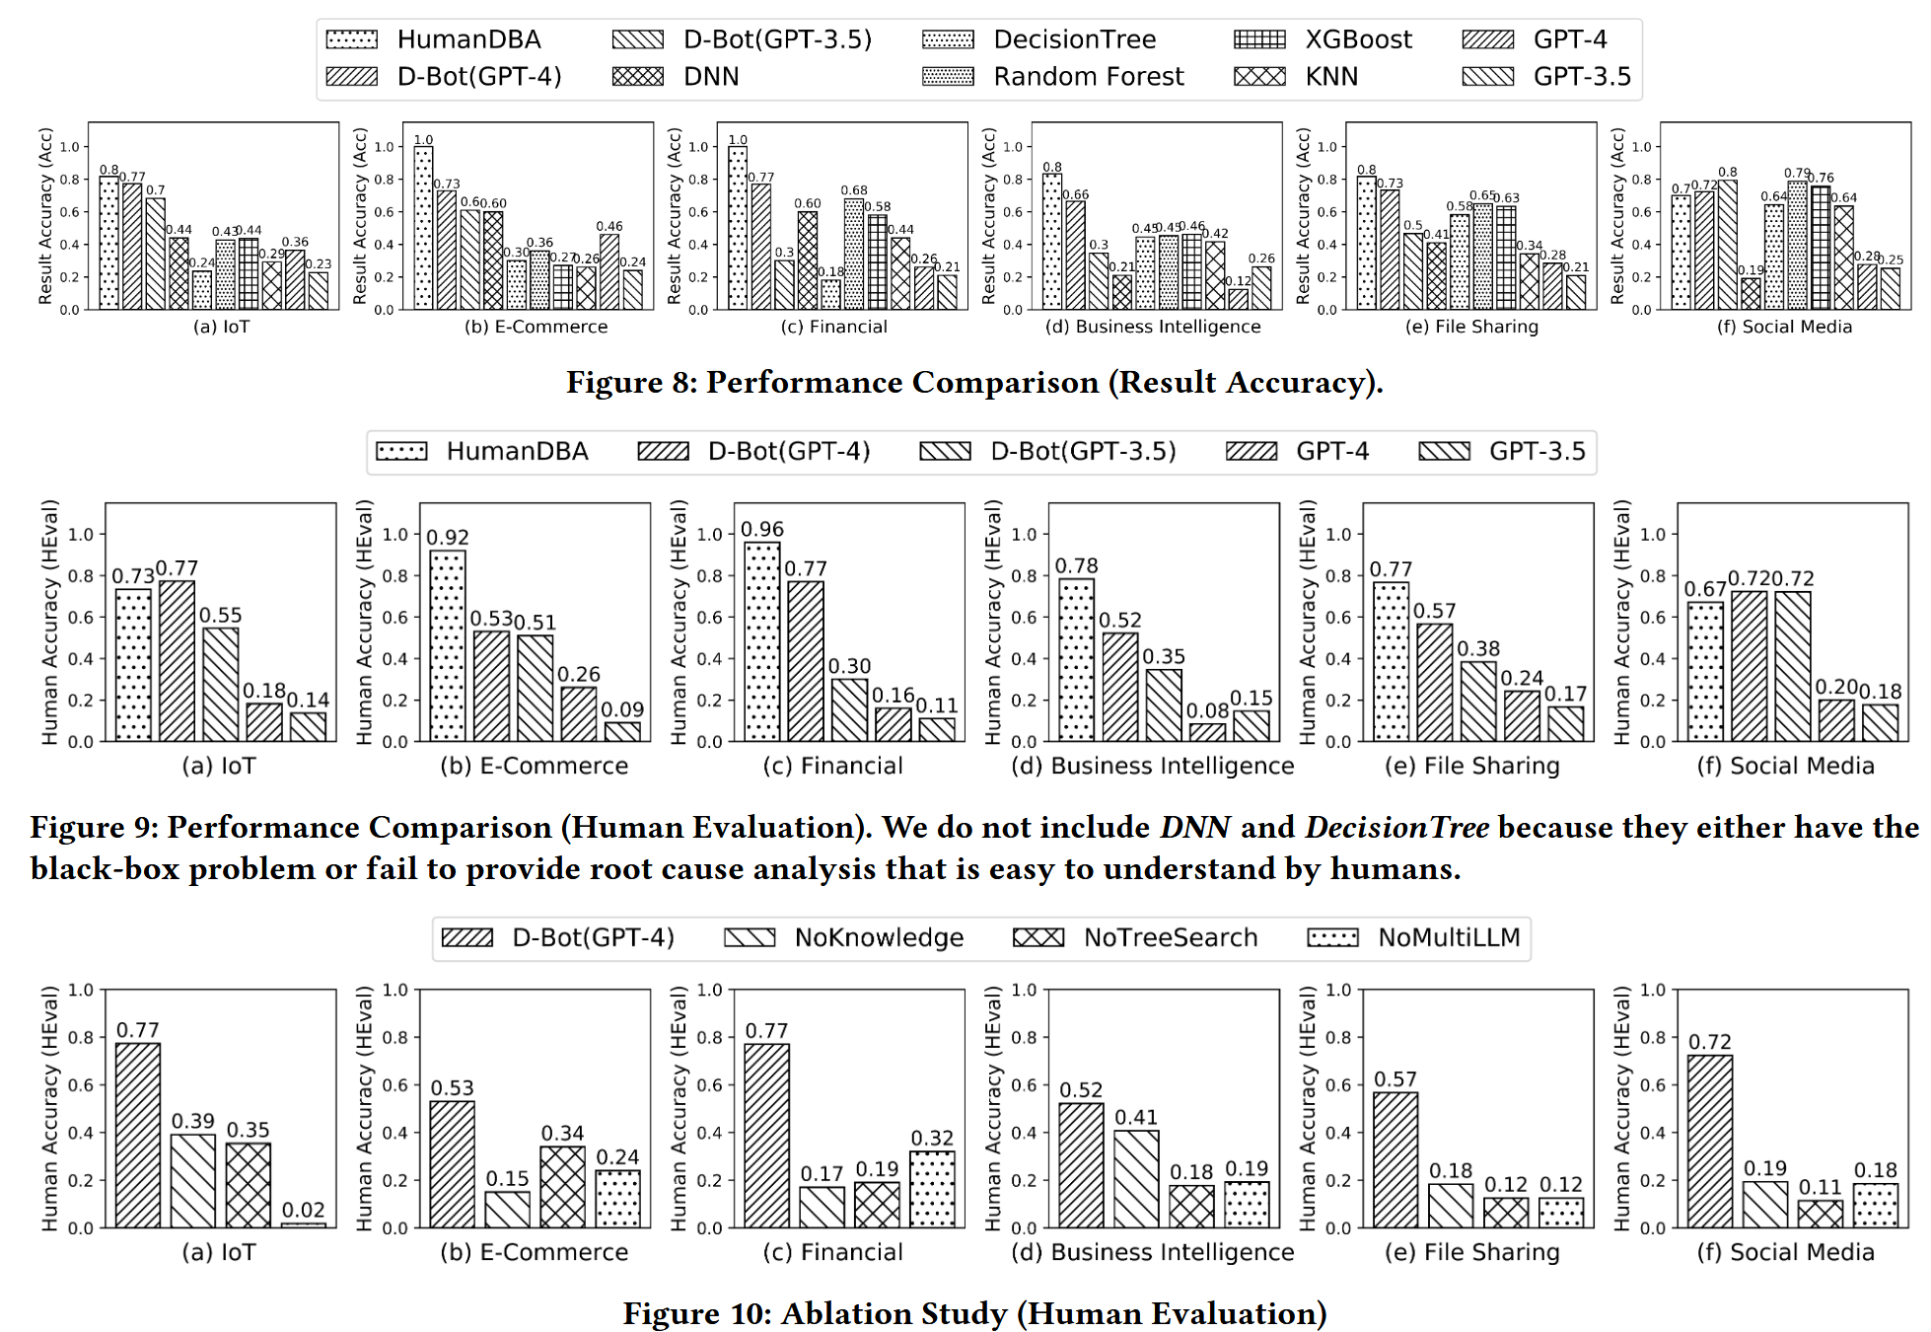
Experiment Results

Slide 23
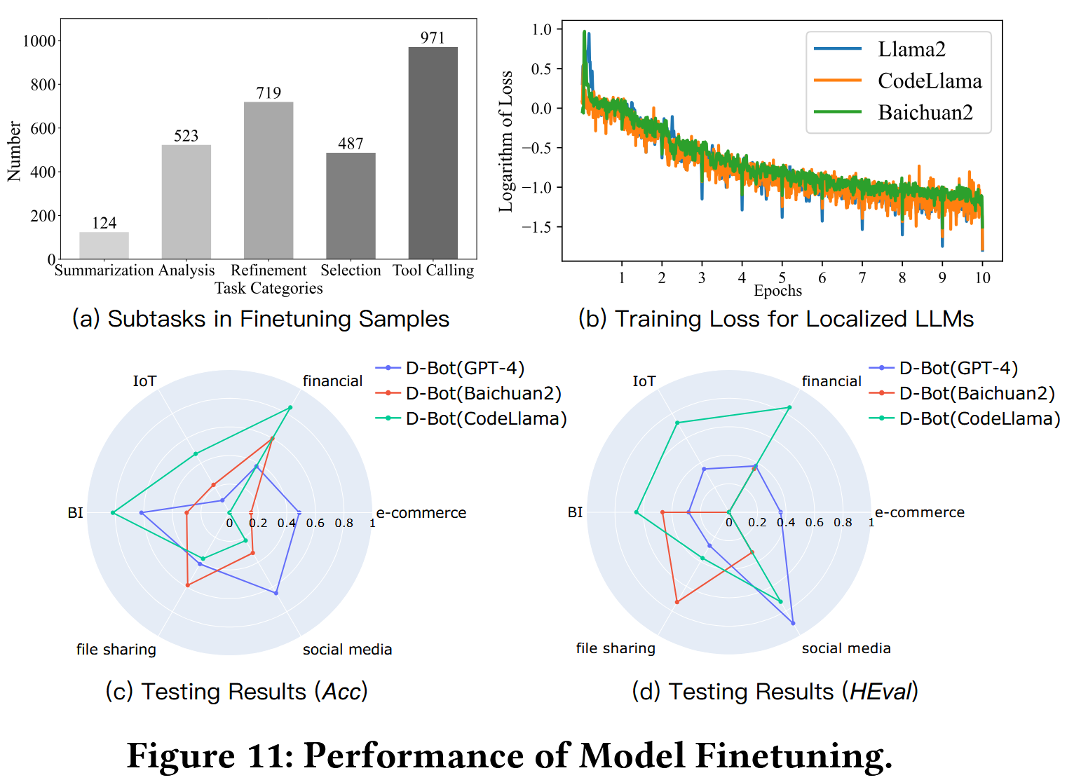
Experiment Results
Model Fine-tuning
Recording the diagnosis processes of D-Bot (GPT4) consisting of 5 sub-tasks (e.g., tool calling) and 2819 samples in total. We mix them together as a multi-task finetuning dataset.
LLM: Llama 2, CodeLlama, Baichuan 2
D-Bot using localized SOTA LLMs can achieve comparable diagnosis performance to D-Bot (GPT-4), but their generalizability is greatly affected by the fine-tuning samples.

Slide 24
Conclusion
This paper presents D-Bot, an LLM-based database diagnosis system.
D-Bot extract knowledge from documents and integrate tool APIs into LLM prompts for online reasoning.
A tree-search algorithm is proposed to locate root causes and generate solutions accurately.
A multi-LLM collaborative mechanism further boosts diagnostic efficiency.
Experiments show D-Bot outperforms baseline methods and human DBAs significantly.

