Slide 1

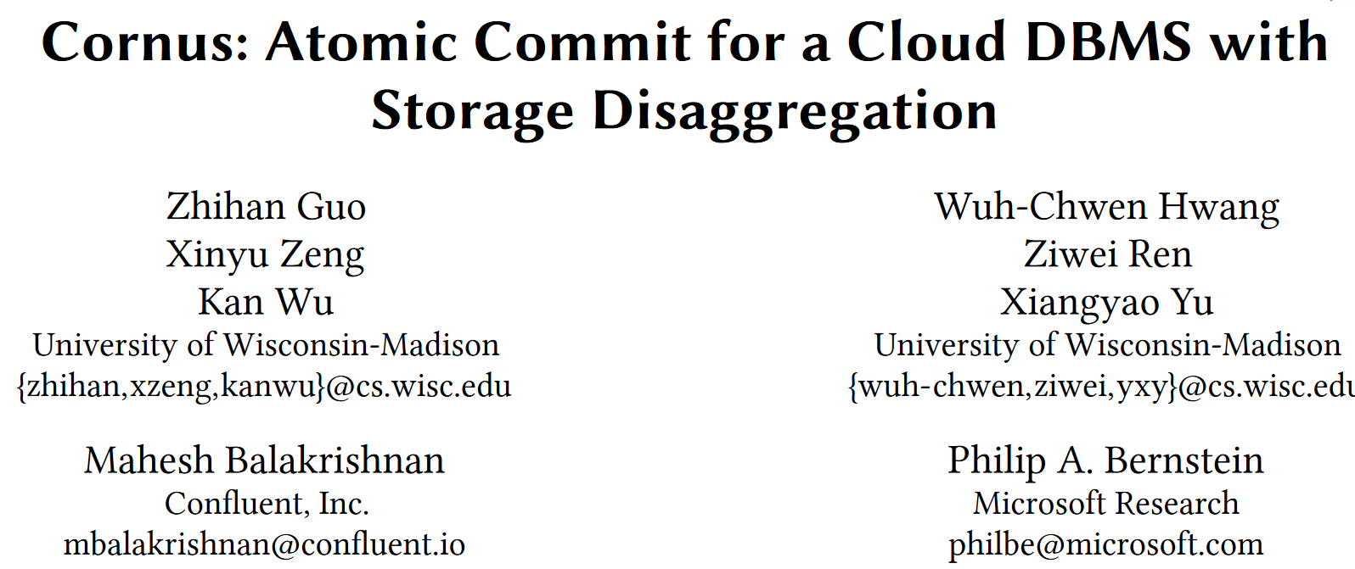

Slide 2
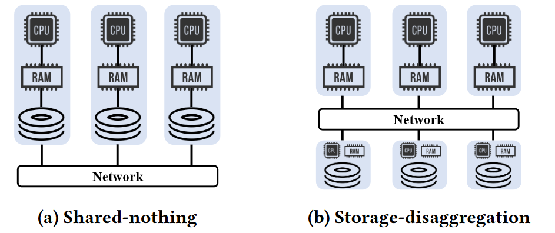
INTRODUCTION
Background
Modern cloud-native databases feature a storage-disaggregation architecture where the storage is decoupled from computation as a standalone service.
QUESTION
What is the minimal requirement from the storage layer to enable 2PC optimizations addressing high latency and blocking?

Slide 3
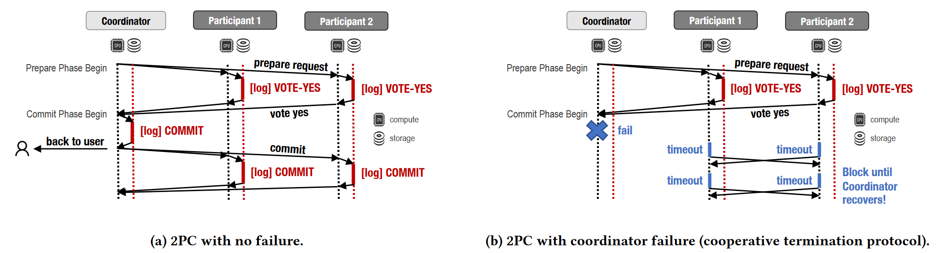
INTRODUCTION
Problem
Long latency: 2PC requires two round-trip network messages and associated logging operations.
Blocking: Blocking occurs if a coordinator crashes before notifying participants of the final decision.

Slide 4
INTRODUCTION
Existing Solution
Some techniques proposed optimizations target the shared-nothing architecture through:
reducing latency by making strong assumptions about the workload and/or system;
mitigating the blocking problem by adding an extra phase.
Other researches address both problems through customizing the storage, including:
Paxos Commit, TAPIR, MDCC and parallel commit in CockroachDB.

Slide 5
CONTRIBUTION
revisit the design of 2PC in the context of the novel storage-disaggregation architecture.
develop Cornus, an optimized 2PC protocol for the storage-disaggregation architecture, which reduces transaction latency during normal processing and alleviates the blocking problem.
deploy Cornus on practical storage services, Redis and Azure Blob, and show up to a 1.9× speedup in latency.

Slide 6
DESIGN
Feature
Disaggregated storage enables the optimizations in Cornus as it has the following features:
A disaggregated storage service has built-in data replication to support high availability.
A disaggregated storage service can be accessed by all the participants.
A disaggregated storage service can support limited computation tasks beyond basic reads and writes.

Slide 7
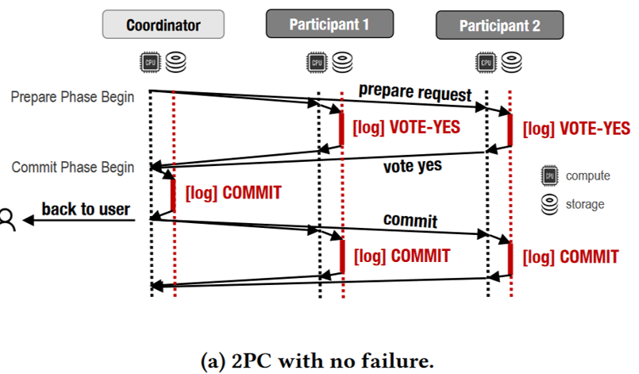
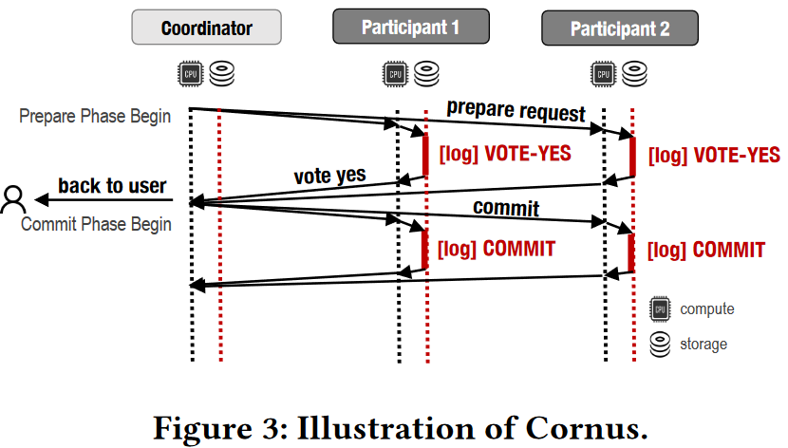
DESIGN
Latency reduction
The coordinator no longer needs to log the decision.
Non-blocking
If a participant is uncertain about the transaction’s outcome, it can read the votes of all participants to learn that outcome.

Slide 8

DESIGN
API
Remote Procedure Calls (RPC):
communication between participants (supported by Feature #2).
Log(txn, type*):
Log function appends a log record of a certain type to the end of transaction txn’s log.
Type: VOTE-YES, COMMIT, or ABORT.

Slide 9
DESIGN
API
LogOnce(txn, type):
LogOnce function guarantee that a transaction’s state can be written at most once (supported by Feature #3).
It atomically checks if a log record already exists for txn, and if not assigns type to the record.
It returns the state of txn after performing the atomic operation.

Slide 10
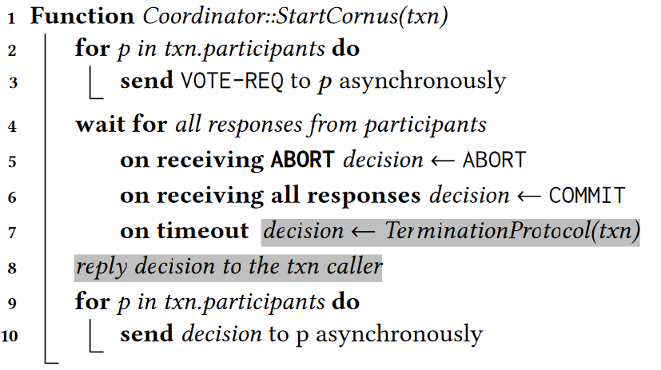
DESIGN
Protocol：Coordinator::StartCornus(txn)
The coordinator sends out vote requests to all participants.
If it receives an ABORT, the transaction reaches an abort decision; otherwise reaches an commit decision(without logging).
If it times out, it invokes the termination protocol to finalize a decision.
the coordinator broadcasts the decision to all participants asynchronously.

Slide 11
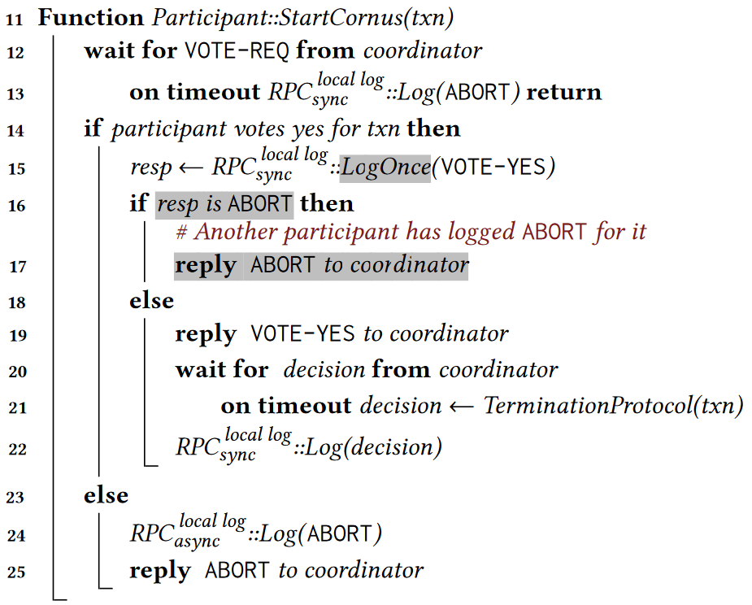
DESIGN
Protocol：Participant::StartCornus(txn)
The participant logs the record using LogOnce().
Return the result of LogOnce().
Waiting for coordinator if vote YES. If it times out, it invokes the termination protocol to finalize a decision.

Slide 12
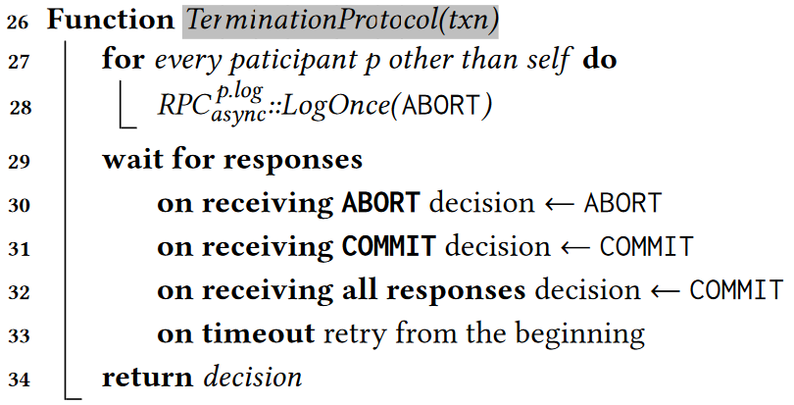
DESIGN
Protocol：TerminationProtocol(txn)
A participant executes the termination protocol when it times out while waiting for a message and cannot unilaterally abort the transaction.
It will try to abort all participants. Abort operation will fail if:
Some participants has reached COMMIT phase(line 31);
All participants voted YES(line32).
Parse | Type(COMMIT) | Type(ABORT)
prepare | VOTE-YES | VOTE-YES/ ABORT
committing | VOTE-YES/COMMIT | VOTE-YES/ ABORT
commit | COMMIT | ABORT

Slide 13
DESIGN
Failure：Coordinator Failure
 | Requesting vote | Sending decision | Solution
Case1 | None | None | All participants can unilaterally abort the transaction locally.
Case2 | Some | None | The participants that received the request will abort transaction by termination protocol while time out.
Case3 | All | None | All participants run the termination protocol to learn the final outcome and act accordingly.
Case4 | All | Some | Participants time out waiting for the decision run the termination protocol to learn the final decision.
Case5 | All | All | No effect.

Slide 14
DESIGN
Failure： Participant Failure
 | Prepare Phase | Solution
Case1 | Before receiving the vote request | Coordinator aborts the transaction by termination protocol while time out waiting for response.
Case2 | Before logging its vote | Same as above.
Case3 | Before replying to the coordinator | The coordinator run the termination protocol to learn the final outcome from the storage.
Case4 | After sending out the vote | No effect.

Slide 15
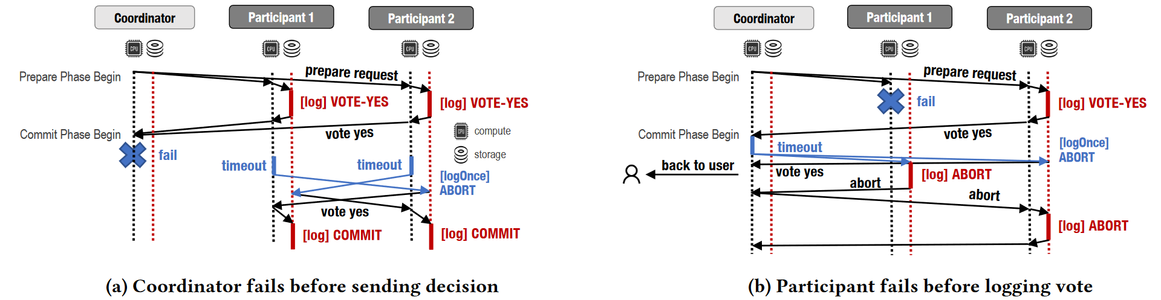
DESIGN
Failure

Slide 16
DESIGN
Read-Only Transactions
If a transaction issues only read requests to one participant, this participant does not need to log during the prepare phase and can directly release locks.
Multiple Responses(future work)
After a participant’s vote is logged in the storage layer, the response can be sent to both the requesting participant(1) and the coordinator(2), or be even broadcasted to all participants.
(2)
(1)

Slide 17
EVALUATION
Setup
8 servers on Microsoft Azure(8C64G).
The servers are connected by a 12.5 Gbps Gigabit Ethernet(0.5ms for a network round trip).
Two cloud storage services: Azure Blob(geo-distributed) and Redis(same region).
Workload
YCSB (with uniform data distribution)
Notes:
Pgbench是pg提供的一款测试工具，内置tpcb，tpcb比较简单，包含一个读写case（没有delete）和一个纯读case
the one-phase commit protocol not only reduces the overhead of communication between the coordinator and segments, which exists in two-phase commit protocol, but also could eliminate unnecessary CPU cost on segments which in fact does not insert any tuple.

Slide 18
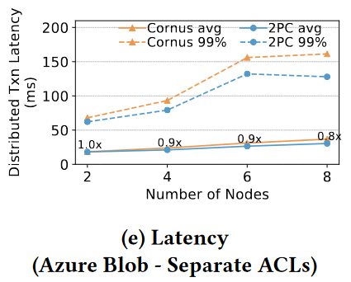
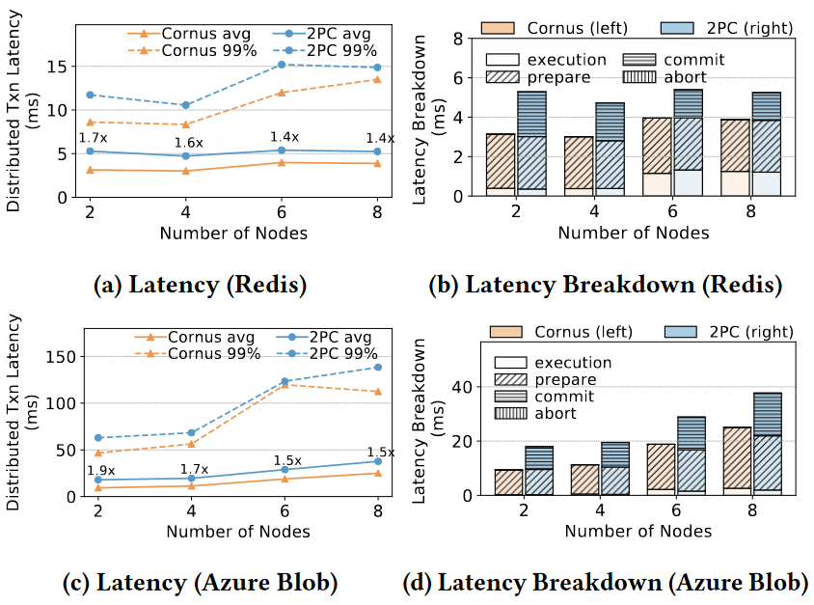
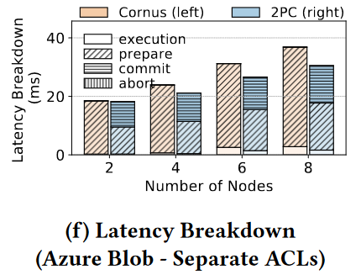
EVALUATION
Scalability
Notes:
As Azure Blob does not support batch updates of two resources with separate access control, we implemented two versions. In the second version, we use separate ACLs for data and states so that two requests should be used in LogOnce(). Profiling shows that the second version increases the time for LogOnce() from an average of 10.40 ms to an average of 18.43 ms.

Slide 19
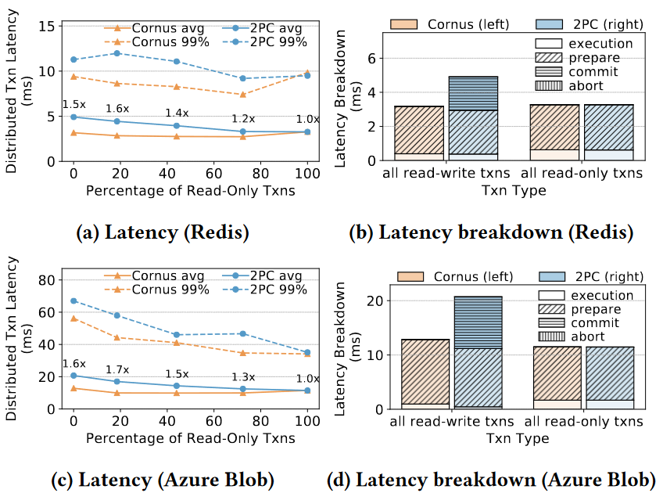
EVALUATION
Read-only Transactions
Notes:
both Cornus and 2PC omit the prepare and commit phases for read-only transactions
Cornus to obtain a latency speedup only for read-write transactions

Slide 20
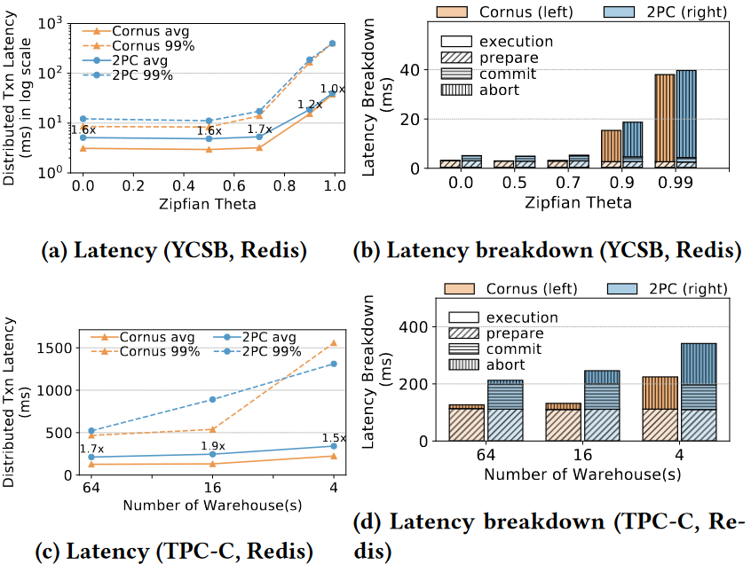
EVALUATION
Contention
Notes:
both Cornus and 2PC omit the prepare and commit phases for read-only transactions
Cornus to obtain a latency speedup only for read-write transactions

Slide 21
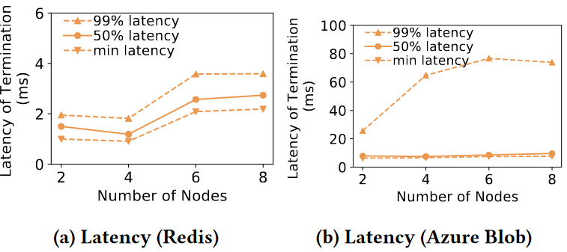
EVALUATION
Time of Terminate Protocol
Notes:
The tail latency of Azure Blob increases more than Redis as the number of nodes increases. This is due to the geo-distribution setup and some synchronous replication in Azure.

Slide 22
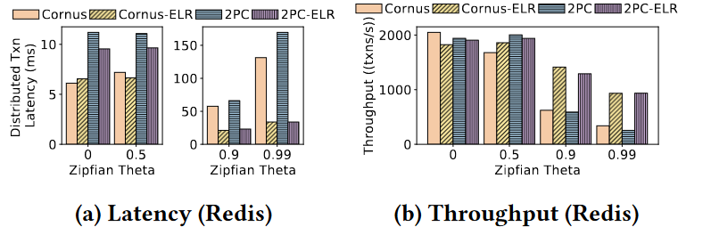
EVALUATION
2PC Optimizations: Early read
This optimization assumes that a transaction entering the prepare phase is unlikely to abort due to system crashes.
Therefore, a transaction can allow others to read its pre-committed data while waiting for the log to be persistent.
Notes:
ELR can significantly improve both 2PC and Cornus, particularly when workload contention is high.

Slide 23
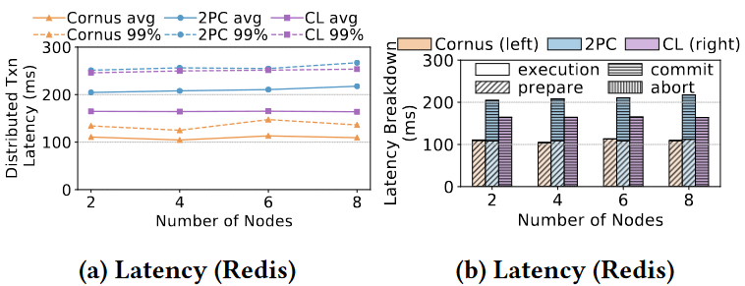
EVALUATION
2PC Optimizations: Coordinator Log
This optimization is to let the coordinator log on behalf of all participating nodes so that the transaction does not wait for other nodes to persist the logs.

Slide 24
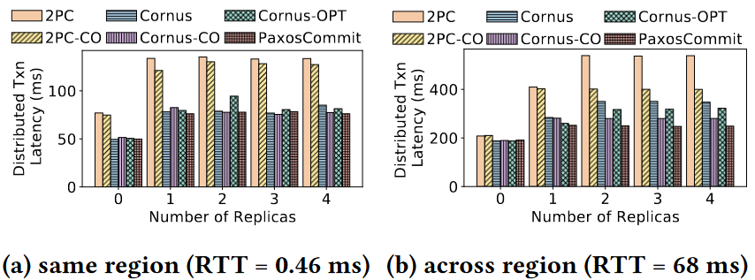
EVALUATION
Integration with Replication Protocol
For 2PC and Cornus, we assume each process runs an instance of Multi-Paxos in the underlying storage.
Notes:
Cornus (optimization) can save the latency of logging acknowledgment from Paxos leader to participant (0.5 RTT) by forwarding the message to the coordinator.
Cornus (co-location) and 2PC (co-location) represent the designs that co-locates a participant with the Paxos leader

