Slide 1

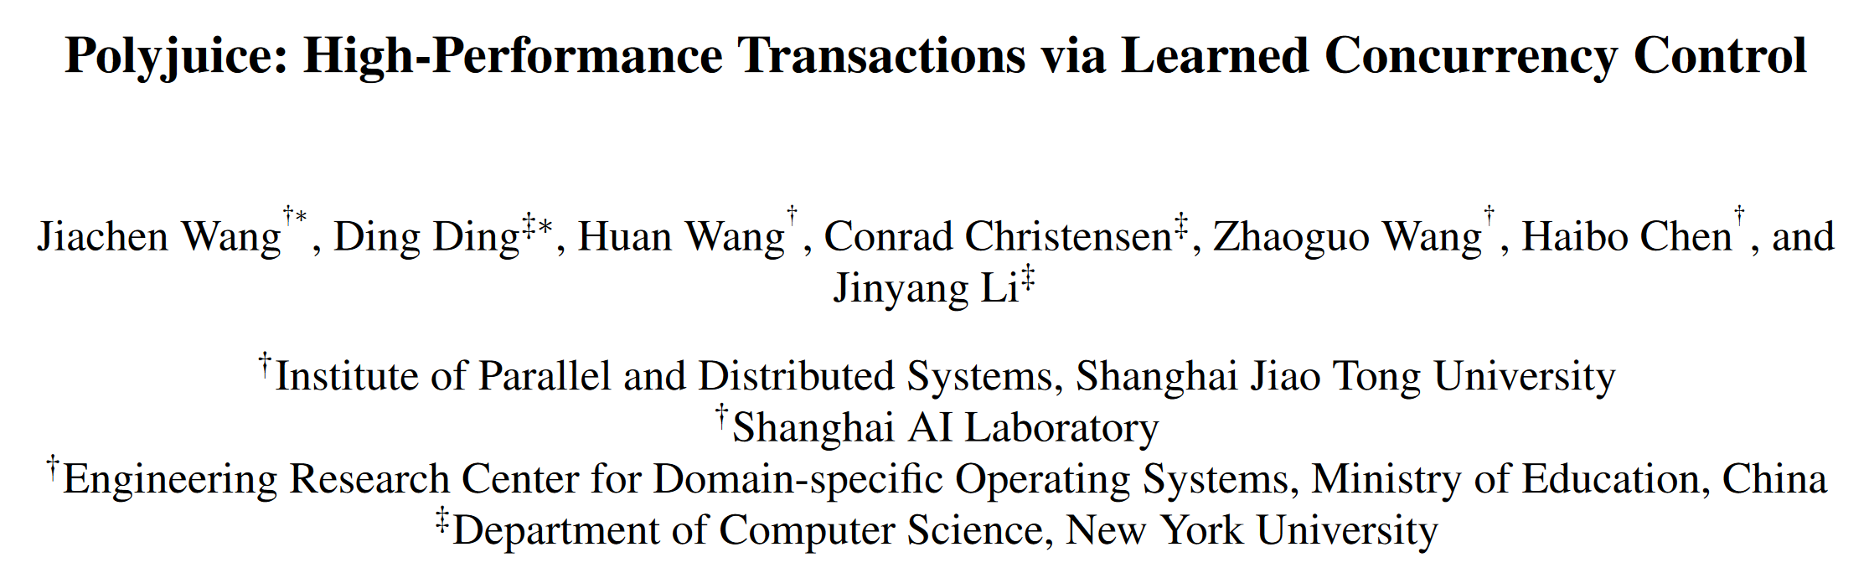

Slide 2
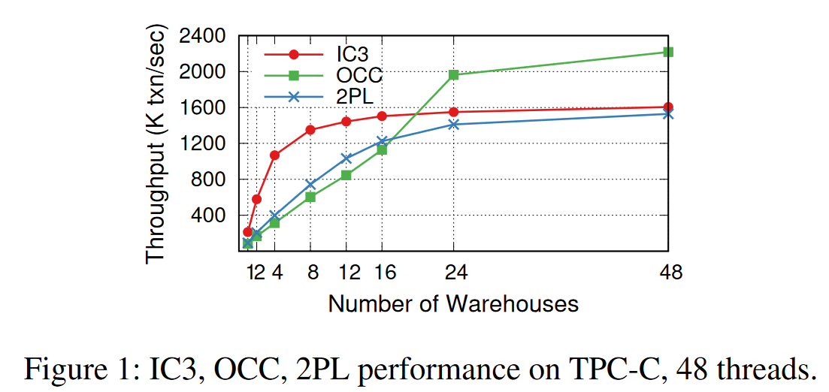
INTRODUCTION
BACKGROUND
A Concurrency control (CC) algorithm aims to maximize concurrent execution while guaranteeing correctness.
The relative performance of different CC algorithms varies depending on the transaction workload.
2PC: high contention
OCC: low contention

Slide 3
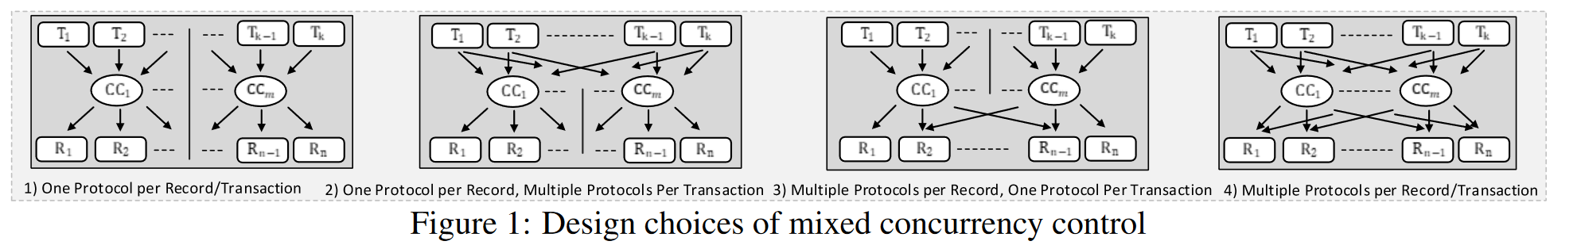
INTRODUCTION
BACKGROUND
To adapt to different workloads, prior works propose a federated approach based on a small number of existing CC algorithms.
They require users to partition the workload either by data or by transaction type.(The kinds of transaction are known a priori as stored procedures.)
2)D. Tang and A. J. Elmore, “Toward Coordination-free and Reconﬁgurable Mixed Concurrency Control”.
3)Chunzhi Su, et al. Bringing modular concurrency control to the next level. ICDE, pages 283–297, 2017.
Chao Xie, et al. High-performance acid via modular concurrency control. sosp, pages 279–294, 2015.

Slide 4
INTRODUCTION
LIMITATION OF CURRENT WORK
lacks the flexibility to customize concurrency control to fully exploit the workload.
lacks a systematic solution to optimize concurrency control for performance.

Slide 5
CONTRIBUTION
present the first framework to learn concurrency control using a policy space of fine-grained actions.
design Polyjuice’s policy space according to the framework so that it can encode a variety of existing CC algorithms while allowing the exploration of new ones.
show that Polyjuice’s policy, represented as a table, can be optimized simply using an evolutionary algorithm.

Slide 6
LEARNING FRAMEWORK
The key ingredients in RL are:
a policy that maps perceived states of the environment to actions to be taken when those states are reached.
——how its data access can interleave.
a reward signal that defines the optimization goal.
——maximize performance.
and the environment under which the learning system operates.
——the transaction workload and system setup under which the CC operates.

Slide 7
POLICY SPACE OF CC
Policy is a mapping from some state of execution to a specific action to take upon encountering that state.
control how the data access of concurrent transactions can interleave during transaction execution;
control when and how to perform validation in order to detect whether an executed transaction has violated serializability.

Slide 8
POLICY SPACE OF CC
Read control
Wait: whether wait until dependent transaction commit?
Read version: what data version should read?
Write control
Wait: ⬆
Write visibility: when can other transactions read this version?
Validation
When to validate: validate early, abort early.
How to validate: whether to use each transaction’s commit-timestamp?

Slide 9
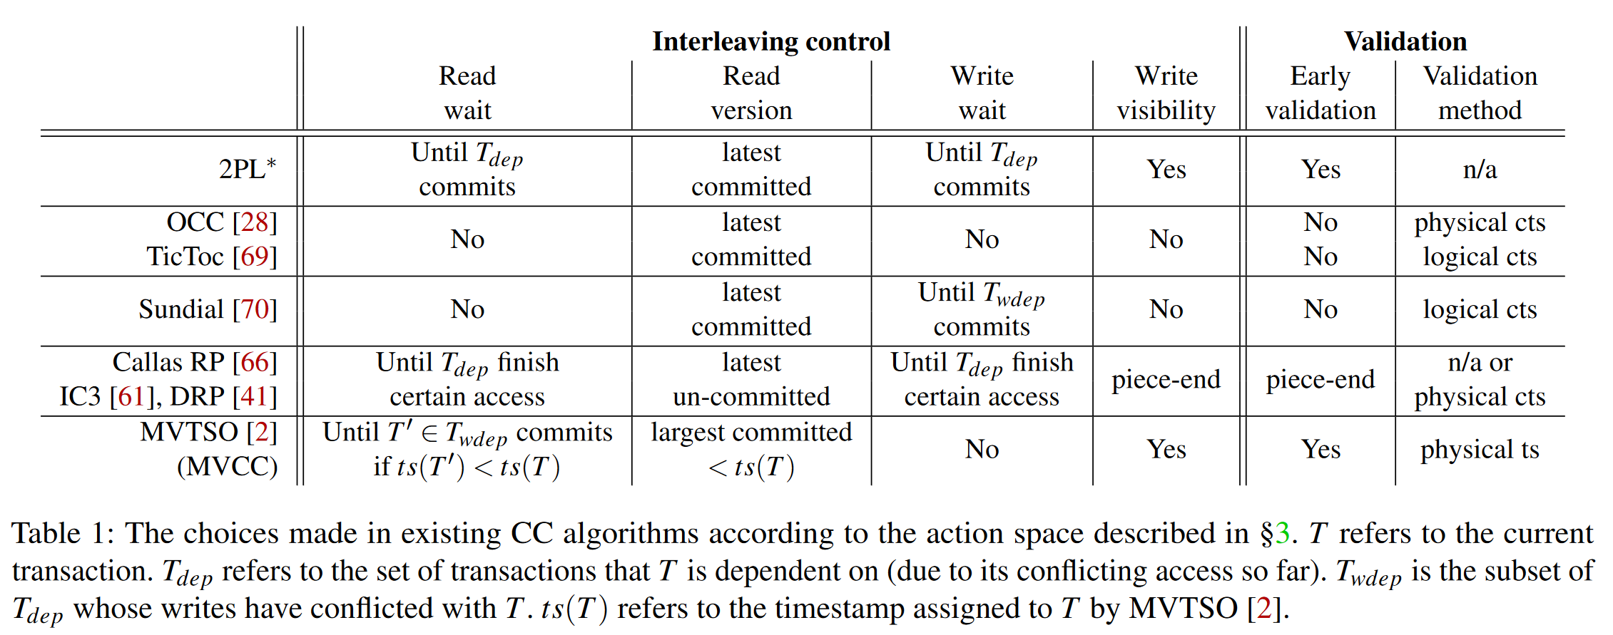
POLICY SPACE OF CC

Slide 10
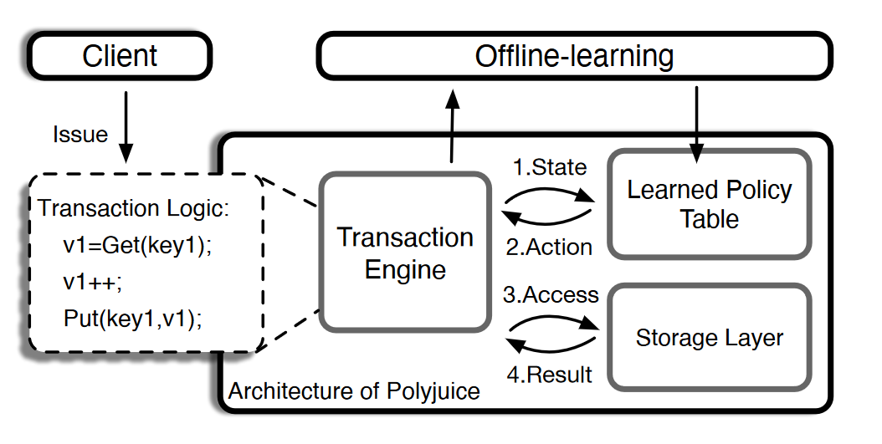
DESIGN
Architecture
Polyjuice is a multi-core in-memory database without multi-version support.
For each data object, Polyjuice stores the latest committed data as well as a per-object access list.
State X Action

Slide 11
DESIGN
CC policy
State space
The type of the transaction being executed.
Which access of the transaction is being executed.
Action space
Wait. How long should read/write be?
Read-version. CLEAN_READ (committed version) / DIRTY_READ (uncommitted (but visible) version)
Write-visibility. Keep write results PRIVATE/PUBLIC.

Slide 12
DESIGN
Validation
waits for all T ’s dependent transactions to commit (or abort).
locks each record in T ’s write set
validates each record in the read set by checking two conditions;
whether the current committed version in the database is different from that kept in the read set.
whether the record is being locked by another transaction.
Abort if meets one of these conditions.
applies T ’s writes to the database and releases the locks.

Slide 13
TRAINING
Evolutionary Algorithm
Evolutionary Algorithm mutates each cell of CC policy table independently with probability p.
For binary choices (read-version or write visibility), the mutation flips the choice.
For integer choices (e.g. any of the wait actions), the mutation varies the integer value by some distance uniformly sampled from the interval [−λ, λ].

Slide 14
TRAINING
Reinforcement Learning
It parameterizes the policy table by representing each table cell using one or a set of parameters to denote the probability distribution of the action values.
For training, each iteration samples a batch of policies according to the probability distribution specified by the current table parameters.
We measure the throughput of each sampled policy and use it as the “reward” in RL.

Slide 15
TRAINING
Real-world Training
Many real-world workloads are fairly predictable on a day-to-day basis.
The goal is to use Polyjuice to improve commit throughput during the peak time.
One can predict tomorrow’s peak workload characteristics using the statistics gathered from today’s peak workload

Slide 16
EVALUATION
Setting
Hardware
56-core Intel machine with 2 NUMA nodes.
Each NUMA node has 28 cores and 188GB memory.
Benchmark
TPC-C/TPC-E/micro-benchmark with 10 types of transactions.
Baseline
OCC (Silo) , 2PL , IC3, Tebaldi and CormCC

Slide 17
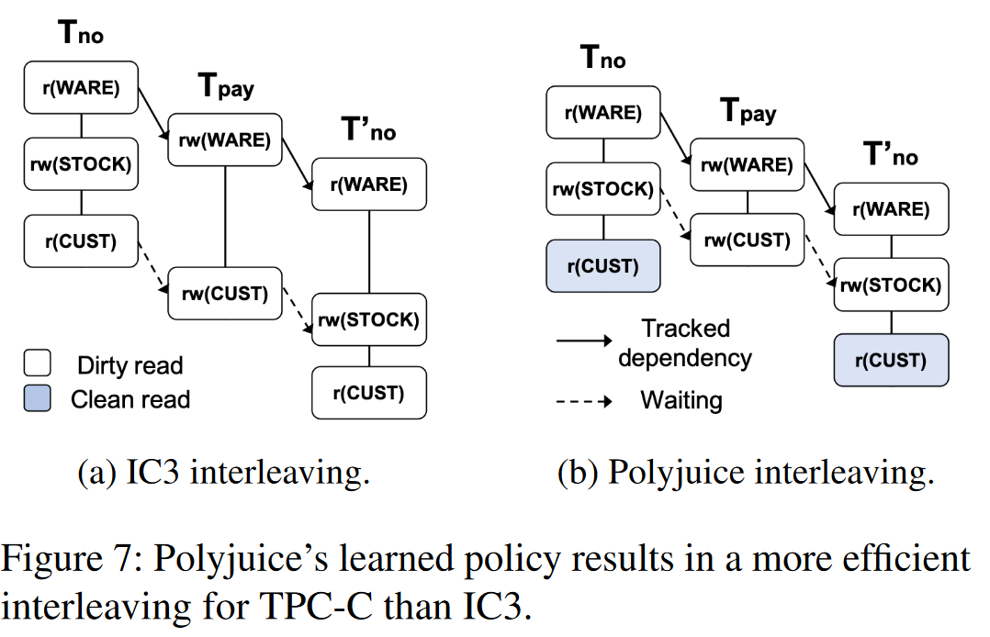
EVALUATION
Case Study
Tno (NewOrder), Tpay (Payment) and T ′ no (NewOrder).
All three access the same warehouse.

Slide 18
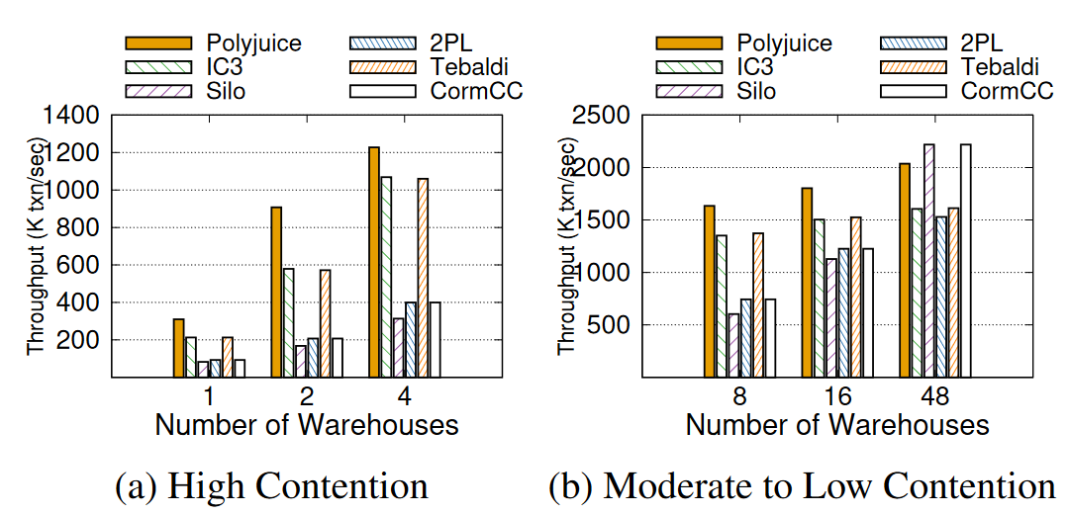
EVALUATION
Throughput(TPC-C)
avoid unnecessary waiting by the runtime information to infer the CC action.
can either read dirty or clean versions of data.
needs to maintain additional metadata in each tuple, which affects the cache locality.

Slide 19
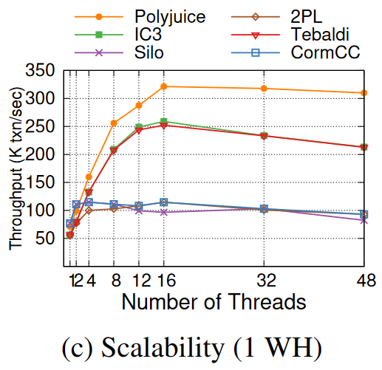
EVALUATION
Scalability(TPC-C)
Silo and 2PL do not scale beyond four threads because they cannot exploit parallelism under high contention.

Slide 20
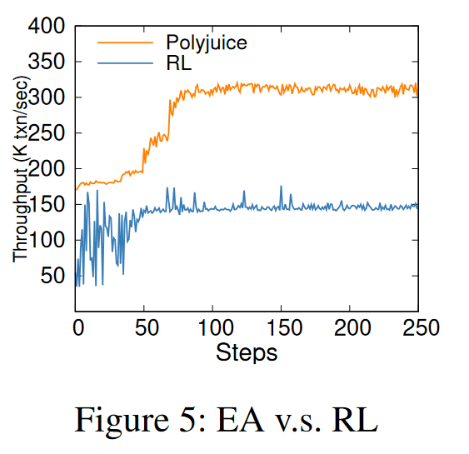
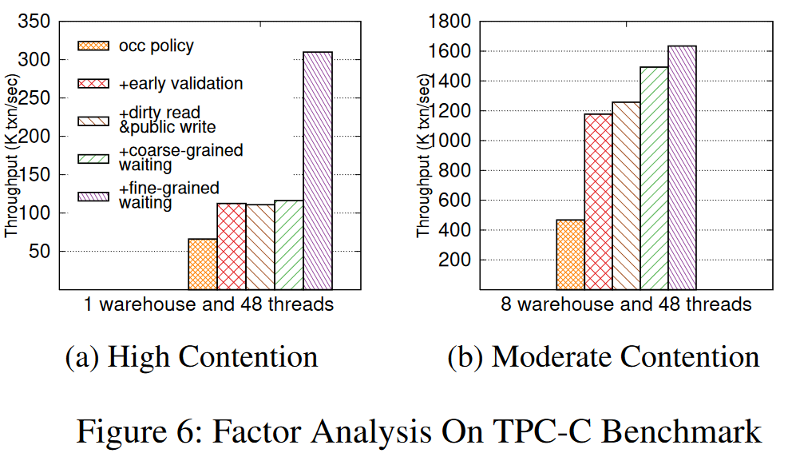
EVALUATION
Factor Analysis
RL works worse.
Each action has a different effect factor with different workloads.

Slide 21
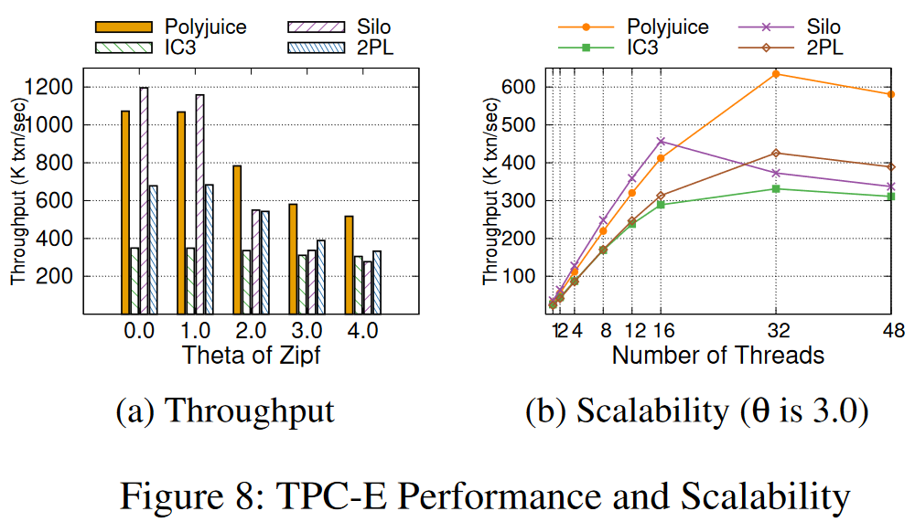
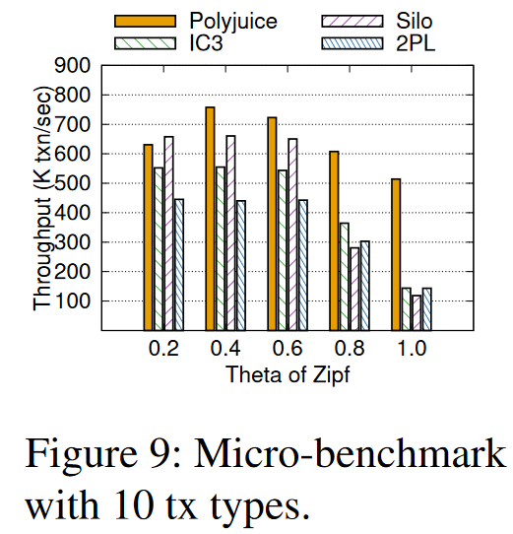
EVALUATION
Other Benchmarks
The learned policy pipelines the operations on some of the high-contention records while optimizing the waits for low-contention records.

Slide 22
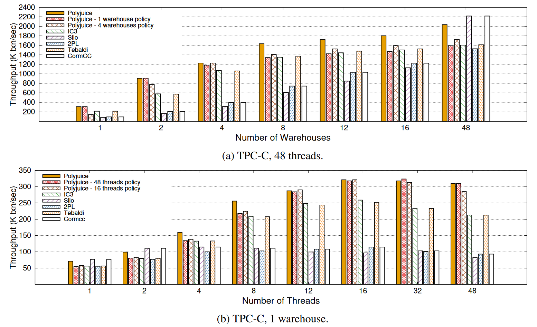
EVALUATION
Transportability
A trained policy is fairly robust to training and evaluation workload mismatch.

Slide 23
LIMITATION
Not suitable for rapidly changing workloads.
Training takes on the order of several hundred seconds.
Inaccurate workload emulation.
Transaction inter-leavings during training differ from that of the original execution, a transaction’s outputs also differ.
Large state space.
Number of states and actions increases the state space rapidly.
More expressive policy space.
MVCC, CPU scheduling and fine-grained contention expand the policy space.
Weaker and mixed isolation levels.
Polyjuice currently only guarantees serializability.

