Slide 1
An Evaluation of Distributed Concurrency Control
VLDB 2017
Paper authored by Rachael Harding et al.

Slide 2
What We’ll Cover
Introduction
Protocols Being Tested
Commitment Protocol
Test and Architectural Overview
Tests
Contention
Update Rate
Multi-Partition Transactions
Scalability
Network Speed
Distributed DBMS Bottlenecks
Potential Solutions

Slide 3
Introduction
◆ Evaluation of performance of protocols across various tests.
◆ Rise of Distributed Database Management Systems (DBMS)
◆ Data Partitioning
◆ Serializability
◆ Deneva
Deployed on Amazon EC2 with 8 virtualized CPU cores and 32 GB of
memory

Slide 4
Protocols Being Tested
Two Phase Lock (2PL)
NO_WAIT
WAIT_DIE
Timestamp Ordering
TIMESTAMP
Multi-Version Concurrency Control (MVCC)
Optimistic Concurrency Control (OCC)
Deterministic (CALVIN)

Slide 5
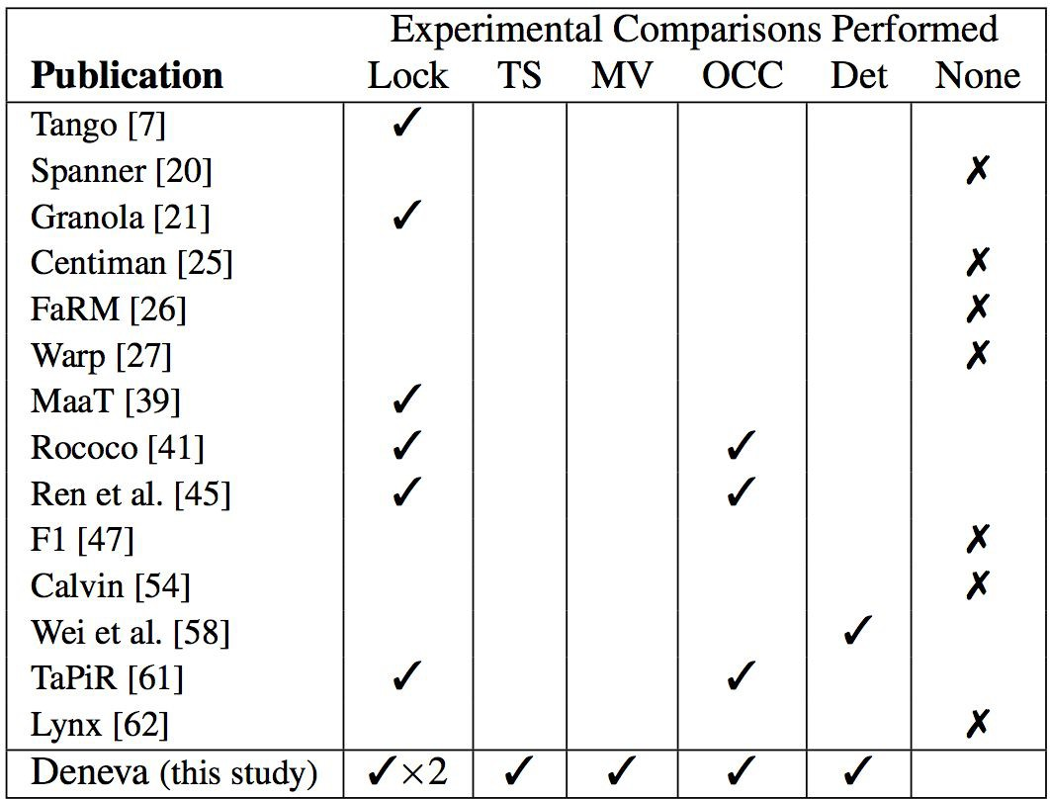
Note:
Lock-based implementations may be different
(e.g. deadlock detection/avoidance)

Slide 6
Two Phase Commit (2PC) Protocol
Coordinator
Participant
CloseTrans()
Execute
Precommit
Execute
not ready
ready
request
Abort
Send NO to coordinator
Uncertain
Send request to each participant
Wait for replies (time out possible)
Precommit
send YES to coordinator
Wait for decision
NO
YES
Timeout or a NO
All YES
COMMIT decision
ABORT decision
Abort
Send ABORT to each participant
Commit
Send COMMIT to each participant
Commit
Make transaction visible
Abort

Slide 7
Two-phase Locking (2PL)
Two phase
Growing phase: lock acquisition (no lock release)
Shrink phase: lock release (no more acquisition)
NO_WAIT
Aborts and restarts the transaction if lock is not available
No deadlocks (suffers from excessive aborts)
WAIT_DIE
Utilizes timestamp
Older transactions wait, younger transactions abort
Locking in shared mode bypasses lock queue (which contains waiting writers)

Slide 8
Timestamp Ordering (TIMESTAMP)
Executes transactions based on the assigned timestamp order
No bypassing of wait queue
Avoids deadlocks by aborting older transactions when they conflict with transactions holding records exclusively

Slide 9
Multi-version Concurrency Control(MVCC)
Maintain multiple timestamped copies of each record
Minimizes conflict between reads and writes
Limit the number of copies stored
Abort transactions that try to access records that have been garbage collected

Slide 10
Optimistic Concurrency Control (OCC)
Maintains time ranges for each transaction
Strong-coupling with 2PC
Validation by constraining the time range of the transaction

Slide 11
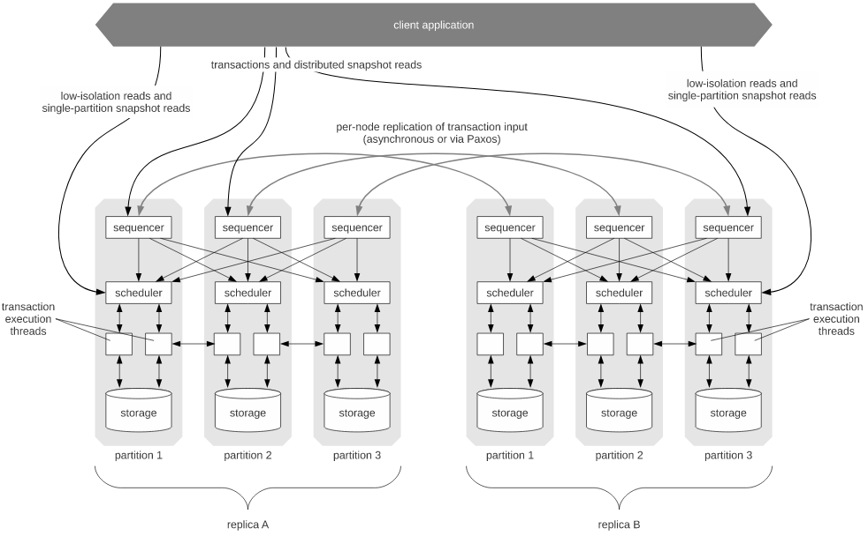
CALVIN
Sequencing layer
Scheduling layer
Storage layer
System Architecture Of CALVIN
[Paper] Calvin: Fast Distributed Transactions for Partitioned Database Systems
[ Blog ] Calvin, the Magic of Determinism
Notes:
Sequencer 负责副本复制，并在每 10ms 打包所收到的事务，发送到相应的 scheduler 之上；
Scheduler 负责执行事务并且确保确定性的结果；
Storage 是一个单机的存储数据库，只需要支持 KV 的 CRUD 接口即可。

Slide 12
CALVIN
The sequencing layer (sequencer) intercepts transactional inputs and places them into a global transactional input sequence—this sequence will be the order of transactions to which all replicas will ensure serial equivalence during their execution. The sequencer therefore also handles the replication and logging of this input sequence.
The scheduling layer (scheduler) orchestrates transaction execution using a deterministic locking scheme to guarantee equivalence to the serial order specified by the sequencing layer while allowing transactions to be executed concurrently by a pool of transaction execution threads.
The storage layer handles all physical data layout. Calvin transactions access data using a simple CRUD interface; any storage engine supporting a similar interface can be plugged into Calvin fairly easily.
Notes:
Sequencer 负责副本复制，并在每 10ms 打包所收到的事务，发送到相应的 scheduler 之上；
Scheduler 负责执行事务并且确保确定性的结果；
Storage 是一个单机的存储数据库，只需要支持 KV 的 CRUD 接口即可。
https://pingcap.com/zh/blog/transaction-frontiers-research-article-talk3

Slide 13
CALVIN
Calvin removes the need for 2PC by removing the nondeterminism caused by 2PL by replacing 2PL with a deterministic locking on each participant
By removing the nondeterminism Calvin avoids 2PC for distributed transactions
Calvin only support transactions in the form of stored procedures
The deterministic locking requires to know the whole read/write set of the transactions. Thus, supporting transactions that need to first read to figure out their final read/write set is challenging in Calvin.
Notes:
Sequencer 负责副本复制，并在每 10ms 打包所收到的事务，发送到相应的 scheduler 之上；
Scheduler 负责执行事务并且确保确定性的结果；
Storage 是一个单机的存储数据库，只需要支持 KV 的 CRUD 接口即可。
https://pingcap.com/zh/blog/transaction-frontiers-research-article-talk3

Slide 14
Tests Overview
◆ Only serializable executions are analyzed.
◆ Online Transaction Processing are done through thread-safe sockets over TCP/IP.
◆ No logging, checkpoint, and recovery.
◆ Table partitions are preloaded on servers.
◆ Each server will carry 10,000 open client connection.
◆ When a transaction aborts, it restarts after a penalized period.
◆ Deneva uses the concept of stored procedures to model transactions.
◆ Support for protocols (e.g., CALVIN) that require READ-SET and WRITE-SET to
be known in-advanced. DBMS needs to compute that in a simplest way,
run transaction without any CC measures.

Slide 15
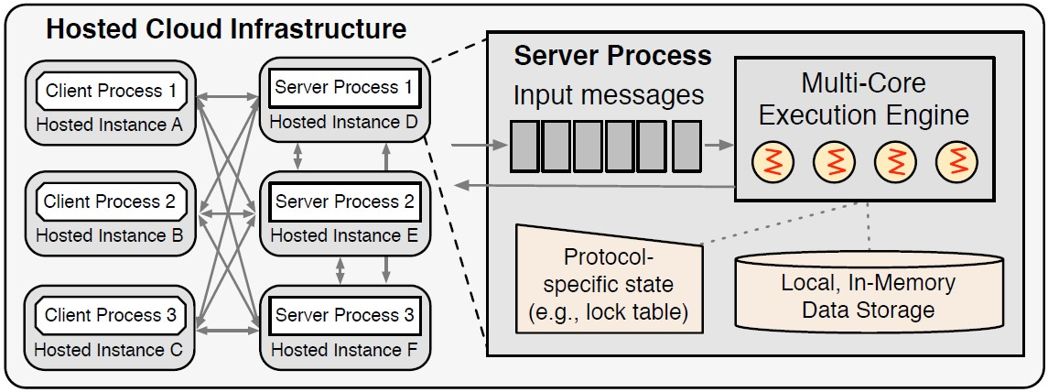
Architectural Overview
Each server can host more than one partition, but each partition exists only on one server.
Does not provide replication or fault tolerance.

Slide 16
TESTS

Slide 17
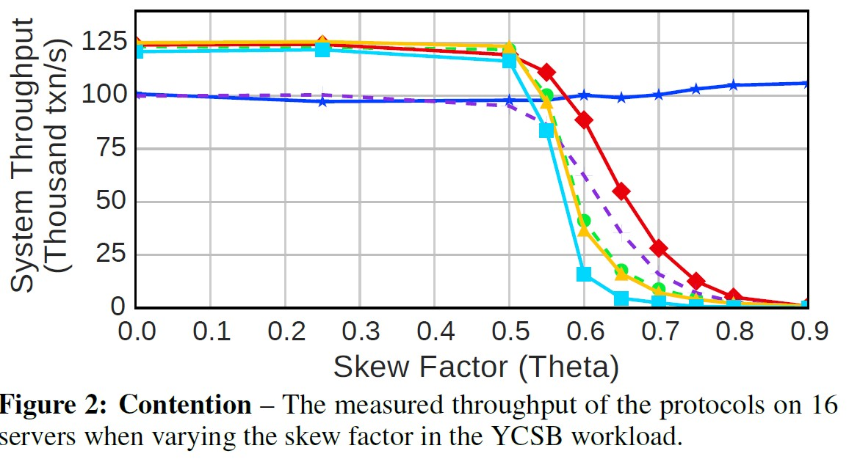
Contention

Slide 18
1. Contention
◆ CALVIN is initially bottlenecked because of thee single threaded schedulers, but it is the only protocol to maintain good performance despite high skew.
◆ This is because locks are released much quicker once the read data is made available.
◆ OCC performs badly under low contention due to the overheads of copy and validation even when chances of modifications are the least.
◆ However, at higher levels the benefit of tolerating more conflicts and thus
avoiding unnecessary aborts outweighs these overheads.
◆ The rest have a steep drop because of excessive wait times caused by data locks.

Slide 19
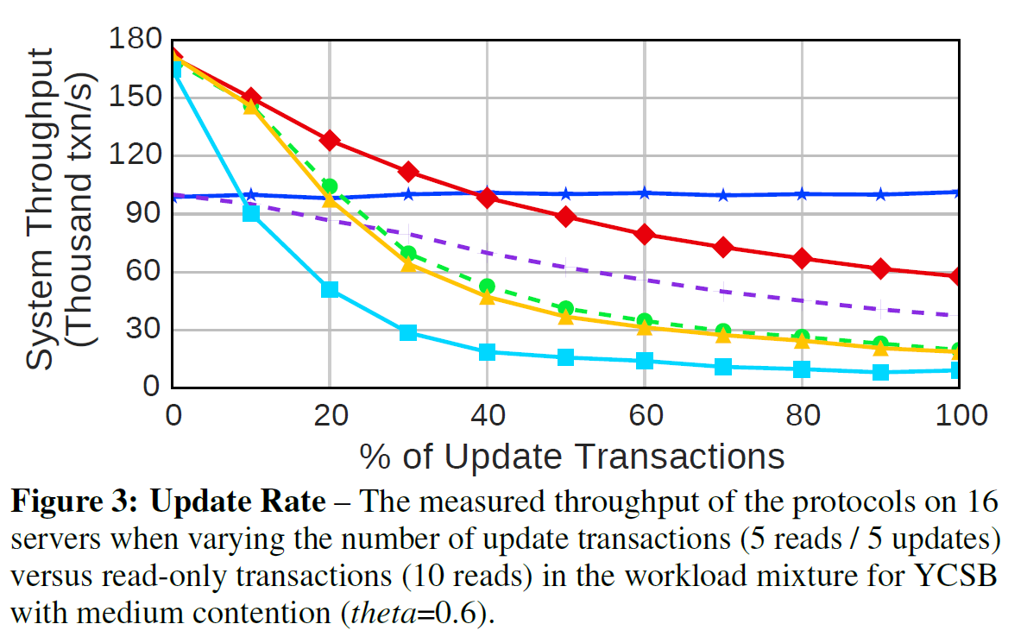
Update Rate

Slide 20
2. Update Rate
◆ As the update% goes up, WAIT_DIE drops drastically and more transaction get queued into wait state as hot records are locked by various transactions.
◆ These transactions waste a lot of resource because they non-deterministically bypass the queues and prolong the natural flow of transactions. Even after all this waiting, they grow old and are aborted.
◆ NO_WAIT on the other hand is not affected because there is no waiting. The
transactions abort straight away if the lock is not available.
◆ TIMESTAMP and MVCC suffer from the wait time caused by locks that are held by active transactions.
◆ OCC suffers from lower rates initially due to unnecessary validation checks,
but at higher update% it is relatively faster as locks are not acquired.
◆ CALVIN's advantage and disadvantage from contention carry over to update rates.

Slide 21
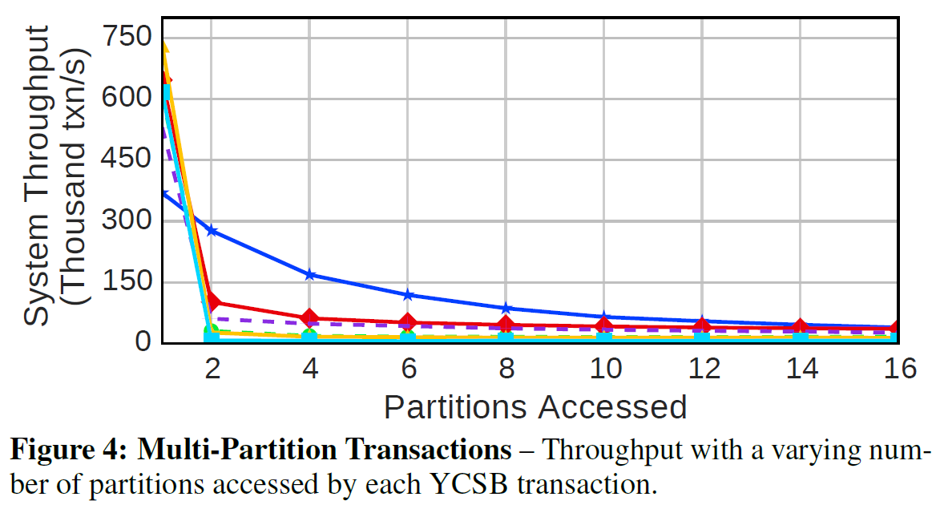
Multi-Partition Transactions

Slide 22
3. Multi-Partition Transactions
◆ Pretty much all protocols plummet equally except CALVIN.
◆ Part of the reason is because CALVIN does not make use of 2 Phase Commit protocol (2PC).
◆ There is also the overhead caused by multiple requests and responses between different server messages.
◆ CALVIN on the other hand synchronizes its schedulers every 5ms and hence the transactions are automatically forwarded to the target partitions.

Slide 23
4. Scalability

Slide 24
USEFUL WORK: All time that the workers spend doing computation on behalf of read or update operations.
TXN MANAGER: The time spent updating transaction metadata and cleaning up committed transactions.
CC MANAGER: The time spent acquiring locks or validating as part of the protocol. For CALVIN, this includes time spent by the sequencer and scheduler to compute execution orders.
2PC: The overhead from two-phase commit.
ABORT: The time spent cleaning up aborted transactions.
IDLE: The time worker threads spend waiting for work.

Slide 25
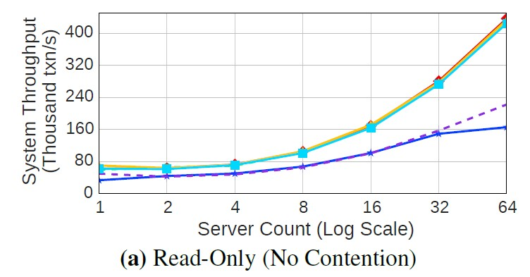
A) Read-only Workload
The throughputs of the protocols are nearly identical except for OCC and CALVIN.
OCC’s throughput is limited by the overhead of copying items for reference during the validation phase and the cost of the validation phase itself.
CALVIN has the lowest throughput due to its bottleneck at the scheduler.
Notes:
The throughputs of the protocols are nearly identical except for OCC and CALVIN.
OCC’s throughput is limited by the overhead of copying items for reference during the validation phase and the cost of the validation phase itself. CALVIN has the lowest throughput due to its bottleneck at the scheduler.

Slide 26
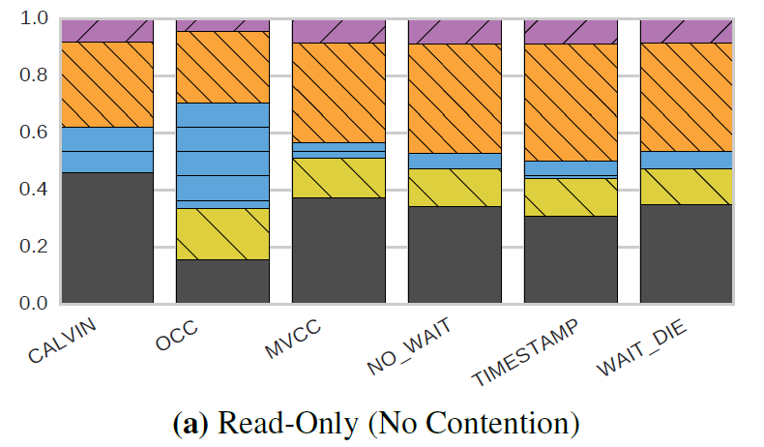
Time % Graph
Time %

Slide 27
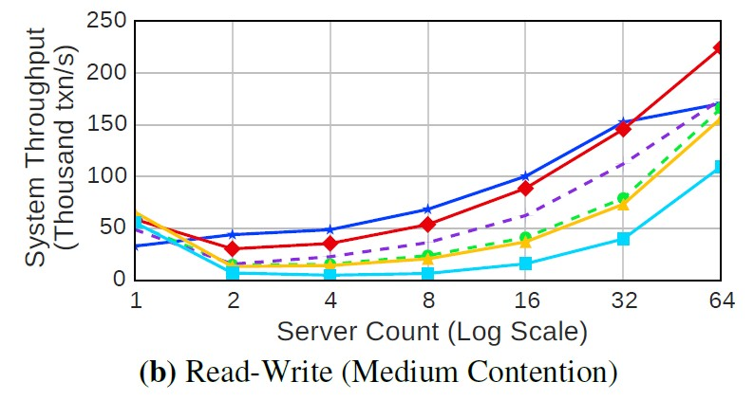
B) Read-Write (Medium Contention)
Although CALVIN shows the best improvement over its single-node performance, NO_WAIT has the best overall performance for all numbers of servers.
In contrast to the read-only results, OCC outperforms all of the protocols with the exception of NO_WAIT and CALVIN when there is more than one server as the benefit of being able to tolerate more conflicts exceeds the costs of copying and validation.

Slide 28
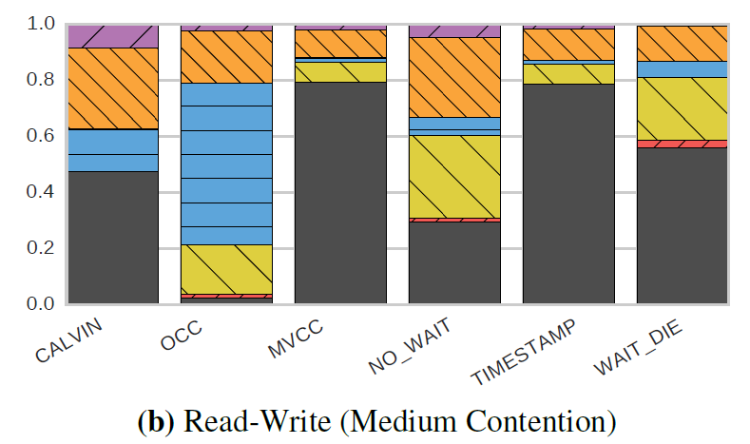
Time % Graph
Time %

Slide 29
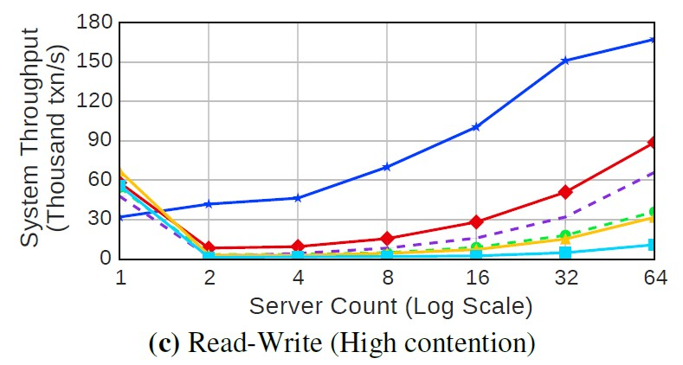
C) Read-Write (High Contention)
Raising the contention even further
continues to degrade the performance of all protocols except for CALVIN.
Its performance remains nearly constant for all results in Figures 5 and 6 regardless of the contention setting and workload mixture.

Slide 30
Time % Graph
Time %

Slide 31
5. Network Speed
◆ Protocols that use 2PC strategy experienced the most loss in throughput as the commits required delivery of transactional messages.
◆ CALVIN does not need to exchange any messages between servers between its read and write phase. Hence, it performs the best.
◆ WAIT_DIE sees the worst performance as not only are the messages being lagged, but the lagging will cause a lot of the waiting transactions to age and abort. The high abort rate in the main reason for the significant loss in performance.
◆ TIMESTAMP and MVCC also suffer loss in performance because of delay in transactional messages, but don't suffer as bad a rate for aborts.

Slide 32
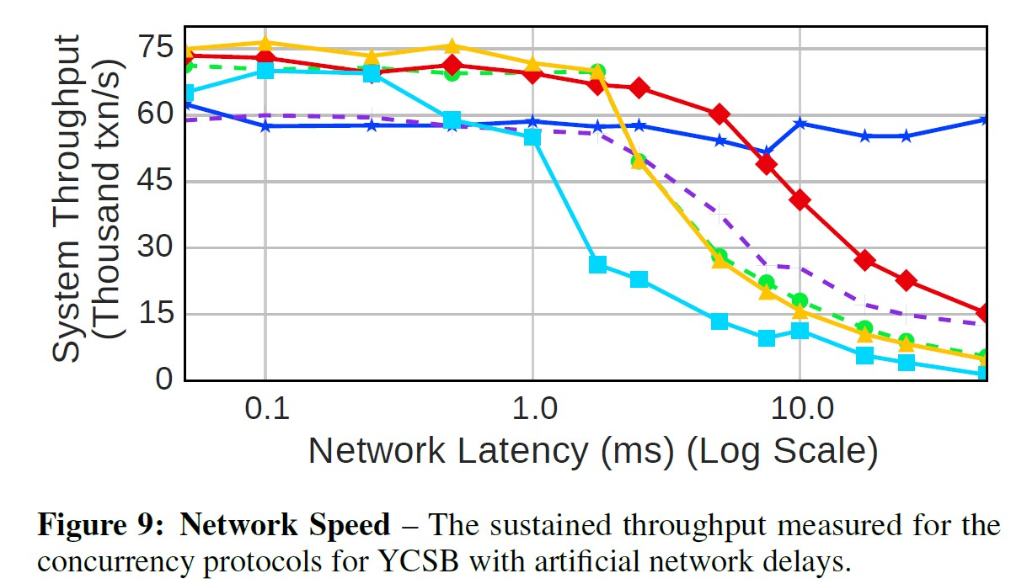
Network Speed

Slide 33
Distributed DBMS Bottlenecks
According to the paper, it boils down to the following bottlenecks:
◆ 2PC delay
CALVIN is designed to eliminate that but in case a transaction will need to abort. It needs to pay the cost of broadcasting the abort decision
Data access contention
Read-only contention can be trivially solved by replication
Write contention is difficult

Slide 34
Distributed DBMS Bottlenecks - 2PC delay
◆ All of the protocols that we evaluated faced scalability challenges
◆ Foremost is that the commit protocol is one of the primary factors that affects throughput. Most of the protocols require two round trips before committing.
◆ CALVIN was designed specifically to try to mitigate the affects of 2PC, but if there is the possibility that a transaction will abort, a round of messages must be broadcast and collected before transactions can commit at their local node and release their locks.
◆ In all cases, locks held during 2PC or while waiting for messages prevent forward progress in the application

Slide 35
Distributed DBMS Bottlenecks – Data Contention
◆ Protocols with minimal overhead, such as 2PL or a timestamp protocol, made the most sense, when there were few updates.
◆ These protocols quickly degraded as the number of writes increased and past a certain threshold using an optimistic or deterministic protocol was a better choice.
◆ Optimistic concurrency control is slightly more resilient to high skew, but once the skew reaches a critical point, CALVIN emerges as the most consistent protocol.

Slide 36
Potential Solutions
Improve the Network
Leverage better network technologies(e.g., RDMA)
Adapt the Data Model
Automatic repartitioning
Seek Alternative Programming Models
Non-serializable behavior maybe no a false
Semantics-based concurrency control methods

Slide 37
Thank You

