Slide 1
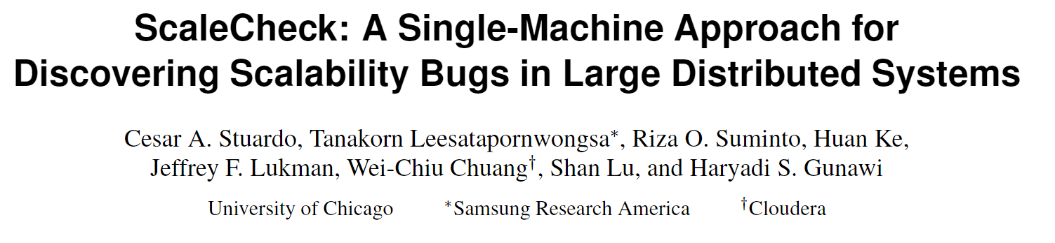
17th USENIX Conference on File and Storage Technologies

Slide 2
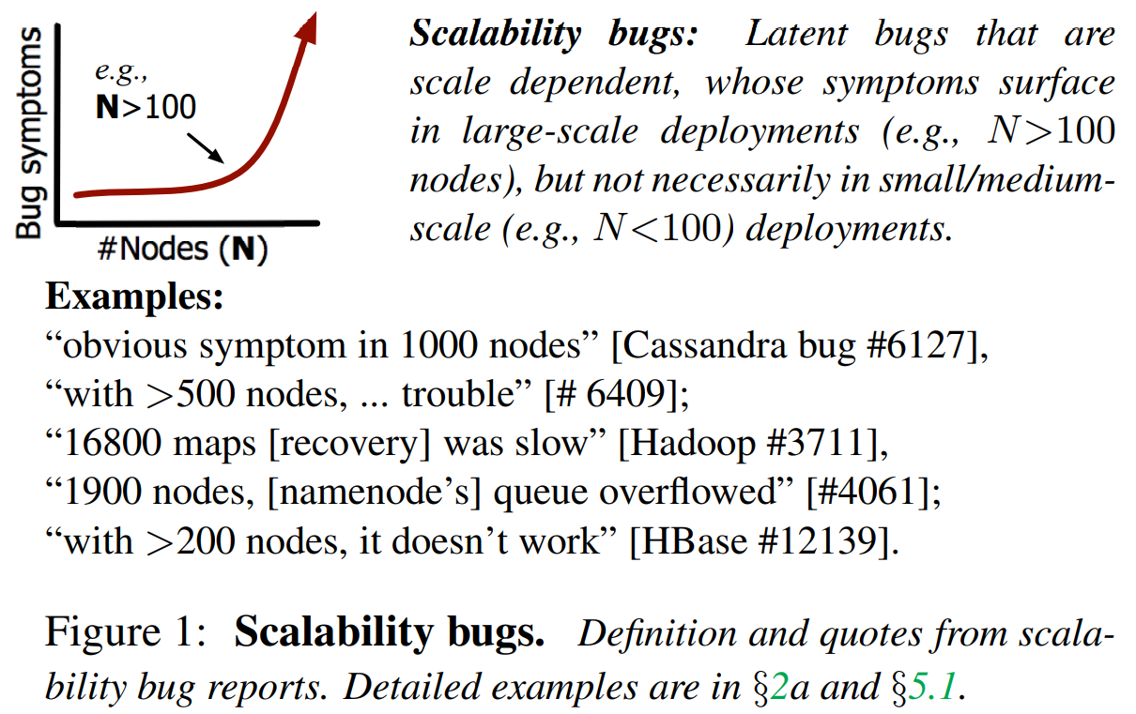
Scalability Bug Definition

Slide 3
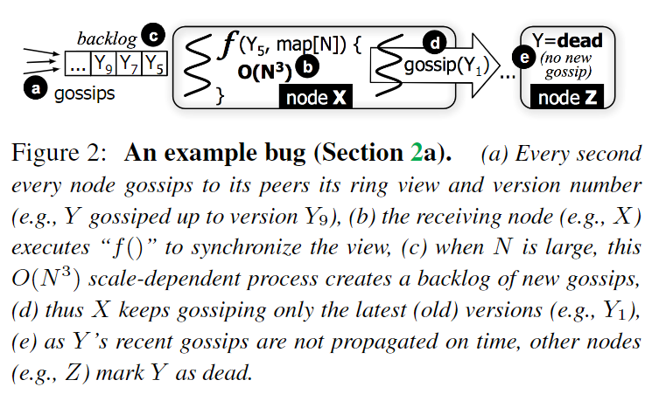
Scalability Bug Example

Slide 4
The Impact of Scalability Bug
Scalability bugs can cause both performance and availability problems. For example,
when nodes are incorrectly declared dead, some data become unreachable;
scale-dependent operations in the master node(e.g., in HDFS) can cause global lock contention, hence longer time to process user read/write requests.

Slide 5
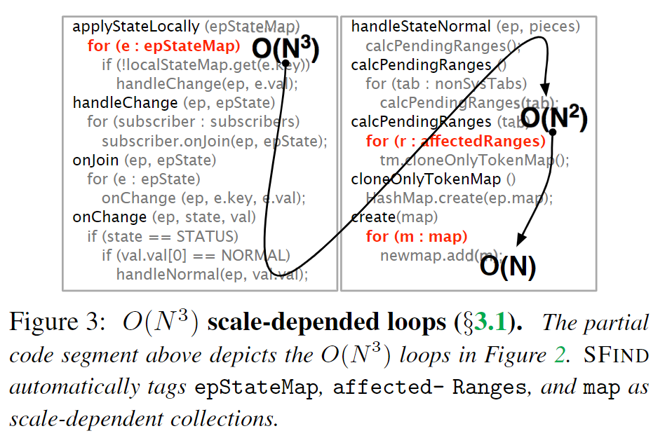
The Root Cause of Scalability Bug
Scale-dependent Loops

Slide 6
ScaleCheck
SFIND
A program analysis to support for finding scale-dependent loops.
STEST
A single-machine scale-testing framework to democratize large-scale testing.

Slide 7
SFIND: finding scale-dependent loops
Below are the three main steps of SFIND
Auto-tagging of scale-dependent collections
This is done by growing the cluster and data sizes (e.g., add nodes and add files/blocks), and then checking each collection’s growth tendency.
Finding scale-dependent loops
This is done by tainting loops (for, while) as well as recursive functions that iterate through the scale-dependent collections.

Slide 8
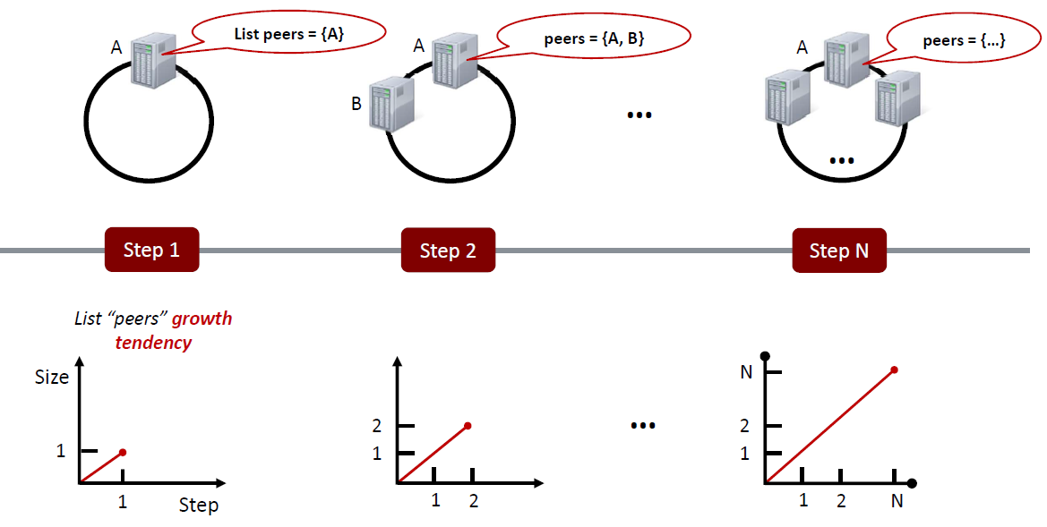
SFIND: finding scale-dependent loops

Slide 9
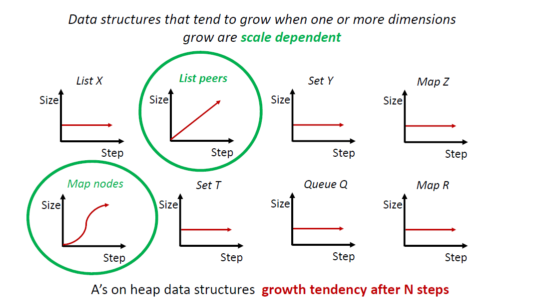
SFIND: finding scale-dependent loops

Slide 10
Discussions: test workload creation
Creating test workloads from SFIND report is a manual process.
Automated test generation is possible for single machine programs/libraries, however, we are not aware of any work that automates such process in the context of real-world, complex, large-scale distributed systems.
We put our work in the context of DevOps culture where developers are testers and vice versa, which (hopefully) simplifies test workload creation.
Notes:
In our experience, by scaling out to just 30 nodes (30 steps), which can be done easily on one machine, scaledependent collections can be clearly observed (though not the symptoms).

Slide 11
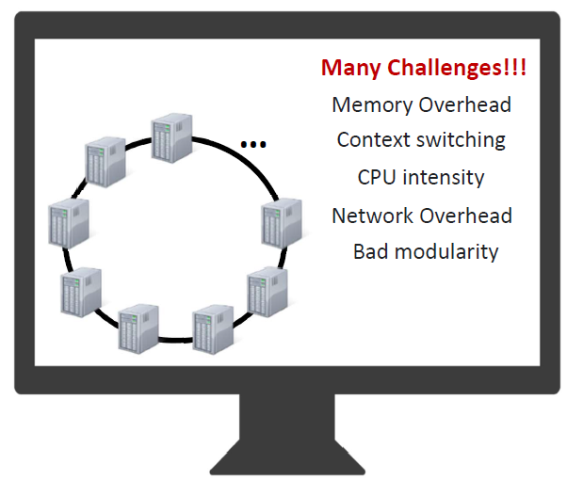
STEST: democratizing large-scale testing
Colocation Bottlenecks

Slide 12
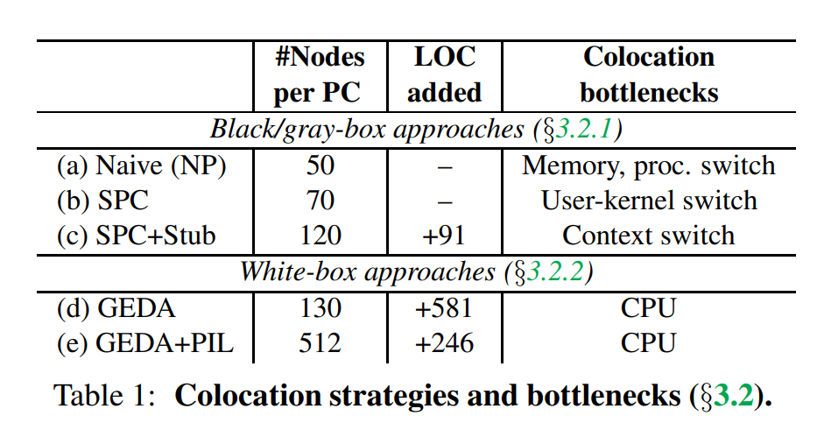
STEST: democratizing large-scale testing
All the methods are summarized in Table 1.

Slide 13
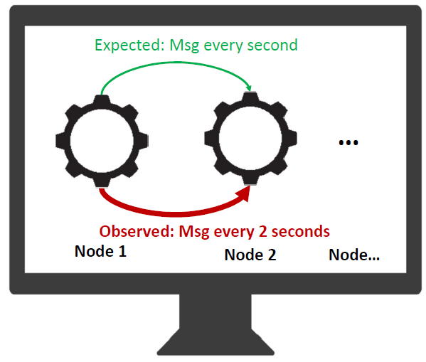
STEST: democratizing large-scale testing
Naive Packing (NP)
Deploy nodes as processes
in a single machine
One process = one node
Max colocation factor
50 nodes
Bad things
Process context switches
Memory bottlenecks

Slide 14
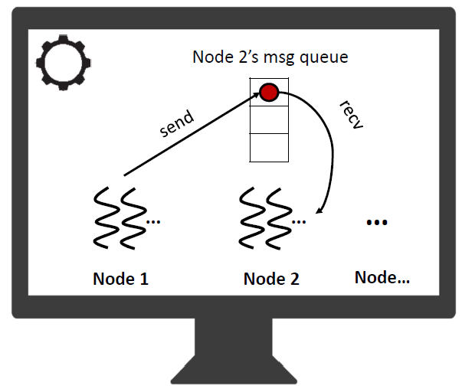
STEST: democratizing large-scale testing
Single-Process Cluster (SPC)
Deploy nodes as processes
threads in a single process
Max colocation factor
120 nodes
Bad things
Systems are not easy to run in
this single-process cluster.
Notes:
改造代码：面向进程编程->面向线程编程

Slide 15
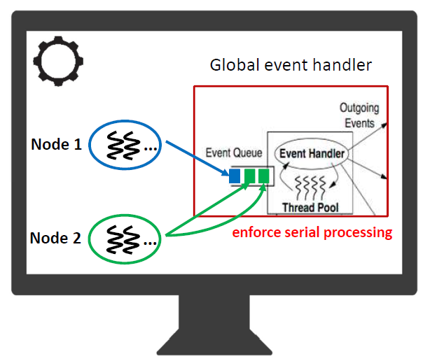

STEST: democratizing large-scale testing
Global Event Driven Arch(GEDA) $White−box$
One global event handler
per service
Max colocation factor
512 nodes
Bad things
The bug symptoms may be
inaccurate with real-scale
deployment, which is caused
by CPU contention.
Notes:
尽量少改动系统的代码，引入全局事件处理器统一处理消息的路由和转发

Slide 16
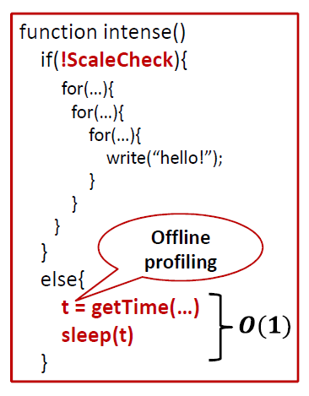
STEST: democratizing large-scale testing
Processing Illusion (PIL)
Replacing CPU intensive computation
with sleep
Notes:
$$The key to computation is$$
$$not the intermediate results,$$
$$but rather the execution time$$
$$and eventual output$$

Slide 17
STEST: democratizing large-scale testing
Processing Illusion (PIL)
Replacing CPU intensive computation
with sleep
Challenges
PIL-safe function
Memoizable output
Predict the timing “t”

Slide 18
STEST: democratizing large-scale testing
Processing Illusion (PIL)
Replacing CPU intensive computation
with sleep
Challenges
PIL-safe function
Memoizable output
Predict the timing “t”
Pre-Memoization
Recording input-output pairs and
the processing time to a
memoization database

Slide 19
Evaluation
We compare SCALECHECK with real deployments of 32 to 512 nodes, deployed on at most 128 machines (testbed group limit), each has 16-core AMD Opteron(tm) with 32-GB DRAM.

Slide 20
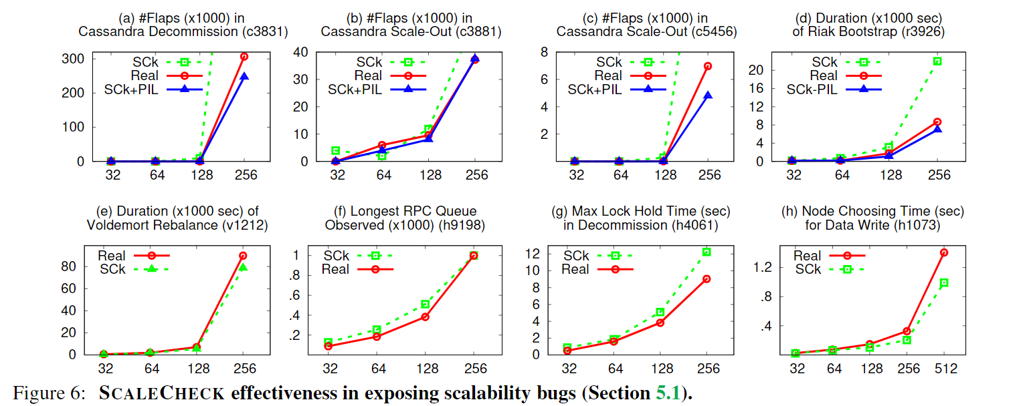
Evaluation
Exposing Scalability Bugs
Notes:
从cassandra中选取了一段代码做实验，通过四个指标去刻画这段代码

Slide 21
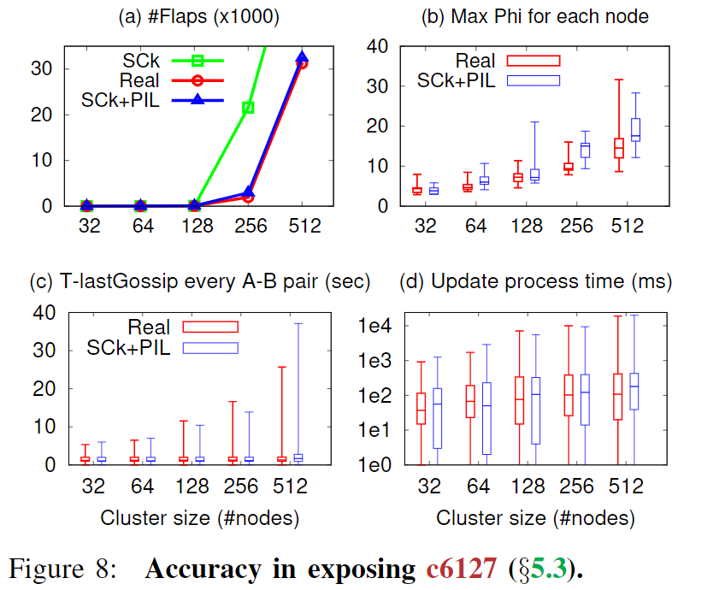
Evaluation
Accuracy
Notes:
从cassandra中选取了一段代码做实验，通过四个指标去刻画这段代码

Slide 22
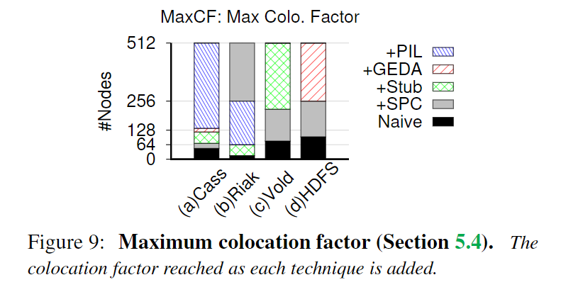
Evaluation
Colocation Factor
Notes:
从cassandra中选取了一段代码做实验，通过四个指标去刻画这段代码

Slide 23
Thank you

