Slide 1

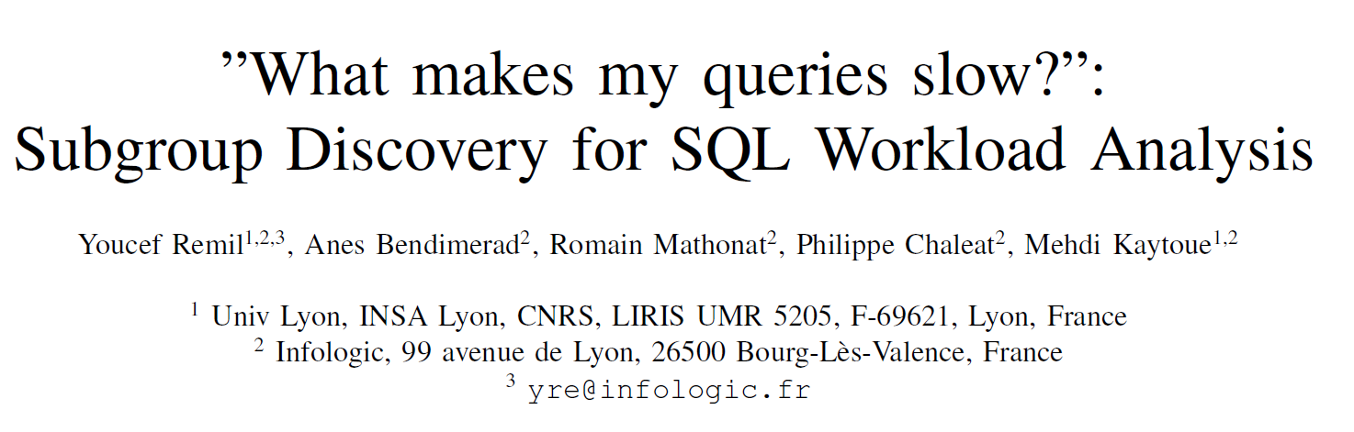
ISO欧美商务简约POWERPOINT

Slide 2
BACKGROUND
A data-driven strategy based on query workload analysis has proven its efficiency to address a large variety of related problems.
The usability of these data on such tasks strongly depends on their representation.
A myriad of Machine Learning methods have been evaluated on different workload analysis tasks.

Slide 3
INTRODUCTION
QUESTION
How to characterize SQL queries that foster some properties of interest?
$→$ What makes queries slow?
APPROACH
Subgroup Discovery approach
RESULT
Table = X $∧$ Where attribute = Y $→$ high execution time

Slide 4
CHALLENGE
The efficiency of such method is challenging as it strongly depends on several complex criteria.
The data needs to be introduced to the algorithm in the right format.
A relevant pattern language needs to be defined.
A right function needs to be chosen to measure the interestingness of a subgroup.
Resulting subgroups need to be interpretable.

Slide 5
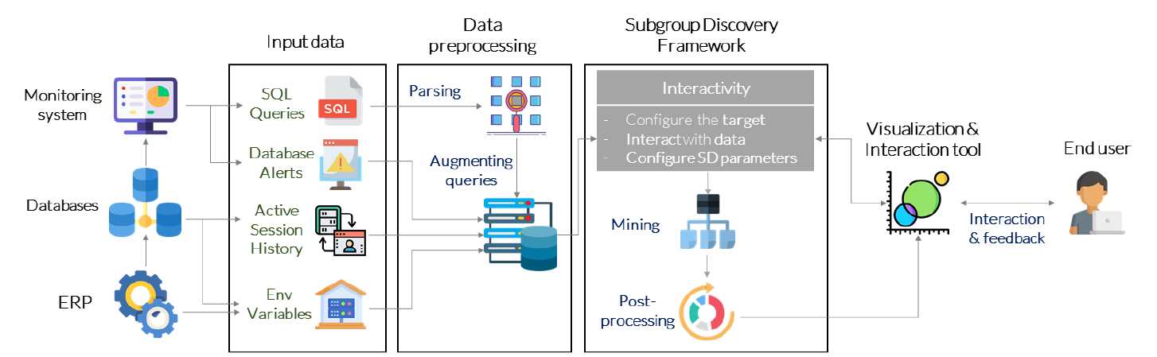
CONTRIBUTION
Propose a data pre-processing step;
Define a suitable pattern language and integrate a set of measures;
Provide exact and heuristic algorithms;
Integrate a visual tool.

Slide 6
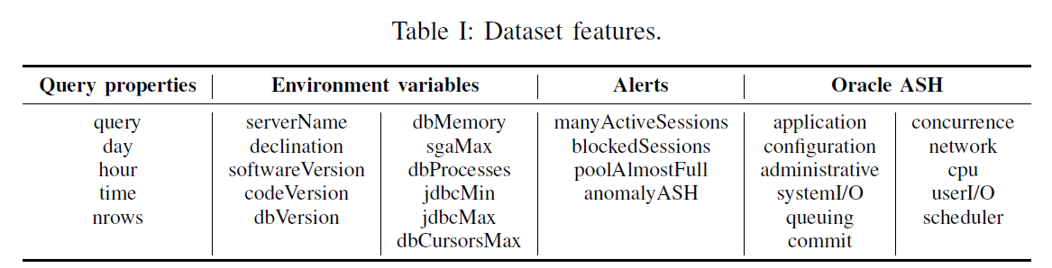
METHODOLOGY
Raw Data
Each query q in workload set W is a SELECT.
Notes:
Active Session History (ASH) [22]
Active Session was introduced in Oracle 10g, and then in other database systems such as PostgreSQL [23]. An active session is a database session waiting for some resource such as CPU, System I/O or Network.
it should be noticed that no prior work has invested such a combination of high dimensional features along with a very expressive representation of SQL queries that we present now.

Slide 7
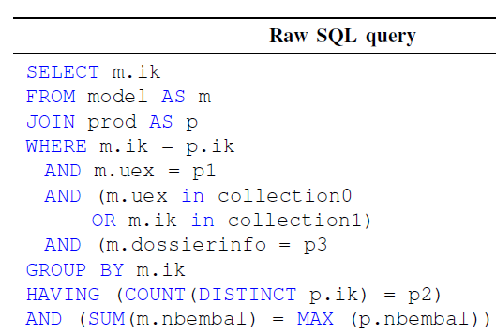
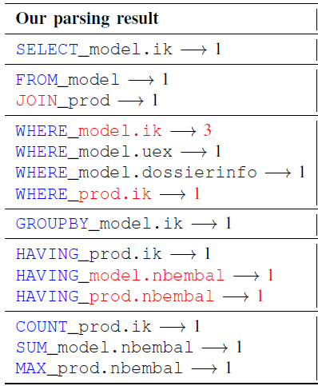
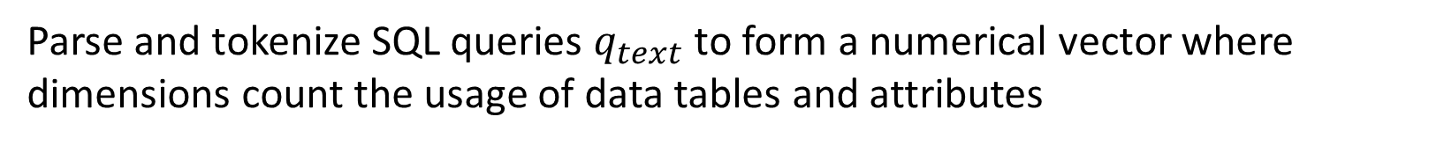
METHODOLOGY
Query Transformation
Parse and tokenize SQL queries $q_{text}$ to form a numerical vector where dimensions count the usage of data tables and attributes
Notes:
clauses they belong to + the indicates appears + the number of time it appears

Slide 8
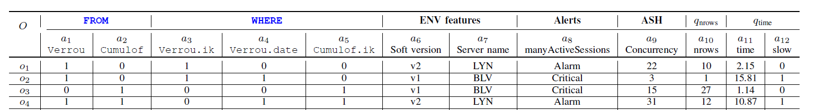
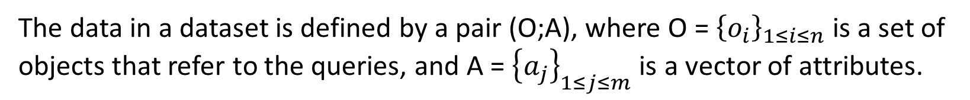
METHODOLOGY
Data Model
The data in a dataset is defined by a pair (O;A), where O = ${\left\{o_{i}\right\}}_{1≤i≤n}$ is a set of objects that refer to the queries, and A = ${\left\{a_{j}\right\}}_{1≤j≤m}$ is a vector of attributes.
Notes:
A包括query里的属性信息（parse）的那些，和其他的信息

Slide 9

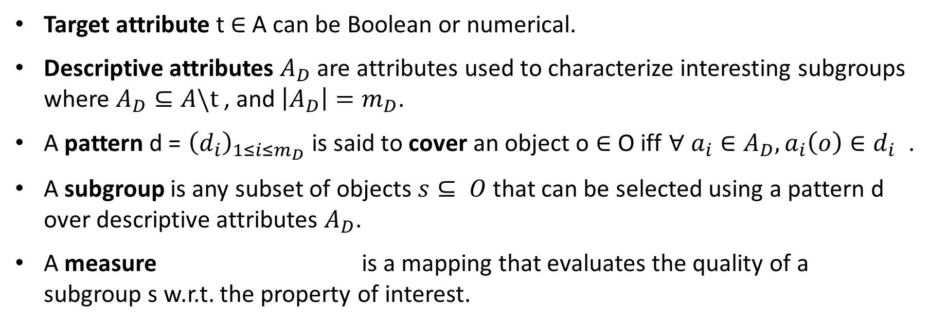
DISCRIMINANT PATTERN DISCOVERY IN WORKLOADS
Subgroup Discovery
Target attribute t $∈$ A can be Boolean or numerical.
Descriptive attributes $A_{D}$ are attributes used to characterize interesting subgroups where $A_{D}⊆A\backslash t$, and $\left|A_{D}\right|=m_{D}$.
A pattern d = ${\left(d_{i}\right)}_{1≤i≤m_{D}}$ is said to cover an object o $∈$ O iff $∀ a_{i}∈A_{D}, a_{i}\left(o\right)∈d_{i}$ .
A subgroup is any subset of objects $s⊆ O$ that can be selected using a pattern d over descriptive attributes $A_{D}$.
A measure is a mapping that evaluates the quality of a subgroup s w.r.t. the property of interest.

Slide 10





DISCRIMINANT PATTERN DISCOVERY IN WORKLOADS
Measuring subgroup interestingness
Many of existing measures belong to the popular family of Klosgen functions.
Average function:
Lift measure:
WRAcc measure:
Mean-test/Binomial test:
T-score:
Median-based measures:

Slide 11
DISCRIMINANT PATTERN DISCOVERY IN WORKLOADS
Algorithms
Depth-first algorithm
Iterate
A refinement operator is recursively applied on selectors of d.
Refinements can be operated by adding a symbolic attribute value, or adding a numerical attribute cut point.
Prune
If a pattern covers less than k objects then this pattern is not refined anymore.
If the TOE of a branch is lower than the score of the top-k already found subgroup, then branch is pruned.
Notes:
tight optimistic estimates
to efficiently upper bound all the subgroup interestingness values in a whole branch of the search space

Slide 12
DISCRIMINANT PATTERN DISCOVERY IN WORKLOADS
Algorithms
Beam-search algorithm
Iterate
It recursively goes to the next level by refining patterns of the current level and selecting the top-w refined patterns that maximize the interestingness.
These top-w patterns are then refined again to continue to a deeper level.

Slide 13
DISCRIMINANT PATTERN DISCOVERY IN WORKLOADS
Reducing Information Redundancy
In order to provide interesting but diverse patterns, and to reduce information redundancy in the subgroup set R, we propose two different solutions based on the Jaccard similarity.
Greedy
Identify the best subgroup s in the initial subgroup set, and added to result set.
Remove from R all the subgroups whose similarity with s exceeds a specified threshold.
Hierarchical Clustering
the user can specify how many non-redundant subgroup patterns she wants without having to specify a dissimilarity threshold.

Slide 14
EVALUATION
Qualitative: validate that the proposed framework is able to characterize discriminant subgroups about different target problems.
Quantitative: analysis the execution time for each algorithm.
Interactive: present the different features provided by our visualization tool.
Notes:
D1最常用的query，D2最常用的表，D3最多并发问题的软件版本，D4发生异常阻塞的服务器

Slide 15
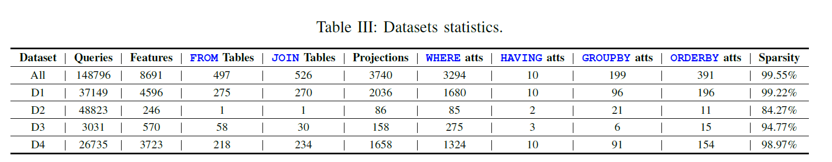
EVALUATION
SQL workload run on our production-environment servers for a period of one week, whose execution time exceeds 5 seconds.
148,796 queries
8,691 features
sparse, with only 0.45% of non-zero values
Notes:
D1最常用的query，D2最常用的表，D3最多并发问题的软件版本，D4发生异常阻塞的服务器

Slide 16
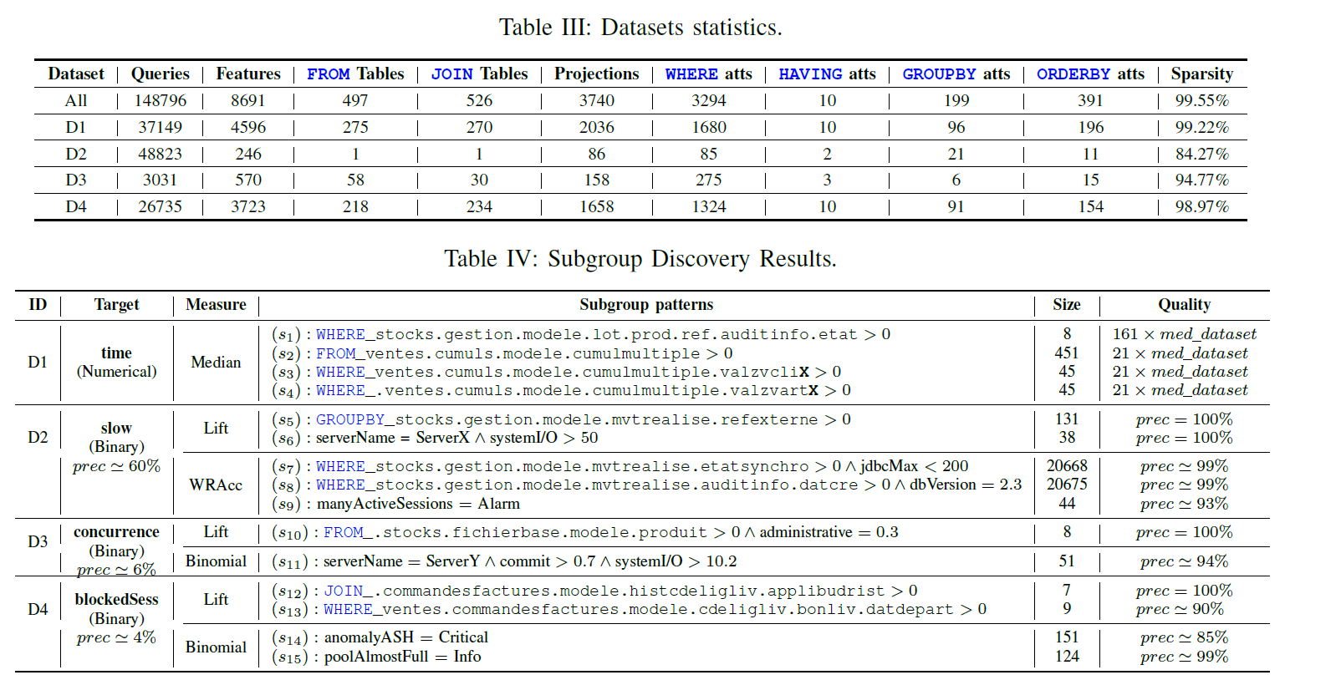
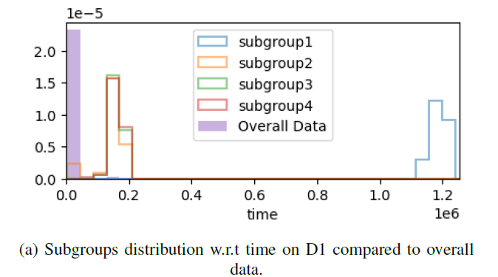
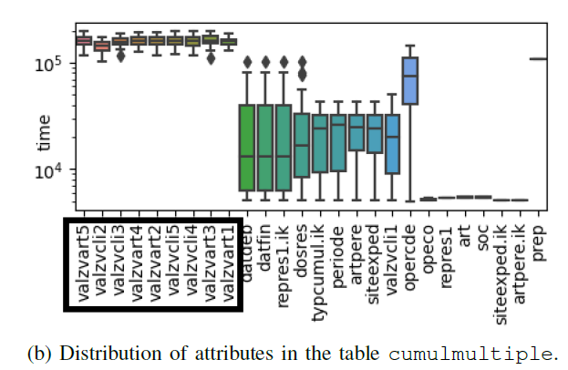
EVALUATION
Qualitative Analysis
What makes queries very slow?
Result sets’ median execution time is higher than the median of the dataset.
Notes:
D1最常用的query

Slide 17
EVALUATION
Qualitative Analysis
What makes queries very slow?
Different measure returns different results.
Notes:
D2最常用的表

Slide 18
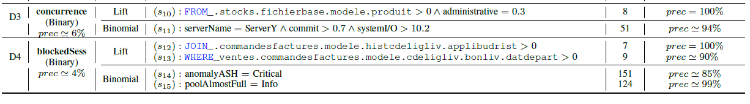
EVALUATION
Qualitative Analysis
In which context do queries present concurrency issues?
How to characterize queries that co-occur the most with alerts of type blocked sessions.
Notes:
D3最多并发问题的软件版本，D4发生异常阻塞的服务器

Slide 19
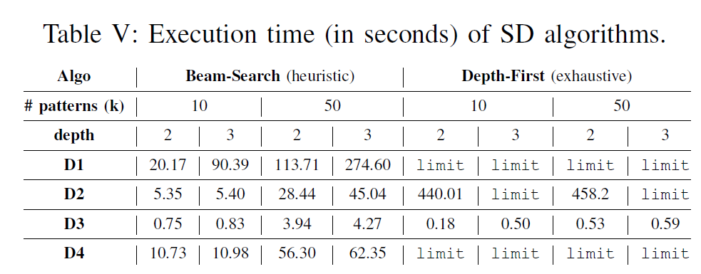
EVALUATION
Quantitative Analysis
Depth-First was slower than Beam-Search in most of cases, except D3. This may be due to the relatively small number of features compared to other datasets.

Slide 20
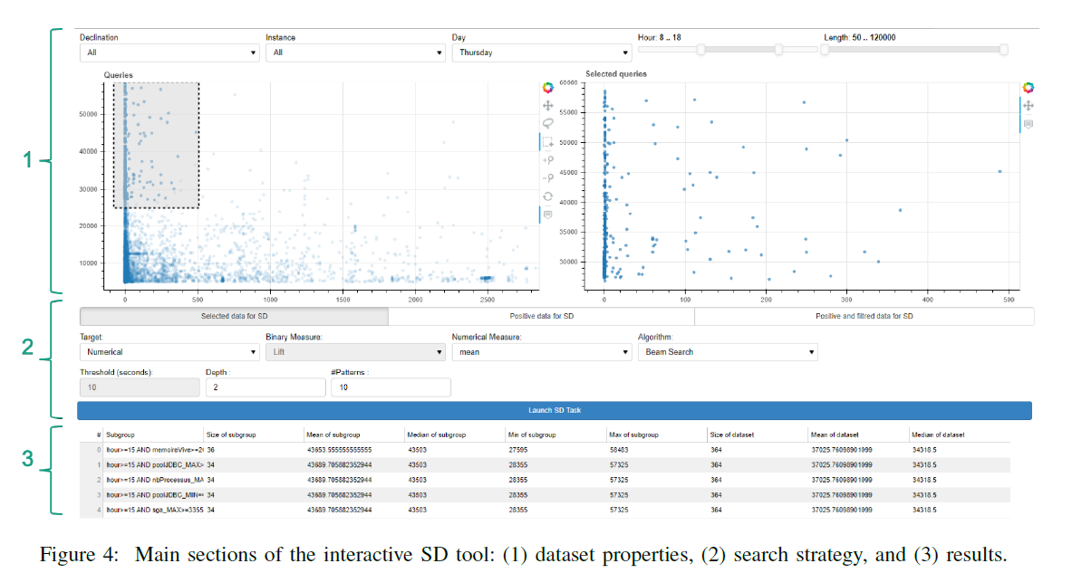
EVALUATION
Interactive Subgroup Discovery

