Slide 1
Ad Hoc Transactions in Web Applications: The Good, the Bad, and the Ugly
_{Chuzhe Tang}
_{Zhaoguo Wang}
_{Xiaodong Zhang}
_{Qianmian Yu}
_{Binyu Zang}
_{Haibing Guan}
_{Haibo Chen}
Institute of Parallel and Distributed Systems, Shanghai Jiao Tong University
Engineering Research Center for Domain-specific Operating Systems, Ministry of Education, China
Shanghai Key Laboratory of Scalable Computing and Systems, Shanghai Jiao Tong University
SIGMOD ‘22

Slide 2
Background
Web applications often use database systems to persist large amounts of data, necessitating the coordination of concurrent database operations for correctness
Most applications manipulate relational data with the help of ORM frameworks, which can transparently generate SQL statements that fetch and persist data according to the application code
Fetched relational data is presented as in-memory, application runtime objects, which we refer to as ORM-mapped objects
Notes:
应用程序使用数据库存储数据，需要并发控制以保证正确性
大部分Web应用程序使用ORM框架访问数据库
ORM框架获取的数据暂存于内存中的ORM映射对象中

Slide 3
Concurrency Control in Web Applications
Database transaction APIs provided by ORM frameworks
Coordinate operations with database transaction
Directly isolate concurrent database operations
Operate at the DBMS level
Invariant validation APIs provided by ORM frameworks
Check the to-be-persisted ORM-mapped objects and related rows fetched from the database systems and report errors on violations
Examine database states to prevent the specified invalid outcomes
Operate at the application level
Notes:
并发控制方法：
- 数据库事务，利用数据库事务保证并发操作的正确性，直接隔离了并发操作来保证正确性
- ORM框架提供的不变式验证API，ORM框架根据用户设定的规则，在读写数据时进行验证，避免数据库进入异常状态

Slide 4
Concurrency Control in Web Applications
Ad Hoc Transactions
Coordinate operations with application code
Directly isolate concurrent database operations
Operate at the application level
Notes:
Ad hoc 事务
由应用开发人员而非数据库开发者负责并发控制，通过隔离并发的操作保证正确性，运行于应用程序级别

Slide 5
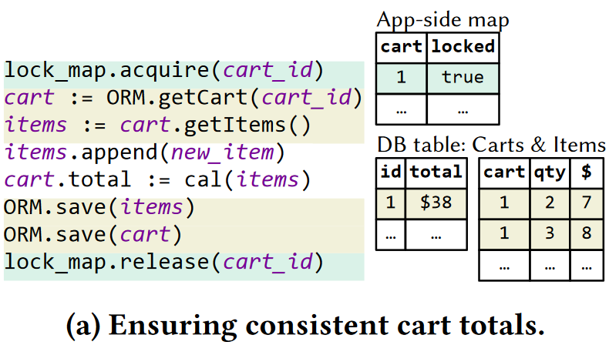
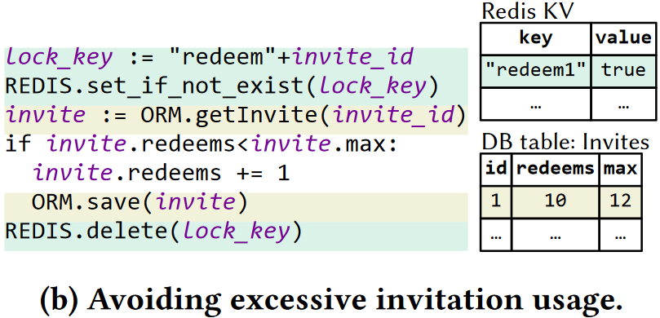
Ad Hoc Transaction Example
Figures (a) and (b) use locks to isolate conflicting operations.
Notes:
图A 通过在购物车ID上加锁，阻止了对同一购物车的并发读写操作，保持购物车商品总量这一列数据与商品条目相匹配。
图B 通过在 invite_id 加锁，确保Read-modify-write的正确性

Slide 6
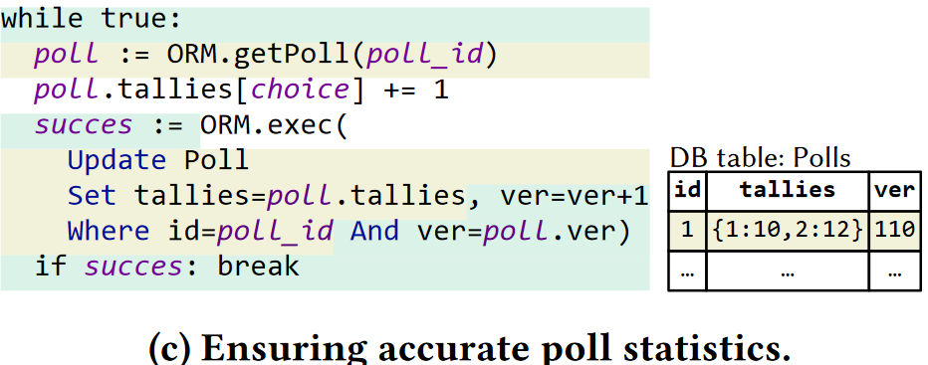
Ad Hoc Transaction Example
Figures (c) uses version checks to detect conflicting changes and ensure read–modify–writes (RMWs) are atomic
Notes:
通过版本验证保证操作的原子性

Slide 7
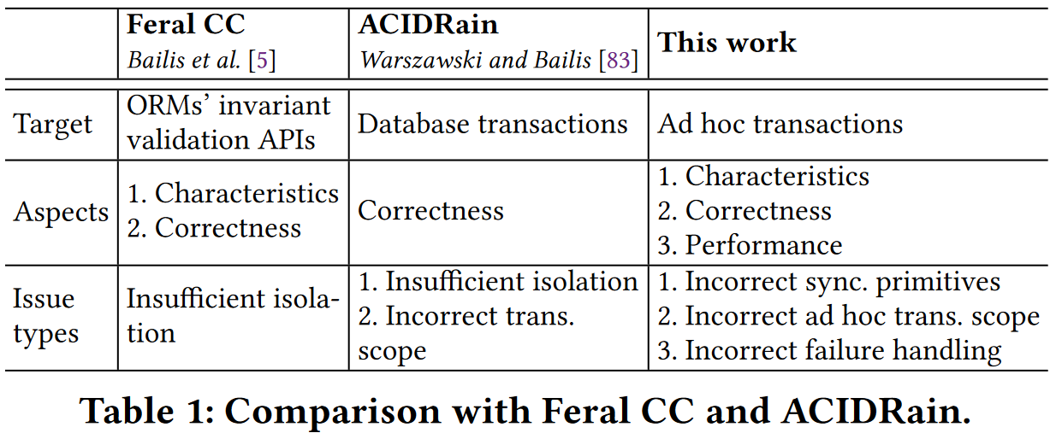
Background
Related works focus on database transactions and ORMs’ invariant validation API
This work targets ad hoc transactions
Notes:
相关工作主要针对数据库事务和ORM的数据验证API
本工作关注ad hoc trx

Slide 8
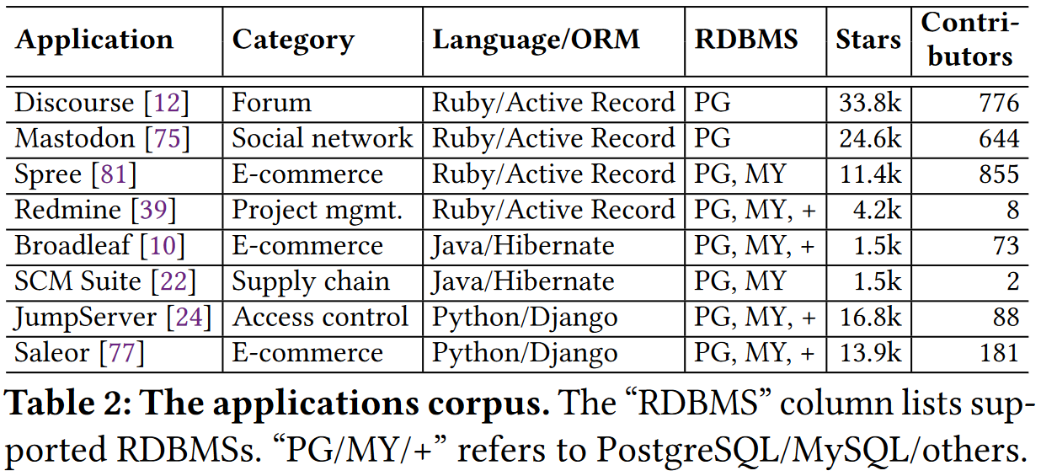
Studied Web Applications
The most representative 8 web applications of 6 categories
Different languages with different ORM frameworks

Slide 9
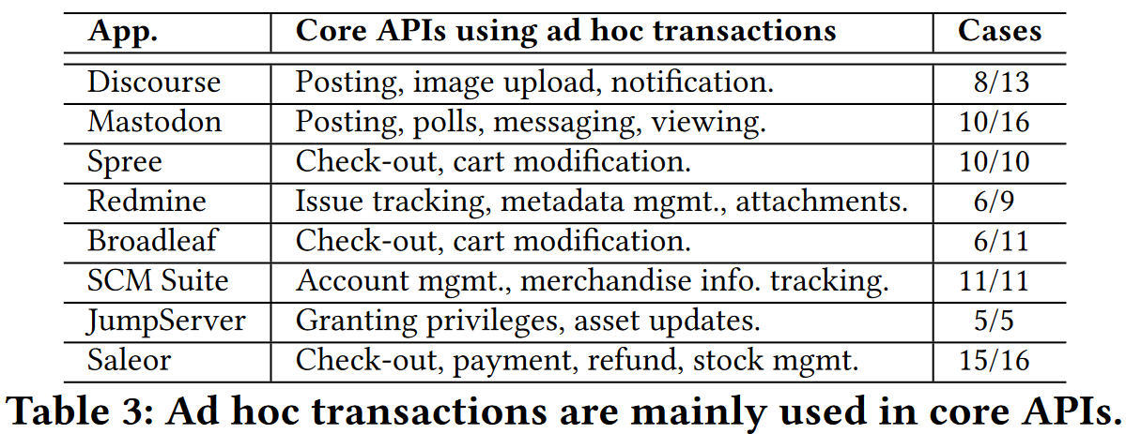
Ad Hoc Transactions is Critical
Every studied application uses ad hoc transactions
Ad hoc transaction is critical if it resides in their core APIs such as check-out and add-cart to ensure safe shopping
Among the 91 ad hoc transactions in total, 71 cases are considered critical to the web applications.

Slide 10
Research Questions
Characteristics: How are ad hoc transactions constructed among applications?
Correctness: Can ad hoc transactions always ensure the correct semantics?
Performance: How is ad hoc transactions’ performance, especially in comparison with database transactions?

Slide 11
Characteristics of Ad Hoc Transactions
What Do Ad Hoc Transactions Coordinate?
How Is The Coordination Implemented?
What Are The Coordination Granularities?
How Are Failures Handled?

Slide 12
What Do Ad Hoc Transactions Coordinate?
Can coordinate only specific database operations instead all operations
Can coordinate Database operations across multiple requests
Can coordinate non-database operations & operations across different systems

Slide 13
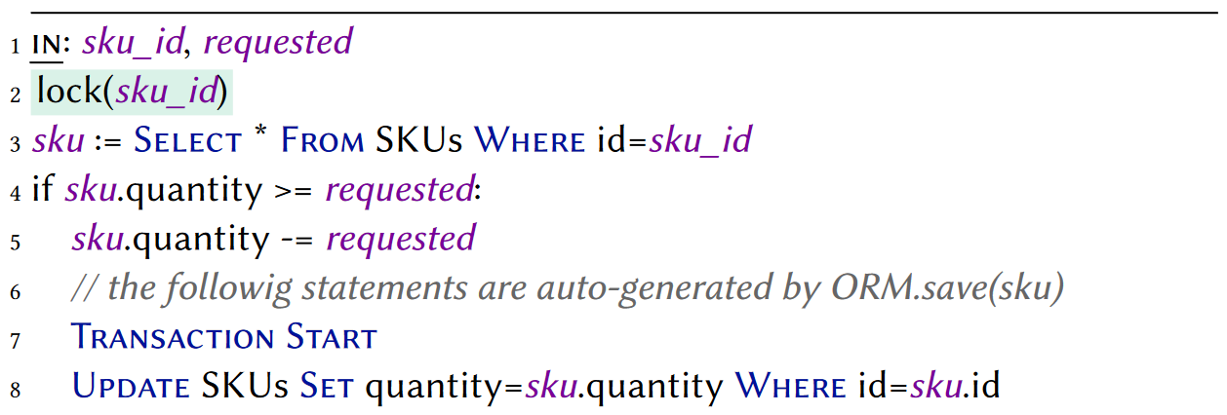
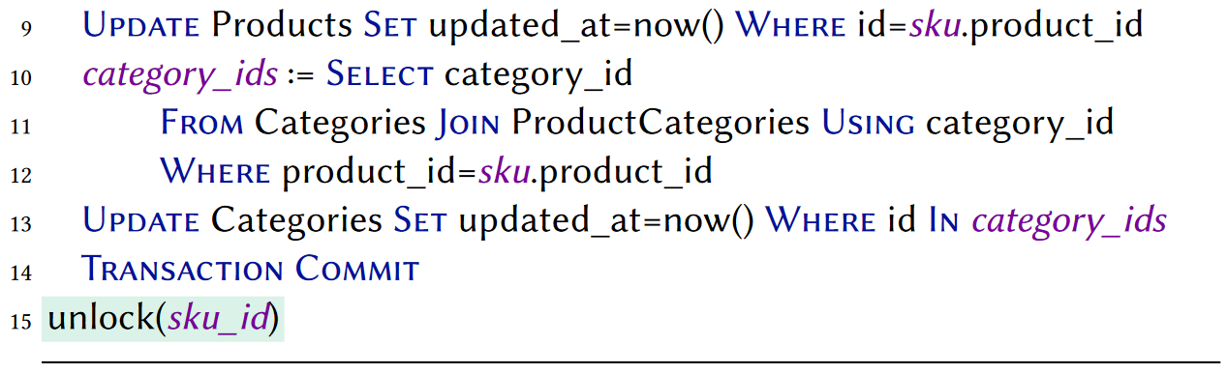
Coordinate Only Specific Operations
This transaction processes customer orders. It first fetches the stockkeeping unit (SKU) data from the SKUs table, checks and updates the SKU’s stock quantity, then persists changes to the database system by invoking the ORM.save() method.
ORM.save() automatically starts a database transaction, within which it issues three updates and one query (line 8–13).
The first update changes the quantity in the SKUs table, and other updates refresh the update_at timestamps of corresponding Products and Categories rows. Categories rows are identified by querying the ProductCategories table, which encodes the many-to-many relationship between products and categories.

Slide 14
Coordinate Only Specific Operations
The Only Critical Operations

Slide 15
Coordinate Only Specific Operations
How about database transactions?
Consider MySQL, one of Spree’s supported RDBMSs. Serializable isolation must be used since all MySQL’s non-Serializable isolation levels will introduce lost updates due to the RMW operations over SKUs
Unfortunately, two Serializable transactions would deadlock when they attempt upgrading to writer locks at line 13 after acquiring reader locks on the same Categories row at line 10.
Deadlock

Slide 16
Coordinate Only Specific Operations
With ad hoc transactions
Only the critical SKU operations are serialized, and Categories accesses are executed in MySQL’s default isolation level, Repeatable Read, which does not acquire reader locks
The Only Critical Operations

Slide 17
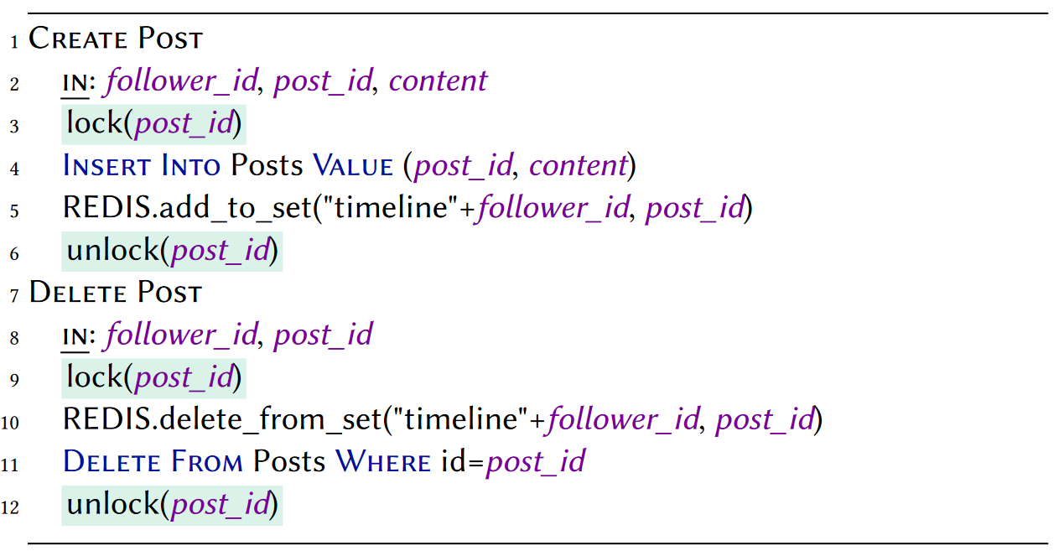
Coordinate Operations Across Different Systems
The code snippet uses a Redis KV store and an RDBMS as its backend storage. Redis holds the IDs of posts shown on each user’s timeline, while the concrete post contents are resident in the RDBMS.
To ensure correctness, Mastodon must guarantee the consistency between the post contents in the RDBMS and the post IDs in Redis.
Specifically, the post IDs in Redis should always refer to post contents in the RDBMS, which can not be achieved solely with database transactions.

Slide 18
How Is The Coordination Implemented?
There are 7 different lock implementations and 2 validation implementations among the 8 applications we studied
All 8 studied applications have lock-based pessimistic ad hoc transactions
6 out of 8 studied applications have validation-based optimistic ad hoc transactions

Slide 19
Lock-based Ad Hoc Transaction
Select For Update
Java synchronized keyword
In-memory-map-based lock
Redis SETNX (short for SET if Not eXists) command
Mastodon, mutex, only needs one round trips
Saleor, adds a re-entrant feature

Slide 20
Lock-based Ad Hoc Transaction
Combination of WATCH, GET, MULTI, and SET Redis commands
Discourse, optimistically ensure the atomicity of checking existing locks and setting new locks
Requires six additional round trips compared to Mastodon’s
RDBMS-based lock
It performs within a database transaction first a Select to check if the existence of a corresponding lock row and then an Update or Insert to acquire the lock

Slide 21
Validation-based Ad Hoc Transaction
ORM-Assisted Validation
Hand-Crafted Validation

Slide 22
What Are The Coordination Granularities?
Among the 91 studied ad hoc transactions, 14 cases perform fine-grained coordination such as column-based coordination
58 cases perform coarse-grained operations, i.e., using a single lock to coordinate multiple operations
9 cases implement both types of coordination for different accesses.

Slide 23
Using a Single Lock to Coordinate multiple operations: two access patterns
Associated Accesses
Given two database rows, r1 and r2, if accesses to r2 always happen in a transaction that also accesses r1, we say r2 is associatively accessed with r1 and refer to this access pattern as the associated access pattern
Read–Modify–Writes
RMW means that a transaction first queries the data from the database system, then makes modification accordingly, and finally persist the modification back to the database system

Slide 24
Using a Single Lock to Coordinate multiple operations: two access patterns
Associated Accesses
Read–Modify–Writes
使用一个加在cart_id的锁访问Cart以及关联的Items
执行RMW之前在invite_id上加锁，避免数据库死锁

Slide 25
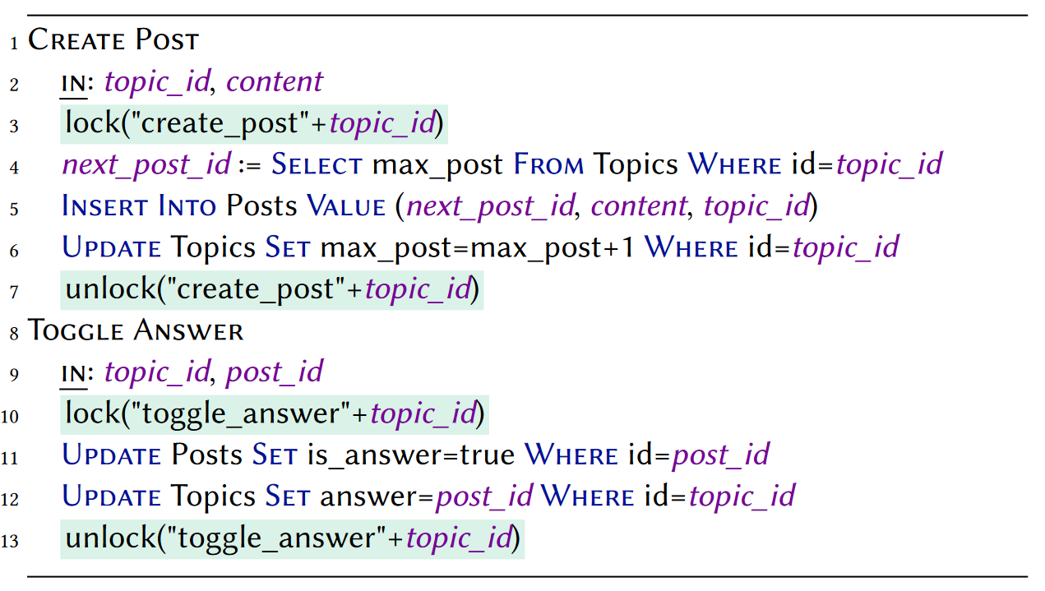
Fine-Grained Columns-Based Coordinating
Line 6 increments the max_post field; line 12 sets the answer field.
Though these operations have no column-level conflicts, if they access the same row, an RDBMS using row locks cannot execute them in parallel.
Therefore, instead of using database transactions, Discourse developers implement two lock namespaces for these two transactions so that locks coordinating line 6 will not interfere with locks for line 12

Slide 26
How Are Failures Handled?
Failures caused by deadlocks or validation failures
Database transactions’ atomicity property
Hand-crafted rollback procedures
Crash Handling
Database system crashes: application performs failure handling after database system recovery
Application server crashes: to correctly resume service after application reboot, applications need to ensure that locks acquired before crashes will not cause deadlocks, and application logic can tolerate potential intermediate database states.

Slide 27
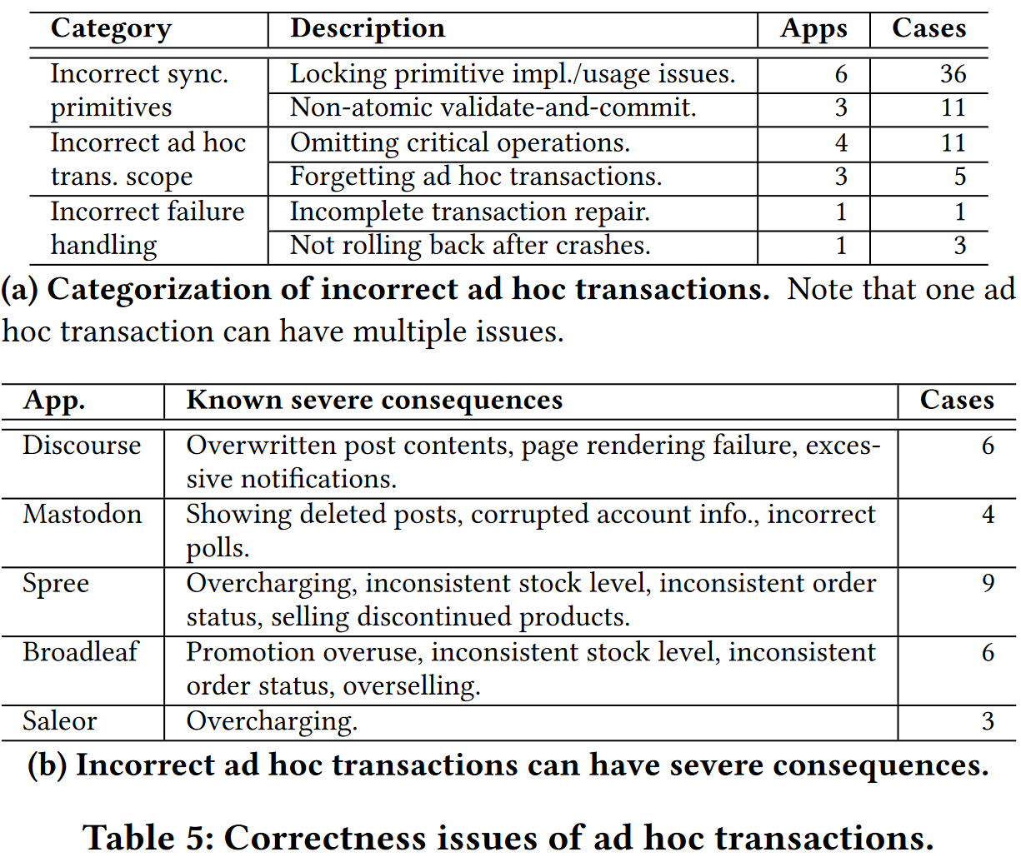
Correctness Issues of Ad Hoc Transactions
69 correctness issues are found in 53 cases (Table 5a); Some cases have multiple issues.
Furthermore, 28 cases have severe consequences (Table 5b), such as charging customers incorrect amounts. Most issues relate to the primitives’ usage and implementations (49/69), while others occur in the choosing of what to coordinate (16/69) and handling abort (4/69).
We have submitted 20 issue reports (covering 46 cases6) to developer communities; 7 of them (covering 33 cases) have been acknowledged.

Slide 28
Performance of Ad Hoc Transactions
Experiment Setup
For API performance, we developed test clients to stress chosen application APIs with valid HTTP requests;
For primitive performance, we reused applications’ original implementations.
Applications are tuned according to official guides and deployed separately from the test client.
We use either MySQL 8.0.25/5.7.36 or PostgreSQL 13.5, whichever is defaulted or recommenced, as the backing RDBMSs, separately deployed and carefully tuned.
Each machine has 2 × 12 2.20 GHz physical cores (Intel Xeon Processor E5-2650 v4), 128 GiB DDR4 memory, and a 1 Gbit/s NIC.

Slide 29
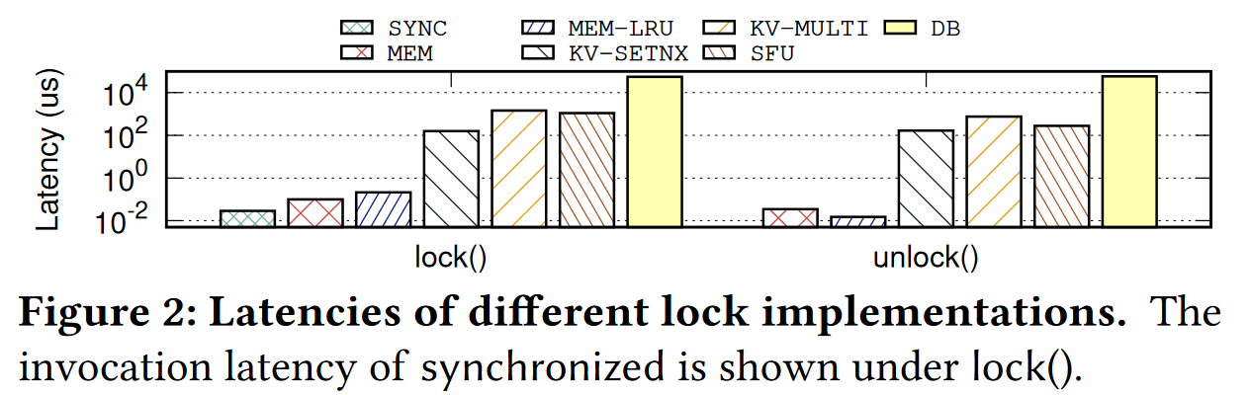
Different Primitive Implementations
Notes:
这个实验对比了各种同步方式的性能表现。
SYNC是编程语言提供的Sync关键字，MEM是基于内存的HashMap，Mem-LRU也是基于内存的HashMap，KV-SETNX是Redis的SETNX操作，KV-MULTI是基于Redis的多种操作实现的锁，SFU是Select for update，DB是用关系数据库中的表维护锁信息。
其中，最慢的是基于关系型数据库的锁表实现，这种情况下，锁的获取和释放执行于事务当中，需要首先执行Select来检查锁的状态，然后通过Update或Insert获取锁。由于数据库需要刷盘保证持久性，这种锁延迟最高。
基于Redis的两种锁、Select for update都具有ms级别的延迟。这些锁不涉及磁盘I/O。
基于内存结构的锁由于不涉及网络通信，延迟比基于Redis的锁更低。
基于Java Sync关键字实现的锁，延迟最低。

Slide 30
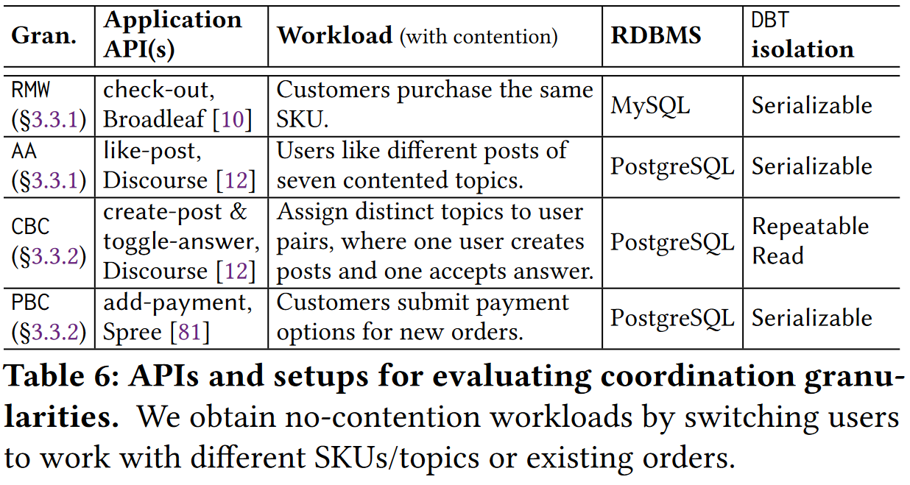
Different Coordination Granularities
Notes:
RMW: read-modify-write，AA：关联访问，CBC：基于列的并发控制，PBC：基于Predicate的并发控制

Slide 31
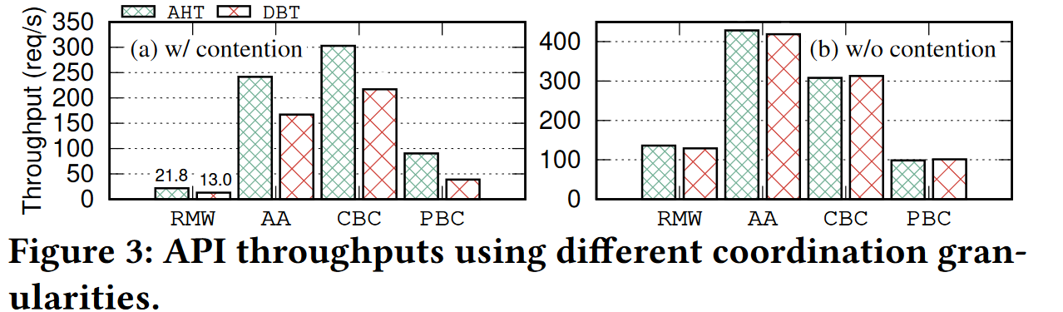
Different Coordination Granularities
Notes:
AHT：原始的Ad Hoc事务；DBT：一个使用最低可用隔离级别的数据库事务版本
在高竞争负载下，AHT能达到DBT 1.3倍的吞吐量，平均改善了为63.0%。
在无竞争负载下，AHT和DBT有着大致相同的性能表现。
由于Ad Hoc事务使用了更细粒度的基于列的锁和基于Predicate的锁，可以预先避免一些冲突，相比于基于数据库的并发控制有更高的性能。

Slide 32
Summary
Every studied application uses ad hoc transactions on critical APIs
Ad hoc transactions’ usages and implementations are much more flexible than database transactions
Ad hoc transactions are prone to errors
Ad hoc transactions can have performance benefits under highcontention workloads
Notes:
AHT：原始的Ad Hoc事务；DBT：一个使用最低可用隔离级别的数据库事务版本
在高竞争负载下，AHT能达到DBT 1.3倍的吞吐量，平均改善了为63.0%。
在无竞争负载下，AHT和DBT有着大致相同的性能表现。
由于Ad Hoc事务使用了更细粒度的基于列的锁和基于Predicate的锁，可以预先避免一些冲突，相比于基于数据库的并发控制有更高的性能。

Slide 33
Discussion
Why are ad hoc transactions error-prone and difficult to understand, but still widely used in the core API of many applications?
Functionality: Database transactions lack critical functionality. Certain coordinated business logic exposes characteristics difficult or impossible for database transactions to handle
Performance: Ad hoc transactions could perform better than database transactions under contentious workloads and similarly under no-contention ones
Thus, new abstractions and tools are needed
OCC Primitives
Proxy Module for Existing Hints
Development Support Tools

Slide 34
OCC Primitives
The CC of existing major database systems is based on either 2PL or multiversion concurrency control (MVCC)
As a result, if the application requires OCC, e.g., to deal with multi-request interactions developers have to craft optimistic ad hoc transactions.
New OCC primitives are required and, given that many systems are closed-source, they should be provided at the ORM layer

Slide 35
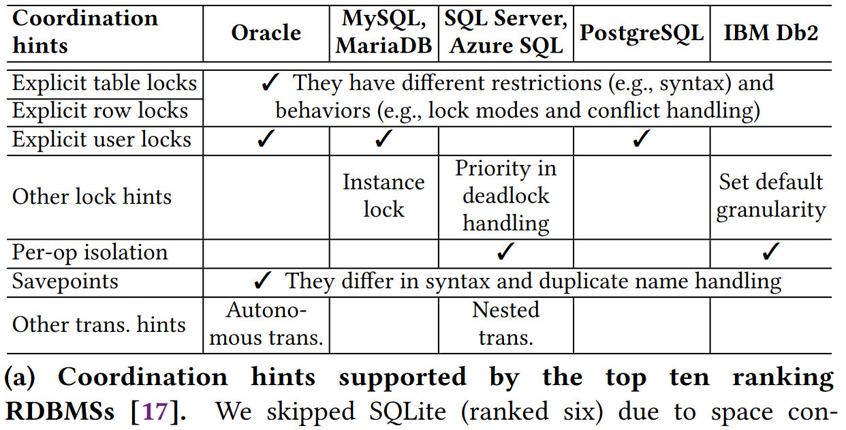
Proxy Module for Existing Hints
To expose advanced functionalities of existing database systems while hiding their differences, we argue for an application-level proxy module that provides general coordination customization interfaces
For generality, this module should provide fallbacks when the database system in use does not support certain hints

Slide 36
Development Support Tools
New development support tools must be devised to help developers locate ad hoc transactions, identify potential correctness and performance issues, and fix them by providing reliable suggestions
Ultimately, such tools should transform most ad hoc transactions into more modular forms, either database transactions or the new abstraction mentioned above.

Slide 37
Thanks

