Slide 1
Real-Time Quantification and Classification of Consistency Anomalies in Multi-tier Architectures
Conference: 2011 ICDE
Kamal Zellag
McGill University
zkamal@cs.mcgill.ca
Bettina Kemme
McGill University
kemme@cs.mcgill.ca

Slide 2
Introduction
As more and more clients concurrently access a service, It becomes increasingly difficult to provide users with a consistent view of the data and to guarantee that the actions of different users do not interfere with each other, especially in multi-tier architecture applications.
Several studies have analyzed the potential anomalies associated with the existing isolation levels. However, it is less clear whether a given application might actually experience such anomalies and if yes, to what degree.
Notes:
This problem is aggravated through the use of multi-tier architectures as execution is now distributed and data are spread across several components.
当前流行的Web服务框架大都是多层架构的
ORM(Object Relation Mapping)：利用描述对象和数据库之间映射的元数据，自动且透明地把Java应用程序中的对象持久化到关系数据库中的表。
Mybatis, Hibernate, Django
Read Uncommitted：脏读，不可重复读，幻读
Read Committed：不可重复读，幻读
Repeatable Read：幻读
Serializable：

Slide 3
Introduction
 | Dirty Read | Non-repeatable Read | Phantom Read
Read Uncommitted | Possible | Possible | Possible
Read Committed | Not Possible | Possible | Possible
Repeatable Read | Not Possible | Not Possible | Possible
Serializable | Not Possible | Not Possible | Not Possible

Slide 4
Introduction
ConsAD
Detect consistency anomalies in real-time
Arbitrary multi-tier application
Do not require any knowledge about the studied application
Support any isolation level that is higher than or equal to read-committed
Notes:
In this work, we propose a new approach for detecting in real-time consistency anomalies that may occur during the run time of an arbitrary multi-tier application. Our approach does not require any knowledge about the studied application and supports any isolation level that is higher than or equal to read committed.

Slide 5
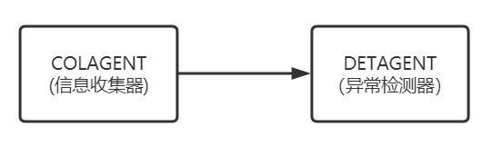
Introduction
ConsAD

Slide 6
Introduction
COLAGENT
Observes the execution and keeps track of the data items accessed by transactions and their execution order
Integrated into the middle-tier layer and is completely independent of the database system
Supports any multi-tier platform that is conform to the JavaEE (Java Enterprise Edition) standard, both for single-server as well as clustered configurations

Slide 7
Introduction
DETAGENT
Completely independent from the multi-tier architecture
Uses COLAGENT’S observations to dynamically build serialization graphs, and detects anomalies by finding cycles in the graph
For each detected cycle, DETAGENT generates detailed information about the transactions and the affected entities. It also classifies the detected anomalies into patterns of anomalies, where each pattern has a different set of business methods that are involved.

Slide 8
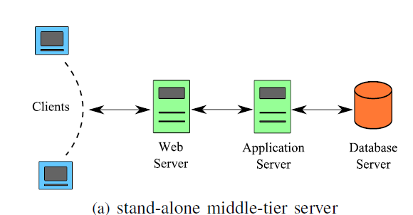
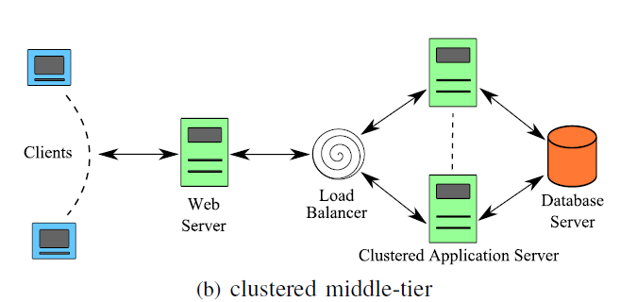
Background
Multi-tier Architectures
The web server (WS) tier handles the communication with external clients, provides static and dynamic web-pages and calls the application server tier (in this paper referred to as middle-tier) for more complex requests.
The middle-tier calls the database system when it has to access persistent data.

Slide 9
Background
Multi-tier Architectures of JavaEE
In JavaEE, the middle-tier consists of two layers.
The first implements the business logic and takes care of starting and committing transactions.
The second layer is the persistence layer which takes care of the mission-critical data that needs to be persisted in a database system.

Slide 10
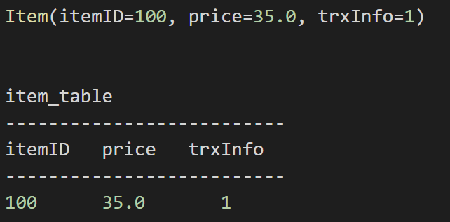
Background
Persistence Layer of JavaEE
In JavaEE, persistence is managed by the Java Persistence API (JPA). JBoss Hibernate and Oracle TopLink are two popular JPA implementations.
This layer provides a high-level object-oriented abstraction of the database layer. Each record of a database table is represented as an entity in the persistence
layer.

Slide 11
Background
Anomalies
Dirty-read
Unrepeatable-read
Lost-update

Slide 12
Background
Anomalies – Dirty read
Transaction A | Transaction B
BEGIN | BEGIN
W(X)
 | R(X) →dirty read
ROLLBACK

Slide 13
Background
Anomalies – Unrepeatable read
Transaction A | Transaction B
BEGIN | BEGIN
 | R(X)
W(X)
 | R(X) →Unrepeatable read

Slide 14
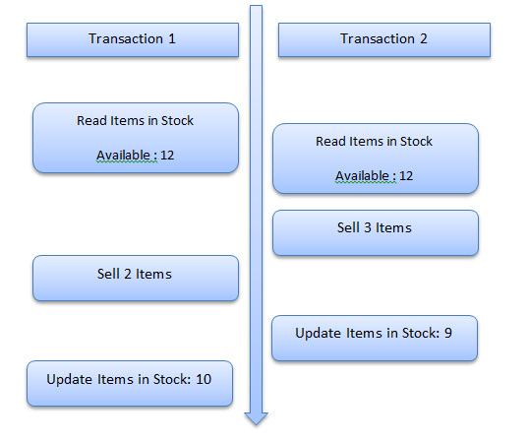
Background
Anomalies – Lost update
Transaction 1 reads the items in stock for laptops which is 12. A little later transaction 2 reads the value for ItemsinStock for laptops which will still be 12 at this point of time.
Transaction 2 then sells three laptops, shortly before transaction 1 sells two items.
Transaction 2 will then complete its execution first and update ItemsinStock to 9 since it sold three of the 12 laptops. Transaction 1 commits itself. Since transaction 1 sold two items, it updates ItemsinStock to 10.
This is incorrect, the correct figure is 12-3-2 = 7

Slide 15
Background
Middle-tier Concurrency Control
An entity can be considered a cached version of the corresponding database record. Entities are accessed through a set of methods provided by an entity manager (EM).
Entities can be read, inserted and deleted through corresponding EM methods.
To update an entity, it must be first read (loaded), then updated via setter methods, and then flushed back to the database. Thus, updates require more than one EM method call.

Slide 16
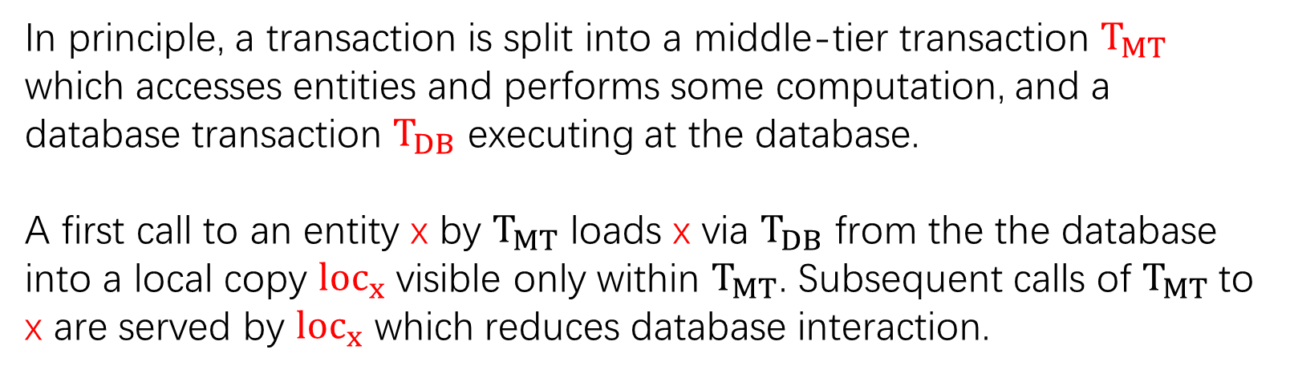
Background
Middle-tier Concurrency Control
In principle, a transaction is split into a middle-tier transaction $T_{MT}$ which accesses entities and performs some computation, and a database transaction $T_{DB}$ executing at the database.
A first call to an entity x by $T_{MT}$ loads x via $T_{DB}$ from the the database into a local copy ${loc}_{x}$ visible only within $T_{MT}$. Subsequent calls of $T_{MT}$to x are served by ${loc}_{x}$ which reduces database interaction.
由于中间层缓存了数据，就需要通过一些并发控制机制，维持一致性，提供合适的隔离级别保证

Slide 17
Background
Isolation Level of Middle-tier
Read-Committed (RC)
JPA OCC (JOCC)
Snapshot Isolation (SI)

Slide 18
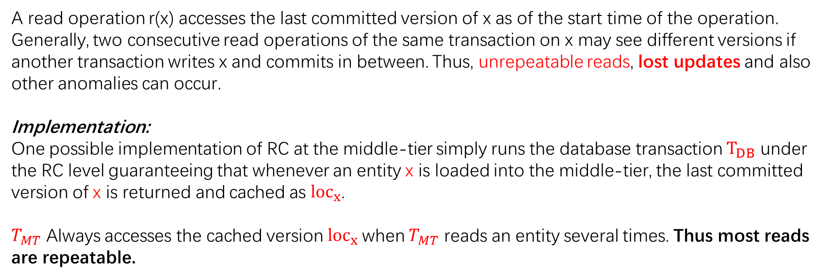
Background
Isolation Level of Middle-tier
Read-Committed (RC)
A read operation r(x) accesses the last committed version of x as of the start time of the operation. Generally, two consecutive read operations of the same transaction on x may see different versions if another transaction writes x and commits in between. Thus, unrepeatable reads, lost updates and also other anomalies can occur.
Implementation:
One possible implementation of RC at the middle-tier simply runs the database transaction $T_{DB}$ under the RC level guaranteeing that whenever an entity x is loaded into the middle-tier, the last committed version of x is returned and cached as ${loc}_{x}$.
$T_{MT}$ Always accesses the cached version ${loc}_{x}$when $T_{MT}$ reads an entity several times. Thus most reads are repeatable.

Slide 19
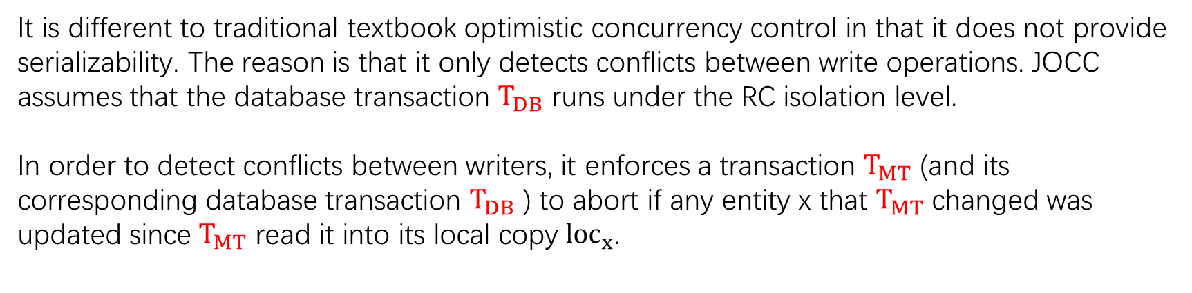
Background
Isolation Level of Middle-tier
JPA OCC (JOCC)
It is different to traditional textbook optimistic concurrency control in that it does not provide serializability. The reason is that it only detects conflicts between write operations. JOCC assumes that the database transaction $T_{DB}$ runs under the RC isolation level.
In order to detect conflicts between writers, it enforces a transaction $T_{MT}$ (and its corresponding database transaction $T_{DB}$ ) to abort if any entity x that $T_{MT}$ changed was updated since $T_{MT}$ read it into its local copy ${loc}_{x}$.

Slide 20
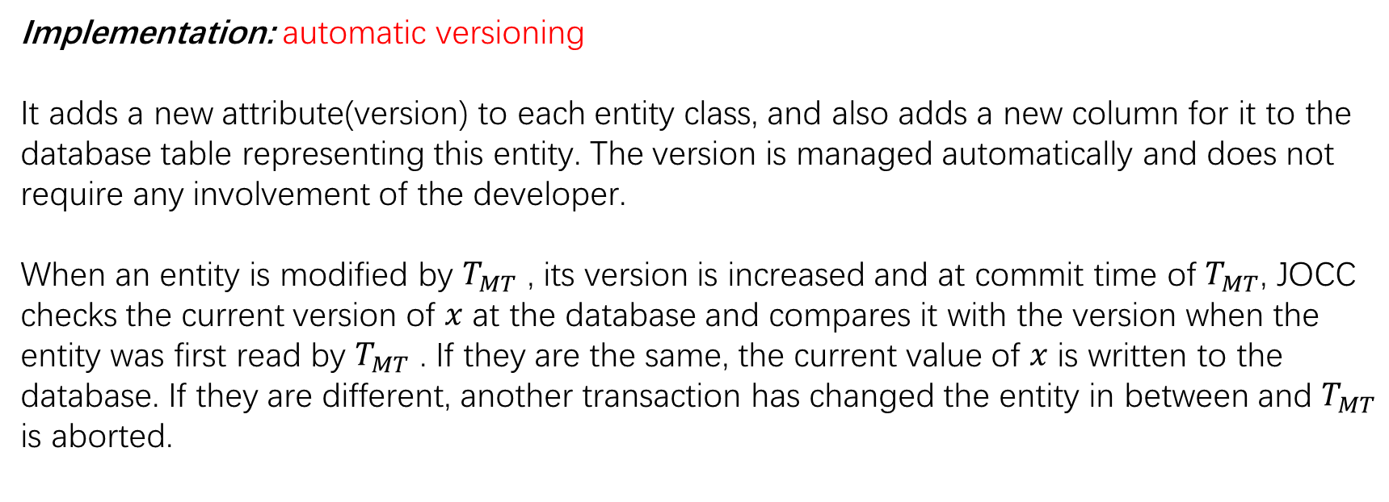
Background
Isolation Level of Middle-tier
JPA OCC (JOCC)
Implementation: automatic versioning
It adds a new attribute(version) to each entity class, and also adds a new column for it to the database table representing this entity. The version is managed automatically and does not require any involvement of the developer.
When an entity is modified by $T_{MT}$ , its version is increased and at commit time of $T_{MT}$, JOCC checks the current version of $x$ at the database and compares it with the version when the entity was first read by $T_{MT}$ . If they are the same, the current value of $x$ is written to the database. If they are different, another transaction has changed the entity in between and $T_{MT}$ is aborted.

Slide 21
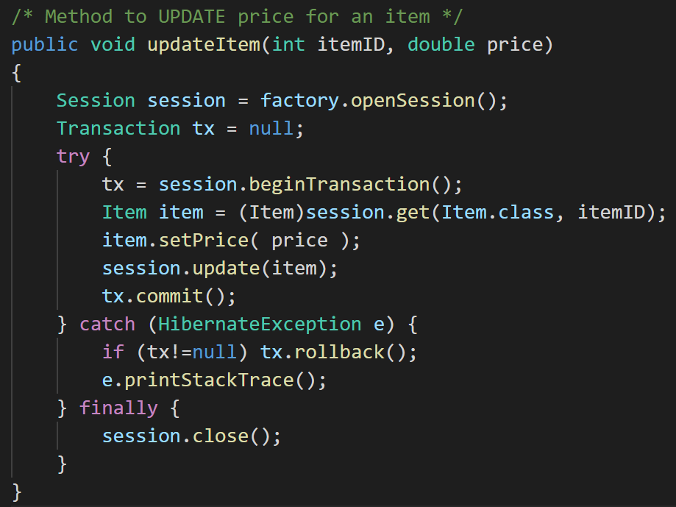
Background
Isolation Level of Middle-tier
itemID | price | version
100 | 35.0 | 1
Example
初始版本
JPA OCC (JOCC)
select itemID, price, version from item_table where itemID = 100; Result: (100, 35.0, 1)
update item_table set price=75.0, version=2 where itemID=100 and version=1;
itemID=100, price=75.0
Item(100, 35.0, 1)
Item(100, 75.0, 2)
如果事务在提交时发现已经有其他事务对item进行了修改，则终止本事务
避免了lost updates

Slide 22
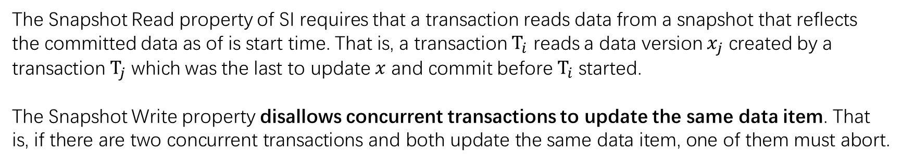
Background
Isolation Level of Middle-tier
Snapshot Isolation (SI)
The Snapshot Read property of SI requires that a transaction reads data from a snapshot that reflects the committed data as of is start time. That is, a transaction $T_{i}$ reads a data version $x_{j}$ created by a transaction $T_{j}$ which was the last to update $x$ and commit before $T_{i}$ started.
The Snapshot Write property disallows concurrent transactions to update the same data item. That is, if there are two concurrent transactions and both update the same data item, one of them must abort.
避免了lost updates

Slide 23
Background
Isolation Level of Middle-tier
Snapshot Isolation (SI)
Implementation:
the DB transaction must run under the SI isolation level instead of RC
no versioning system is needed

Slide 24
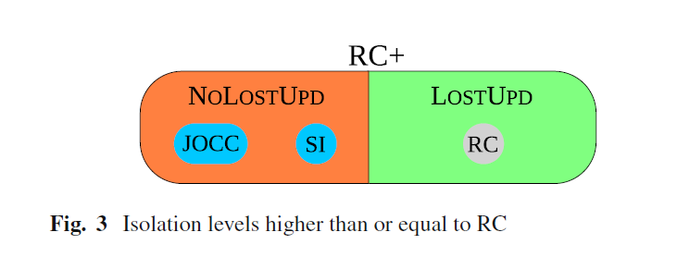
Background
Isolation Level of Middle-tier

Slide 25



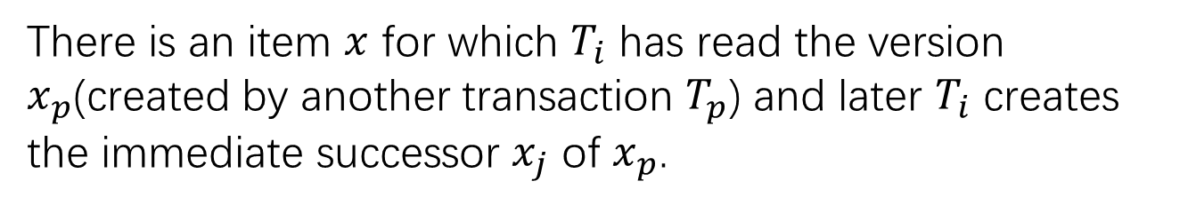
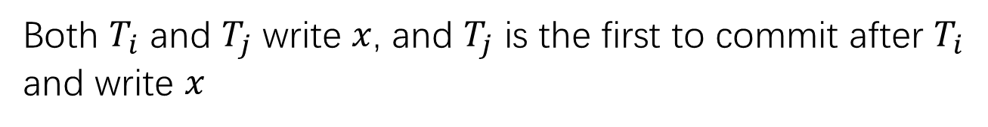
Background
Serialization Graph
$T_{i}$ creates version $x_{i}$ of $x$ and $T_{j}$ reads this version
Both $T_{i}$ and $T_{j}$ write $x$, and $T_{j}$ is the first to commit after $T_{i}$ and write $x$
There is an item $x$ for which $T_{i}$ has read the version $x_{p}$(created by another transaction $T_{p}$) and later $T_{i}$ creates the immediate successor $x_{j}$ of $x_{p}$.

Slide 26
Background
Transactions schedule
A schedule is serializable if and only if its serialization graph is acyclic.

Slide 27
Detection of anomalies
What is anomalies?
An anomaly occurs when the execution is unserializable, that is when the serialization graph has a cycle.
Thus, in the remainder of this paper, we use the words anomaly and cycle interchangeably.
anomaly = cycle

Slide 28
Detection of anomalies
ConsAD system consists of two agents.
The collector agent COLAGENT collects information about transactions and their accessed entities.
The detector agent DELAGENT determines all read-dependencies, write-dependencies and anti-dependencies and detects cycles.

Slide 29
Detection of anomalies
Collector Agent
The collector agent is integrated within the middle-tier application server and intercepts any read or write access to any entity by any middle-tier transaction.
One instance of COLAGENT is installed on each middle-tier server. COLAGENT must extract enough information so that DETAGENT can determine all dependencies.

Slide 30
Detection of anomalies
Collector Agent
Read-dependencies
Write-dependencies
Anti-dependencies
Collector Agent 需要收集足够的信息用于构造依赖图，主要是收集用于建立上述三种依赖关系的信息

Slide 31
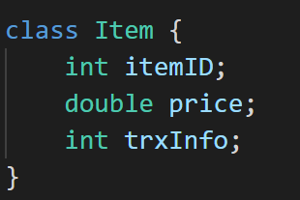
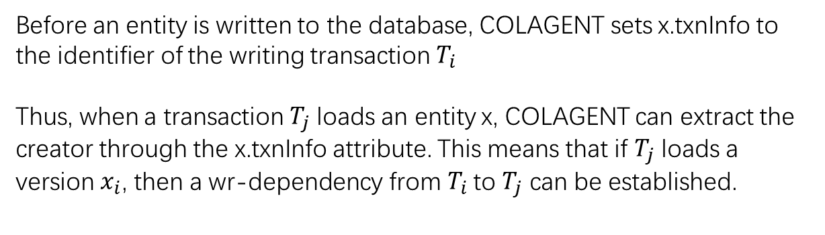
Detection of anomalies
Collector Agent
Read-dependencies
In order to extract this information, we track entity versions by adding an extra txnInfo attribute to each entity class.
Before an entity is written to the database, COLAGENT sets x.txnInfo to the identifier of the writing transaction $T_{i}$
Thus, when a transaction $T_{j}$ loads an entity x, COLAGENT can extract the creator through the x.txnInfo attribute. This means that if $T_{j}$ loads a version $x_{i}$, then a wr-dependency from $T_{i}$ to $T_{j}$ can be established.

Slide 32

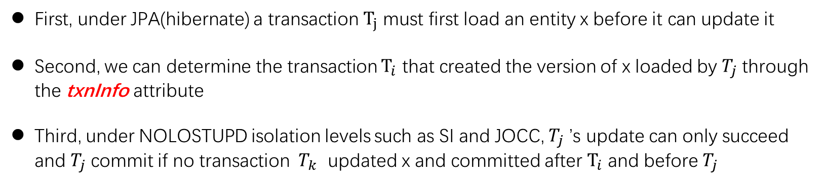
Detection of anomalies
Collector Agent
Write-dependencies
First, under JPA(hibernate) a transaction $T_{j}$ must first load an entity x before it can update it
Second, we can determine the transaction $T_{i}$ that created the version of x loaded by $T_{j}$ through the txnInfo attribute
Third, under NOLOSTUPD isolation levels such as SI and JOCC, $T_{j}$ ’s update can only succeed and $T_{j}$ commit if no transaction $T_{k}$ updated x and committed after $T_{i}$ and before $T_{j}$
Notes:
Proof. Since NOLOSTUPD avoids lost updates, it is guaranteed that no other transaction Tk has created a version xk and committed between rj(xi) and commit of Tj . At commit time of Tj , xj is installed, and since no version has been installed between xi and xj , xj is the immediate successor of xi.

Slide 33
Detection of anomalies
Collector Agent
Write-dependencies
However, if the isolation level allows lost-updates, such as possible with RC, Proposition 1 is not valid.
In this case, COLAGENT enforces a commit order for update transaction in order to be able to deduce ww-edges.
Solution: Exclusive transaction counter
Notes:
Proof. Since NOLOSTUPD avoids lost updates, it is guaranteed that no other transaction Tk has created a version xk and committed between rj(xi) and commit of Tj . At commit time of Tj , xj is installed, and since no version has been installed between xi and xj , xj is the immediate successor of xi.

Slide 34
Detection of anomalies
Collector Agent
Write-dependencies
Implementation 1: memory based counter
In the first solution, at commit time of an update transaction T, COLAGENT get an exclusive lock on a memory-based counter, increments it and assigns the new value to T.co.
The lock is only released after T committed at the database. However, this solution works only when a standalone middle-tier is used
Implementation 2: database counter
The second solution is a database counter, that is accessed in an exclusive way using the SELECT FOR UPDATE statement and works for both stand-alone and clustered middle-tier configurations
Notes:
Proof. Since NOLOSTUPD avoids lost updates, it is guaranteed that no other transaction Tk has created a version xk and committed between rj(xi) and commit of Tj . At commit time of Tj , xj is installed, and since no version has been installed between xi and xj , xj is the immediate successor of xi.

Slide 35
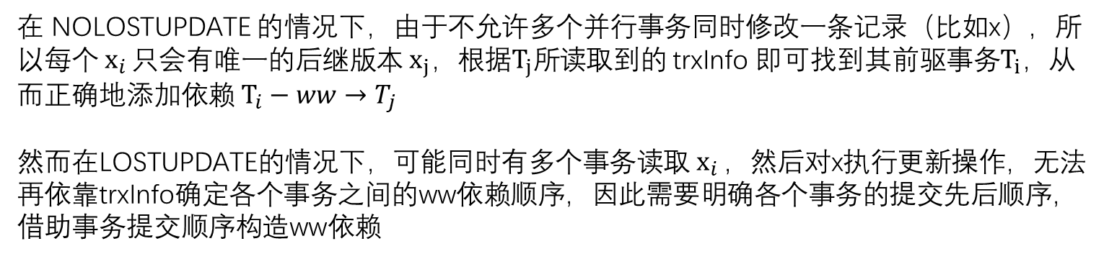
Detection of anomalies
Collector Agent
Write-dependencies
在 NOLOSTUPDATE 的情况下，由于不允许多个并行事务同时修改一条记录（比如x），所以每个$x_{i }只$会有唯一的后继版本${ x}_{j}，$根据$T_{j}所$读取到的 trxInfo 即可找到其前驱事务$T_{i}，$从而正确地添加依赖$T_{i}−ww→T_{j}$
然而在LOSTUPDATE的情况下，可能同时有多个事务读取${ x}_{i }$，然后对x执行更新操作，无法再依靠trxInfo确定各个事务之间的ww依赖顺序，因此需要明确各个事务的提交先后顺序，借助事务提交顺序构造ww依赖
Notes:
Proof. Since NOLOSTUPD avoids lost updates, it is guaranteed that no other transaction Tk has created a version xk and committed between rj(xi) and commit of Tj . At commit time of Tj , xj is installed, and since no version has been installed between xi and xj , xj is the immediate successor of xi.

Slide 36
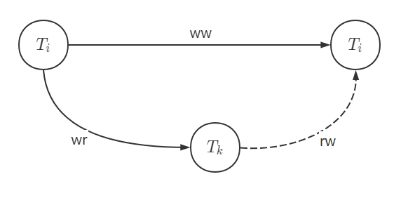
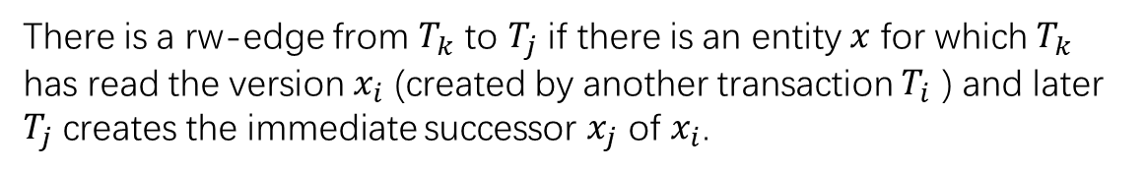
Detection of anomalies
Collector Agent
Anti-dependencies
There is a rw-edge from $T_{k}$ to $T_{j}$ if there is an entity $x$ for which $T_{k}$ has read the version $x_{i}$ (created by another transaction $T_{i}$ ) and later $T_{j}$ creates the immediate successor $x_{j}$ of $x_{i}$.

Slide 37
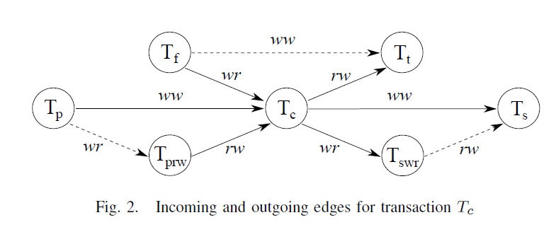
Detection of anomalies
Detector Agent
The detector agent DETAGENT takes the information collected by COLAGENT and dynamically builds the graph and detects cycles.

Slide 38
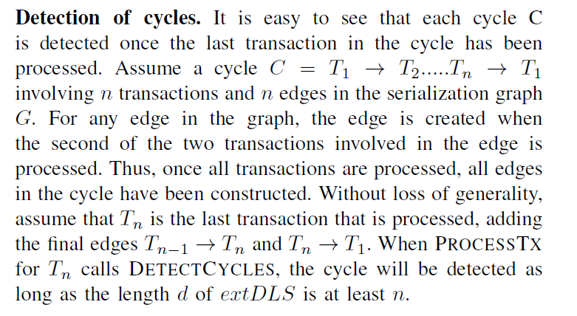
Detection of anomalies
Detector Agent

Slide 39
Detection of anomalies
Detector Agent
Implementation of Detection of cycles: Depth-Limited-Search (DLS) algorithm
Our choice for DLS derives from the experience that cycles in serialization graphs do usually contain only a limited number of transactions, thus specifying a reasonably small DLS depth works well enough for our purposes.
The depth is configurable.

Slide 40
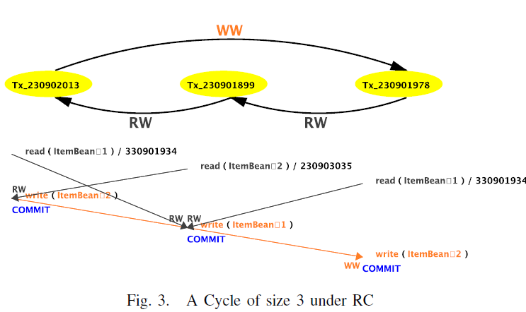
Patterns Classification
So far, the information that DETAGENT provides for each cycle C contains the identifiers of the transaction involved, the edges between the transactions and their types, and the accessed entities.
For each edge, DELAGENT can also indicate the business methods that were involved as COLAGENT provides this information.
However, if there are many different cycles, it is difficult to check what in the application actually caused these cycles.

Slide 41
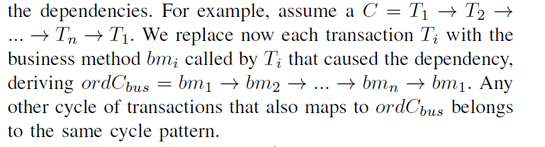
Patterns Classification
For each detected cycle C, we extract the business methods that have created it and present the pattern of calls that lead to the cycle.
Ordered classification: the order of business methods in each cycle in taken in consideration

Slide 42

Patterns Classification
Unordered classification: the order of business methods is not important
不考虑环中业务方法出现的次数以及顺序，按照环中业务方法的集合分类
归入

Slide 43
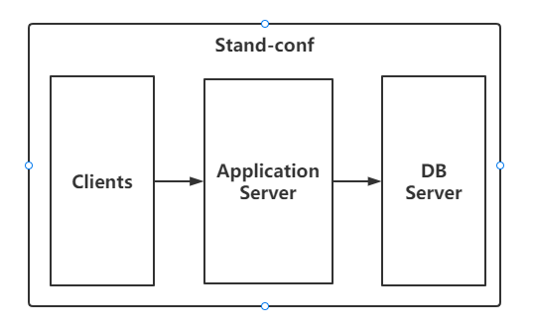
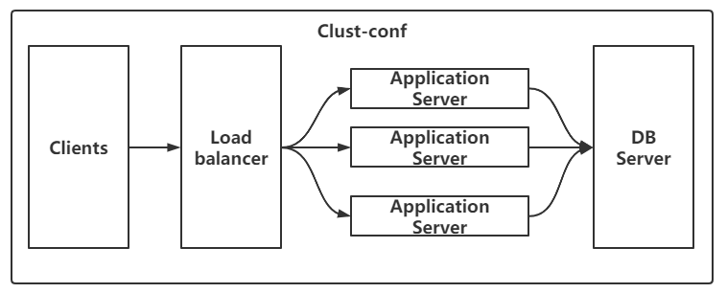
Experiments
Benchmark:
RUBiS(一个只读事务browsing-mix，一个读写事务bidding-mix) + DailyDeal(引入高冲突)
Hardware and Software Configurations:
JBoss6.0.0 as an application server with its persistence layer Hibernate3.5.0
PostgreSQL8.4 as database server

Slide 44
Experiments
Experiment Config1: 80% browsing-mix and 20% bidding-mix
Result:
For config1 we were unable to see any cycle under any isolation level for all evaluated throughput levels, thus we are not showing any figures related to tests under config1. Thus, at least for the tested configuration, none of the isolation levels leads to any anomalies, and any of them can be used.
That is, with this application type, the isolation level with the best performance can be chosen, as even lower isolation levels do not produce any unserializable executions.

Slide 45
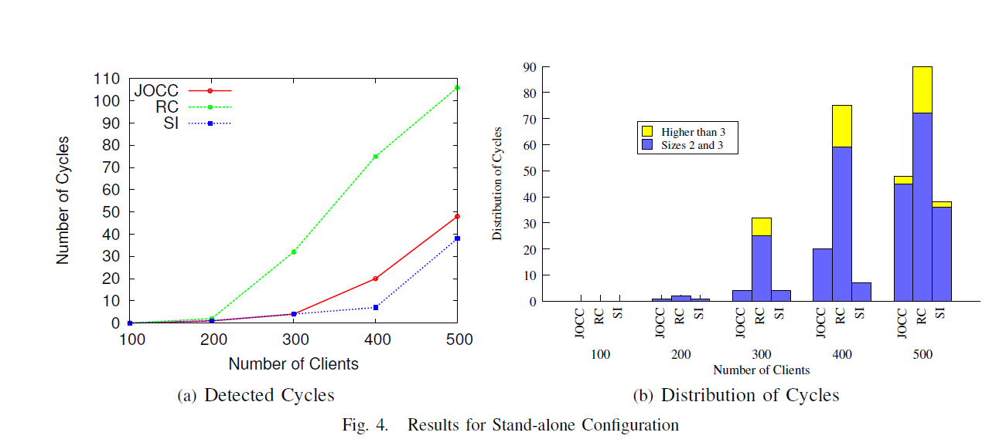
Experiments
Experiment Config2: 50% browsing-mix, 20% bidding-mix and 30% DailyDeal
Result:

Slide 46
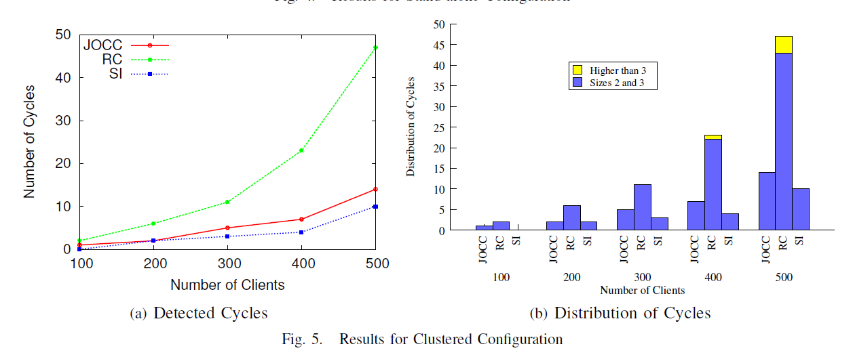
Experiments
Experiment Config2: 50% browsing-mix, 20% bidding-mix and 30% DailyDeal
Result:

Slide 47
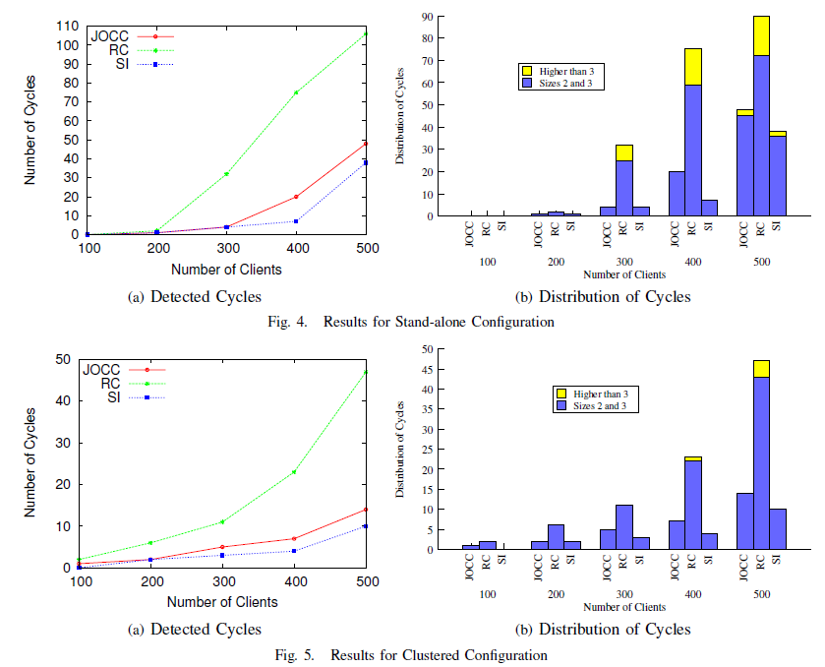
Experiments

Slide 48
Experiments
The pattern visualization shows quickly how dependencies are generated between the business methods leading to cycles.
In particular, two DailyDeal methods alone can already lead to a cycle, if one reads entities x and y and updates x, while another reads x and y and updates y.
However, DailyDeal also triggers cycles with other methods that otherwise interacted cycle-free before.
By looking at these cycles and their frequencies, the application designers can decide whether they can accept the inconsistencies, whether a higher level of isolation should be chosen, or whether the methods should be rewritten to avoid the anomalies.

Slide 49
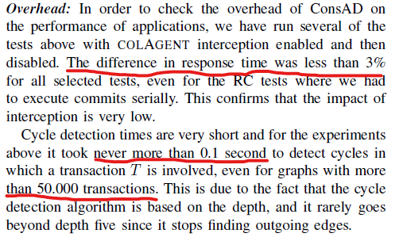
Experiments

