Slide 1
FoundationDB: A Distributed Unbundled Transactional Key Value Store
Apple Inc.、Snowflake Inc.
SIGMOD 2021

Slide 2
主要特点
读写分离，写走事务，读直接穿透事务层到存储层
新颖的分布式OCC/MVCC事务模型
简单快速的恢复与启动
类似quorum机制的副本，每次都保证f+1个均写入成功
重视geo-replication
完善可确定性复现bug的注入错误测试框架

Slide 3
Design Principles
Divide-and-Conquer（or separation of concerns） FDB将事务管理系统的读写路径分离，分别实现了写与读各自的可扩展性。
Make failure a common case 分布式系统里failure是很常见的一种现象。FDB处理的方式是直接重启。
Fail fast and recover fast 为了确保可用性，FDB需要支持快速启动。
Simulation testing 随机化的确定性测试框架，每一次错误都可以重复。
Notes:
FDB先用了两年开发出自己的测试框架，注入错误，用了很多可编程逻辑阵列

Slide 4
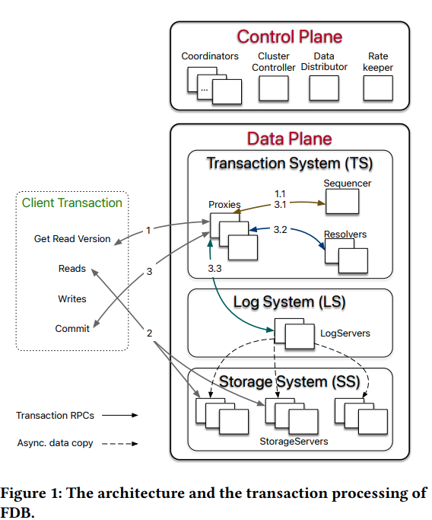
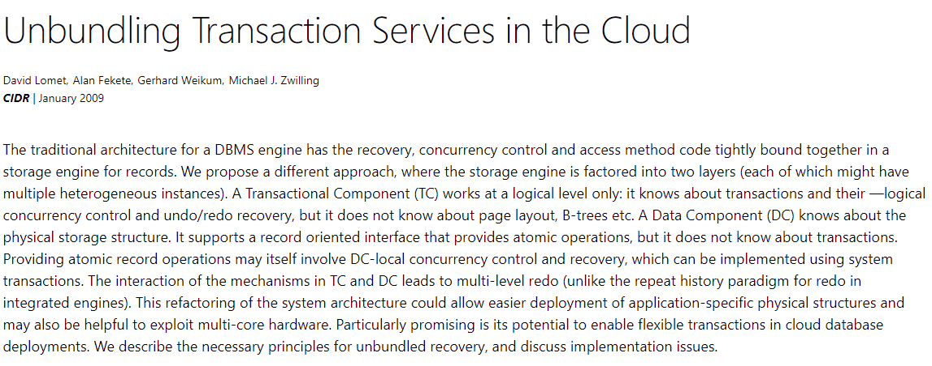
Design
unbundled architecture
Control Plane 包括了Coordinators, Cluster Controller, Data Distributor和Rate Keeper.
Data Plane 包括三个部分: Transaction System(TS), Log System(LS)，Storage System(SS).
Notes:
The traditional architecture for a DBMS engine has the recovery, concurrency control and access method code tightly bound together in a storage engine for records. A Transactional Component (TC) works at a logical level only: it knows about transactions and their ―logical concurrency control and undo/redo recovery, but it does not know about page layout, B-trees etc. A Data Component (DC) knows about the physical storage structure. 事务与存储分离

Slide 5
Control Plane
Coordinators: 组成一个disk Paxos group，持久化系统的各类元配置信息，负责选择Cluster Controller。
ClusterController(CC): 监控集群里的所有服务器，并且选择三个单例服务，Sequencer，DataDistributor和Ratekeeper。
DataDistributor(DD): 负责监 控failure和均衡StorageServer 的数据。
RateKeeper: 防止集群过载。
Notes:
Disk Paxos基于Active Disk的Paxos
Active Disk: (计算靠近存储，一个integrate significant processing power and memory into a disk drive and allow application-specific code to be downloaded and executed的框架)

Slide 6
Data Plane
Transaction System(TS): 一个用于提供分布式in-memory事务处理的子系统。
Sequencer: 用于分配read version和 write version。
Proxies: 向client提供MVCC的read versions，并协调事务的提交。
Resolvers: 负责处理事务之间的 conflict。
Notes:
实际的实现里是有一个Master实例，其中包含了Proxies，Resolvers和Log Servers，组成一个单元，该单元中的任意一个损坏，都会导致 整个单元被更换。

Slide 7
Data Plane
Log System(LS): 由LogServers的集合组成，为TS存储WAL日志，表现为replicated, sharded, distributed queues，每个queue都为一个StorageServer存储对应的WAL日志。
Storage System(SS): 由负责处理读请求的StorageServers组成，每一个StorageServer存储一个data shard。目前的存储引擎是加入了range优化，延迟的后台delete和异步编程等特性的SQLite。内存部分有version，磁盘部分无version。
Notes:
实际的实现里是有一个Master实例，其中包含了Proxies，Resolvers和Log Servers，组成一个单元，该单元中的任意一个损坏，都会导致 整个单元被更换。
内存部分有version与磁盘部分无version的原因：recover的时候更加方便，直接删除即可。

Slide 8
Terminology
read version：每个read version都要确保不小于任意在Tx开始时已经commit的version。注意read version的获取需要Proxy向每个Proxy请求，然后取最大的。
commit version：要比任何现存的read或者commit versions大。
LSN：commit version作为LSN，Proxy在发送请求时会带上LSN和Previous LSN，以确保Resolver和LogServer都会按照顺序处理事务。
Notes:
read version的获取需要Proxy向每个Proxy请求。因为直接向master请求，需要每次都等待master的txn全部完成，时延太高

Slide 9
Transaction Management
事务执行流程:
向任意一个Proxy获取一个read version。
从SS请求读取数据。
本地写入。
client向Proxy发起Commit请求，Proxy向Sequencer获取一个commit version。
由Resolver检测事务冲突。
LS确认f+1个副本均已成功刷入。
返回client commit成功。
异步写入SS。

Slide 10
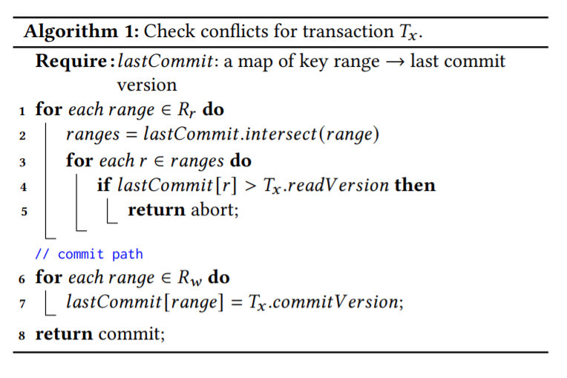
Transaction Management

Slide 11
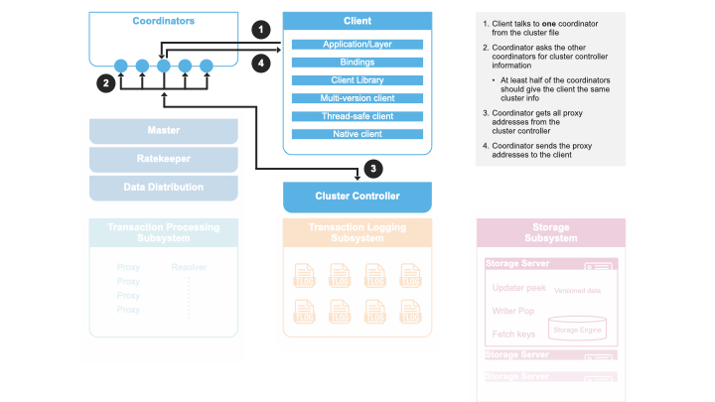
Transaction Management

Slide 12
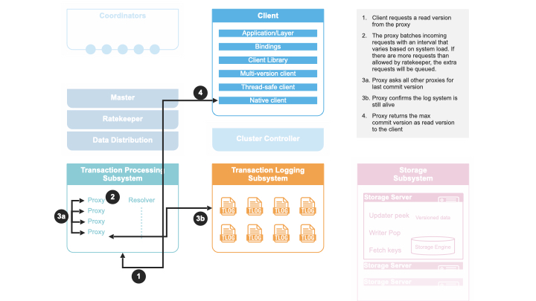
Transaction Management

Slide 13
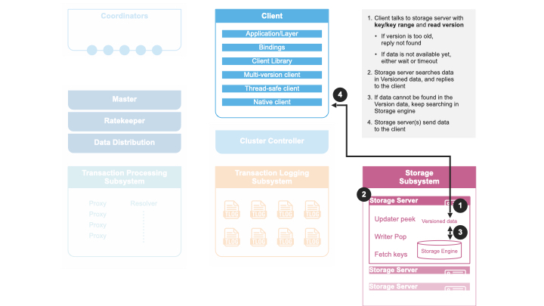
Transaction Management

Slide 14
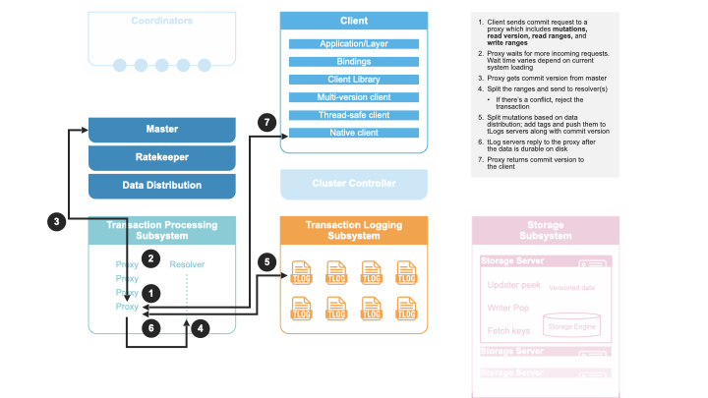
Transaction Management

Slide 15
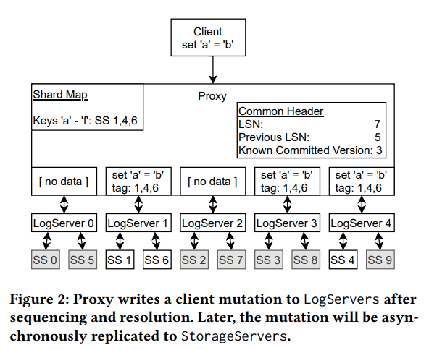
Logging Protocol
Notes:
1. After a Proxy decides to commit a transaction, the log message is broadcast to all LogServers.
2. Because the log data is already durable on LogServers, StorageServers can buffer updates in memory and only persist
batches of data to disks with a longer delay, thus improving I/O efficiency by coalescing the updates.

Slide 16
Read-only Transactions & Snapshot Reads
对于Read-only的Transaction，client无须与Proxy交互，在本地就可以直接commit。
对于Snapshot Reads，FDB不会将它们放入读集之中。

Slide 17
Transaction System Recovery
recover的步骤
从Coordinator获取系统状态，并锁定Coordinator。
Sequencer开始恢复关于旧的LogServers的信息，并关闭旧的LogServers。
重建新的事务系统后，Sequencer就写入新的事务系统状态到Coordinators中。
开始执行新的事务。
When will recovery happen? Proxies，LogServers等挂掉的话；网络故障导致半数以上Coordinator无法被CC访问到；Better master；Configuration change。SS或者DD的failure不会触发recovery。
Notes:
Because Proxies and Resolvers are stateless, their recoveries
have no extra work. In contrast, LogServers save the logs of committed transactions, and we need to ensure all previously committed
transactions are durable and retrievable by StorageServers.
Failure of certain roles in FDB can cause recovery. Those roles are cluster controller, master, GRV proxy, commit proxy, transaction logs (tLog), resolvers, log router, and backup workers.

Slide 18
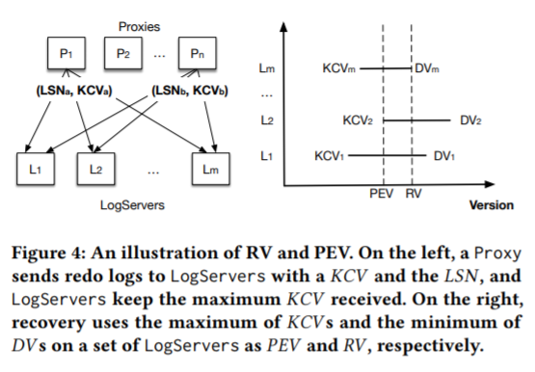
Transaction System Recovery
重建新的事务系统
Proxies & Resolvers：由于是无状态的服务，所以恢复很简单，直接恢复即可。
LogServers：需要决定redo log的end，也就是Recovery Version(RV)，在这之后的都可以删除。

Slide 19
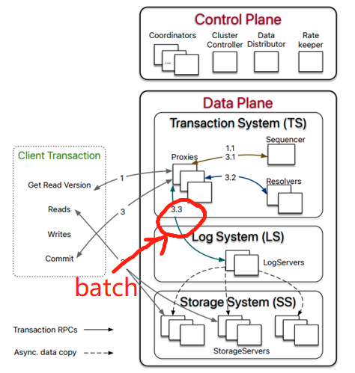
Other Optimizations
Transaction batching：传输Log时按照batch的方式来进行传输，减少网络I/O。
Atomic operations：atomic add, bitwise “and”等。

Slide 20
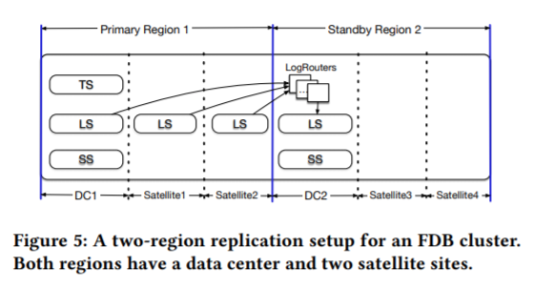
Geo-replication and failover
Notes:
LogRouter的设计：减少WAN的网络I/O
还有其他可能的配置方案，在容错与性能间tradeoff

Slide 21
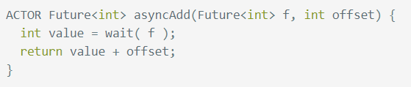
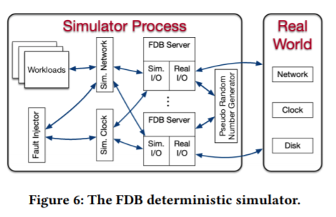
Simulation testing
作者设计了Flow（一个actor-based concurrency的C++框架）
基于Flow实现了他们的simulation技术Simulation，最重要的特征是deterministic simulation of an entire FoundationDB（single-threaded process）
Notes:
Actor
Deterministic
Single-threaded, multithreaded concurrency is avoided
Test oracles & Fault injection(tidb)

Slide 22
Simulation testing
传统的随机测试采用的是用一个configuration来尽可能地扩大code coverage。Swarm testing采用增大测试用例的多样性的方式来增大coverage和fault injection。
文中实现了一个开源的针对FoundationDB的Swarm testing框架，每次run都会有不同的cluster size，configuration等。
Conditional coverage：文中使用如TEST(buffer.is_full())的条件语句来确保某些branch的语句被invoke的次数足够多。

Slide 23
Performance testing
对于Performance testing，FoundationDB采用的测试方式是在用他们的“Circus”环境运行多个测试，指定每个测试的配置（如workload，cluster等），测试可以parallel地运行，也可以线性地运行，每天都会对性能进行比对，用图形化的方式进行展示。

Slide 24
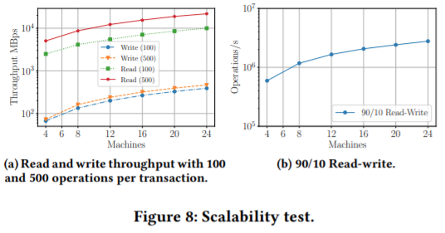
Evaluation-Scalability test
Notes:
The experiments were conducted on a test cluster of 27 machines in a single data center. Each machine has a 16-core 2.5 GHz Intel Xeon CPU with hyper-threading enabled, 256 GB memory, 8 SSD disks, connected via 10 Gigabit Ethernet. Each machine runs 14 StorageServers on 7 SSD disks and reserves the other one SSD for LogServer. In the experiments, we use the same number of Proxies and LogServers. The replication degrees for both LogServers and StorageServers are set to three
(8.a)For both reads and writes, increasing the number operations in a transaction boosts throughput. However, increasing operations further (e.g. to 1000) doesn’t bring significant changes.(8.b) Figure 8b shows the operations per second for 90/10 read-write traffic, which increases from 593k to 2,779k (4.69X). In this case, Resolvers and Proxies are CPU saturated.
Figure 9 illustrates the client performance on a 24-machine cluster with varying operation rate of 90/10 read-write load.
When Ops exceeds 100k, all these latencies increase because of more queuing time. At 2m Ops, Resolvers and Proxies are saturated. Batching helps to sustain the throughput, but commit latency spike to 368ms due to saturation.

Slide 25
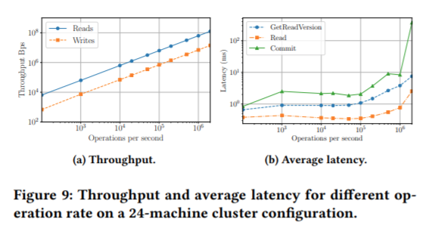
Evaluation-Scalability test
Notes:
Figure 9 illustrates the client performance on a 24-machine cluster with varying operation rate of 90/10 read-write load.
When Ops exceeds 100k, all these latencies increase because of more queuing time. At 2m Ops, Resolvers and Proxies are saturated. Batching helps to sustain the throughput, but commit latency spike to 368ms due to saturation.

Slide 26
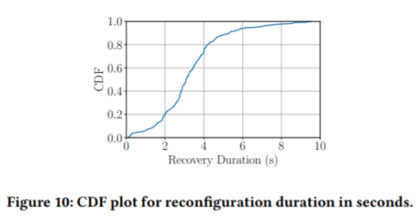
Evaluation-Recovery Duration
Notes:
289reconfiguration, median 3.08s, 90-percentile 5.28s

Slide 27
Lessons Learned
高端先进的decoupling架构设计
优雅全面的测试框架
快速恢复
节约内存的5s MVCC window设计

