Slide 1
CockroachDB: The Resilient Geo-Distributed SQL Database
Rebecca Taft, Irfan Sharif, Andrei Matei, Nathan VanBenschoten, Jordan Lewis,
Tobias Grieger, Kai Niemi, Andy Woods, Anne Birzin, Raphael Poss, Paul Bardea,
Amruta Ranade, Ben Darnell, Bram Gruneir, Justin Jaffray,
Lucy Zhang, and Peter Mattis

Slide 2
Focusing on the following features
Fault tolerance and high availability
Geo-distributed partitioning and replica placement
High-performance transactions
Additional feature:
cloud-neutral: can span an arbitrary number of different public and private clouds
trying to make it serverless: improve support for operational automation
geo-aware query optimizations

Slide 3
Architecture of CockroachDB
SQL
SQL Layer
KV operations
Gateway
Transactional KV Layer
SQL Client, Load Balancing
Multiple KV range atomic operations
Distribution Layer
LeaseHolder
A single logical key range
Replication
RaftLeader
Replicate KV ranges over many nodes
Storage
KV store base on disk(RocksDB etc.)
Notes:
SQL: 负责解析编译，优化查询树，和执行引擎
Transactional KV: 一个具有事务功能的KV， 确保SQL层发来的跨多个KV pair的请求仍然可以保持atomicity和isolation，a single monolithic sorted map
Distribution: 代表了一个逻辑上的key的分区，一个分区64MB，称为一个Range。As described in the meta ranges section, the locations of all the ranges in a cluster are stored in a two-level index。1. Receives requests from the transaction layer on the same node. 2. Identifies which nodes should receive the request, and then sends the request to the proper node's replication layer.
Replication：每一个Range都会复制3份，consensus-based replication
Storage：本地的基于disk的一个KV store

Slide 4
Raft Consensus
What is Consensus? 5 machines need to work even if 2 of them are down.
Raft (thesecretlivesofdata.com)
Raft Consensus Algorithm

Slide 5
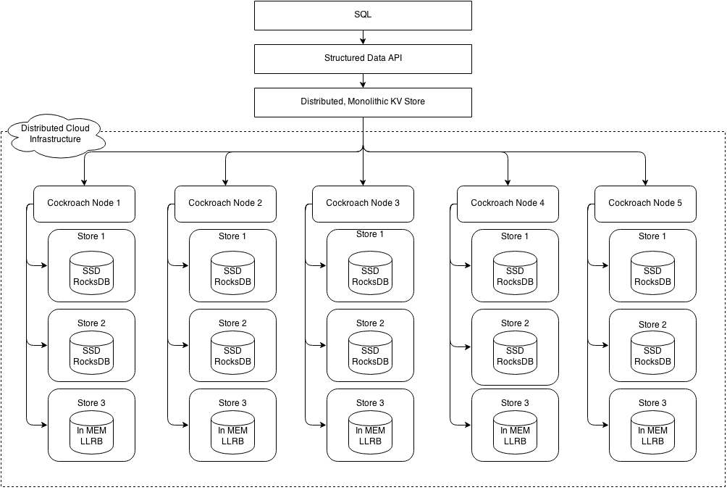

Slide 6
Transaction
Writes and Reads(Phase 1)
Write: write intent
Read: MVCC vs. write intent
Commits(Phase 2)
Sets the transaction record's state to STAGING, and checks the transaction's pending write intents to see if they have succeeded (i.e., been replicated across the cluster).
Cleanup(Phase 3)
Moves the state of the transaction record from STAGING to COMMITTED.
Resolves the transaction's write intents to MVCC values by removing the element that points it to the transaction record.
Deletes the write intents.
Notes:
If the transaction has not been aborted, the transaction layer begins executing read operations. If a read only encounters standard MVCC values, everything is fine. However, if it encounters any write intents, the operation must be resolved as a transaction conflict.

Slide 7
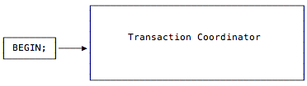
Transaction
Notes:
The client starts the transaction. A transaction coordinator is created to manage the state of that transaction.

Slide 8
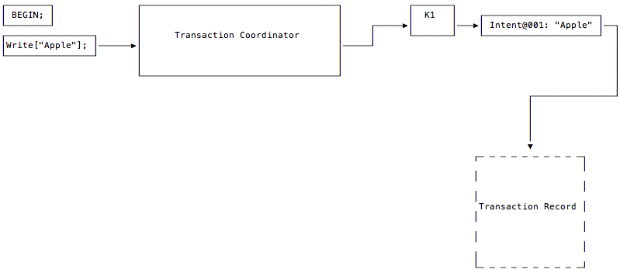
Transaction
Notes:
The client issues a write to the "Apple" key. The transaction coordinator begins the process of laying down a write intent on the key where the data will be written. The write intent has a timestamp and a pointer to an as-yet nonexistent transaction record. Additionally, each write intent in the transaction is assigned a unique sequence number which is used to uniquely identify it.
The coordinator avoids creating the record for as long as possible in the transaction's lifecycle as an optimization. The fact that the transaction record does not yet exist is denoted in the diagram by its dotted lines.

Slide 9
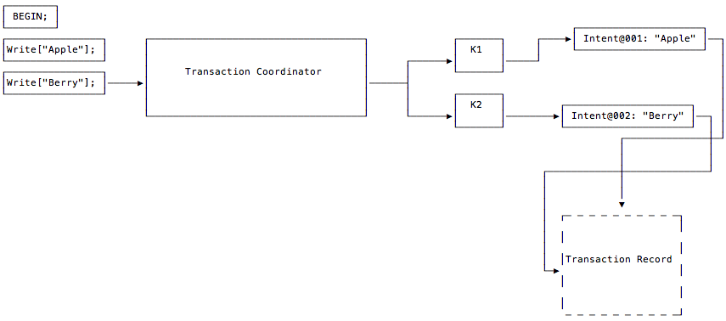
Transaction
Notes:
The client issues a write to the "Berry" key. The transaction coordinator lays down a write intent on the key where the data will be written. This write intent has a pointer to the same transaction record as the intent created in Step 2, since these write intents are part of the same transaction.
As before, the coordinator does not need to wait for write intents to replicate from leaseholders before moving on to the next statement from the client.

Slide 10
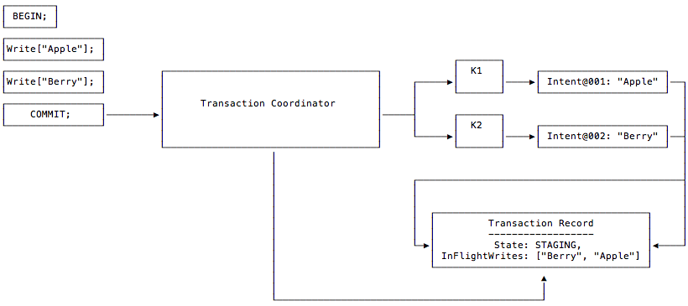
Transaction
Notes:
The client issues a write to the "Berry" key. The transaction coordinator lays down a write intent on the key where the data will be written. This write intent has a pointer to the same transaction record as the intent created in Step 2, since these write intents are part of the same transaction.
As before, the coordinator does not need to wait for write intents to replicate from leaseholders before moving on to the next statement from the client.
Parallel Commits在论文中的实验中为throughput带来了72%的提升，并至少减小了47%p50的latency

Slide 11
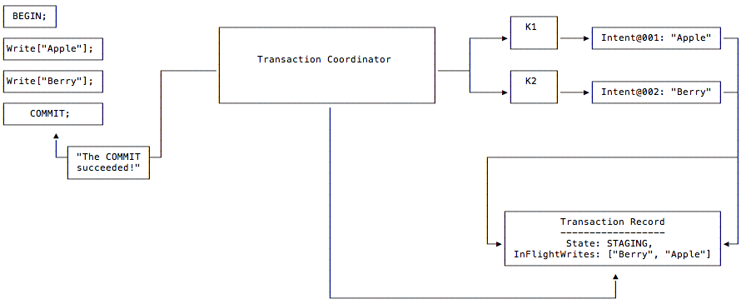
Transaction
Notes:
The transaction coordinator, having received the client's COMMIT request, waits for the pending writes to succeed (i.e., be replicated across the cluster). Once all of the pending writes have succeeded, the coordinator returns a message to the client, letting it know that its transaction has committed successfully.

Slide 12
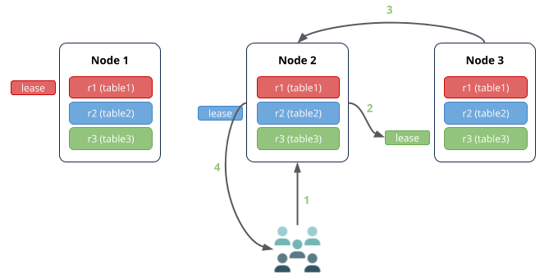
Transaction
Notes:
Read Scenario 1
Node 2 (the gateway node) receives the request to read from table 3.
The leaseholder for table 3 is on node 3, so the request is routed there.
Node 3 returns the data to node 2.
Node 2 responds to the client.

Slide 13
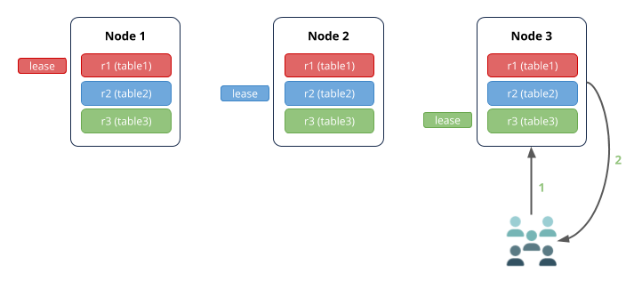
Transaction
Notes:
Read Scenario 2
Node 2 (the gateway node) receives the request to read from table 3.
The leaseholder for table 3 is on node 3, so the request is routed there.
Node 3 returns the data to node 2.
Node 2 responds to the client.

Slide 14
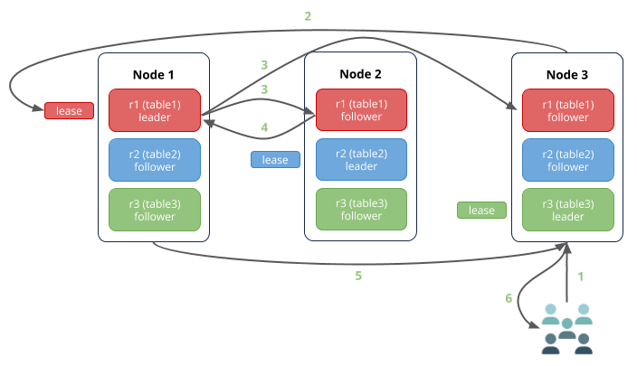
Transaction
Notes:
Write Scenario
Node 3 (the gateway node) receives the request to write to table 1.
The leaseholder for table 1 is on node 1, so the request is routed there.
The leaseholder is the same replica as the Raft leader (as is typical), so it simultaneously appends the write to its own Raft log and notifies its follower replicas on nodes 2 and 3.
As soon as one follower has appended the write to its Raft log (and thus a majority of replicas agree based on identical Raft logs), it notifies the leader and the write is committed to the key-values on the agreeing replicas. In this diagram, the follower on node 2 acknowledged the write, but it could just as well have been the follower on node 3. Also note that the follower not involved in the consensus agreement usually commits the write very soon after the others.
Node 1 returns acknowledgement of the commit to node 3.
Node 3 responds to the client.

Slide 15
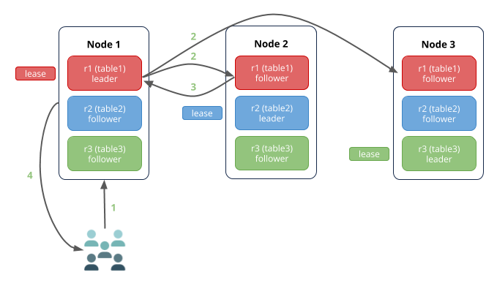
Transaction
Notes:
Write Scenario
Just as in the read scenario, if the write request is received by the node that has the leaseholder and Raft leader for the relevant range, there are fewer network hops

Slide 16
Transaction
Write-Read Conflicts: 读操作可能会遇到比自身ts低的write intent时会检查优先级和liveness，这些检查都无误后，会等待它完成，等待的方式是用queue的方式。对于比自己ts高的write intent直接跳过即可。CRDB做的一个优化是queue目前会优先在本地进行等待。
Write-Write Conflicts：与Write-Read Conflicts的处理方式类似。
X
ts:3
X
txn record
Y
ts:4

Slide 17
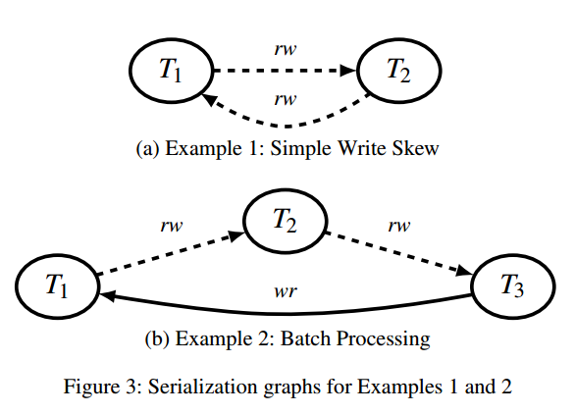
Transaction - SSI
Every cycle in the serialization，history graph contains a sequence of edges T1 ==rw==> T2 ==rw==>> T3，where each edge is a rw-antidependency. Furthermore, T3 must be the first transaction in the cycle to commit.
----“Making snapshot isolation serializable”.
Transaction T1 is concurrent with T2, and T2 is concurrent with T3, because rw-antidependencies occur only between
concurrent transactions.
----”Serializable snapshot isolation in PostgreSQL”
Notes:
SSI

Slide 18
Transaction
Read-Write Conflicts：与前两个都可以用write intent检测的Conflict不同，这个conflict需要用timestamp cache检测，timestamp cache是一个保存了key range的读取ts高水位的数据结构，保存在内存中。如果发现该conflict就会尝试push写txn的ts。
Uncertainty Conflicts：该Conflicts是由引入的HLC引起，由于具有不确定性，因而可能需要push txn的ts。做法是发现比自己大但又在uncertainty interval范围内的write intent以后，就push自己的ts。

Slide 19
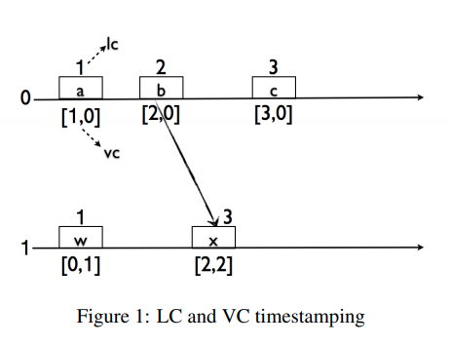
Lamport Timestamp & Vector Clock
Lamport timestamp
Vector clock
# send
t = t + 1;
send(t);
# receive
r = receive();
time = max(r, t) + 1;
t = <t1, …, tn>
# initialize
t = <0, …, 0> for all nodes
# internal event at node i
t = <t1, …, ti + 1, tn>;
# send(sender i, receiver j)
t = <t1, …, ti + 1, tn>;
send(t)
# receive
r = receive();
r = <r1, …, ri + 1, rn>;
t = <max(t1, r1), …, max(tn, rn)>;
Notes:
1. A process increments its counter(time) before each event in that process;
2.When a process sends a message, it includes its counter value with the message;
3.On receiving a message, the counter of the recipient is updated, if necessary, to the greater of its current counter and the timestamp in the received message. The counter is then incremented by 1 before the message is considered received.
One result of Lamport timestamps is that multiple events on different processes may all be tagged with the same timestamp.

Slide 20
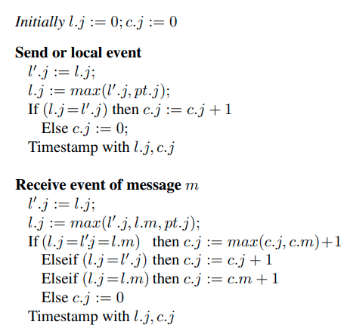
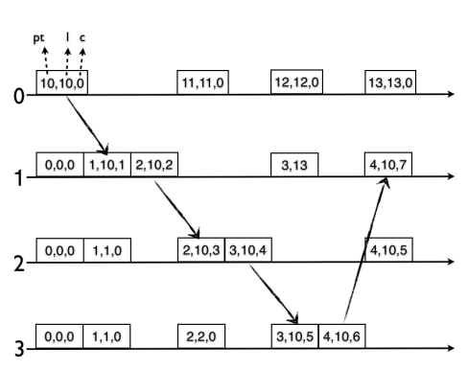
Hybrid Logical Clock
CRDB支持NLP或者Amazon Time Sync Service来提供时间。
HLC实际是一个lamport timestamp和一个wall clock的结合。
比vector clock的效率要高，由于没有中心化的节点，所以仍然可能会有一些问题，无法提供strict serializability
每个节点都会维护自己的HLC，保证HLC>=本地wall clock，每当节点接收到一个read/write的事件后，本地的HLC会update，从而保证了timestamp < next HLC time。
CRDB目前容忍500ms的误差。
Notes:
Send
对于send，如果是事件，那么会增加c；如果不是，那么不会增加c
对于receive，最大化（l，c）; if l1>l2, (l1,c1) > (l2,c2); l1=l2, c1>c2, (l1,c1) > (l2,c2).

Slide 21
Timestamp
在coordinator的本地HLC会在txn被创建时分配一个HLC，作为初始commit_ts
实际上的commit_ts还容忍一个max_offset的误差，[commit_ts, commit_ts + max_offset]
当一个节点发现它与至少一半的节点与最大的offset产生了80%的误差，它就会自动shut down。

Slide 22
Behavior under Clock Skew
Range leases contain a start and an end timestamp. A leaseholder cannot serve reads for MVCC timestamps above its lease interval or writes for MVCC timestamps outside its lease interval.
Each write to a Range’s Raft log includes the sequence number of the Range lease that it was proposed under. . Because lease changes for a Range are themselves written to the Range’s Raft log, only a single leaseholder is ever able to make changes to a Range at a time.
Notes:
These two safeguards ensure that a pair of leaseholders that are active concurrently cannot serve requests that would
violate serializable isolation

Slide 23
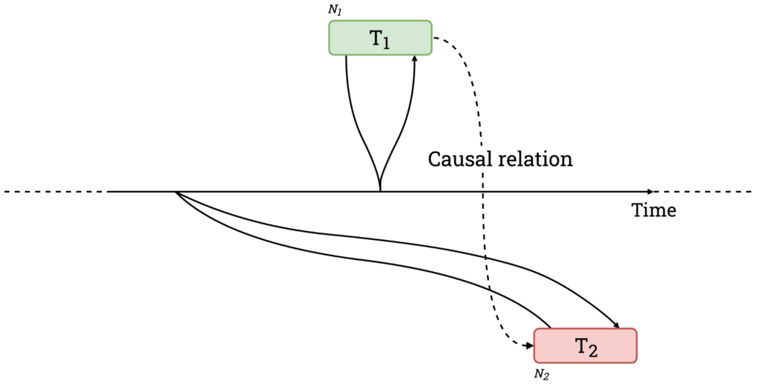
Strict Serializability
Linearizability: single-operation, single-object, real-time order
Serializability: multi-operation, multi-object, arbitrary total order
Strict Serializability: Why don’t we have both?
----http://www.bailis.org/blog/linearizability-versus-serializability/
CockroachDB does not offer strict serializability
Consider the history HN2 (assume every statement is its own transaction, for simplicity):
1. Nathan runs select * from hacker_news_comments. Doesn't get a response yet.
2. I run insert into hacker_news_comments (id, parent_id, text) values (1, NULL, 'a root comment') and commit.
3. Tobi runs insert into hacker_news_comments (id, parent_id, text) values (2, 1, 'OP is wrong') and commits.
4. Nathan's query returns and he gets Tobi's row but not mine.
While Spanner always waits after writes, CockroachDB sometimes retries reads.
No stale reads!
Notes:
wait out the uncertainty
since CockroachDB was designed to support conversational SQL where the read/write sets are indeterminate, we can’t know the nodes in advance.
if Nathan had have started his transaction after Tobi committed (in particular, if Nathan would have started his transaction because Tobi committed his),

Slide 24
DistSQL
In non-distributed queries, the coordinating node receives all of the rows that match its query, and then performs any computations on the entire data set. However, for DistSQL-compatible queries, each node does computations on the rows it contains, and then sends the results (instead of the entire rows) to the coordinating node. The coordinating node then aggregates the results from each node, and finally returns a single response to the client. -- cockroachlab
目前仅支持只读的query这样做。
Notes:
和tidb的下推算子类似。。。

Slide 25
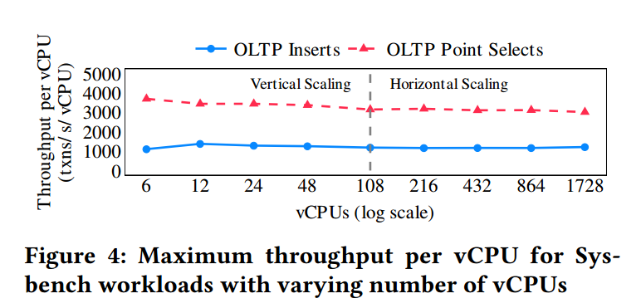
Vertical and horizontal scalability
Notes:
The left-hand side of the chart demonstrates vertical scalability, with experiments run on a three node cluster with varying AWS instance types
(c5d.large, c5d.xlarge, c5d.2xlarge, c5d.4xlarge, and c5d.9xlarge with 2, 4, 8, 16, and 36 vCPUs respectively). The right-hand side of the chart demonstrates horizontal scalability, with experiments run on c5d.9xlarge instances with the cluster size varying from 3 to 48 nodes.
Sysbench OLTP suite

Slide 26
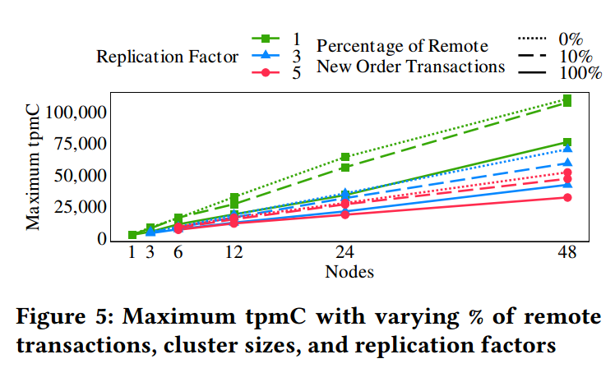
Scalability with cross-node coordination.
Notes:
Fig. 5 shows that in these experiments, the overhead of replication can reduce throughput by up to 48% for three replicas or 57% for five replicas,
and distributed transactions may further reduce throughput by up to 46%.
TPC-C New-Order.

Slide 27
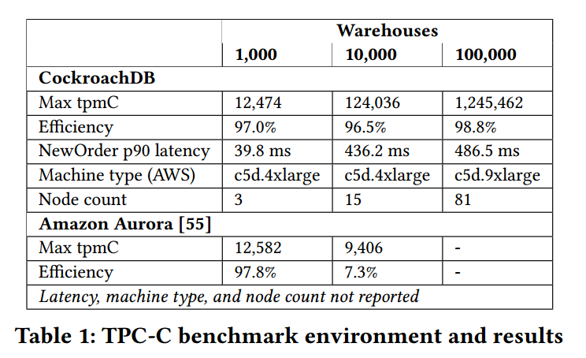
TPC-C performance comparison with Amazon Aurora
Notes:
TPC-C
In contrast to CRDB, single-master Aurora only achieves 7.3% efficiency with 10,000 warehouses [55]. AWS has not published TPC-C numbers for multi-master Aurora [3].

Slide 28
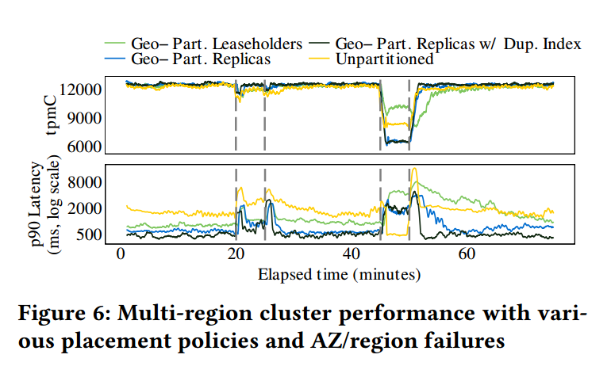
Multi-region Availability and Performance
Notes:
The periods between the dashed lines in Fig. 6 represent, in order, an AZ failure and recovery, and a region-wide failure and recovery.
On failure, requests are routed to fallback AZs (either in the same region or another, depending on the policy). Tables and indexes are partitioned by warehouse for partitioned policies. For the duplicated indexes policy, the read-only items table is replicated to every region.
Of the four policies, only geo-partitioned leaseholders is tolerant to region-wide failures. This translates to a higher sustained throughput during region-wide failures, but comes at a cost of higher p90 latencies during stable operation and recovery (compared to the geo-partitioned replicas variants).

Slide 29
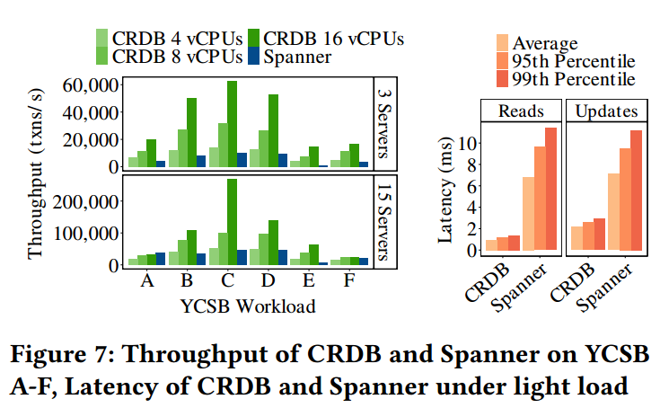
Comparison with Spanner
Notes:
For most YSCB workloads, CRDB shows significantly higher throughput. Both systems demonstrate horizontal scalability
as the cluster size increases. One exception is Workload A (update-heavy, zipfian distribution of keys), on which CRDB does not scale well because of the workload’s high contention profile.
We therefore compare against several CRDB configurations (4, 8 and 16 vCPUs per node). For reference, three n2-standard-8 GCP VMs (8 vCPUs each) with local storage cost within 0.2% of a one łnodež Spanner instance (consisting of three replicas).

Slide 30
Lessons Learned
Raft Made Alive
Reducing the Chatter: To mitigate this overhead, we made two changes to the basic protocol: (1) we coalesce the heartbeat messages into one per node to save on the per-RPC overhead, and (2) we pause Raft groups which have seen no recent write activity.
Joint Consensus
Removal of Snapshot Isolation: To guarantee strong consistency across concurrent mixed isolation levels, CRDB would need to introduce pessimistic locking for any row updates, even for SERIALIZABLE transactions.

