Slide 1

VLDB 2025

Slide 2
Design goals
1. aim to implement a disk-based vector index that leverages the core storage and query processing capabilities of the underlying GDBMS.
2. aim to efficiently evaluate predicate-agnostic kNN queries, i.e., kNN queries over arbitrary subsets S of vectors V，that performs robustly under queries that contain both attribute filtering and joins, and whose selected subsets have different selectivities and correlations to the query vector vQ .

Slide 3
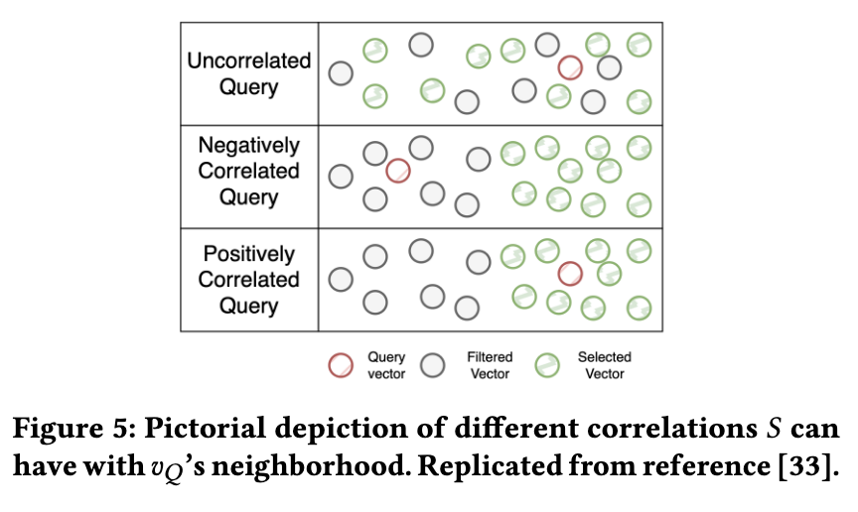
Selectivities and correlations

Slide 4
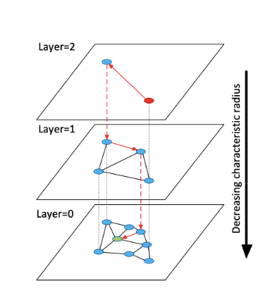
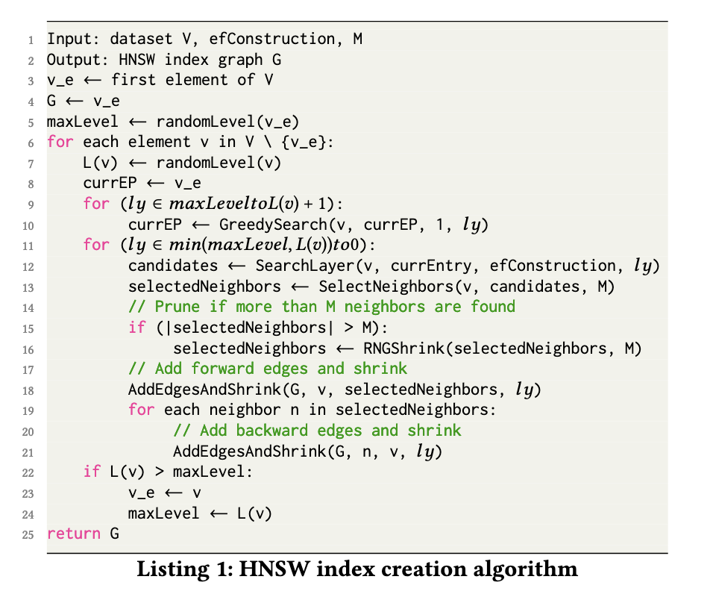

Index design

Slide 5
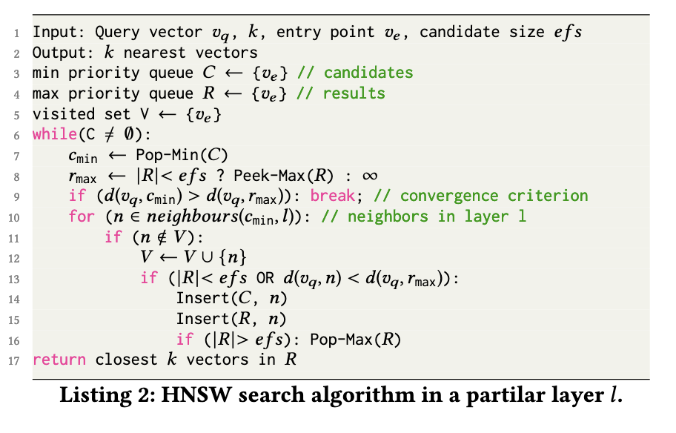
Index design
The efs parameter controls the trade-off between search accuracy and latency.

Slide 6
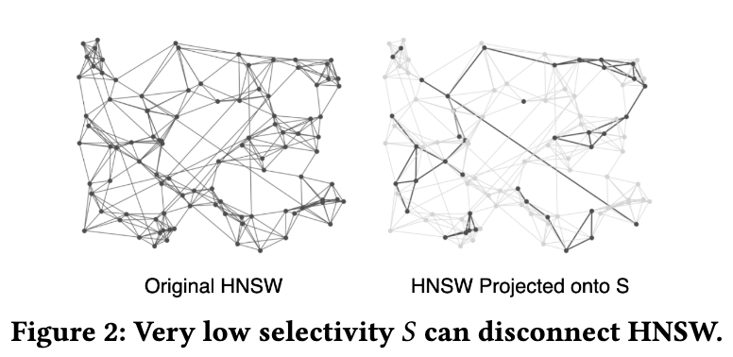
Predicate-agnostic kNN search
Postfiltering approaches：continuously find from nearest to furthest to vQ，and check if each streamed vector is in S, until k such vectors are found.
Prefiltering approaches：compute the subset S first and then pass S to the kNN search algorithm, which finds the kNNs of vQ only within S.
V’s neighbors in GH that are actually in S can be very sparse or v can even be disconnected from other vectors in S.

Slide 7
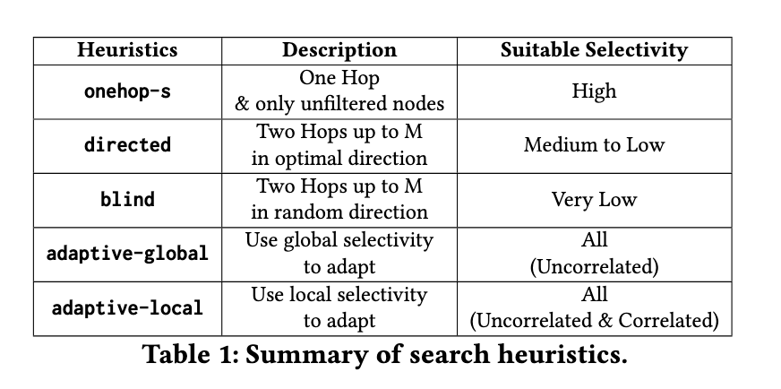
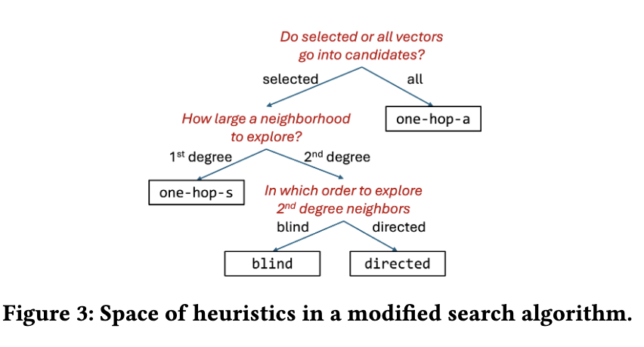
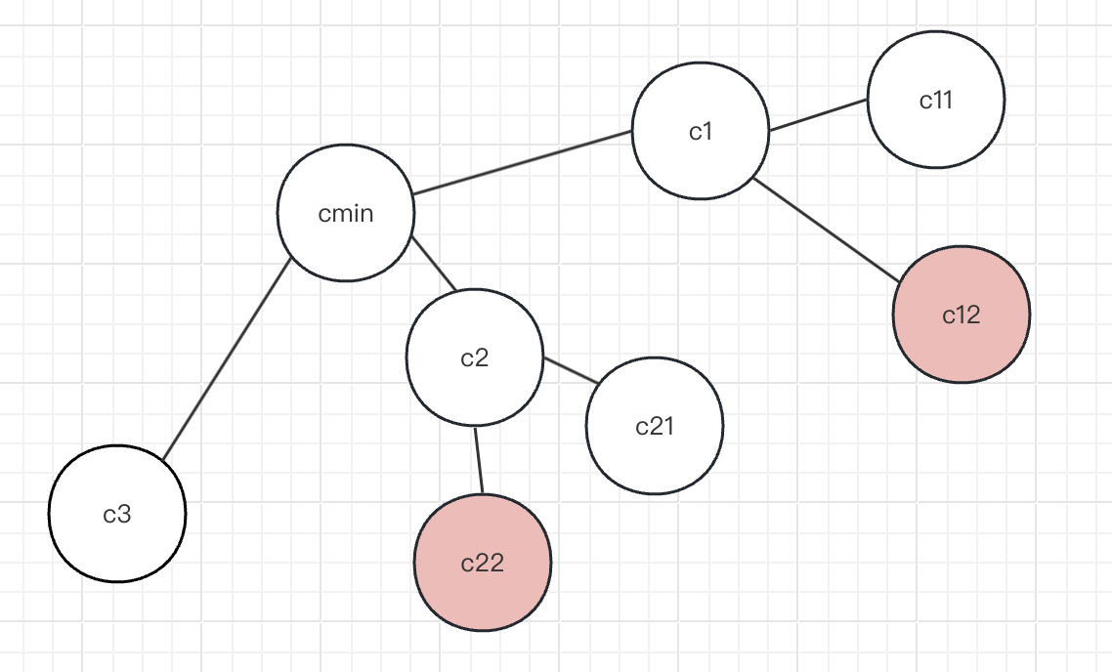
FILTERED SEARCH HEURISTICS

Slide 8
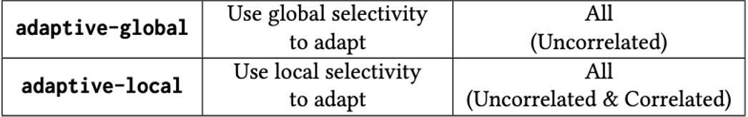
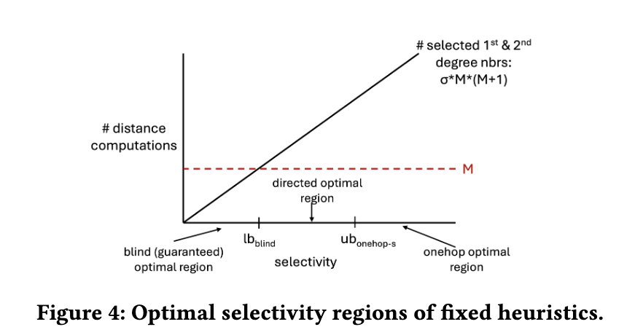
Adaptive Algorithms
50%
σg = |S |/|V |（global selectivity）
σl = |S(nbrs(cmin))|/|nbrs(cmin)|（local selectivity）

Slide 9

Implementation of NaviX in Kuzu
Index Creation
1.Index creation is executed as a standalone CALL function in Cypher.
2. 2-level HNSW implementation. GL (for lower level) and GU (for upper level）constructed in memory, all accesses to the vectors, happen through the buffer manager.
3. tolerate possible data race
4. Once GL is contructed, we pass it to Kuzu’s CSR construction pipeline.

Slide 10
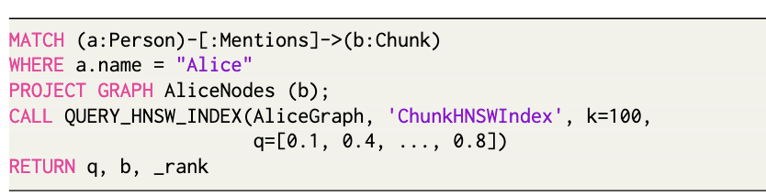
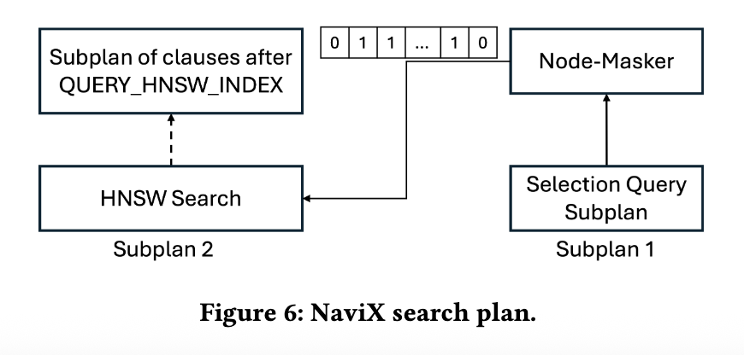
Implementation of NaviX in Kuzu
Index Search Query Syntax and Plan
The first subplan evaluates QS and uses Kuzu’s Node-Masker operator to create a node semimask.
All accesses to the persisted adjacency lists of vectors (GL) in the index and to the actual vectors happen through the buffer manager of the system.

Slide 11
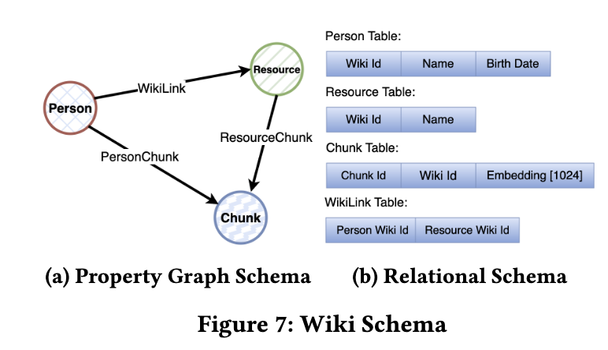
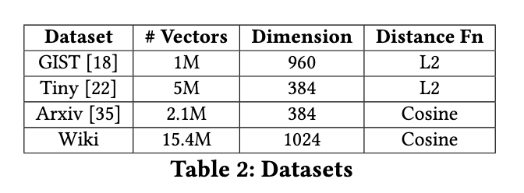
Evaluation
Datasets

Slide 12
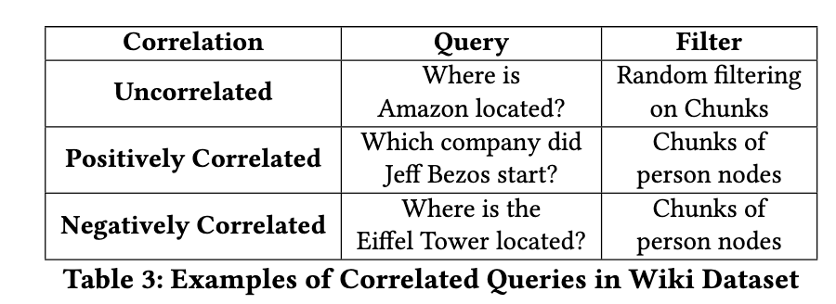
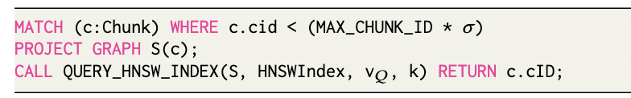
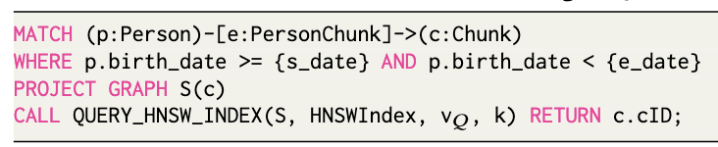
Evaluation
Query Workloads
Uncorrelated Workloads:
Wiki Positively Correlated Workload:
vQ: used OpenAI’s o1 model to generate questions about p using these chunks as context.
Wiki Negatively Correlated Workload:
vQ: we prompt o1 to generate questions about non-people entities.

Slide 13
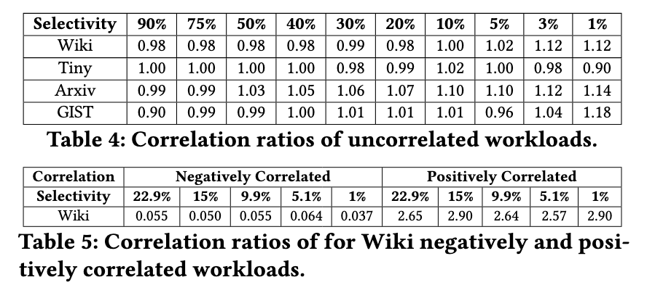
Evaluation
Query Workloads
ce = σvq /σ

Slide 14
Evaluation
Evaluation metric
adjust the efs parameter to stay within 1% of 95% recall
If a baseline gives higher recall than 95% with the minimum efs value, then we match that for all other baselines.
If a baseline fails to reach 95% recall even at efs 1000, we mark that point with a cross sign in our figures.

Slide 15
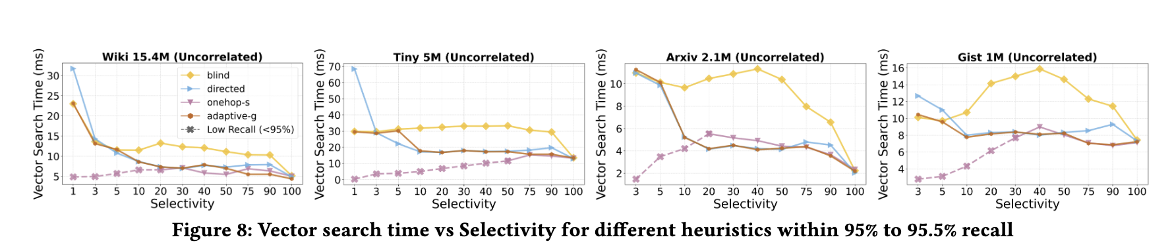
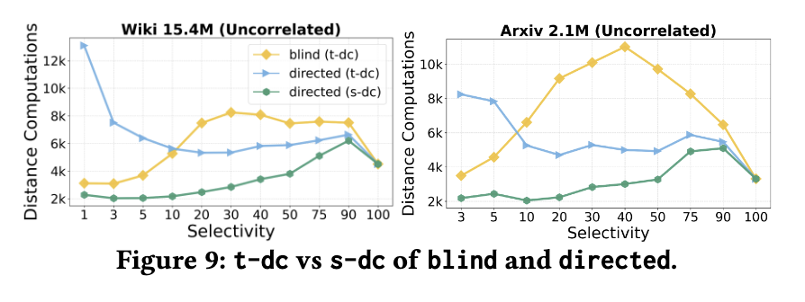
Evaluation
Prefiltering Fixed Heuristics and Adaptive-G

Slide 16
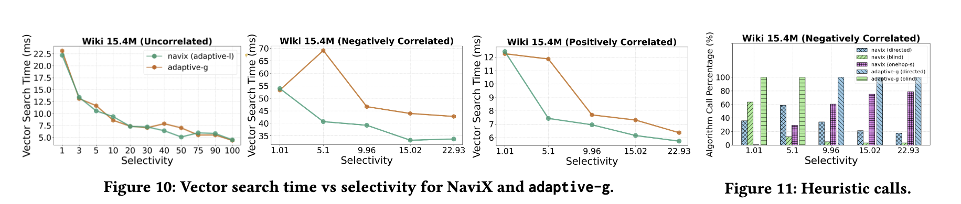
Evaluation
Adaptive-G and NaviX

Slide 17
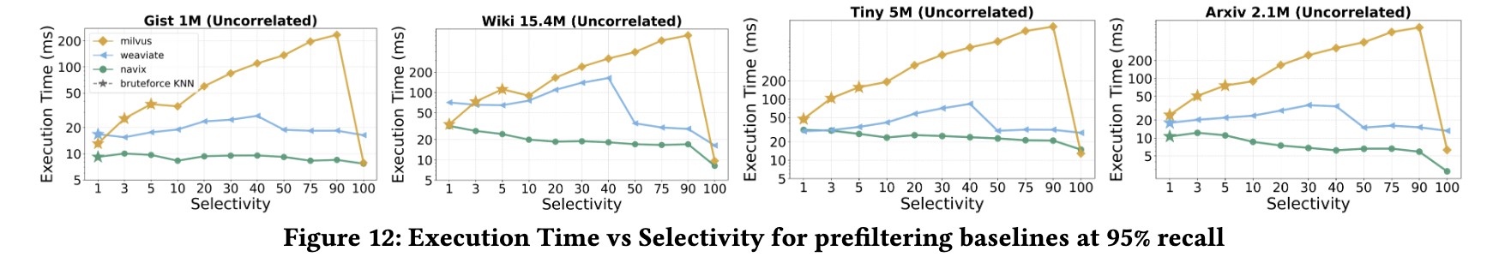
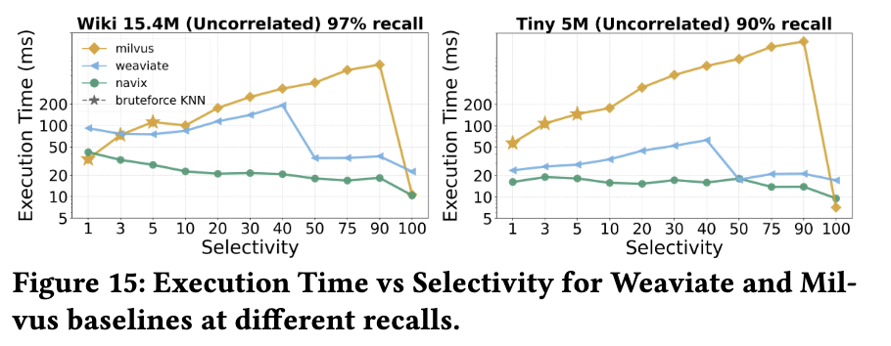
Evaluation
Weaviate and Milvus(specialized vector databases)
These systems do not support joins, so we compare their behavior only on uncorrelated workloads.

Slide 18
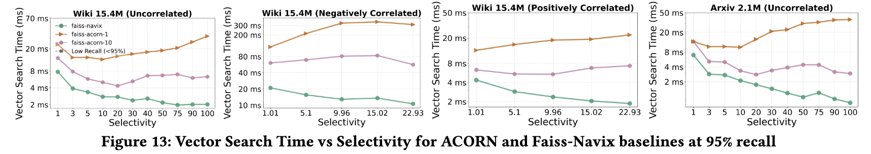
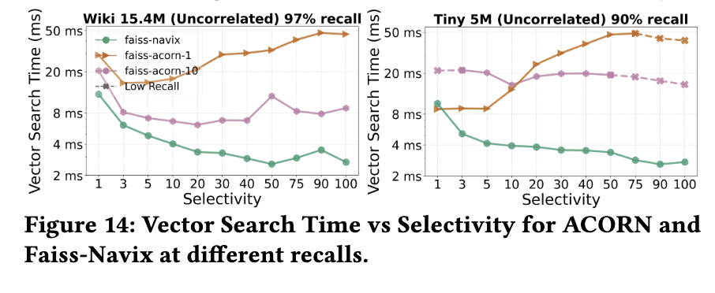
Evaluation
ACORN(in-memory FAISS HNSW index)

Slide 19
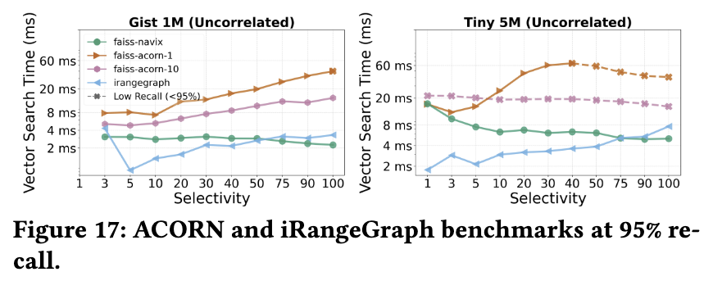
Evaluation
iRangeGraph
iRangeGraph constructs segmented proximity graphs as sub-indices for different ranges and merges them during search time to support arbitrary ranges.

Slide 20
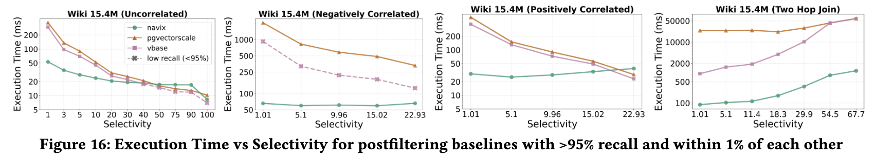
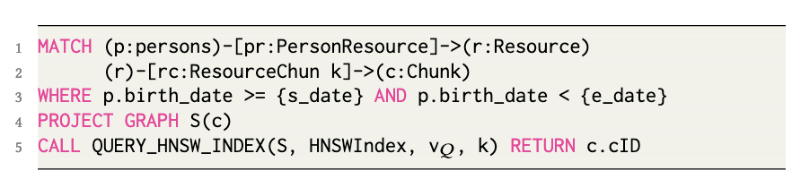
Evaluation
PGVectorScale and Vbase(postfiltering-based systems)
high-selectivity levels, postfiltering approaches have an advantage over prefiltering appraoches.

Slide 21
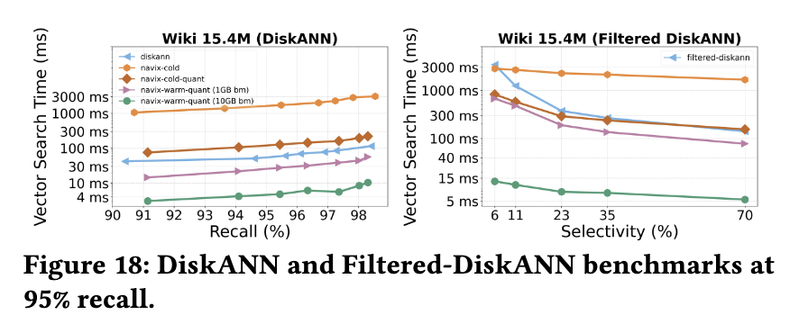
Evaluation
DiskANN and Filtered-DiskANN(disk-based)
NaviX-cold: just measure the first cold run of each query.
NaviX-cold-quant: similar to DiskANN(vectors compressed in memory, performs I/Os only to read adjacency lists).
NaviX-warm-quant-1GB: We give a small amount buffer manager space to NaviX-cold-quant,and the adjacency lists are partially cached.
NaviX-warm-quant-10GB: We give enough buffer manager space to Kuzu to cache most or all of the adjacency lists.

Slide 22
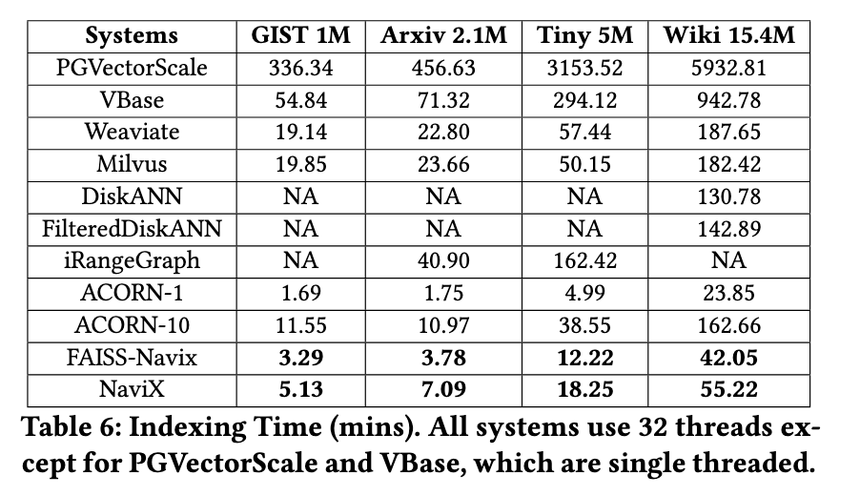
Evaluation
Indexing Time (mins)

