Slide 1

Carousel: Low-Latency Transaction Processing for Globally-Distributed Data
1/26

Slide 2
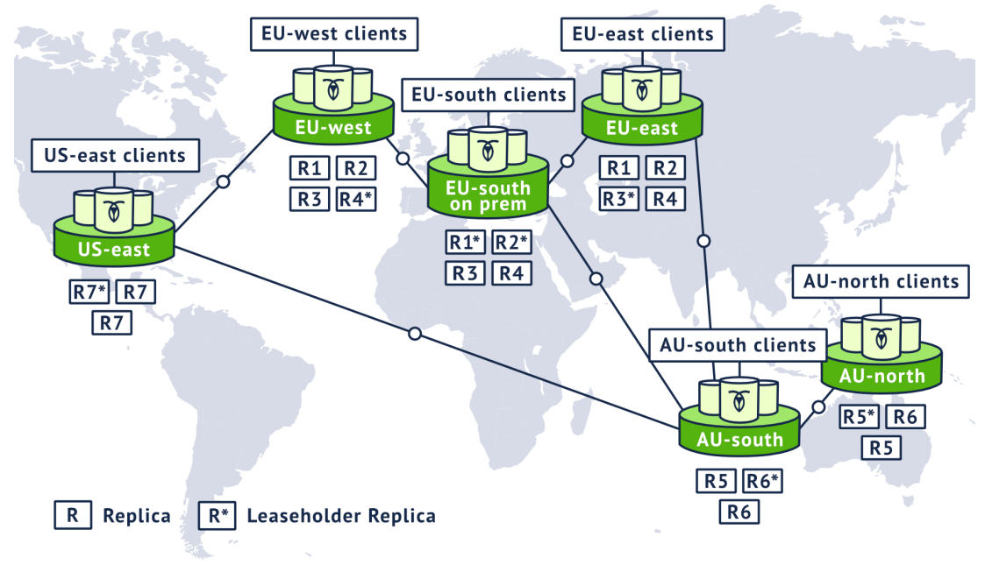
Background
Geo-distributed Database
Spanner, CockroachDB
Partition data and store each partition at the datacenter where it will most frequently be used.
Use a consensus protocol (Paxos or Raft) to replicate each partition to enough additional datacenters to meet users fault tolerance requirements.

Slide 3
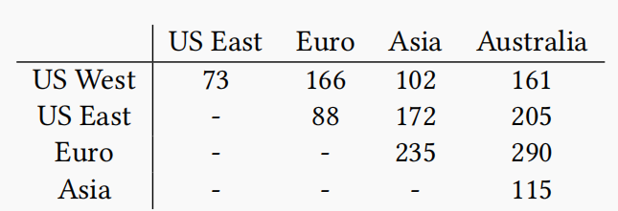
Background
High Latency of Geo-distributed Transactions
(Transaction Layer) Several wide-area network roundtrips are required to fetch the data from other datacenters and commit the transaction (2PC).
(Replication Layer) Achieve availability by using a consensus protocol to replicate both the updates to the database and the changes to the 2PC states to majority.
Latency in the same datacenter is around 0.2ms.
WANRT (Wide Area Network Roundtrip)
Request Time
Datacenter 1
Datacenter 2
Acknowledgment Time

Slide 4
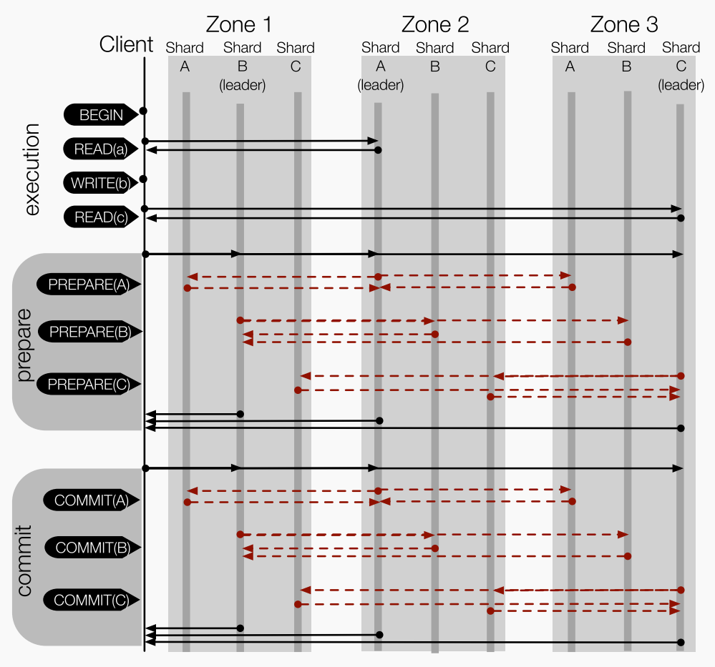
Background
1
2
Distributed Transactions
with Replications
-------------------------------------------
Read Phase
(1) (4) (2 * WANRT)
-------------------------------------------
Write Phase
(2) (3) (2 * WANRT)
-------------------------------------------
Prepare Phase
(5)(6)(7) (2 * WANRT)
-------------------------------------------
Commit Phase
(8)(9)(10) (2 * WANRT)
-------------------------------------------
3
4
5
6
7
8
9
10

Slide 5
Background
Distributed Transactions with Replications
Layer transaction management, such as concurrency control and 2PC on top of a consensus protocol.
Advantages
Facilitate reasoning about the system’s correctness and allows for a relatively straightforward implementation.
Drawbacks
Introduce additional wide-area network roundtrips with multiple reads and writes (run SQL statements one after another).
Sequentially processing, committing, and replicating each transaction.

Slide 6
Key Ideas of Carousel
Use 2FI Transaction Model to ensure one round of reads and writes.
Use hints provided by the transaction to overlap transaction processing with the 2PC.
Borrow ideas from Fast Paxos to parallelize 2PC with consensus.

Slide 7
Transaction Model
2-round Fixed-set Interactive (2FI) Transaction
2-round: Perform one or more keyed record read and write operations in two rounds: a read round, followed by a write round.
Fixed-set: All read and write keys must be known in advance.
Interactive: Target interactive transactions (read-modify-write), write values can depend on reads.

Slide 8
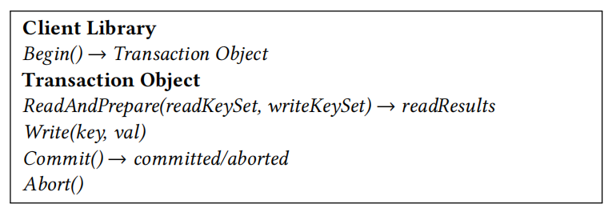
Transaction Model
2-round Fixed-set Interactive (2FI) Transaction
Begin: Create a transaction object and assigns a unique transaction ID (TID).
ReadAndPrepare: Read all data in the read round and send prepare messages in parallel.
Write: Perform writes which are buffered in the client.
Commit: Submit new values for the keys in the write set.

Slide 9
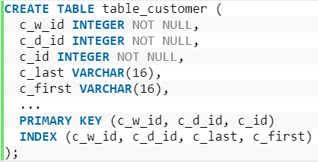
Transaction Model
Drawback of 2FI Transaction
Cannot perform dependent reads and writes (the key to be read or written depends on the value of a previous read), need application-level workaround.
Example: Access through a secondary index (TPC-C Payment). Payment transactions may identify the paying customer by customer ID (the key) or by customer name.
Application-level Workaround: Perform a reconnaissance transaction that determines the customer ID by accessing a secondary index keyed by customer name.

Slide 10
Transaction Protocol
Concepts
Carousel Data Servers (CDSs): Manage one or more data partitions.
Datacenter: Consists of a set of CDSs.
Clients: Run applications in the same datacenters as CDSs.
Participant: When a transaction accesses (reads or writes) data from a partition, that partition becomes one of its participant partition. The leader of a participant partition’s consensus group is called participant leader.
Coordinator: Client selects the leader of a local consensus group to serve as coordinator, which are fault tolerant. (prefer a local participant leader)
Transaction Control: OCC + 2PC
Consensus Protocol: Raft

Slide 11
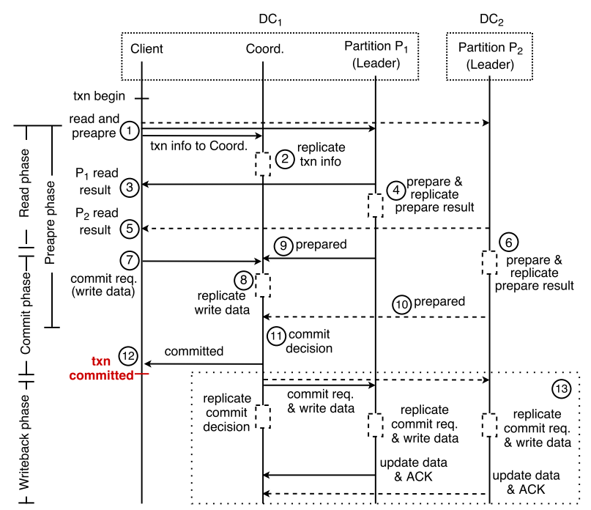
Transaction Protocol
Basic Carousel Protocol
----------------------------------------------------
Read Phase |
(1) (WANRT) | Prepare Phase
(3) (5) | (2)
-----------------------| (4) (6) (WANRT)
Commit Phase |
(7) (8) (WANRT) | (9)
(11) | (10) (WANRT)
(12) |---------------------------
-----------------------|
Writeback Phase |
(13) (2 * WANRT)|
----------------------------------------------------
Notes:
Solid Line: Not WANRT
Dashed Line: WANRT
Read Phase:
1. Txn info to Coord. is the transaction’s read set and write set.
11. Safe to send committed to the client, since all the transaction’s updates are replicated in the coordinator’s consensus group, and prepare decisions have been replicated in all participant partitions during prepare phase.
Writeback Phase: Distribute the transaction’s updates and commit decision to the participants.
13. Includes the transaction’s commit decision and, if the transaction committed, its updates.
Prepare Phase: Start at the same time as Read Phase. Client piggybacks a prepare request on the read request to each participant leader. Prepare request includes read/write set for that partition. Participant leader maintains a list of pending (prepared, but not yet committed or aborted) transactions, along with their read and write sets, to check for conflicts with concurrent transactions. If there are none conflicts, it adds the new transaction to its pending list, marks the new transaction as prepared.

Slide 12
Transaction Protocol
Prepare Request: Read/write set for the partition and the transaction coordinator.
Concurrency Control: Participant partitions maintains a list of pending (prepared, but not yet committed or aborted) transactions, along with their read and write sets, to check for conflicts with concurrent transactions.
Prepare Result:
Prepare decision, read set, write set, read version.
The transaction’s read set and write set
Notes:
Solid Line: Not WANRT
Dashed Line: WANRT
Read Phase:
1. Txn info to Coord. is the transaction’s read set and write set.
11. Safe to send committed to the client, since all the transaction’s updates are replicated in the coordinator’s consensus group, and prepare decisions have been replicated in all participant partitions during prepare phase.
Writeback Phase: Distribute the transaction’s updates and commit decision to the participants.
13. Includes the transaction’s commit decision and, if the transaction committed, its updates.
Prepare Phase: Start at the same time as Read Phase. Client piggybacks a prepare request on the read request to each participant leader. Prepare request includes read/write set for that partition. Participant leader maintains a list of pending (prepared, but not yet committed or aborted) transactions, along with their read and write sets, to check for conflicts with concurrent transactions. If there are none conflicts, it adds the new transaction to its pending list, marks the new transaction as prepared.

Slide 13
Transaction Protocol
Summary of Basic Carousel Protocol
Take the advantage of the properties of 2FI transactions to perform early 2PC prepares, which parallelize the transaction execution and commit.
The total number of WANRT delays observed by the client is at most two when these are no failures.

Slide 14
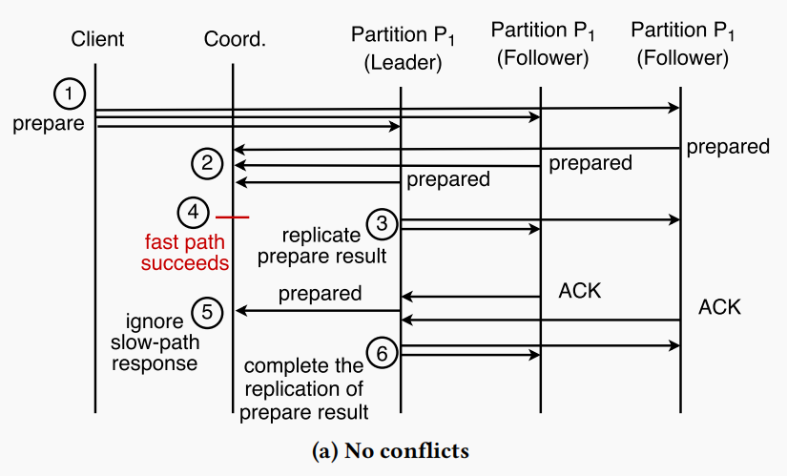
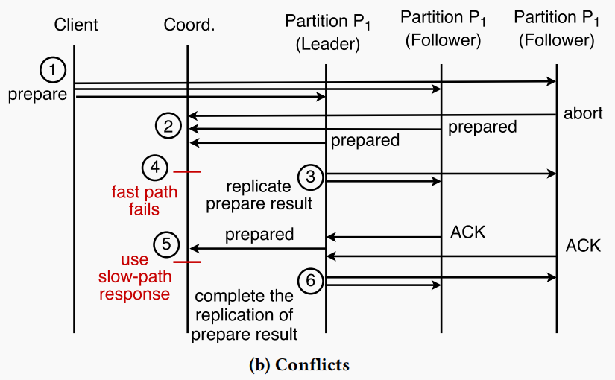
Parallelizing 2PC and Consensus
Carousel Prepare Consensus (CPC)
CPC introduces a fast path that can prepare a transaction in one WANRT if it succeeds. In CPC, a client sends a prepare
request to every participant leader and follower, which starts both the fast path and the slow path.
------------------------------------------------------------
Fast Path | Slow Path
(1) (2) (4) (WANRT) | (1) (3) (5) (2 * WANRT)
------------------------------------------------------------
Notes:
This fast path benefits any transactions where the combined latency of the Read and Commit phases is lower than the latency of the Prepare phase using the slow path. This
can occur when the wide-area network latencies from the client to the participant leaders are higher than the latencies between the coordinator and its consensus group.

Slide 15
Parallelizing 2PC and Consensus
Fast Path Prepare Decision
For Participant
Each participant maintains a persistent list of pending transactions along with their read and write keys.
For Coordinator
Coordinator receives the same prepare decision from a supermajority^{[1]} of the consensus group members, and each member is up-to-date.
The participant leader must be part of the supermajority.
Notes:
Coordinator 1. the need for participant to use the same data versions to prepare the transaction as the participant leader.
Coordinator 2. the need for the participant leader to be part of the supermajority stems from the requirement that CPC must safely run the fast path in parallel with the slow path, if the fast path succeeds, the fast path and the slow path will arrive at the same prepare decision.

Slide 16
Parallelizing 2PC and Consensus
Summary of CPC
Compress the latency to WANRT in the case fast path succeeds.
This fast path benefits any transactions where the combined latency of the Read and Commit phases is lower than the latency of the Prepare phase using the slow path.

Slide 17
Handling Failures
Client Failures
Client Commit(7): Coordinator commit the transaction
regardless of client failures.
Client Not Commit: Transaction on coordinator
timeout and abort.
Coordinator Failures
Coordinator Commit(12): Commit decision has been
recorded(11), continue replicate commit decision(13) if necessary.
Coordinator Not Commit: TxnInfo has been recorded(2), new Coordinator reacquire the prepare responses from the participant leaders.
Follower Failures
Prepare results (4)(6) are replicated.
Raft can operate without blocking with up to f follower failures.
Notes:
Follower Two Functions:
Respond to leader’s replicate request.
Respond to client’s fast path prepare request in Carousel Prepare Consensus.

Slide 18
Handling Failures
Leader Failures
Basic Carousel Protocol:
State of each participant leader is replicated.
A new participant leader for the partition is elected and continues processing pending transactions.
Carousel Prepare Consensus:
leader failure
leader failure
Notes:
Carousel Prepare Consensus:
1. A newly elected participant leader to arrive at the same prepare decisions that may have been exposed to the coordinator via the fast path.

Slide 19
Handling Failures
Leader Failures
Carousel Prepare Consensus:
Leader Election: Extends Raft leader election protocol by making each participant piggyback its pending-transaction list on its vote message.
Examine Pending-Transaction Lists: New leader examines pending-transaction lists of the vote messages from a majority of participants. A fast-path prepared transaction have been prepared on a supermajority of the participants. With up to f participant failures, the transaction must be in at least a majority of f + 1 pending-transaction lists. A transaction could potentially be a fast-path prepared transaction if it is prepared with the same data versions in at least f + 1 lists.
Detecting Conflicts: Examine all potential transactions to exclude the transactions that conflict with the slow-path prepared transactions or are prepared based on stale data versions. The failed leader may have decided not to prepare the transaction.

Slide 20
Evaluation
Protocols Comparison
Carousel Basic / Carousel Fast / TAPIR
Experimental Setup
Amazon EC2 instances across 5 datacenters in different geographical regions: US West (Oregon), US East (N. Virginia), Europe (Frankfurt), Australia (Sydney), and Asia (Tokyo)
Notes:
Define inconsistent replication, a new replication technique that provides fault tolerance without consistency.
Design TAPIR, a new distributed transaction protocol that provides strict serializable transactions using inconsistent replication for fault tolerance.
TAPIR [50], which represents the current state-of-the-art in low-latency distributed transaction processing systems.

Slide 21
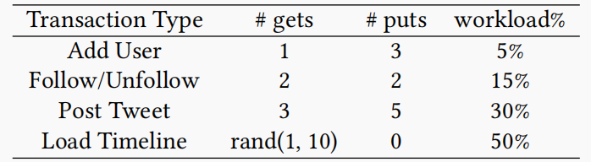
Evaluation
Workloads
Retwis: transactions for a Twitter-like system.
Each transaction touches an average of 4.5 keys.
TCSB+T
Each transaction consists of 4 read-modify-write operations that access different keys.
Datasize and Distribution: 10 million keys, Zipfian distribution with a coefficient of 0.75.

Slide 22
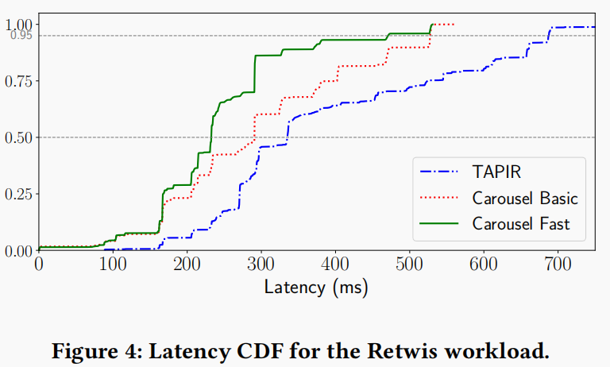
Evaluation
Retwis Latency
Focus on the performance of the system when network latency, rather than resource contention, is the primary latency source. Each system receives 200 transactions per second (tps).
Median Latency: TAPIR 334 ms / Carousel Fast 232 ms / Carousel Basic 290 ms. Performance gap widens at higher percentiles.

Slide 23
Evaluation
Reasons why Carousel Fast and Carousel Basic have lower latencies than TAPIR in Retwis.
Carousel requires a maximum of two WANRTs to complete a transaction. TAPIR requires as many as three WANRTs.
50% of the Retwis workload consists of read-only transactions, which complete in just one WANRT.
TAPIR waits for a fast path timeout before it begins its slow path to commit a transaction.
TAPIR does not allow a client to issue a transaction that potentially conflicts with its own previous transaction until the previous transaction has been fully committed on TAPIR servers. This increases the transaction completion time for a small number of transactions.

Slide 24
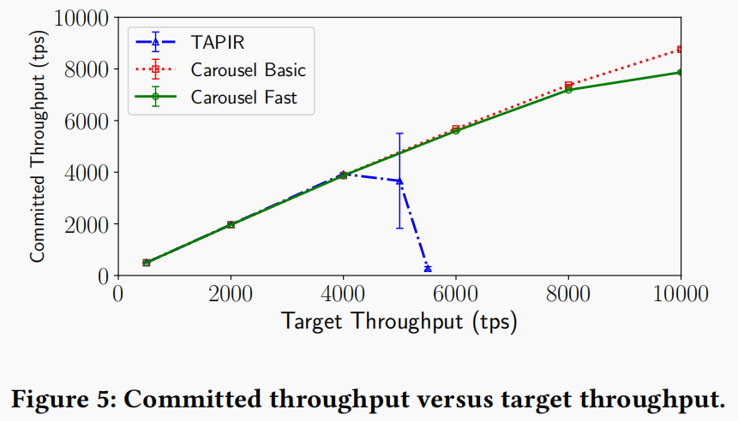
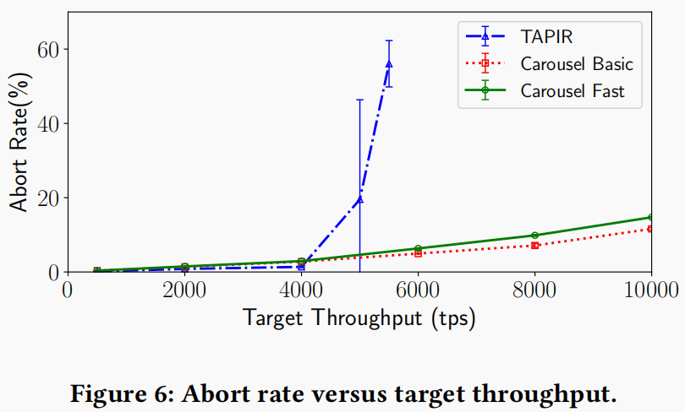
Evaluation
Retwis Throughput
TAPIR is unable to meet the target throughput greater than 5000 tps. It experiences excessive queuing of pending transactions at the TAPIR servers, resulting in a precipitous drop in its committed throughput.
Carousel Fast’s committed throughput falls below the target throughput earlier than Carousel Basic, since Carousel Fast needs to send more messages per transaction than Carousel Basic.

Slide 25
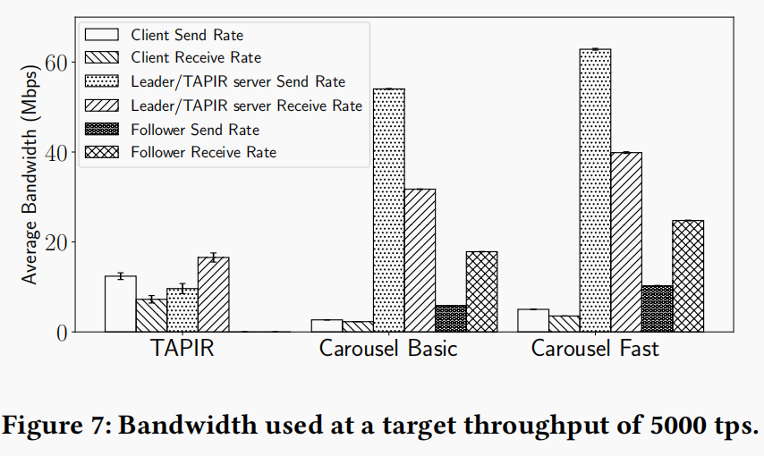
Evaluation
Retwis Network Utilization (5000 tps)
Carousel Basic and Fast servers, require more network bandwidth than TAPIR servers, since Carousel Basic and Fast replicate both 2PC state and data to their consensus groups.
Carousel Fast servers require more bandwidth than Carousel Basic servers since Carousel Fast performs both fast path and slow path concurrently.

Slide 26
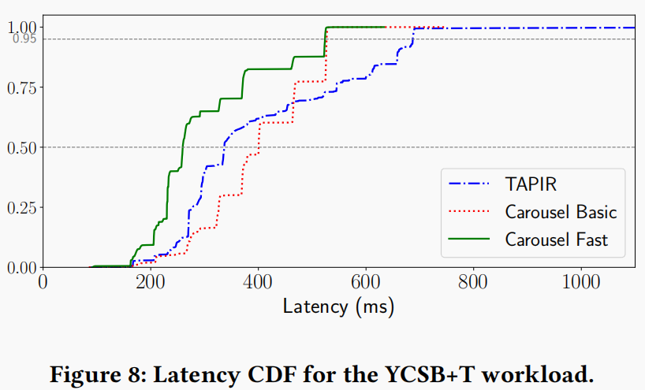
Evaluation
YCSB+T
YCSB+T consists of only read-modify-write transactions, whereas 50% of Retwis’ transactions are read-only, the optimization of read-only transactions in Carousel does not work.
TAPIR must fall back to its slow path when there is data contention and fast path execution is not possible, resulting in transaction execution that requires three WANRTs to complete.

Slide 27
Conclusion
Have a clear definition of the research question and scope.
Make comprehensive summary of the focus of different approaches in related works.
Propose a concise and effective method for parallelizing transaction processing and transaction state replication to reduce latency.

