Slide 1
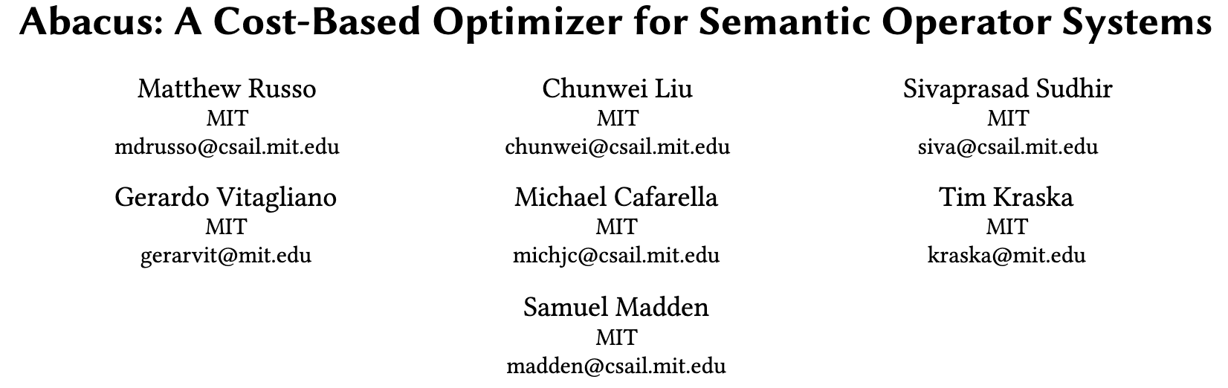
Proc. VLDB Endow., Vol. 19, No. 5, pp. 1060–1073. Publication date: January 2026.

Slide 2
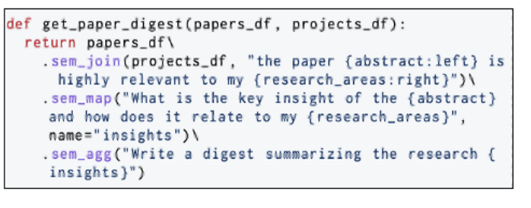
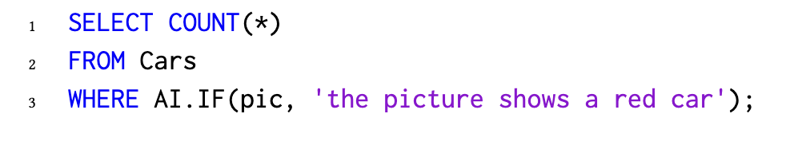
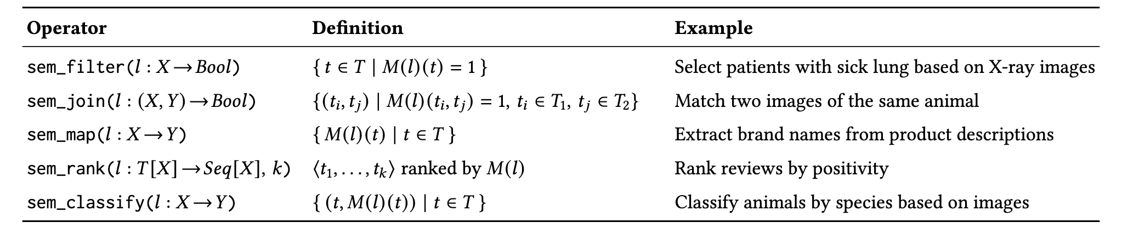
Background : Semantic operators
SemBench: A Benchmark for Semantic Query Processing Engines, VLDB’26

Slide 3
Background : Semantic Operator Systems

Slide 4
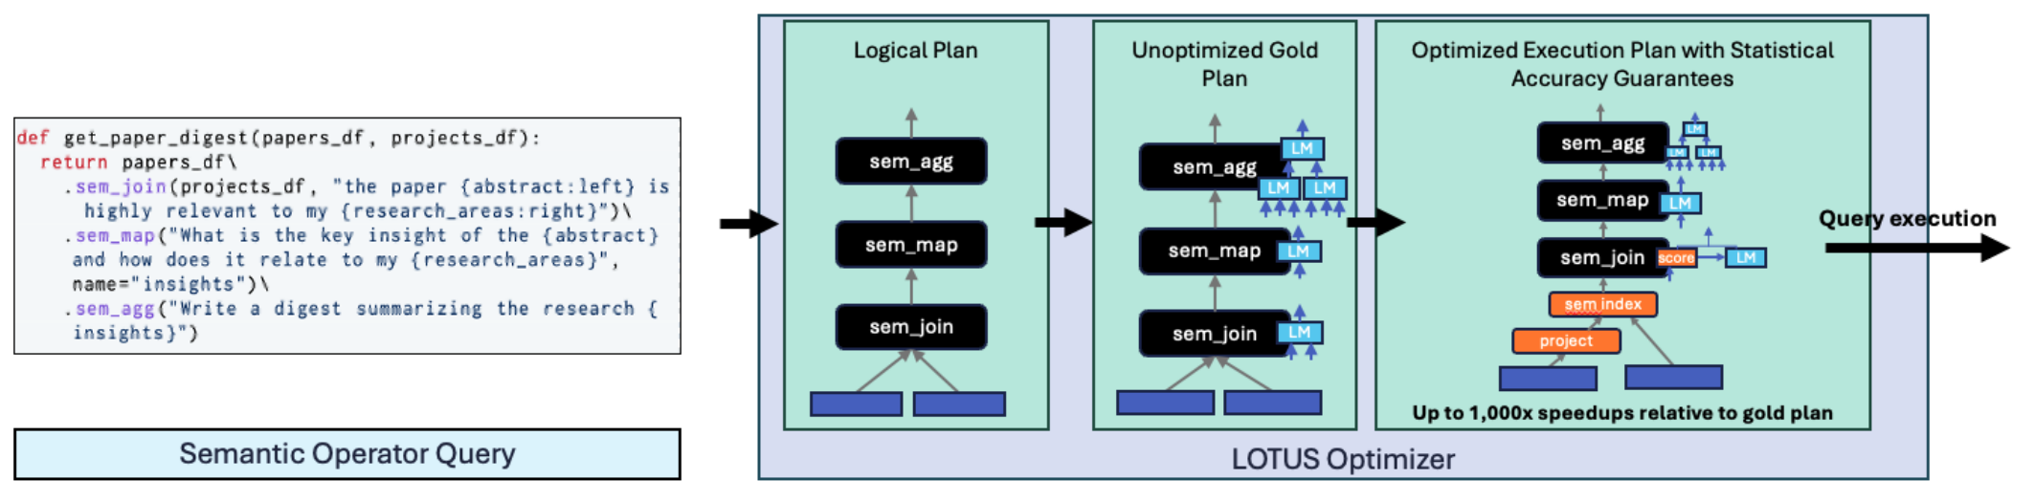
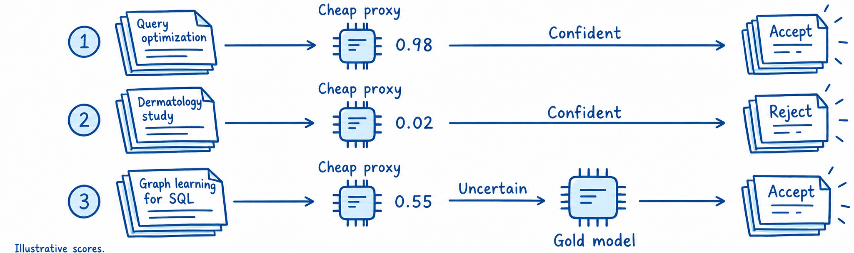
LOTUS
Filter example
Q：Is the paper about
data systems?
Semantic Operators and Their Optimization: Enabling LLM-Based Data Processing with Accuracy Guarantees in LOTUS, VLDB’25

Slide 5
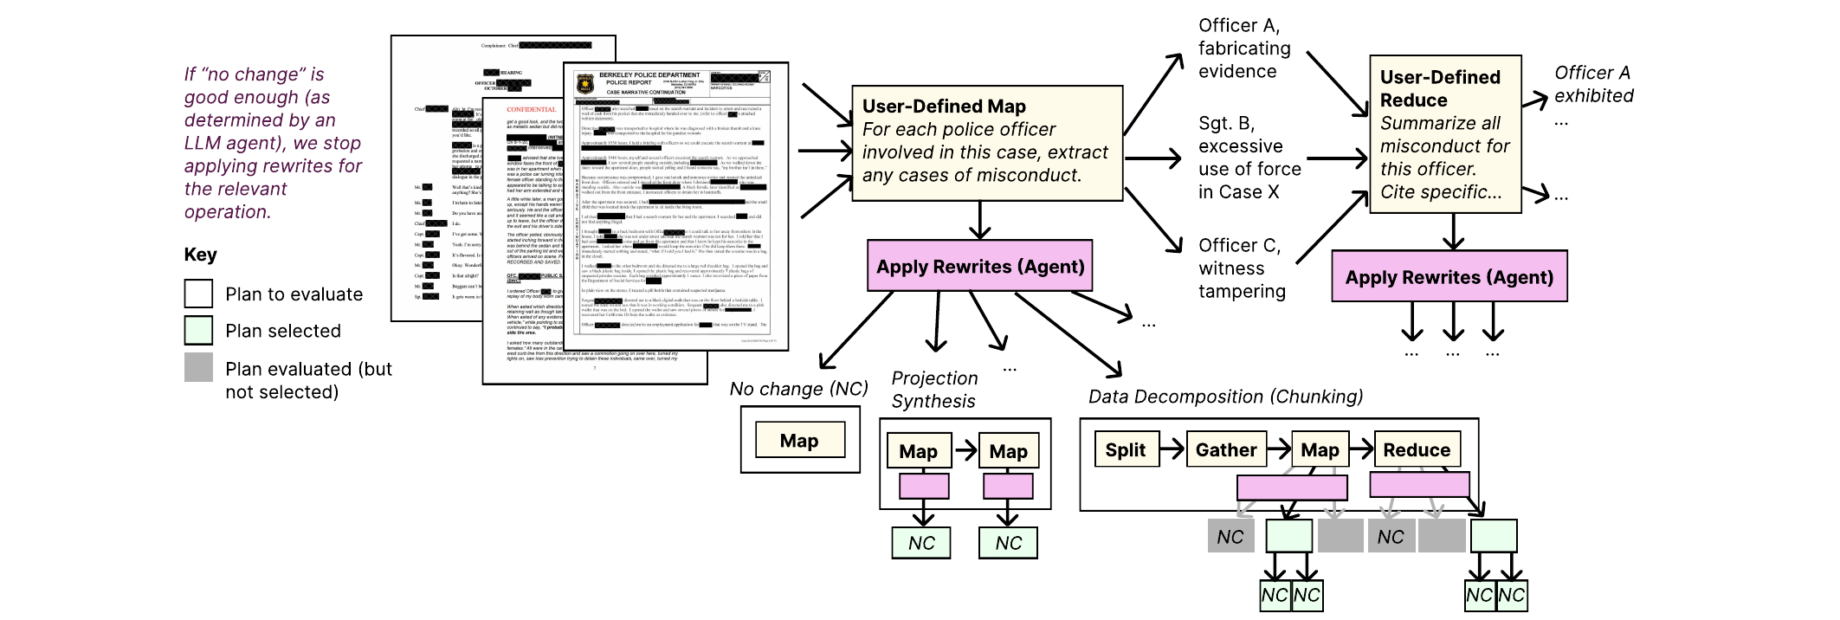
DocETL
Rewrite complex operations into simpler, more accurate operations
DocETL: Agentic Query Rewriting and Evaluation for Complex Document Processing，VLDB’2025

Slide 6
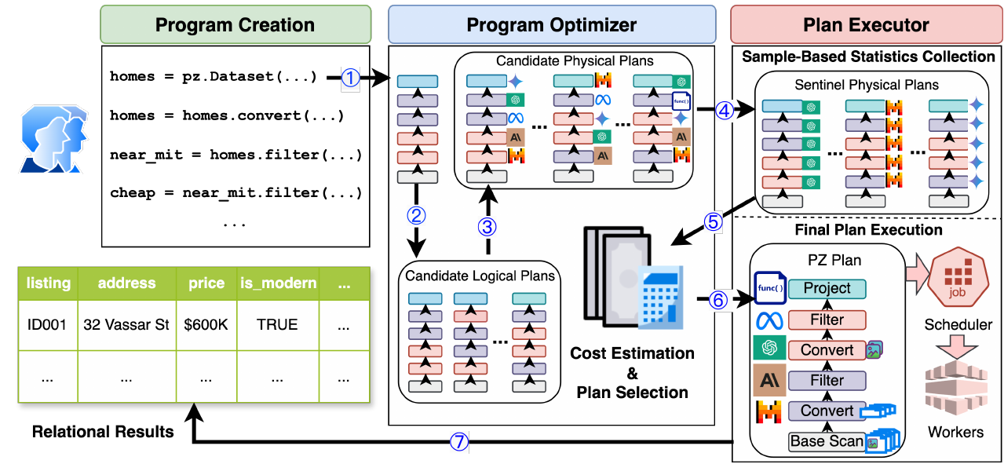
Palimpzest
Palimpzest: Optimizing AI-Powered Analytics with Declarative Query, CIDR’25

Slide 7
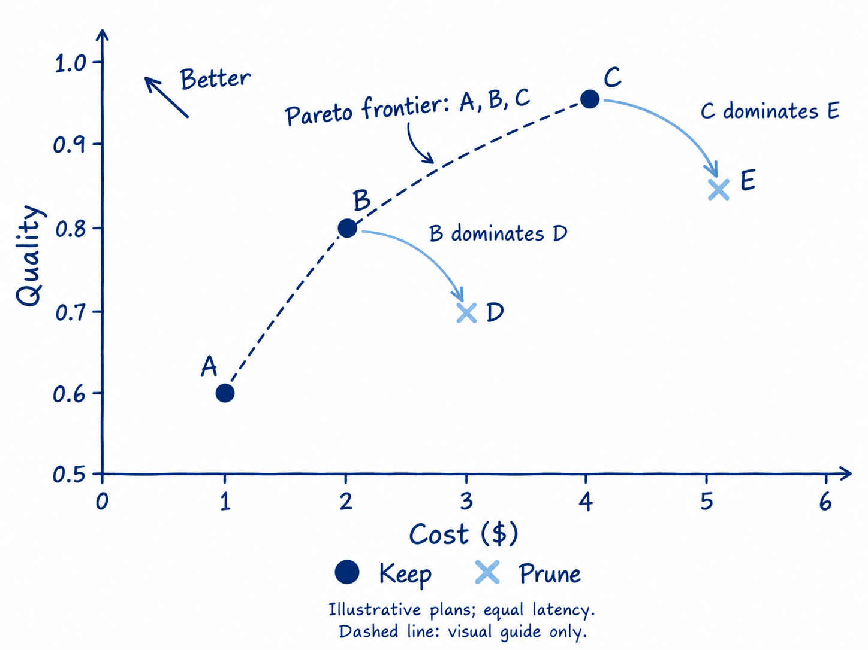
Palimpzest — Pareto Pruning
Dominance: no worse in all metrics and strictly better in at least one.
Prune dominated plans; select from the Pareto frontier using the user policy.
Palimpzest: Optimizing AI-Powered Analytics with Declarative Query, CIDR’25

Slide 8
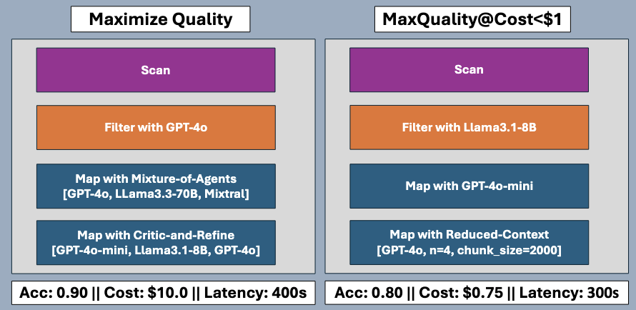
Problem 1 — Constrained Optimization
Operator implementations must be chosen jointly to maximize quality under a plan-level budget.

Slide 9
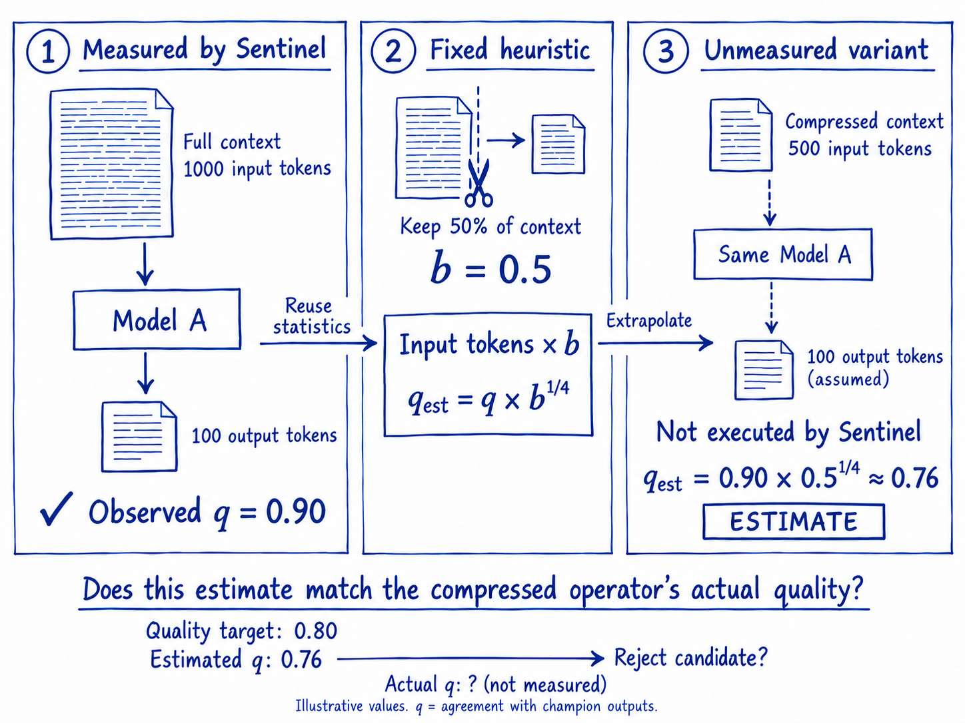
Problem 2 — Heuristic Performance Estimation

Slide 10
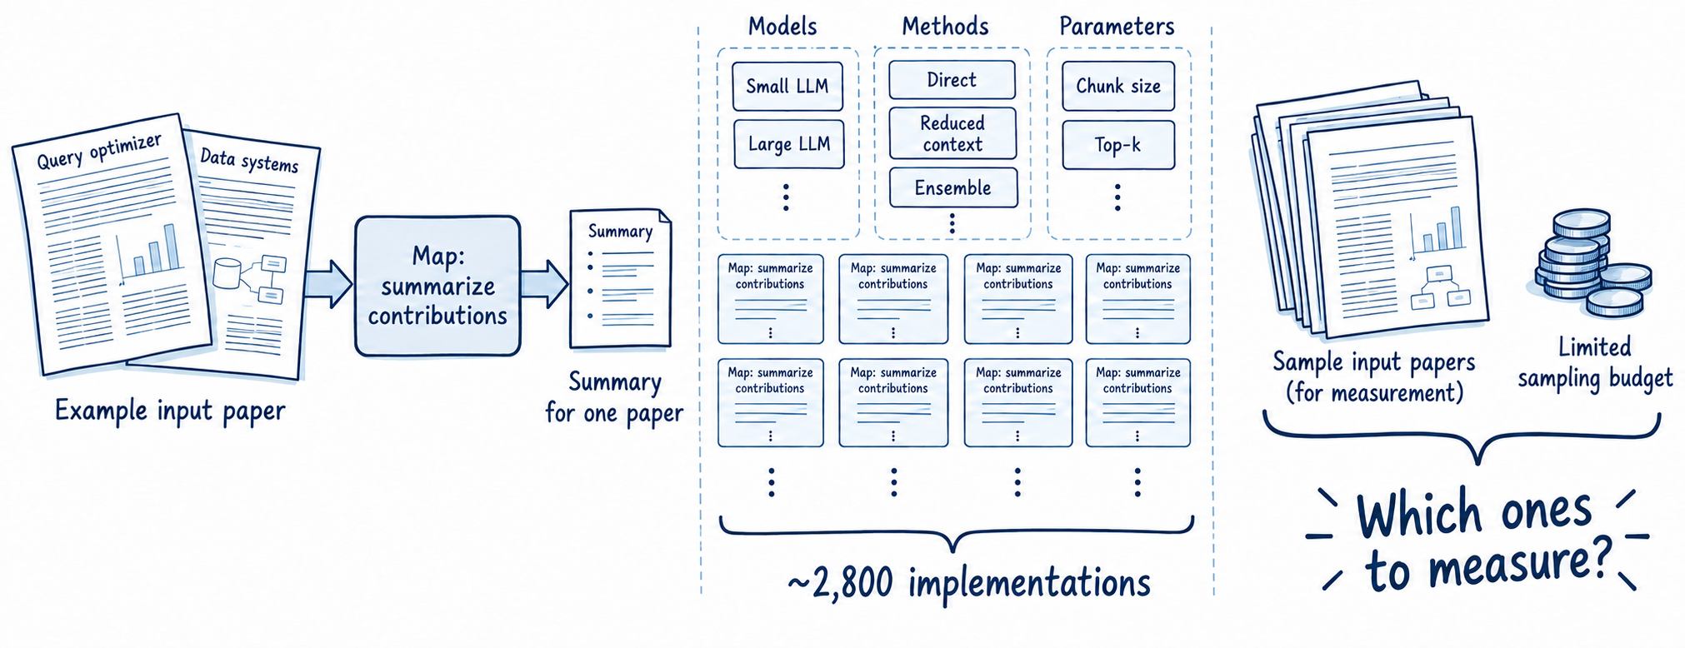
Problem 3 — Large Implementation Space
A semantic Map can have ≈2,800 physical implementations.
6 operators × 10 choices → 10⁶ plan combinations (illustrative, before reordering).

Slide 11
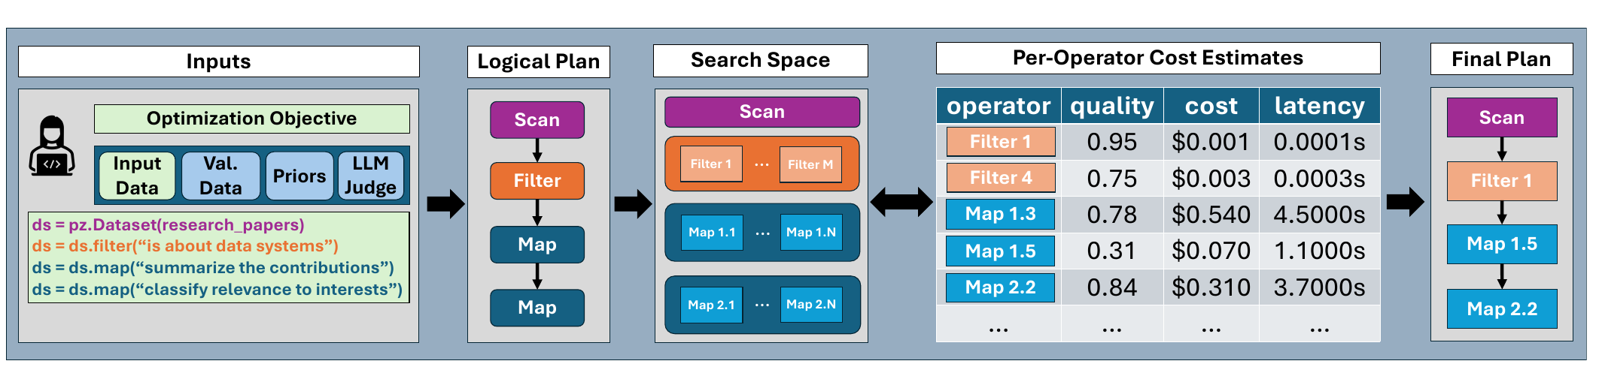
Abacus — Overview and Key Ideas
Estimate operator performance → Select a constrained plan
1 MAB — Adaptive Operator Sampling
2 Pareto-Cascades —Based on Cascades
Identify promising physical implementations
through sampling.
Narrow the candidate set before plan selection.
keeps track of the Pareto frontier of subplans throughout the optimization procedure.

Slide 12
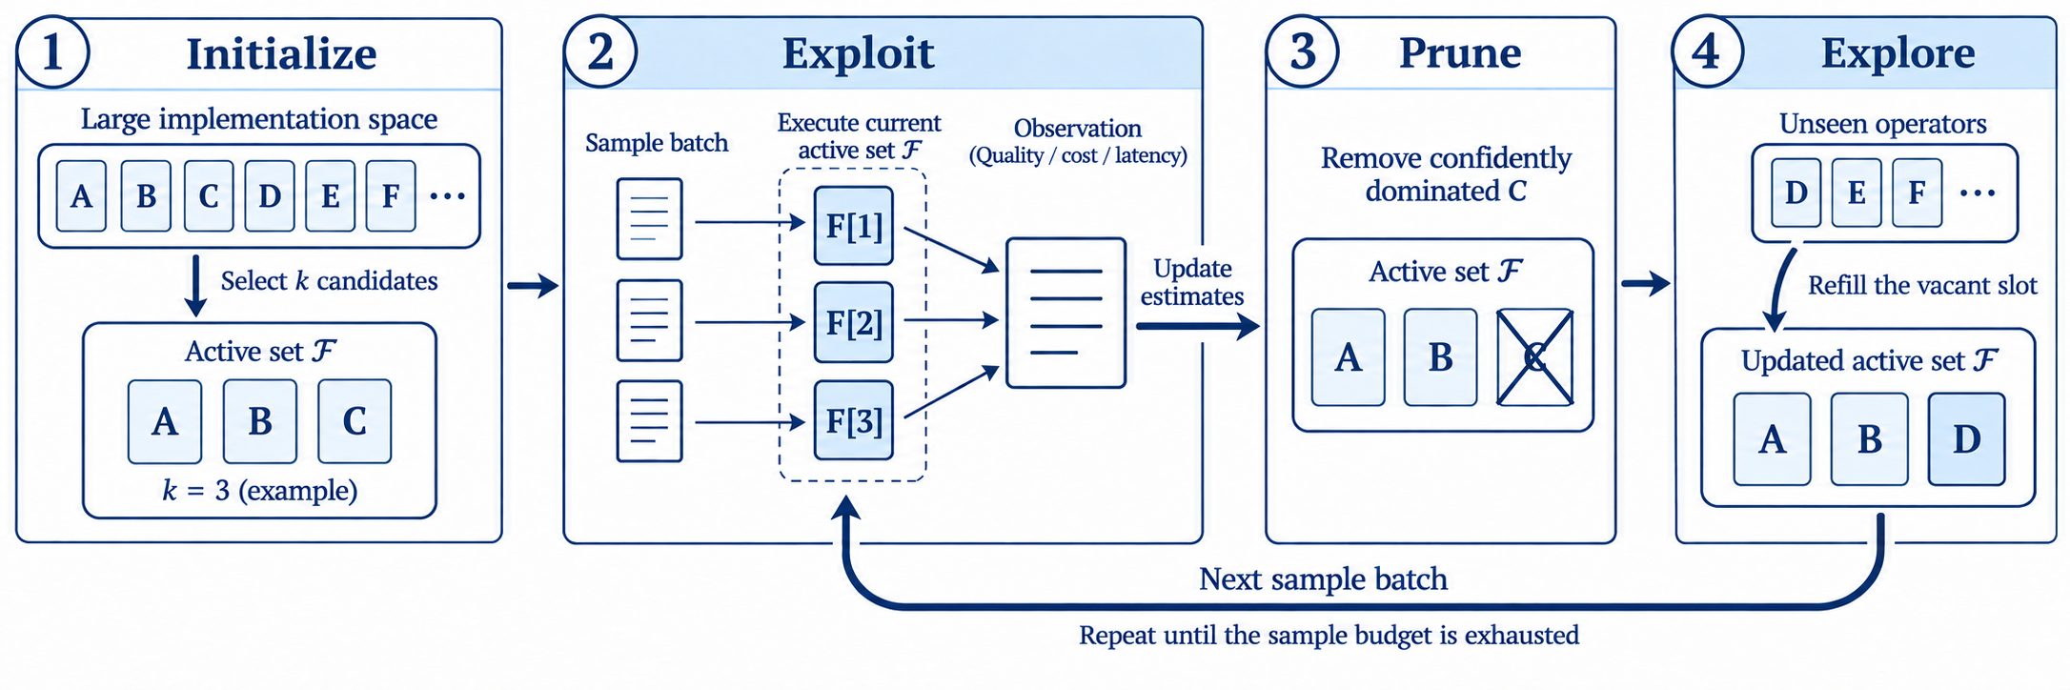
MAB — Multi-Armed Bandit Operator Sampling
Balance exploration and exploitation under a limited sampling budget.
Arm = physical operator · Pull = one sampled execution
Exploit: refine estimates in the active pool.
Explore: introduce unseen candidates.

Slide 13
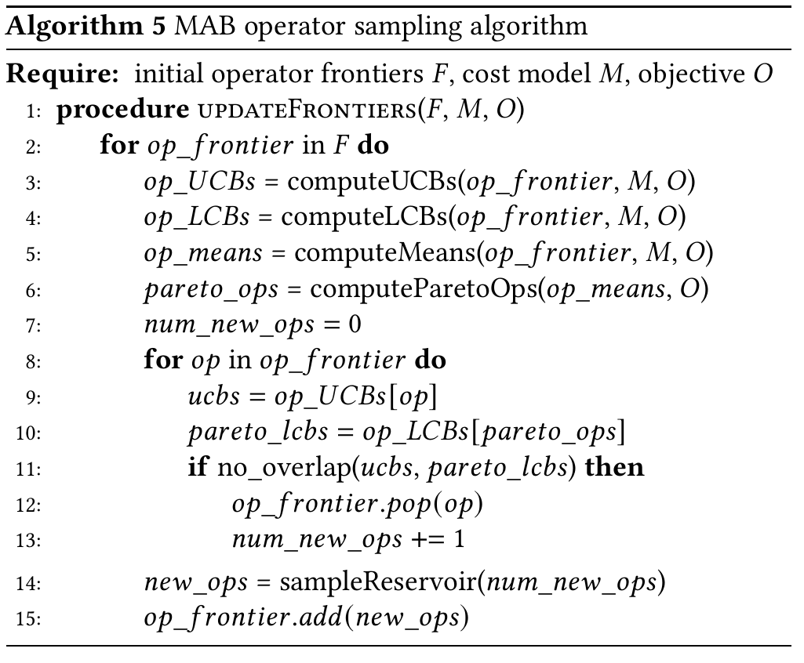
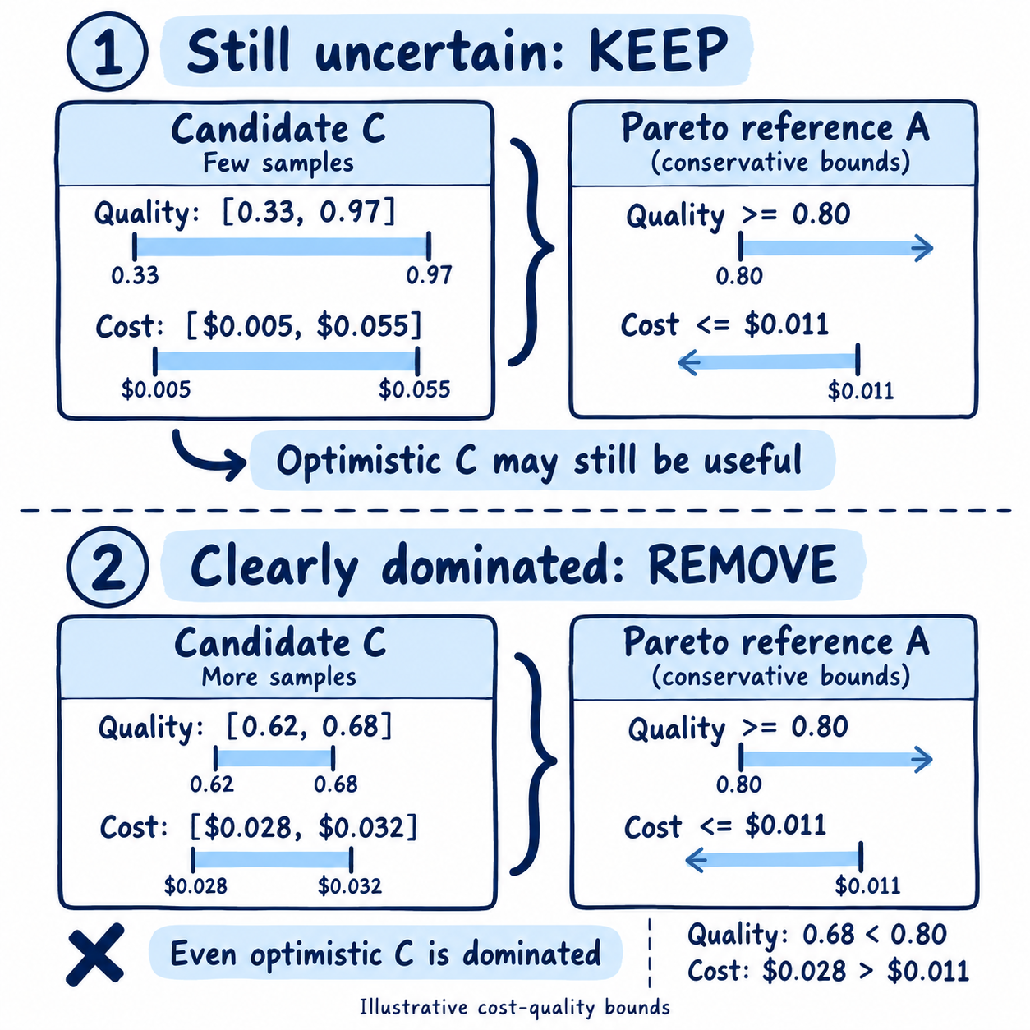



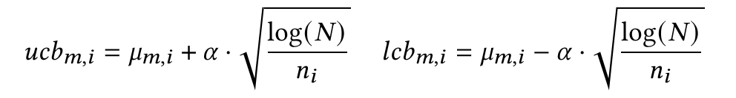
MAB — Confidence Bounds and Candidate Update

Slide 14
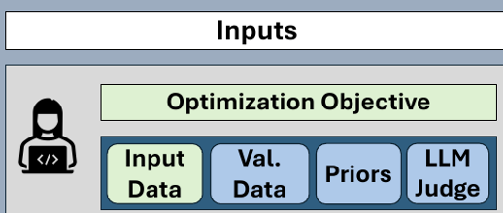
Prior Beliefs — A Better Starting Pool
Prior beliefs express expected operator quality, cost, and latency.
They guide the initial candidate pool and subsequent replacements.

Slide 15
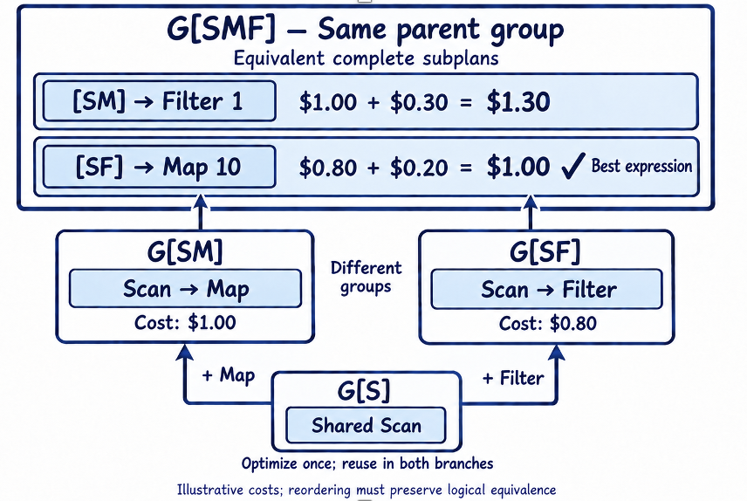
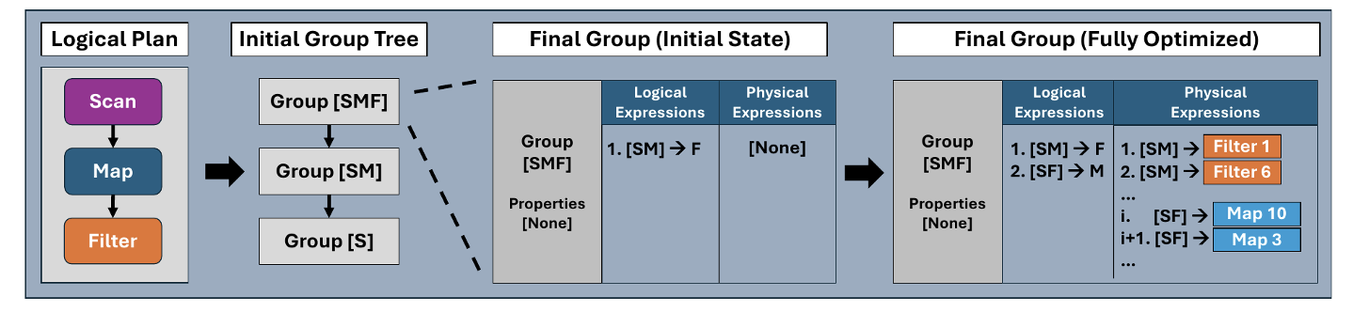
Traditional Cascades
Start with a scalar objective: minimize plan cost.
1 Build groups
2 Apply rules
3 Optimize each group
Equivalent logical and physical
subplans share a group.
Transformation rules
Implementation rules
Evaluate expressions using optimal input subplans.
Keep the minimum-cost choice in each group.

Slide 16
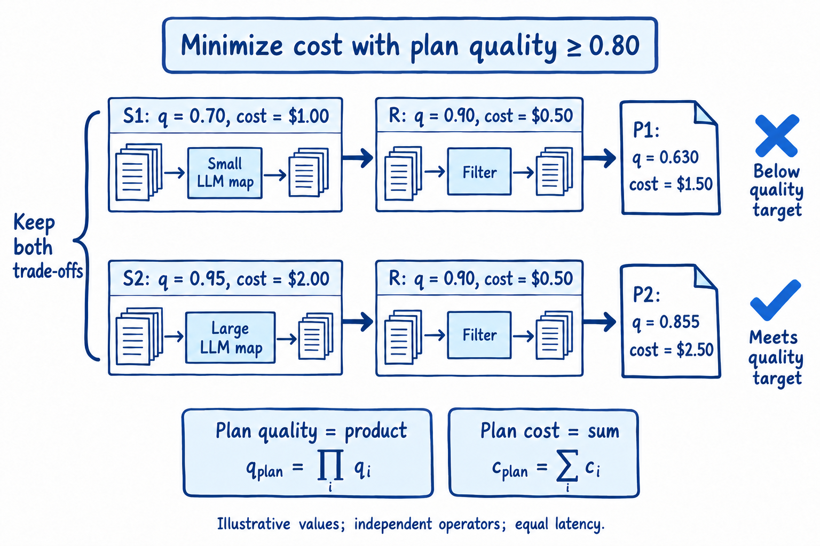
Pareto-Cascades
Theorem 3.1
Every subplan of a
Pareto-optimal physical plan
is itself Pareto-optimal.

Slide 17
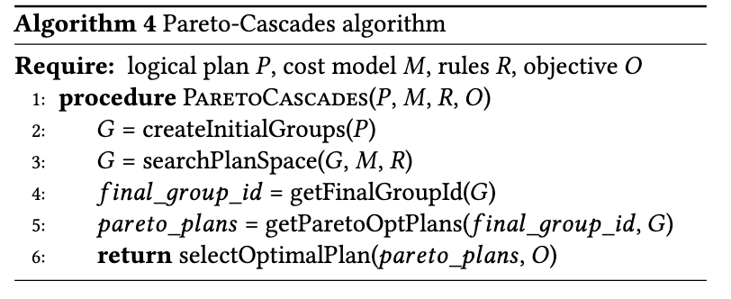
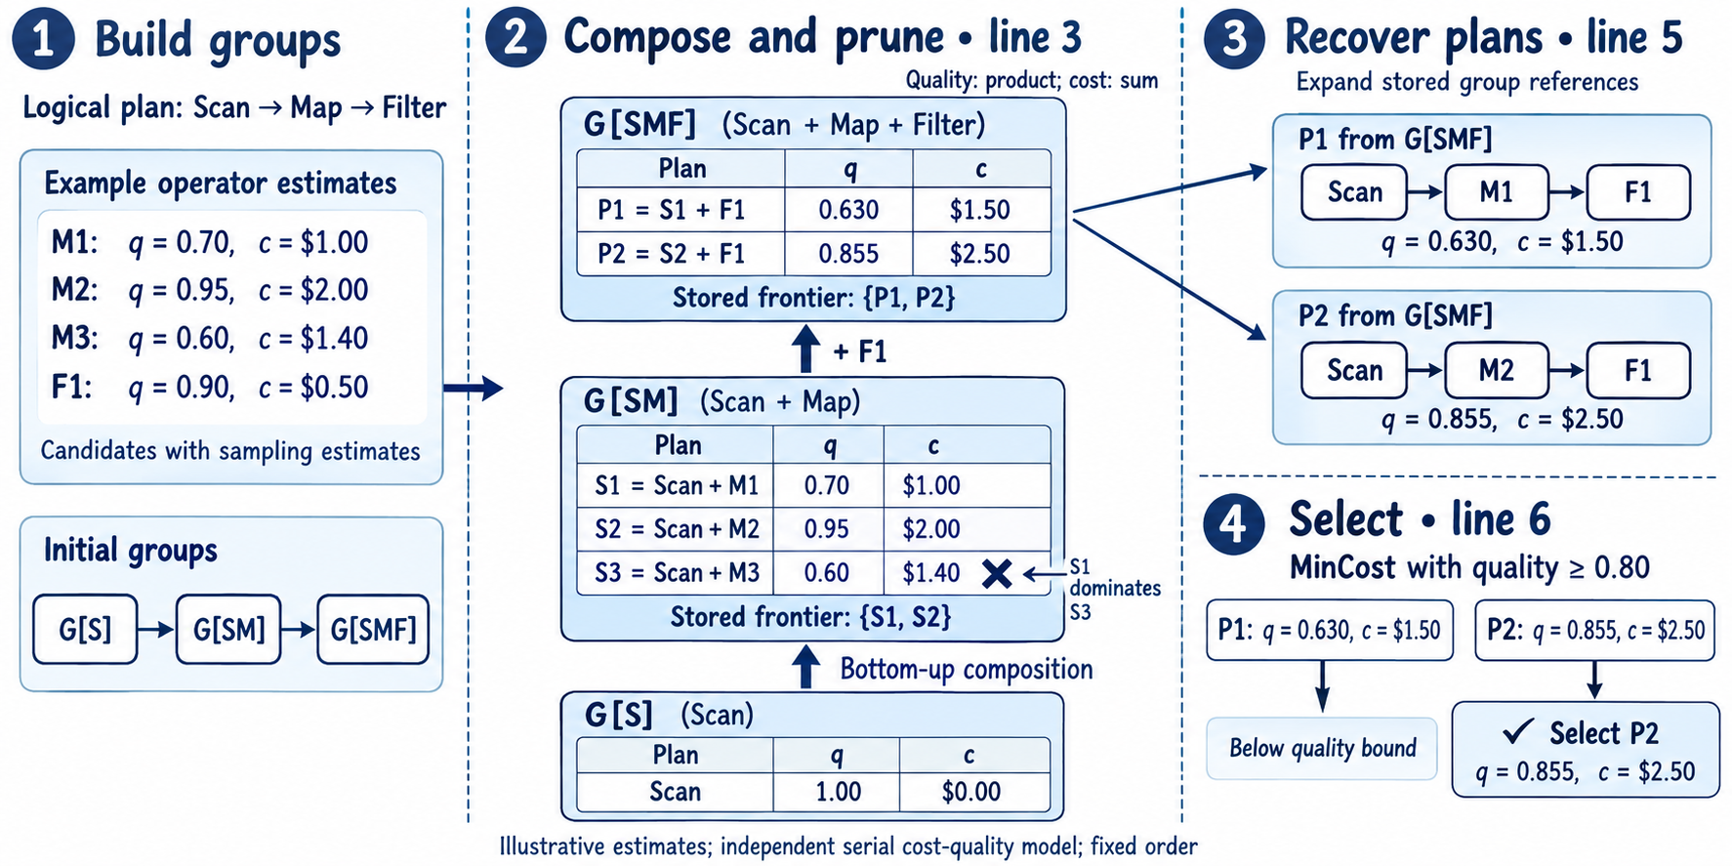
Pareto-Cascades

Slide 18
Physical Implementations Rules
Model Selection: Execute the operator with a single LLM.
Mixture-of-Agents: Combine proposer outputs using an aggregator model.
Reduced-Context Generation: Select relevant input chunks before invoking an LLM.
Critique-and-Refine: Generate an initial output, critique it, and produce a refined output.

Slide 19
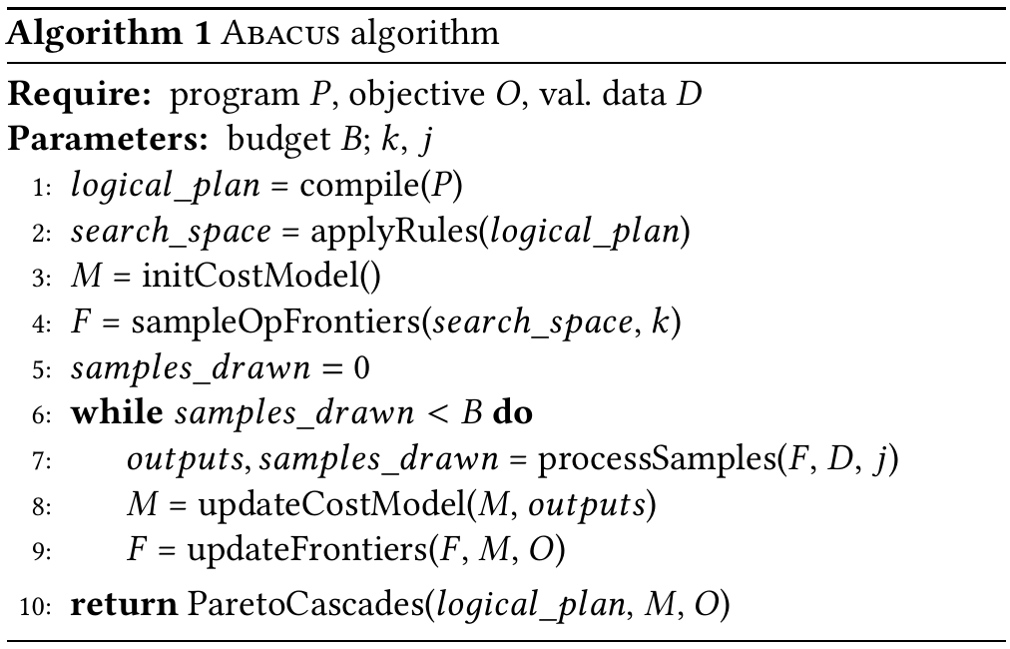
Abacus algorithm
1 Initialize · lines 1–3
P: program · O: objective · D: validation data · B: sampling budget
Enumerate physical implementations without logical rewrites.
Initialize the cost model.
2 MAB sampling · lines 4–9
1
Measure operator performance and update estimates.
Refine and replace candidates within the sampling budget.
2
3 Pareto-Cascades · line 10
Search logical and physical alternatives using the estimates.
Maintain Pareto frontiers and select by policy.
3

Slide 20
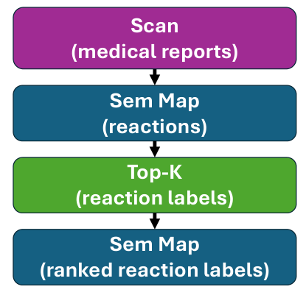
BioDEX — Adverse Reaction Ranking
Workload
Input
Medical reports describing drug-related
adverse reactions.
Task
Identify reactions and produce
a ranked list of reaction labels.
Metric
RP@K (Rank Precision at K)

Slide 21
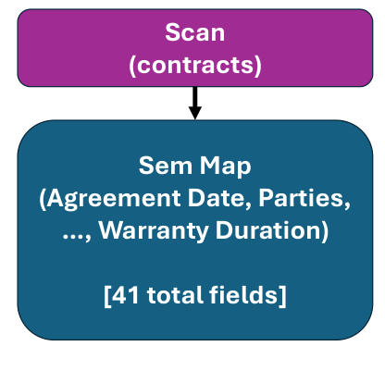
CUAD — Contract Clause Extraction
Workload
Input
Long legal contracts.
Task
Extract text spans corresponding
to 41 contract clause types.
Metric
F1 score

Slide 22
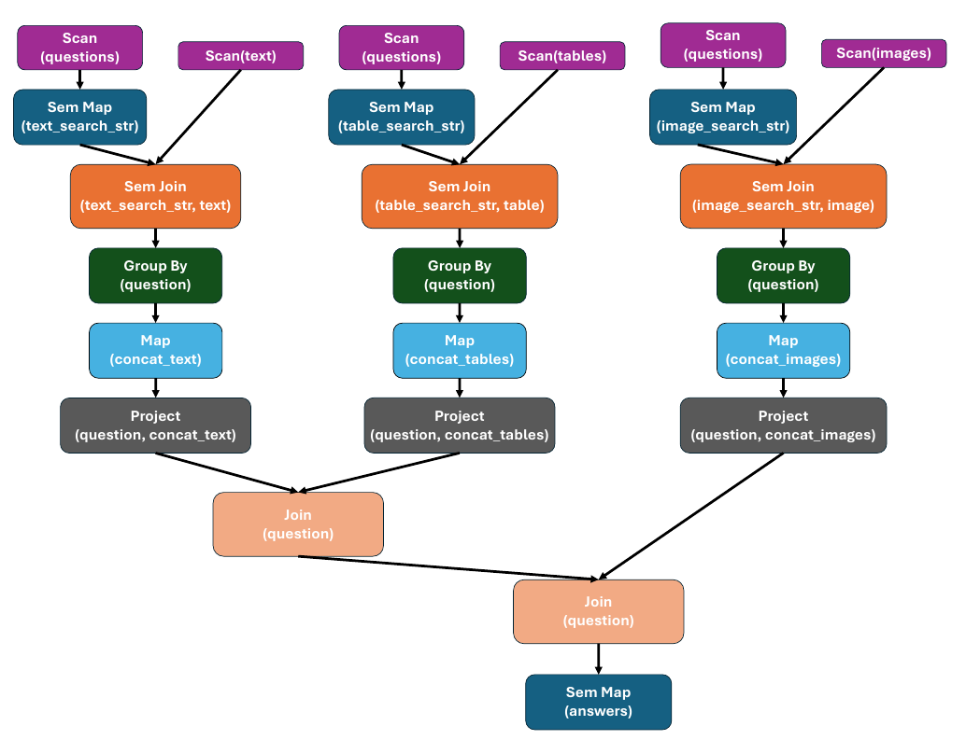
MMQA — Multimodal Question Answering
Workload
Input
Questions, text, tables and images.
Task
Retrieve relevant information
and answer each question.
Metric
F1 score

Slide 23
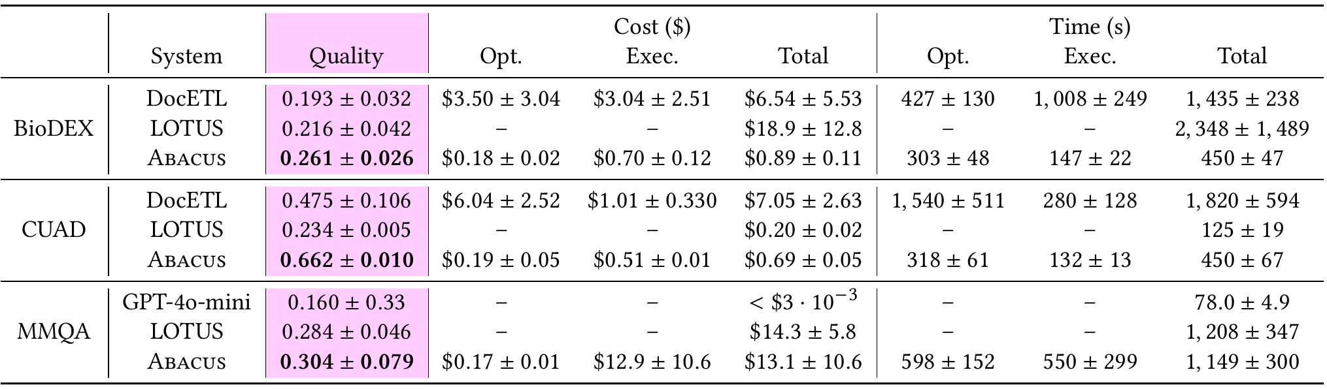
Experiment 1 — Maximum-quality Comparison
Aim: Compare systems optimized to maximize output quality.
Finding: Abacus achieves the highest mean quality on all three workloads.
10 trials · mean ± standard deviation

Slide 24
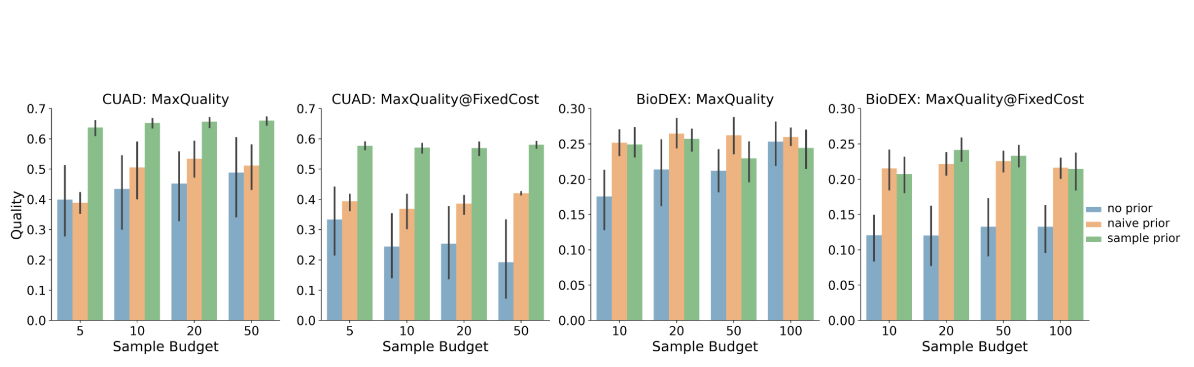
Experiment 2 — Benefits of Prior Beliefs
Aim: Test whether priors improve quality at a fixed sample budget.
Finding: Priors usually improve quality, especially under cost constraints.

Slide 25
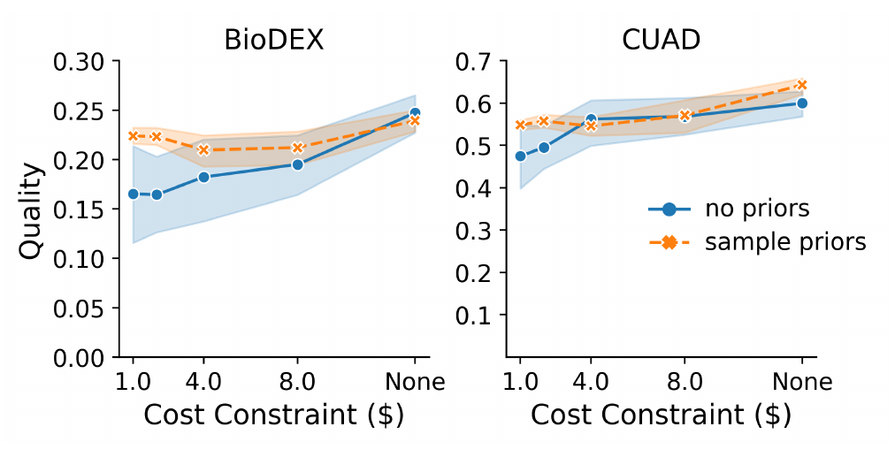
Experiment 3 — Relaxing Cost Constraints
Aim: Test how output quality changes as the cost constraint is relaxed.
Finding: Looser budgets generally allow higher quality; priors help with tight budgets.

Slide 26
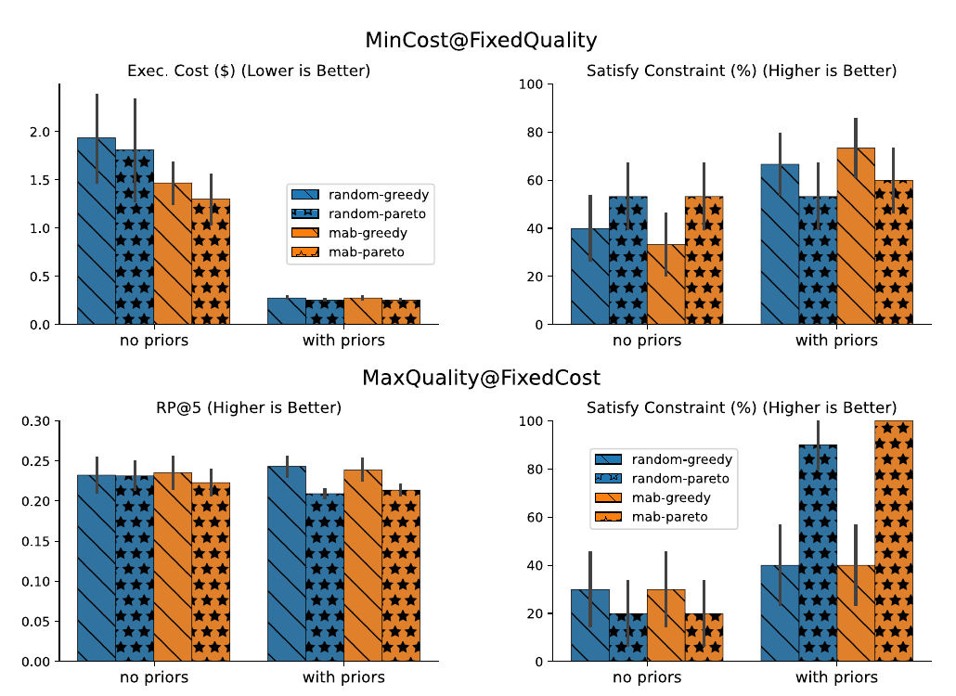
Experiment 4 — Ablation Study
Aim
Isolate the effects of priors,
MAB and Pareto-Cascades.
Finding
On average:
Priors improve optimization.
MAB helps minimize cost.
Pareto-Cascades helps
satisfy constraints.

