Slide 1

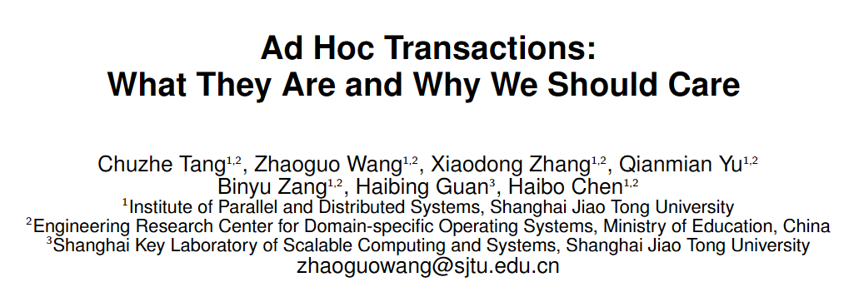

Slide 2
INTRODUCTION
Background
Coordinating concurrent database operations is necessary for web application correctness. To this end, there are two common approach:
using database transactions.
using object-relational mapping (ORM) invariant validation APIs.
So far, much work has been done to investigate and improve these two approaches.

Slide 3
INTRODUCTION
ORM Frameworks
ORM frameworks can transparently generate SQL statements that fetch and persist data based on how applications manipulate in-memory objects.
They allow developers to use database transactions explicitly.
ORMs also provide built-in invariant validation APIs to check the constraints in App, e.g. column uniqueness.

Slide 4
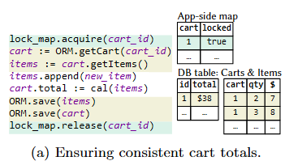
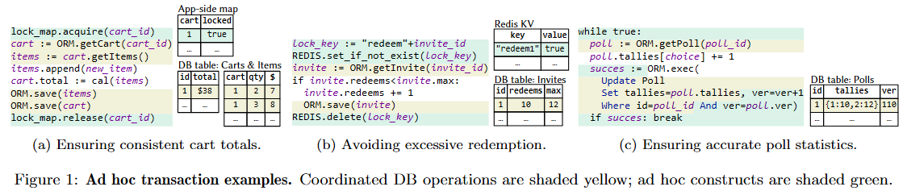
INTRODUCTION
Background
Besides these approaches, application developers are also accustomed to coordinating critical database operations ad hoc.
Specifically, developers might explicitly use locking primitives and validation procedures to implement concurrency control (CC).

Slide 5
INTRODUCTION
Ad hoc transactions
Ad hoc transactions provide isolation to concurrent database operations.
However, their coordination is manually programmed by application developers instead of relying on database systems.
They directly coordinates conflicting database operations.

Slide 6
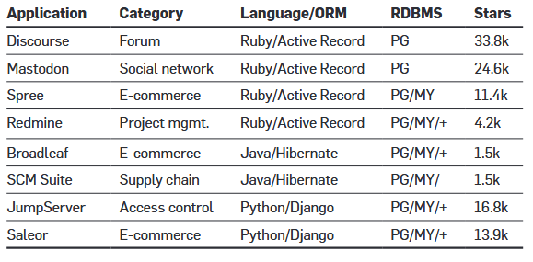
INTRODUCTION
Study Scope
Surveyed 91 ad hoc transaction cases across 8 popular open-source web applications belonging to six different categories.

Slide 7
INTRODUCTION
Findings
Ad hoc transactions appear at critical APIs in every studied application.
Ad hoc transactions’ usages and implementations are much more flexible than database transactions.
Ad hoc transactions are prone to errors.
Ad hoc transactions can have performance benefits under high-contention workloads.

Slide 8
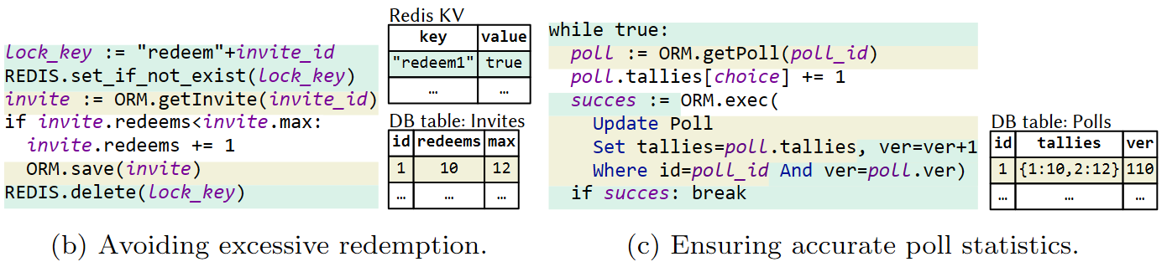
CHARACTERISTICS
Implementation
Even though developers implement ad hoc transactions in various ways, these cases can still be classified into pessimistic ad hoc transactions (65/91) and optimistic ad hoc transactions (26/91).
Notes:
if the records are ordered in large batches (in the background) , then only the first read to the unordered portion would incur overhead

Slide 9
CHARACTERISTICS
Usage
Developers are thus flexible in choosing which and how operations are coordinated, resulting in interesting patterns:
partial coordination;
cross–HTTP request coordination;
coordination with non-database operations.
Notes:
if the records are ordered in large batches (in the background) , then only the first read to the unordered portion would incur overhead

Slide 10
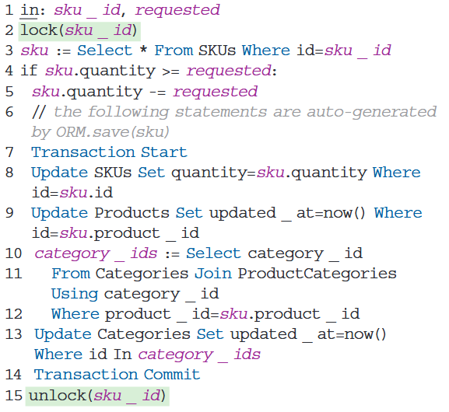
CHARACTERISTICS
All DB operations vs. specific DB operations.
With ad hoc transactions, developers can coordinate only specific database operations instead of all operations in the transaction scope.
Notes:
if the records are ordered in large batches (in the background) , then only the first read to the unordered portion would incur overhead

Slide 11
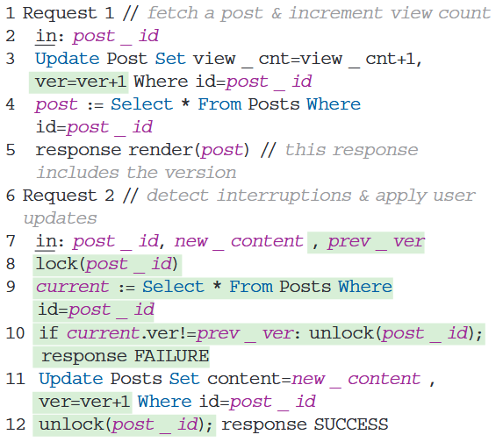
CHARACTERISTICS
Individual requests vs. multiple requests.
Database transactions spanning multiple HTTP requests are a performance anti-pattern, as they introduce long-lived transactions (LLTs).
Notes:
if the records are ordered in large batches (in the background) , then only the first read to the unordered portion would incur overhead

Slide 12
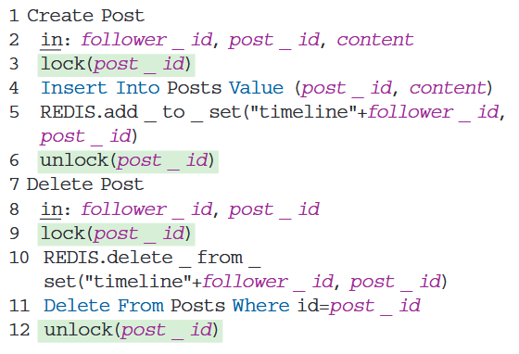
CHARACTERISTICS
DB operations vs. non-DB operations.
A Web application may use multiple storage systems. Thus, it needs to ensure data consistency across different systems.
Notes:
if the records are ordered in large batches (in the background) , then only the first read to the unordered portion would incur overhead

Slide 13
CHARACTERISTICS
Implementation
There are seven different lock implementations and two validation implementations among the eight applications we studied.
Except for Broadleaf, developers consistently use the same lock/validation implementation in individual applications.
Notes:
if the records are ordered in large batches (in the background) , then only the first read to the unordered portion would incur overhead

Slide 14
CHARACTERISTICS
Locks from existing systems vs. manually crafted locks.
All eight applications studied have lock-based pessimistic ad hoc transactions.
Four applications directly use the locking primitives provided by the database systems or language runtimes.
Three other applications have locks implemented from scratch by storing lock information, including lock keys and status (locked/unlocked), in the Redis KV store.
Broadleaf is the only application using both from-scratch lock implementations and existing systems’ primitives.
Notes:
if the records are ordered in large batches (in the background) , then only the first read to the unordered portion would incur overhead

Slide 15
CHARACTERISTICS
ORM-assisted validation vs. manual validation.
Six out of eight applications studied have validation-based optimistic ad hoc transactions.
Four applications use ORM-provided validation procedures via framework-specific interfaces.
When using hand-crafted validation procedures, developers must ensure the atomicity between validation and commit. Additional locks are employed for this purpose.
Notes:
if the records are ordered in large batches (in the background) , then only the first read to the unordered portion would incur overhead

Slide 16
CHARACTERISTICS
Coordination Granularities
Among the 91 ad hoc transactions identified, 14 cases perform fine-grained coordination, such as column-based coordination.
It can improve parallelism.
58 cases perform coarse-grained operations—that is, using a single lock to coordinate multiple operations.
This can largely reduce ad hoc transactions’ CC complexity and avoid deadlocks.
Nine cases implement both types of coordination for different accesses.
Notes:
if the records are ordered in large batches (in the background) , then only the first read to the unordered portion would incur overhead

Slide 17
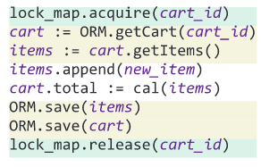
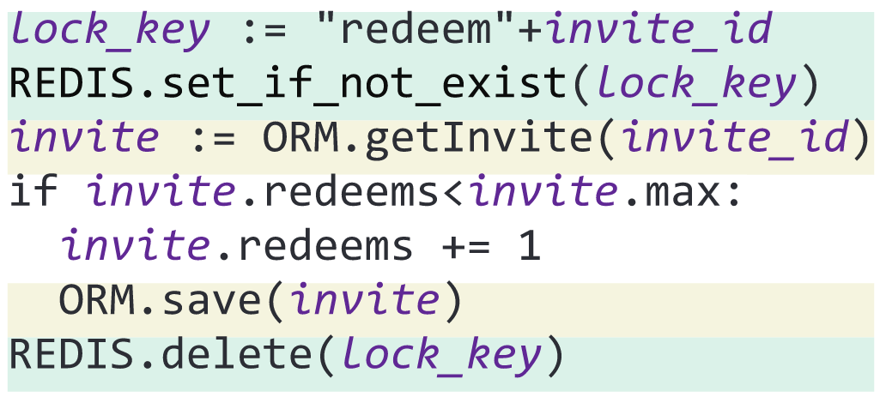
CHARACTERISTICS
Single access vs. multiple accesses.
Fifty-eight ad hoc transactions use only one lock to coordinate multiple database accesses:
Associated access: when two rows are always accessed in the same transaction associatively. Only the first row needs to acquire the lock.
Read–modify–write (RMW): to avoid deadlock caused by RMW, developers craft ad hoc transactions to acquire exclusive locks before the first read.
Notes:
if the records are ordered in large batches (in the background) , then only the first read to the unordered portion would incur overhead

Slide 18
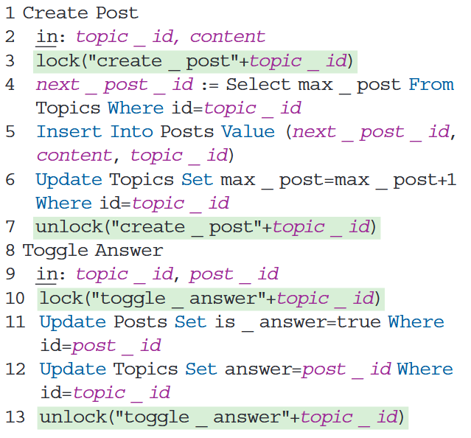
CHARACTERISTICS
Fine-grained vs. coarse-grained.
Ad hoc transactions can also use fine-grained column- or predicate-based coordination.
In this case, though these operations have no column-level conflicts, if they access the same row, an RDBMS using row locks cannot execute them in parallel.
Notes:
if the records are ordered in large batches (in the background) , then only the first read to the unordered portion would incur overhead

Slide 19
CHARACTERISTICS
Failures Handle
Ad hoc transactions are typically not equipped with complex failure-handling logic, because:
individual ad hoc transactions might face fewer potential failure scenarios than general database transactions;
developers seem to often assume failure-free executions.
Notes:
if the records are ordered in large batches (in the background) , then only the first read to the unordered portion would incur overhead

Slide 20
CHARACTERISTICS
Automated rollback vs. manual rollback.
Unlike database transactions, which have a system-level catch-all rollback mechanism, application developers need to craft failure-handling logic on a case-by-case basis.
Each pessimistic ad hoc transaction either uses a single lock (52/65) or acquires locks in a consistent order (13/65). Thus, none needs to handle deadlock at runtime.
In 19 optimistic cases, no update is persisted before validation, thus avoiding the need for rollback.
In other cases, early persisted updates require developers to either use certain rollback methods or use repair techniques.
Notes:
if the records are ordered in large batches (in the background) , then only the first read to the unordered portion would incur overhead

Slide 21
CHARACTERISTICS
Automated rollback vs. manual rollback.
One case uses the former approach, where a Read Committed database transaction is used to enclose update and validation operations.
Two cases use manually programmed rollback procedures triggered by validation failures and will undo persisted updates.
Four cases choose to repair the inconsistent values instead of rolling back on conflicts.
Notes:
if the records are ordered in large batches (in the background) , then only the first read to the unordered portion would incur overhead

Slide 22
CHARACTERISTICS
Crash handling.
Recovering database states after crashes is more challenging than validation failure rollback since developers are unaware of the progress of interrupted ad hoc transactions.
tolerate intermediate states with preventative measures;
simply let the inconsistency propagate to end users.
Notes:
if the records are ordered in large batches (in the background) , then only the first read to the unordered portion would incur overhead

Slide 23
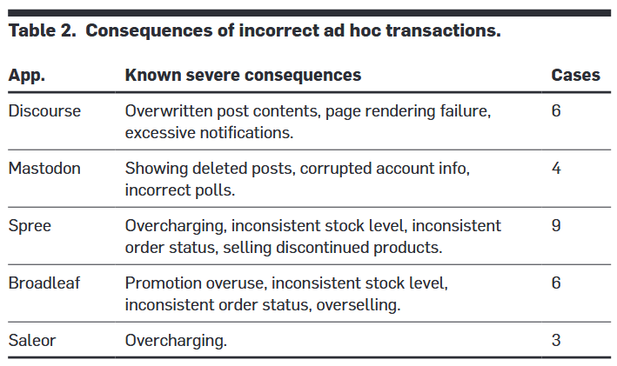
CORRECTNESS ISSUES
Building bug-free ad hoc transactions is nontrivial.
Notes:
if the records are ordered in large batches (in the background) , then only the first read to the unordered portion would incur overhead

Slide 24
CORRECTNESS ISSUES
Incorrect locks and validation procedures.
Thirty-six out of 65 pessimistic ad hoc transactions incorrectly implement or use locking primitives.
Incorrect lock usage.
Incorrect lock implementation.
11 out of 26 optimistic ad hoc transactions fail to provide atomic validation and commit, causing correctness issues.
Non-atomic validate-and-commit.
Notes:
if the records are ordered in large batches (in the background) , then only the first read to the unordered portion would incur overhead

Slide 25
CORRECTNESS ISSUES
Incorrect coordination scope.
Sixteen issues arise from incorrect coordination scope. Specifically, developers
either omit some critical operations in existing ad hoc transactions (11/16)
or forget to employ ad hoc transactions for certain business procedures altogether (5/16).
Notes:
if the records are ordered in large batches (in the background) , then only the first read to the unordered portion would incur overhead

Slide 26
CORRECTNESS ISSUES
Incorrect failure handling.
Ad hoc transactions are often vulnerable to incorrect handling of both runtime failures and server crashes.
Incomplete repair.
Unexpected intermediate states after crashes.
Notes:
if the records are ordered in large batches (in the background) , then only the first read to the unordered portion would incur overhead

Slide 27
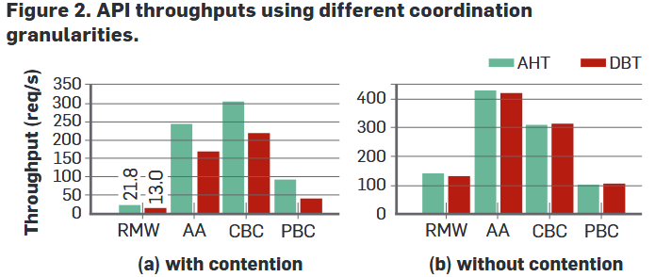
PERFORMANCE IN ACTION
We evaluated four real-world APIs, where the four customized granularities discussed earlier are employed, denoted as RMW (read–modify-write), AA (associated access), CBC (column-based coordination), and PBC (predicate-based coordination).
Notes:
if the records are ordered in large batches (in the background) , then only the first read to the unordered portion would incur overhead

Slide 28
DISCUSSION
Reason of using ad hoc transaction.
There is an emerging gap between the coordination requirements of Web applications today and what database systems currently offer.
Certain business logic using ad hoc transactions exhibits characteristics that are difficult, sometimes impossible, for database transactions to handle.
the use of multiple storage backends;
life span crossing multiple requests
Notes:
if the records are ordered in large batches (in the background) , then only the first read to the unordered portion would incur overhead

Slide 29
DISCUSSION
Three-step approach.
we need to systematically quantify the gap.
what if developers choose to work around database transactions instead?
further study on both development efforts and runtime overheads is still required.
Notes:
if the records are ordered in large batches (in the background) , then only the first read to the unordered portion would incur overhead

Slide 30
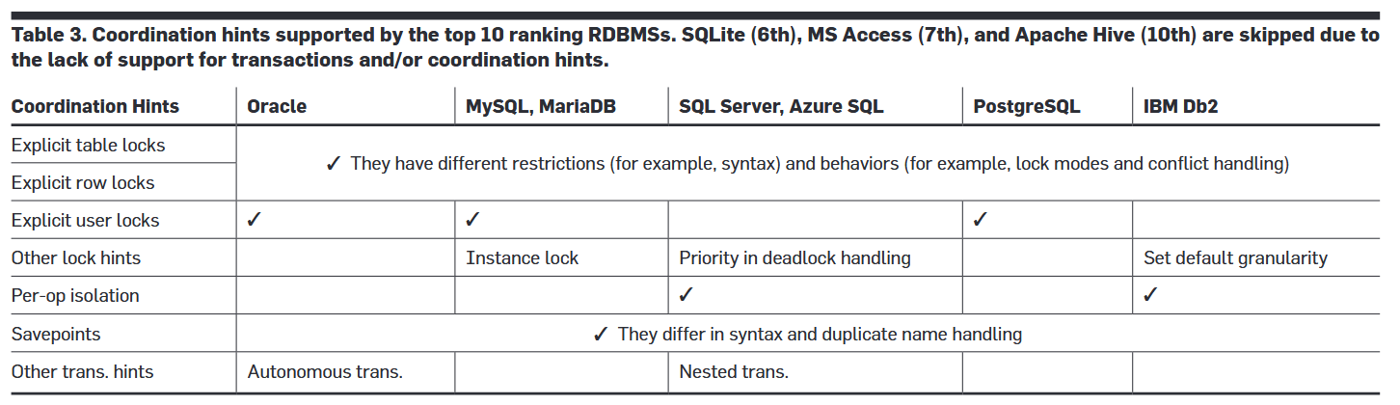
DISCUSSION
Three-step approach.
we need to explore incremental remedies for existing applications.
Many existing database systems already provide interfaces for passing hints that customize the coordination.
Notes:
if the records are ordered in large batches (in the background) , then only the first read to the unordered portion would incur overhead

Slide 31
DISCUSSION
Three-step approach.
we should explore alternative abstractions for emerging applications.
Instead of focusing on intra-component coordination driven by individual database systems, new global abstractions that address inter-component concurrency are urgently needed.
Notes:
if the records are ordered in large batches (in the background) , then only the first read to the unordered portion would incur overhead

