Slide 1
Removing Double-Logging with Passive Data Persistence in LSM-tree based Relational Databases
Kecheng Huang†‡, Zhaoyan Shen†, Zhiping Jia†, Zili Shao‡ and Feng Chen§
†Shandong University
‡The Chinese University of Hong Kong
§Louisiana State University
FAST '22

Slide 2
Background
MySQL server
New Requirements
Write-intensive Workloads
Scalability
Space Efficiency
Compressibility
B-tree based storage engine
Traditional B-tree based Relational Databases

Slide 3

Background
MySQL server
New Requirements
Write-intensive Workloads
Scalability
Space Efficiency
Compressibility
LSM-tree based storage engine
LSM-tree based Relational Databases

Slide 4
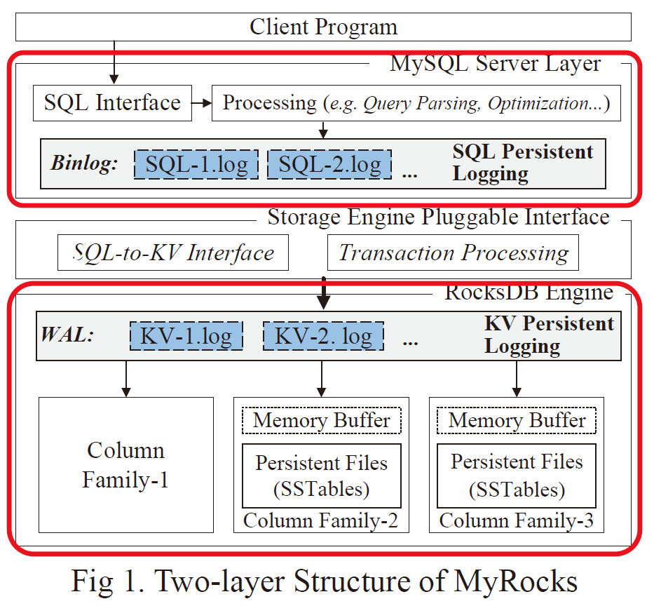
MyRocks: MySQL Server & RocksDB Engine
RDB Server Layer
Buffer pool management
Query processing & optimization
Transaction support
Data Recovery
LSM-tree based Storage Engine Layer
Processes requests from the RDB Layer
Responsible for reliably and efficiently storing data in persistent storage

Slide 5
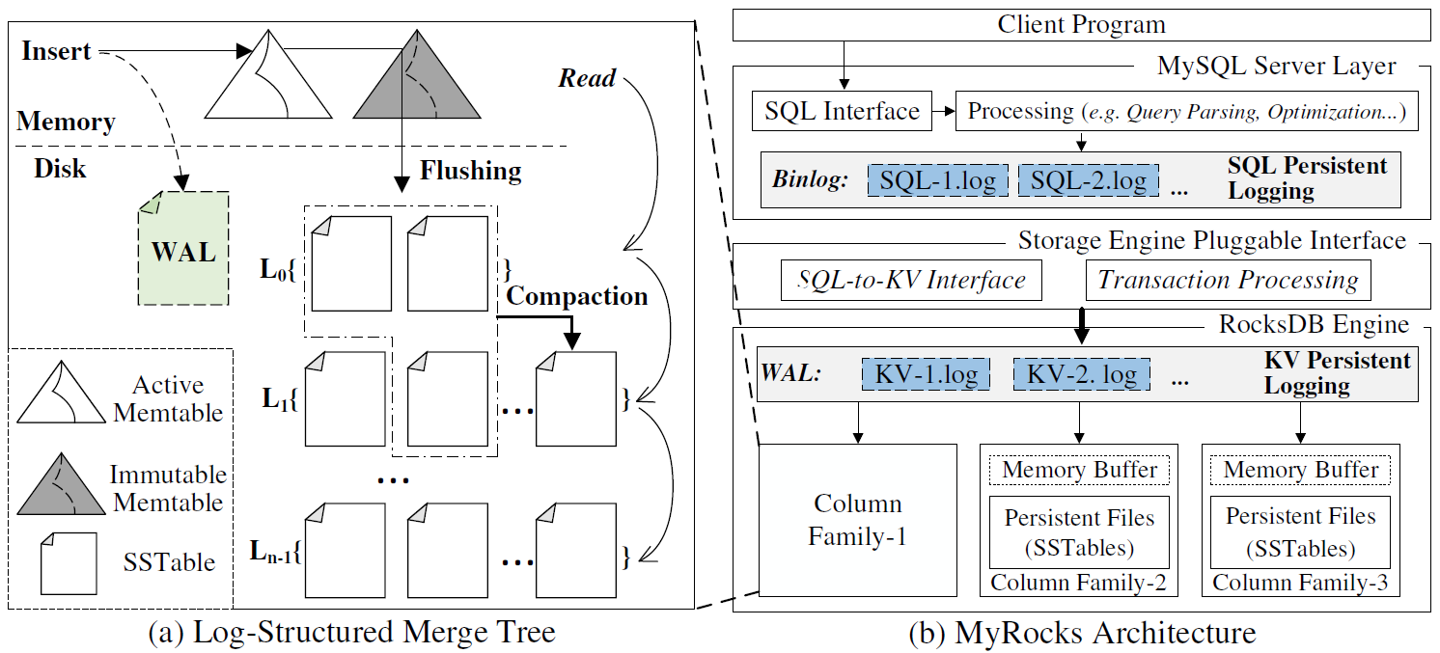
Each CF is a LSM-tree, all CFs share a global WAL

Slide 6
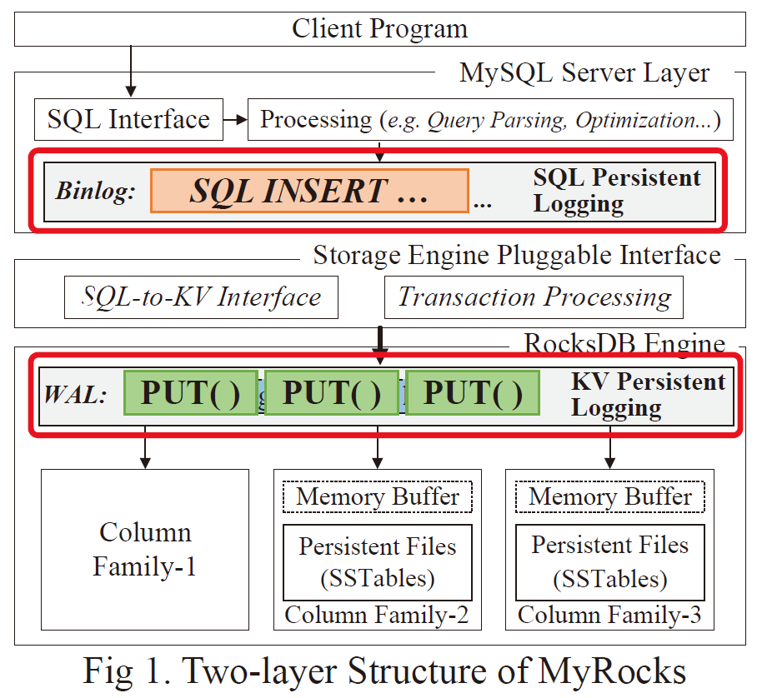
How MyRocks works
RDB layer logs SQL statements in the binlog
RDB layer issues the transactions to SQL-to-KV translator
Translator converts the transactions of each transaction into a KV batch (some KV items)
RocksDB Engine issues KV items to the corresponding CFs
Before inserting a KV item into the LSM-tree’s Memtables, it is first written to the WAL

Slide 7
How MyRocks works
Once all the KV items belonging to a transaction are inserted into the Memtables, the transaction can be safely regarded as “persistent”, and a commit flag for this transaction is returned to RDB layer
The point is that the commit flag in the binlog can be reliably viewed as the safe point for data persistence,

Slide 8
How MyRocks recovery – Two phase recovery
First, The storage engine retrieves the batched KV items in the WAL and rewrites them into the Memtables of the corresponding LSM-trees.
Then, the RDB layer replays all the transactions in the binlog after the safe point (commit flag).
The first phase guarantees that the storage engine itself is recovered to the state before the crash;The second phase guarantees the consistency of the SQL logic in the MySQL server layer.

Slide 9
LSM-tree as Storage Engine
Two-layer Structure
RDB Server Layer
LSM-tree based Storage Engine Layer
Advantages
Flexibility
Efficiency
A "Modular" System

Slide 10
LSM-tree as Storage Engine
Two-layer Structure
RDB Server Layer
LSM-tree based Storage Engine Layer
Advantages
Flexibility
Efficiency
A "Modular" System
New Issues
Redundancy
Resource Waste
Negative Performance Impact
Log Redundancy

Slide 11
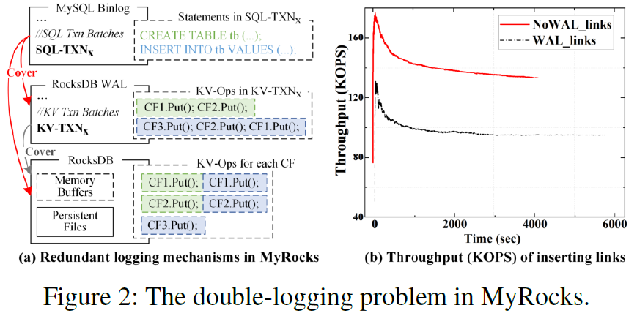
Preliminary test

Slide 12
LSM-tree as Storage Engine
Insight: Data are "double-protected"
Unnecessary Space Usage
Critical Path Blocking
I/0 0verheads
Log Redundancy
➔ "Double-logging"

Slide 13
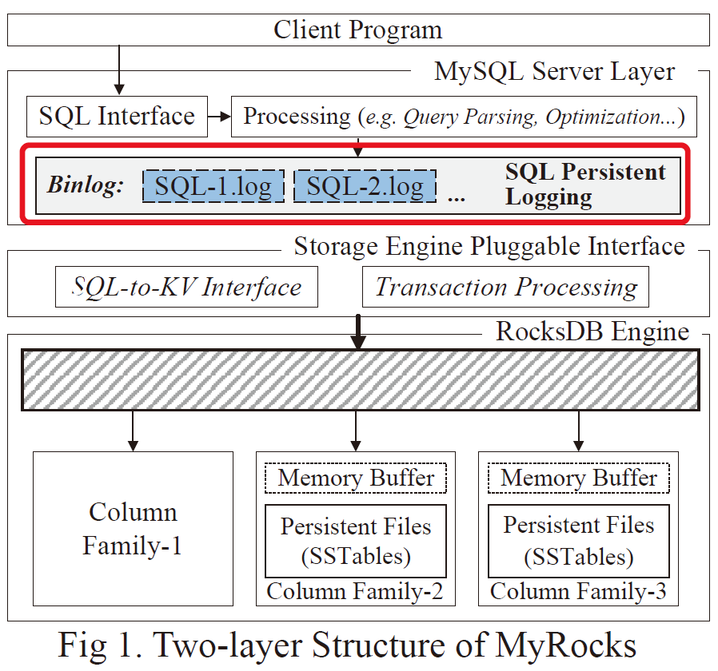
The Solution
Key idea: How about removing WAL from LSM-tree?

Slide 14
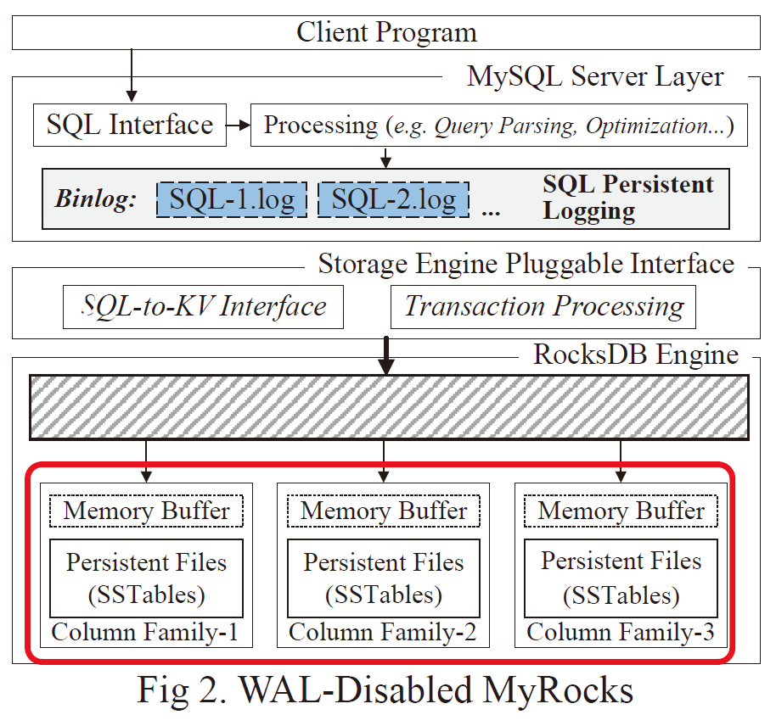
Critical Challenges
Unwarranted Data Persistence
"Committed" data may still be in
volatile memory buffers.

Slide 15
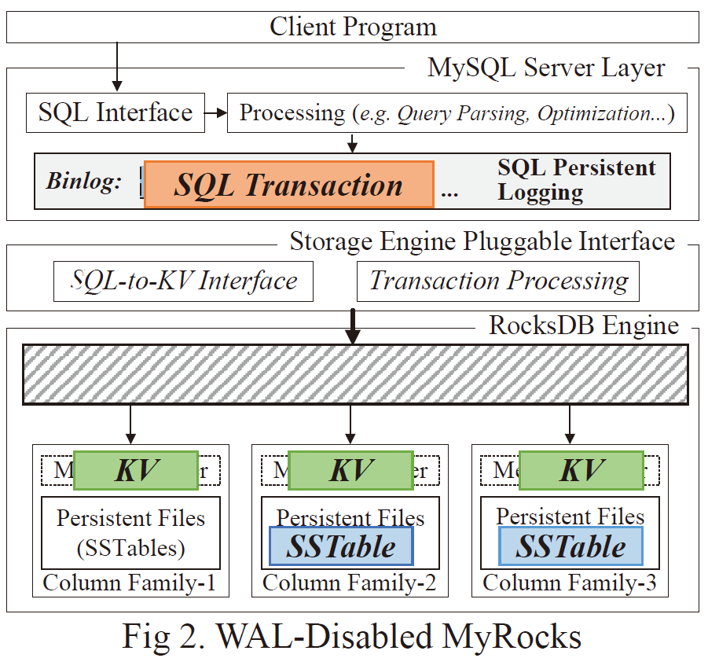
Critical Challenges
Unwarranted Data Persistence
Partial Persistence
A transaction can be "partially" persistent.

Slide 16
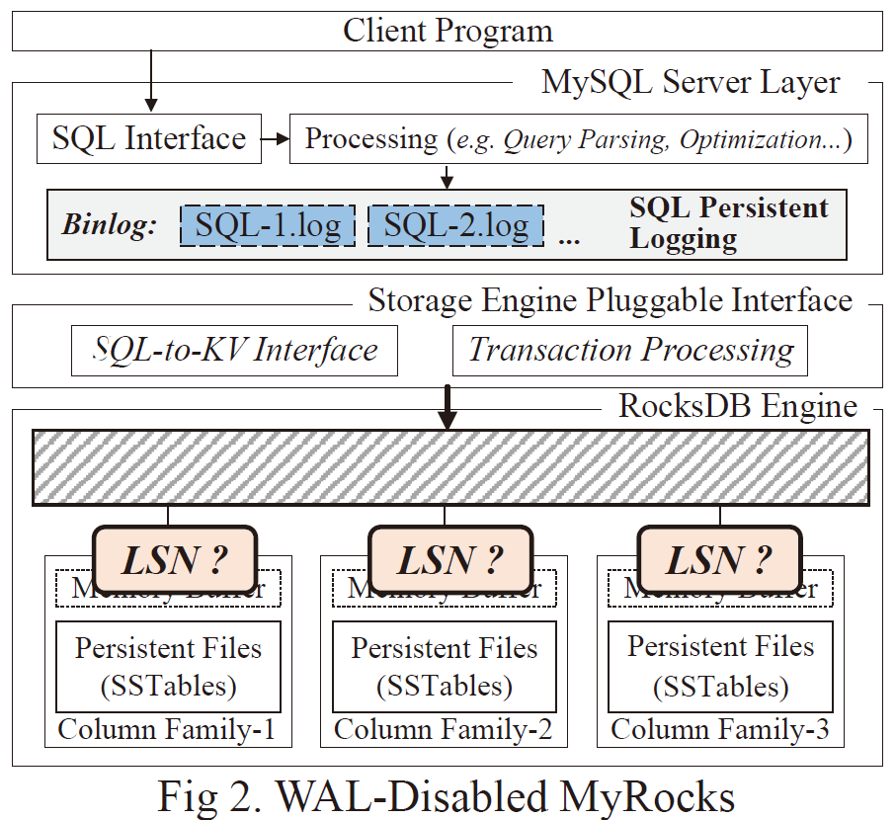
Critical Challenges
Unwarranted Data Persistence
Partial Persistence
Lost Track of LSN
The original ordering cannot be restored without LSNs.

Slide 17
The Problem: How to recover from crash after removing WAL?
How to track safe point?
How to recover as fast as possible？

Slide 18
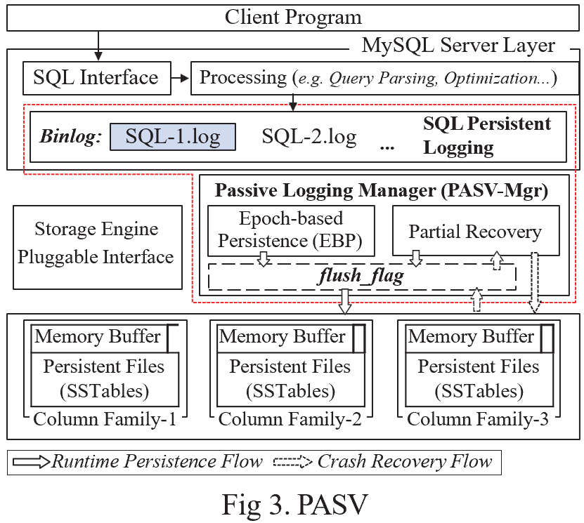
Passive Data Persistence Scheme (PASV)
Major Components
Passive Flushing Policy
Epoch-based Persistence(EBP)
Partial Recovery

Slide 19
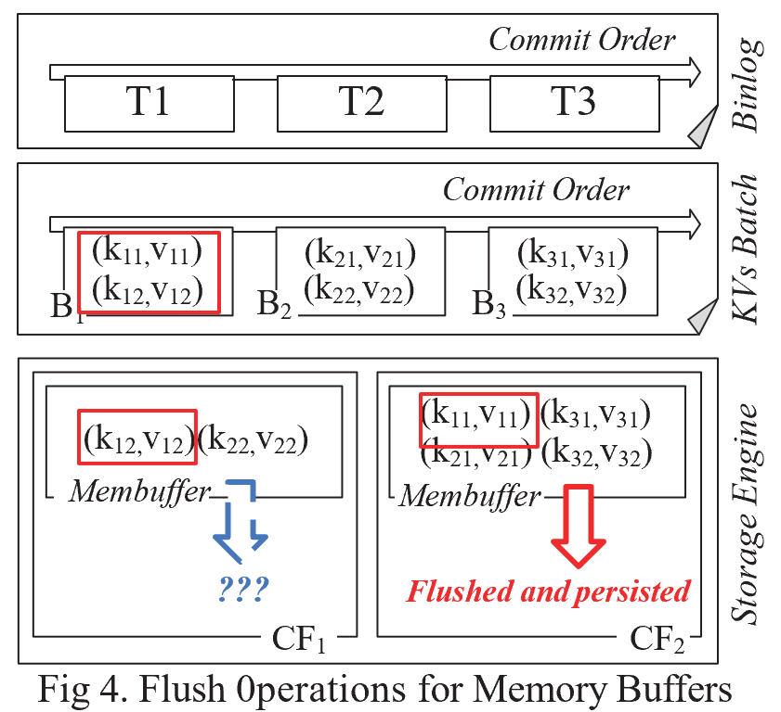
Passive Flushing

Slide 20
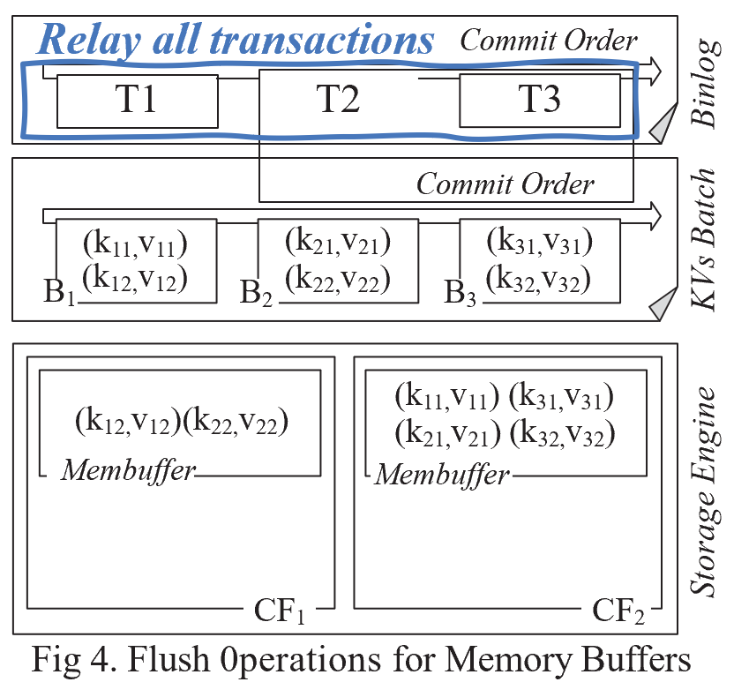
Passive Flushing
Possible Approaches
The Naive Approach
Replay all Transactions in Binlog

Slide 21
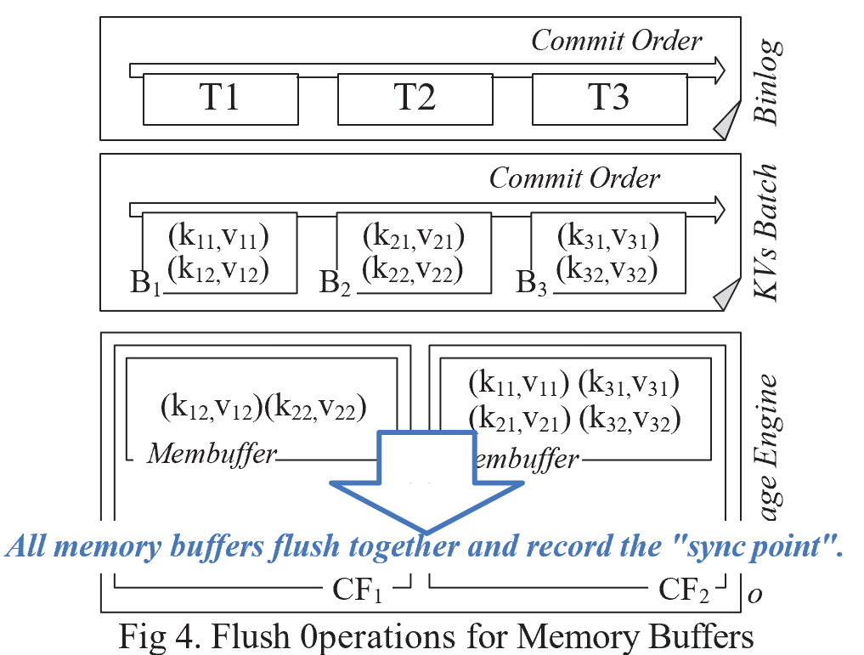
Passive Flushing
Possible Approaches
The Naive Approach
The Active Approach
No Parallelism
Invalidated Memory Buffer
Impaired System Modularity

Slide 22
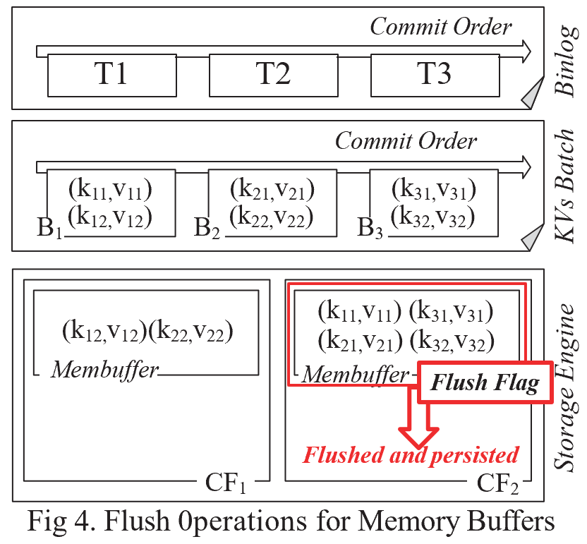
Passive Flushing
Possible Approaches
The Naive Approach
The Active Approach
Passive Flushing
Flush Flag
A special key-value item
Key: A magic number
Value: Data persistent point and LSN range
<CF, TSN, LSN_{first}, LSN_{last}>

Slide 23
Passive Flushing
Flush Flag <CF, TSN, LSN_{first}, LSN_{last}>
CF is the column family (LSM-tree) whose memory buffer is being flushed
TSN is the Transaction Sequence Number of the last transaction whose KV items are inserted in the memory buffer of the column family
LSN_{first} and LSN_{last} are the LSNs of the first KV and the last persisted KV of the transaction, respectively.

Slide 24
Serial Property of transaction processing in LSM-tree based RDBs
In LSM-tree based RDBs, it is guaranteed that the KV items are processed in a serial manner
During the transaction commit process, all transaction records are persisted to the binlog in serial
The SQL transactions are parsed in the RDB layer and translated into KV batches in the storage engine layer in serial
The KV items that are translated from a transaction are inserted into the LSM-trees’ memory buffers in serial

Slide 25
Serial Property of transaction processing in LSM-tree based RDBs
Hence, we can ensure that all KV items logically prior to the last KV item of the last transaction in a column family would never be persisted to storage later than it.

Slide 26
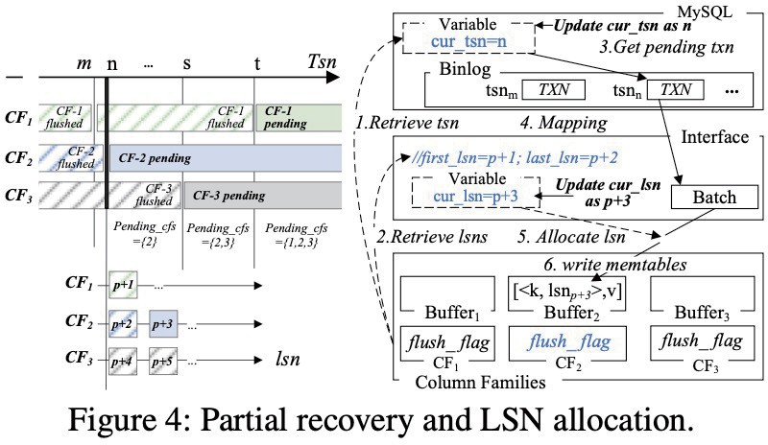
Epoch-based Persistence (EBP) & Partial Data Recovery

Slide 27
Evaluation
Prototype Implementation
An 0pen-source Prototype based on MyRocks
Source Code: https://github.com/ericaloha/MyRocks-PASV
Experimental Setup
Hardware: Intel i7-8700 3.2GHz processor, 32GB memory, 500GB SSD
Software: Ubuntu 18.04 LTS with Linux Kernel 4.15 and Ext4 file system
Workloads
LinkBench and TPC-C

Slide 28
Evaluation
General Performance
Better performance
higher throughput
faster loading and execution
Lower storage cost
by removing WAL in the storage engine layer
 |  | MyRocks | PASV | Improvement
Loading phase | Total Loading Time (sec) | 6,027.3 | 4,019.9 | 33.3%
 | Throughput (KOPS) | 72.6 | 108.8 | 49.9%
 | Storage Engine I/O (GB) | 206.5 | 117.9 | 42.9%
Query phase | Total Execution Time (sec) | 3,371 | 2,614 | 22.5%
 | Throughput (KOPS) | 2.97 | 3.82 | 28.6%

Slide 29
Evaluation
Comparison with the "Active" Approach
Better Performance & Less I/Os
Smaller Recovery Time Variance
Total Execution Time (sec)
4500
4200
3900
3600
PASV ACT100 ACT200 ACT500 ACT1000 ACT2000
Compaction I/Os (GB)
110
90
70
50
Recovery Time range (sec)
Recovery time 25%~75%
Median line Mean
15
10
5
PASV ACT100 ACT200 ACT500 ACT1000 ACT2000
Throughput (KOPS)
110
PASV
ACT-100 ACT-200 ACT500 ACT1000 ACT2000
100
90
PASV ACT100 ACT200 ACT500 ACT1000 ACT2000

Slide 30
Evaluation
Evaluation with TPC-C
Performance: Better than MyRocks and nearly identical to the Naive approach
Recovery Time: Stable and far less than the Naive approach
 | PASV |  | Naive |  |  | MyRocks
Total Execution Time (sec) | 2,658.4 |  | 2,651 |  |  | 3,612
Throughput (KQPS) | 35.6 |  | 35.7 |  |  | 26.2
Storage Engine I/O (GB) | 204.2 |  | 204.2 |  |  | 267.6
Naive
PASV
4000
MyRocks
Recovery Time (sec)
3000
2000
2251.3
39.2
40
20
0
10
12 14 16
TimeStamp (minute)
18
20

Slide 31
Conclusion
Double-logging is a critical problem in LSM-tree based relational databases.
PASV effectively address the double-logging problem.
Experiments show that PASV can achieve significant improvement without sacrificing fast recovery capability

