Slide 1
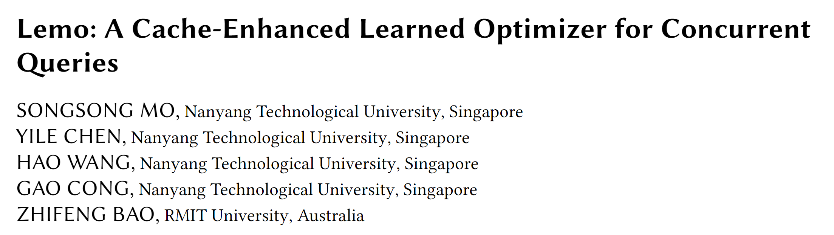

Slide 2
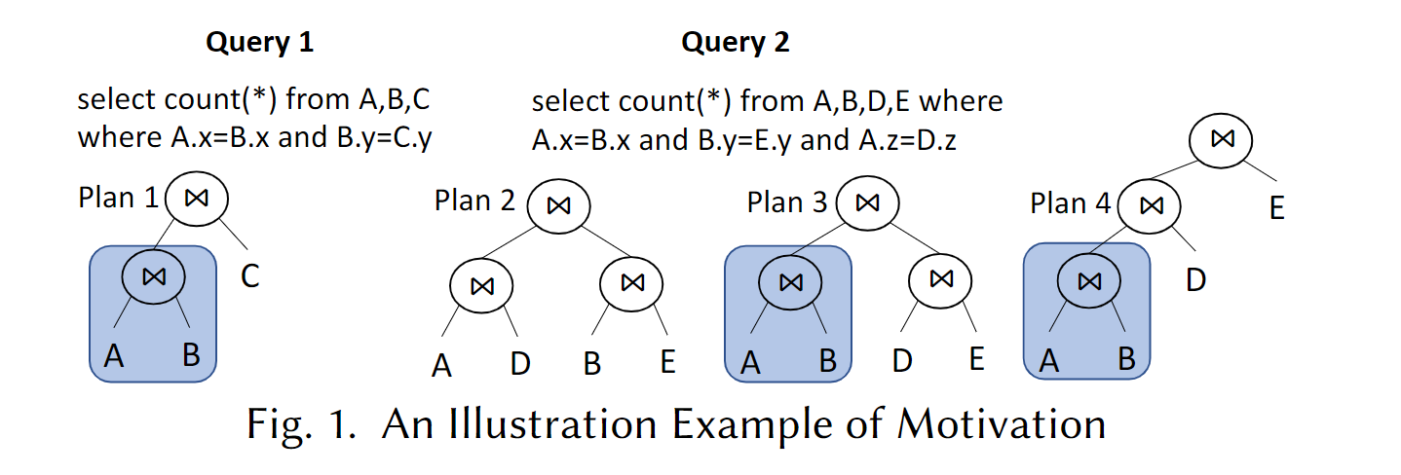
Introduction
Consecutive queries from the same user in a query session or queries submitted by different users frequently contain identical subqueries.
Many users may search for same products within the time frame, resulting in many identical concurrent queries.

Slide 3
Introduction
Related work
Batch query optimization
Real-time query optimization
Challenges
How to maximize the reuse of common subqueries, which are shared among multiple queries
How to generate an optimal query plan is nontrivial in the setting of concurrent query execution.

Slide 4
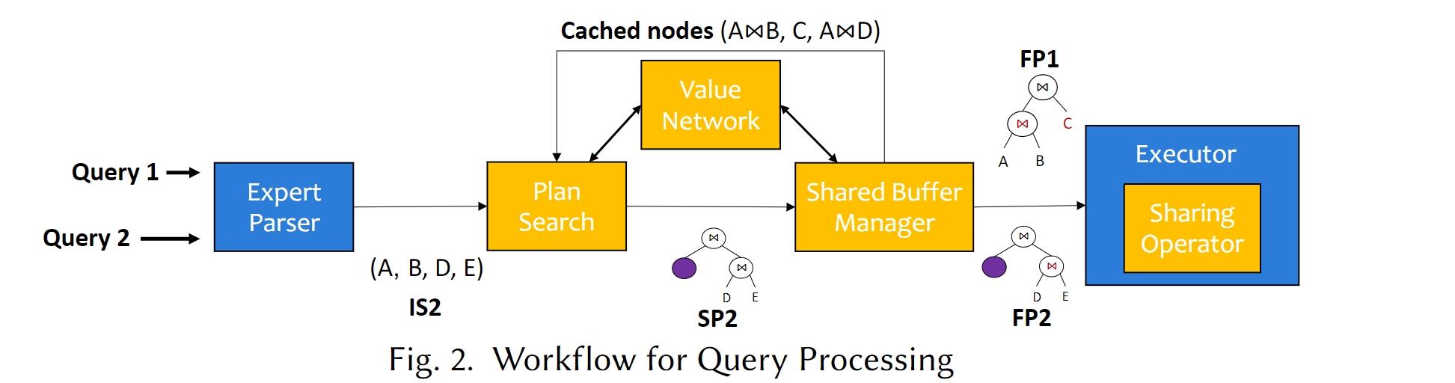
System overview
Value network
Plan search
Shared buffer manager
Sharing operator

Slide 5
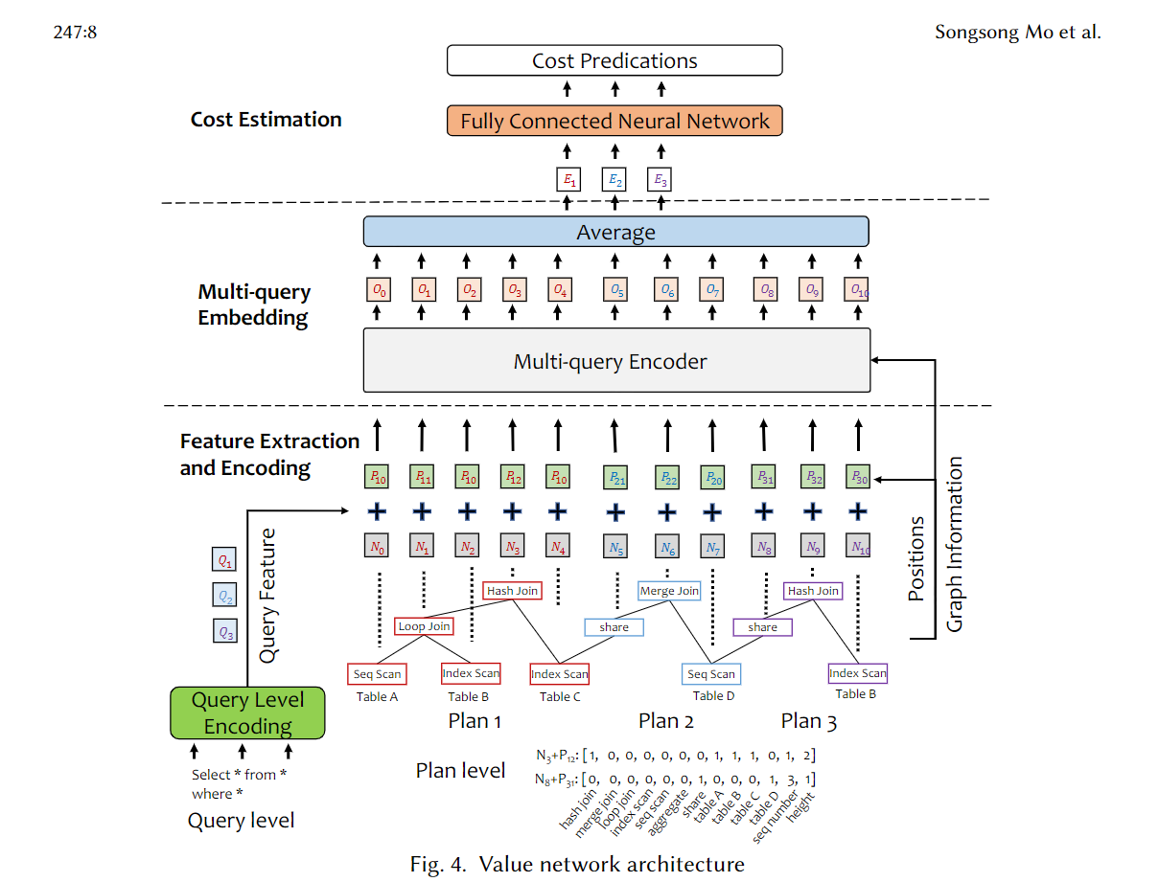
Value network
First, the tree structure of a query plan would be a directed acyclic graph (DAG) .
Second, it is essential to capture the correlations among concurrent queries.

Slide 6
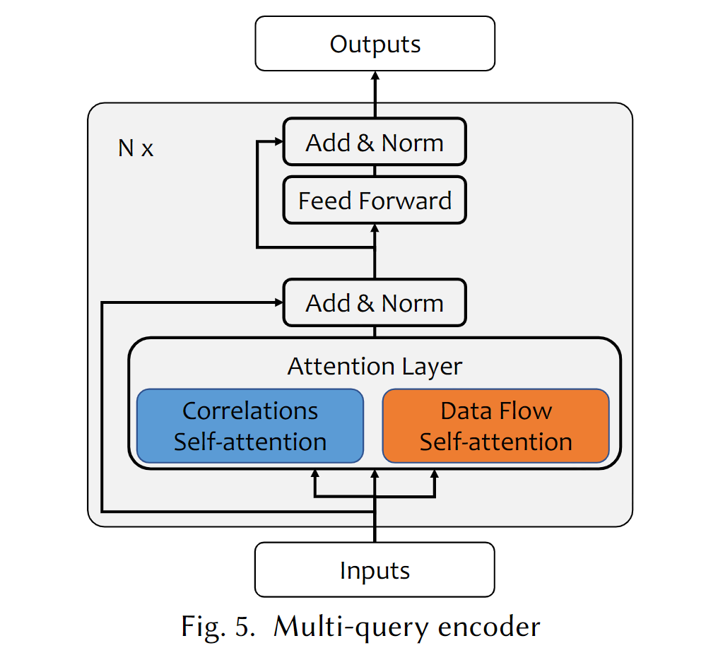
Value network
Advantage of self-attention:
Self-attention can capture long-range dependencies between nodes.
Two types of attention:
Data flow attention.
Correlation attention.

Slide 7
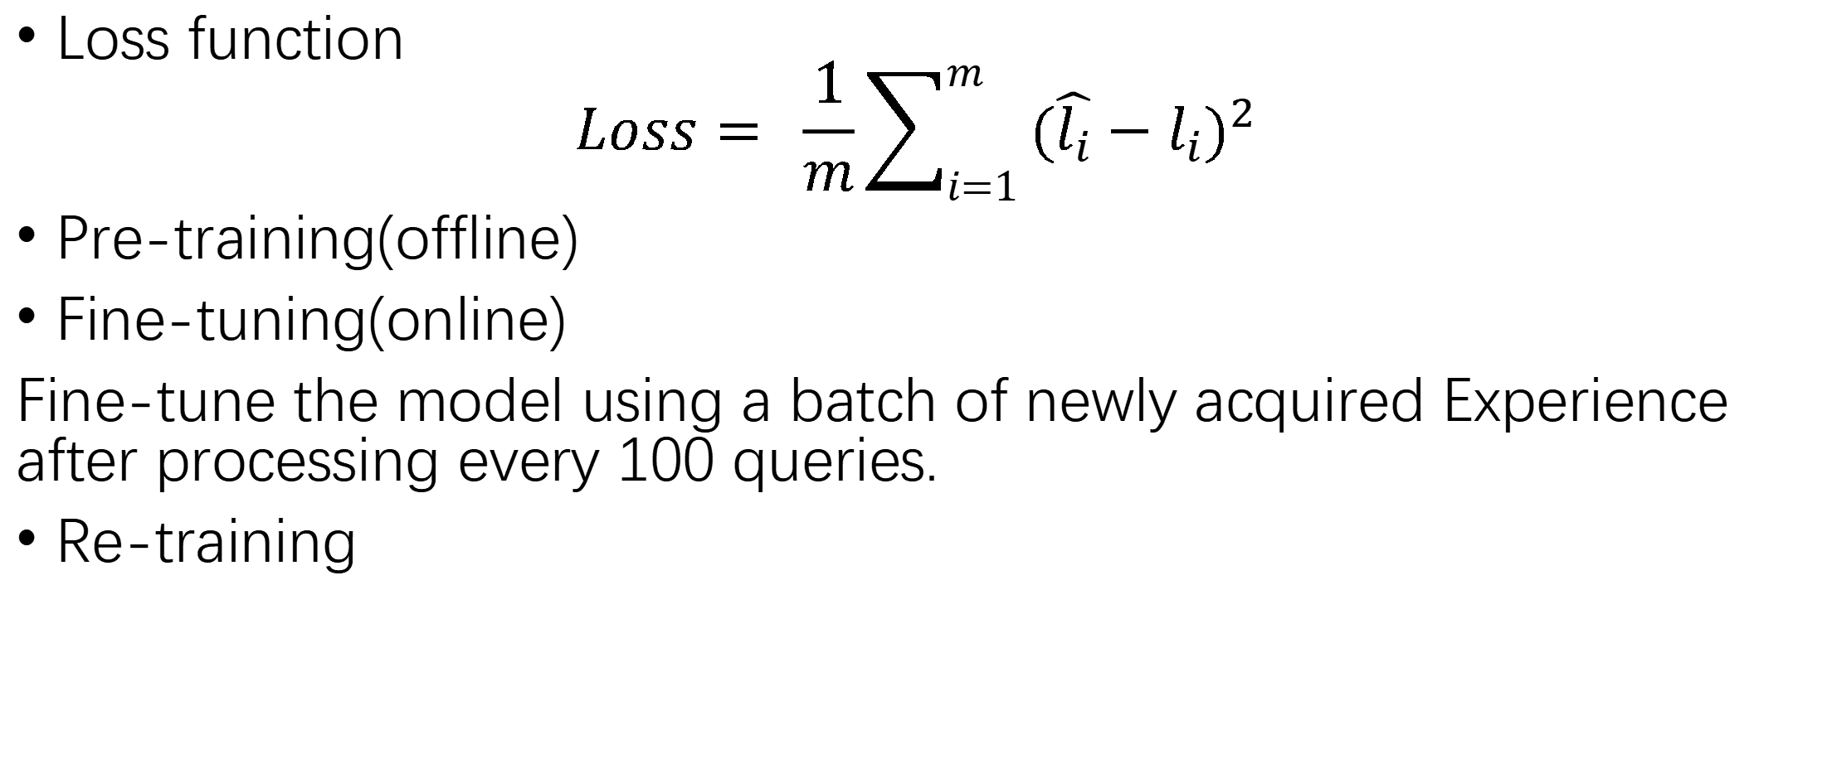
Value network
Loss function
$$Loss= \frac{1}{m}\sum_{i=1}^{m}{{(\hat{l_{i}}−l_{i})}^{2}}$$
Pre-training(offline)
Fine-tuning(online)
Fine-tune the model using a batch of newly acquired Experience after processing every 100 queries.
Re-training

Slide 8
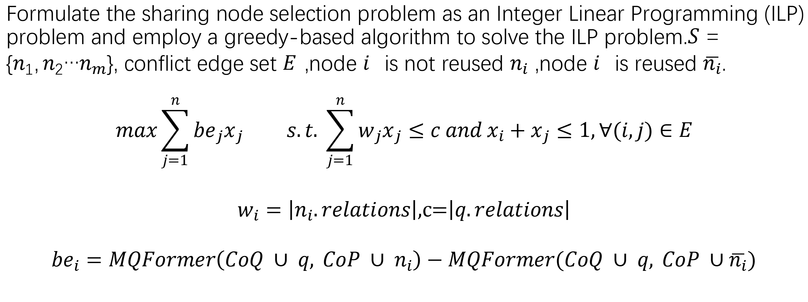
Plan search
Formulate the sharing node selection problem as an Integer Linear Programming (ILP) problem and employ a greedy-based algorithm to solve the ILP problem.$S=\{n_{1},n_{2}…n_{m}\}$, conflict edge set 𝐸,node 𝑖is not reused $n_{i} ,$node 𝑖is reused $\overline{n_{i}}$.
$$max\sum_{j=1}^{n}{{be}_{j}x_{j} s.t. \sum_{j=1}^{n}{w_{j}x_{j}≤c and x_{i}+x_{j}≤1,∀(i,j)∈E}}$$
$w_{i}=\left|n_{i}.relations\right|,$c=$\left|q.relations\right|$
$${be}_{i}=MQFormer\left(CoQ ∪ q, CoP ∪ n_{i}\right)−MQFormer(CoQ ∪ q, CoP ∪\overline{n_{i}})$$

Slide 9
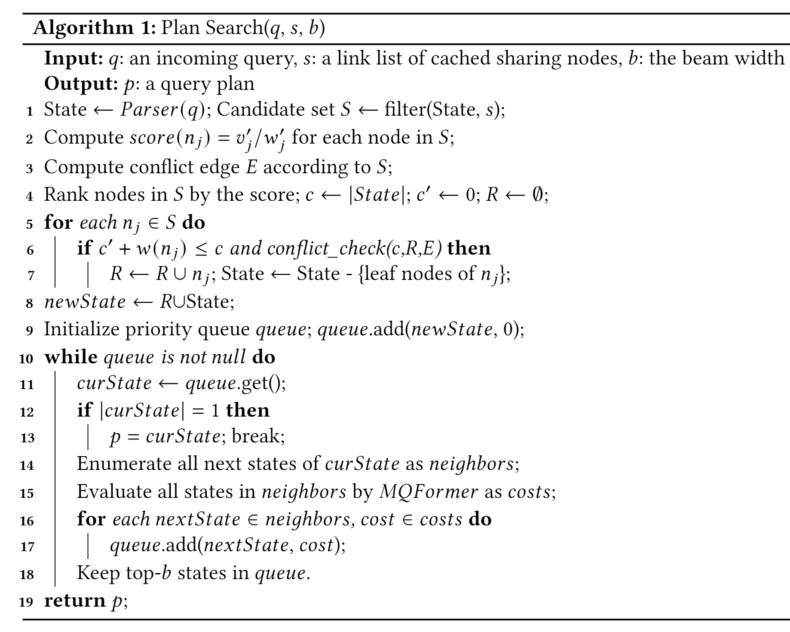
Plan search
Selection stage
Line1-Line8
Search stage
Line9-Line19

Slide 10
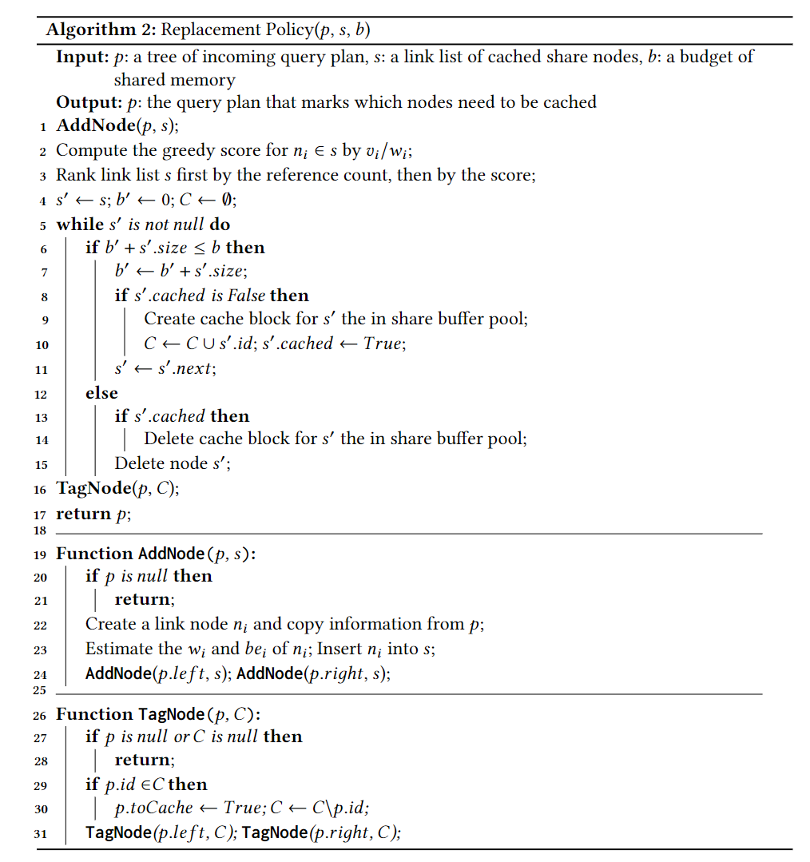
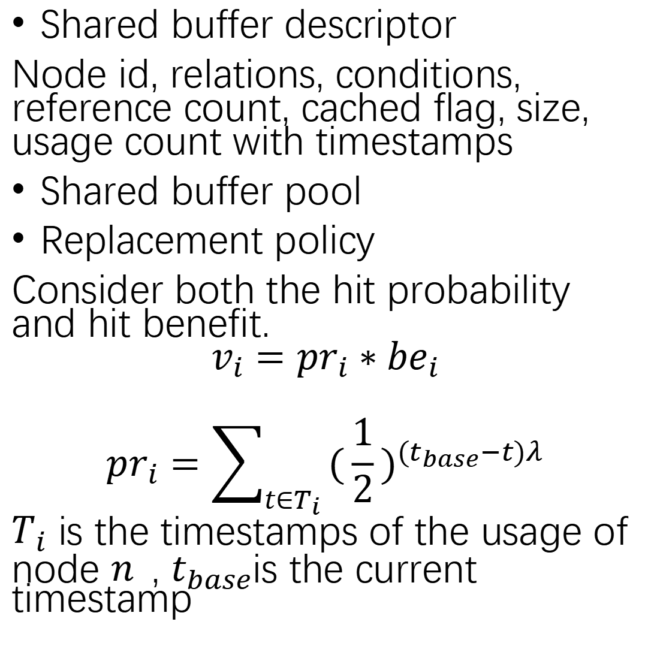
Shared buffer manager
Shared buffer descriptor
Node id, relations, conditions, reference count, cached flag, size, usage count with timestamps
Shared buffer pool
Replacement policy
Consider both the hit probability and hit benefit.
$$v_{i}={pr}_{i}∗{be}_{i}$$
$${pr}_{i}=\sum_{t∈T_{i}}{{(\frac{1}{2})}^{(t_{base}−t)λ}}$$
$T_{i}$ is the timestamps of the usage of node 𝑛, $t_{base}$is the current timestamp

Slide 11
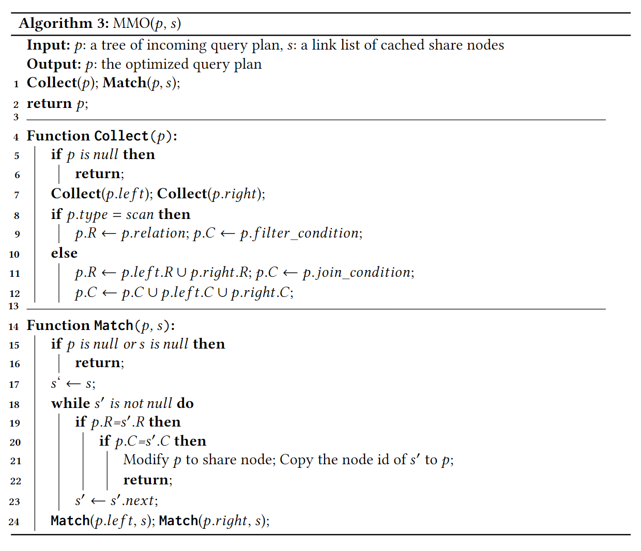
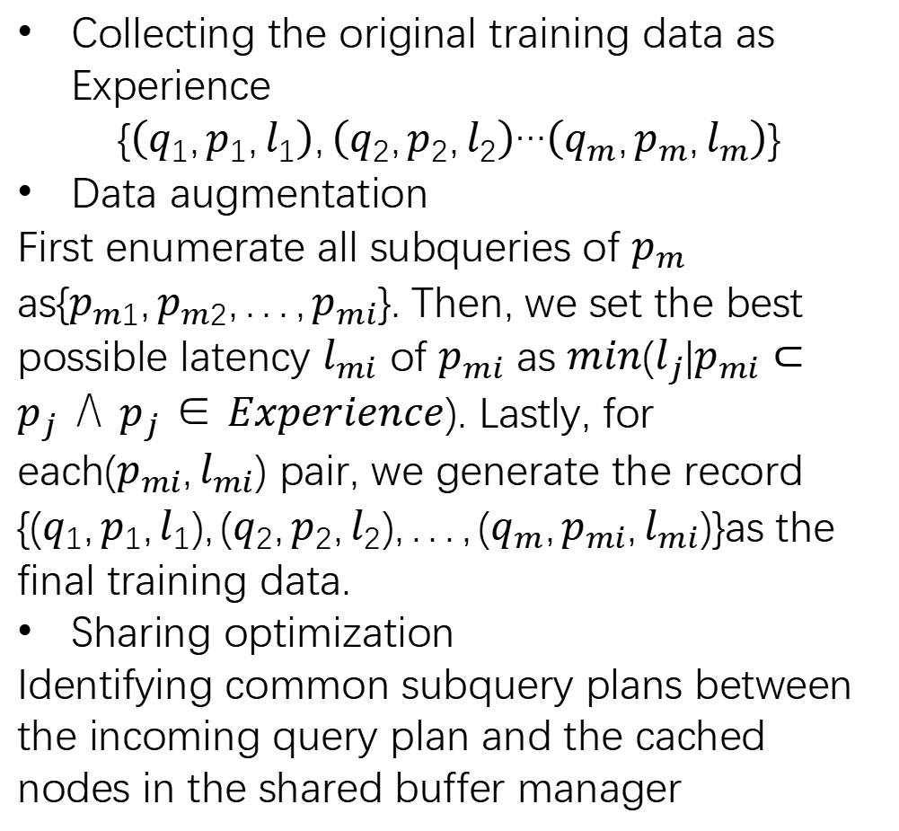
Training data collection
Collecting the original training data as Experience
$$\{\left(q_{1},p_{1},l_{1}\right),\left(q_{2},p_{2},l_{2}\right)…\left(q_{m},p_{m},l_{m}\right)\}$$
Data augmentation
First enumerate all subqueries of $p_{m}$ as$\{p_{m1},p_{m2},...,p_{mi}\}$. Then, we set the best possible latency $l_{mi}$ of $p_{mi}$ as $min(l_{j}|p_{mi}⊂p_{j}∧p_{j}∈Experience)$. Lastly, for each$(p_{mi},l_{mi})$ pair, we generate the record $\{(q_{1},p_{1},l_{1}),(q_{2},p_{2},l_{2}),...,(q_{m},p_{mi},l_{mi})\}$as the final training data.
Sharing optimization
Identifying common subquery plans between the incoming query plan and the cached nodes in the shared buffer manager

Slide 12
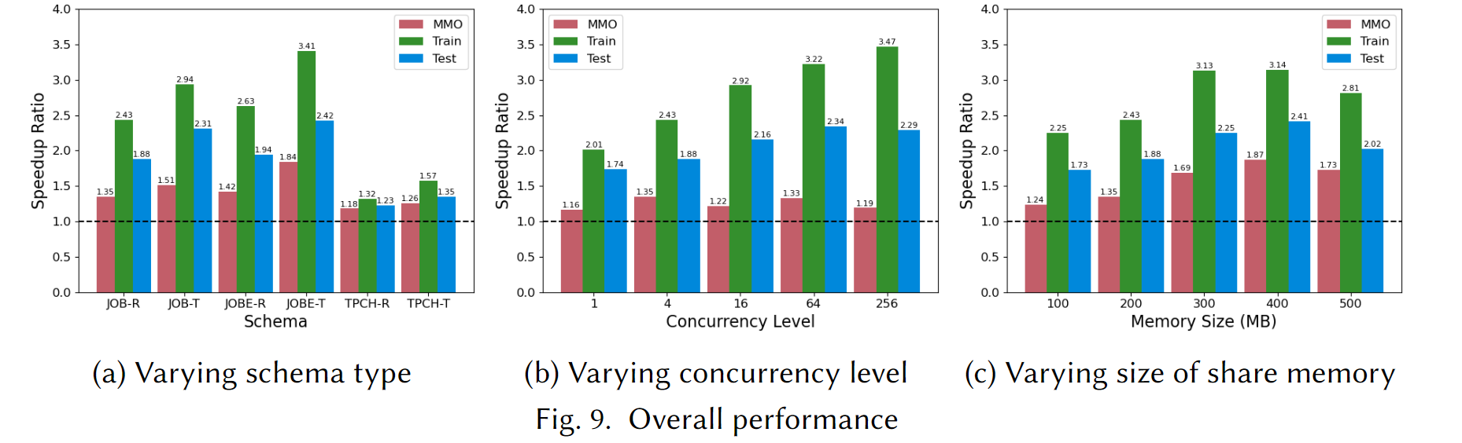
Experiments
Datasets
JOB,JOBE,TPCH
Overall Performance
Metrics
Speedup ratio is the expert system(PG)'s runtimes divided by the runtimes of all solutions.

Slide 13
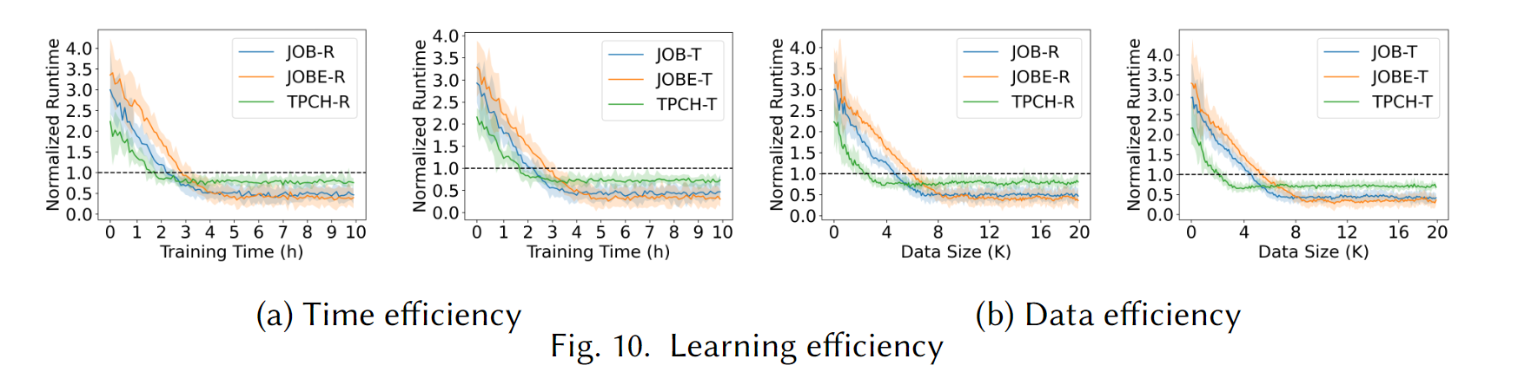
Experiments
Learning efficiency
How long it takes to surpass the expert performance and reach its peak performance.

Slide 14
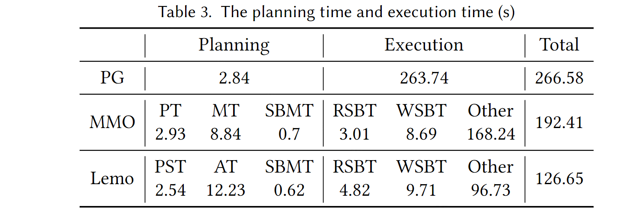
Overhead analysis
Discuss the impact of the extra plan search time and the buffer maintenance time brought by Lemo on the latency.
PG to generate a query plan (PT)
The time taken to match subqueries with previously cached intermediate results (MT)
Shared buffer maintenance time (SBMT).
Plan search time (PST)
Attention computation time (AT)
Time needed to read from the shared buffer (RSBT)
The time spent writing to the shared buffer (WSBT)

Slide 15
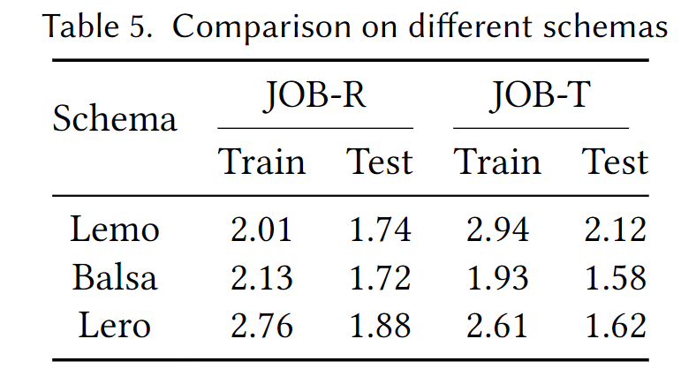
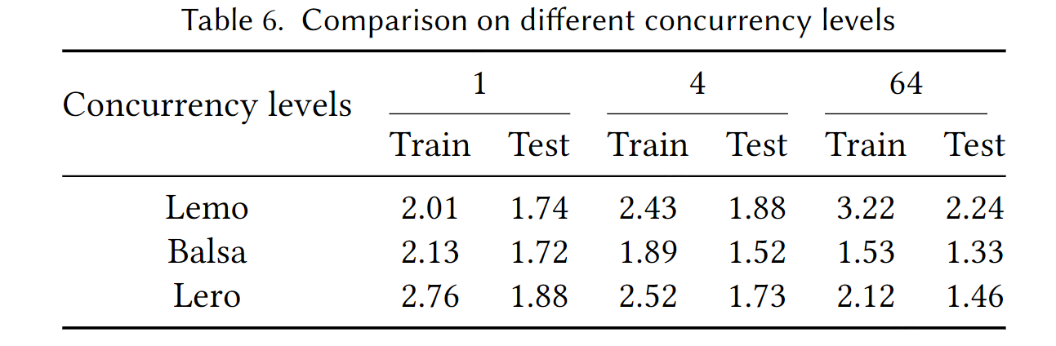
Comparison with Learned Query Optimizer

Slide 16
Optimize the MMO algorithm.
Reorganize the order of query submission.
Use reinforcement learning instead of greedy-based method.

