Slide 1
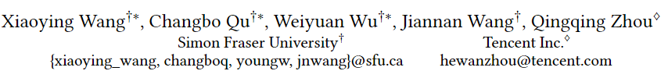
Are We Ready For Learned Cardinality Estimation?

Slide 2
Background
Learned models have the potential to replace existing cardinality estimators
We ask a forward-thinking question:
Are we ready to deploy these learned cardinality models in production?

Slide 3
Three Main Parts
Are Learned Methods Ready For Static Environments?
Are Learned Methods Ready For Dynamic Environments?
When Do Learned Methods Go Wrong?

Slide 4
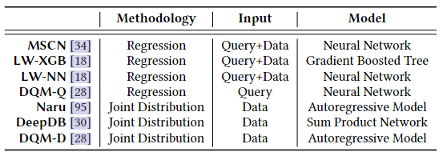
Taxonomy
Referring to "traditional methods" as the methods based on histogram or classic ML models like KDE and Bayesian Network
The novelty of recent learned methods is to adopt more advanced ML models, we call these methods "new learned methods" or "learned methods"
Taxonomy of New Learned Cardinality Estimators

Slide 5



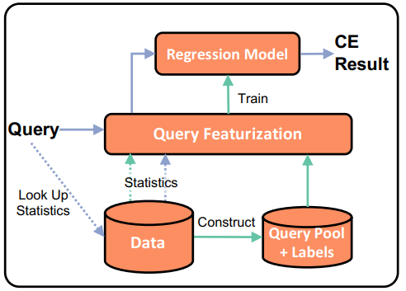
Methodology: Regression
Train stage:
Constructing a query pool and getting the label (CE result) of each query
Going through the query featurization module, which converts each query to a feature vector
Finally, a regression model is trained on a set of 〈feature vector, label〉 pairs
Inference stage:
Workflow of Learned Methods
Given a query, it converts the query to a feature vector using the same process as the training stage, and applies the regression model to the feature vector to get the CE result

Slide 6
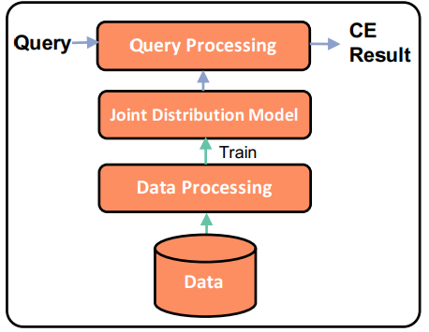
Methodology: Joint Distribution
Train stage:
Transforming the data into a format ready for training a joint distribution model
Inference stage:
Given a query, it generates one or multiple requests to the model and combine the model inference results into the final CE result
Workflow of Learned Methods

Slide 7
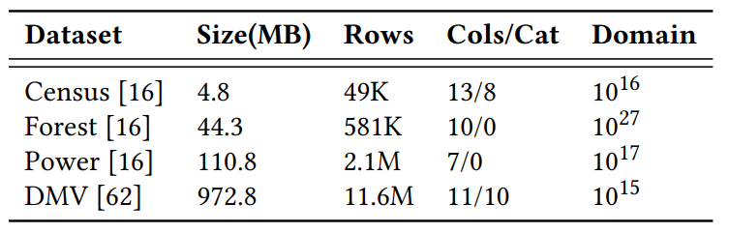
Experimental Setup
Evaluation Metric:
Q-error : error = $\frac{max⁡(est\left(q\right),act\left(q\right))}{min⁡(est\left(q\right),act\left(q\right))}$
Dataset:
Using four real-world datasets with various characteristics

Slide 8
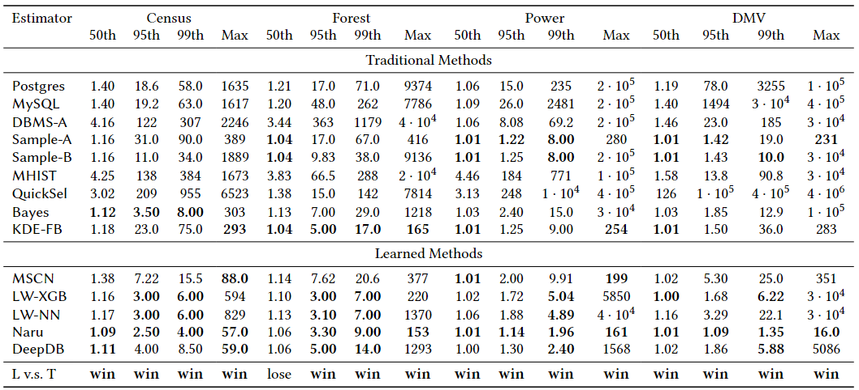
Are Learned Methods Ready For Static Environments?
Estimation errors on four real-world datasets

Slide 9
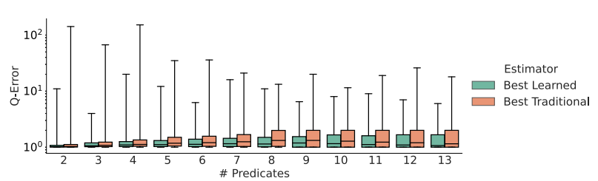
Are Learned Methods Ready For Static Environments?
Q-Error comparison between the best learned and traditional method by varying # of predicates on Census
Best Learned always outperforms Best Traditional
We also divide the queries based on the operator type (equality or range) and have the same observation that Best Learned outperforms Best Traditional in both groups
New learned estimators can deliver more accurate prediction than traditional methods in general

Slide 10
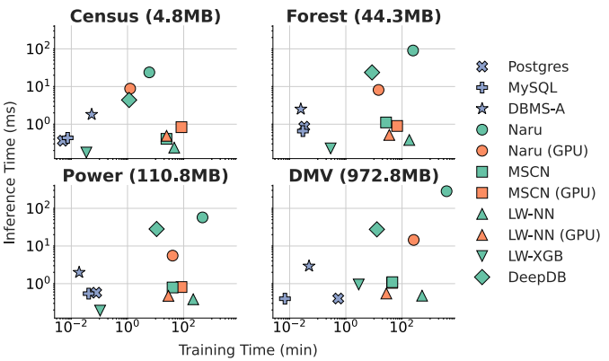
What Is the Cost For High Accuracy?
In terms of training time, new learned methods can be slower than DBMS products in magnitudes except for LW-XGB
New learned estimators that based on regression models can be competitive to database systems in inference time, while methods that model the joint distribution directly requires much longer time
Training and inference time comparison between learned methods and real database system
GPU can speed up the training and inference time of some of the new learned estimators, however it cannot make them as quick as DBMS products and sometimes introduce overhead
Notes:
MSCN需要处理条件工作流来最小化其损失(平均q误差)，这在GPU上变得较慢，当模型较小时，影响更加明显

Slide 11
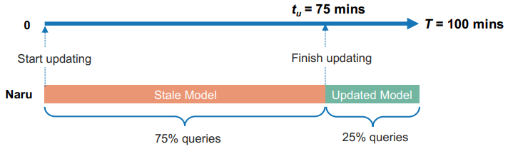
Are Learned Methods Ready For Dynamic Environments?
Dynamic Environment:
An illustration of a dynamic environment
Considering a time range [0, T]. Suppose that there are n queries uniformly distributed in this time range. Suppose that given a trained initial model, the model update starts at timestamp 0 and finishes at timestamp tu. For the first n · $\frac{tu}{T}$ queries, their cardinalities will be estimated using the stale model. For the remaining queries, the updated model will be used

Slide 12
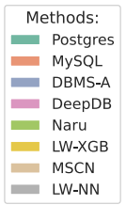
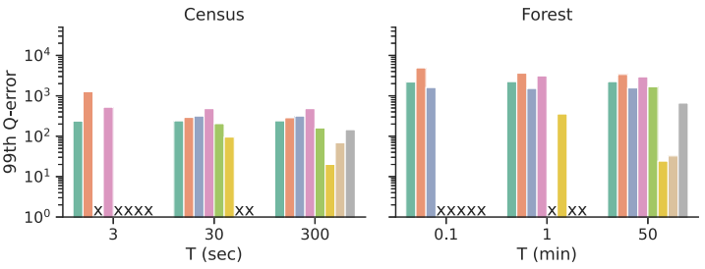
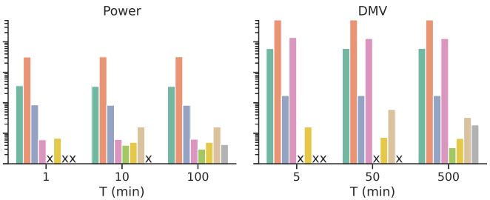

Are Learned Methods Ready For Dynamic Environments?
DBMSs have more stable performance than learned methods by varying T
Many learned methods cannot catch up with fast data updates. Even if they can, they do not always outperform DBMSs
In terms of updating time, there is no all-time winner on different datasets. For example, on Census, DeepDB (data driven) is the fastest method, whereas on DMV, LW-XGB (query driven) is the fastest one

Slide 13
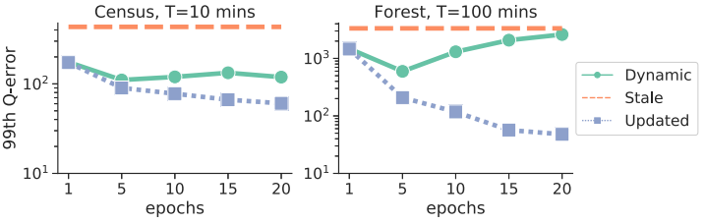
What Is the Trade-off Between Updating Time and Accuracy?
Trade-off (Naru): epochs vs accuracy
Long training time (epochs) makes the model update slow. It leaves more queries executed using the stale mode. Even though more epochs improve the updated model's performance, it hurts the overall performance
It is not easy to balance the trade-off in practice and requires more research efforts on this topic

Slide 14
When Do Learned Methods Go Wrong?
Dataset:
Generating datasets with two columns by varying three key factors: distribution (of the first column), correlation (between the two columns) and domain size (of the two columns). Each dataset contains 1 million rows
distribution parameter :
s : 0 to 2, s = 0 represents uniform distribution and the data becomes more skewed as s increases
correlation :
c : 0 to 1, c = 0 represents the two columns are independent
domain size :
d : the number of distinct values

Slide 15
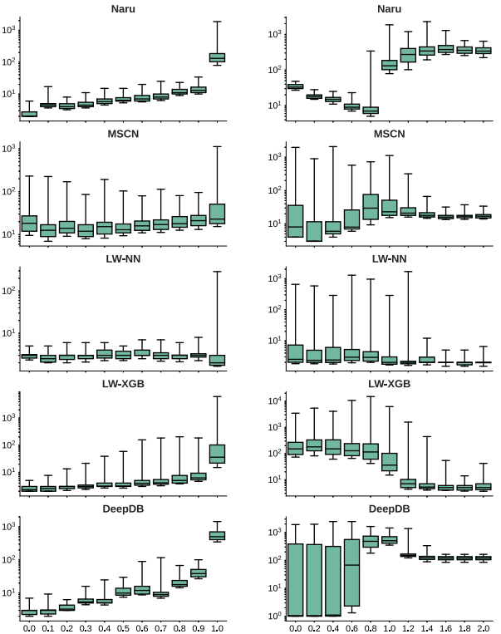
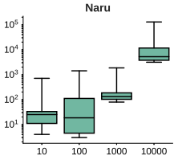
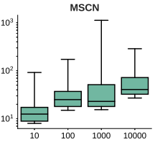
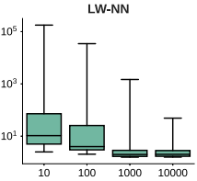
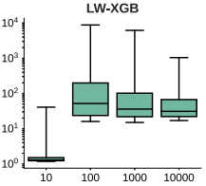
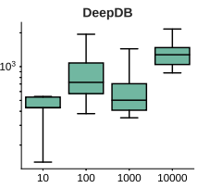
s = 1.0 d = 1000
c = 1.0 d = 1000
s = 1.0 c = 1.0

Slide 16
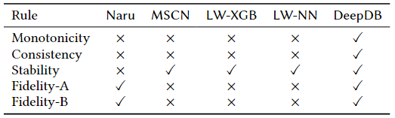
Do Learned Estimators Behave Predictably?
Five basic rules for CE which the users may expect cardinality estimators to satisfy:
Monotonicity: With a stricter (or looser) predicate, the estimation result should not increase (or decrease)
Consistency: The prediction of a query should be equal to the sum of the predictions of queries split from it (e.g., a query with predicate [100, 500] on A can be split to two queries with[100, 200) and [200, 500] on A respectively and other predicates remain the same)
Stability: For any query, the prediction result from the same model should always be the same
Fidelity-A: Result should be 1 for querying on the entire domain (e.g. SELECT * FROM R WHERE min <= A <= max)
Fidelity-B: Result should be 0 for a query with an invalid predicate (e.g. SELECT * FROM R WHERE 100 ≤ A ≤ 10)
Satisfaction and violation of rules by learned estimators (√: satisfied, ×: violated)
Notes:
DeepDB不违反任何规则，因为它建立在基本直方图上，节点之间的计算仅限于加法和乘法

Slide 17
What Will Go Wrong in Production?
Debuggability: It is challenging to debug black-box models
Explainability: It brings some challenges for query optimizer version update. We might find a new model architecture improve the accuracy and want to adopt it to the new version. However, it is hard to explain to the database users about which type of query and what kind of scenario will be affected by this upgrade
Predicability: Learned methods do not follow some basic logic rules, the database system may behave illogically, thus confusing database users
Reproducibility: It is common that a database developer wants to reproduce customers’ issues. However, some methods are hard to reproduce the result

