Slide 1

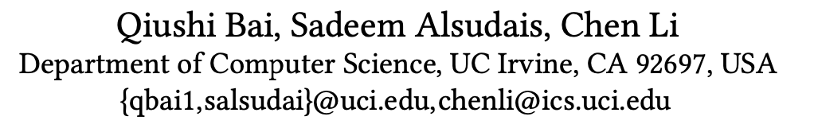

Slide 2
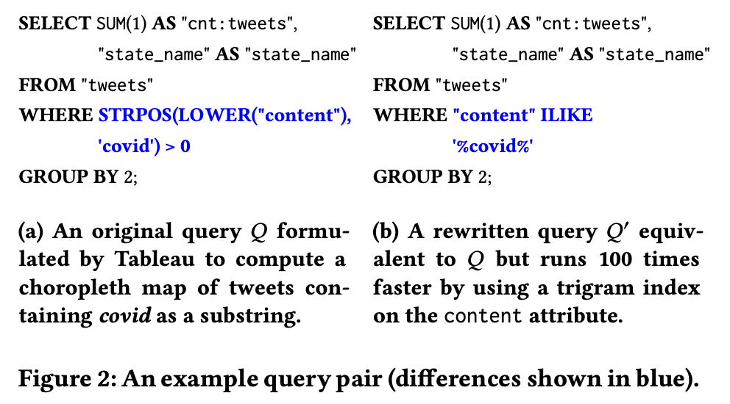
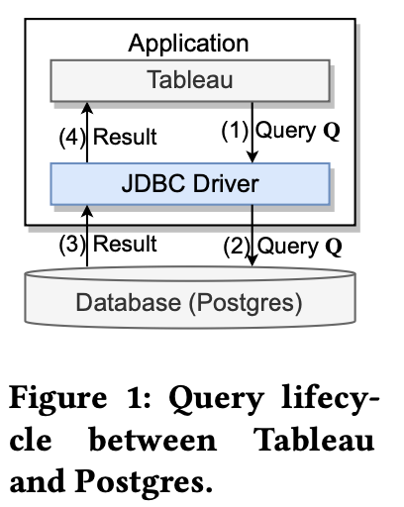
Background
A natural question is whether we can let Tableau generate 𝑄’ instead of 𝑄 for the database.
We may also consider using the CREATE RULE interface provided by Postgres to introduce a rewriting rule inside the database.

Slide 3
Background
The developers need to treat the application layer as a black box and cannot modify its logic of generating SQL queries.
the source code of application is not available
the source code of the application is too complicated or old to modify.
The developers need to treat the database as a black box.
the developers do not have the privileges to modify the database
the database is used by many clients, and the developers want to avoid side effects of database changes to these clients
Problem Statement: Given an application and a database as black boxes, develop a middleware solution for users to easily express their rules to rewrite application queries for a better performance.

Slide 4
Contributions
We study the suitability of existing rule languages in the literature and show their limitations. We then develop a novel rule language (VarSQL) that is expressive and easy to use.
We develop transformations to generalize pairs of rewriting queries to rules and propose using the metric of minimum description length to measure rule quality.
We present a framework to search the candidate rewriting rules efficiently and suggest high-quality rules based on user-given examples.

Slide 5
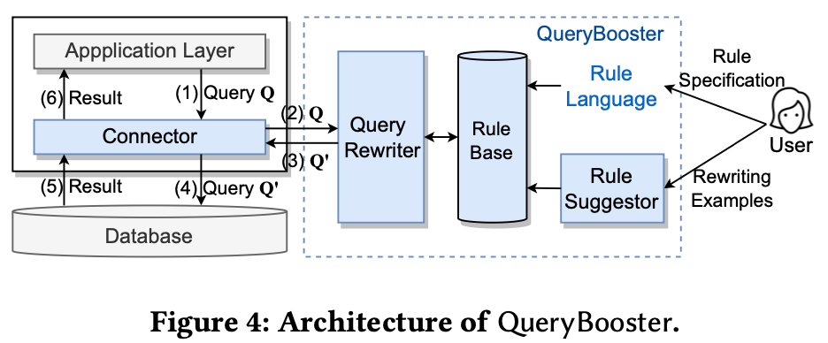
Overview
Rule Formulation phase:
provides an expressive and easy-to-use rule language
allows users to express their rewriting intentions by providing examples
Query Rewriting phase:
provides a customized connector that communicates with its service to rewrite application queries.
To develop QueryBooster, we have the following two tasks.
(Task 1) Developing an expressive and easy-to-use rule language.
(Task 2) Suggesting rules from examples.

Slide 6
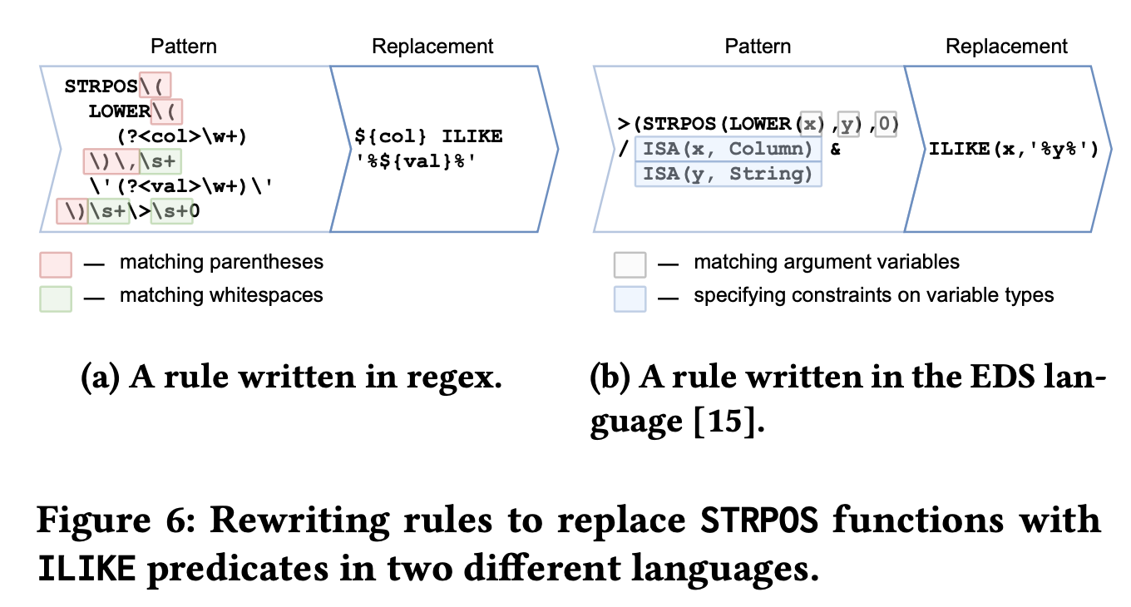
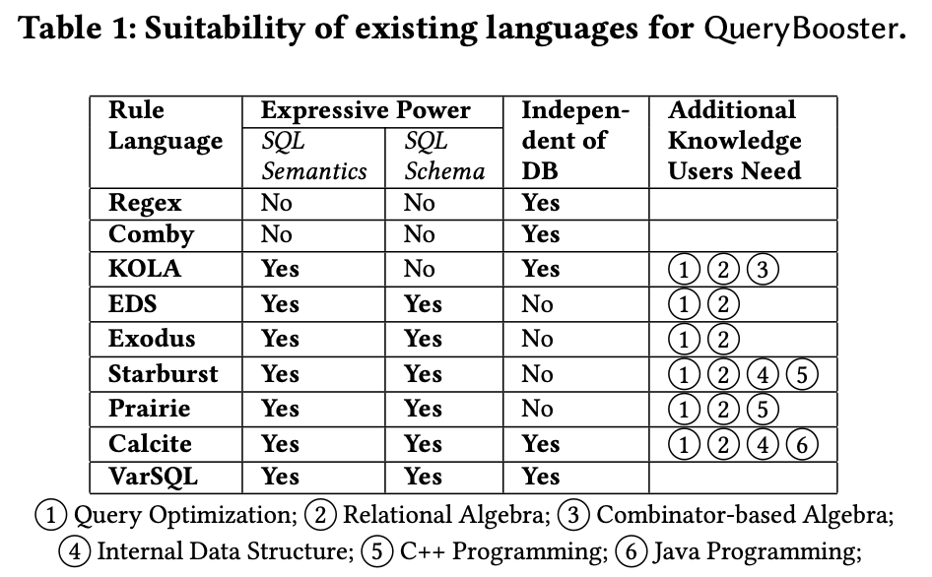
Existing Rule Language
Notes:
能理解SQL语义的好处是形式简单而且能够添加一些hint，缺点是可能只针对特定的系统，而且需要对数据库执行比较了解
imperative的language缺点是需要写代码来定义规则，好处是可以访问数据库的schema信息（例如消除self-join的时候需要知道unique信息）

Slide 7
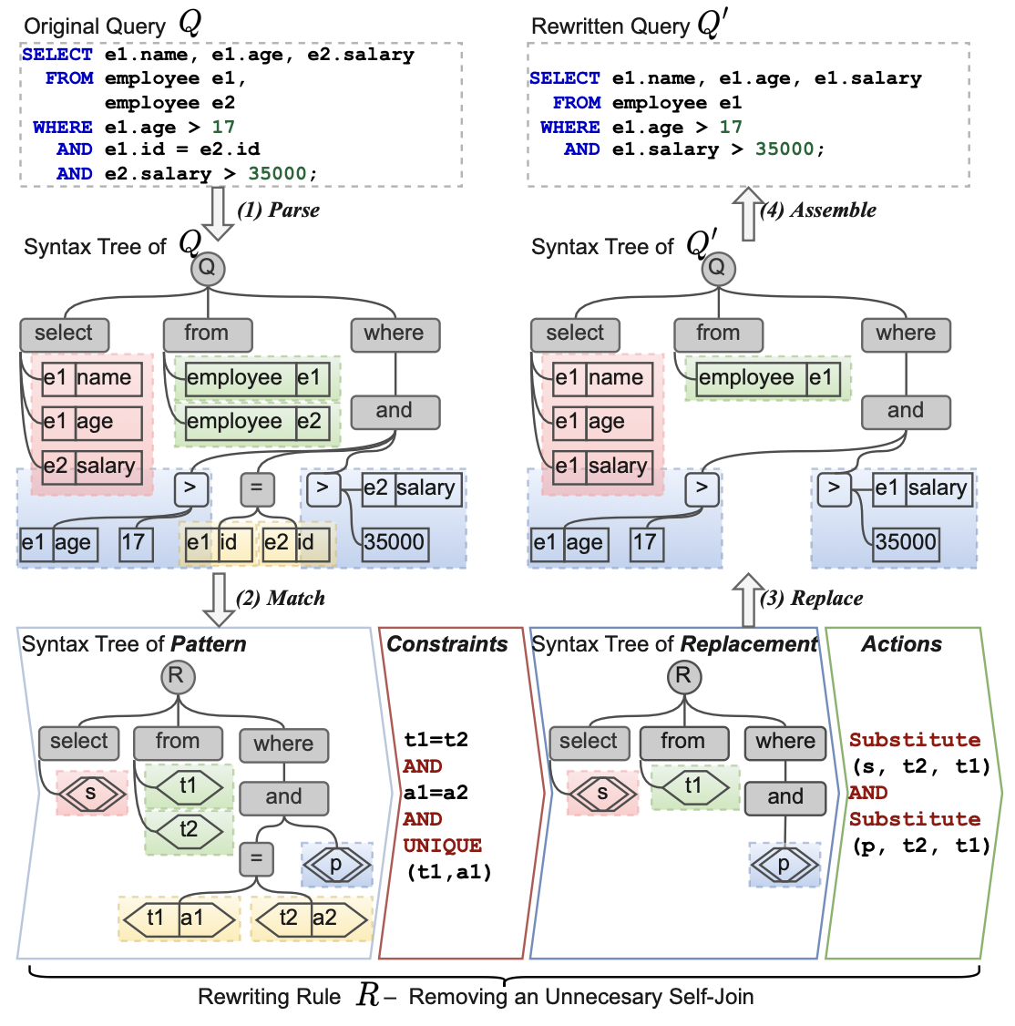
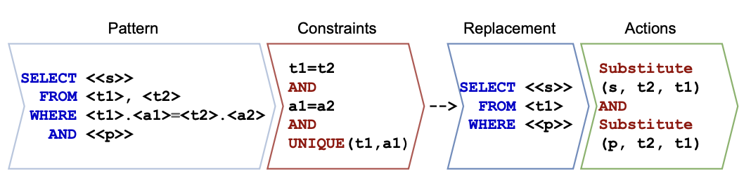
VarSQL: A Novel Rule Language
Syntax:
[Rule] ::= [Pattern] / [Constraints] --> [Replacement] / [Actions]

Slide 8
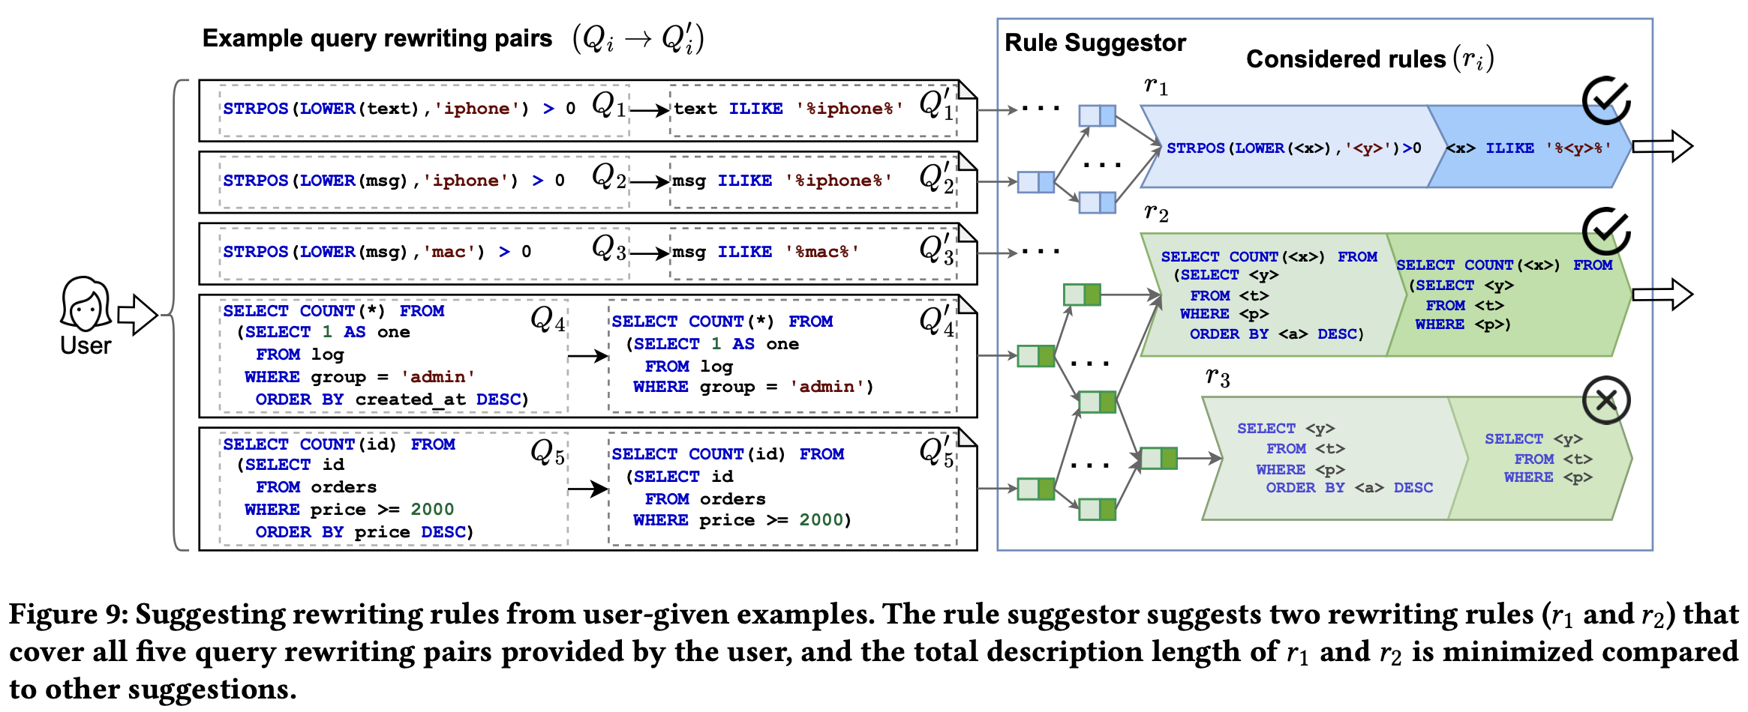
Quality of Rewriting Rules
To avoid underfitting or overfitting the given examples, an effective way is through the Minimum Description Length (MDL) principle, which minimizes the total length required to describe the underlying patterns in the data.

Slide 9
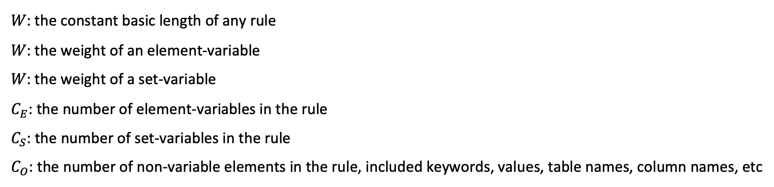
Description Length Function
Each rule had a constant basic length
The more variables it had, the larger its description length should be
High-quality rules could match as many given examples as possible, but not over-generalized to match unseen queries
𝑊: the constant basic length of any rule
𝑊: the weight of an element-variable
𝑊: the weight of a set-variable
$C_{E}$: the number of element-variables in the rule $C_{S}$: the number of set-variables in the rule
$C_{O}$: the number of non-variable elements in the rule, included keywords, values, table names, column names, etc

Slide 10
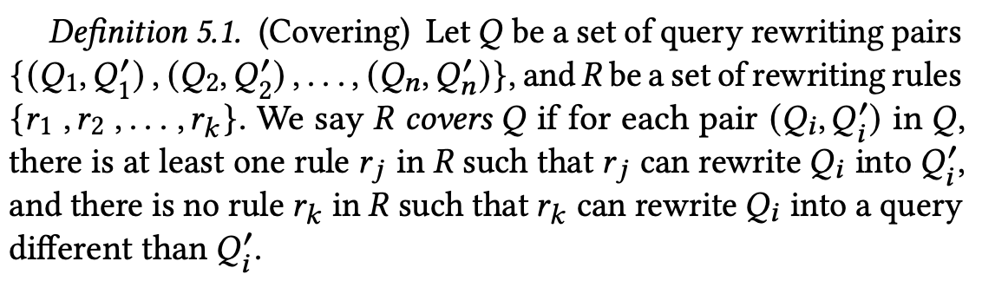
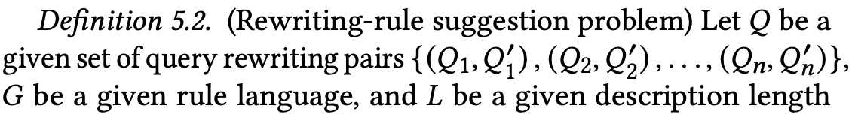
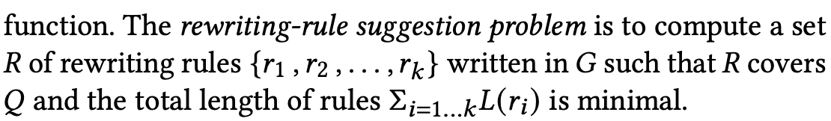
Suggesting High-quality Rules From Given Examples

Slide 11
Suggesting High-quality Rules From Given Examples
We propose a two-step solution:
First, we define a set of transformations that can generalize a rewriting rule into a more general form such that the transformed rule can cover more rewriting pairs than the original rule.
Second, we adopt a greedy-search strategy to efficiently explore different subsets of rules as candidates and minimize the total description length.

Slide 12
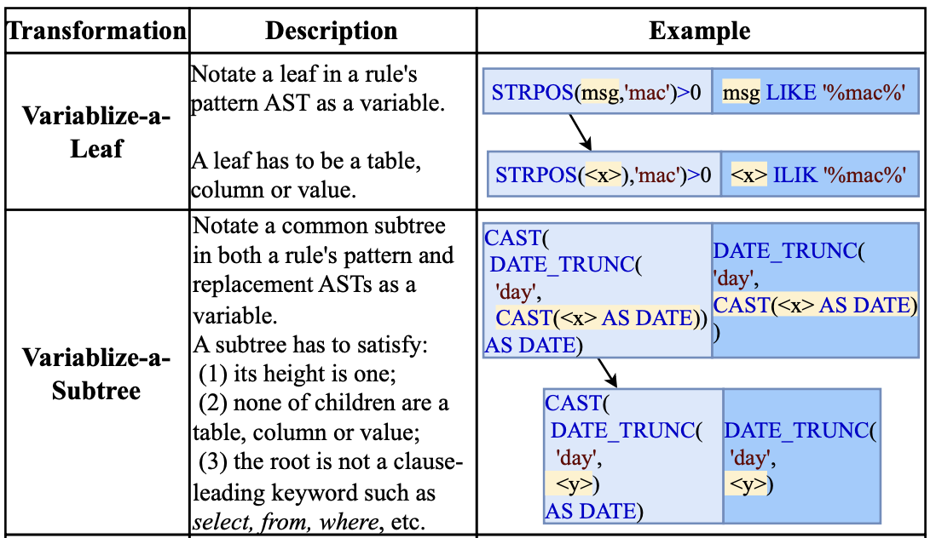
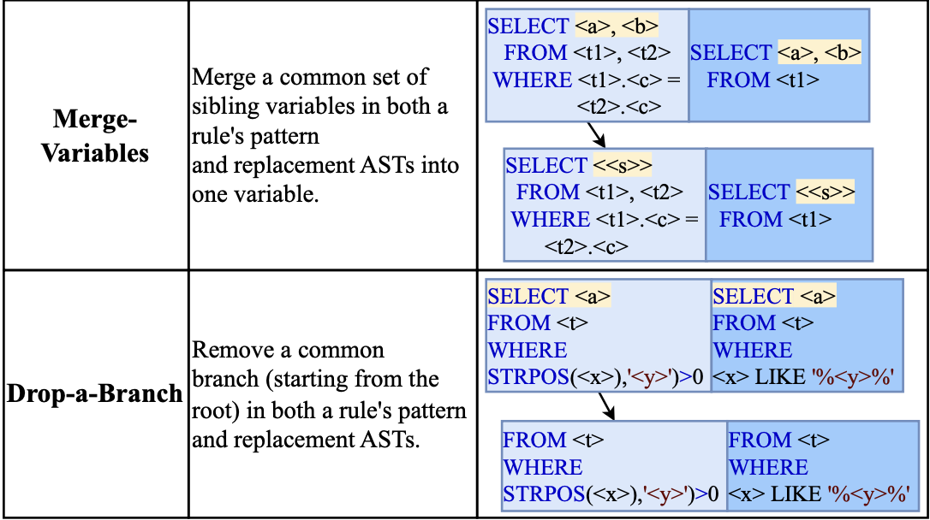
Transforming Rules to More General Forms

Slide 13
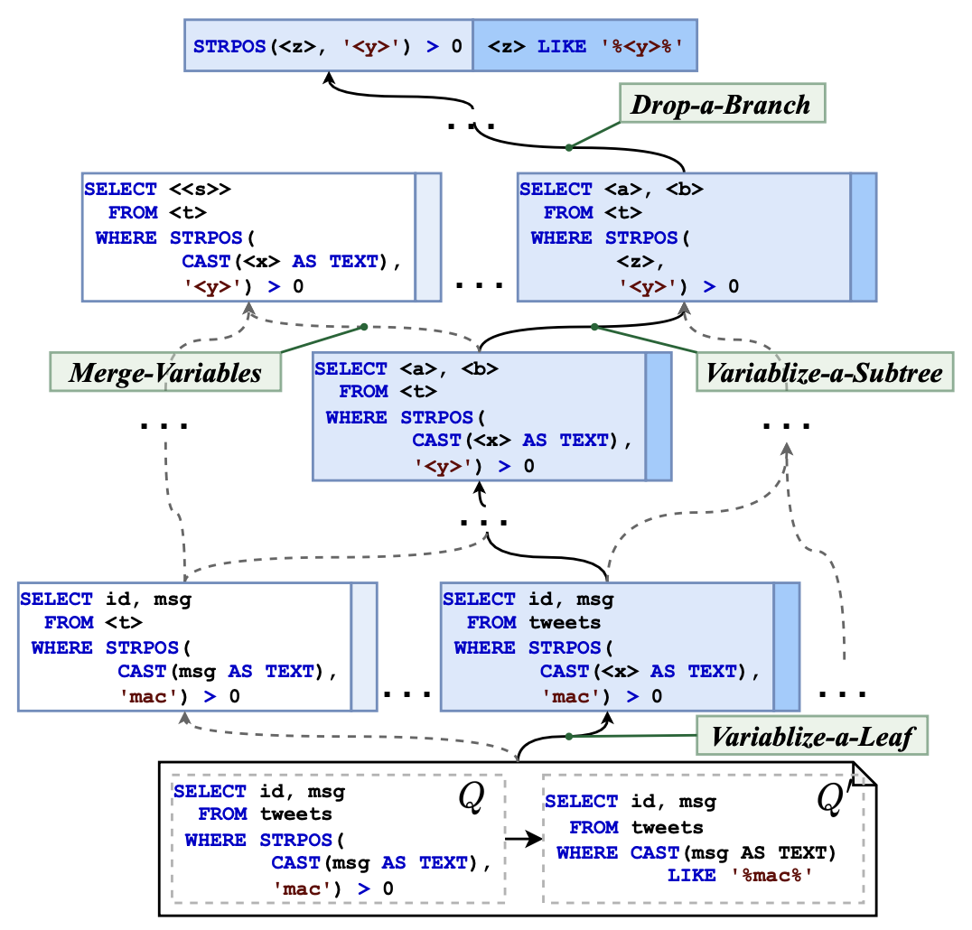
Rule Graph
If we treat each newly-generated rewriting rule as a vertex and a transformation as an edge, we can obtain a graph of rewriting rules. We call it a rule graph.
The candidate sets of generalized rules can be very large. It can be computationally expensive to search all possible sets to compute an optimal solution with the minimum description length.

Slide 14
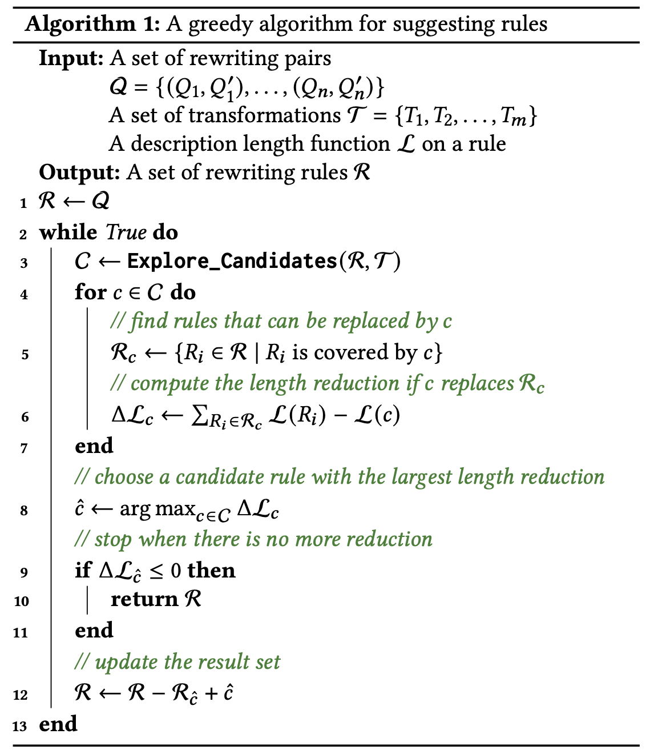
Searching For High-quality Rules
We say a rule 𝑥 covers another rule 𝑦 if 𝑥’s pattern matches 𝑦’s pattern and 𝑥 can rewrite 𝑦’s pattern to 𝑦’s replacement.
For each candidate rule, we compute the reduction of the total description length if we use it to replace its covered rules in the solution (lines 4-7).
A naive candidate-exploration method: 𝑘-hop-neighbor exploration (KHN). This method has two problems:
It is hard to decide the 𝑘 value.
A fixed 𝑘 value for all base rules ignores their different amounts of potential to discover a high-quality rule.

Slide 15
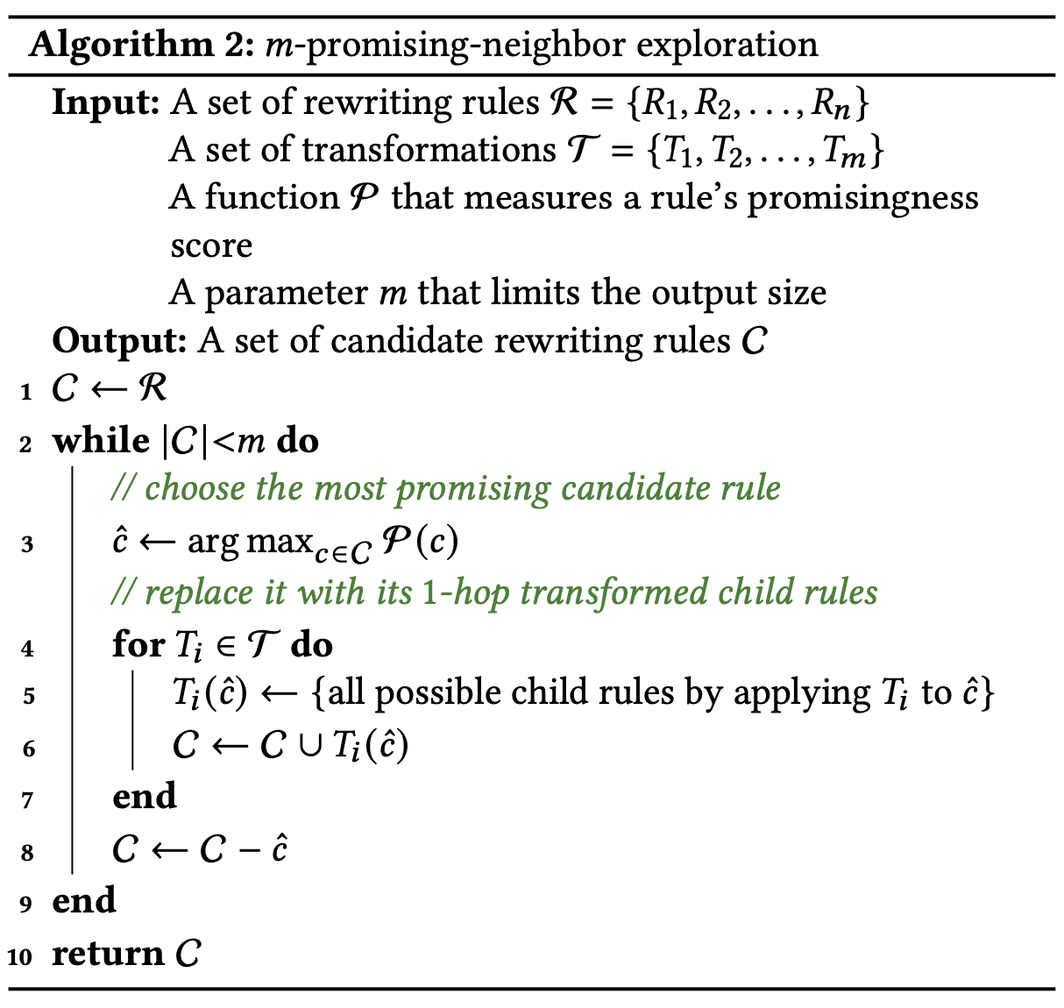
Exploring Candidate Rules Adaptively
m-promising-neighbor(MPN) Algorithm:
In each iteration, we choose a rule that is most promising to be transformed into a more general rule that reduces the total length the most, replaces it with all its 1-hop transformed rules in the candidate rule set, and stops until the rule set reaches the given size 𝑚.

Slide 16
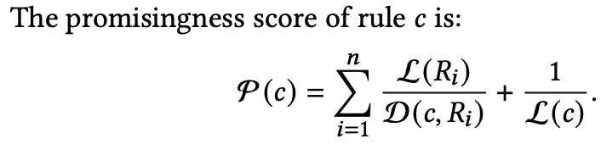
Measuring the Promisingness Score of a Rule
Consider three signals to measure a rule’s promisingness score:
the total length of those base rules that can be covered if we transform a candidate rule into a more general form
the number of transformations needed to apply to a candidate rule if we want it to cover more base rules
the length of a candidate rule
D (𝑐, 𝑅𝑖 ): the number of transformations on rule 𝑐 to cover rule 𝑅i
A rule c’ covers rule 𝑅i if the pattern of c’ matches 𝑅i’s pattern, and we can rewrite it to 𝑅i’s replacement.

Slide 17
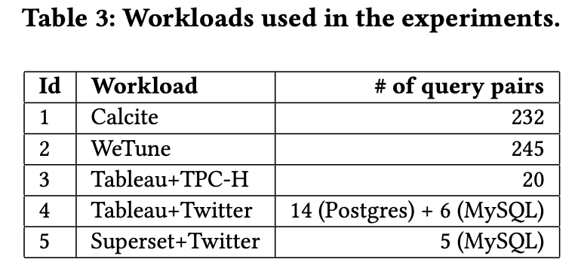
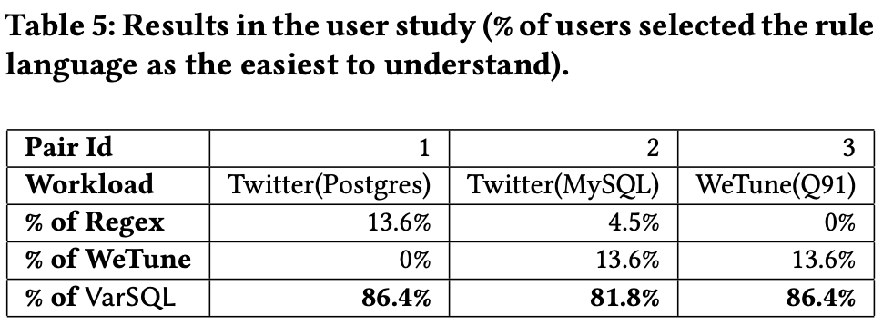
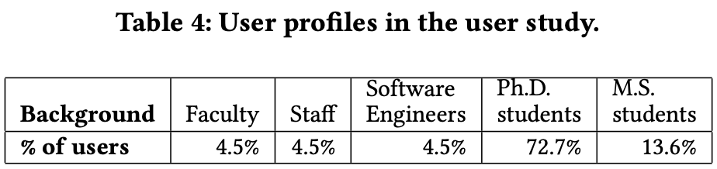
Experiments

Slide 18
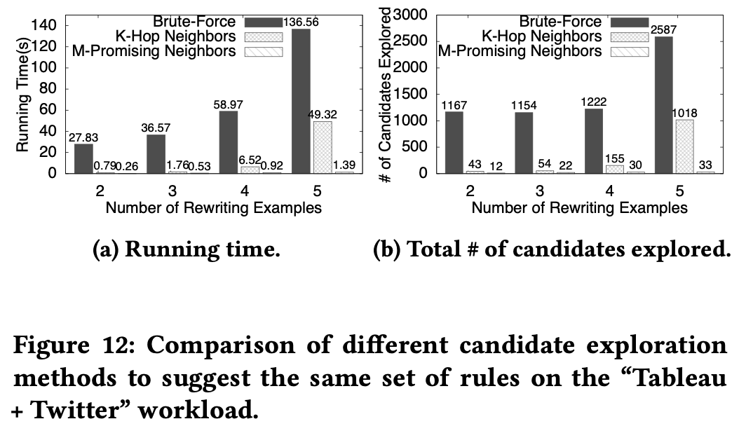
Experiments
Notes:
随着输入的example数量变多，三个策略花费的时间变化

Slide 19
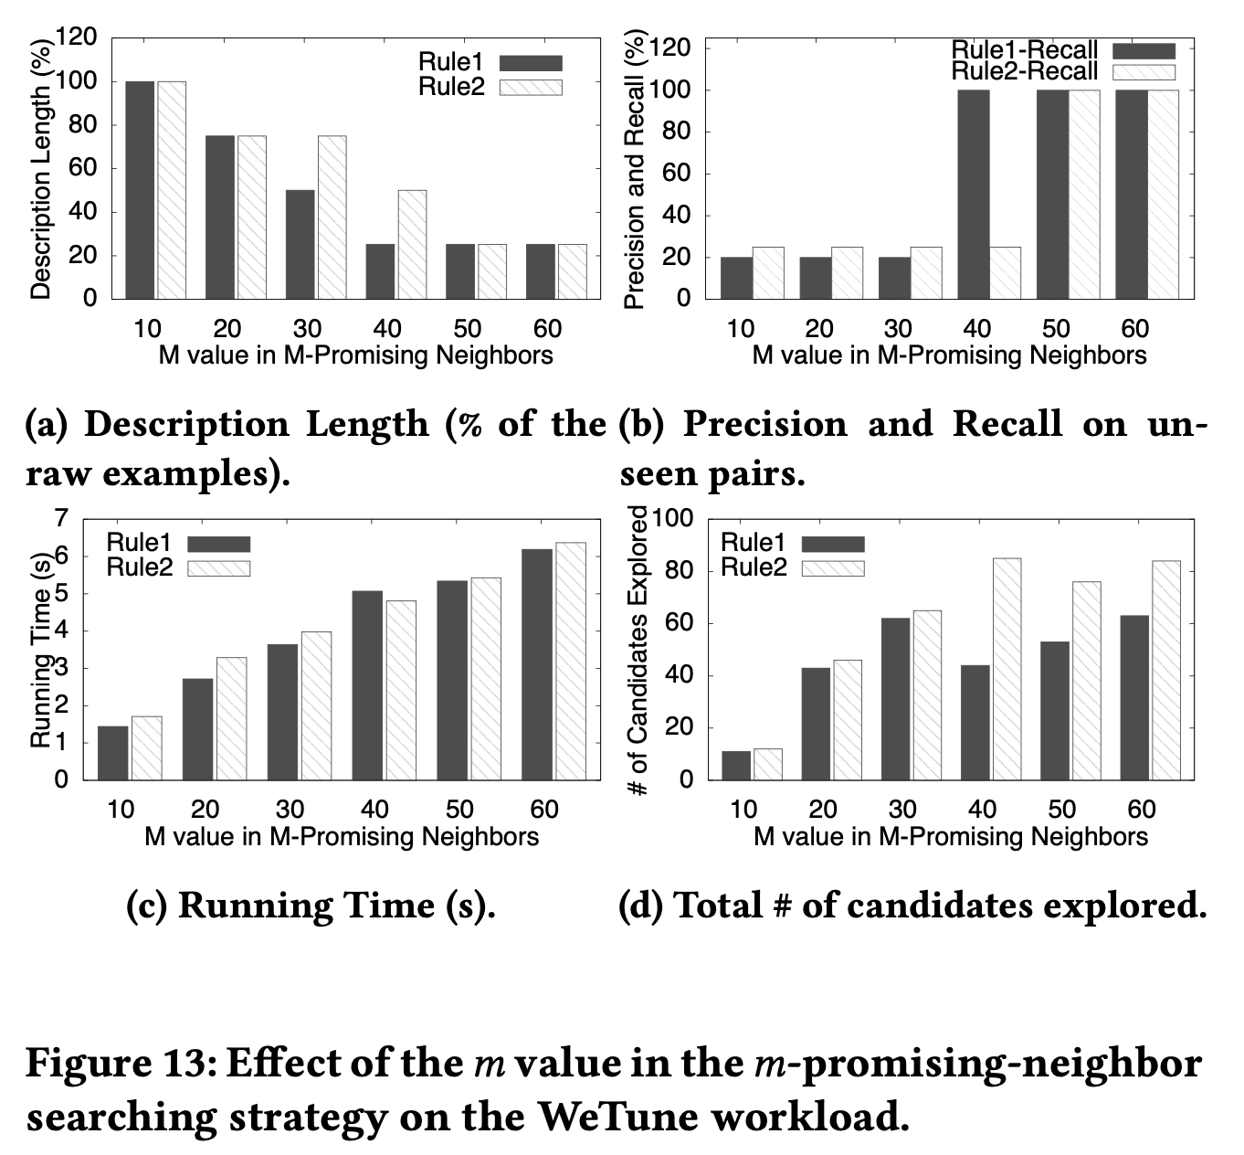
Experiments
Suppose the rule set rewrote 𝑥 unseen pairs of queries, among which 𝑥1 pairs satisfied the intent of the user. Then the precision is x1/x.
Suppose the user wanted 𝑦 pairs of queries in the testing set to be successfully rewritten, and the rule set only rewrote 𝑦1 out of 𝑦. Then the recall is y1/y.
Notes:
随着m增大，得到的description length趋于稳定且最小，同时运行时间和探索到的rule数量也变多
另外，召回率一开始比较小，最后慢慢地达到100%，但准确率一直是100%。
因为算法的输入是matching pair生成的example，所以一开始m小的时候可能匹配不到（只能匹配到输入的具体example），所以召回率是慢慢变大的。
准确率100%是因为一旦匹配到了，改写方式一定是用户想要的，因为该算法的最小length原则就是不会over-generalized（why）

Slide 20
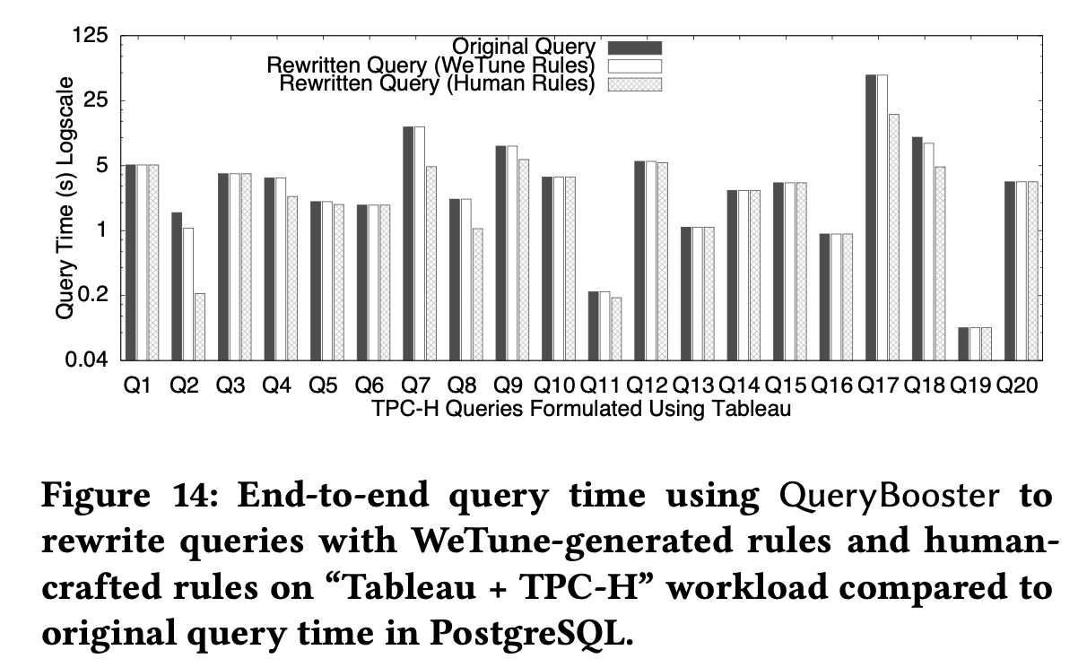
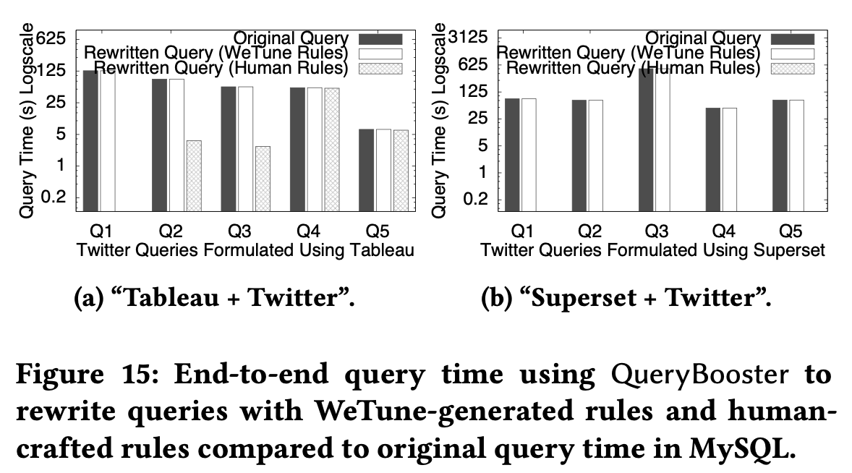
Experiments

Slide 21
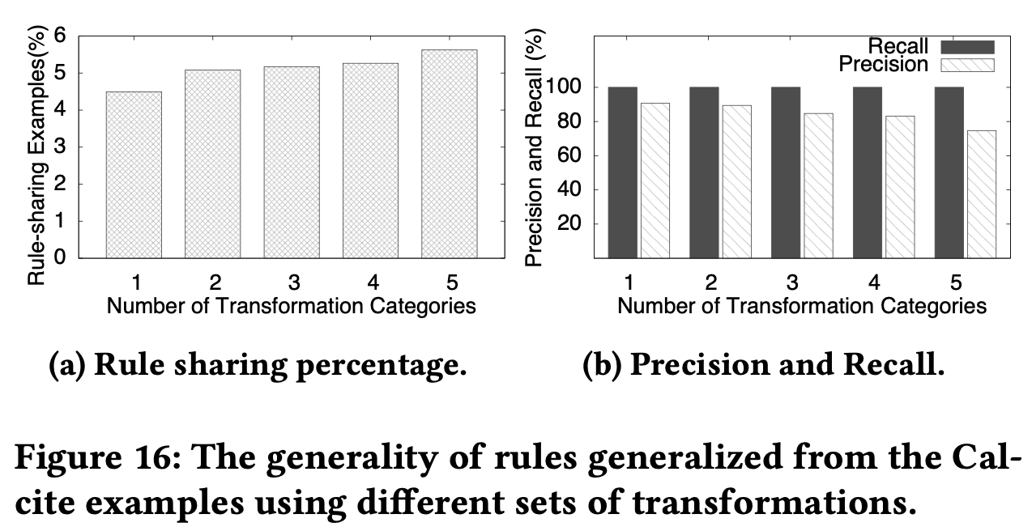
Experiments
Notes:
准确率会下降，因为可能over-generalized了，不是用户想要的
召回率一直是100%因为seed也作为输入了所以一定能match

