Slide 1
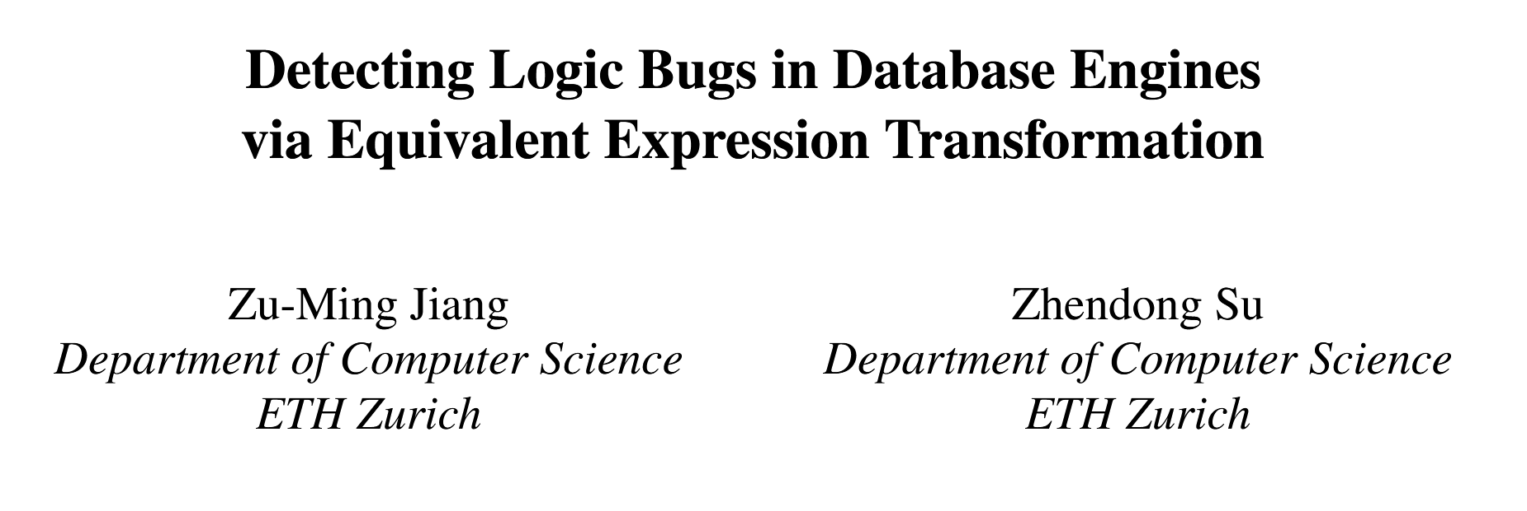
OSDI 24

Slide 2
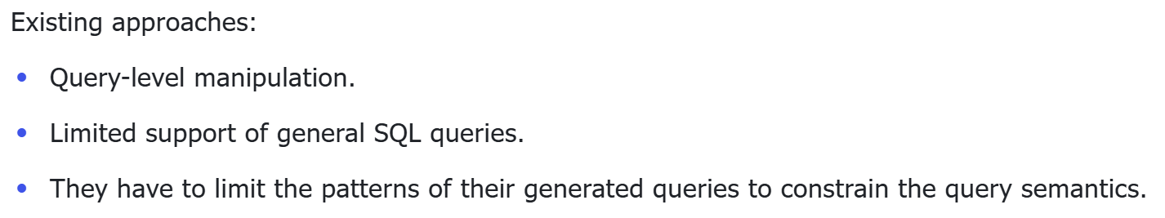
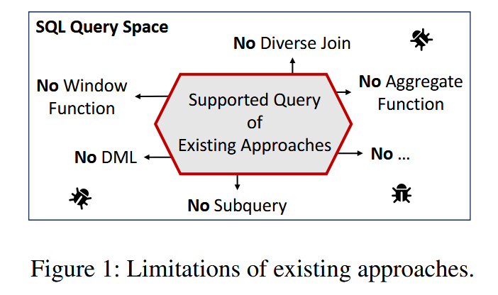
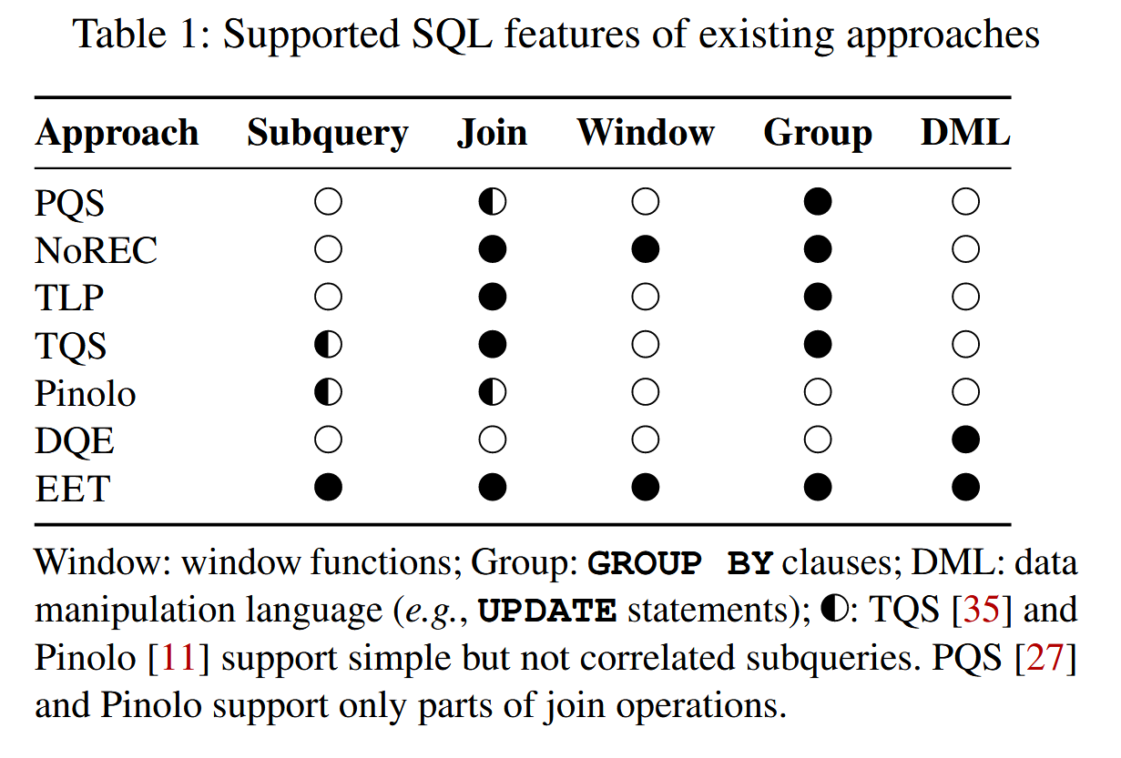
Background
Notes:
必须限制查询模式以约束查询语义

Slide 3
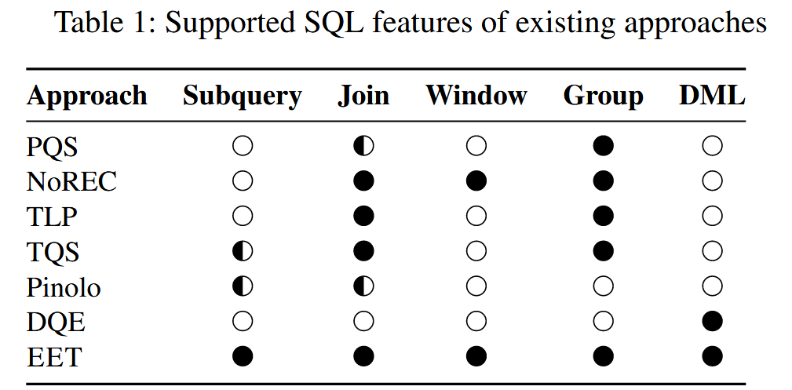
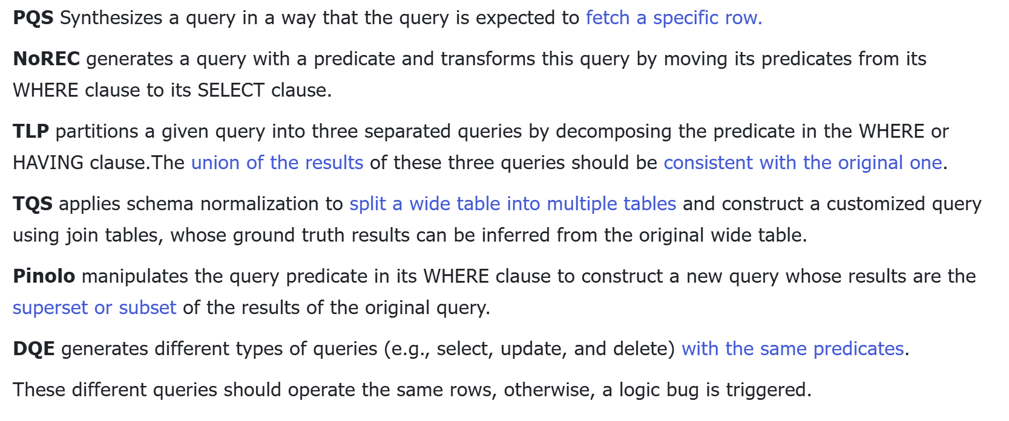
Background
Notes:
PQS 的核心思想是合成一个包含预定义 (即支点行, pivot row) 行的查询, 当执行查询时, 如果结果中不包含这个行, 那么目标 DBMS 就包含一个逻辑问题.
NoREC 将一个能够被 DBMS 优化的查询转化为一个不 能被有效优化的查询, 然后对比两个查询的结果集是否一致

Slide 4
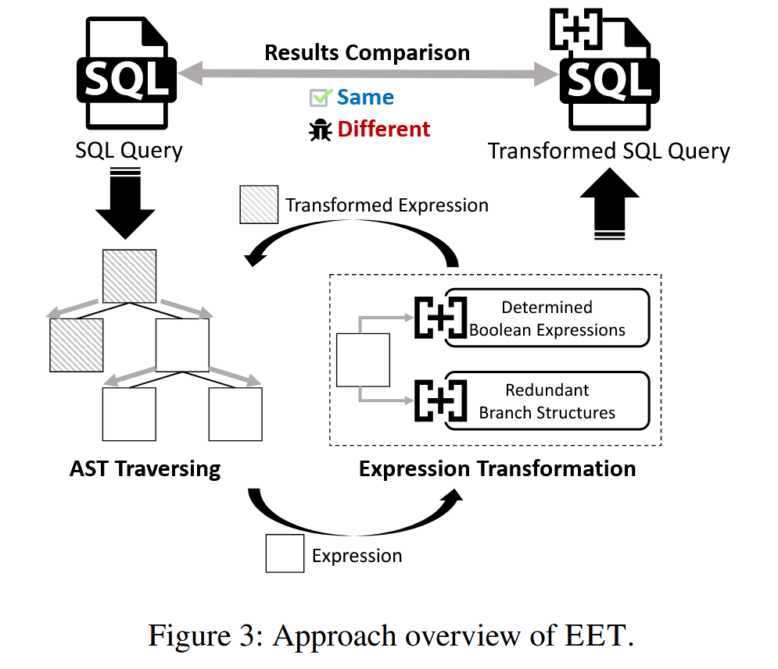
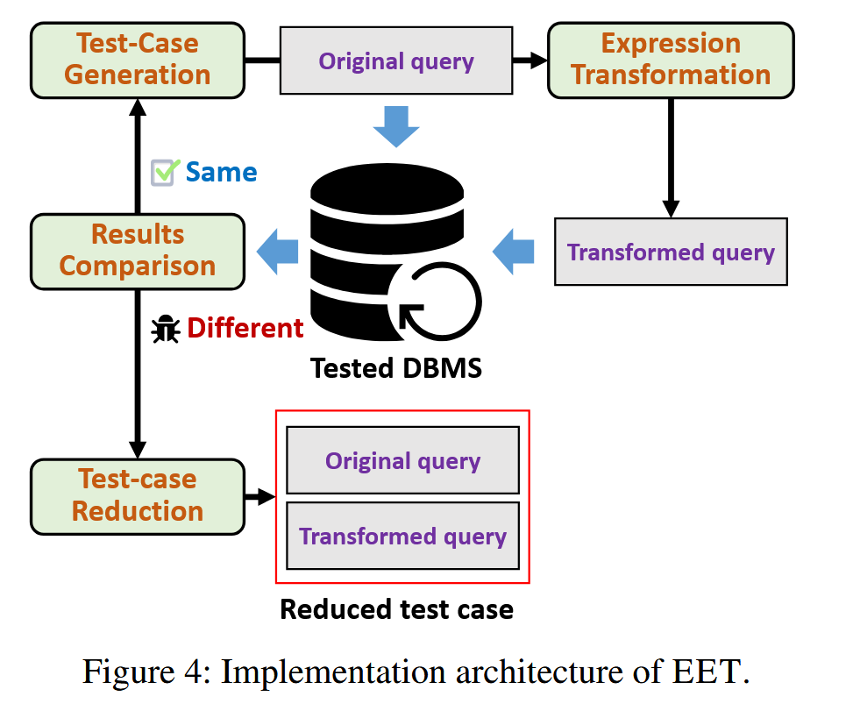
Approach Overview of EET
Notes:
基于布尔表达式和逻辑表达式的查询等价性转换

Slide 5
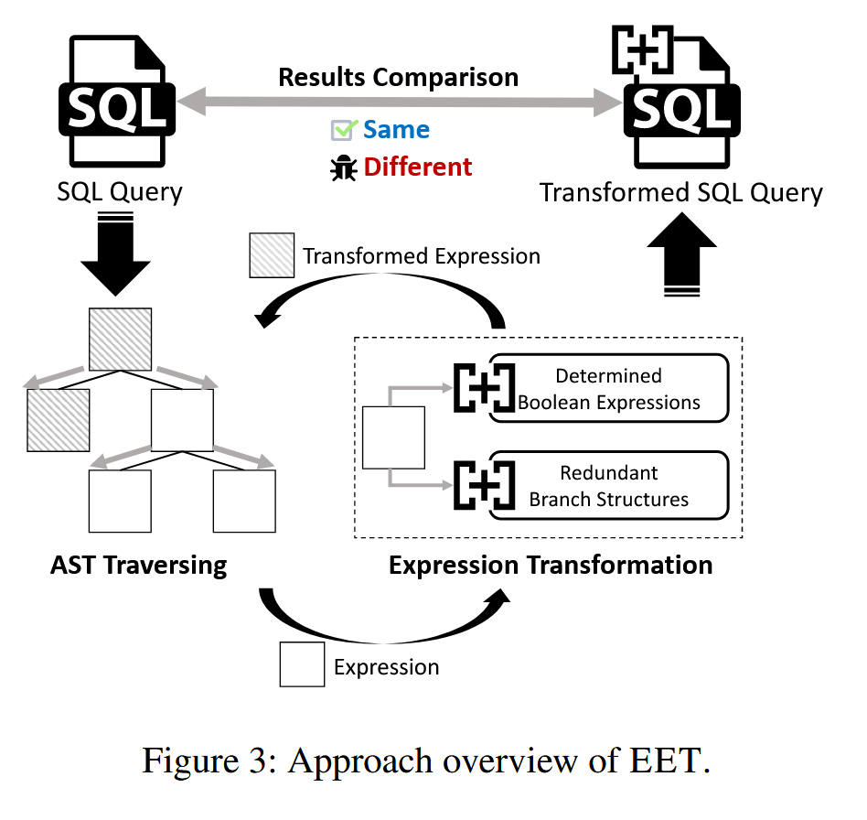
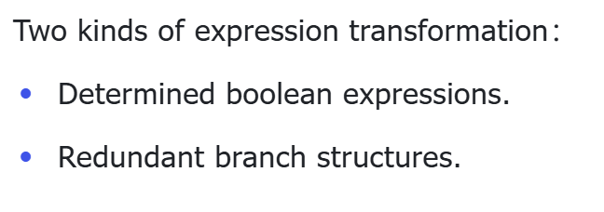
Equivalent Expression Transformation
Notes:
E是Q的一个子表达式，将E进行变换为E’,并且转换后的 E’执行结果恒等于 E
将 E’替代 Q 中的 E，如果 Q’与 Q 执行结果不同，就说明存在 bug

Slide 6
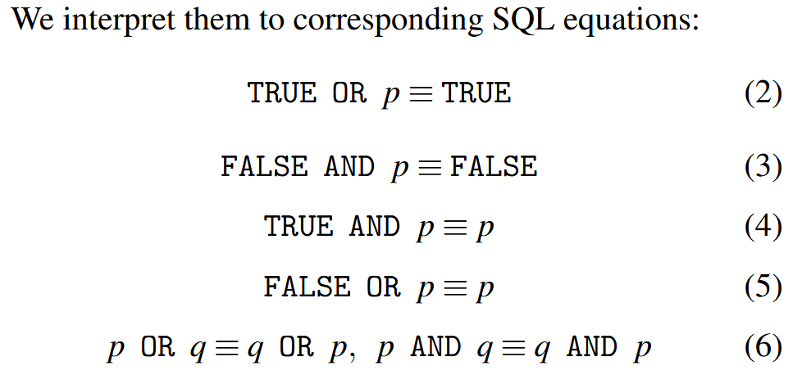
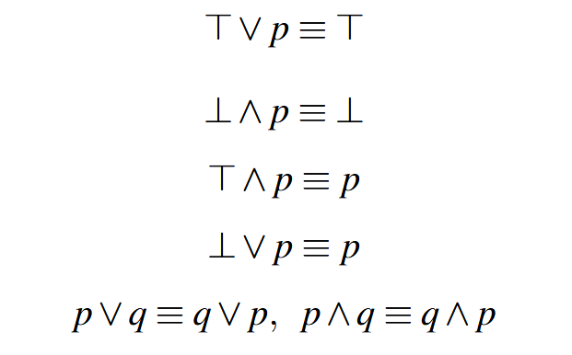
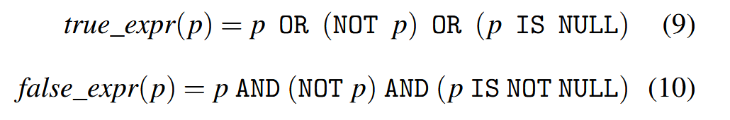
Determined Boolean Expressions
P is an arbitrary boolean expression.

Slide 7
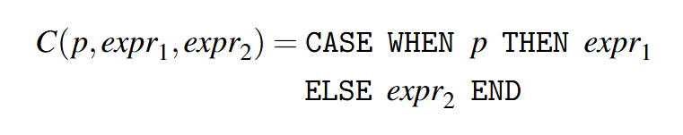
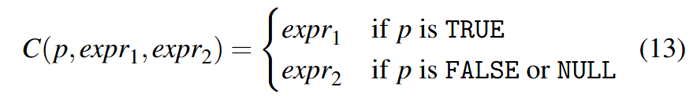
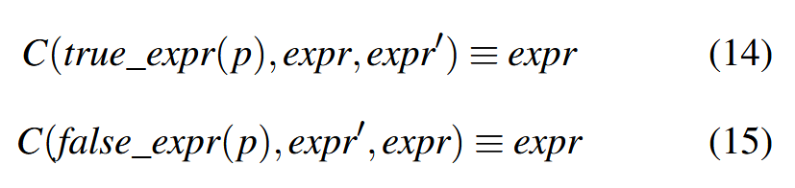
Redundant Branch Structures
To transform non-boolean expressions, we propose to leverage CASE WHEN expressions.
P is an arbitrary boolean expression.
Expr is an arbitrary non-boolean expression.

Slide 8
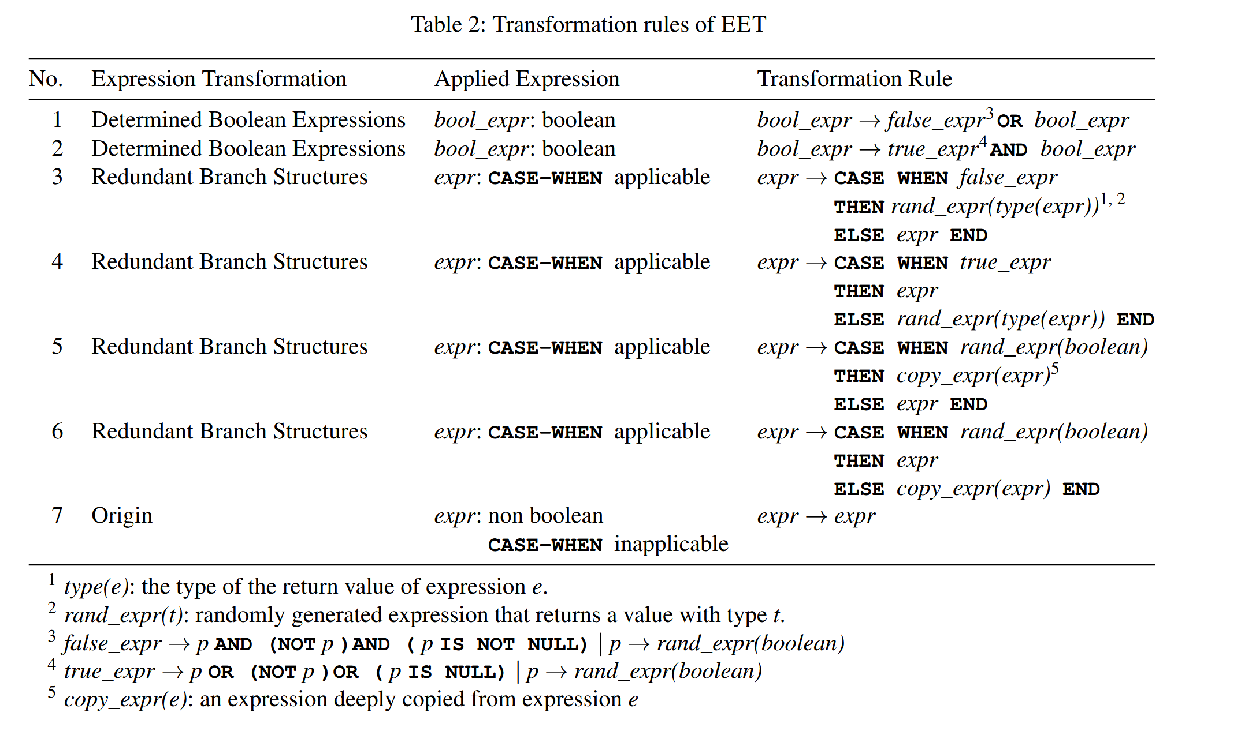
Transformation Rules Conclusion

Slide 9
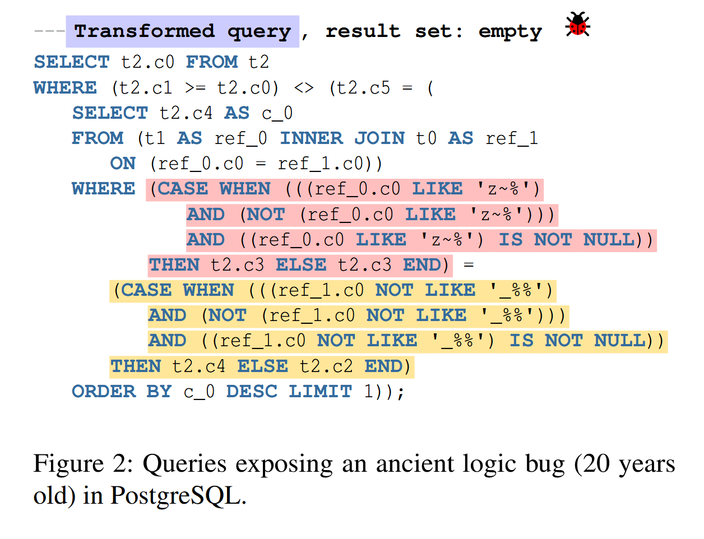
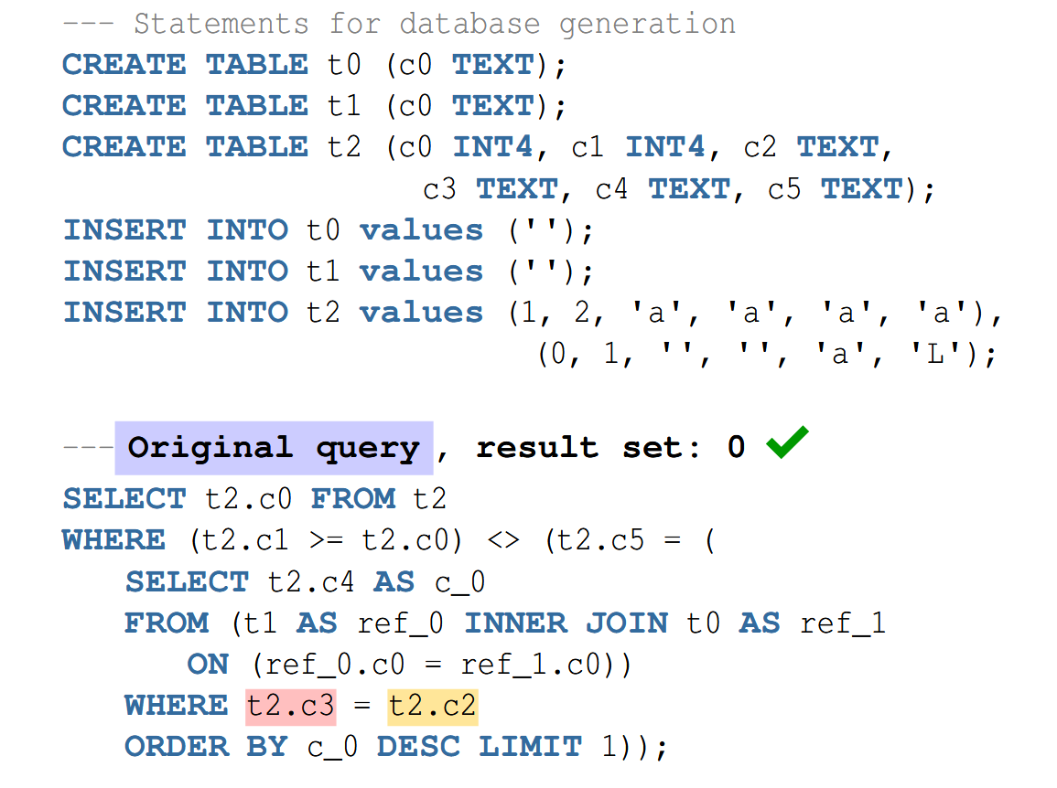
Logic Bug Found by EET
Root Cause. (Bug introduced by query optimization.)
When rescanning a hash join, we'll skip rebuilding the hash table if the inner subplan contains no updated Param values.
However, the inner hash key expressions can themselves contain Param references, which evidently are not caught by that test.
A change in the value of such a Param necessitates rebuilding the hash table, and this example shows that we're not doing that.
Notes:
Root Cause：（查询优化引发的bug）
When rescanning a hash join, we'll skip rebuilding the hash table if the inner subplan contains no updated Param values.
However, the inner hash key expressions can themselves contain Param references, which evidently are not caught by that test.
A change in the value of such a Param necessitates rebuilding the hash table, and this example shows that we're not doing that.

Slide 10
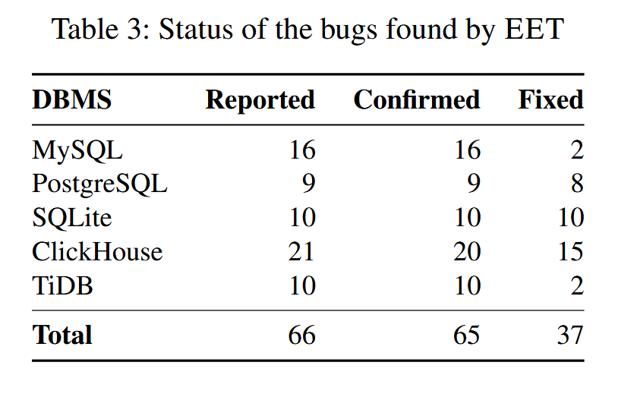
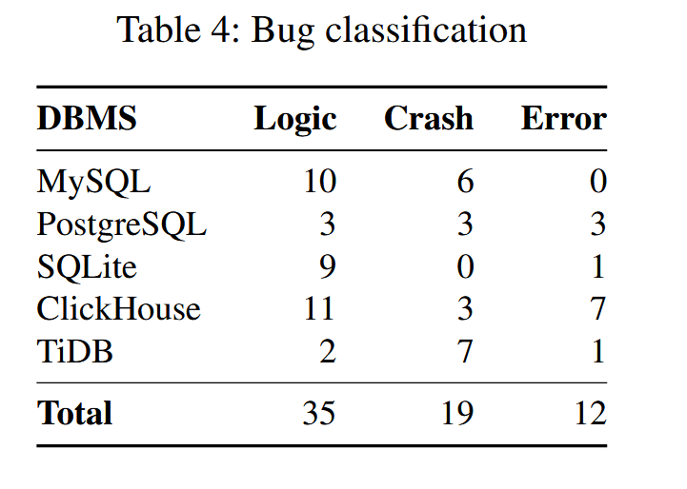
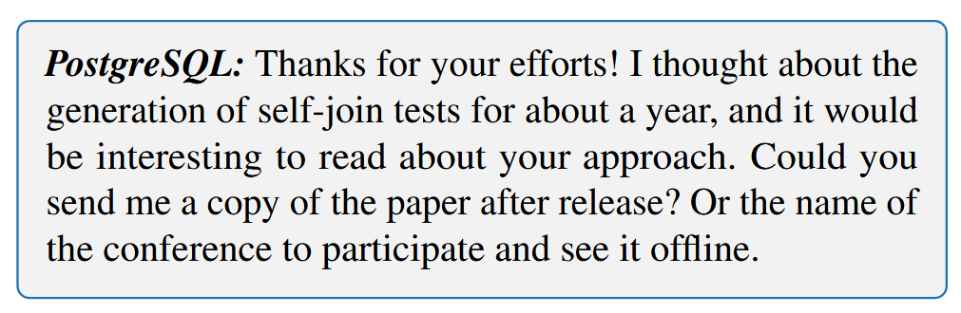
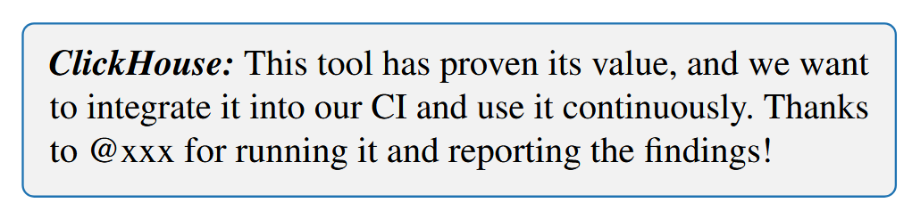
Evaluation

Slide 11
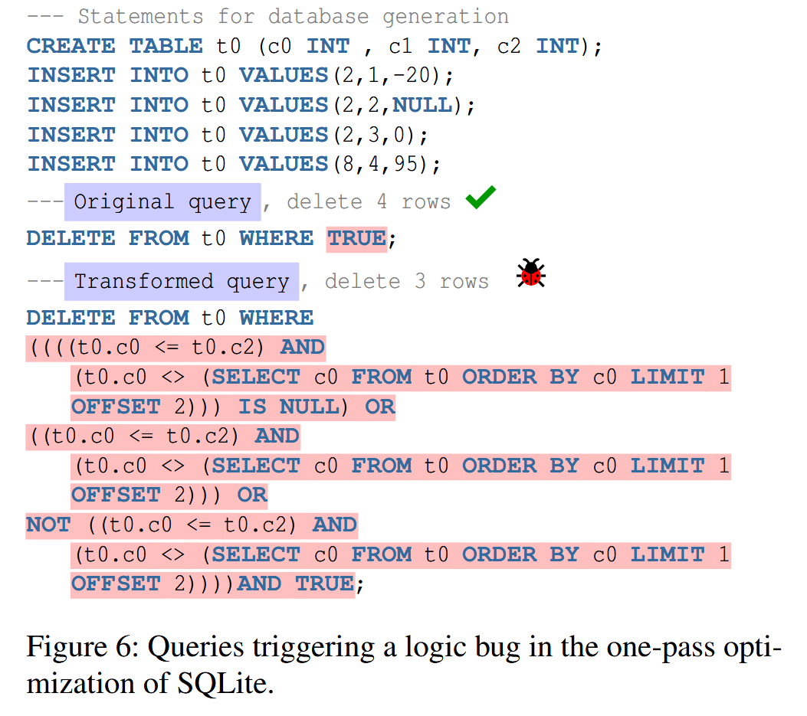
Logic Bug Found by EET
EET transforms this query by applying rule No.2 in Table 2.
Root Cause. (Bug introduced by query optimization.)
1. short-circuit operator.
2. One-pass optimization.
Notes:
Root Cause: （优化引入的bug）
1. short-circuit operator，A and B，如果 A = false，则不再经过 B
2. One-pass optimization, 遍历一条若where为true删一条，例子中 LIMIT 1 OFFSET 2 在只剩最后一行时返回空，前三个 OR 返回了 false，因此不再执行后面的 and true。
原先没优化前是先遍历所有进行标记，第二次遍历统一删除。

Slide 12
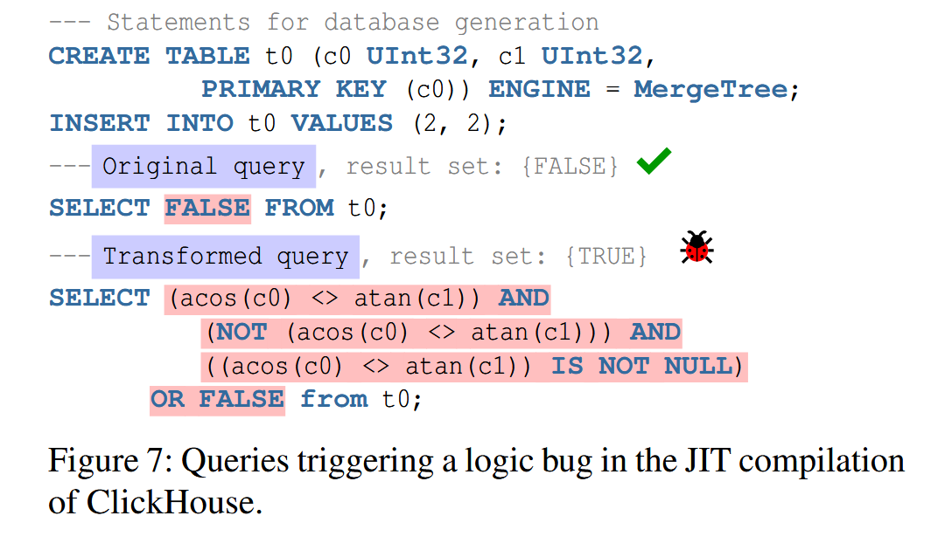
Logic Bug Found by EET
EET transforms the FALSE expression in the SELECT clause, applying rule No.1 in Table 2.
Root Cause. (Bug introduced by JIT compilation.)
The JIT compiler incorrectly compiled the non-equal operation (i.e., <>),
and thus the machine code produced wrong results when comparing the NaN value returned from acos (c0).
Notes:
Root Cause: （JIT错误编译导致的bug）
The JIT compiler incorrectly compiled the non-equal operation (i.e., <>),
and thus the machine code produced wrong results when comparing the NaN value returned from acos (c0).

Slide 13
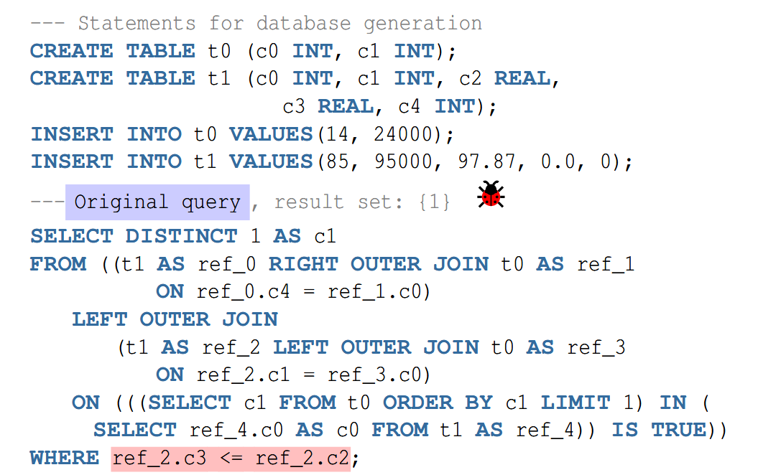
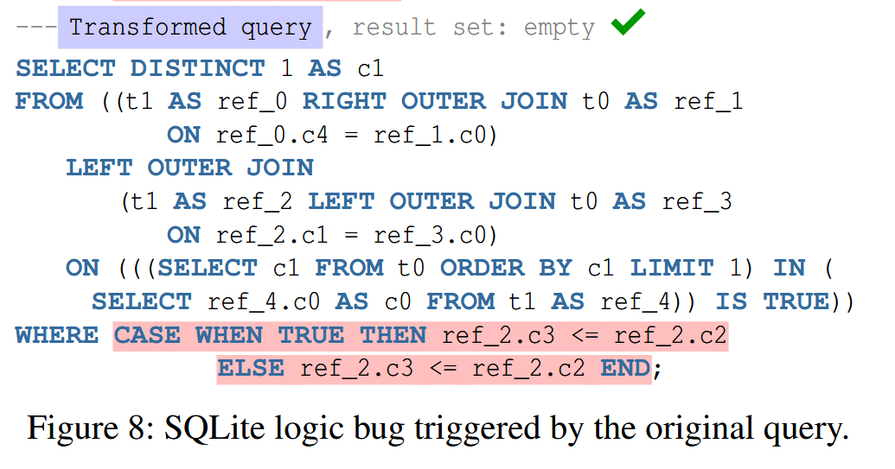
Logic Bug Found by EET
EET transforms this query by applying rule No.4 in Table 2.
Root Cause. (Bug introduced by query optimization.)
In this case, SQLite applies the omit-outer-join optimization, which can reduce the useless join tables (e.g., ref_3) that are not referenced outside their JOIN expressions.
However, this optimization did not work well when SQLite also flattened the subqueries in the JOIN expressions (e.g., the two subqueries in the last ON clause).
Notes:
Root Cause：（查询优化引入的bug）
In this case, SQLite applies the omit-outer-join optimization, which can reduce the useless join tables (e.g., ref_3) that are not referenced outside their JOIN expressions.
However, this optimization did not work well when SQLite also flattened the subqueries in the JOIN expressions (e.g., the two subqueries in the last ON clause).

Slide 14
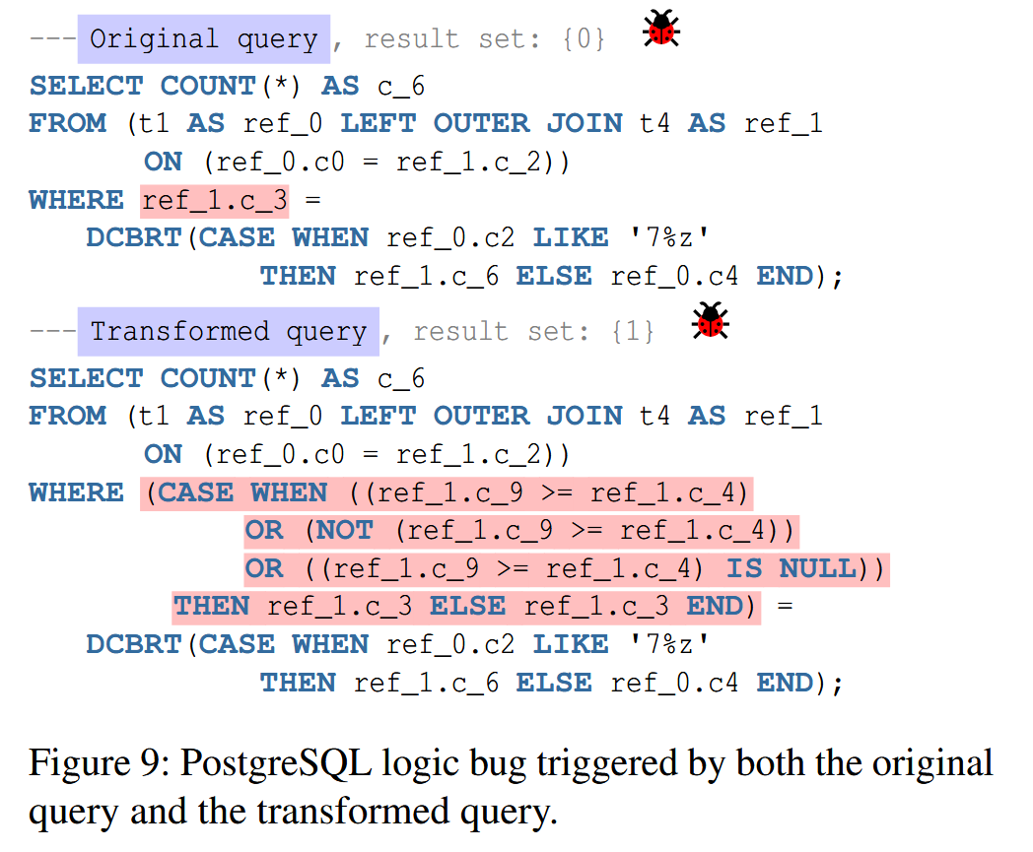
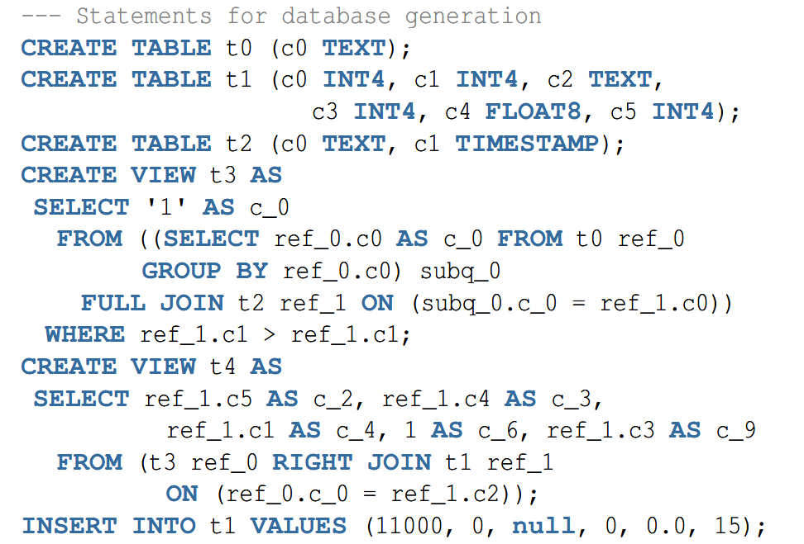
Logic Bug Found by EET
EET transforms this query by applying rule No.5 in Table 2.
Root Cause. (Bug introduced by query plan.)
original query plan uses hash join, transformed query plan uses hash right join.
Both query plans are problematic because they lose join filters, which are responsible for filtering the rows that satisfy the predicate in the WHERE clauses.
Notes:
Root Cause：（查询计划的bug）
查询计划不同引入的bug，original 用的是 hash join, transform 用的是 hash right join
Both query plans are problematic because they lose join filters, which are responsible for filtering the rows that satisfy the predicate in the WHERE clauses.

Slide 15
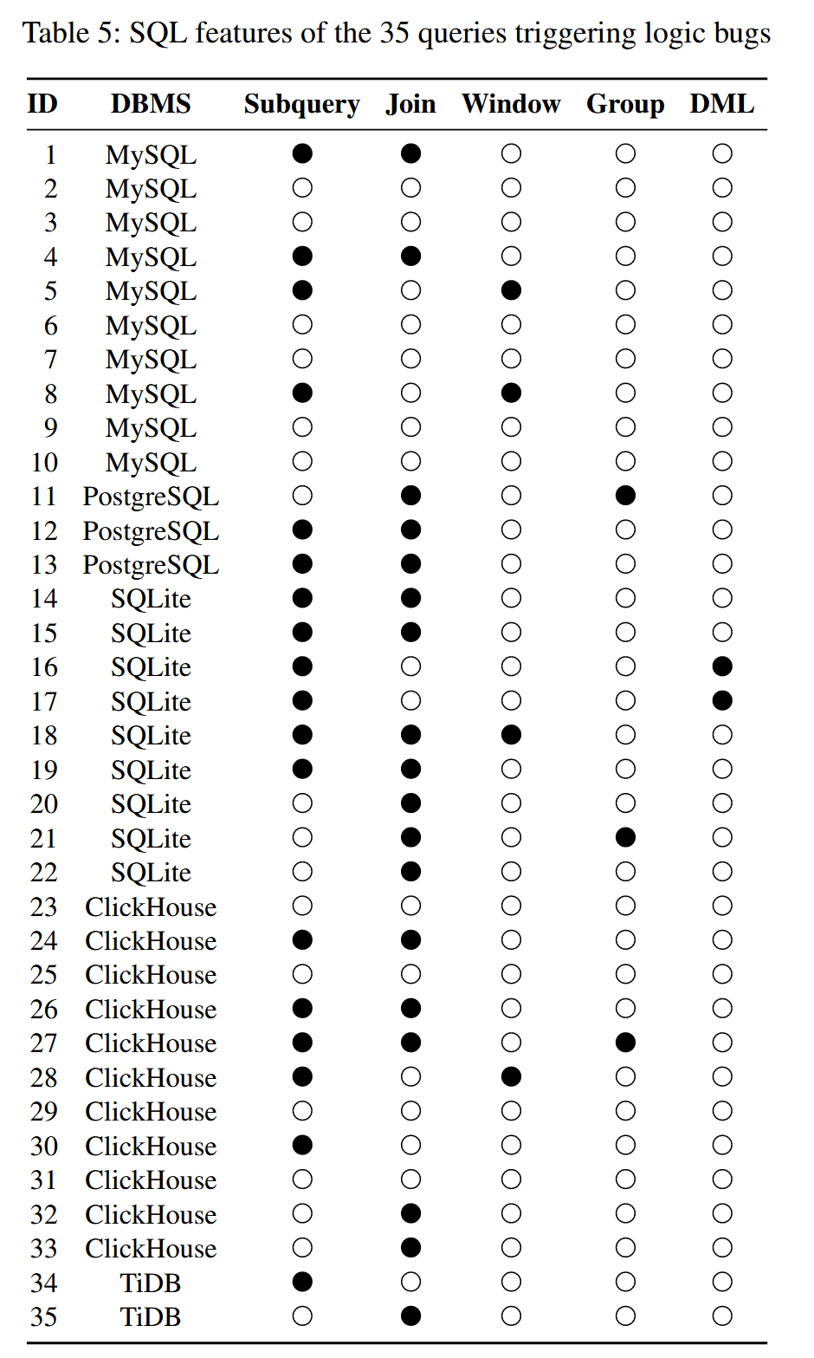
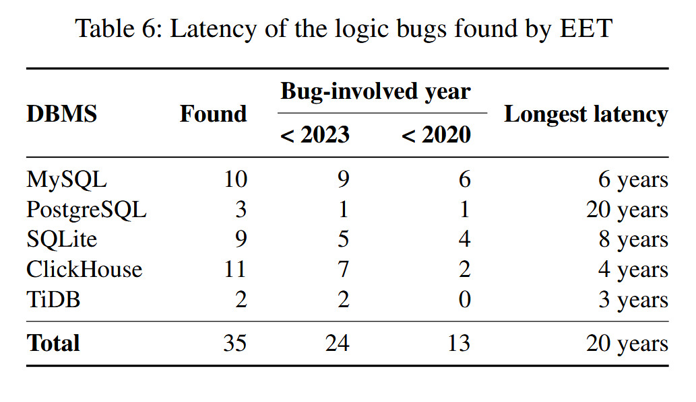
Evaluation

