Slide 1

Paper Reading
CoroBase: Coroutine-Oriented Main-Memory Database Engine
VLDB 21

Slide 2
A brief introduction
In fact, this paper is about software prefetching by coroutine-to-transaction paradigm.
What’s interesting is, they show us a clear approach about:
How to enable inter-transaction batching and avoid interface changes while retaining the benefits of software prefetching?
How much end-to-end benefit can software prefetching bring to a database engine under realistic workloads?
The goal in this paper is to adopt coroutine-based interleaving in a database engine and understand its end-to-end benefits.

Slide 3
Software Prefetching Development
Group Prefetching and Software-pipelined Prefetching. (ICDE 04)
AMAC: Asynchronous Memory Access Chaining. (SOTA) (VLDB 15)
Interleaving with Coroutines for Index Join. (VLDB 17)
Coroutine-to-Transaction Paradigm. (VLDB 21)
Hiding the Impact of Multiple Latency Sources. (coroutine + io_uring) (VLDB 23)
Notes:
解决内存访问的延迟

Slide 4
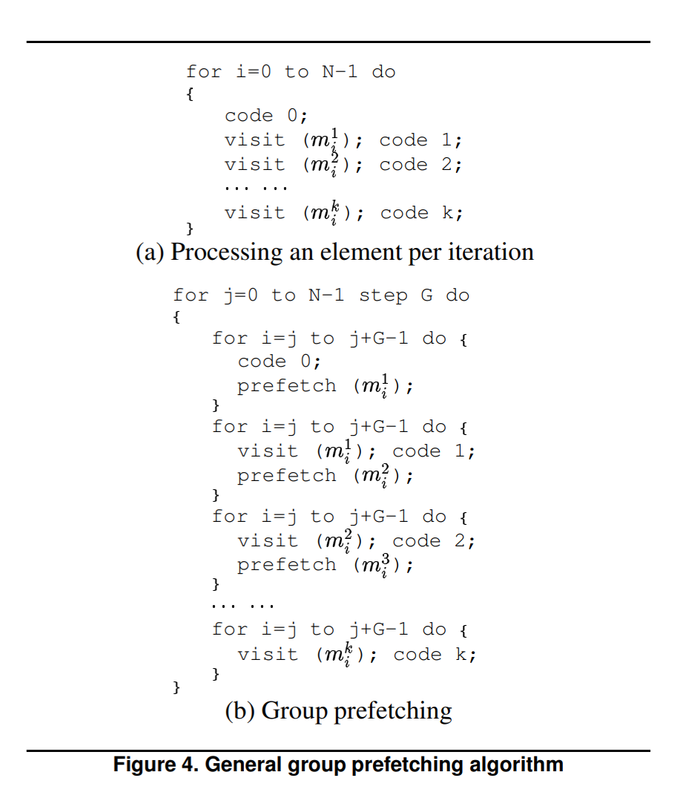
Group Prefetching
G indicates group size, which is the number of elements in a group.
Split data into groups so they can fit L3 cache.
Process code that would access the same memory simultaneously.
If there is no Code 0, then m1 will always suffer from cache miss.

Slide 5
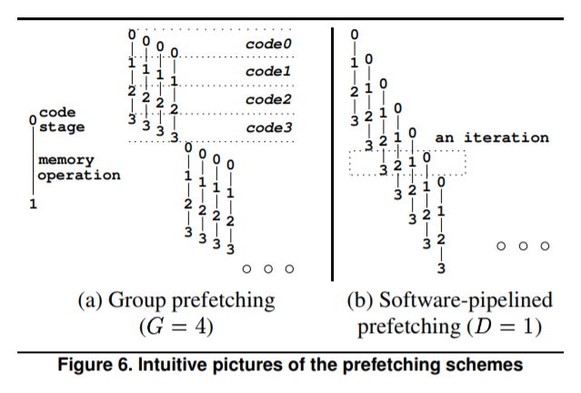
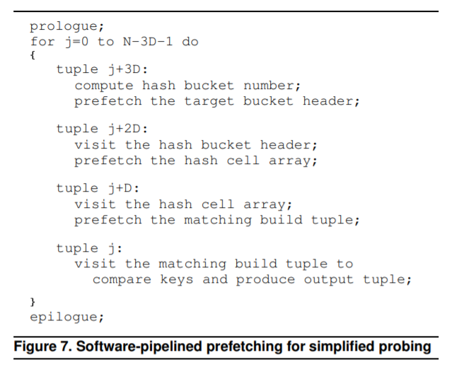
SPP(Software-pipelined Prefetching)
Different from Group Prefetching, SPP doesn’t share cache prefetching but overlap the cache prefetching with other stage.
Can always hide all cache miss latencies. (GP achieves this only when code 0 is not empty).
Notes:
group perfetch：如果每组在执行之前的 code 0 都有个访存开销，那么每组在执行prefetch之前都会有 cache miss 开销
SPP：流水线的连续性不会出现每组都有个访存的开销

Slide 6
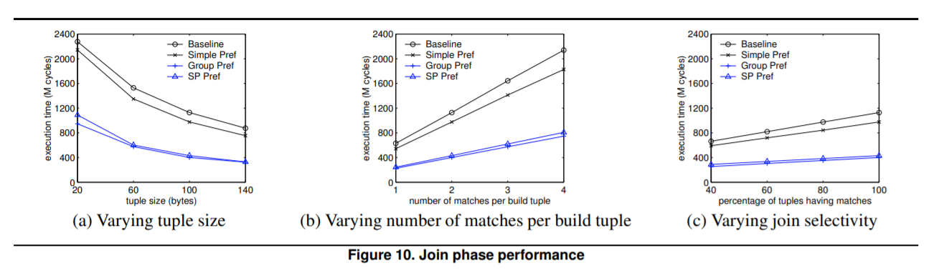
GP V.S. SPP
Group Prefetching
Pros: Easy to implement.
Cons: Cannot hide all the cache miss.
Software-pipelined Prefetching
Pros: Can always hide all the cache miss.
Cons: Has large bookkeeping overhead(some synchronize operation may break pipeline)
Notes:
SPP：跨线程同步开销大，会破坏流水线带来的优势

Slide 7
AMAC
AMAC: Asynchronous Memory Access Chaining.
State of the art.
Use finite state machine to organize prefetching.

Slide 8
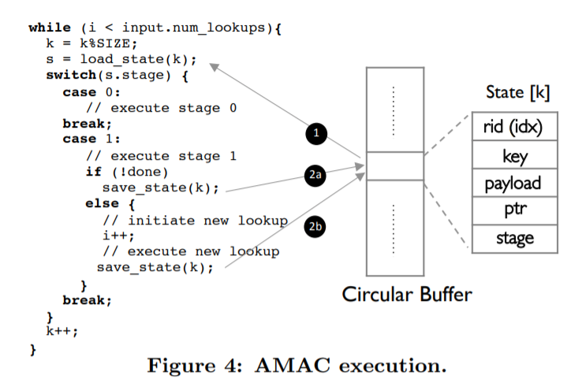
AMAC
Store state of memory accesses in a Circular Buffer.
Round robin the circular buffer, execute corresponding stage with state.
Difficult to handle locking or latching.
Notes:
AMAC技术。其核心思想是构造类似于缓冲池的结构，来解决倾斜访问模式下内存延迟的问题。
轮询每个状态的内存访问是否完成，否则执行下一个lookup的状态。
AMAC的设计本质上是将每一组操作都转换为了一组状态机，将每个操作的状态存储在循环缓冲区中。当完成当前内存访问时，可以立即执行新的内存访问。
AMAC的主要缺点是将同步操作转换为状态机，需要将原始代码完全重写，生成的代码与原始同步版本的代码相差巨大，降低了代码的可读性和可维护性。

Slide 9
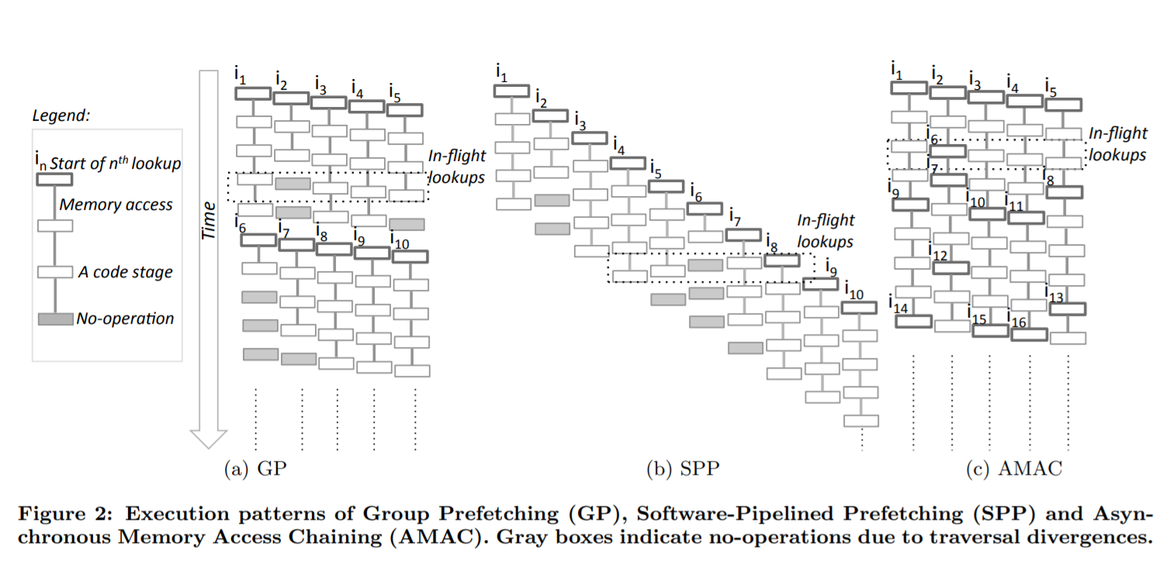
AMAC

Slide 10
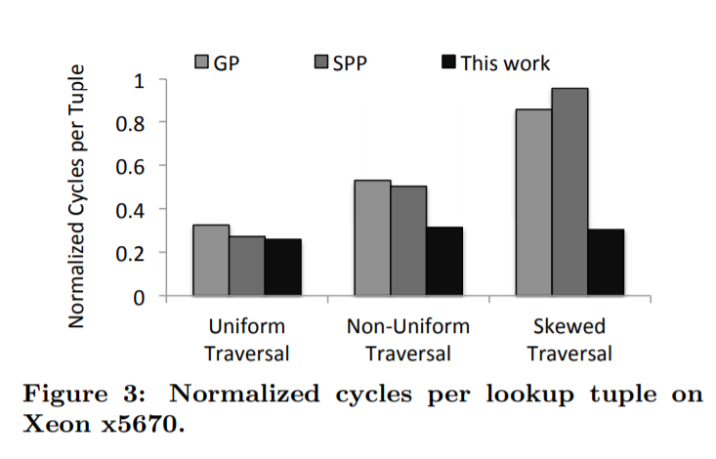
AMAC
Pros: Stable performance in different data distribution, as useless code stage can be skipped by state machine jumping.
Cons: Difficult to implement, should rewrite code in state machine pattern, which is hardly maintainable.

Slide 11
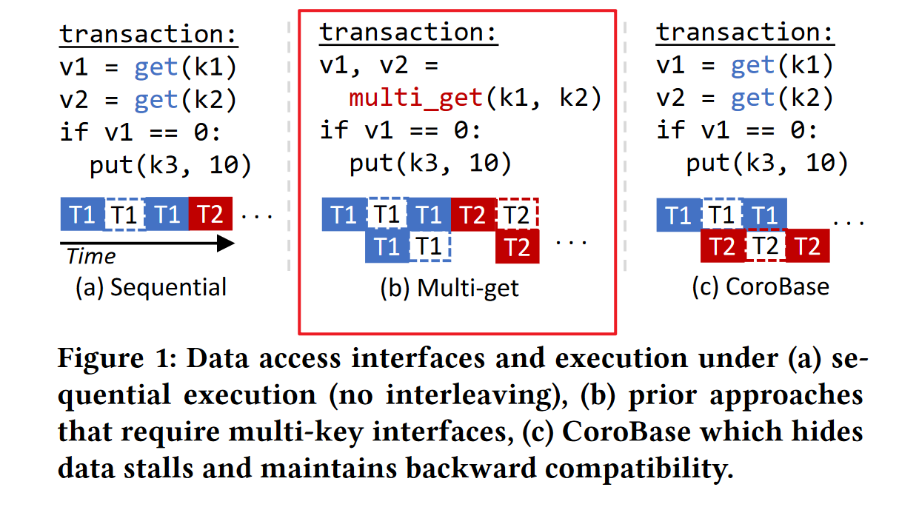
SAP HANA
Pros: Cache misses caused by probing k1 (k2) in a tree are hidden behind the computation part of probing k2 (k1).
Cons: While intra-transaction batching is a natural fit for some operators (e.g., IN-predicate queries), it is not always directly applicable.Short (or even single-record) transactions also cannot benefit much due to the lack of interleaving opportunity.

Slide 12
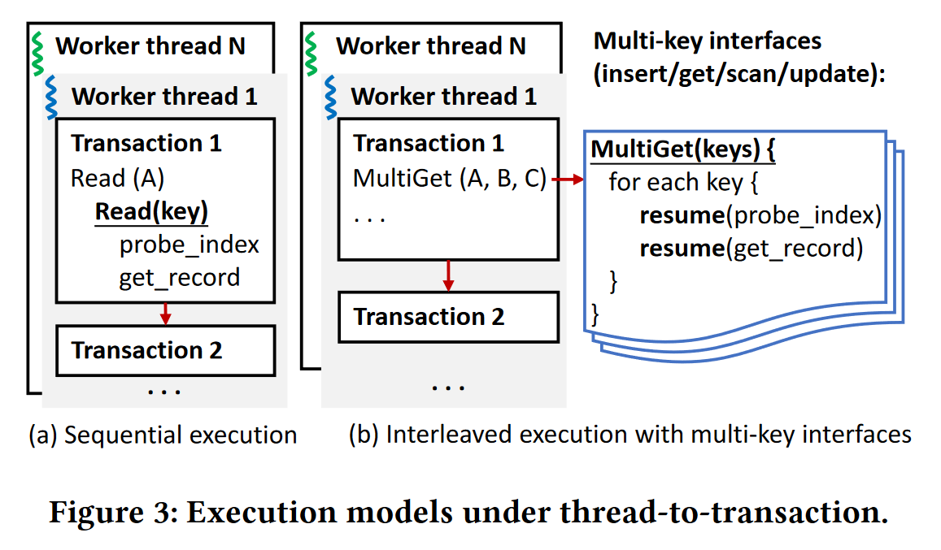
Software Prefetching under Thread-to-Transaction
Under thread-to-transaction, once a thread starts to work on a transaction, it cannot switch to another.
Another transaction can only be started after the current transaction being handled concludes, limiting inter-transaction batching and necessitating interface changes that may break backward compatibility.

Slide 13
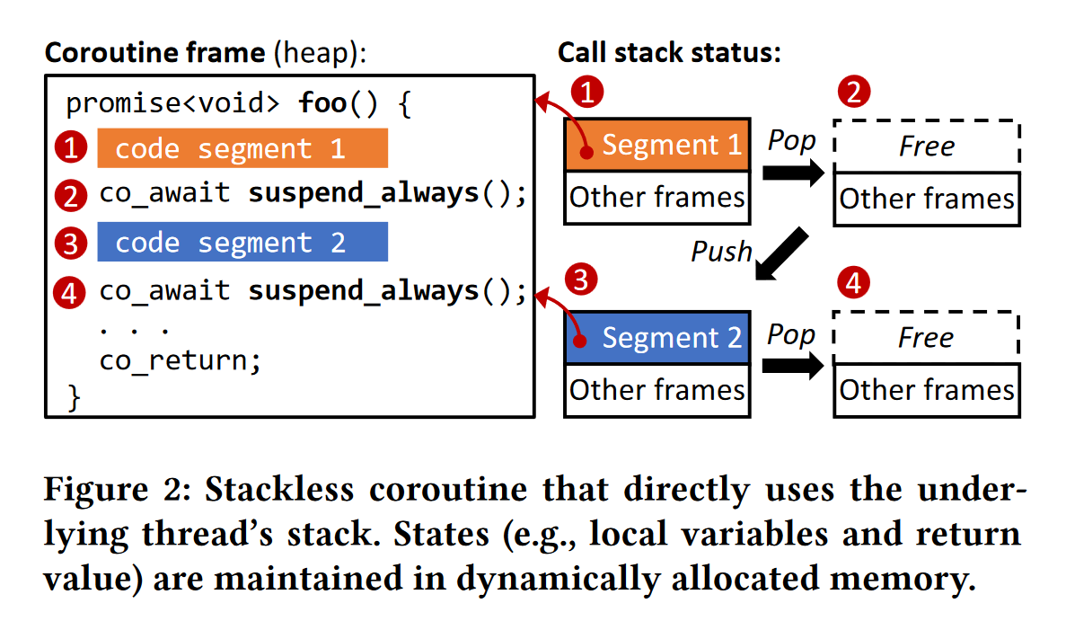
C++20 Stackless Coroutine
During the execution between invoke and return, a coroutine can suspend and be resumed at manually defined points.
Recent stackless coroutines standardized in C++20 (which is our focus) exhibit low overhead in construction and context switching (cheaper than a last-level cache miss).
Its states (e.g., local variables that live across suspension points) are kept in dynamically allocated memory (coroutine frames) that survive suspend/resume cycles.

Slide 14
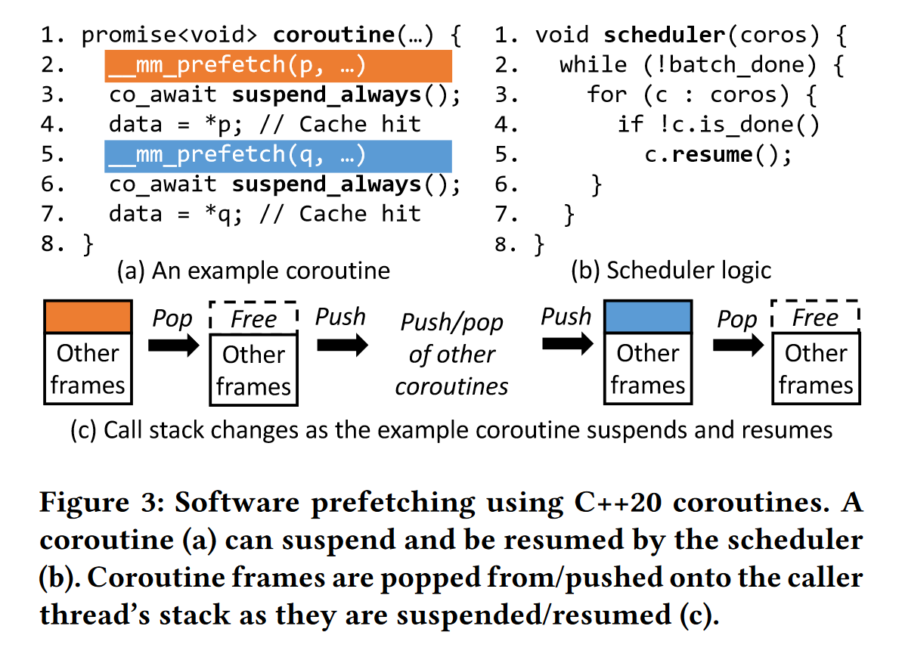
Software Prefetching under Coroutine-to-Transaction

Slide 15
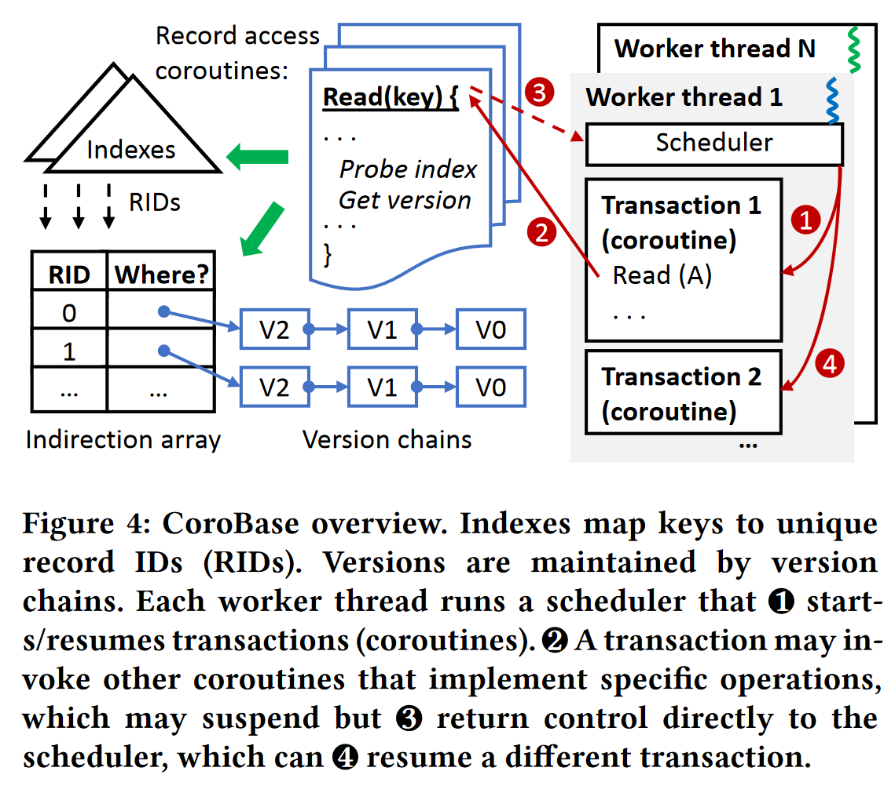
CoroBase Overview
Under traditional thread-to-transaction, the two-step process (traverse index, version chain) is done synchronously by the worker thread.
Under coroutine-to-transaction, each worker thread independently runs a scheduler that switches between a batch of transactions (coroutines).

Slide 16
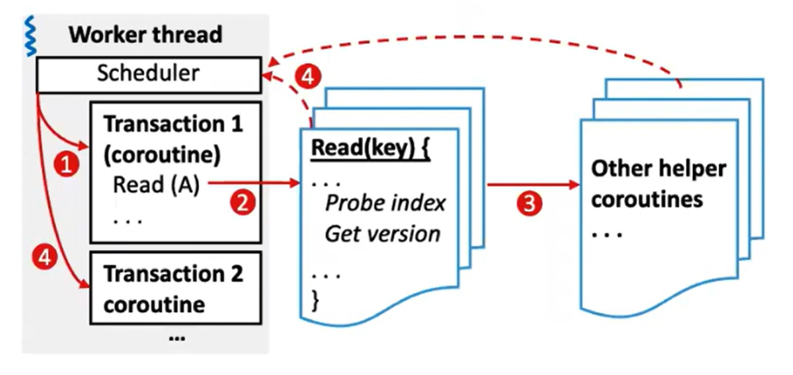
How to Implement Coroutine-to-transaction
Naive approach: turn function call chains to coroutine call chains.
Problems.
Switching overhead overshadows benefits, which leads to more than LLC cache misses.

Slide 17
How to Implement Coroutine-to-transaction
CoroBase approach: Two-Level Coroutine-to-Transaction
Level 1 - One transaction per coroutine.
Level 2 - Flatten only nested calls within the database engine.
Function call chains in the storage engine are “flattened” to become a single coroutine, which can be called by transaction coroutines.
Coding cost: The overhead of manually inlining most code is relatively small.
Moreover, there is a rich body of work in compilers about function inlining and flattening that can help automate this process.
Notes:
第一级协程作为事务执行的驱动函数，串联事务处理的所有过程，调用其他函数或协程完成事务的最终执行。
第二级协程用来优化某个步骤中所有可能发生 cache miss 的地方，所有需要改成 coroutine 的函数都通过手动 inline 或编译器 inline 的方式拍平在这个 coroutine 中。将整个 coroutine 调用链深度限制在了 2 层，以此减少协程切换开销。

Slide 18
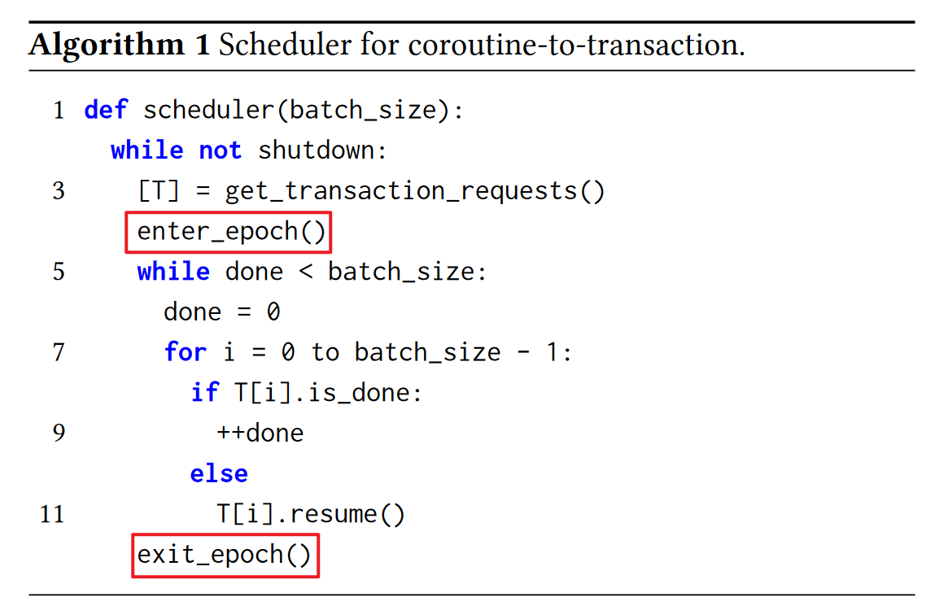
Resource Management
Under the coroutine-to-transaction execution model, resources may be concurrently modified by multiple transactions that are executed in parallel.
CoroBase solves this problem by decoupling epoch enter/exit from transactions for the scheduler to issue them.

Slide 19
Concurrency Control and Synchronization
Concurrency Control.
Snapshot isolation with the serial safety net for serializability.
Version visibility is controlled using timestamps drawn from a global, monotonically increasing counter maintained by the engine.
Synchronization.
Avoid holding latches upon suspension.

Slide 20
Evaluation
Variants.
Naive: Baseline that uses thread-to-transaction and executes transactions sequentially without interleaving or prefetching.
ERMIA: Same as Naïve but with prefetch instructions carefully added to index and version chain traversal code.
AMAC-MK: Same as ERMIA but applications use hand-crafted multikey interfaces based on AMAC.
CORO-MK: Same as ERMIA but applications use multi-key interfaces based on flattened coroutines.
CORO-FN-MK: Same as CORO-MK but with fully-nested coroutines.
CoroBase-FN: CoroBase that uses the fully-nested coroutine-totransaction design. No changes in applications.
CoroBase: Same as CoroBase-FN but uses the optimized 2-level coroutine-to-transaction design.
Hybrid: Same as CoroBase but selectively leverages multi-key interfaces in TPC-C transactions.

Slide 21
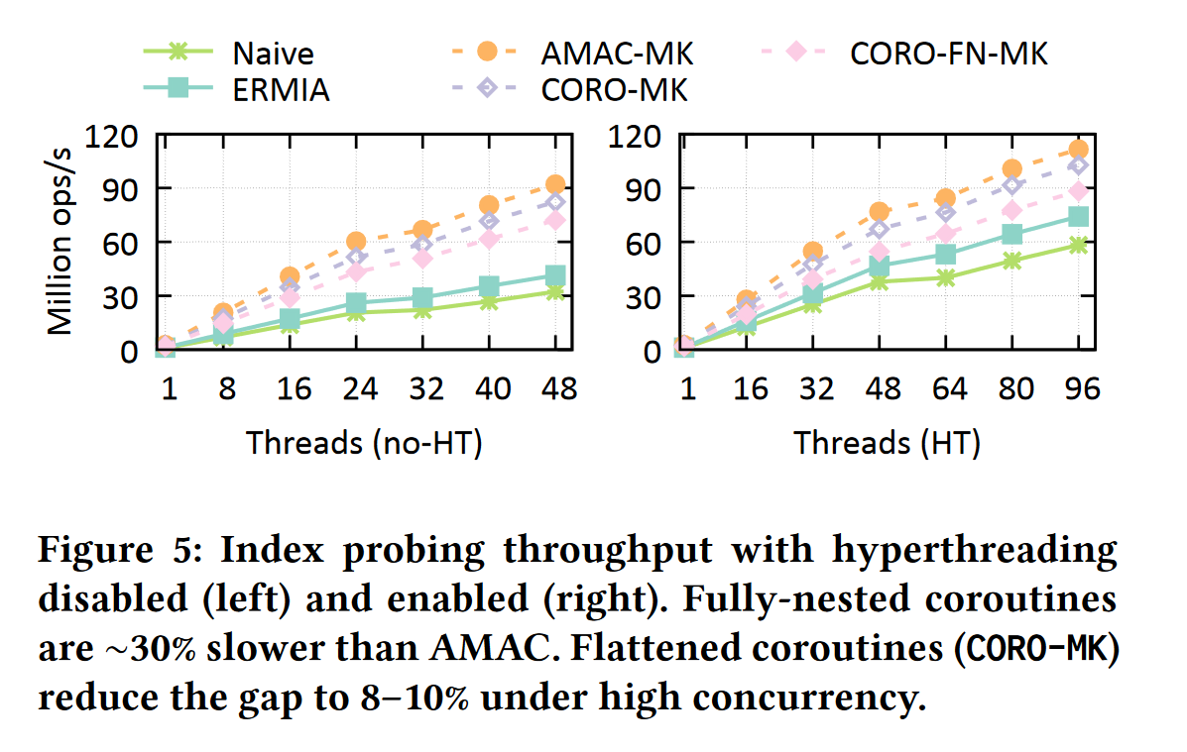
Evaluation
When used MK as interfaces, AMAC-MK remains state-of-the-art (SOTA).
However, AMAC-MK uses highly-optimized but complex, hand-crafted code, making it much less practical.
CORO-MK achieves higher throughput than Naïve/ERMIA and CORO-FN-MK because of its lower switching overhead.

Slide 22
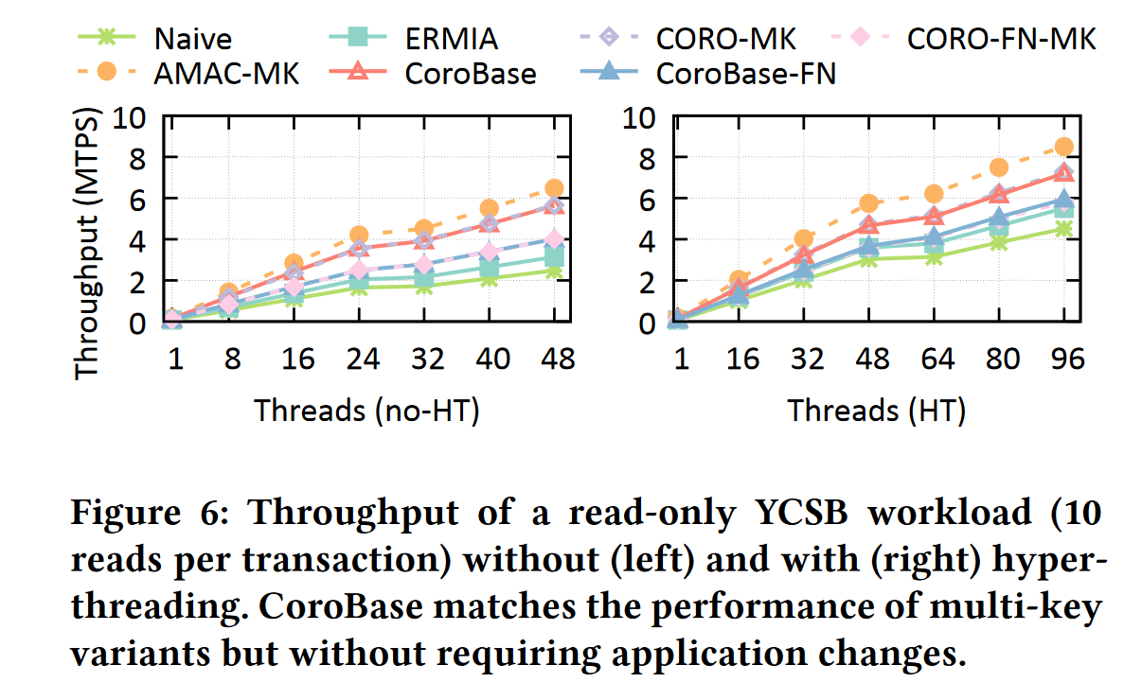
Evaluation
CoroBase achieves throughput comparable to CORO-MK without altering the interface.
Because of the use of highly-optimized, hand-crafted state machines and multi-key interfaces, AMAC-MK outperforms all the other variants.

Slide 23
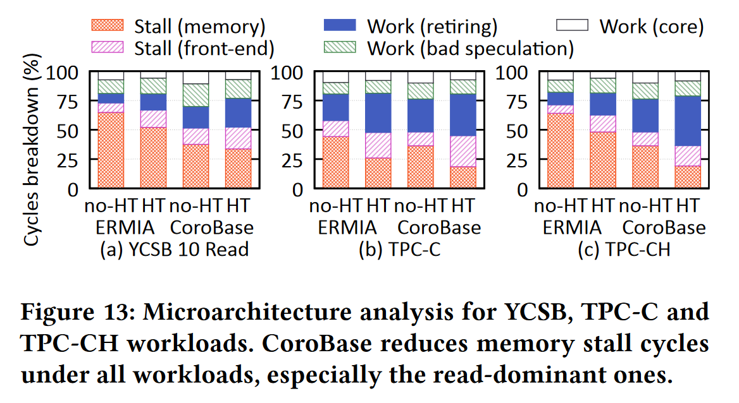
Evaluation
The main difference between CoroBase and ERMIA lies in its ability to effectively reduce CPU idle time caused by memory access.
TPC-C exhibits less than 50% of memory stall cycles, which do not provide enough room to benefit from prefetching.

Slide 24
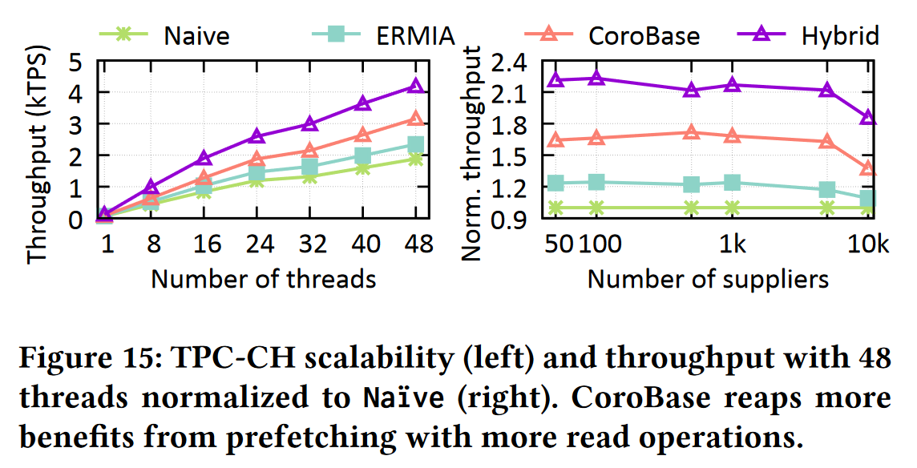
Evaluation
For operators that already exhibit or are easily amenable to multi-key interfaces, Hybrid can be an attractive option.

Slide 25
Thanks

