Slide 1
Benchmarking Query Optimizer
Presented by Zhaokun Xiang
Notes:
asjdhakd

Slide 2
Outline
Query Optimizer Component
Background in Optimizer Testing
Some Related Work
Notes:
本次主要从三点讲，第一个是查询优化器的部分，第二个是查询优化器测试的背景 第三个是一些相关的工作

Slide 3
Query Optimizer Component
A space of plan(Search Spaces)
A cost estimation technique so that a cost may be assigned to each plan in the search space.
An enumeration algorithm that can search through the execution space
Cost Model
Search Space
Enumeration Algorithm
Notes:
这次带大家复习一下，主要有三个部分，第一个是搜索空间，第二个是Cost model，第三个是枚举算法

Slide 4
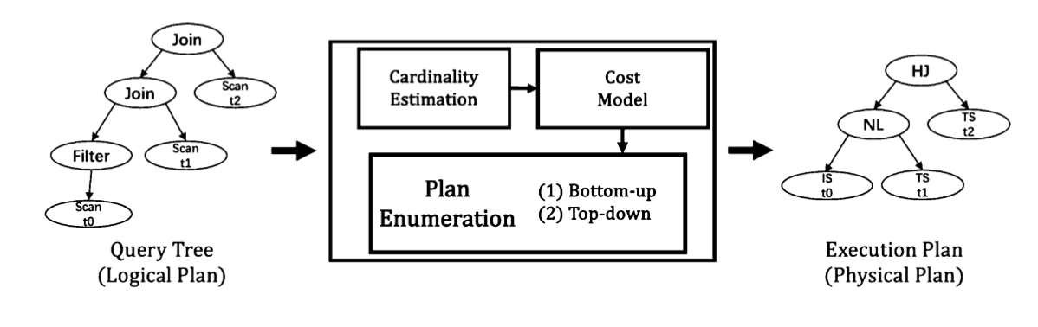
Query Optimizer Component
Notes:
Plan enumerator主要是枚举Join order，有两种方式，一个是system R的自定向上 一个是Cascades/Volcano的Top-down的方式

Slide 5
Query Optimizer Component
Cardinality Estimation use statistics of data and some assumptions about data distribution, column correlation, and join relationship to get the number of tuples generated by an intermediate operator.
Cost Model can be regarded as a complex function that maps the current state of database and estimated cardinalities to the cost of executing a plan.
Plan Enumeration is an algorithm to explore the space of semantically equivalent join orders and find the optimal orders with minimal cost.
Notes:
现在来一个细粒度总结，基数预告使用数据的统计信息、数据分布的假定、列之间的关系、去估算算子的中间结果
Cost model能被看成一个复杂的函数，映射了当前数据库的状态，和预告的基数，来得到查询计划的Cost,之前暑期学校王国平也说这个状态不是很重要，相比基数来说，后面也有论文会证明
然后Plan enumerator主要枚举的是join order

Slide 6
Root of all evil
Errors in cardinality will propagate to the cost model and lead to suboptimal join order.
Eliminating or reducing the errors in cardinality is the first step to build a capable optimizer.
The root of all evil, the Achilles Heel of query optimization, is the estimation of the size of intermediate results, known as cardinalities”
Notes:
下一个是一个经典的博客，就是说查询优化器的万恶之源，就是基数

Slide 7
The Works in getting Exact Cardinality
Exact Cardinality Query Optimization for Optimizer Testing, VLDB 09
Exact Cardinality Query Optimization with Bounded Execution Cost, SIGMOD 19
Exact Selectivity Computation for Modern In-Memory Database Query Optimization , arXiv:1901.01488
Notes:
所以才有了这3篇工作，之前我讲过第一篇，以最小执行子查询的方式，然后另外两篇工作也是最小执行的方法，我就不讲了，只是说精确的基数计算一直有人做，目的就是为了更好的评估优化器

Slide 8
Background
Performance evaluation with benchmarks has a long-standing tradition in the database industry
Most benchmarks are suitable to demonstrate performance enhancements of storage and query execution
None of the benchmarks/tools are good at accessing the query optimizer to help database developer judge their effort on query optimizer
Notes:
接下来是优化器测试的一个背景
大多数基准测试还适合单独证明存储和查询执行等方面的性能增强，但是没有一个很好的benchmark能很好的评估查询优化器，去帮助数据库开发者判断在优化器上的开发效果

Slide 9
The ideal attributes of this benchmark
Simple
  The result should be a single value to represent the ability of optimizer
Technology agnostic
  The benchmark should be agnostic of particular optimizer technology used
platform specific
  A query optimizer tries to generate the optimal plan for a given target platform. The score must take into account that every optimizer will optimize for a different target platform
Notes:
所以这个benchmark应该具备什么样的标准呢
第一个是简单，就是说我们使用这个工具，应该得到一个简单的值，去表示这个优化器的能力
第二个是该工具应该是技术容忍的，就是说不管你用什么技术优化 都能使用
第三个是该工具应该考虑平台的因素，就是说优化器

Slide 10
The ideal attributes of this benchmark
Portable
  Ideally the benchmark can be applied to any query optimizer
Surgical
  The benchmark should work for individual queries to troubleshoot specific optimizer problems
application specific
  It should apply to any workload in addition to individual queries to enable optimizer to access whether an optimizer is suitable for a specific application scenario
practical
  The score should be straight-forward to compute and lend itself easily to automation in test suites
Notes:
该benchmark应该是精确的，就是说能生成单个的查询去troubleshoot特定的查询优化问题
然后是workload，就是说不仅仅是query，我能生成一个负载的场景，该场景能说明优化器不好
然后最后一个是实用，就是说 我能自动的测试优化器的分数
当然了 这些是最理想的状态，现在还没有这种benchmark

Slide 11
Testing the Quality of a Query Optimizer
ICDE 1993
Notes:
然后是相关的工作，第一篇是ICDE1993的工作，测试查询优化器的质量，这篇应该是最早的

Slide 12
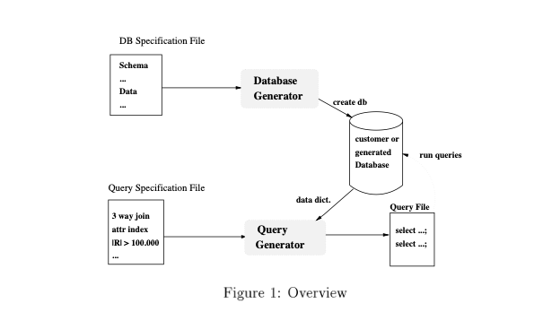
Statement the importance of optimizer testing
During the development cycle of the database, the optimizer might undergo important modifications.
The database vendors must prove that those changes improve the optimizer, so they should have a tool to verify the changes analytically.
The tool consists of two parts: a database generator, a query generator
Notes:
这篇文章主要是说明了测试优化器的重要性
第一个点就是在数据库的开发过程中，优化器可能会面临很多的修改，所以数据库开发者必须要证明这些改变提升了优化器的质量，所以他们需要一个工具去量化这些修改

Slide 13
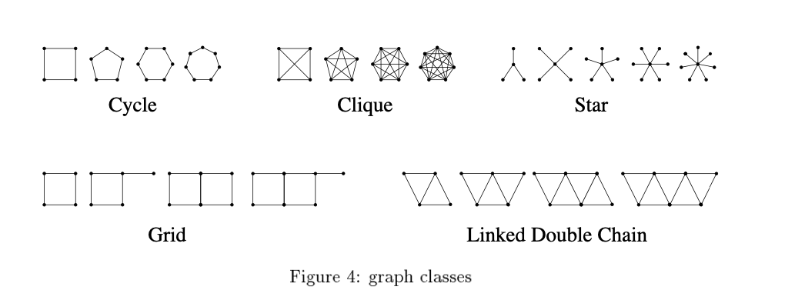
Join order problem
We must be able to generate large database schemas that allow the user to generate queries with many joins
Notes:
环形的 Clique型的，星型的 网格型的，的Join，
这篇文章没有给出这些工具，也没有实验，只是说了一个工具的雏形，我们需要生成带有分布的数据，query

Slide 14
Testing the Accuracy of a Query Optimizer
DBTest 2012
Notes:
下一篇文章是测试优化器的精度，这篇文章主要的关注点在于测试优化器的Cost model的效果

Slide 15
Contribution
We develop a framework to quantify an optimizer’s accuracy for a given workload.
We use hint to generate multiple alternative plan for each test query.
We execute all alternative plan and rank them by their actual cost.
We compare this ranking with the ranking of the estimated cost and compute a score for the accuracy of the optimizer.
Notes:
主要的贡献是提出了一个框架，去量化针对给定query的优化精度
主要是用hint这个关键字，去强制优化器生成很多plan，然后去执行所有的Plan，得到一个真实的排序，那这个真实的排序和优化器预估的排序进行比较

Slide 16

Measuring Accuracy
Cost model is not accurate, but we can define the accuracy as the cost model’s ability to order any two given plans correctly.
Given a query Q, let Pi and Pj be two plans in the search space, Pi’s estimated cost be denoted by ei , and Pi ’s actual execution cost be denoted by ai
Notes:
这个工作我觉得是比较好的，因为评估了cost model的核心能力，cost model确实是不精确的，但是它的作用就是排序
理想的优化器的应该是对于任意两个plan，如果预估的排序和执行的排序一致，表示优化器是精准的

Slide 17
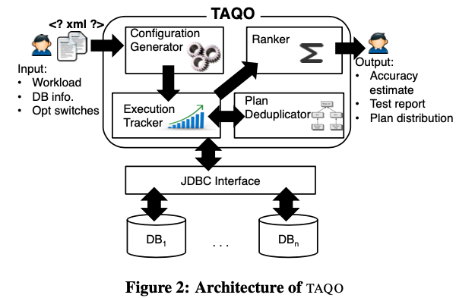
System Overview
Notes:
这是系统的架构图，输入时workload 数据库的信息 优化器的支持的query hint的信息，然后生成一堆query plan candidate，然后去执行，然后排序，最终输出准确度和测试报告

Slide 18
Testing SQL Server’s Query Optimizer: Challenges, Techniques and Experiences
ICDE 2008
Notes:
然后是微软表在ICDE industrial2008的一篇文章
主要是分析了测试Sql server优化器的挑战、技巧以及经验

Slide 19
Key Challenges in query optimization
Large input space and multiple paths
  Generate a combinatorial explosion that makes exhaustive testing impossible.
Optimization time
  The problem of finding the optimal join order in query optimization is NP-hard
  Introduces a tradeoff between optimization time and plan performance.
Cardinality estimation
Cost estimation
  Not all hardware characteristics, runtime conditions, and physical data layouts are modeled by the query optimizer
Notes:
搜索空间太大，有很多path，所以枚举测试不可行
找到Join order是能找到的，Nphard问题是无法在线性时间找到答案
优化时间和优化性能是冲突的

Slide 20
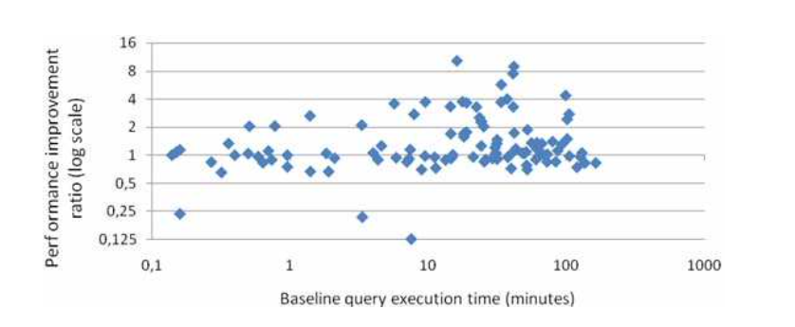
Key Challenges
Two wrongs can make a right” and Overfitting
  Result of ”lucky” combinations of two or more inaccuracies canceling each other.
Optimization quality is a problem of statistical nature
Notes:
优化器的质量本来就是一个统计问题
就是说我修改了优化器后，不会保证所有的计划都会提示，总是有计划性能会降低

Slide 21
Query Optimization Testing Techniques
Correctness testing
  Test query transformation rules
Large-scale stochastic testing
Performance baselines
  The task of validating changes in the query optimizer’s plan choice logic in presence of the various engineering tradeoffs can become rather difficult.
Optimization quality scorecards
  Optimization time and query performance is not sufficient
  The amount of optimization memory, cardinality estimation errors, execution plan size, search space size, and others
Notes:
第一个是正确性测试，就是说我测试转换规则的正确性 能不能转换对
第二个就是大规模随机测试 生成很多的Query 测试优化器
第三个就是验证优化器的计划变动可能很困难，就是说我们获得baseline很困难
第四个我觉得比较重要，就是说评估优化器的效果 单单使用优化时间和
就是说优化器评估 一定和是这些综合的得分

Slide 22
OptMark: A Toolkit for Benchmarking Query Optimizers
CIKM 2016 Demo
Notes:
CIKM的demo 只有6页
TiDB根据这篇文章的一部分 做出来那个horoscope

Slide 23
Contribution
Tt decouples the quality of an optimizer from the quality of its underlying execution engine
Tt evaluates independently both the effectiveness of an and its efficiency
Effectiveness: The quality of plans generated for queries in a given query suite.
Efficiency : The resources (i.e., time and space) required by an optimizer to generate plans.
Notes:
这篇文章的主要共享就是只评估优化器 不涉及到查询执行器 因为现代数据库系统优化器和执行器是一起的 执行器会影响到优化器 所以这篇文章对优化器和执行器做了一个decouple
在不受执行器的影响的情况下 评估优化器
所以它定义了优化器的两个维度，一个是有效性 一个是效率
有效性就是说它选出的计划 在计划空间里是不是最好的 这其实也是评判了Cost model
效率

Slide 24
Effectiveness(有效性)
It is insufficient to compare the execution times of plans chosen by the optimizers for the same query
MySQL queries can only be executed as nested-loop joins, But this does not necessarily reflect the effectiveness of the MySQL optimizer.
Thus, optimizer effectiveness must be assessed evaluating generated plans relative to other plans the DBMS’ query execution engine is capable of running.
Notes:
因为Mysql只支持nest loop join，会很慢，但是这不能说mysql的优化器效率很低

Slide 25
Efficiency(效率)
A given optimizer could be very effective if it combines exhaustive search (thus considering all possible plans for a given query) with an extremely accurate cost model.
Efficiency is a measure of how well a query optimizer can scale to process the most complex of queries.
Notes:
因为对于复杂的Query，无法枚举所有的plan
所以效率能反映出优化器能处理多复杂的query

Slide 26
Benchmark Generality
The benchmark code should be configurable to any DBMS.
Time-based metrics of effectiveness (runtime of generated plan for given query) and efficiency (time spent optimizing given query) should be avoided as they are incomparable for systems running on different platforms.
Notes:
然后这篇文章讨论了该benchmark的普适性，就是说该benchmark应该适用于任何的数据库优化器，同时该benchmark没有以执行时间来判断优化器的有效性和效率，因为他和执行器分解开来了

Slide 27
Isolated Assessment
A DBMS optimizer’s performance must be decoupled from that of the DBMS’ query execution engine.
TPC-H and TPC- DS benchmarks are not good query optimizer benchmarks because they report query execution times which depend not only on the plan chosen by an optimizer but (even more) on the capabilities of the DBMS query execution engine.
Notes:
所以他提出了优化器的性能一定要和执行器去decouple，所以这也是TPC-H和TPC- DS无法很好的评估优化器的原因，因为这两个benchmark评估了执行时间，然而执行时间不仅仅依赖于优化器 还依赖于执行器

Slide 28

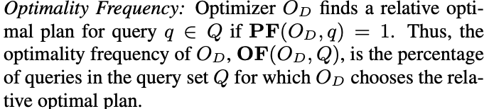
Effectiveness Metrics
The relative optimal plan refers to the best plan the DBMS can run for that query. This plan might be different across different DBMSs.
  Performance Factor:
  Optimality Frequency
Notes:
所以这篇文章提出了自己的有效性的标准，首先是一个相对最优查询的概念，就是优化器选出的计划
然后是一个性能因子的概念，对于数据库D的优化器，OD，P DQ是搜索空间，对于搜索空间中的任意一个计划，如果都比优化器选出的计划坏，就表明优化器比较好，如果PF为1，就表明优化器选出的是相对最优的计划
最优的频率，就是给出一个query. set，在

Slide 29
Effectiveness Metrics
Provide insight on
  (a) the quality of the optimizer-chosen plan
  (b) the quality of the cost model
  (c) the quality of the plan enumeration process of a given optimizer.
Notes:
如果在考虑的空间内，优化器没有选择最佳的计划，就说明Cost model不太好，
计划枚举的质量可以通过比优化器选择的计划更好并且优化器没有考虑的计划的数量来衡量。对于优化器考虑的计划，优化器没有选择它们，因为成本模型不准确。对于优化器未考虑的计划，由于计划枚举不佳，优化器没有将它们包括在其搜索空间中。

Slide 30
Plan Space Generation
Evaluating the effectiveness requires the enumeration and execution of all possible plans the optimizer could execute for a given query.
  Collect those plans that optimizer considered
  However, this approach ignores flaws that might exist in the optimizer’s enumeration strategy
For example an optimizer that only considers poor plans but costs them correctly would be considered effective despite choosing poor plans.
Notes:
但是关于Plan space的选取 有两个考虑的因素，第一个就是在优化器选择的plan space中选择，第二个就是在所有可能的plan中考虑，第二个可能很麻烦
目前TiDB的那个优化器评估的工具就只在优化器选择的计划空间中找
所有这就有一个问题 如果优化器的搜索空间选择的都是poor plan，因为所有的plan都是poor的

Slide 31
Plan Space Generation
OptMark takes an alternative approach and generates a set of comparable plans for a given query by generating a random sample set of candidate execution plans that may or may not have been considered by the optimizer.
  Sample Size
  Random Plan Generation
Notes:
所以这篇文章使用了一种自己生成执行计划的方法，包括两个部分 一个是抽样的空间大小，确定大小后随机生成执行计划

Slide 32
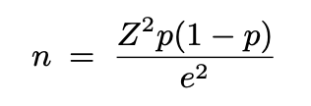
Sample Size
e is the desired level of precision (aka sampling error),
Z corresponds to the desired confidence level
p is an estimate of the proportion of plans that will be worse than the optimizer’s plan or 0.5 when this estimate is unknown.
Z^2 = 1.96 p = 0.5, e=0.05，n = 385
Notes:
这个公式是概率论统计里面的公式，e是京都，Z是置信度水平，P默认是0.5
因此，如果用户希望以95%的置信度水平和5%的精度来估计查询的性能因子，则需要生成至少385个随机样本计划。
因此，如果我们随机生成385个计划，并发现80%的计划执行得比优化器选择的计划差，我们可以95%的信心得出结论，优化器的计划比75%-85%的可能计划更好，即性能因子是0.75-0.85。

Slide 33
Random Plan Generation
OptMark generates these plans by exploring the three main features that characterize query plans
  join ordering
  the physical join algorithm used for each join
  table access methods
DBMS-Specific
Notes:
通过上一步确定了要生成的生成空间大小后，然后生成执行计划，主要是从3个方面，第一个是join order，第二个是join的物理执行计划，第三个是表的访问方法，所以这个部分就是需要配饰不同的数据库

Slide 34
Random Join Orderings
Every join ordering of a query joining n tables can be encoded as a pair (s, p) such that:
  s is a bit sequence that represents the preorder traversal of the ordering’s binary tree such that each successive bit denotes the next node of the tree visited in the traversal
  p represents the sequence of tables to populate the leaf nodes in the binary tree.
OptMark generates random join orderings by generating random encodings of join trees (s, p).
Notes:
首先是随机生成join order，这个是一个已有的方法 就是通过二进制枚举

Slide 35
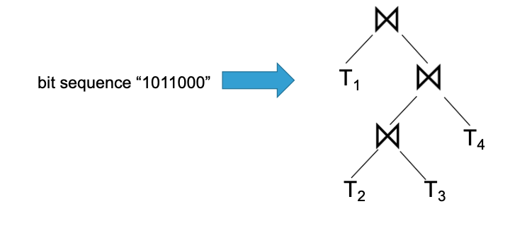
Random Join Ordering
Notes:
随机生成一个二进制序列，表示二叉树的前序遍历，如果为1表示为Join 节点，为0表示叶子结点

Slide 36
Generate Plan
Given the join ordering, we then replace all join operators with randomly selected physical join operators to generate a physical plan
  Specifically, for each join node in the join tree, we randomly select one of the physical join operators supported by the execution engine.
  Then add random access methods for each input table by randomly selecting an applicable index or, if one does not exist, a sequential scan as the table access method.

Slide 37
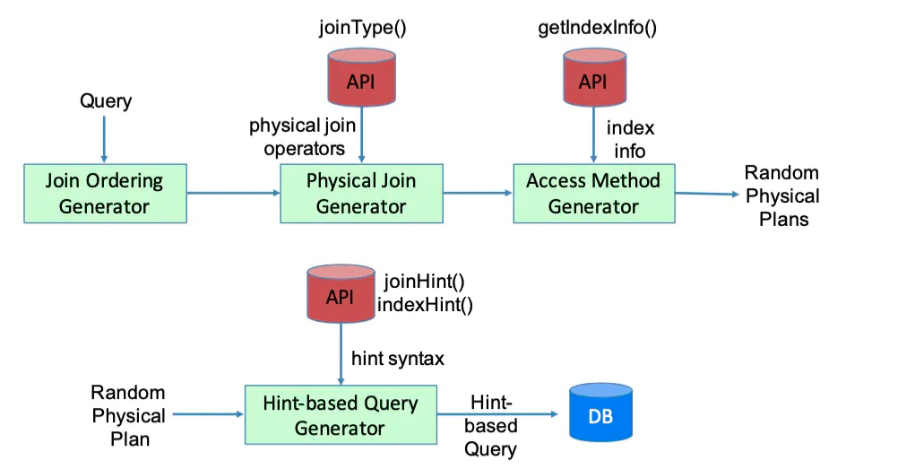
Effectiveness Test Flow
Notes:
需要数据库提供这些方法

Slide 38
Optimizer Efficiency
One possible approach to measure optimizer efficiency is to calculate the average time that an optimizer spends optimizing queries in the benchmark query suite.
  Optimizer times recorded for DBMSs running on different platforms are incomparable
  this metric only measures time and not memory.
Redefine 4 metric
  LP: the number of logical plans enumerated
  JO: the number of join orderings enumerated
  PP: the number of physical plans costed
  PJ: the number of physical join plans costed.

Slide 39
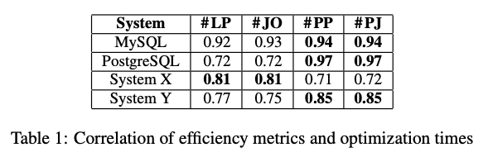
Optimizer Efficiency
These metrics are strongly correlated with optimization time.
Non-join plans (table scan plans and index scan plans) are typically much fewer than join plans, and thus take much less optimization time[1]
[1] I.F.Ilyas,J.Rao,G.M.Lohman,D.Gao,andE.T.Lin.Estimating
compilation time of a query optimizer. In SIGMOD, 2003.
Notes:
虽然这些指标都是和search space强相关的，但是它做了一个实验 表明了这些指标可以反应优化的时间,我们可以看到Lp和JO是很相近的，因为Join order才是搜索空间扩充的主要的点
我们可以看到LP和JO非常相近，这也说明了Join order是搜索空间扩充的主要的点

Slide 40
How Good Are Query Optimizers, Really?
VLDB 2016
Notes:
之前讲的这篇文章 有个结论没讲 导致一些错误的想法

Slide 41
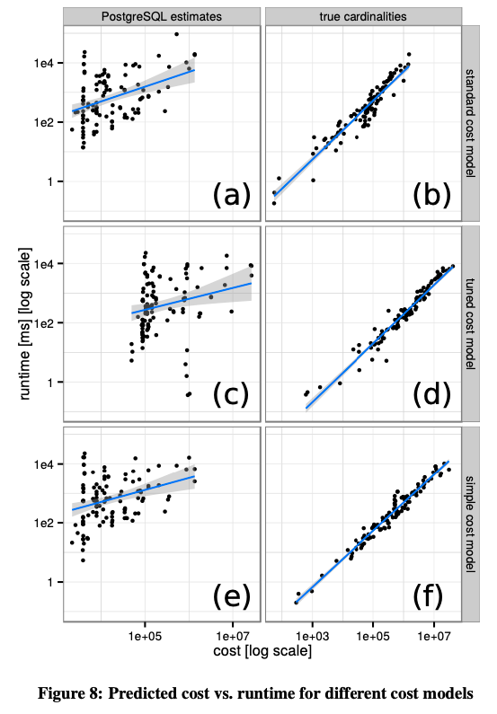
Notes:
Cardinality几乎占到绝对作用

Slide 42
Key Conclusion
准确的Cardinality，远远比代价模型本身重要
调节代价模型的参数，是有一定的影响，但是远远不如准确的Cardinality带来的提升
Join order enumeration is the key factor in search space exploration

Slide 43
Query Optimizer Component
Cardinality Estimation (Evaluation)
Cost Model. (Evaluation)
Join order enumeration. (Evaluation)
transformation rules（Query Rewriter） (Testing/Validation)
Notes:
现在提到了基数预估、Cost Model、连接顺序枚举

Slide 44
A Framework for Testing Query Transformation Rules
SIGMOD 09
Notes:
所以Sigmod09有了一篇文章 测试查询优化器的转换规则，之前王国平 也说他们的优化器是在System-R上修改的，最主要的部分就是他们的改写部分

Slide 45
Introduction
Modern Optimizer typically leverage a transformation rules framework.
Testing the correctness of the rule is crucial in verifying the functionality of optimizer
We present a framework to test the transformation rules
  Efficient generation of queries that exercise a particular rules
  Efficient(minimum) execution
Notes:
所以这篇文章主要是测试改写的正确性

Slide 46
Introduction
Testing the query optimizer has several dimensions which include accuracy of cardinality estimation and costing modules, the search space of the optimizer etc.
We focus rule testing:
  Coverage: Ensure that a transformation rule has been exercised during query optimization
  Correctness: Ensure that a transformation rule does not alter the results returned when the query is executed
  Performance: Analyze how the transformation rule impacts the performance of a query.
Notes:
第三个部分有点难 所以这篇文章就只关注了前两个方面

Slide 47
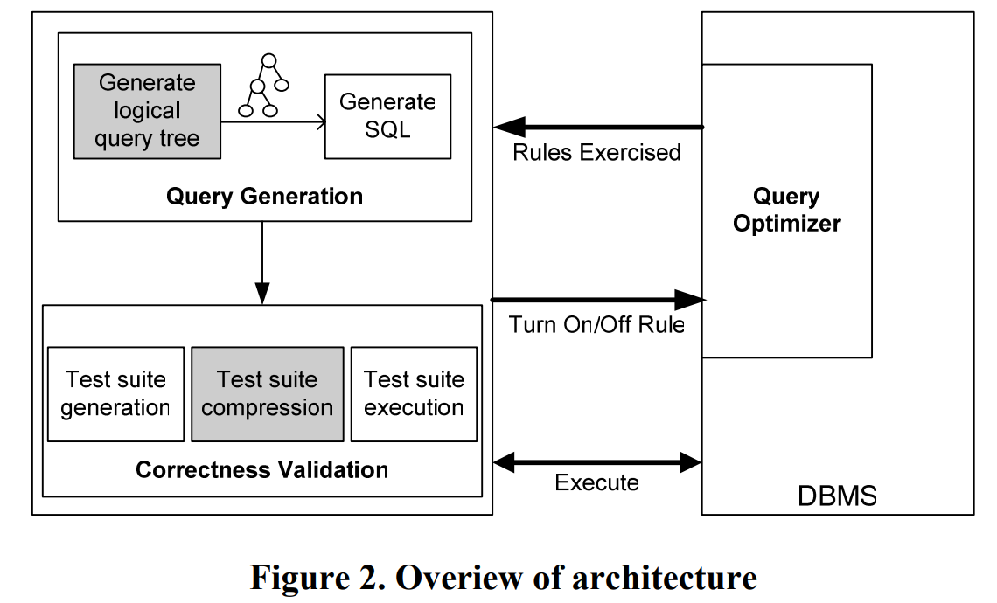
System overview
Notes:
所以这就需要优化器有关闭和开启某个rule的功能，tidb是有的，还需要数据库的查询优化器反馈哪个rule被应用了，这个tidb我不清楚有没有，但是这个也好弄，改代码就可以

Slide 48
Challenges
Query Generation
  a key challenge is to efficiently generate a logical query tree with a small number of operators that exercises a given rule.
  The state-of-art approach query generation (RAGS) using a stochastic method until one query exercises the required rules
Correctness Testing
  To validate correctness of each rule, we need to generate K distinct queries, each of query exercises the rule
K queries
rule1
K queries
rule2
rule3
K queries
rule4
K queries
Notes:
所以我们不能随机生成

Slide 49
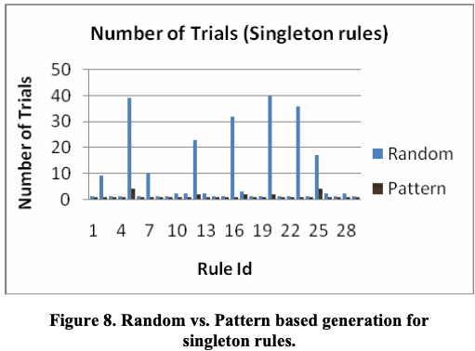
Experiment
Notes:
比较随机生成和基于模式的生成，就是说我不用尝试那么多次，就能生成符合测试这种转换规则的Query

Slide 50
My Idea
Evaluate cardinality estimation
Evaluate join order
Testing the transformation rules

Slide 51
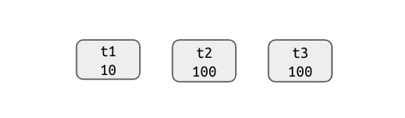
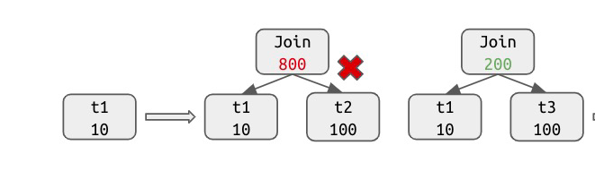
TiDB Join Order Generation Algorithm
Greedy Algorithm
Notes:
TiDB会先选一个最小的表，然后分别与其他表预join，选择中间结果集最小的进行join
在表比较多的情况下，可能比较高效
但是在表比较少的情况下，

Slide 52
Test Transformation rules
Generate the query that exercise the rules with test oracle
Turn on the rules, execute the query
Turn off the rules, execute the query
Compare the result and execution time

Slide 53
Related Work
 | Cardinality Estimation | Join Order Enumeration | Transformation Rules | Cost Model
Test Trans. Rules |  |  | 1
OptMark |  | 1 |  | 1
Exact Cardinality Computation | 1
TAQO |  |  |  | 1
Test Cardinality Works | 1

Slide 54
Contribution
Testing cardinality estimation effectively
Testing Join order effectively
Testing the transformation rules
Put the testing of three component of query optimizer into a work

Slide 55
Benchmarking Query Optimizer
Thanks
Presented by Zhaokun Xiang
Notes:
asjdhakd

