Slide 1
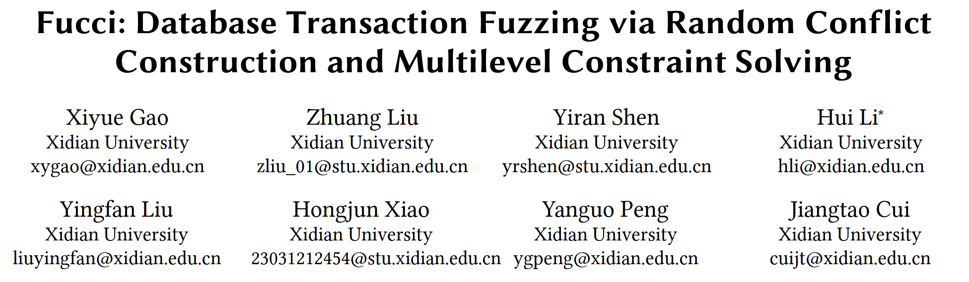
VLDB 25

Slide 2
Background & Challenge
Existing transaction fuzzing tools suffer from key limitations:
​​Low Efficiency: Generate many invalid test cases that don't trigger conflicts.
Low Accuracy: Oracles like differential testing fail on shared bugs.
Poor Readability: Bug reports are too complex and require extensive manual simplification.

Slide 3
Core Idea
Random Conflict Construction. (RCC)
Generate test cases with guaranteed read-write or write-write conflicts.
Multilevel Constraint Solving. (MCS)
Determine the ground truth of transaction execution by simulating versioning and locking.
Experience-driven Automatic Simplification. (EAS)
Propose a Experience-driven approach to automatically reduce complex bug cases.
Bug Finding.
Find 6 previously unknown transaction bugs and 14 known duplicate transaction bugs.
Notes:
冲突负载生成；
多级约束求解；
负载精简；

Slide 4
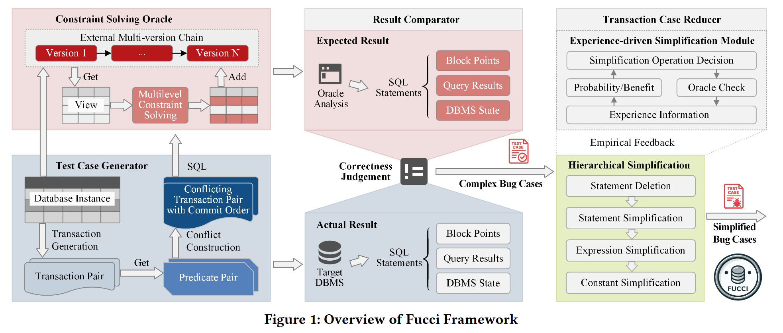
Framework
Notes:
AST模板 + 填入表达式 + 填参
1. 测试用例生成，先根据事务模板生成事务，然后选择 filter 构造冲突；（冲突构造技术）
2. 根据构造的这些事务构建外部的 MVCC 版本链，进行约束求解，得到最后的结果
3. 结果集的对比，发现不一样，进行 case 精简；
4. 四个维度的精简：语句级删除、语句内部精简、表达式精简、约束精简；

Slide 5
Test Case Generation
Random Conflict Construction.
To increase the probability of triggering bugs by ensuring conflicts between transactions.
(1) Fully Shared Filters (FSF)
Making two statements in different transactions to operate on the exact same set of rows.
(2) Partially Shared Filters (PSF)
Modifies one statement predicate to contain the other.
(3) Conflict Tuple Containment (CTC)
By adding NOT or IS NULL to make predicates include conflicting tuples.
Notes:
1. FSF：针对两个事务中的语句，where 子句替换为相同的；
2. PSF：通过 OR 等方式，让两个 SQL 操纵的元组呈包含关系；
3. CTC：通过在 where 子句中添加 NOT, 或 IS NULL 等方式让两个SQL子句产生冲突。

Slide 6
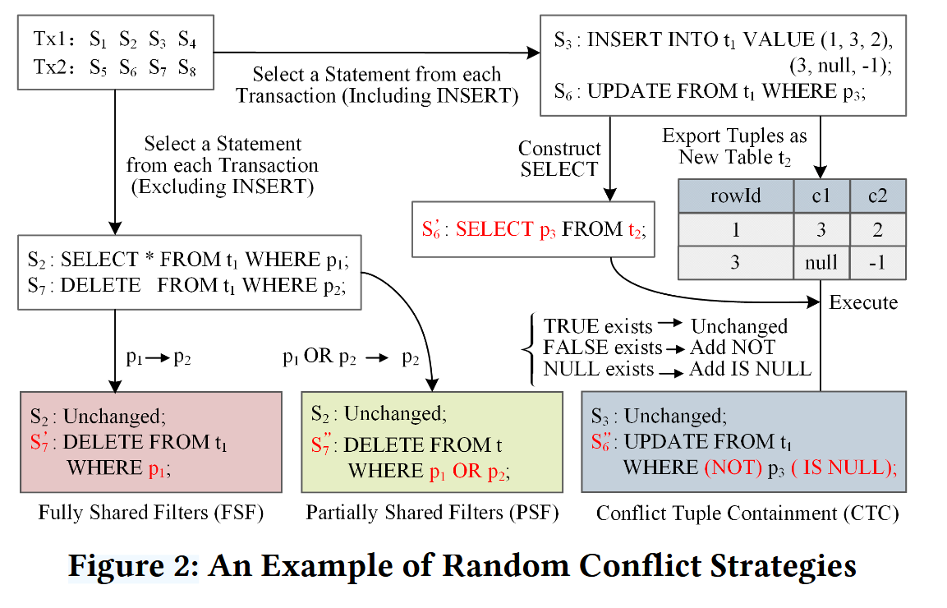
Test Case Generation
Notes:
下面三个颜色，对应三种构造冲突的方法；
第三种，针对 S6 的 predicate 构造 select，如果跟 insert 的集合不为包含关系，通过增加 NOT, IS NULL 方式构造冲突条件。

Slide 7
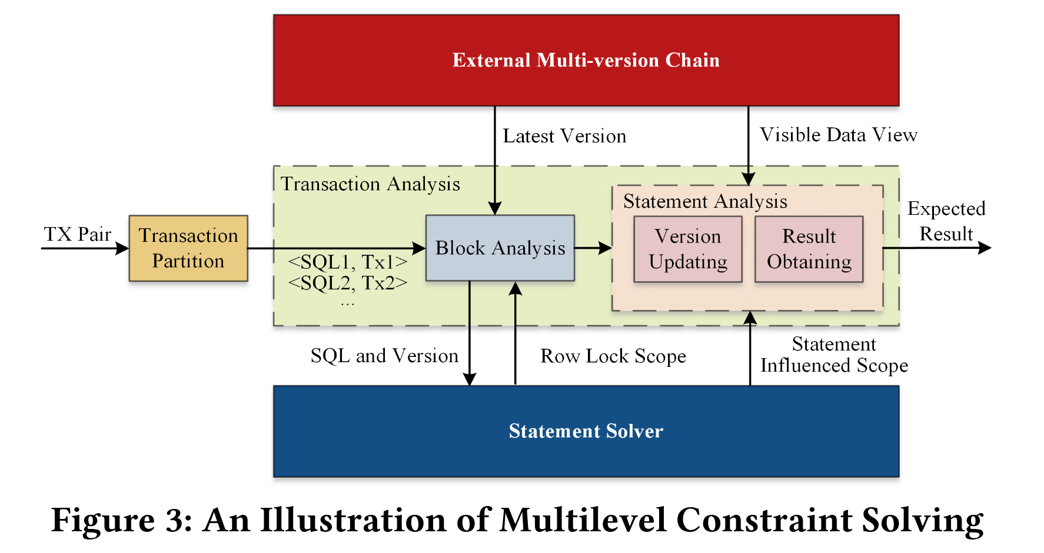
Multilevel Constraint Solving
Notes:
语句解析器：扫描外部结构维护的所有元组，判断是否满足当前 SQL 的 predicate 条件；
事务划分：首先把并发的两个事务，按执行顺序拆成一个个独立的SQL语句。
语句求解和阻塞分析：对每个语句，基于隔离级别分析应读到哪个数据版本，即数据的可见性。
然后检查这些锁是否和之前语句持有的锁冲突。如果冲突，这个语句就被“阻塞”，轮到另一个事务的语句执行。

Slide 8
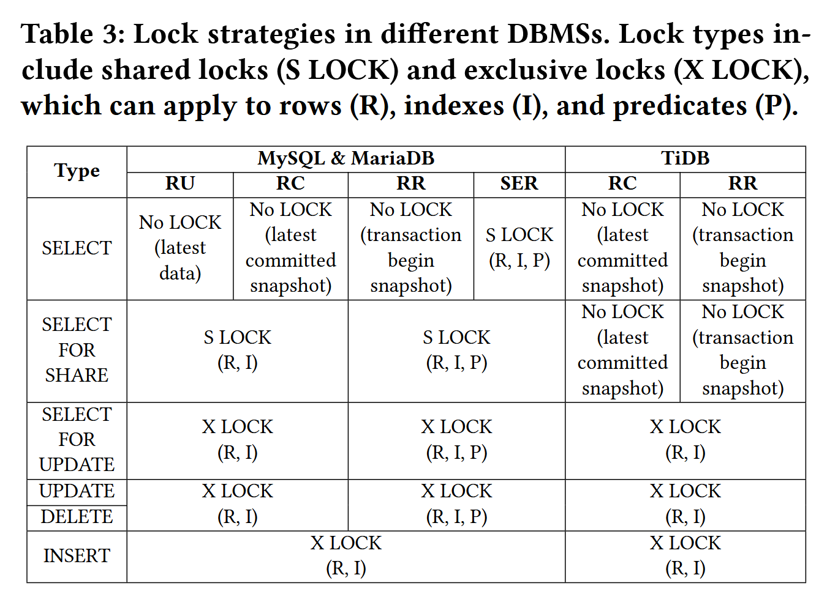
Multilevel Constraint Solving
Notes:
多级约束求解：通过构建外部多版本控制系统，模拟事务执行并获取 “基准结果”，用于验证目标数据库的执行是否正确。
主要是根据锁类型和隔离级别实现机制，构建一个外部的MVCC，得到真实结果。

Slide 9
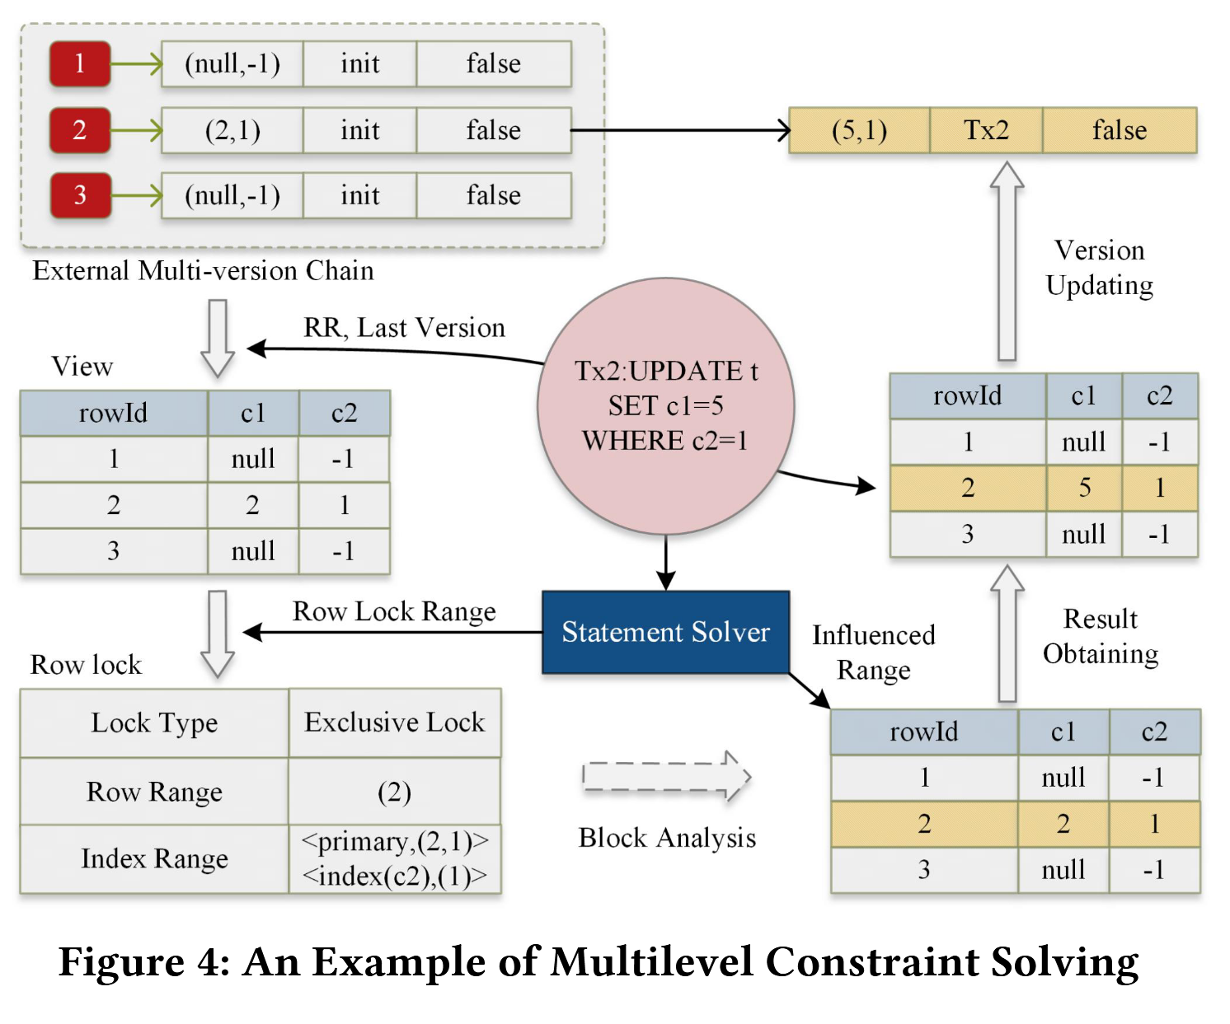
Multilevel Constraint Solving
Notes:
1. 首先根据隔离级别 RR 获取可见版本；
2. 根据每行是否被其他事务锁住进行下一步操作，如果遇到锁，这行 SQL 所在的事务 TX2 被阻塞住，继续进行 TX1，直到 TX1 事务完成；
3. 将该行修改成最新的版本，并应用到外部版本链上（更新外部维护的版本链）。

Slide 10
Experience-driven Automatic Simplification
Hierarchical Simplification.
(1) Statement Deletion. Try to remove entire SQL statements.
(2) Statement Simplification: Remove parts of a statement. (e.g. remove non-critical cols in ''update set'')
(3) Expression Simplification: Remove operators from WHERE clauses (e.g. ''a=1 AND b=2'' to ''a=1'').
(4) Constant Simplification: Replace complex values with simpler ones (e.g. 'long_string' to 'a').
Notes:
分层精简
1. 语句级删除；
2. 语句级精简；
3. 表达式精简；
4. 常量化简。

Slide 11
Experience-driven Automatic Simplification
To improve efficiency, EAS employs two smart decision-making strategies:
(1) Dynamic Probability Table.
Maintains a probability table recording the historical success rate of each simplification operation.
After each attempt, the table is updated.
EAS then prioritizes actions with the highest proven effectiveness, ensuring it learns from past experience.
Notes:
动态概率表的精简方法

Slide 12
Experience-driven Automatic Simplification
To improve efficiency, EAS employs two smart decision-making strategies:
(2) The Epsilon-Greedy Algorithm (A Multi-Armed Bandit Strategy).
This strategy perfectly balances two competing needs:
Exploitation: Most of the time, it chooses the simplification operation with the best-known success rate to maximize current efficiency.
Exploration: It tries a random, less-used operation to avoid getting stuck and to discover potentially better simplification methods.
Notes:
多臂老虎机：平衡利用和探索
1. 利用：选择历史精简成功率最高的操作（删除where子句等）
2. 探索：选择最少使用的精简操作（语句级删除等）

Slide 13
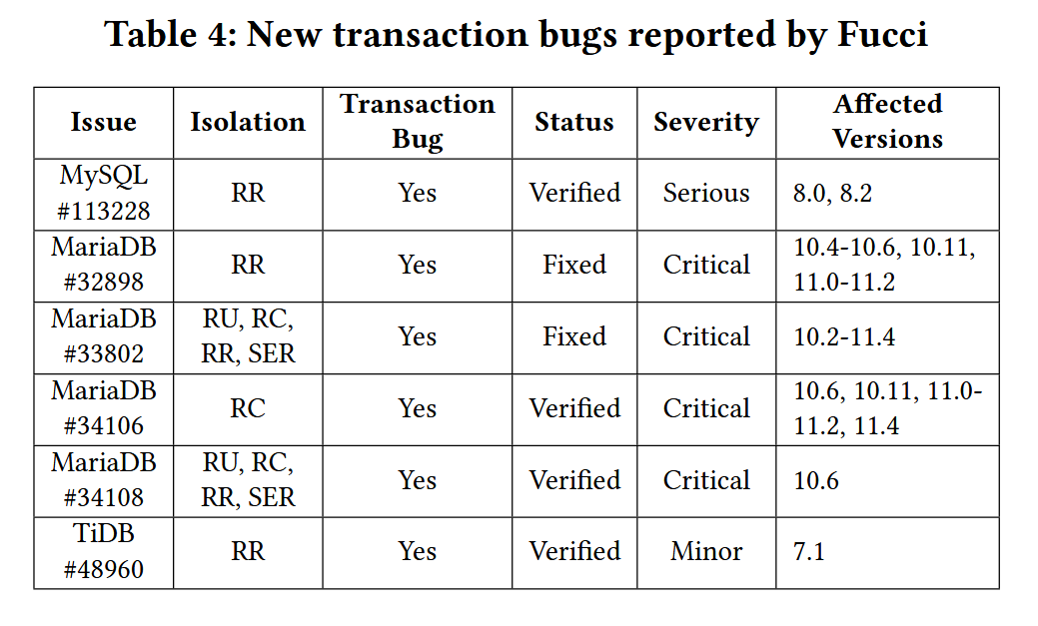
New transaction bugs

Slide 14
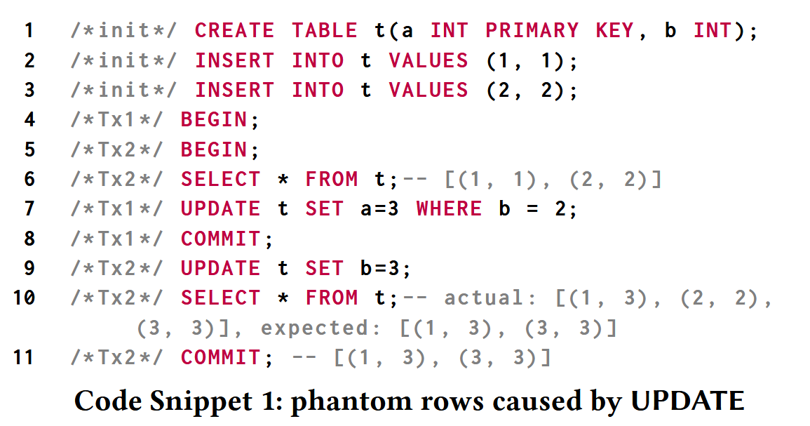
Case Study
MySQL #113228
Notes:
Root Cause：Tx2 的 UPDATE 语句(第9行) 锁定了当前事务中快照中本应不可见的记录( 2，2 )，使其对Tx2中后续语句可见

Slide 15
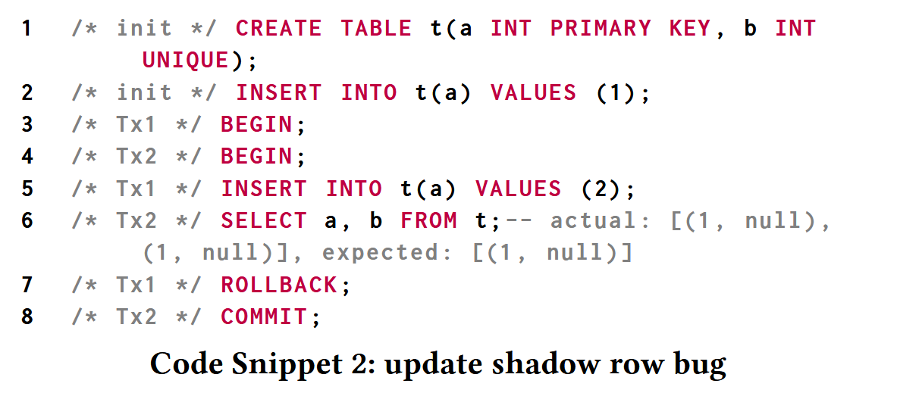
Case Study
MariaDB #32898
Notes:
Root Cause：唯一约束允许 NULL 值，但游标查找时未正确区分 NULL 值记录的物理 ID 与逻辑 ID；

Slide 16
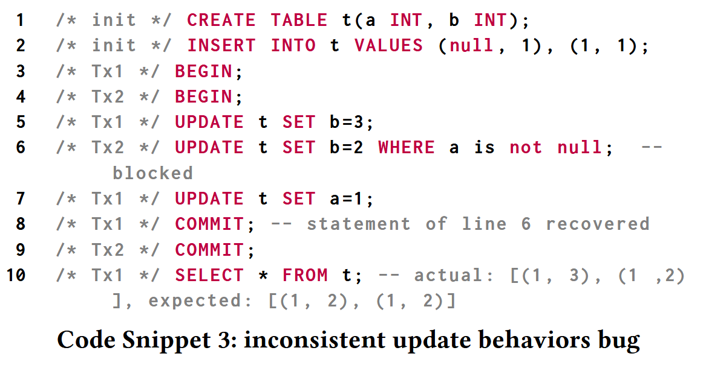
Case Study
MariaDB #34108
Notes:
Root Cause: tx2 阻塞结束后的 update 可见性出现了问题，update 语句并没有拿到最新的当前读，而是拿到的快照读。

