Slide 1



传统基数预估总结（直方图）
ECNU
DaSE
DBHammer

Slide 2
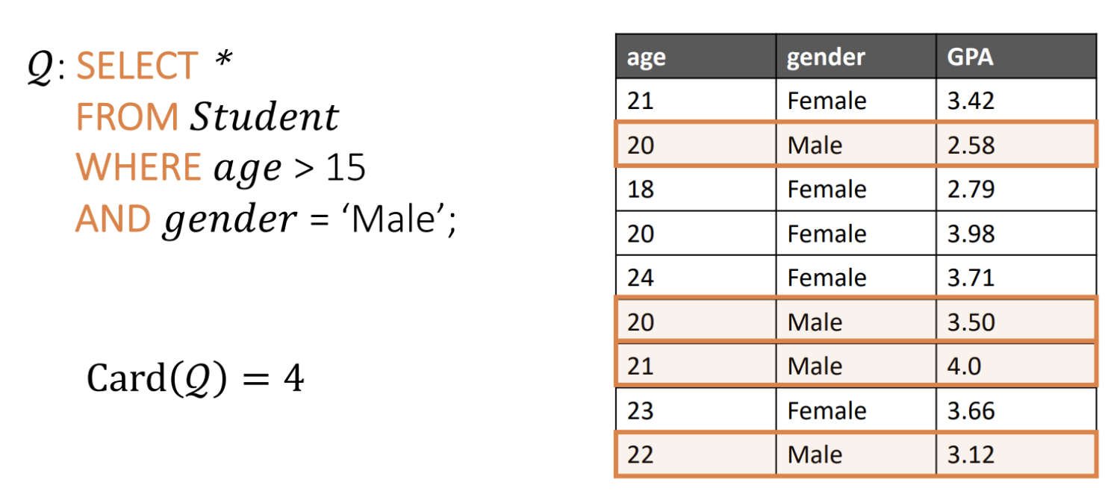
什么叫基数预估
对query结果集大小的估计
基数预估在查询优化中的地位非常重要，因为它的结果会直接影响查询优化器对查询计划的选择，从而影响查询优化的效果

Slide 3
基数预估的效果为什么不好
误差主要来源：
单表Predict估计的误差：目前主流的方案还是采用直方图存储统计信息，但一维直方图无法给出准确的统计信息，而且一般都伴随着一些假设（均匀分布/列间独立），估计效果不是很好。另一方面，多维直方图能够刻画属性间的依赖关系，但又受困于庞大的存储空间要求。
多表间join的误差：目前没有很好的办法获取多表间的统计信息，而且在涉及多个表的复杂查询中，估计误差会从查询计划的叶子节点传播、放大到根节点，进一步增大了误差。
A Survey on Advancing the DBMS Query Optimizer: Cardinality Estimation, Cost Model, and Plan Enumeration

Slide 4
传统方法分类——Synopsis-based method
Synopsis-based method
Histogram-based method
Fast algorithm for histogram construction
new partition methods to divide the data into different buckets to achieve better accuracy
histogram construction based on query feedback
缺点
节点一维直方图无法刻画列间关系
多维直方图太耗费存储空间
无法捕获多表之间列的关联关系
A Survey on Advancing the DBMS Query Optimizer: Cardinality Estimation, Cost Model, and Plan Enumeration

Slide 5
传统方法分类——Synopsis-based method
Synopsis-based method
Sketch-based method
calculate the distinct count
estimate the join size
缺点：无法处理更一般的情况，例如 join with filter
A Survey on Advancing the DBMS Query Optimizer: Cardinality Estimation, Cost Model, and Plan Enumeration

Slide 6
传统方法分类——Sampling‐Based Methods
Sampling‐Based Methods
capture the correlations between different tables
缺点
tuple更新后采样的数据就过时了
原始数据量大的时候，采样耗费的空间和时间代价都很高
目前只能处理等值连接（equi-join）
A Survey on Advancing the DBMS Query Optimizer: Cardinality Estimation, Cost Model, and Plan Enumeration

Slide 7
SQL执行的四个步骤
Parsing：语法解析
Optimization：
检查query中的table、column是否存在
获取表的元信息（表的大小、所占的page页数等）
根据column的Type和Length检查select list和where list的语义正确性
进行路径选择，如果from后面有多表则考虑所有连接顺序并选择cost最小的访问路径，输出执行计划
Code Generation：将查询计划转化为机器语言代码
Execution：直接执行机器码或者将机器码保存在数据库中以后执行。执行时通过存储系统接口(RSI)调用System R内部存储系统(RSS)来扫描每个查询中的物理表
Access Path Selection in a Relational Database Management System

Slide 8
Research Storage System（RSS）
RSS（The Research Storage System）是 System R 中的存储子系统。RSS 负责维护表的物理存储以及这些表上的访问路径。RSS为上层调用提供RSI接口。
RSS 按page组织tuple数据，分为data page和index page，tuple不跨page，page逻辑上组成segment，一个segment可包含多个relation的page，relation不跨segment。RSS提供顺序扫描和索引扫描。
Access Path Selection in a Relational Database Management System

Slide 9
单表的代价评估
公式：COST = PAGE FETCHES + W * (RSI CALLS)
其中Cost是 IO 和 CPU的代价总和，W是权重因子， PAGE FETCHES 是IO代价，RSI CALLS 表示预测从RSS返回的元组数量。文章认为System R的大部分CPU时间都花在RSS上，所以用RSI的调用次数来近似CPU的利用情况是一个很好的选择
Access Path Selection in a Relational Database Management System

Slide 10
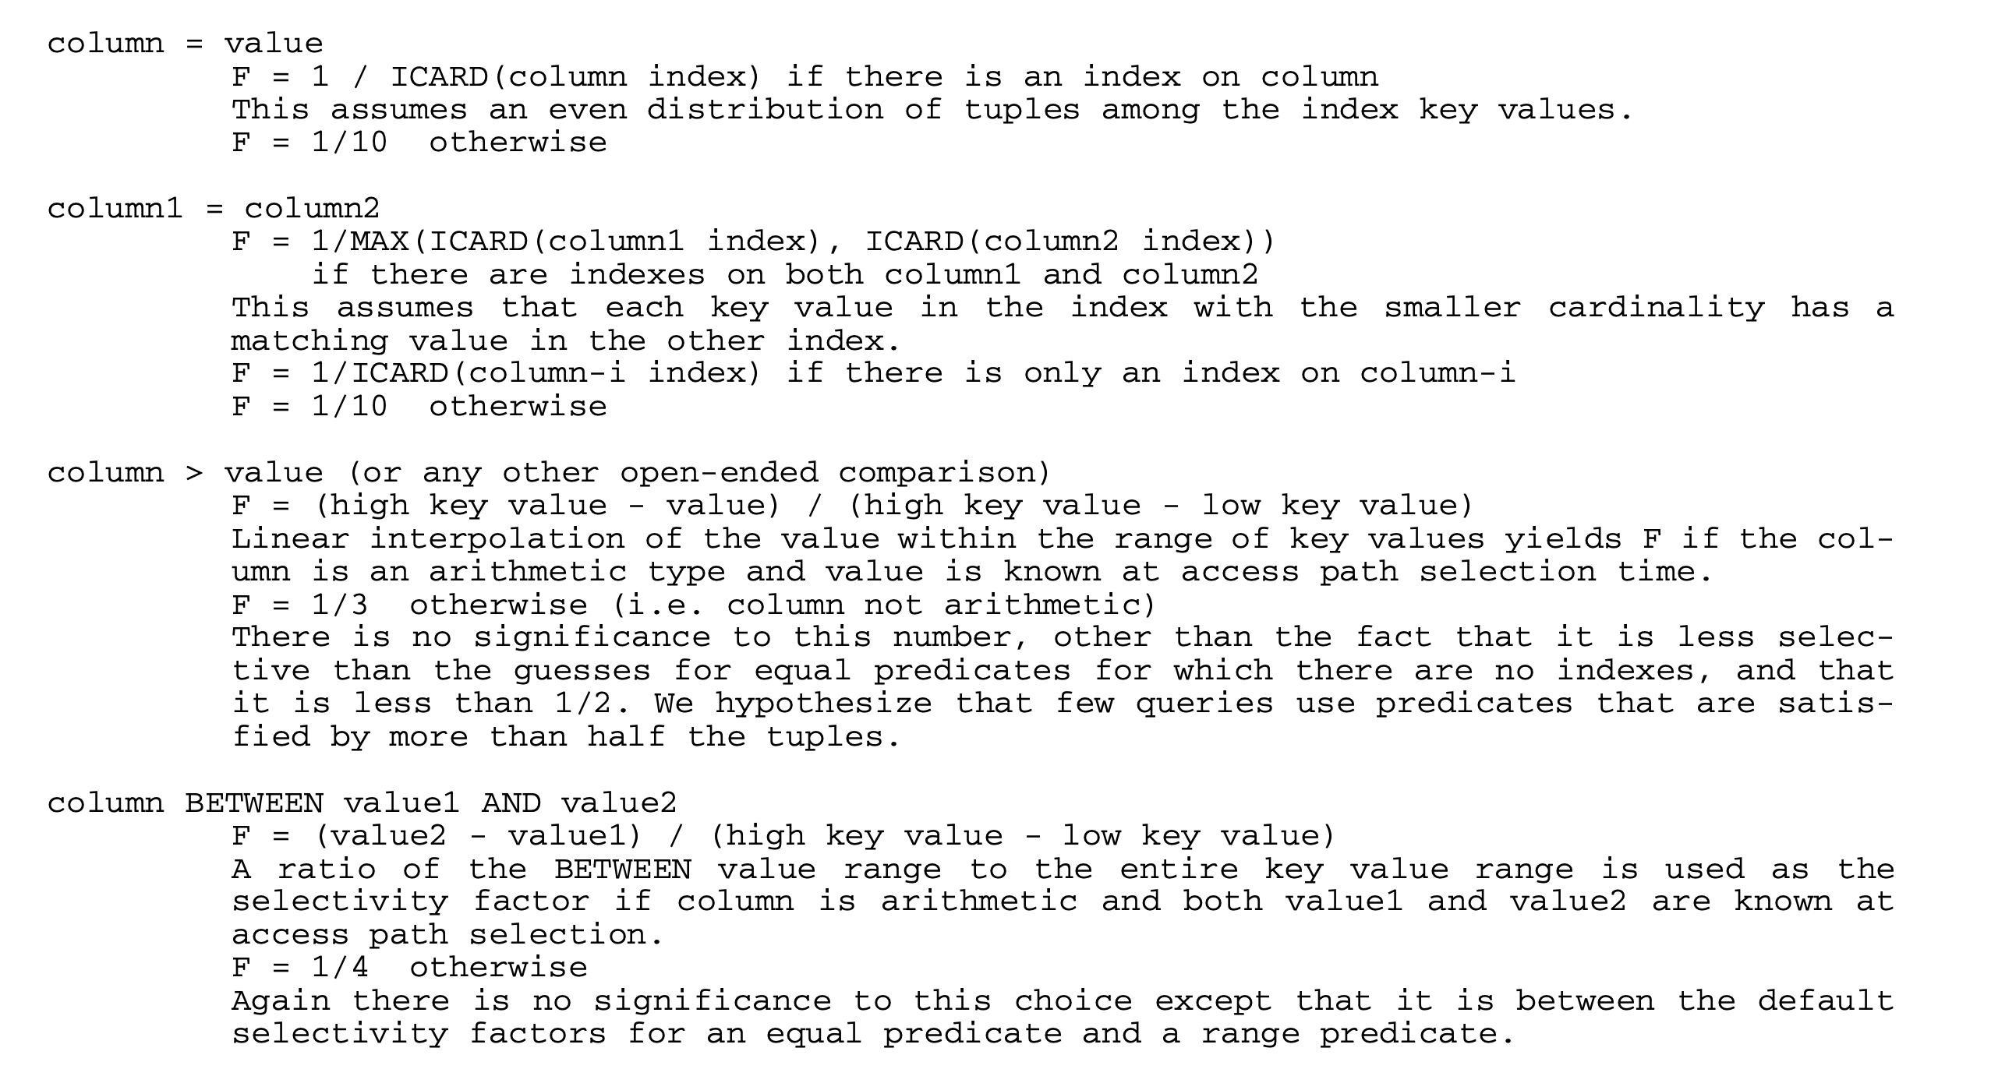
预测元组数量
选择率：selectivity factor（F）
Access Path Selection in a Relational Database Management System

Slide 11
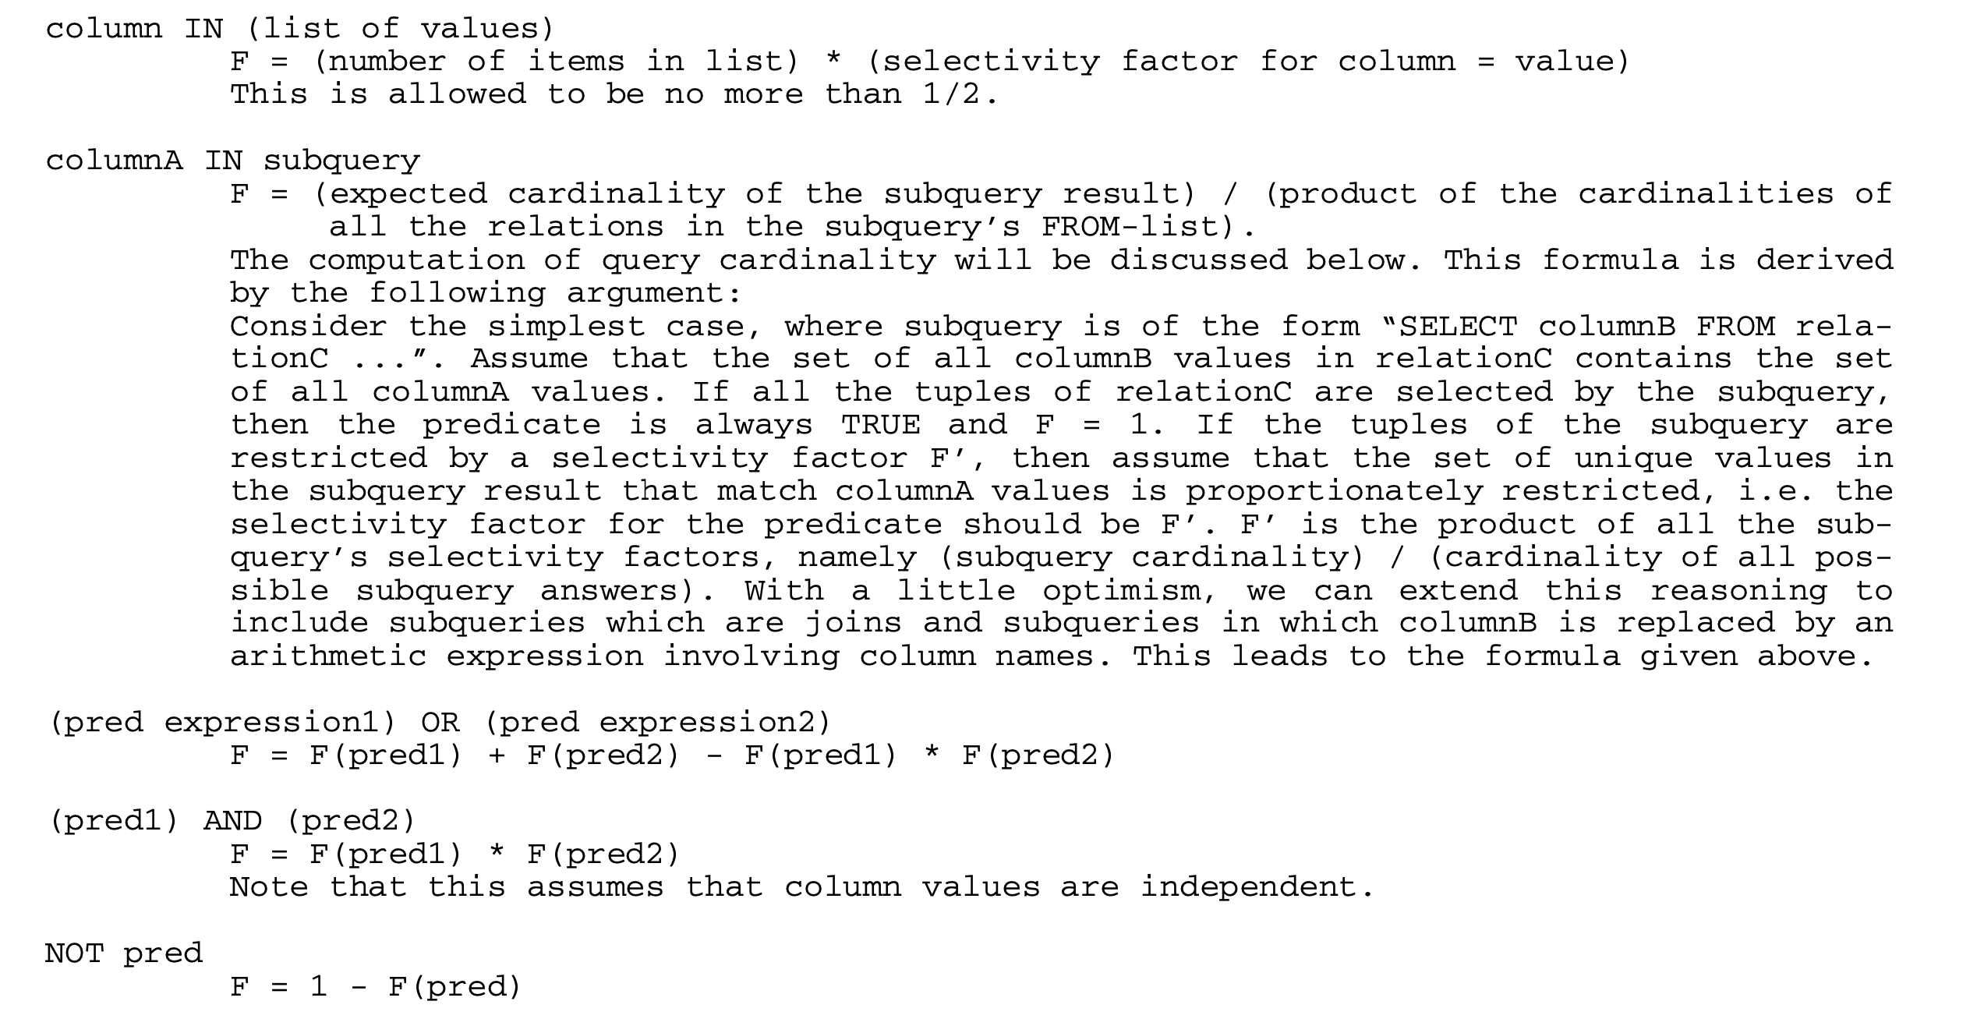
预测元组数量
Access Path Selection in a Relational Database Management System

Slide 12
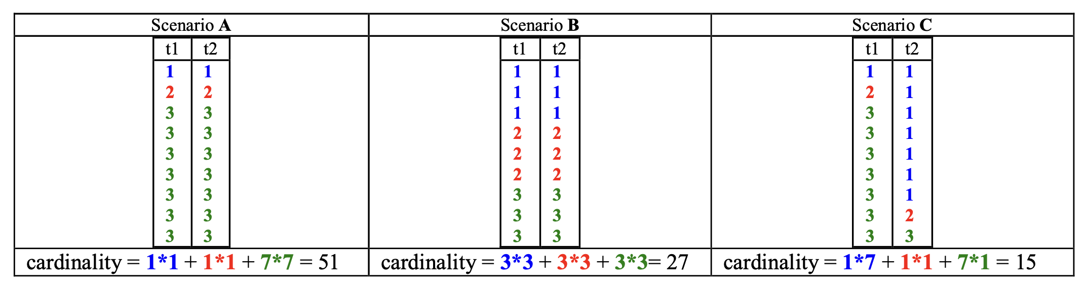
直方图
一般公式：
对Join操作的基数预估不仅依赖于数据分布的“形状”，同时也取决于数据的匹配方式。如果要得到准确的基数预估结果，必须知道两张表所有数据的精确分布。然而，“perfect map”所需的存储空间十分庞大，同时，我们也不需要完全精确的结果，所以一般可以结合采样的方式。
Join Over Histograms

Slide 13
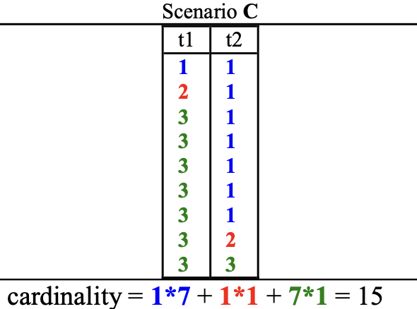
挑战
最大的采样数量有限制
无法确定要采样哪些“重要信息”
如果只保留两个数据
t1保留2和3，t2保留1和2
Actual estimation：15 ---> 1
Join Over Histograms

Slide 14
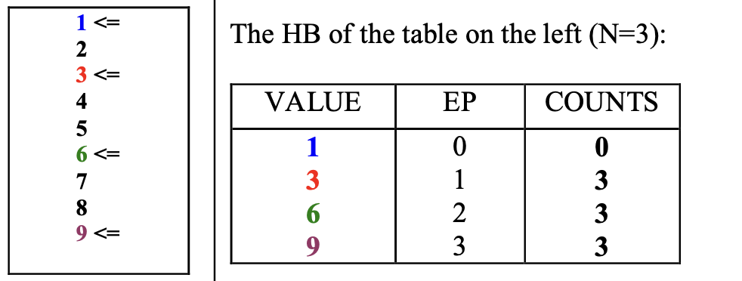
平衡高度直方图（ Height-balanced histograms ）
采样间隔：Num_rows / N EP：最后一次采样是第几次
max_ep = max(EP) diff_ep(i) = current (EP) - previous (EP)
COUNTS(i) = num_rows * diff_ep(i) / max_ep
Join Over Histograms

Slide 15
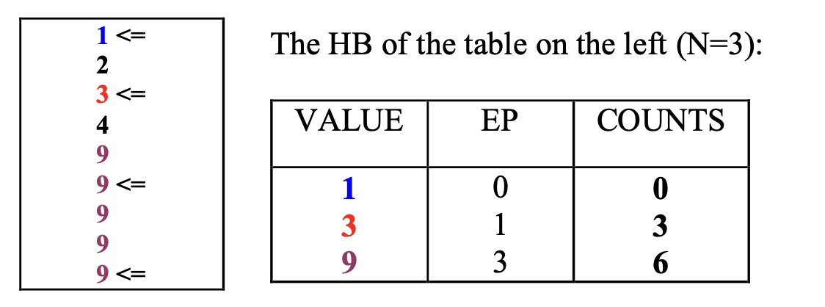
同一个value被采样多次
Join Over Histograms

Slide 16
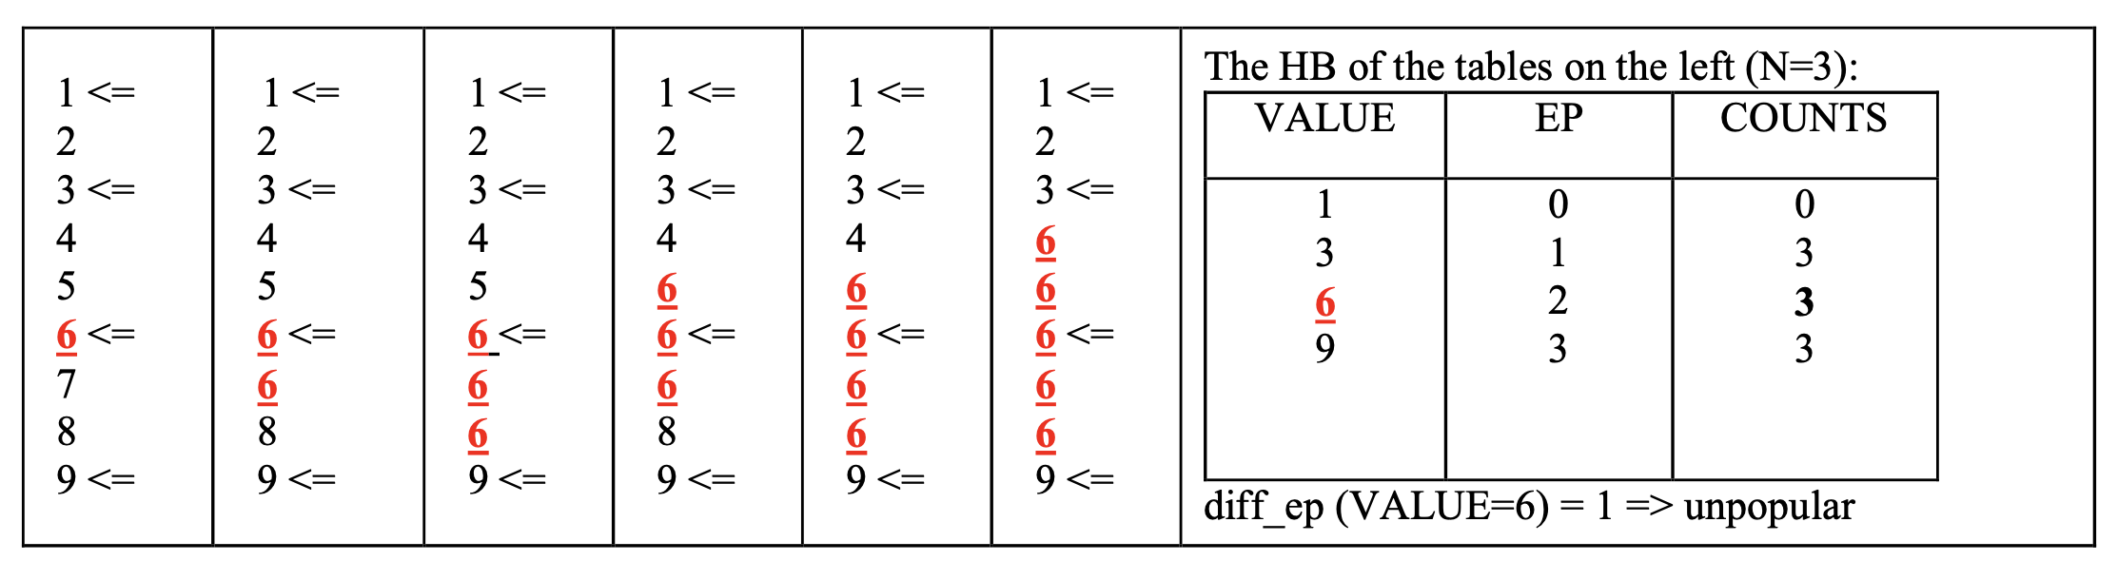
Popular与unpopular
Popular的定义：diff_ep > 1。但这个定义在某些情况下会出现偏差：
为了解决这个问题：对unpopular value进行计数的时候，使用num_rows * density这个指标，而不是count值。（通过移除热门值来构建一个“非热门子表”；“select count(value) / select count(distinct value) from subtable”应该非常接近原始表的“num_rows * density” ）
Join Over Histograms

Slide 17
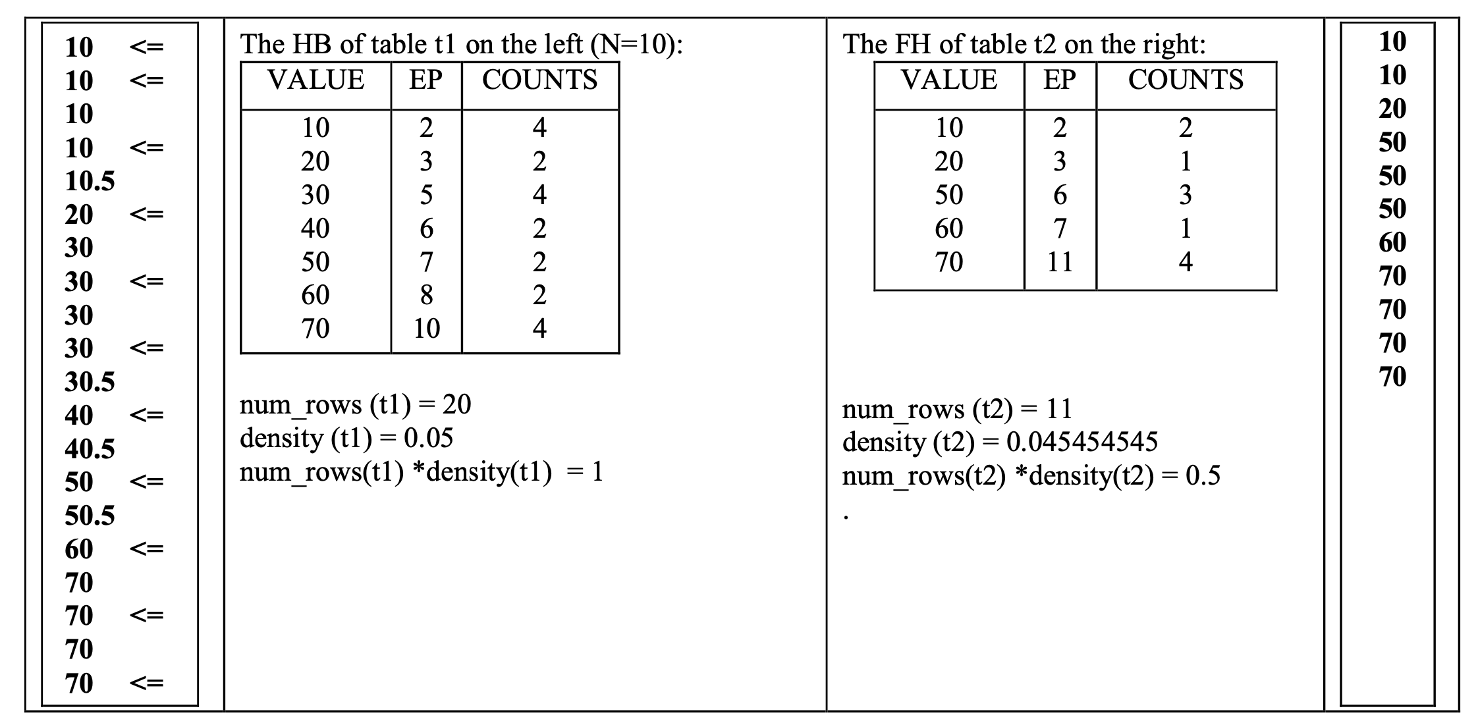
Join Histogram Example
Join Over Histograms

Slide 18
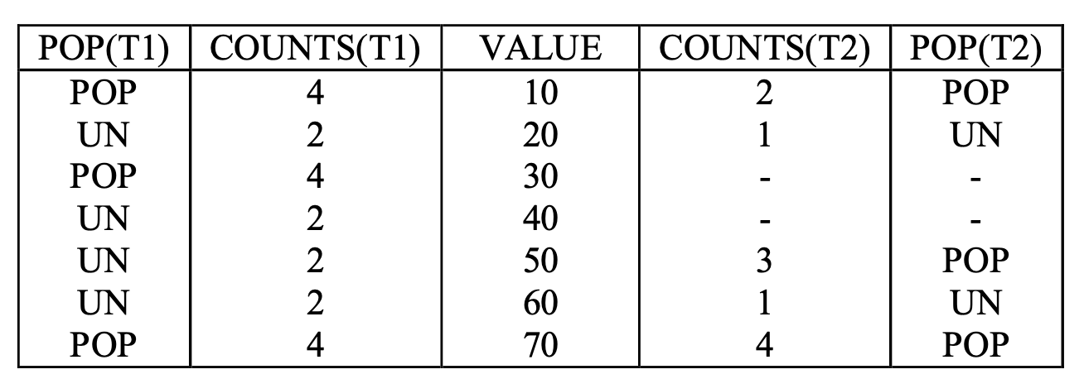
Join Histogram Example
Join Over Histograms

Slide 19
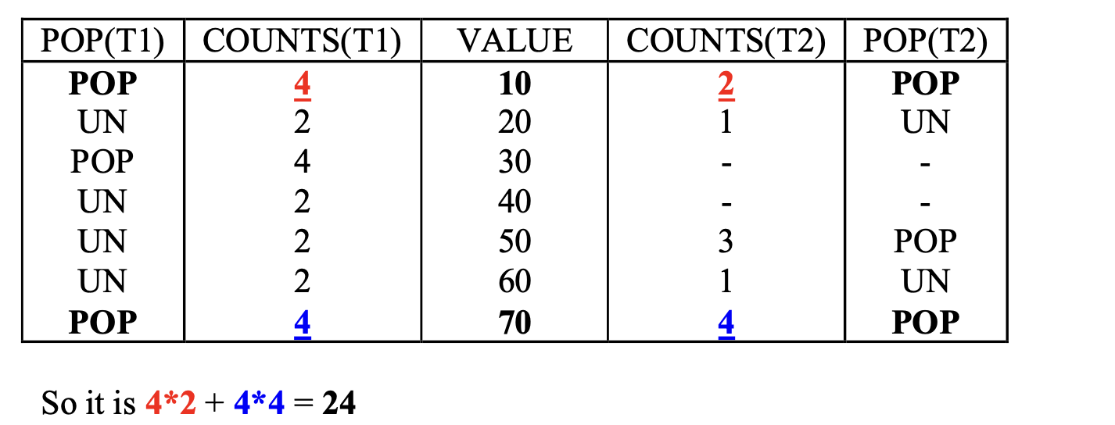
Join Histogram Example
Join Over Histograms

Slide 20
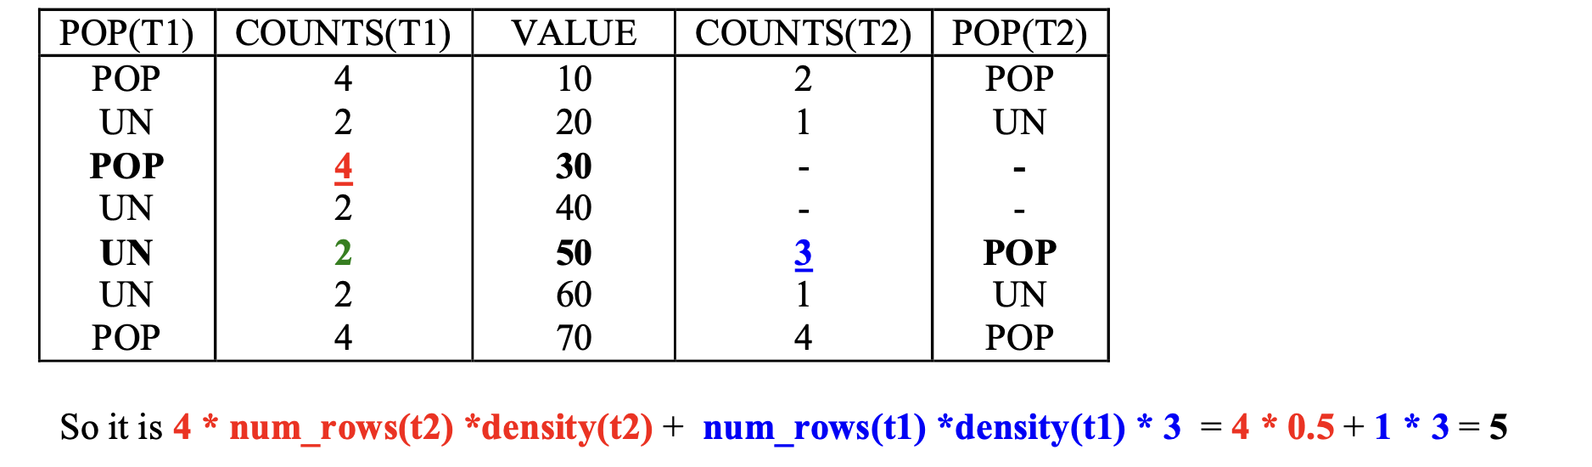
Join Histogram Example
Join Over Histograms

Slide 21
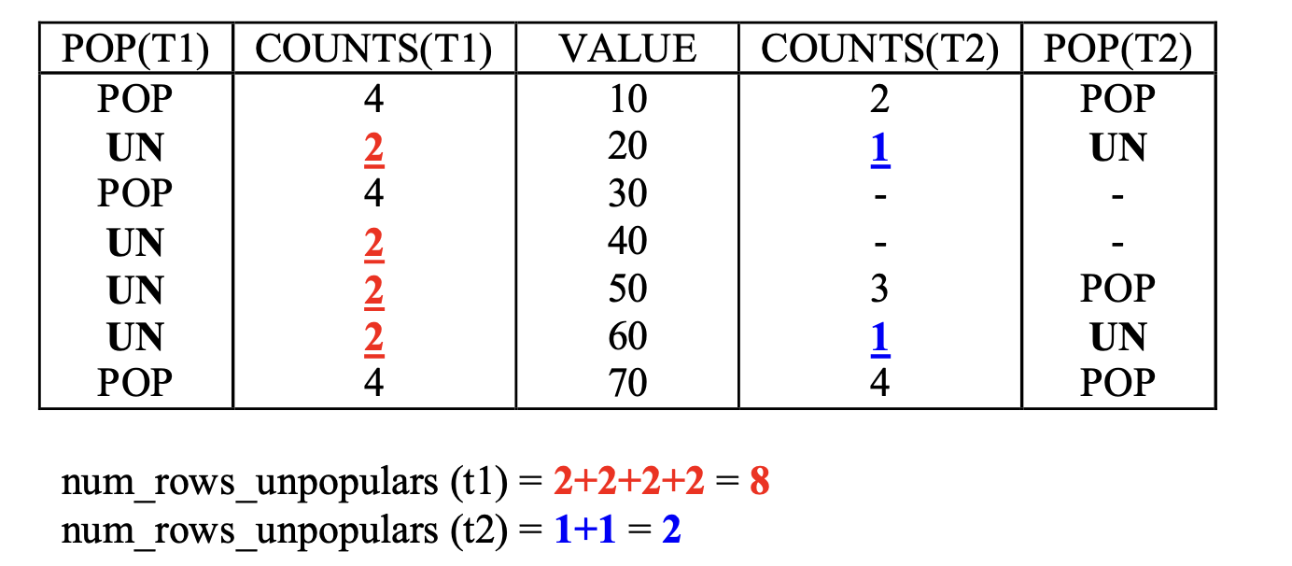
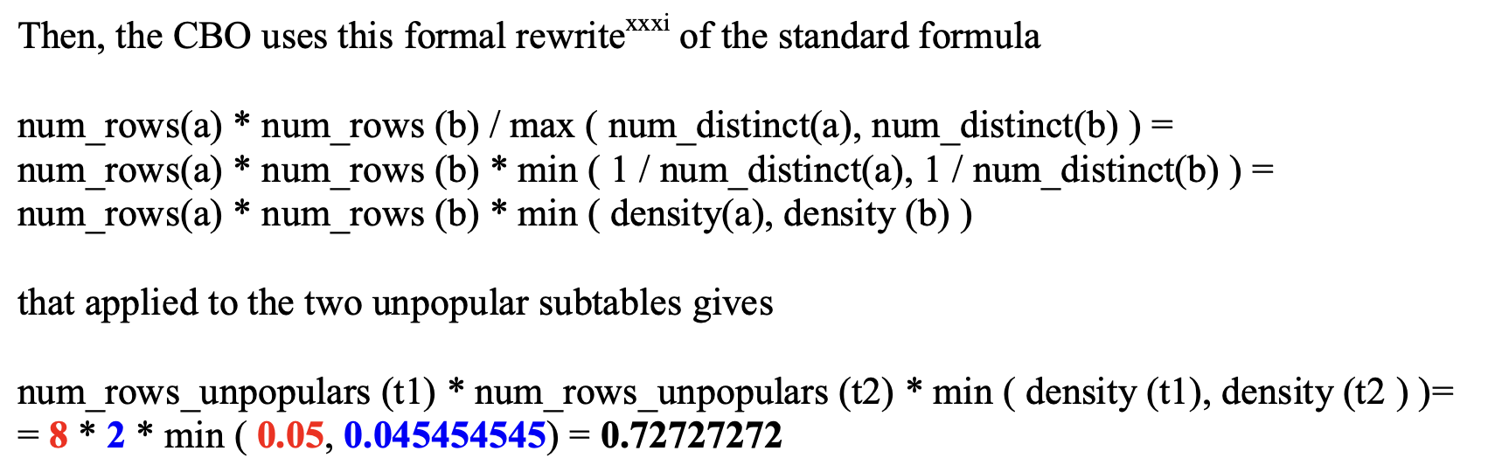
Join Histogram Example
Join Over Histograms

Slide 22
更抽象的构建方式
The approximate representation of D is called a histogram.
Such a representation divides D into B ≪ n disjoint intervals [bi,ei], where bi and ei are indices of the data items and 1 ≤ i ≤ B; these intervals are called buckets or segments.
Each segment is attributed a single representative value vi, which approximate all values dj under its scope, j ∈ [bi,ei]. A single bucket is described by the triplet si = {bi, ei, vi}.
Fast and effective histogram construction

Slide 23
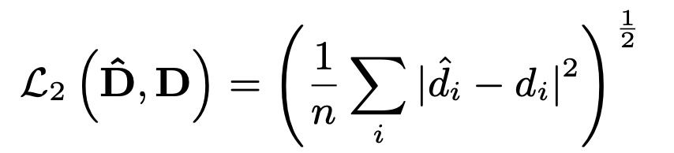
问题定义
Given an n-size data vector D = ⟨d0,d1,...,dn−1⟩, the problem is to devise an approximate representation Dˆ of D using at most B space units, so that the Euclidean error of the approximation is minimized. This Euclidean error is expressed as
The task of a segmentation algorithm is to define boundary positions that achieve low approximation error for the error metric at hand
Fast and effective histogram construction

Slide 24
A Basic Greedy Algorithm
算法思想：对于随机的一种直方图，在每次迭代中都找到一种使目标函数（误差）减小的重分割方式，即对某一个bucket进行分割（误差会减小），同时对另外两个bucket进行合并（误差会增大），这两个操作相互抵消后必须使得总误差减小。
( The objective of these moves is reduce the total L2 error. For that purpose, we maintain a min-heap H+ of all running boundary positions bi, 1 ≤ i ≤ B − 1 (b0 and bB are fixed) along with the potential error increase Δ+Ei that can be incurred if bi is removed. At each iteration, the boundary bi* of minimum Δ+Ei is discarded.
Furthermore, we also maintain a max-heap H− of all running segments sj, 1 ≤ j ≤ B, where sj = [bj−1,bj], along with their potential error decrease Δ−Ej that can be effected if sj is optimally split into two subsegments. At each iteration, the removed boundary is repositioned so as to split the segment of maximum Δ− Ej. )
Fast and effective histogram construction

Slide 25
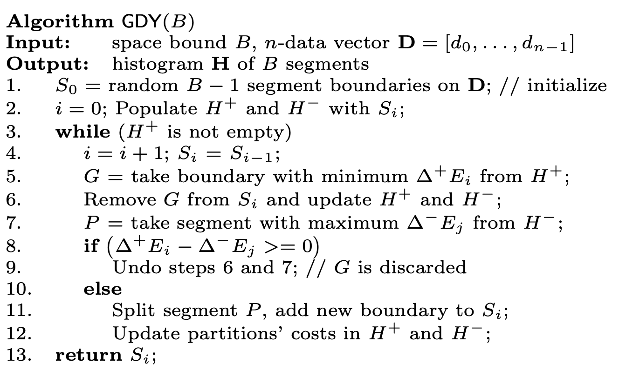
A Basic Greedy Algorithm
Fast and effective histogram construction

Slide 26
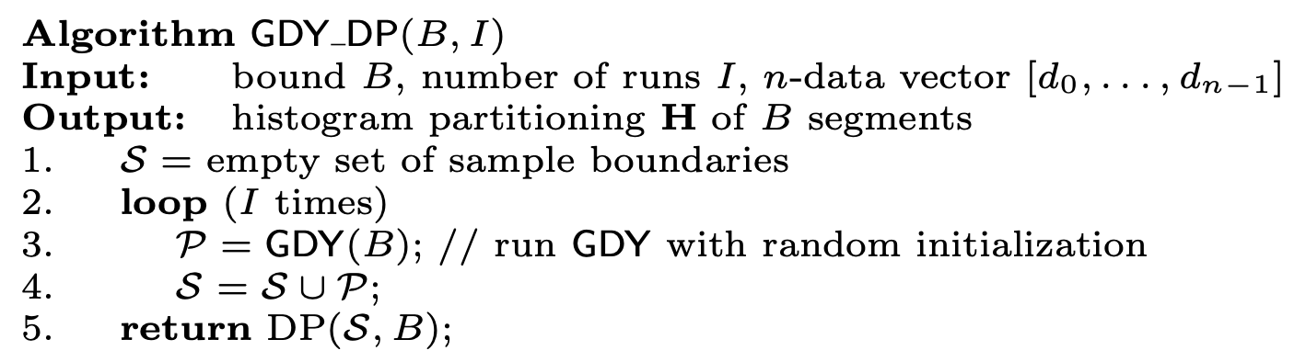
The Greedy-DP Algorithm
复杂度：
In case B is less than √n, we run I iterations of GDY until we collect up to O(√n) samples. Although this is a quadratic algorithm, it behaves as linear in n, taking advantage of the fact that the input size is bounded by √n and O(√n√n) = O(n).
Fast and effective histogram construction

Slide 27
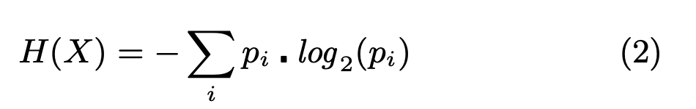
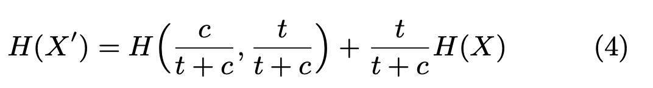
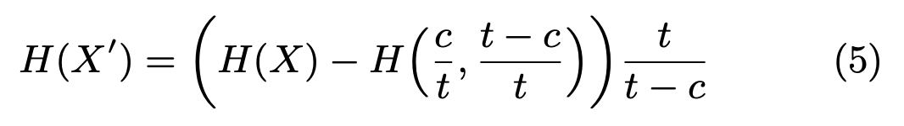
Entropy-based Histograms
The goal of any histogram is to capture as much in- formation from the data as possible, which is essentially the aim of the entropy maximization.
with a probability distribution X = (p1,p2,...)
Entropy update: (t is the cardinality of X before insertion and c is the cardinality of R.)
Entropy-based Histograms for Selectivity Estimation

Slide 28

A Histogram for Range Query
define entropy of a histogram：
算法思想：从只含有一个bucket（即包含所有数据）的直方图开始，逐步分割，每次选择使熵减小最少的分割方式，对分割后的每个小bucket采取同样的分割方式，直到达到指定数量的bucket。
( Therefore, our idea is to select the histogram boundaries that minimize reduction in total entropy. Every global cut splits a bucket into two new disjoint buckets. The global cut is represented by its position, which is computed from the local best cut. At each iteration, the local best cut minimizes entropy reduction within each bucket, which is defined as the original bucket entropy minus the sum of the entropies of the two new buckets.)
Entropy-based Histograms for Selectivity Estimation

Slide 29
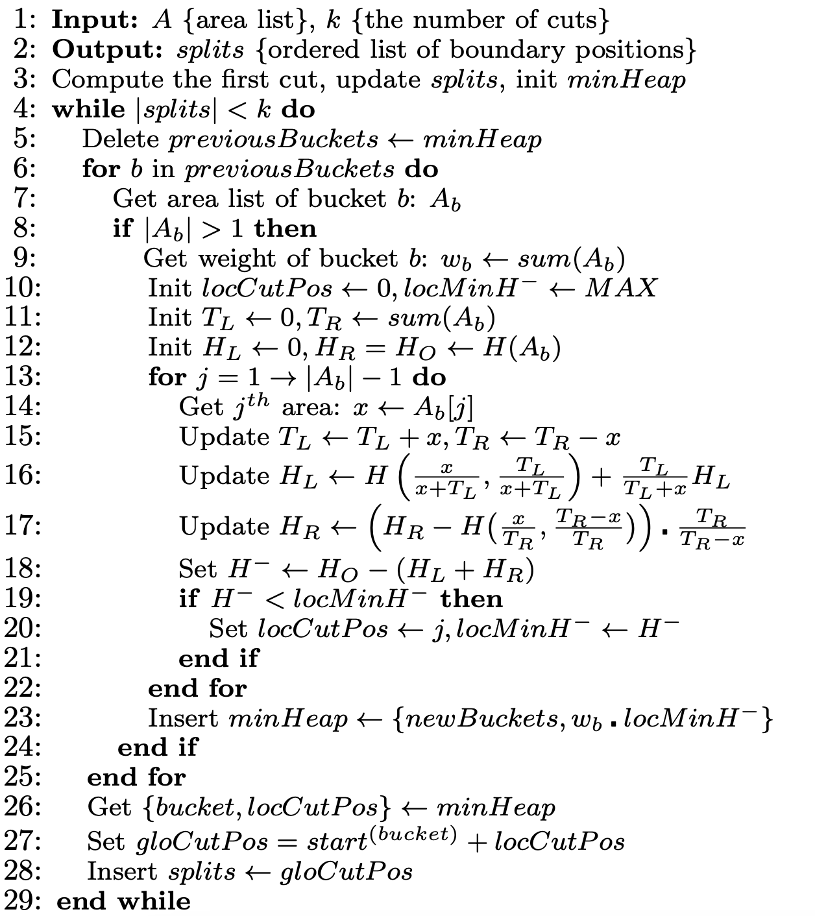
A Histogram for Range Query
Entropy-based Histograms for Selectivity Estimation

Slide 30
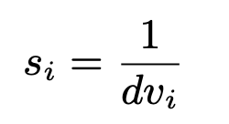

A Histogram for Equality Query
With assumptions of uniform frequency and continuous value, selectivity factor of an equality query X = val (val ∈ ri ) is defined as
the more bias in a distribution, the smaller the entropy, for example H(0.5,0.5) = 1, H (0.6, 0.4) = 0.97 and H (0.8, 0.2) = 0.72. Thus, entropy seems to be a good metric for capturing bias. Particularly, we propose the following formula as a replacement for Equation (1).
The selectivity factor increases as the bias in the data grows. For instance, for (0.6, 0.4) distribution s = 2^(−0.97) = 0.51, and for (0.8, 0.2) distribution s = 2^(−0.72) = 0.61.
Entropy-based Histograms for Selectivity Estimation

Slide 31

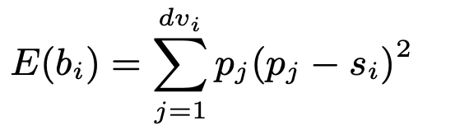
A Histogram for Equality Query
The algorithm minimizes the total mean squared error of selec- tivity factor, or briefly the total selectivity error, defined as
E(bi) is further derived as
where dvi is the number of distinct values within bi, pj is the probability of a value in the bucket, and si is the selectivity factor for the bucket
Entropy-based Histograms for Selectivity Estimation

Slide 32
总结
直方图目前还是比较主流的基数预估手段
基本的思想是找到一个快速且预估效果较好的直方图构建方式，在这个基础上把数据分配到各bucket中收集统计信息
Equality Query 和 Range Query 所需要的直方图可能不完全一样
大多数方法只是针对一维的列，无法扩展到多维

