Slide 1
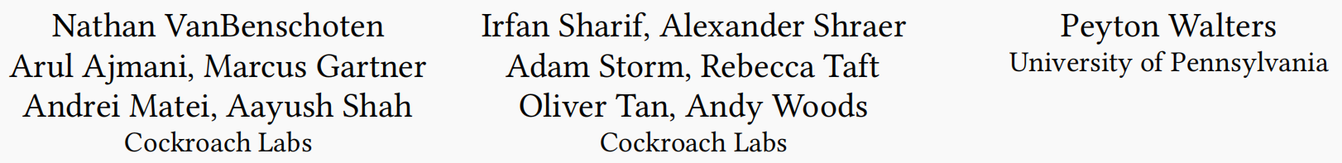
Enabling the Next Generation of Multi-Region Applications with CockroachDB
SIGMOD 2022

Slide 2
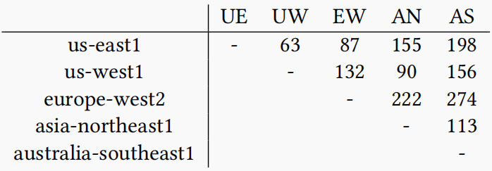
Multi-region Database Background
Multinational companies have global user bases.
Low latency: High cross-region latencies cause a severe performance penalty when data is served from remote regions.
High availability: Natural disasters, hardware and software failures, and misconfigurations cause data center and region-wide failures.
Compliance with regulations: Privacy regulations like GDPR place strict requirements on where data can and cannot reside.

Slide 3
Contributions
New SQL syntax that dramatically simplifies multi-region database deployments.
Innovations in the SQL Query optimizer such as support for global uniqueness constraints and efficient queries on geo-partitioned data.
A detailed description of our implementation of serializable read-only transactions on historical data that operate locally on any replica.
A novel global transaction protocol that enables serializable/linearizable transactions from any replica in GLOBAL tables.

Slide 4
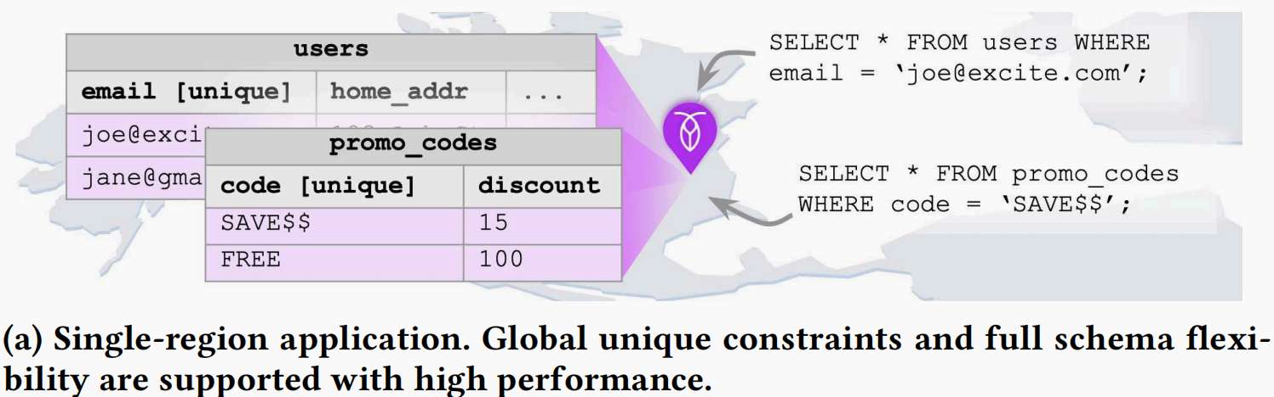
New SQL Syntax Example
A ride-sharing application from a fictional company called movr.

Slide 5
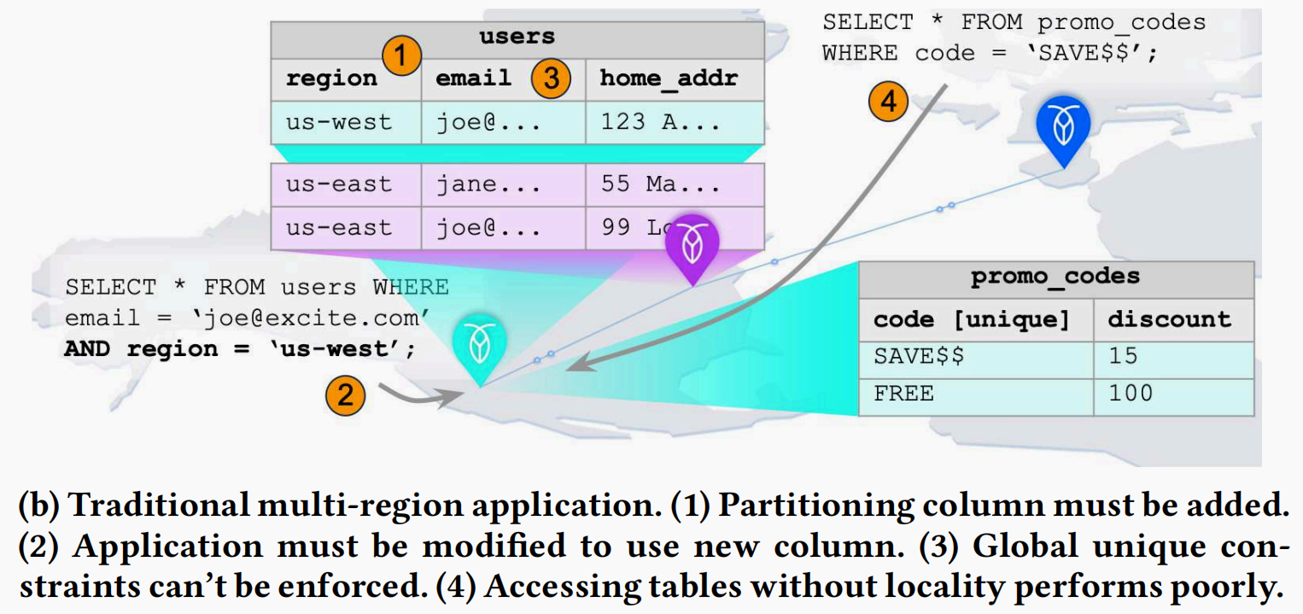
New SQL Syntax Example

Slide 6
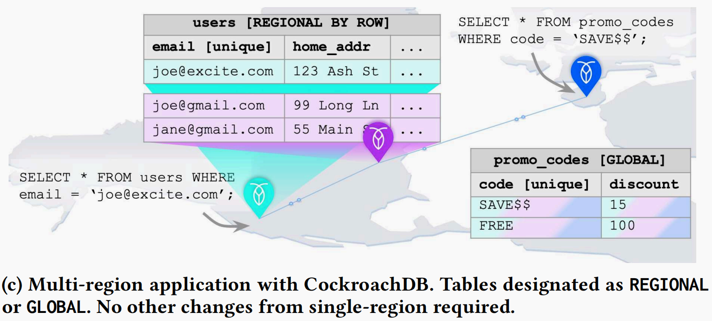
New SQL Syntax Example

Slide 7
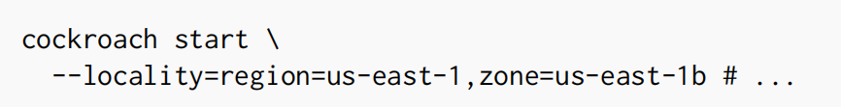
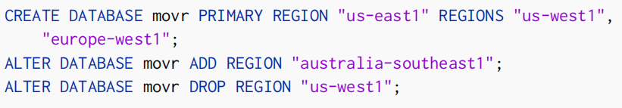
New Multi-region Abstraction
Regions and zones
Database regions are maintained in a special ENUM SQL data type called crdb_internal_region, updated whenever regions are added or removed from the database.

Slide 8

New Multi-region Abstraction
Survivability goal
ZONE survivability ensures that replicas are spread across availability zones.
REGION survivability ensures availability for reads and writes, even if an entire region goes down.

Slide 9
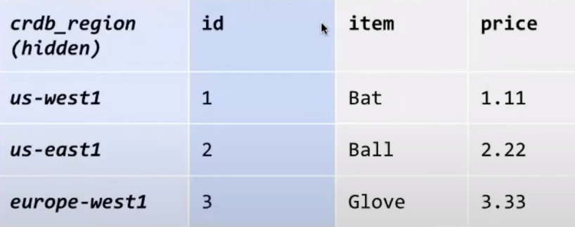
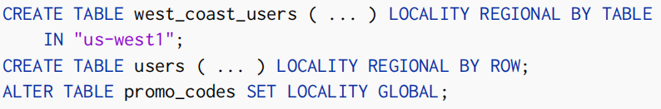
New Multi-region Abstraction
Table locality configuration
REGIONAL BY TABLE: All rows in the table are primarily accessed from the same home region.
REGIONAL BY ROW: A table and all of its indexes are divided into partitions with each partition optimized for access from a different region.
GLOBAL: Optimization for low-latency, strongly consistent reads from every region, at the expense of increased write latencies.

Slide 10
A Note on Usability
Make complex concepts easier to reason about.
Prevent users from mistakenly using anti-patterns.
Queries over partitioned tables will likely perform poorly if secondary indexes are not partitioned in the same way as the primary index.
Users could still get poor performance if they select regions far from most clients or choose the wrong table locality for their workload.
Notes:
performance characteristics have changed drastically in a multi-core and main-memory setting due to the absence of disk operations
there are newer high-performance variants that remove locks/latches and centralized data structures, and are optimized for byte-addressable storage

Slide 11
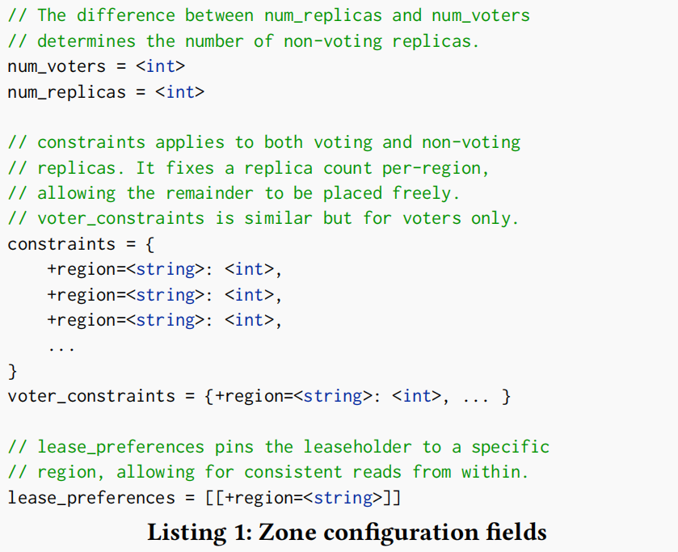
Placement Configuration
REGIONAL BY TABLE and GLOBAL tables are assigned one zone configuration per table.
REGIONAL BY ROW tables have one zone configuration per partition.
The specific configuration depends on the home region and survivability goal.
Notes:
Concurrency control protocol:
1. whether to allow a transaction to access or modify a particular tuple version in the database at runtime
2. whether to allow a transaction to commit its modifications

Slide 12
Contributions
New SQL syntax that dramatically simplifies multi-region database deployments.
Innovations in the SQL Query optimizer such as support for global uniqueness constraints and efficient queries on geo-partitioned data.
A detailed description of our implementation of serializable read-only transactions on historical data that operate locally on any replica.
A novel global transaction protocol that enables serializable/linearizable transactions from any replica in GLOBAL tables.

Slide 13
Enforcing Unique Constraints
Constraint checks that run after an INSERT or UPDATE statement as part of the same transaction.
The optimizer uses an efficient join algorithm executing one point lookup in the partitioned unique index for each region containing data.
Notes:
Basic read-write concurrency for operating on only one item
When operating on several items, still suffer from write skew

Slide 14
Enforcing Unique Constraints
To avoid incurring cross-region latencies, the optimizer omits these checks whenever it is safe to do so.
Use a UUID type for the unique column and let the system generate values with DEFAULT gen_random_uuid().
Explicitly include crdb_region in the uniqueness constraint definition. For example, UNIQUE (crdb_region, col) creates an explicitly partitioned unique index, guaranteeing that col is unique per region.
Define crdb_region as a computed column dependent on the unique column.

Slide 15
Locality Optimized Search
Optimization for searching limited rows whose specific location is unknown. For example, SELECT * FROM users WHERE email = ‘some-email’.
LOS favor local access over remote access.
Unique index
FK Check
Limited scan
Lookup join
Notes:
use tuple-level locking as this is sufficient to ensure serializable execution
txn-id:
1. mark tuple versions that a transaction accesses
2. use for the serialization order of transactions
3. serves as the version’s write lock

Slide 16
Contributions
New SQL syntax that dramatically simplifies multi-region database deployments.
Innovations in the SQL Query optimizer such as support for global uniqueness constraints and efficient queries on geo-partitioned data.
A detailed description of our implementation of serializable read-only transactions on historical data that operate locally on any replica.
A novel global transaction protocol that enables serializable/linearizable transactions from any replica in GLOBAL tables.

Slide 17
Follower Reads
Leaseholder replicas can serve up-to-date reads locally.
Non-leaseholder replicas can serve read-only queries on a sufficiently old MVCC snapshot.
Reduce latency for reads of data from geographical locations that are distant from that data’s leaseholder but near one of its follower replicas.
Balance read traffic across the replicas.
Notes:
#1 MVTO never allows a transaction to read uncommitted versions and allow the transaction to read an older version without updating read

Slide 18
Closed Timestamps
CRDB is a serializable timestamp-based MVCC system, so a read with timestamp 𝑇 needs to reflect all overlapping writes with timestamps 𝑇′≤ 𝑇 .
Transactions start with (read timestamp, provisional timestamp).
The follower needs a guarantee that no new writes will be committed to the Range at MVCC timestamps 𝑇′≤ 𝑇.
The follower needs to have applied the prefix of the Raft log that can contain writes at MVCC timestamps 𝑇′≤ 𝑇.

Slide 19
Closed Timestamps
A closed timestamp is a promise (Raft Log) made by the leaseholder that it will not accept new writes at or below that MVCC timestamp.
When a follower applies a command carrying a closed timestamp 𝑇 , it knows that there will not be further commands writing at or below.
Since new writes below a closed timestamp are not allowed, long-running read-write transactionsare forced to increase their provisional commit timestamp, which necessitates a Read Refresh on commit.

Slide 20

Exact Staleness Reads
Stale reads operate on a stale MVCC snapshot, corresponding to the exact read timestamp.
If the requested timestamp is old enough(below the Range’s closed timestamp), the read can be served from a follower replica. Otherwise, the query is redirected to the leaseholder.
Notes:
#1 MVTO never allows a transaction to read uncommitted versions and allow the transaction to read an older version without updating read

Slide 21
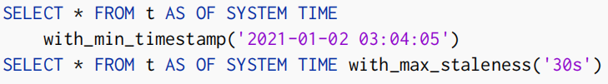
Bounded Staleness Reads
Use a dynamic, system-determined timestamp, subject to a user-provided staleness bound.
In exchange for this dynamism, bounded staleness reads are marginally more expensive than exact staleness reads. The implementation of bounded staleness reads involves an extra timestamp negotiation phase.

Slide 22
Contributions
New SQL syntax that dramatically simplifies multi-region database deployments.
Innovations in the SQL Query optimizer such as support for global uniqueness constraints and efficient queries on geo-partitioned data.
A detailed description of our implementation of serializable read-only transactions on historical data that operate locally on any replica.
A novel global transaction protocol that enables serializable/linearizable transactions from any replica in GLOBAL tables.

Slide 23
Global Table
Enable strongly-consistent low-latency reads that can be served locally by any replica with tolerance for longer write latencies.
The difference between stale reads and GLOBAL table reads.
Serve present-time reads as part of read-only or read-write transactions.
The difference from OceanBase Replicated tables.
Enable reads from non-voting replicas.

Slide 24
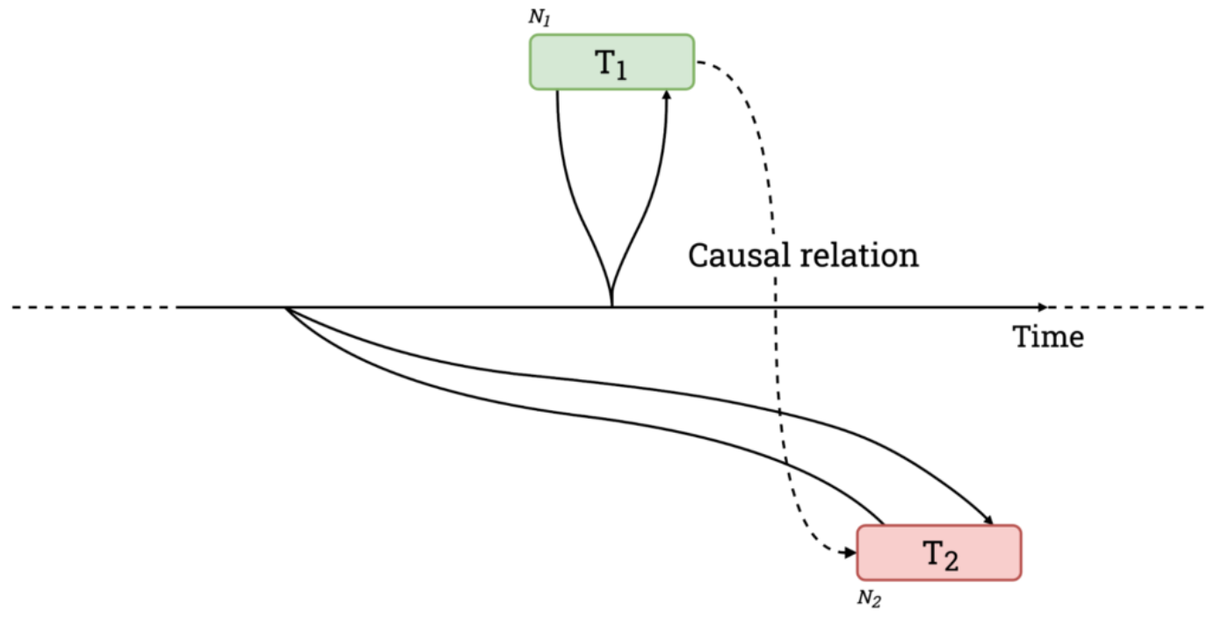
Uncertainty Intervals
CRDB guarantees linearizability for reads and writes at the level of a single key and only relies on loose clock synchronization.
The uncertainty interval of T2 is [commit_ts, commit_ts + max_offset] and T1 is within it.
A reader that encounters the same key within its uncertainty interval checks whether the values previously read by the transaction remain unchanged at the newer timestamp.

Slide 25
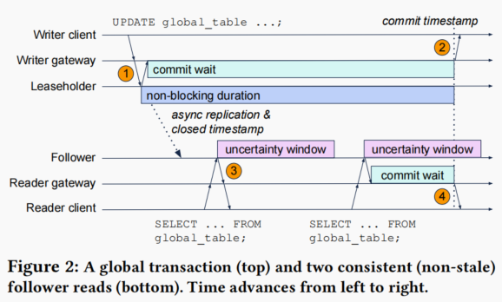
Future-time Transactions
The coordinator delays completion of a write operation until its local timestamp advances beyond the transaction’s commit timestamp.

Slide 26
Evaluation
Tradeoffs between REGIONAL and GLOBAL
Performance of REGIONAL BY ROW
Performance of GLOBAL Tables

Slide 27
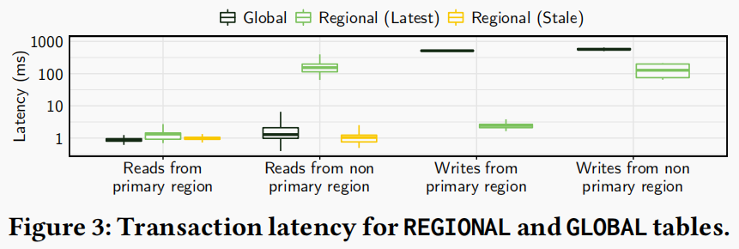
Tradeoffs between REGIONAL and GLOBAL
YCSB-A with 1:1 ratio of single-key reads to writes.
GLOBAL tables enable fast reads (< 3𝑚𝑠) from anywhere, at the expense of slower writes (500−600𝑚𝑠).
REGIONAL tables support fast reads and writes(< 3𝑚𝑠) from the leaseholder’s local region, at the expense of slower remote reads and writes (100 − 200𝑚𝑠).

Slide 28
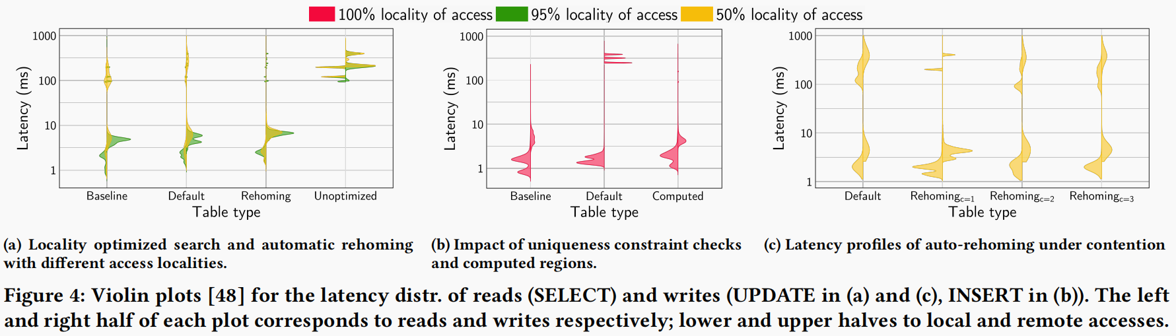
Performance of REGIONAL BY ROW
YCSB-B or YCSB-D with 95% reads and 5% updates/inserts.
Configure clients with a locality of access value, corresponding to the percentage of operations accessing rows in the originally homed region.
Baseline: Manual partitioning method uses the primary key to derive the partition.

Slide 29
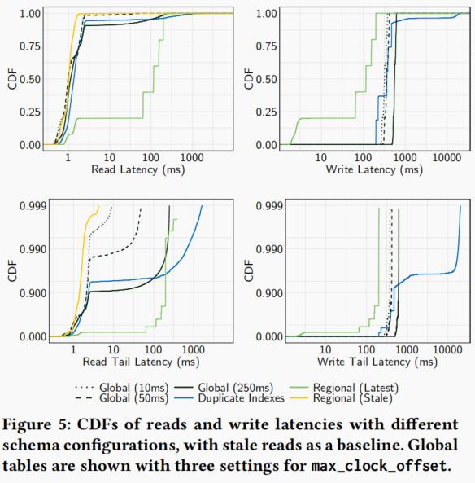
Performance of GLOBAL Tables
YCSB-A with 1:1 ratio of single-key reads to writes.
Baseline: CRDB’s previous approach for low-latency consistent reads from all regions (Duplicate Indexes).

Slide 30
Conclusion
Easy-to-use deployment options but lacks functionality.
Locality optimized search that reduces cross-region latency.
Non-voting replicas distributed across multiple regions that provide bounded stale reads.
Global transactions in support of multiple replicas of GLOBAL tables.

