Slide 1

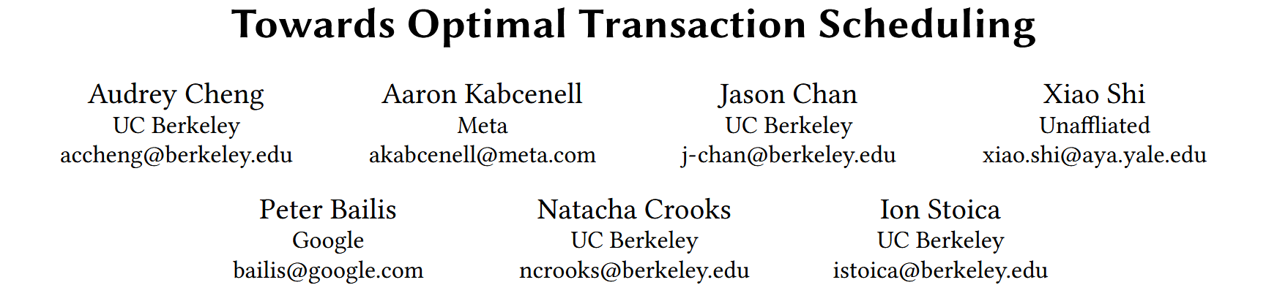

Slide 2
INTRODUCTION
BACKGROUND
Performance differs significantly depending on how systems schedule transactions.
Searching for the optimal schedule is infeasible in practice —— optimal scheduling is NP-Complete.

Slide 3
INTRODUCTION
BACKGROUND
Current scheduling methods(concurrency control protocols) are classified into two kinds:
The majority execute requests based on arrival order(e.g. 2PL, MVCC).
missing opportunities to avoid conflicts by planning ahead
Other work schedules transactions more intelligently by leveraging full information about access sets (e.g., deterministic databases) and/or predicting key accesses.
consider only a small subset of the schedule space and make suboptimal scheduling decisions

Slide 4
INTRODUCTION
BACKGROUND
The main challenges of transaction scheduling are:
how to efficiently find fast schedules with partial information and
how to enforce schedules during execution without violating isolation guarantees.

Slide 5
CONTRIBUTION
We introduce a novel scheduling policy, SMF, that efficiently finds fast schedules on a range of transactional workloads.
We propose a schedule-first concurrency control protocol, MVSchedO, that maximizes the benefits of scheduling by enforcing fine-grained operation ordering.
We develop and evaluate R-SMF, which integrates SMF and MVSchedO in RocksDB to improve throughput by up to 3.9× and reduce tail latency by up to 3.2×.

Slide 6
SCHEDULING
Makespan
For a given schedule, transaction execution is constrained by:
operation dependencies(i.e., partial orders) within a transaction, and
inter-transaction dependencies determined by a concurrency control protocol enforcing a specified isolation level.

Slide 7
SCHEDULING
Makespan
We evaluate schedule makespan, or the total time required for all transactions to complete.
For a finite batch of transactions, minimizing makespan is equivalent to maximizing throughput.

Slide 8
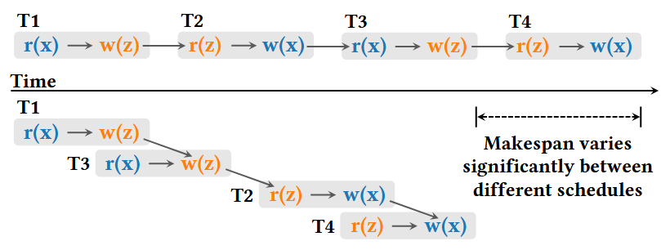
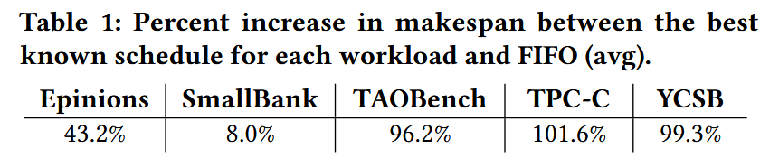
SCHEDULING
Makespan
We observe that these schedules have varying makespan because they have different cost of conflicts, or how much conflicts delay the execution of other operations.

Slide 9
SCHEDULING
Shortest Makespan First
We introduce a new scheduling policy, Shortest Makespan First (SMF), that greedily minimizes the impact of conflicts and thus, total makespan.
SMF places transactions with high conflict costs far apart. Concretely, we evaluate the incremental makespan increase when a given transaction is added to the schedule.

Slide 10
SCHEDULING
Shortest Makespan First
SMF starts the schedule with a random transaction.
At each iteration, SMF finds the transaction that increases makespan the least among k randomly sampled unscheduled requests and appends this transaction to the schedule.
The policy repeats this process until all transactions have been scheduled.

Slide 11
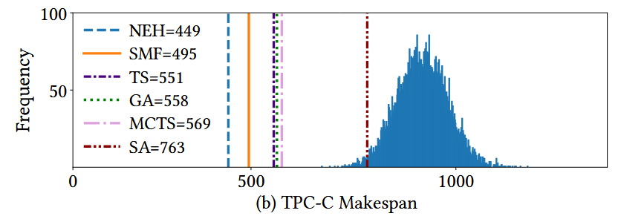
SCHEDULING
Why SMF Finds Fast Schedules —— Case Study
For TPC-C, SMF finds close-to-optimal schedules by allowing New-Order and Payment transactions that do not conflict to run in parallel.
SMF captures most of its scheduling wins by making the right ordering decisions for hot keys.

Slide 12
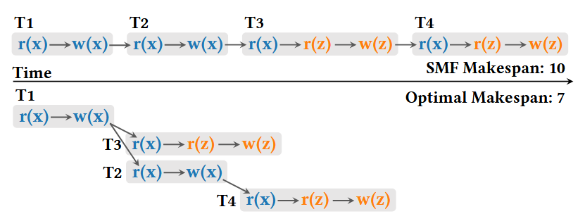
SCHEDULING
Why SMF Finds Fast Schedules —— Adversarial Cases
Real-world workloads have diverse conflict patterns (e.g., more transaction types, many hot keys, etc.), so SMF is unlikely to repeatedly make poor choices in the long run.

Slide 13
SCHEDULING
Why SMF Finds Fast Schedules —— Statistical Performance Bounds
How well does SMF compare to all possible (serializable) schedules for a given workload?
We uniformly sample the schedules of a given workload to construct a representative distribution of schedule performance.

Slide 14
SCHEDULING
Why SMF Finds Fast Schedules —— Statistical Performance Bounds
Each schedule maps to one corresponding conflict graph, which has nodes representing transactions and directed edges representing the order of conflicting operations.
Interval-Reversal (IR) Random Walk uniformly samples over conflict graphs.
We can bound the proportion of schedules that have lower makespan than our best random sample with a specified confidence level.

Slide 15
SCHEDULING
ONLINE SCHEDULING
There are two main challenges we must address: (i) making scheduling decisions without full information and with low overheads and (ii) ensuring correct execution of schedules.
Solution: only consider hot key access of in-flight transactions.

Slide 16
SCHEDULING
ONLINE SCHEDULING
Application Hints. We leverage two types of application hints in our system: transaction type and hot key accesses.
Classifier.
mapping transactions to metadata vectors;
finding the optimal number of clusters;
determining a set of hot key operations for each cluster.
Approximating Makespan.
considering in-flight transactions;
ignoring transactions without hot keys;
focusing on the latest conflict operation on the hot key.

Slide 17
SCHEDULING
ONLINE SCHEDULING
Our protocol MVSchedO extends MVTSO in two main ways.
MVSchedO assigns timestamps using SMF rather than FIFO.
Operations accessing hot keys with later timestamps do not execute until conflicting ones earlier in the schedule have completed.

Slide 18
EVALUATION
Baseline
RocksDB Optimistic Concurrency Control (OCC)
RocksDB Locking (Lock)
RocksDB Multi-Version Timestamp Ordering (MVTSO)
Aria(reordering conflict operations)
TsDEFER (Defer) (delaying conflicting operations)
TsDEFER-MVTSO (Defer-MVTSO)

Slide 19
EVALUATION
Benchmark
SmallBank
TPC-C
YCSB
TAOBench(social network)
Epinions(consumer reviews website)

Slide 20
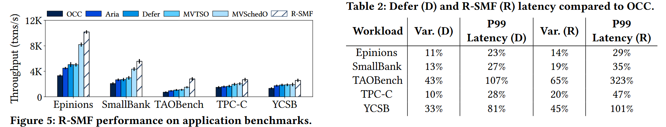
EVALUATION
Performance
R-SMF outperforms all baselines on the five application benchmarks since it executes transactions following schedules that minimize conflict costs.

Slide 21
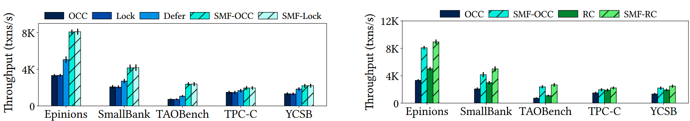
EVALUATION
Performance
R-SMF’s policy is useful for different concurrency control protocols and isolation levels.

Slide 22
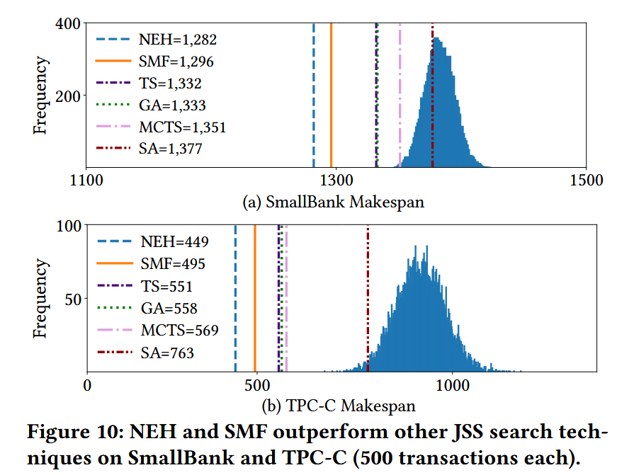
EVALUATION
SMF’s Search Quality
SMF has robust performance on all workloads, finding schedules with less than 10% difference compared to the best Job-Shop Scheduling techniques.
50s searching time
5s searching time
Notes:
However, the overheads of these techniques are too high (e.g., in the order of seconds for each scheduling decision [69]) for us to obtain meaningful results in a real system, so we evaluate these policies in our makespan simulator.

Slide 23
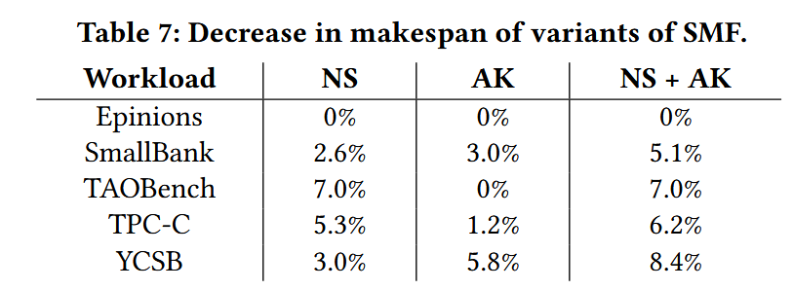
EVALUATION
SMF Optimizations for R-SMF
SMF’s run time optimizations have limited impact on makespan.
Searching all transactions in each search iteration
Considering no only hot keys
Notes:
However, the overheads of these techniques are too high (e.g., in the order of seconds for each scheduling decision [69]) for us to obtain meaningful results in a real system, so we evaluate these policies in our makespan simulator.

Slide 24
TAKE AWAY
Evaluate a heuristic algorithm
Sampling in the whole search space, and calculating a bound with confidence level.
Explain an obvious premise
Case, Math, Evaluation.
Notes:
However, the overheads of these techniques are too high (e.g., in the order of seconds for each scheduling decision [69]) for us to obtain meaningful results in a real system, so we evaluate these policies in our makespan simulator.

Slide 25
LIMITATION
Threats to Validity
TQS source code and TQS’s bug reports on PolarDB are not available.
The correctness of our implementation.
We built DQP on a popular DBMS testing framework, SQLancer, and made the source code publicly available.
The reliability of the results we presented.
We reported each found bug to the DBMSs’ developers and annotated the bug status according to developers’ replies. We also made all bug reports public.

