Slide 1


Slide 2
Weak isolation theories
Models the execution of concurrent transactions as a dependency serial- ization graph (DSG) and defines different isolation levels as preventing different types of cycles in the DSG.
Types of dependencies across operations
Read dependency (wr)
Write dependency (ww)
Anti-dependency (rw)

Slide 3
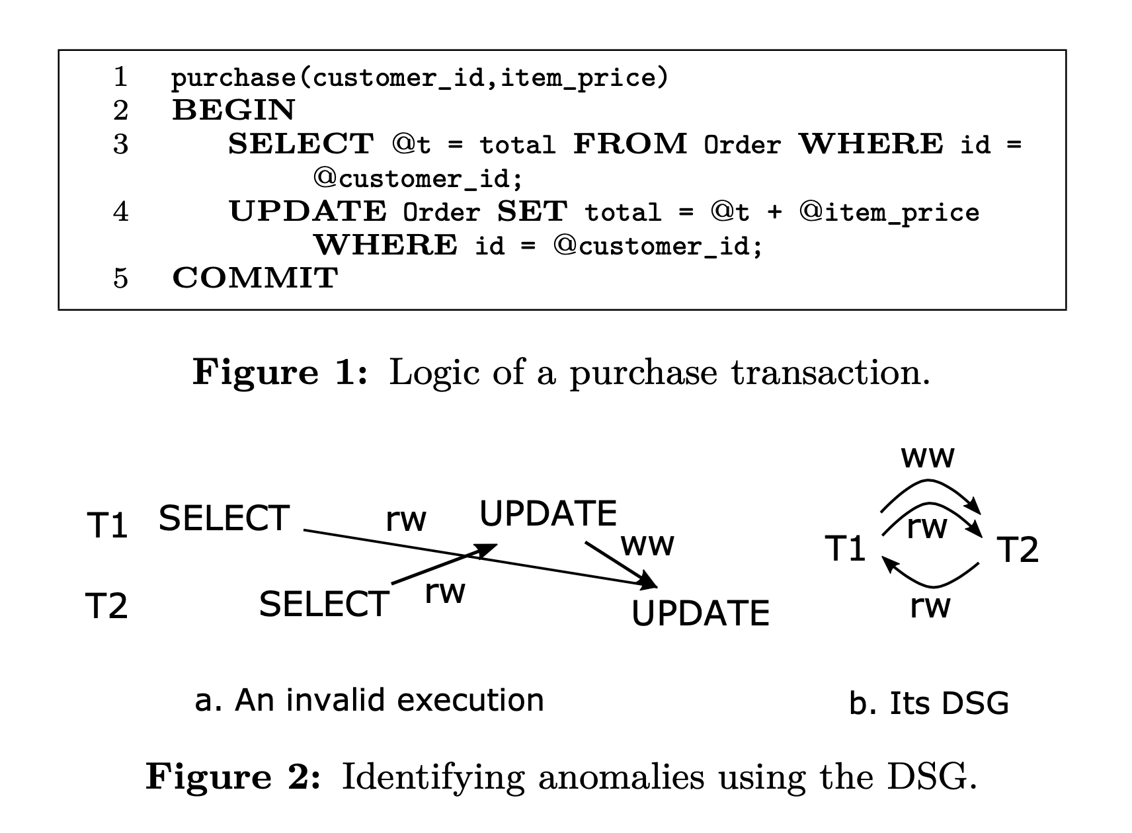
Example
How a weaker isolation level can introduce problems

Slide 4
Weak isolation theories
Serializable isolation level disallows a cycle consisting of any type of edge
Read Committed disallows a cycle consisting of wr and ww edges (It allows cycles with at least one rw edge).
Identify ananomalies
For Read Committed we should identify cycles with at least one rw edge
For Snapshot Isolation we should search for cycles with two consecutive rw edges

Slide 5
Challenges
Weak isolation levels can introduce anomalous executions a developer may not be aware of
Existing methods for correctly identifying and repairing isolation anomalies may produce a high number of false negatives and false positives
It is infeasible to identify all cycles
Cycle may never happen in practice
Even if a cycle occurs, it is not a real problem to the application
Notes:
Existing works model the execution of transactions as a dependency graph and identify anomalies by searching for certain types of cycles in this graph

Slide 6
IsoDiff
This paper proposes IsoDiff, a tool to help a developer debug the anomalies caused by weak isolation for an application.
Introduces an algorithm to identify a representative subset of cycle
Identify the simplest way to eliminate these cycles

Slide 7
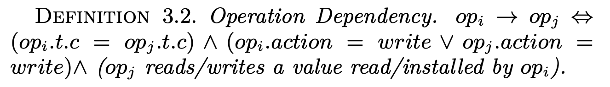
Definition
Operation Dependency

Slide 8
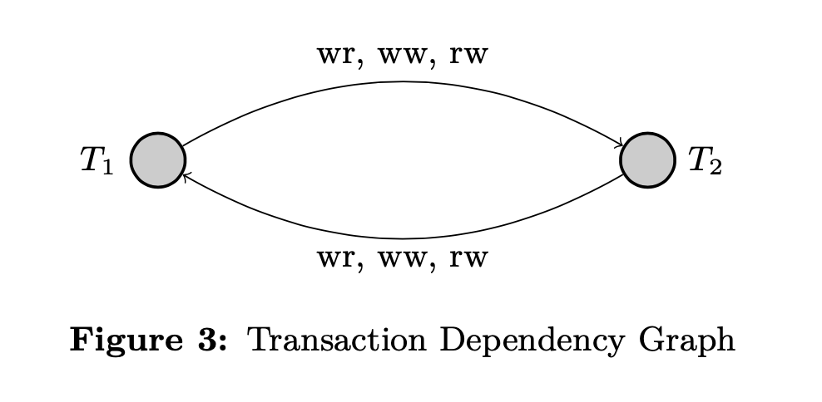
Definition
Operation Dependency

Slide 9
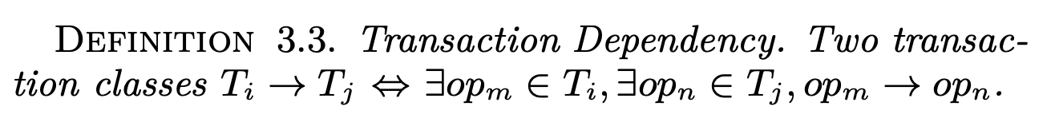
Definition
Transaction Dependency

Slide 10
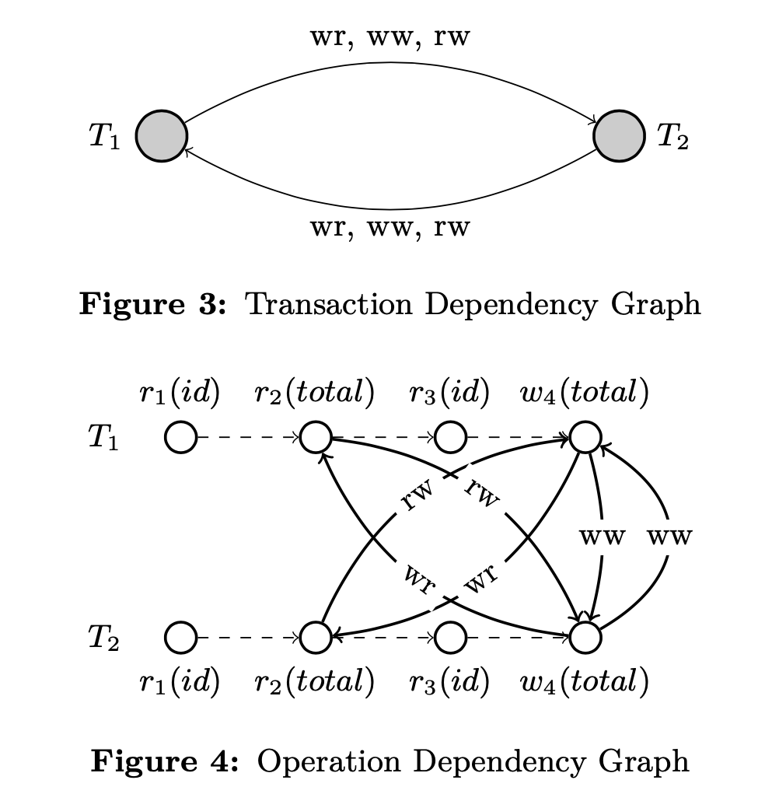
Definition
Transaction Dependency

Slide 11
Definition
Cycle
Cycle is a cycle that can happen in the transaction dependency graph under database isolation level but cannot happen under Serializable.
Cycle in Read Committed
Contains at least one rw edge
Cycle in SI
Contains at least two consecutive vulnerable rw edges

Slide 12
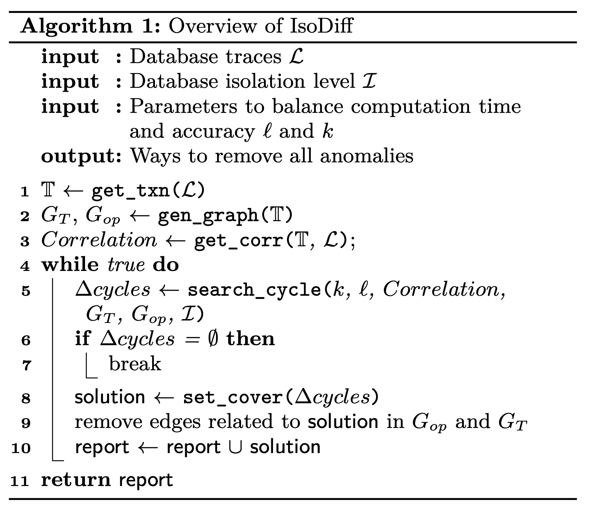
Overview of IsoDiff
The major goal of IsoDiff is to search cycles in the transaction dependency graph, because they represent anomalies that can happen under I but cannot happen under Serializable.

Slide 13
Details
Generating transaction classes
Building dependency graphs
Finding correlations
Searching for cycles
Validating cycles
Eliminate found cycles

Slide 14
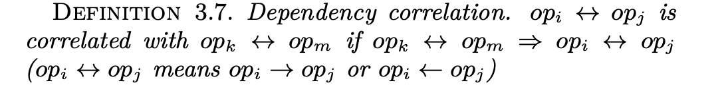
Finding correlations
Definition
Correlations are helpful to remove false positives
Correlations are common in the applications
Correlations are used in two ways
Identify non-vulnerable rw edges for Snapshot Isolation
Check whether a found cycle is valid

Slide 15
Finding correlations
Identify non-vulnerable rw edges for Snapshot Isolation
Trasaction Class
T1=[r1(id), r2(total), r3(id), w4(total)]
T2=[r1(id), r2(total), r3(id), w4(total)]
Operation Dependency
T1.r2(total) → T2.w4(total)
Correlations
T1.r2(total) always accesses the same row as T1.w4(total)
T1.r2(total) → T2.w4(total) => T1.w4(total) → T2.w4(total)
Notes:
this rw edge is not vulnerable since it is always correlated with a ww edge
For Snapshot Isolation, the dangerous path should include two consecutive vulnerable rw edges, and thus one rw edge marked as non-vulnerable may make a few other vulnerable rw edges harmless

Slide 16
Definition
Dangerous path
For Read commited, a dangerous path is one rw edge
For Snapshot isolation, a dangerous path is two consecutive vulnerable rw edges
Notes:
this rw edge is not vulnerable since it is always correlated with a ww edge
For Snapshot Isolation, the dangerous path should include two consecutive vulnerable rw edges, and thus one rw edge marked as non-vulnerable may make a few other vulnerable rw edges harmless

Slide 17
Searching for cycles
IsoDiff introduces a multi-iteration algorithm to find a representative subset of cycles
Principles
For each dangerous path, which is essentially a pattern a cycle must have, IsoDiff should find at least one cycle involving it
If one dangerous path is involved in multiple cycle, IsoDiff should first try to find shorter ones
If for the same dangerous path and for the same length, there are still many cycles, IsoDiff try to select cycles that involve different transactions.
Notes:
second's reason: because shorter ones are easier to analyze and breaking them can often break longer ones as well.

Slide 18
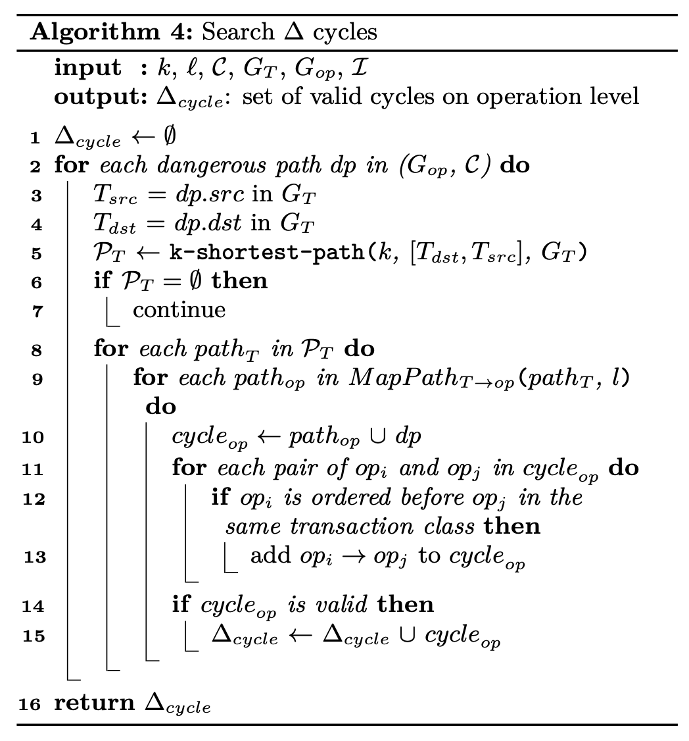
Searching for cycles

Slide 19
Validating cycles
we present two techniques to detect invalid cycles automatically, and one technique to incorporate the developer’s knowledge into the analysis
Timing violation
Correlation
Developer knowledge

Slide 20
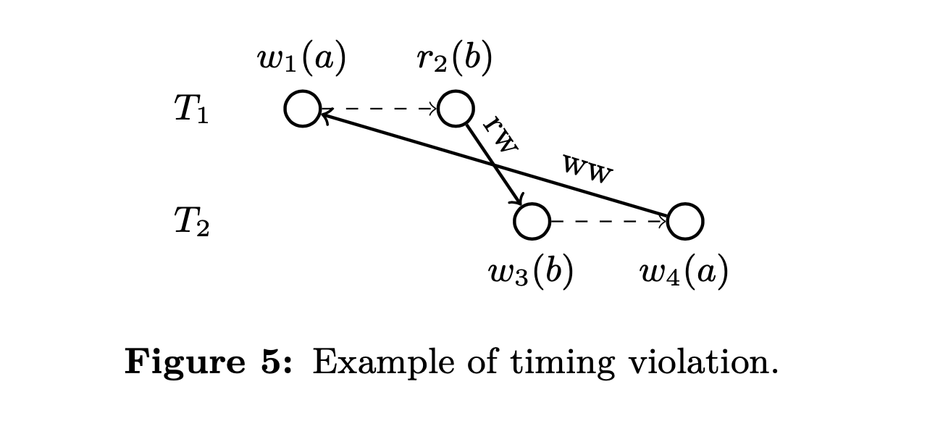
Timing violation
It is possible that a cycle found in the previous step has an internal cyclic happened-before relationship, which will never happen.

Slide 21
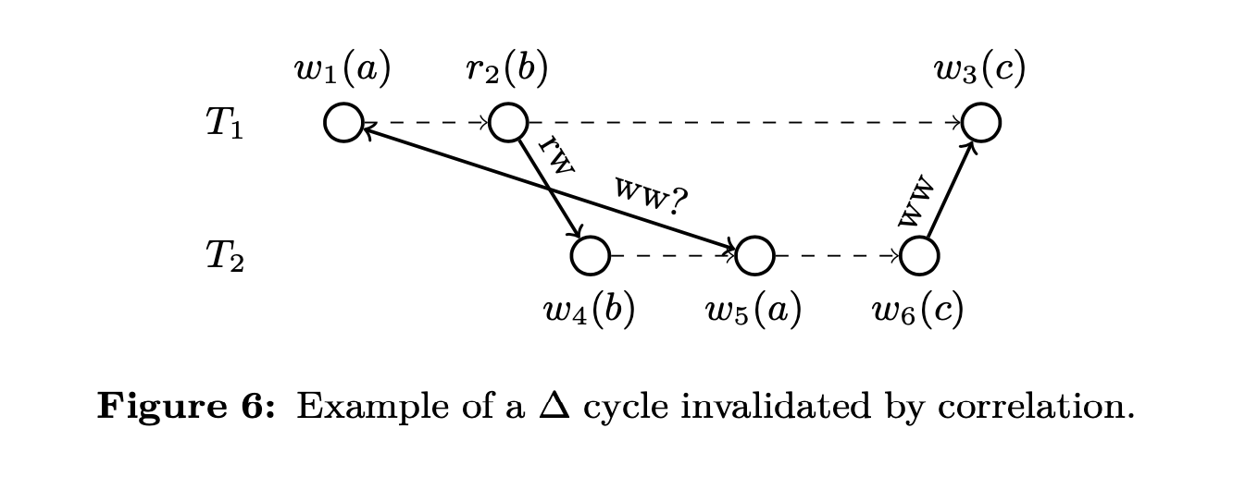
Correlation
Correlation are used in two ways
...
Check whether a found cycle is valid

Slide 22
Developer knowledge
IsoDiff provides a mechanism to incorporate the developer’s knowledge about certain properties of the dependency graph
IsoDiff allows a developer to express his/her knowledge as certain properties on the dependency graph
e.g stock-level
Notes:
For example, the TPC-C specification suggests that the stock-level transaction can tolerate inconsistent results. In this case, incorporating developer knowledge—stock-level should be excluded from analysis— into IsoDiff eliminates many false cycles altogether.

Slide 23
Eliminate found cycles
In this step IsoDiff simulates the simplest way to reduce the cycles found in each iteration
Remove dependency edges around a certain column
Always access different rows
Use stronger protection for statements accessing the column

Slide 24
Eliminate found cycles
IsoDiff finds the minimal number of columns so that every cycle includes at least one edge related to these columns
Find the minimal number of columns that can cover all cycle
Such columns called TargetColumns
Notes:
Set Cover Problem is NP hard, it has a well-known approximate solution, which identifies the set that can cover the most number of uncovered elements in each iteration

Slide 25
Limitations
False negatives
Dynamic analysis may miss rare events
False positives
Cannot eliminate all false positives
Inaccuracies due to approximation
Solutions to fine the TargetColumn are just approximate solutions to NP-hard problems

Slide 26
Evaluation
How effectively can IsoDiff find anomalies in real applications
Overhead of IsoDiff
Effect of each individual technique of IsoDiff

Slide 27
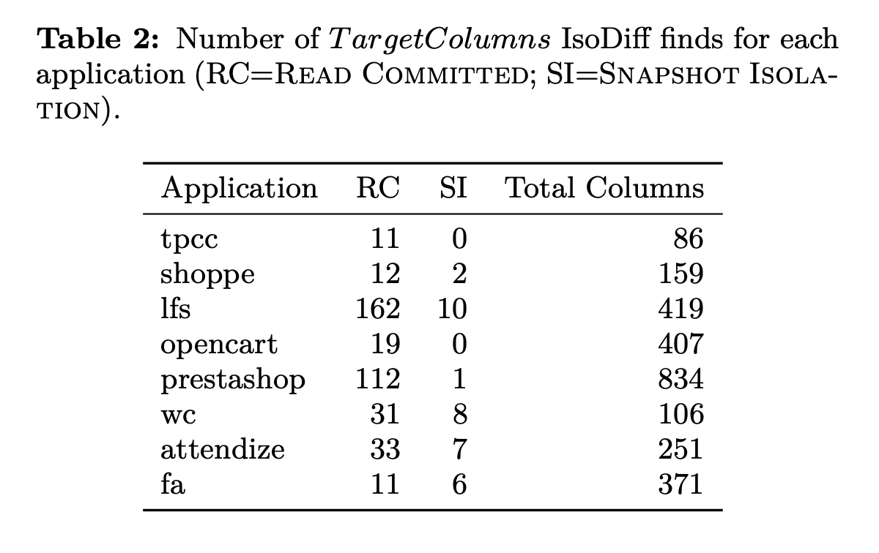
How effectively can IsoDiff find anomalies in real applications？

Slide 28
Overhead of IsoDiff
IsoDiff has two parameterskandlto balance overheadand accuracy
k is used by the k-shortest-path algorithm
l determines the number of samples to get when mapping a cycle to operation levelad of IsoDiff

Slide 29
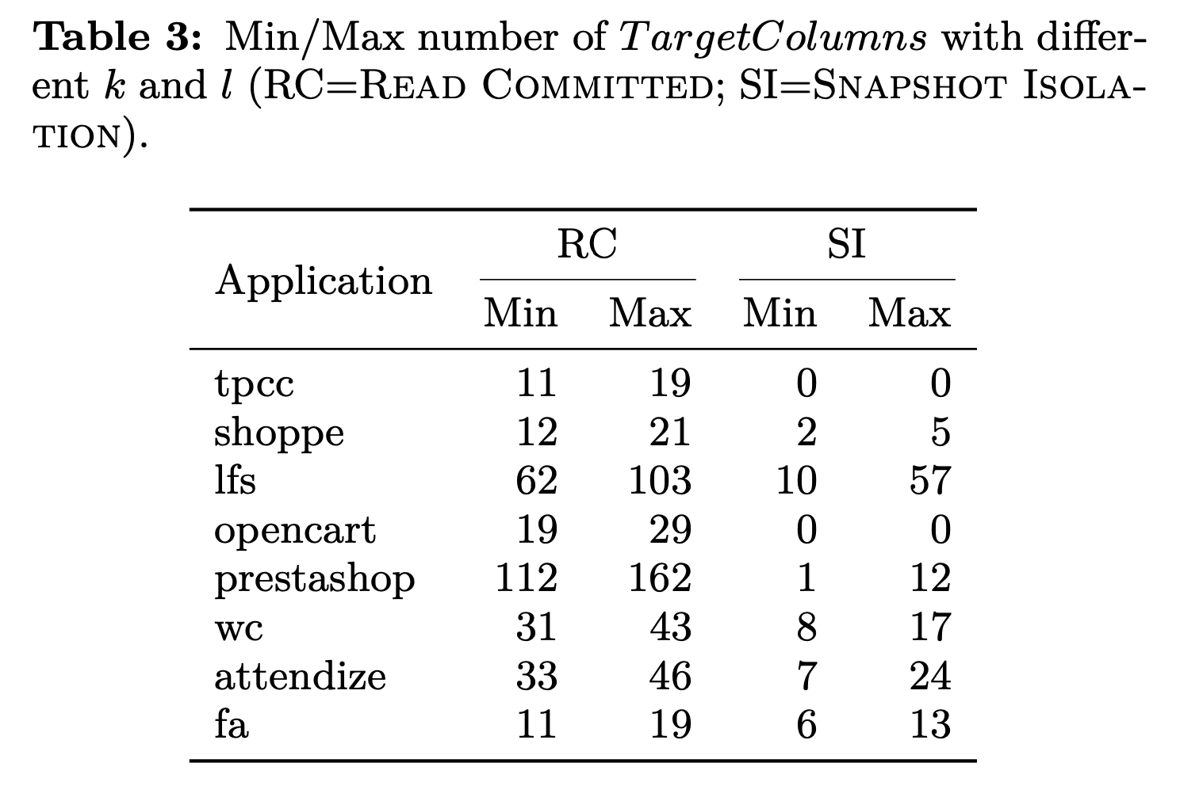
Overhead of IsoDiff

Slide 30
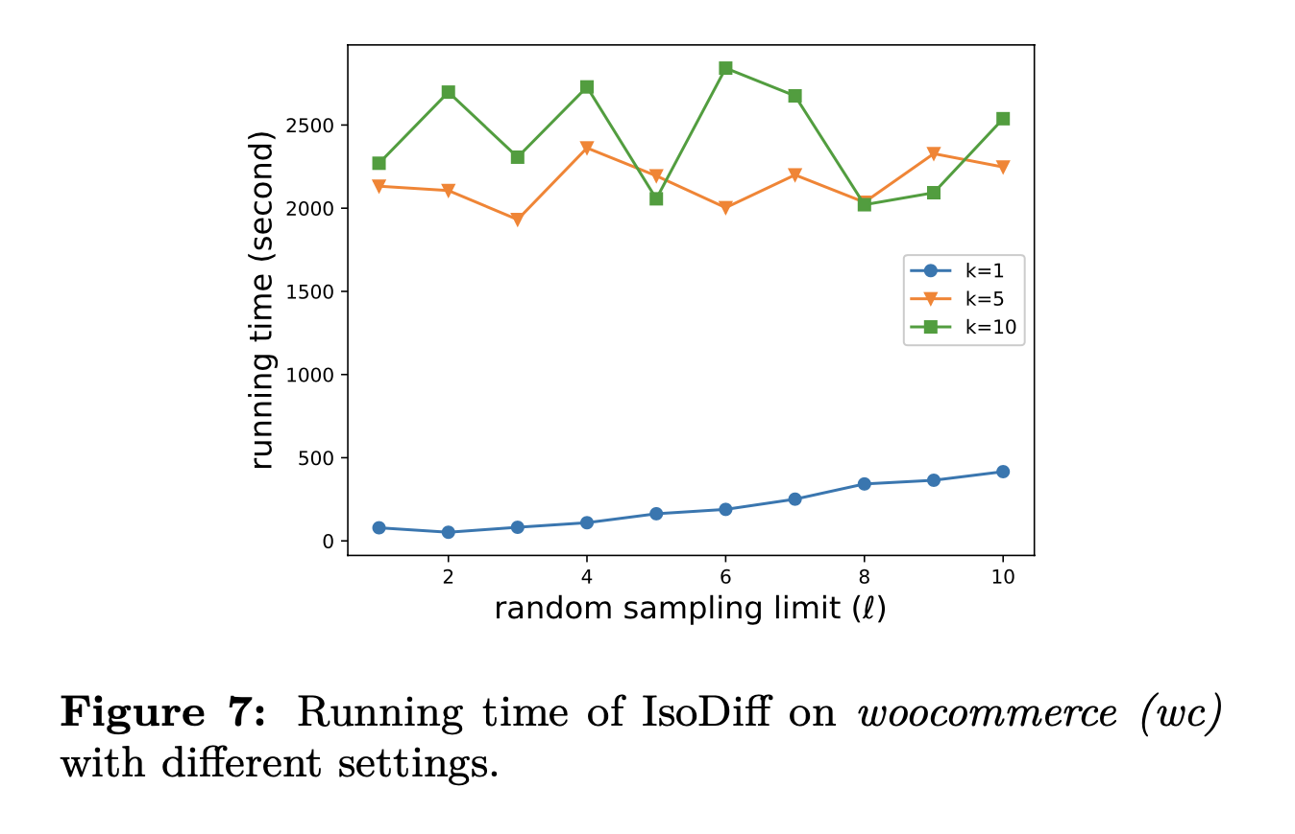
Overhead of IsoDiff
To measure the impact of the k and l parameters on overhead, we measure the running time of IsoDiff on woocommerce(wc) under Snapshot Isolation
Notes:
We further profile the time spent in different functions in this setting and find that 99.4% of the time is spent in search_cycle. Note that search_cycle has already been parallelized while other parts have not.
wc has the most dangerous paths of all applications
reach a larger k and l ,which require more running time

Slide 31
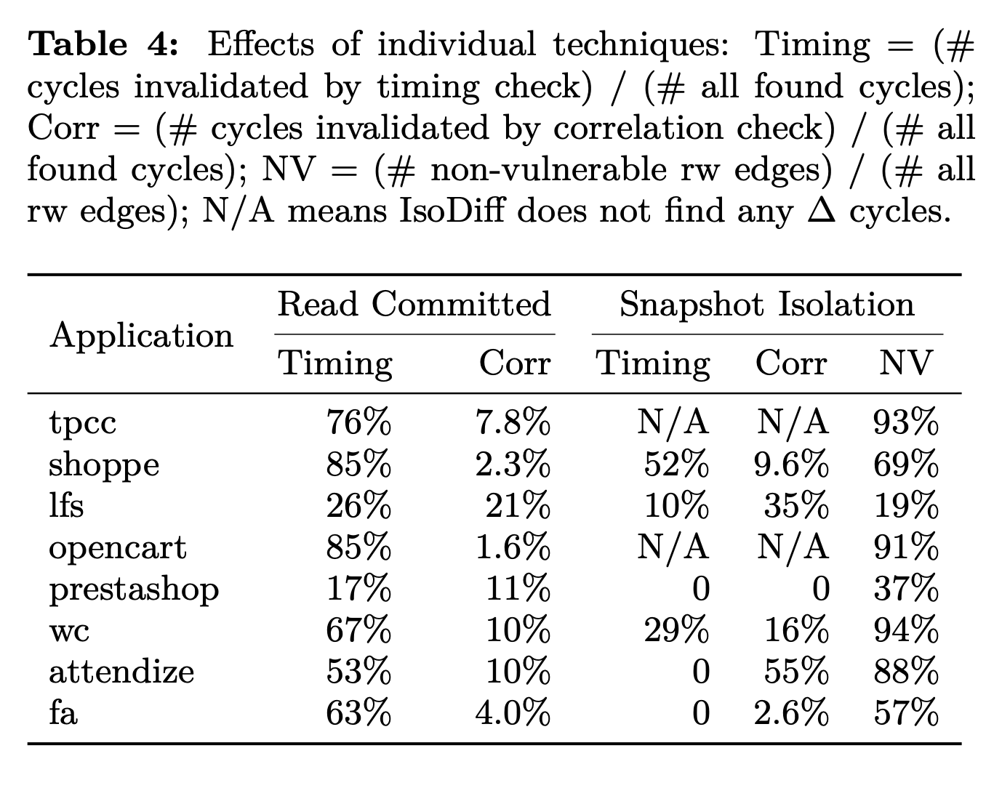
Effects of individual techniques
Notes:
because for Snapshot Isolation, the dangerous path should include two consecutive vulnerable rw edges, and thus one rw edge marked as non-vulnerable may make a few other vulnerable rw edges harmless

Slide 32
Effects of individual techniques
Checking timing constraint
Invalidate up to 85% of the found cycle
Checking correlation
Up to 94% of the rw edges are non-vulnerable
Invalidate up to 55% of the found cycle

Slide 33
Contribution
Reduces the computation overhead and thus makes analysis tractable even for complex applications
The longest experiment takes 46 minutes to identify and validate 40K cycles on a single machine.
The timing relationship check of IsoDiff invalidates up to 85% of the found cycles
The correlation check of IsoDiff invalidates up to 55% of the found cycles

