Slide 1
One-shot Garbage Collection for In-memory OLTP through Temporality-aware Version Storage
AUNN RAZA, EPFL, Switzerland
PERIKLIS CHRYSOGELOS∗, Oracle, Switzerland
ANGELOS CHRISTOS ANADIOTIS†, Oracle, Switzerland
ANASTASIA AILAMAKI, EPFL, Switzerland
SIGMOD2023

Slide 2
Background
MVCC creates a new version on each write operation
Increase the memory footprint and the associated maintenance cost.
Garbage collection: collect unreachable versions
Active GC: place a garbage collection phase at the end or during the execution of each transaction.
Passive GC: employ background process that periodically vacuums them.

Slide 3
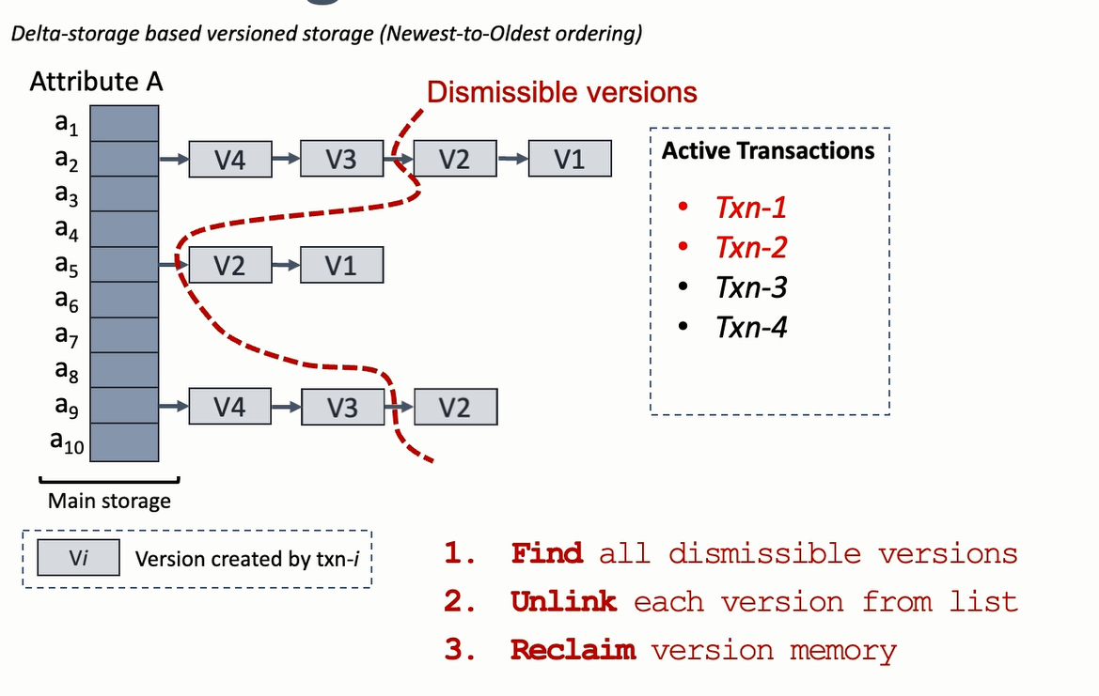
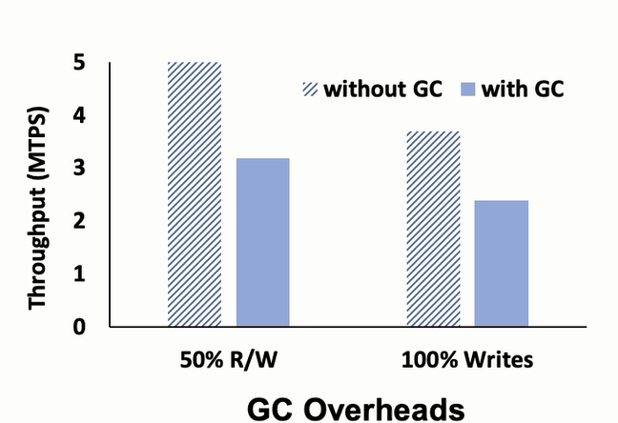
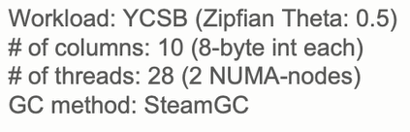
Garbage Collection in MVCC-based OLTP
Overhead with GC grows with # of versions

Slide 4
Scalability Bottlenecks of GC
Bottlenecks: traverse versions → random accesses
Tracking obsolete versions
Unlinking/Updating individual version chains
Memory reclamation
Version chain consolidation

Slide 5
Observation
Transactions with similar profiles, which are started and executed in parallel in a multi-socket multi-core server, are likely to finish at a similar time.
The lifetime of versions in MVCC follows a sliding temporal window fashion → enables OneShotGC to scale by grouping the versions based on their expected deletion time.

Slide 6
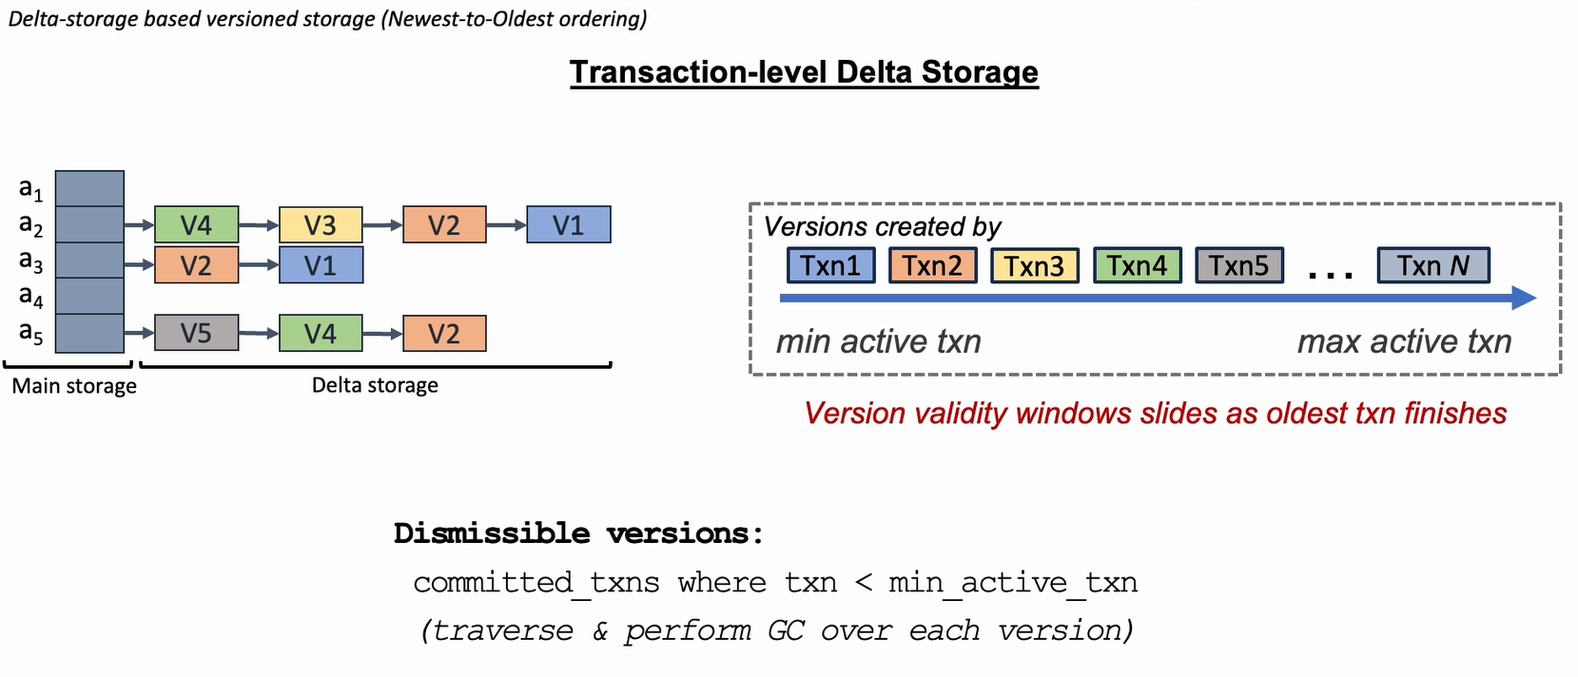
Temporality in Version Life Cycle
Version validity behaves in temporal window fashion

Slide 7
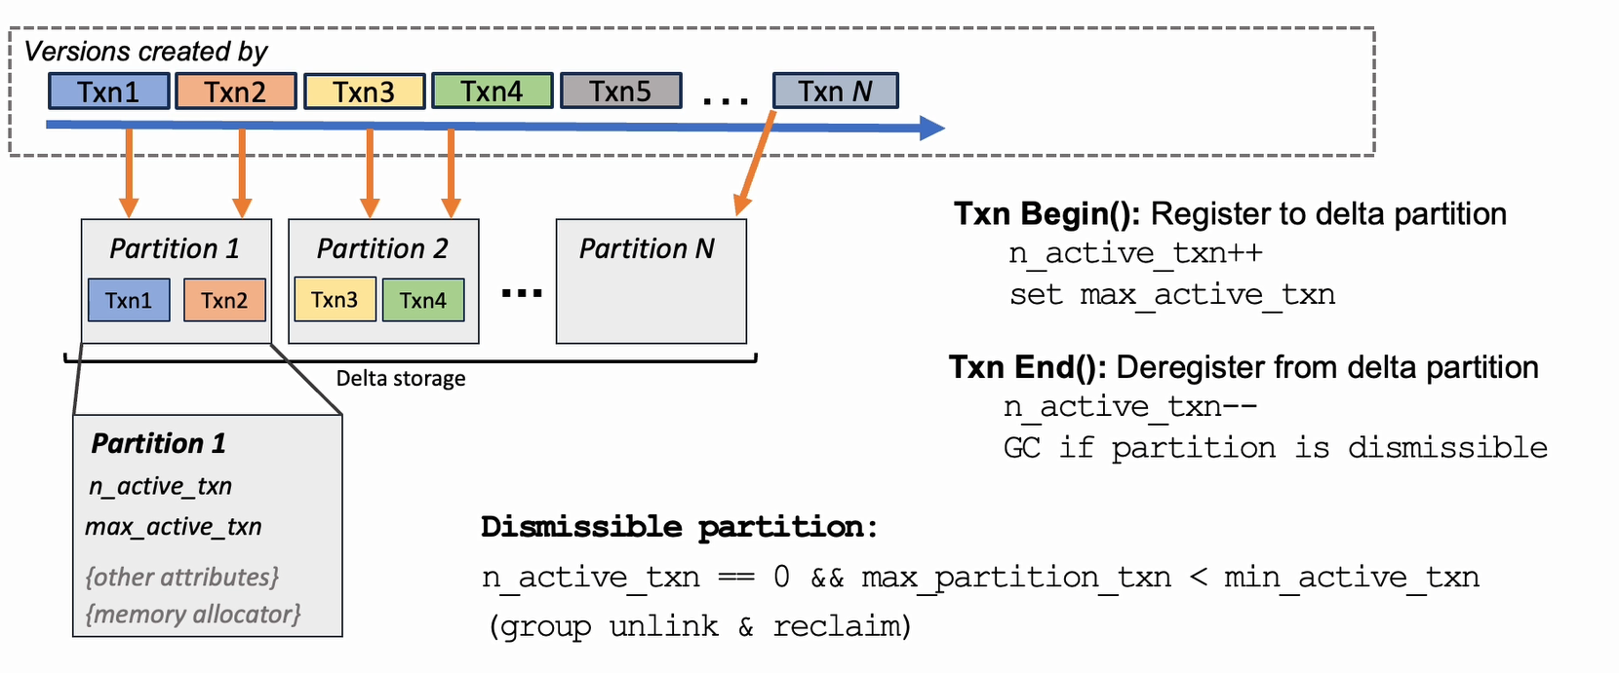
Temporality-aware version storage
OneShotGC: Group versions based on expiry

Slide 8
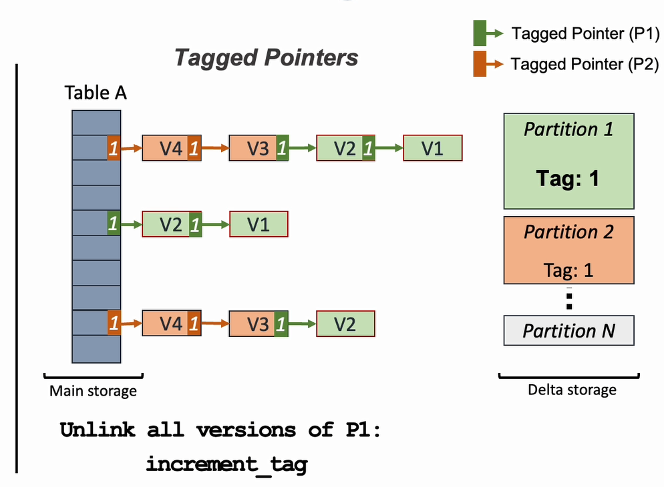
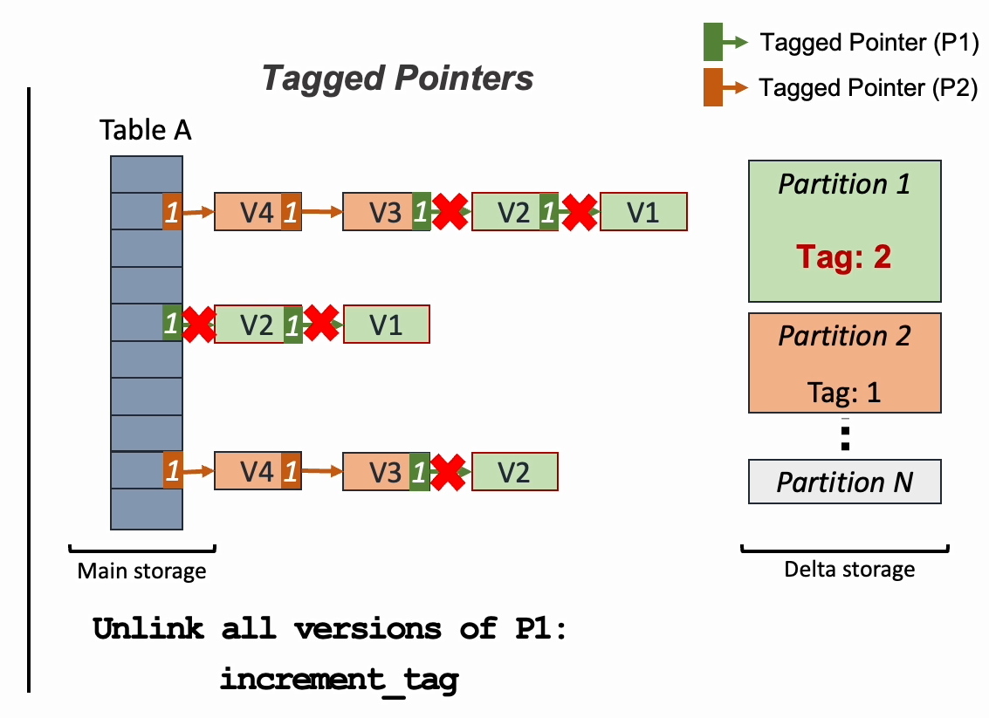
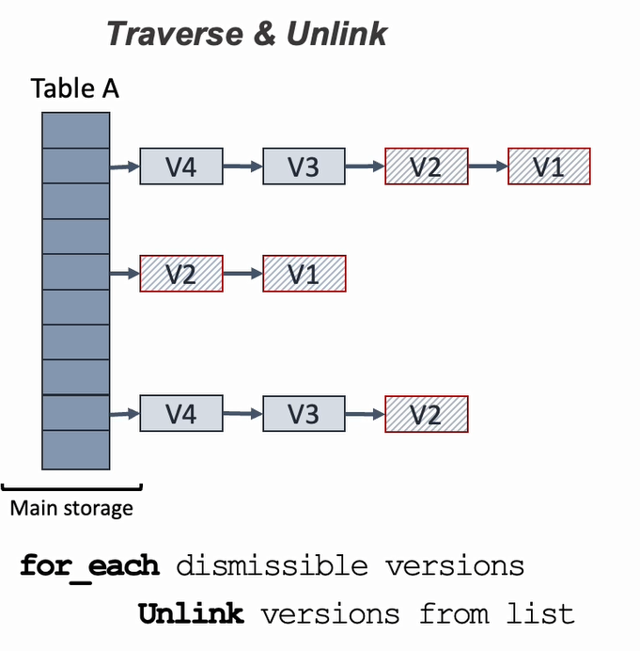
Unlinking versions during GC
OneShotGC: Tagged pointers to batch unlinking

Slide 9
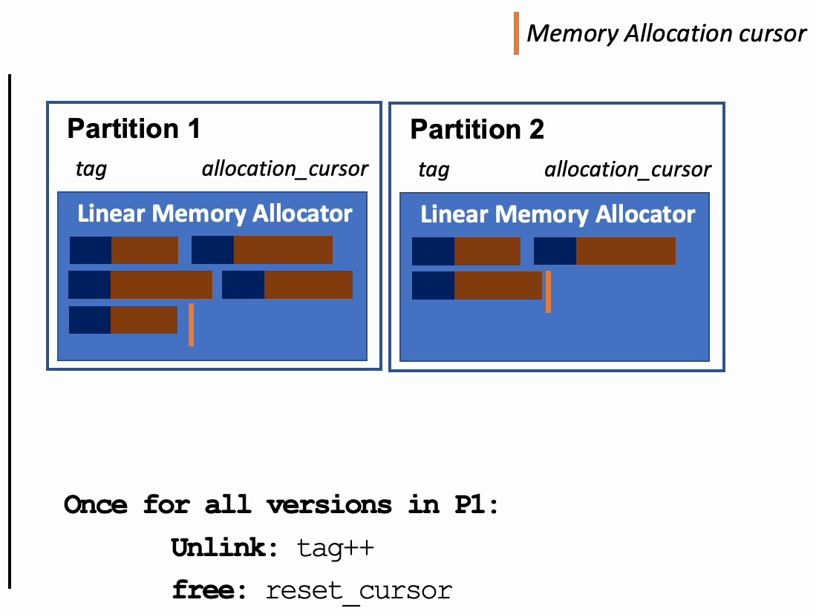
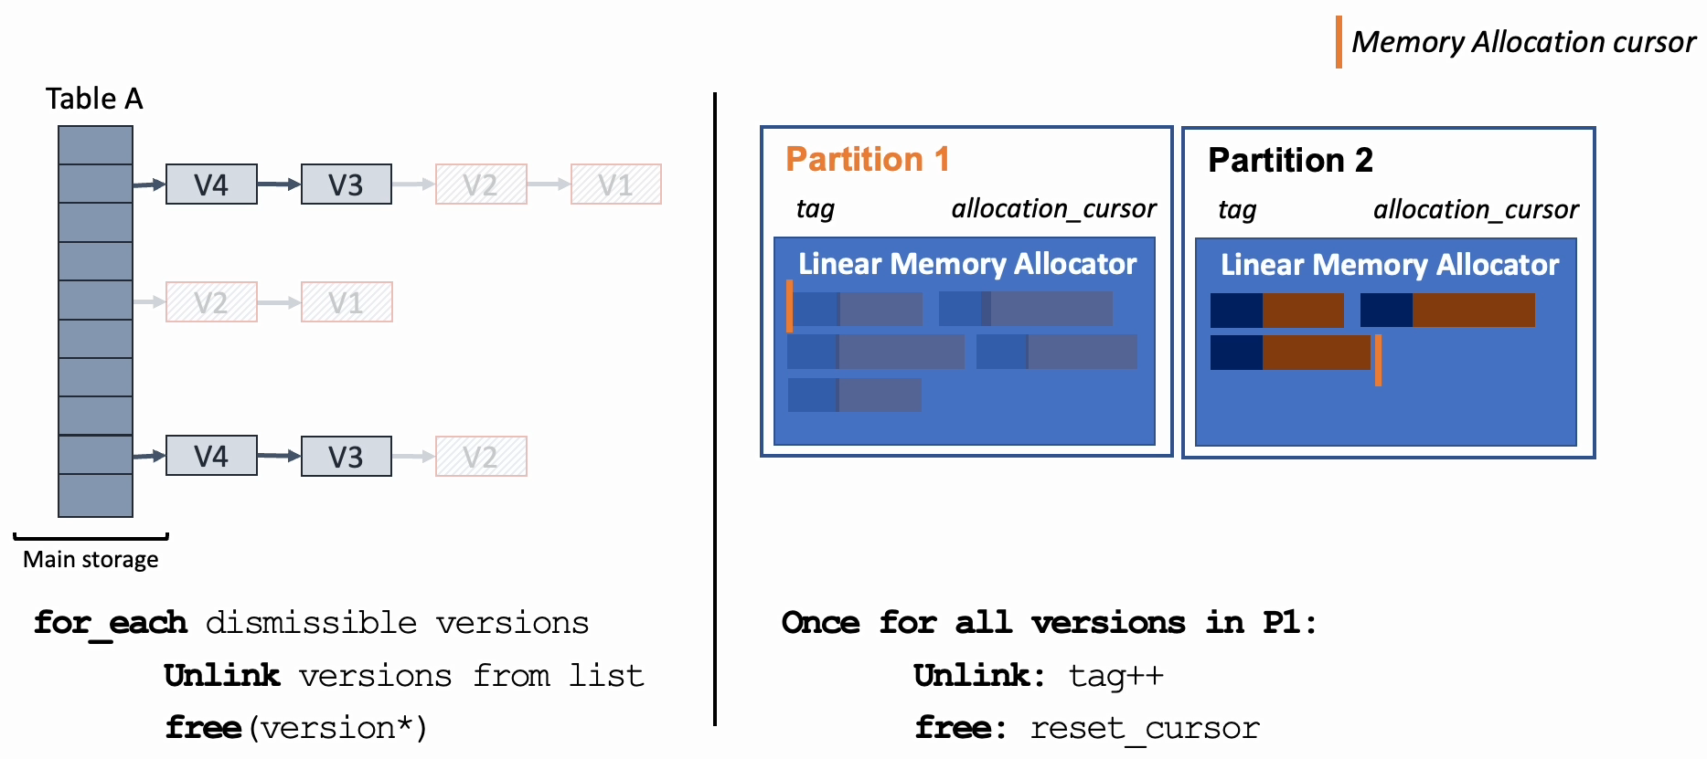
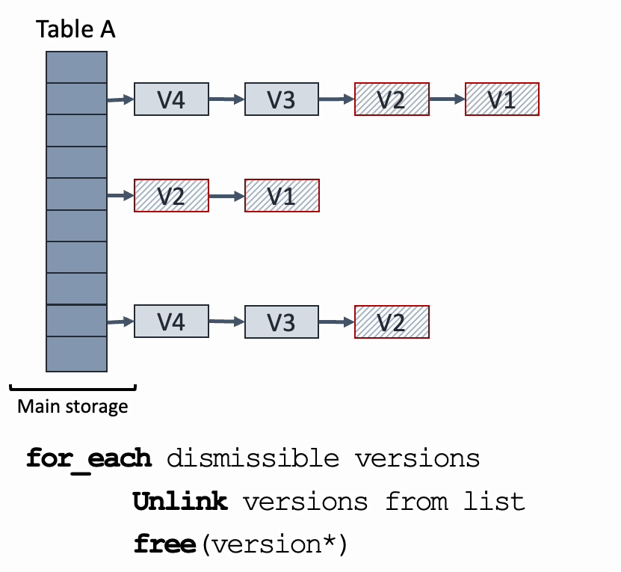
Reclaiming Version Memory
OneShotGC: Reclaims entire partition via cursor reset

Slide 10
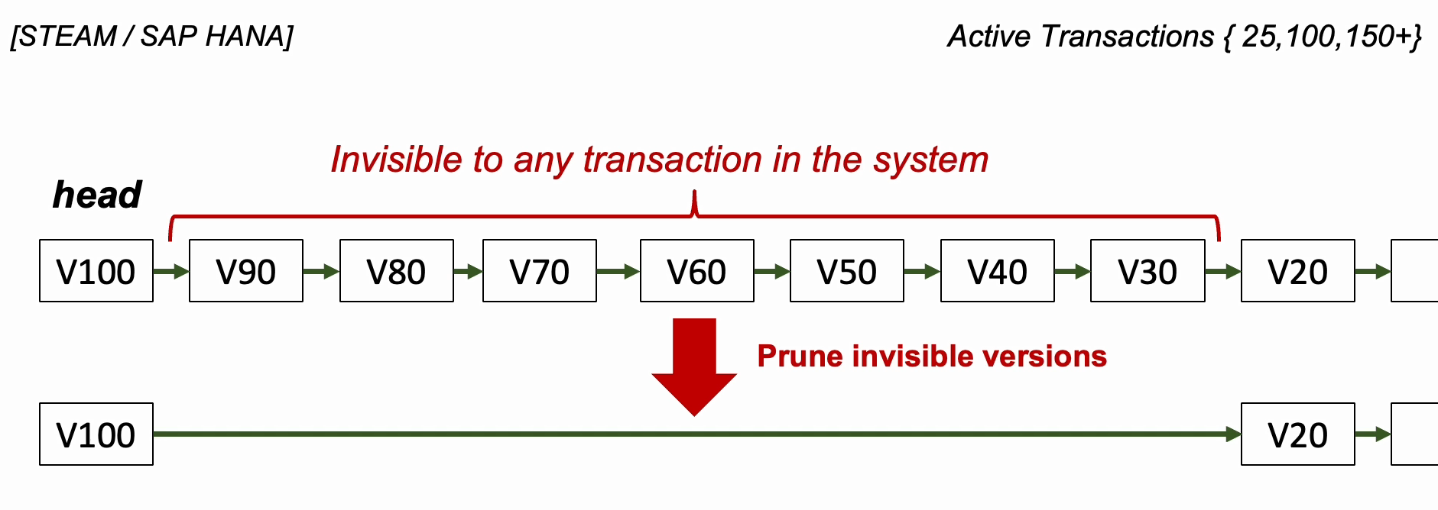
Chain Consolidation in existing methods
Steam GC with EPO: checks and prunes obsolete versions during every update of the tuple
SAP HANA’s interval-based GC: performed by a background thread, triggered periodically
Requires visibility check for each version with all active txns

Slide 11
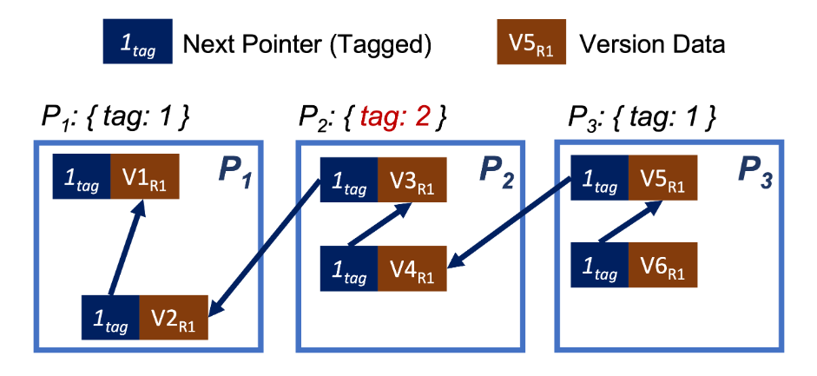
Chain Consolidation in OneShotGC
Required time: the GC manager reclaims a partition containing versions that are not the oldest ones in the chain

Slide 12
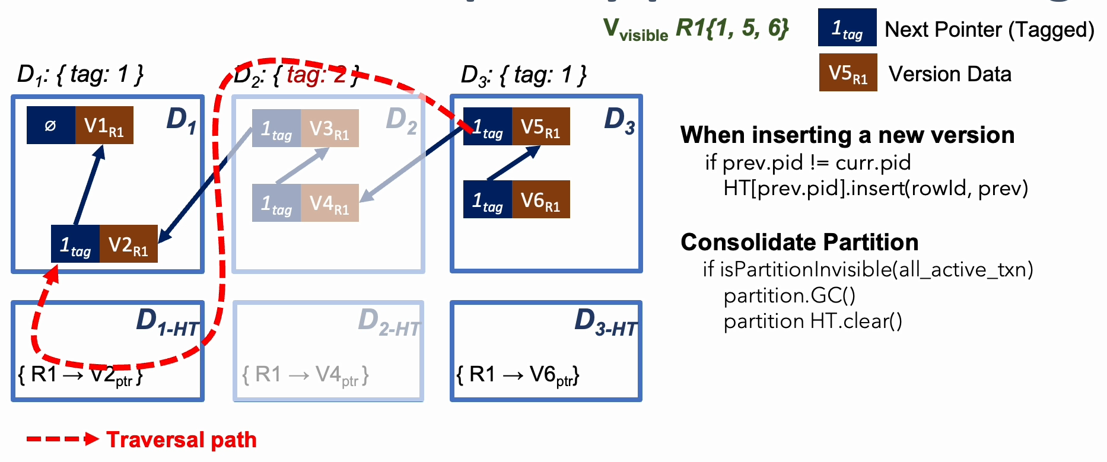
Chain Consolidation in OneShotGC
Introduce the hash table to bridge the chains

Slide 13
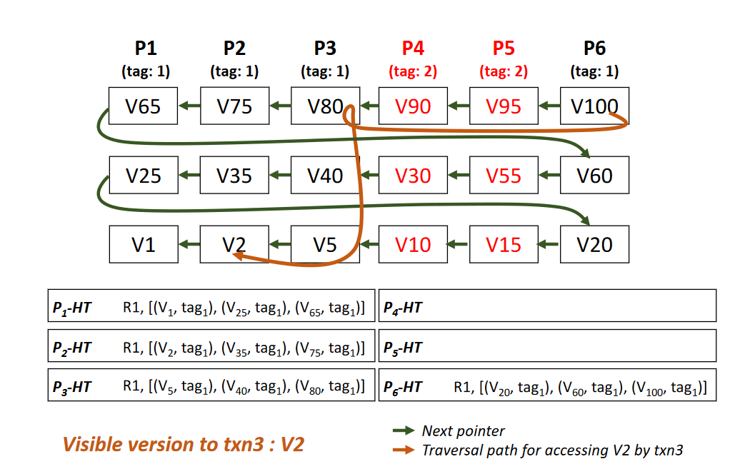
Chain Consolidation in OneShotGC
Record Update
Va
Traversal
New version
Table A
Partition 1
P1-HT
Va
Vb
Vc
[Rid, (Vc, tag)]
Vd
Partition 2
P2-HT
Vb
Main storage

Slide 14
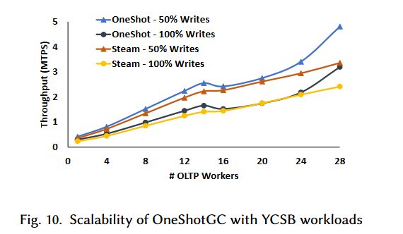
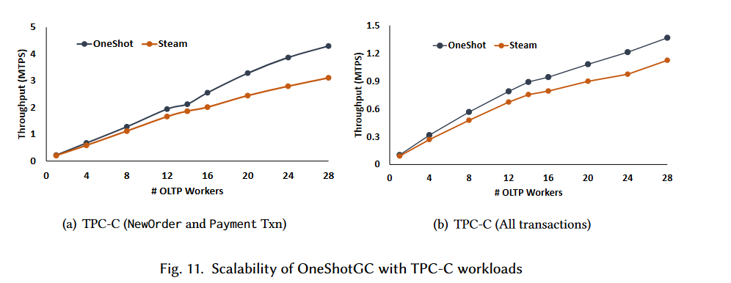
Experiment(Scalability)
Hardware:2x14-core Intel Xeon Gold 6132 processor
Baseline: SteamGC
Workload: YCSB & TPC-C
Pays off cross-NUMA loads.

Slide 15
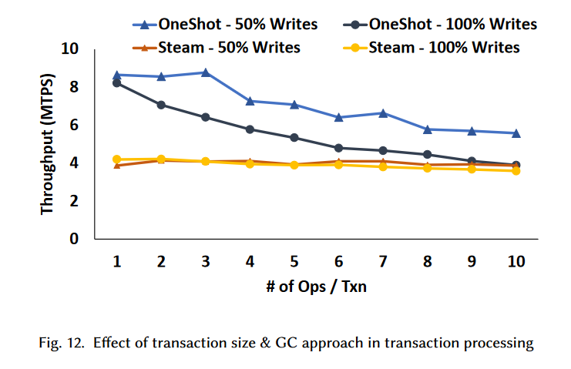
Experiment(Transaction size)
Steam has a constant overhead of acquiring the global minimum active transaction after each transaction.
OneShotGC does not impose any overhead per transaction except atomic operations(register, deregister).

Slide 16
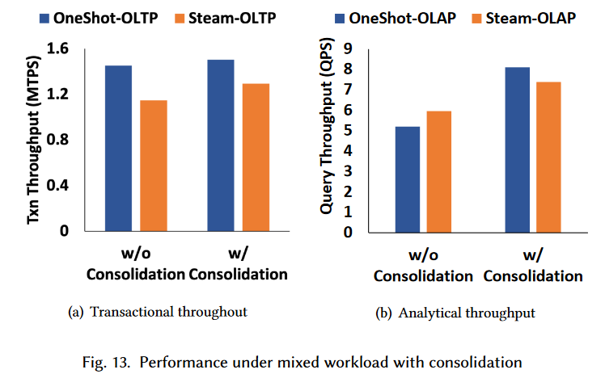
Experiment(consolidation)
The version traversal requires checking tag validity.

Slide 17
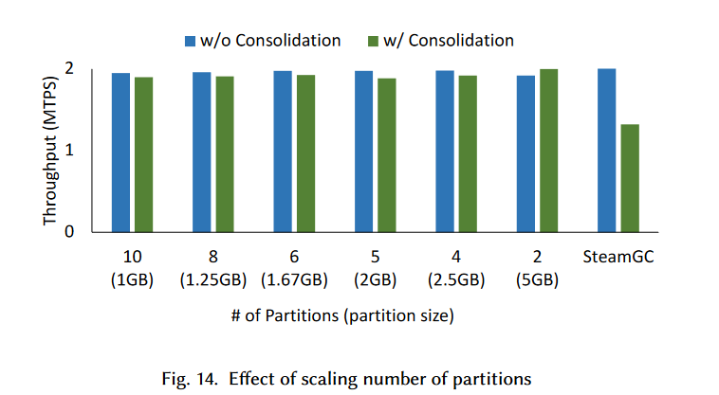
Experiment(partition size)
With only two partitions, the storage size to store versions of a batch of transactions is enough to maintain the maximum throughput of the system.

