Slide 1

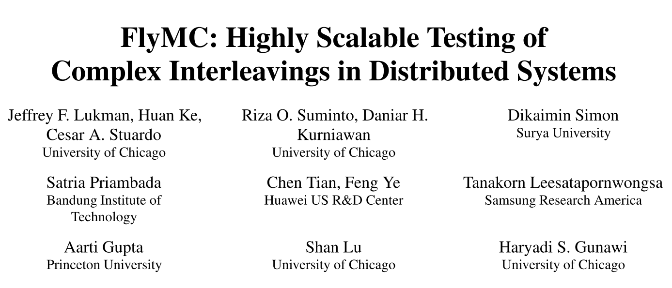

Slide 2
INTRODUCTION
Background
A non-deterministic order of events(messages, crashes, and reboots) across multiple nodes cause “distributed concurrency” bugs to surface.
QUESTION
Path explosion problem: How to find a event sequence triggered the bug?
APPROACH
Reduction algorithm: ignore the symmetry sequences.

Slide 3
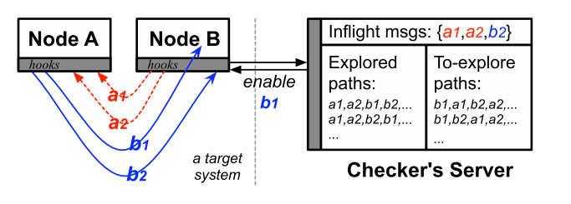
INTRODUCTION
The checker’s server enables one message event at a time and intercepts other events until the current one is finished.
This whole process repeats until it reaches an end or a specification is violated.
The event sequence forms an explored path.
A new path is generated by flipping the events of the old path.

Slide 4
CONTRIBUTION
Highly scalable checker algorithms that provide systematic state coverage for given workloads.
A checker design that is backed with static analysis help developers extract information from the target system and use it to write the system-specific parts of the algorithms.
Additional optimizations that improve the checker’s wall-clock speed in exploring paths.
A comprehensive integration with challenging applications, and detailed evaluations that demonstrate the checker’s effectiveness.

Slide 5
ALGORITHM
Communication and state symmetry: The state transitions of nodes have same role usually depend solely on the order and content of messages, irrespective of the node IDs/addresses.
Event independence: Many events within the non-symmetrical paths are independent, which needn’t to be reordered.
Parallel flips: In existing checkers, only one pair of events is flipped (reordered) at a time. To speed this up, parallel flips can quickly reach hard-to-reach corner cases.

Slide 6
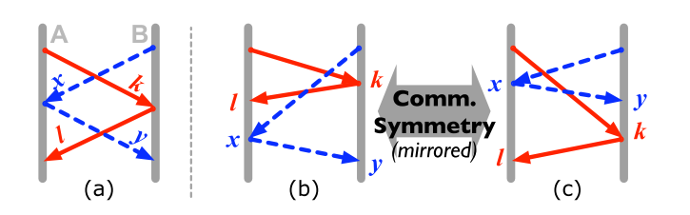
ALGORITHM
Communication and State Symmetry
Communication Symmetry: We abstract the sender and destination node IDs (e.g., IP addresses) to a canonical receiving order.

Slide 7
ALGORITHM
Communication and State Symmetry
Communication Symmetry:
To avoid losing meta data, static analyses outputs a list of message variables that state transitions depend on, hence cannot be abstracted (excluded).

Slide 8
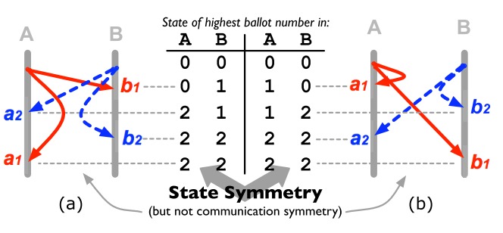
ALGORITHM
Communication and State Symmetry
State Symmetry: We keep a history of {absState+absEv} transitions where absState denotes the abstracted global state.

Slide 9
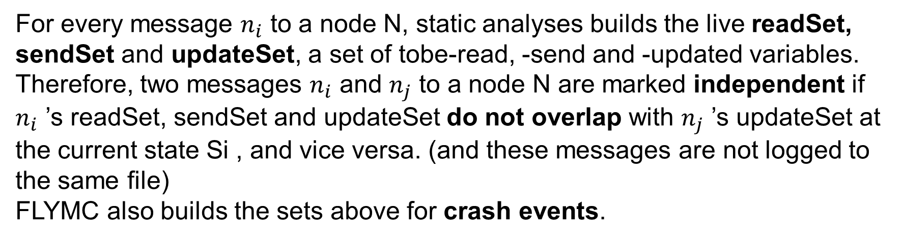
ALGORITHM
Event Independence
For every message $n_{i}$ to a node N, static analyses builds the live readSet, sendSet and updateSet, a set of tobe-read, -send and -updated variables.
Therefore, two messages $n_{i}$ and $n_{j}$ to a node N are marked independent if $n_{i}$ ’s readSet, sendSet and updateSet do not overlap with $n_{j}$ ’s updateSet at the current state Si , and vice versa. (and these messages are not logged to the same file)
FLYMC also builds the sets above for crash events.

Slide 10
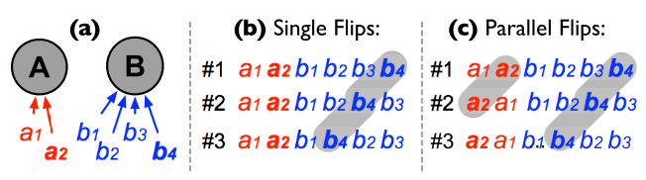
ALGORITHM
Parallel Flips
For the next to-explore path, we flip a pair of two messages in every node, hence N simultaneous flips across all the N node.
*This algorithm helps developers to unearth bugs faster but does not reduce the state space.

Slide 11
OPTIMIZATION
Local Ordering Enforcement
Stand-alone checkers must wait a non-negligible amount of time before enabling the next event, for two purposes: to prevent concurrency issues within itself and to wait for new updated state from the target system.
We enhance FLYMC’s interposition mechanism at the target system side to enforce local action ordering.

Slide 12
OPTIMIZATION
State-event Caching
Here, after enabling ej and before enabling the next event ek, FLYMC must collect statement infomation Si+ej→Sj from the target system, which is another expensive round-trip time.
If ej is to be enabled at Si and the state transition Si+ej already exists in the history, then no wait is needed between enabling ej and ek

Slide 13
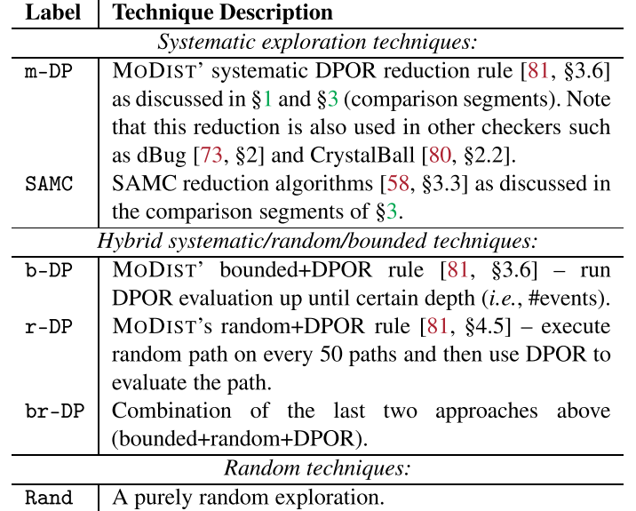
EVALUATION
Tech
DPOR reduction rule:
A message to be processed by a given node is independent of other concurrent messages destined to other nodes.

Slide 14
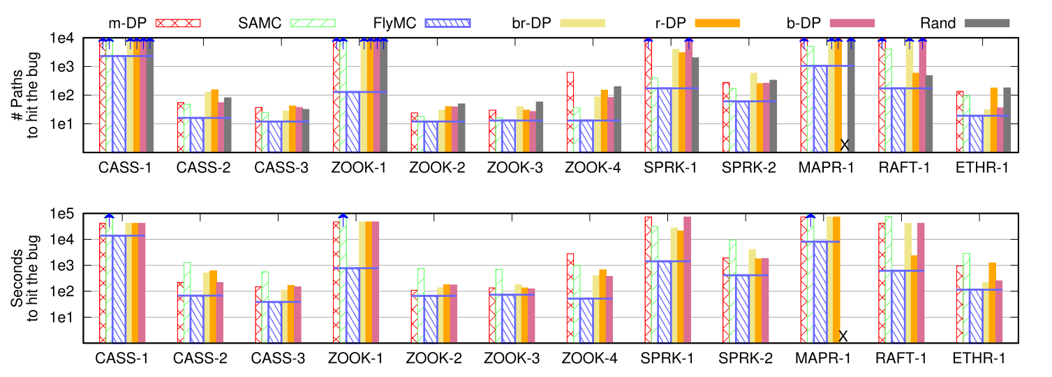
EVALUATION
Speed

Slide 15
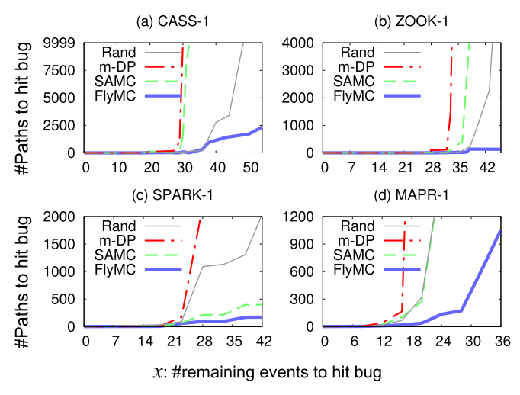
EVALUATION
Scalability

Slide 16
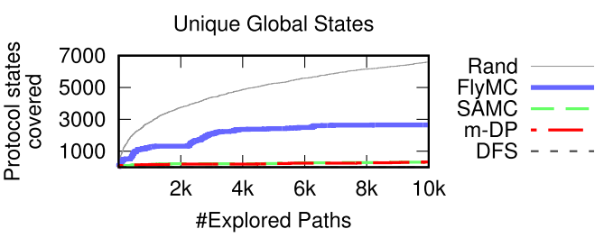
EVALUATION
State coverage

Slide 17
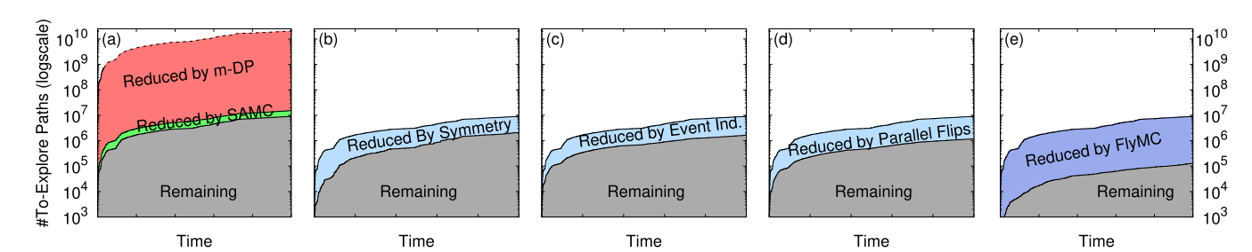
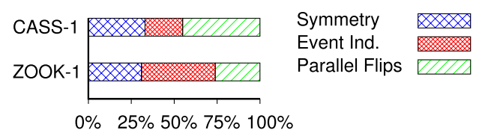
EVALUATION
Reduced paths over time
Ratio of reduced paths per algorithm

