Slide 1

Cardinality Estimation in DBMS: A Comprehensive Benchmark Evaluation

Slide 2
Problem
To what extent can these Cardest methods improve the performance of query optimizer in real-world settings.

Slide 3
Remaining problems of Cardest(cardenality estimation for short) experiments.
The data and query workloads used for evaluation may not well
represent the real-world scenarios.
Most of the evaluations do not exhibit the end-to-end improvement of CardEst methods on the query optimizer.
Exsisting works: √ Estimation Accuracy √ Inference Latency
Issue a Goden Standard:record the end-to-end query time, including both query plan generation time and execution time.

Slide 4
Contribution : A new benchmark
Establish a new benchmark for CardEst that can represent
real-world settings. Our benchmark includes a real-world dataset
STATS.

Slide 5
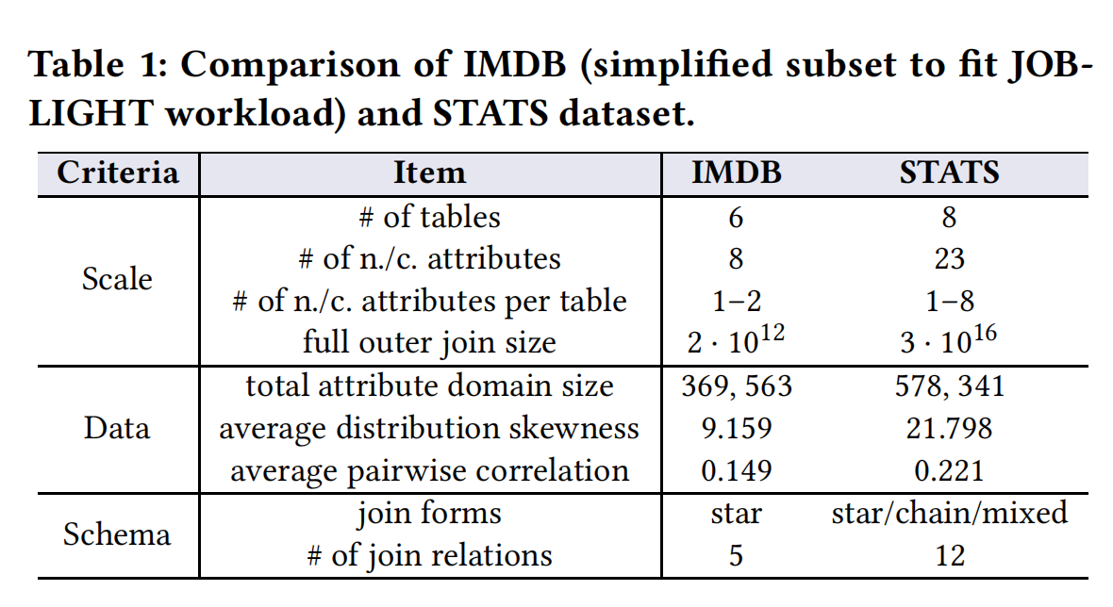
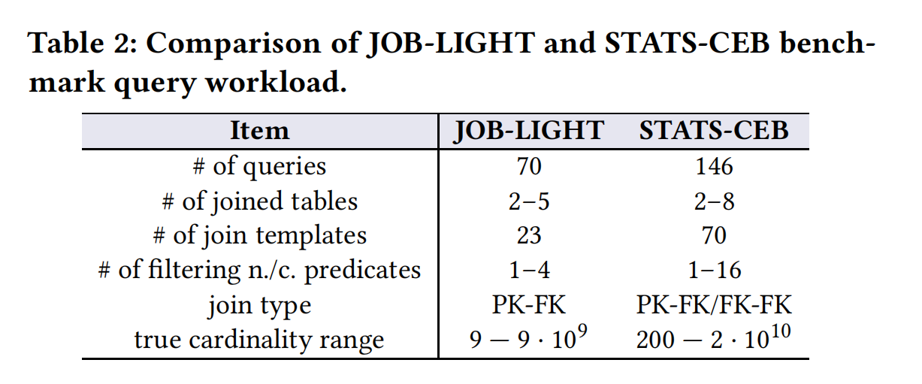

Slide 6
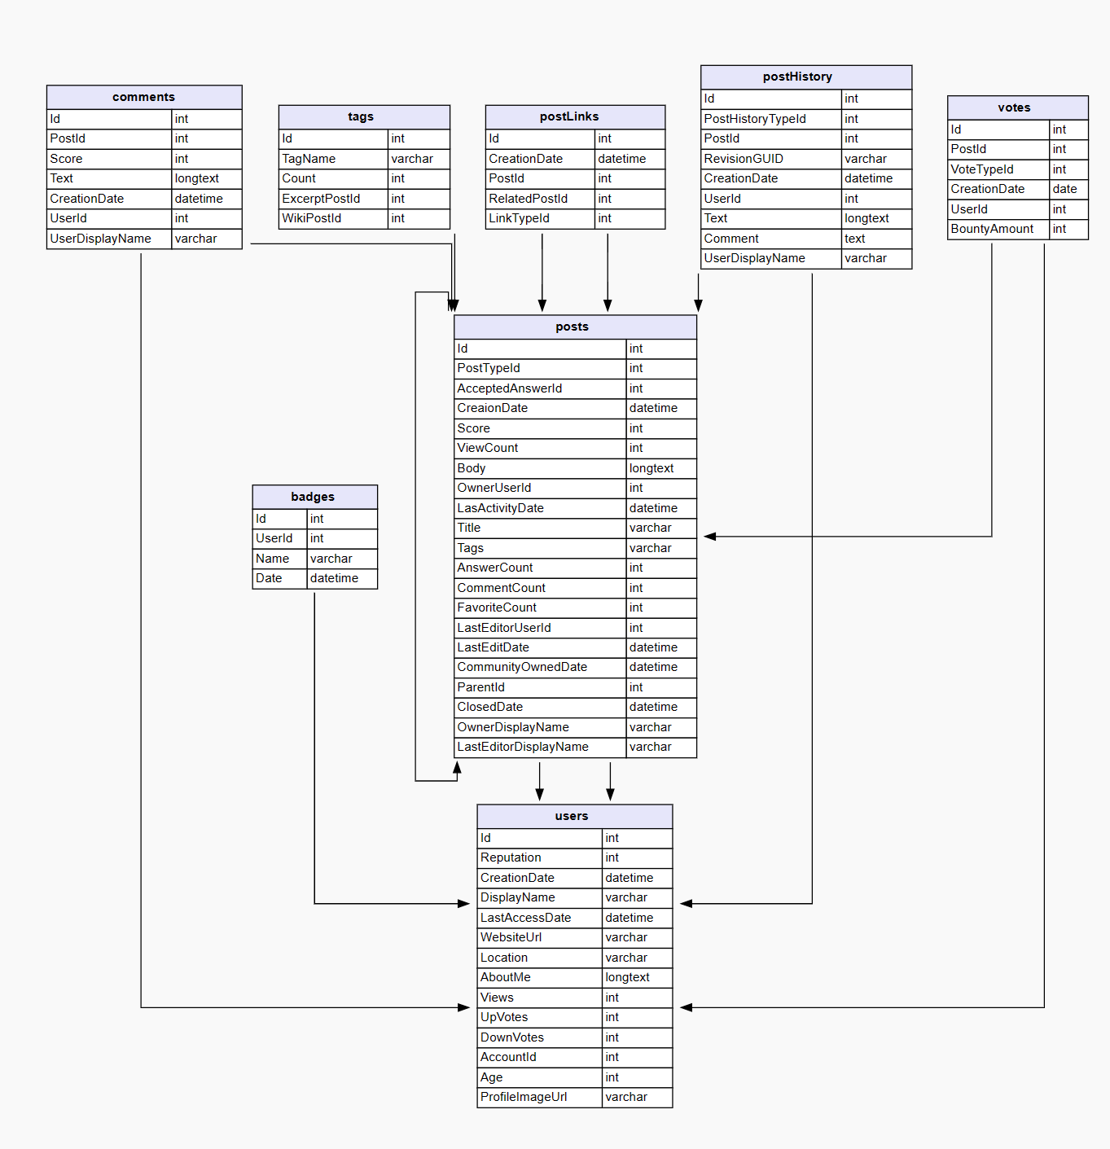
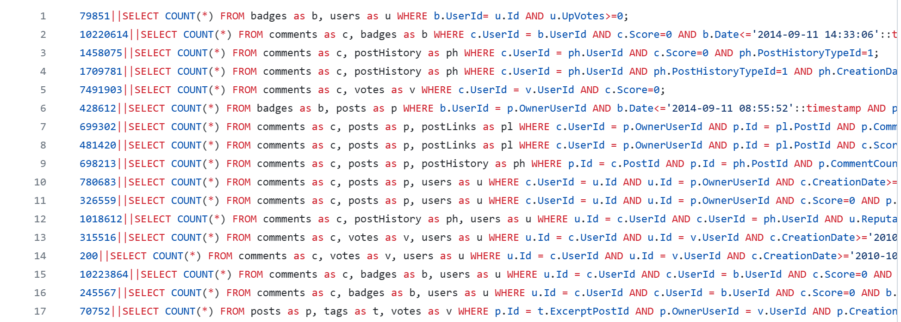
Large attribute numbers
Strong distribution skewness
High attribute correlations
Complicated join schema(star and chain)

Slide 7
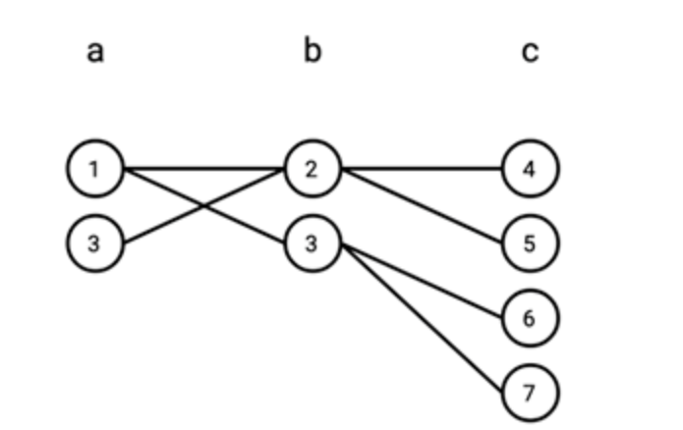
Contribution : end-to-end evaluation plan
Traditional CardEst method
PostgreSQL(histogram-based）
MultiHist
UniSample
WJSample
ML-based CardEst method
Query-driven
Data-driven

Slide 8
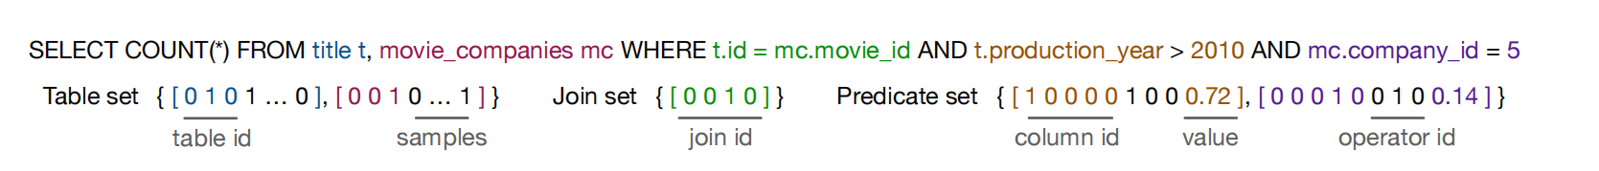
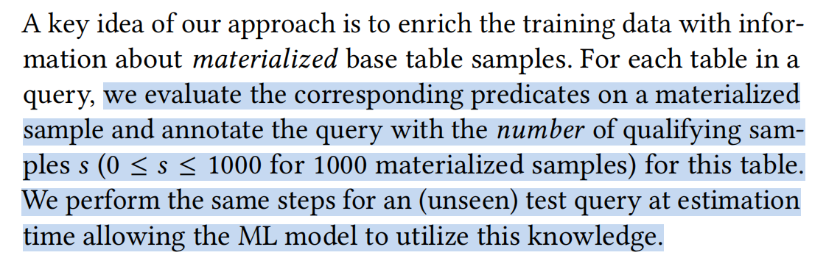
Query-driven
Learned Cardinalities:Estimating Correlated Joins with Deep Learning
Set-Based Query Representation

Slide 9
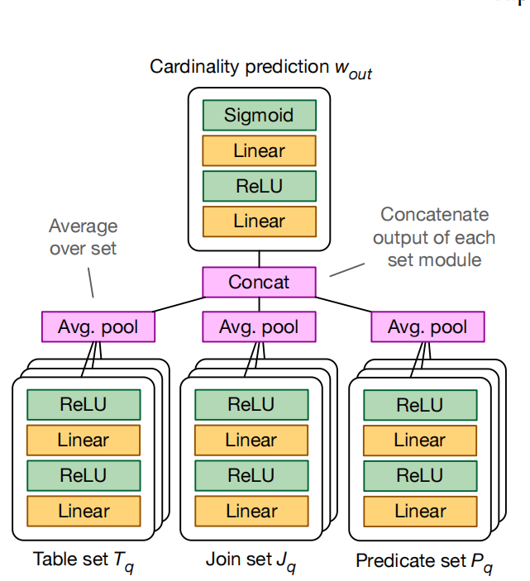
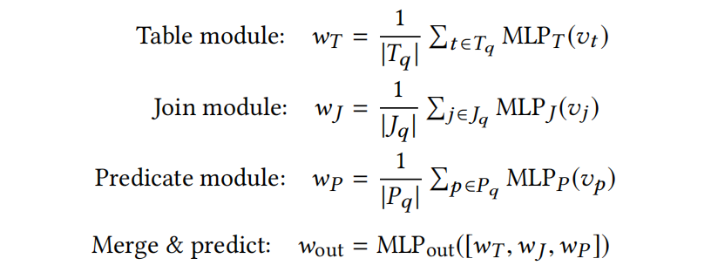
Query-driven
multi-set convolutional network (MSCN)

Slide 10
Query-driven
Generating Training Data
Obtain an initial training corpus by generating random queries based on schema information.
Enriching the Training Data

Slide 11
Data-Driven
DeepDB: Learn from Data, not from Queries.
Cardinality Estimation
Approximate Query Processing
Machine Learning

Slide 12
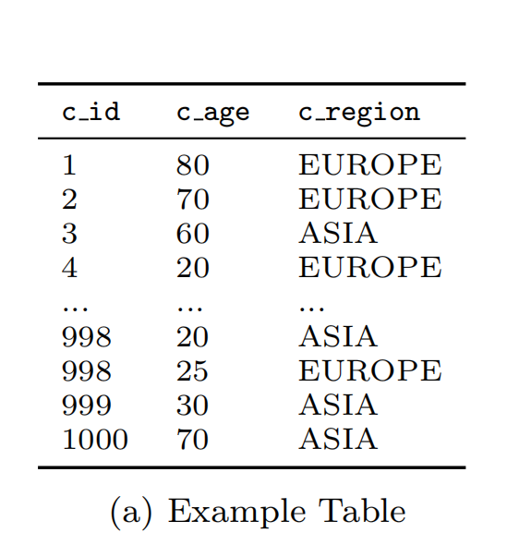
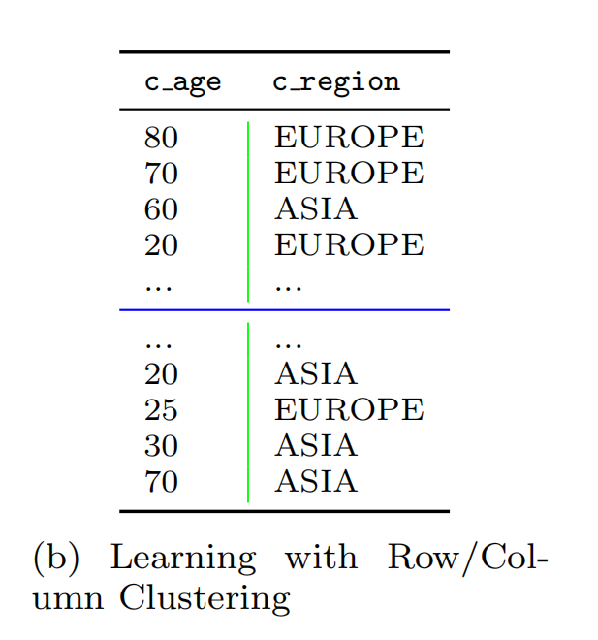
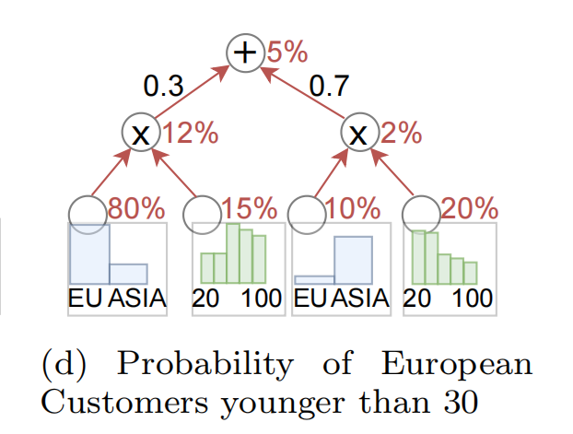
Data-Driven
Cardinality Estimation

Slide 13
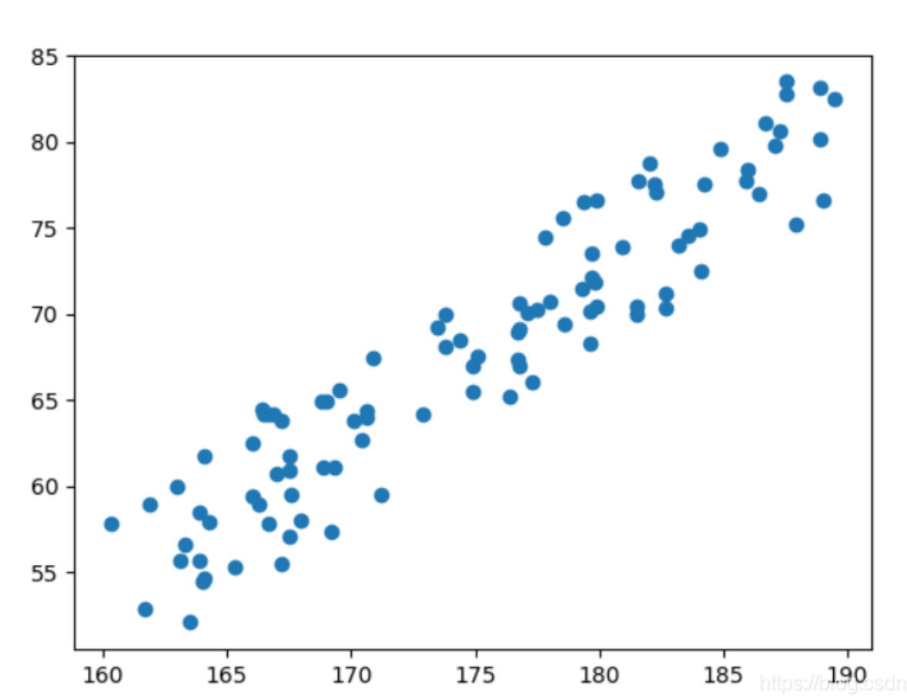
Data-Driven
Most of the Cardest Methods are based on a naive assumption:attributes are independent from each other.

Slide 14
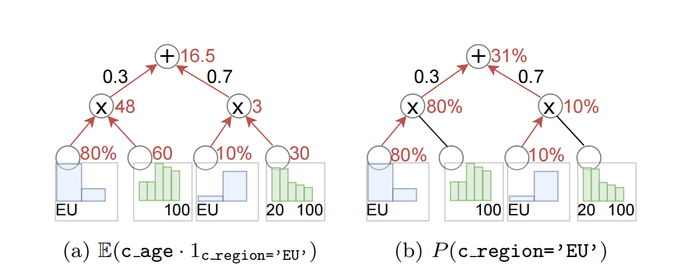

Data-Driven
Approximate Query Processing (AQP)
SELECT AVG(c_age) FROM t GROUP BY c_region

Slide 15

Data-Driven
Machine Learning (ML)
Regression
$f(x) = E(Y|X = x)$
Classifacation
P(Y = 0 | $X_{1} = m, X_{2} = n$) P(Y = 1 | $X_{1} = m, X_{2} = n$)

Slide 16
Difference between query-diven and data-driven
Query-Driven
Big model, concentrated on encoding,training,sampling...
Data-Driven
More lightweight, concentrated on learning precise data distribution.

Slide 17
With different estimation cardinality, which part of the query plan will be influnced?
Table-scan methods
Index scan or seq-scan
Join order
Join method
Nested-loop-join, merge-join, or hash-join...

Slide 18
Evaluation Metrics
End-to-end time
Including both the query plan generation time and physical plan execution time.
Inference latency
Query plan generation time.
Space cost
CardEst model size.
Training cost
Model’s offline training time.
Updating speed
The time cost for CardEst models to fit the data changes.

Slide 19
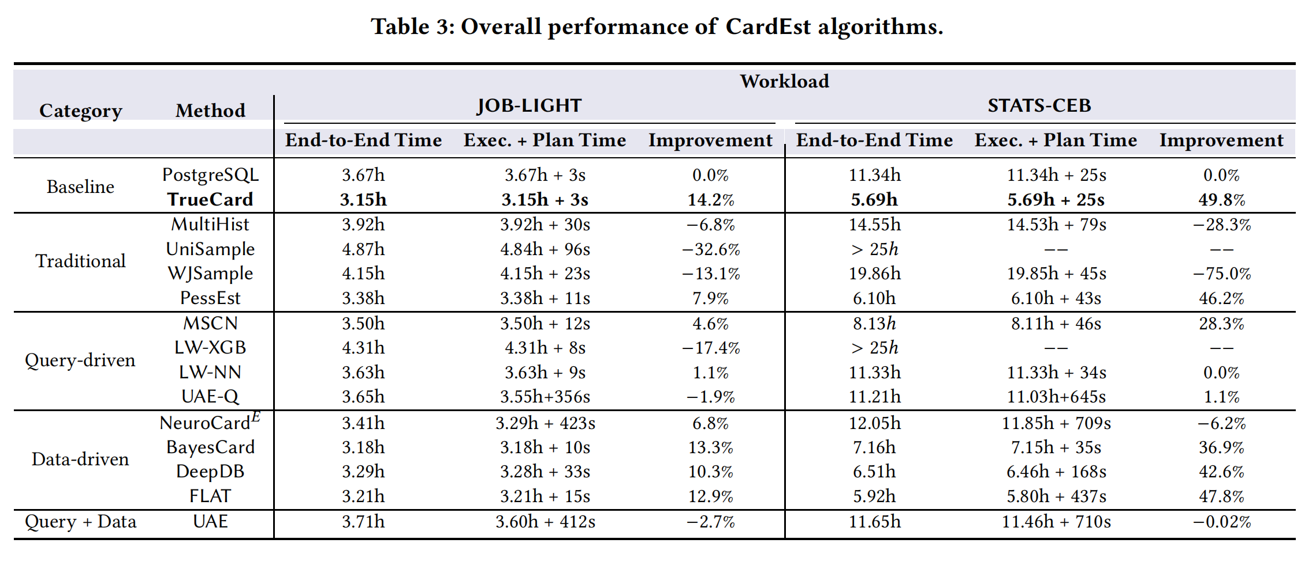
Experiment

Slide 20
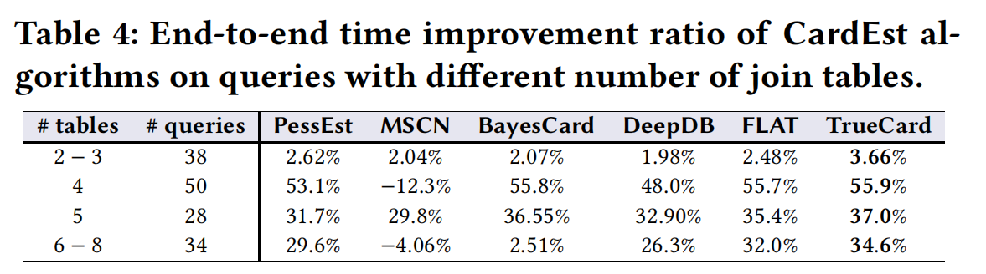
Observations
(1). Data-driven CardEst methods outperforms query-driven CardEst methods.
(2). More complicated workloads expand the performance gap between CardEst methods.
(3). The improvement gaps between these methods and the performance of TrueCard increase with the number of join tables.

Slide 21
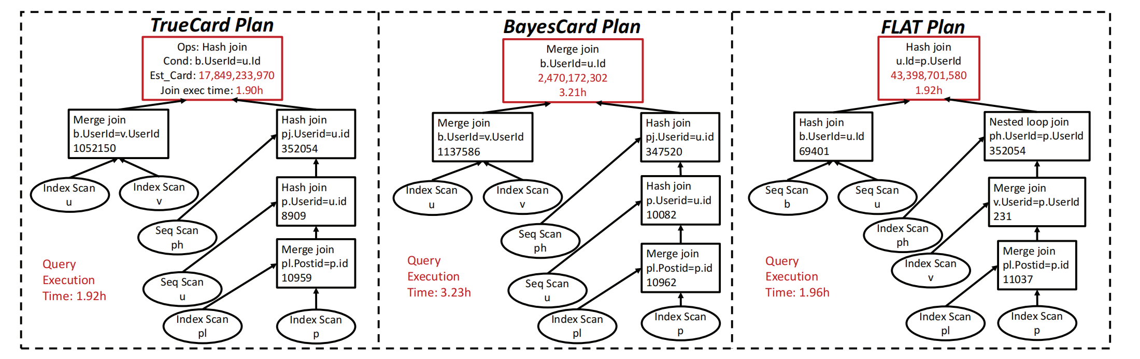
Observations
(4). Accurate estimation of (sub-plan) queries with large cardinalities is sometimes more important than the small ones.

Slide 22
Observations
Inference Latency
Refered to Planning time.
Model deployment
Refered to model size and training time.
Model update
Refered to update speed and update accuracy.

Slide 23
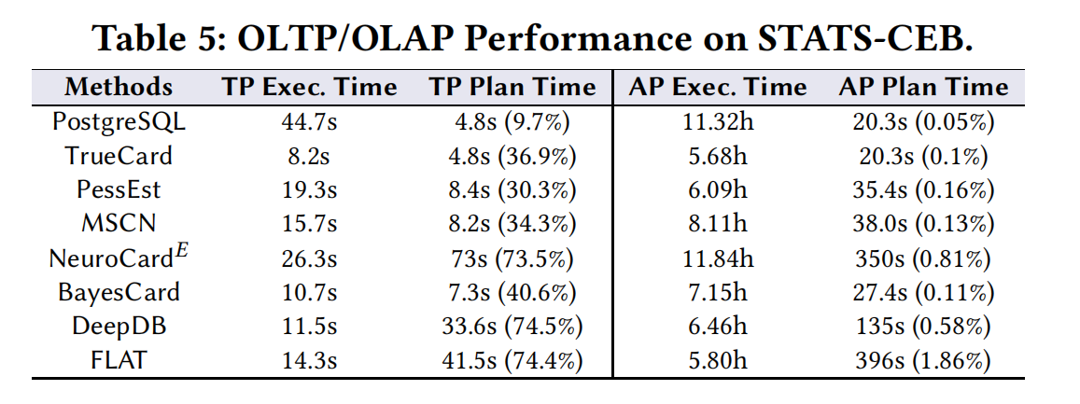
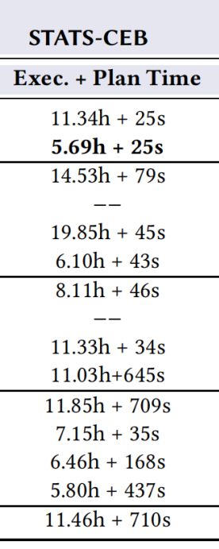
Observations-Inference latency
(5). Inference latency can have a significant impact on the OLTP workload but a trivial impact on the OLAP workload.

Slide 24
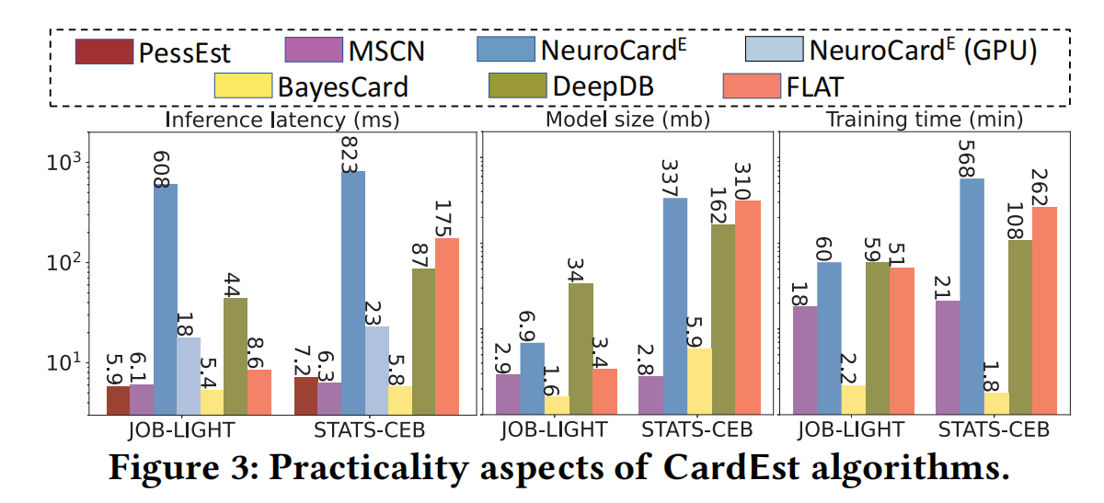
Observations-Model deployment
(6). BN-based CardEst approach is very friendly for system deployment.

Slide 25
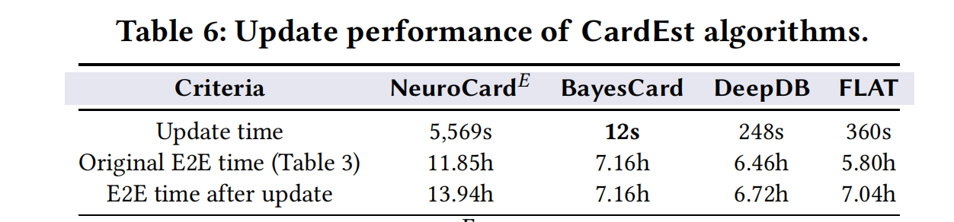
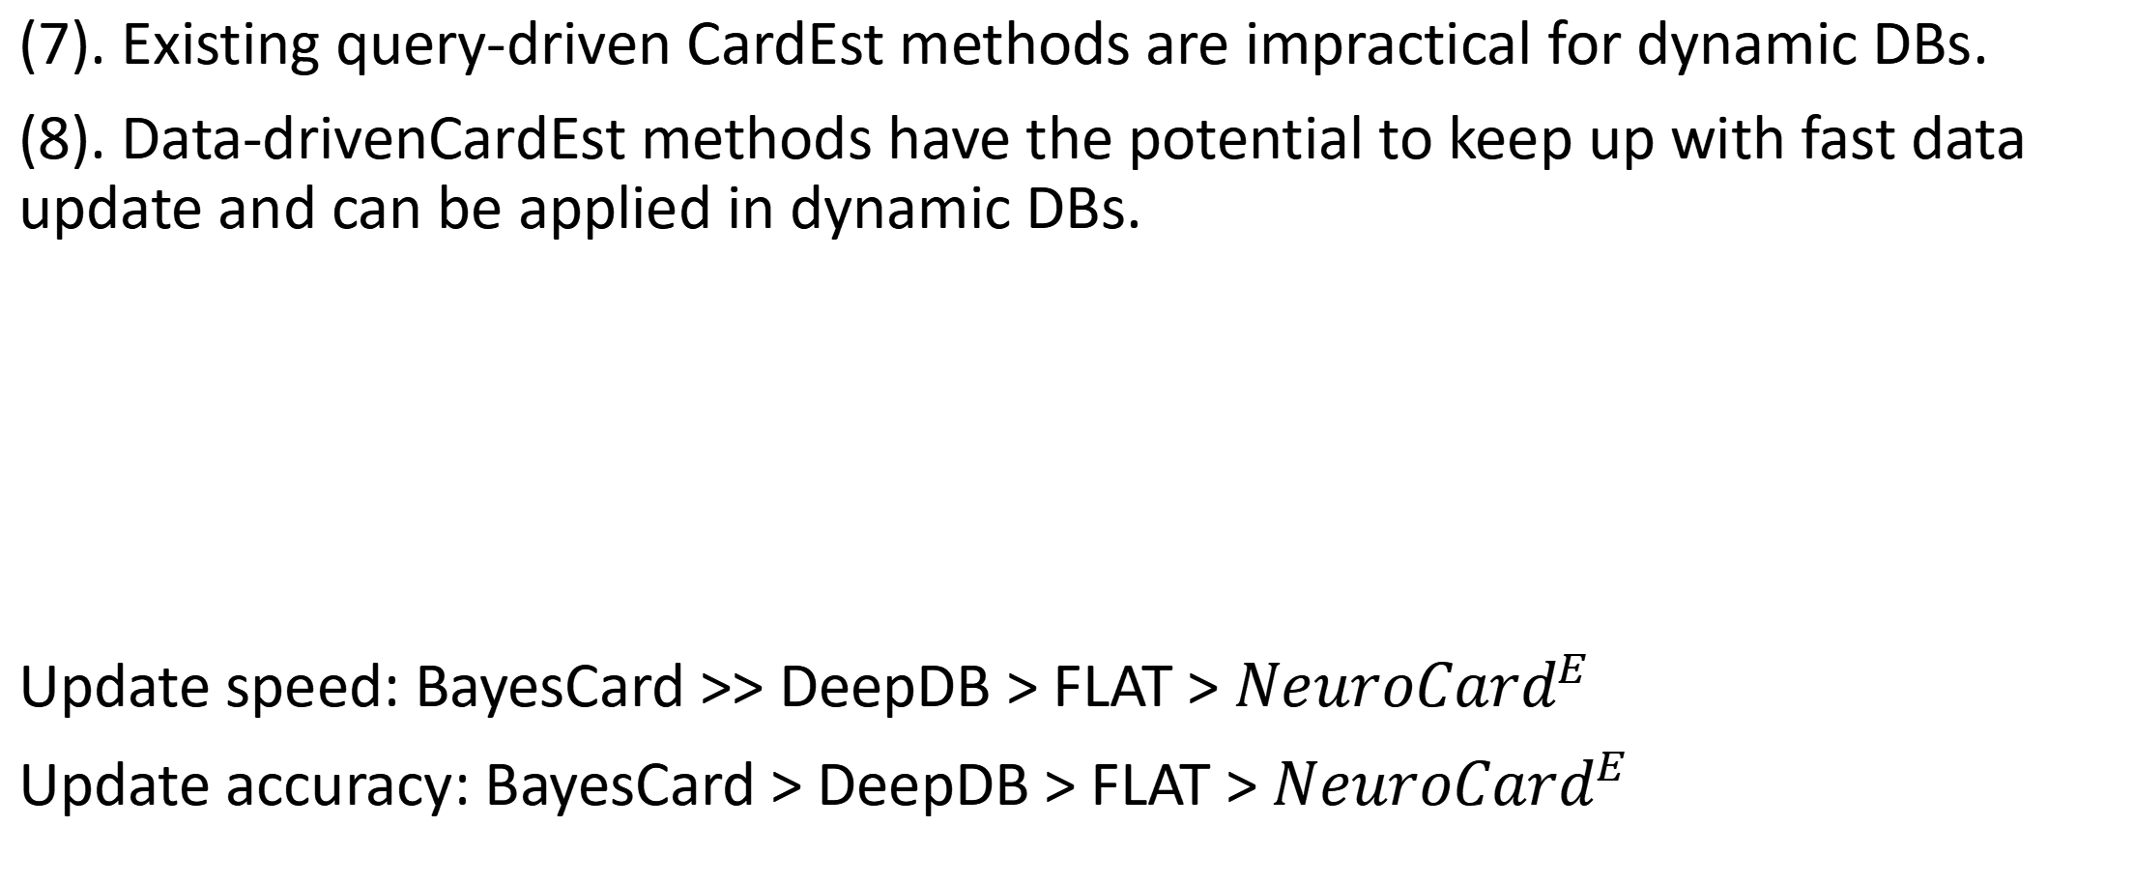
Observations-Model update
(7). Existing query-driven CardEst methods are impractical for dynamic DBs.
(8). Data-drivenCardEst methods have the potential to keep up with fast data update and can be applied in dynamic DBs.
Update speed: BayesCard >> DeepDB > FLAT > ${NeuroCard}^{E}$
Update accuracy: BayesCard > DeepDB > FLAT > ${NeuroCard}^{E}$

Slide 26
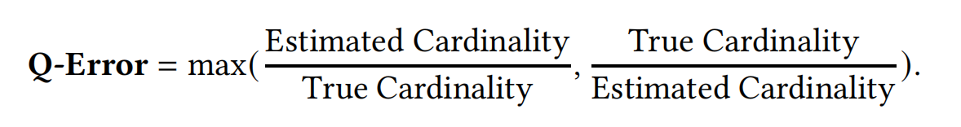
Current Metric
Would CardEst methods with smaller Q-Errors definitely generate query plans with shorter execution time?

Slide 27
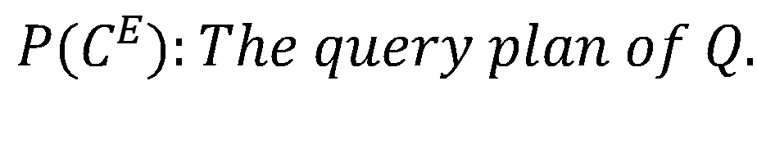
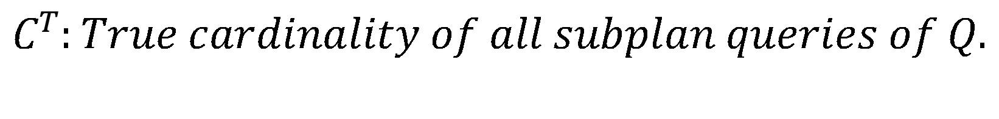
An Alternative Metric: P-Error
The best way to evaluate the quality of a CardEst method is to directly record its query execution time on some benchmark datasets and query workloads.
Not suitable for the situations where fast evaluation is needed, e.g. hyper-parameter tuning.
We believe that the estimated cost could serve as a good metric for evaluating the CardEst methods.
$$P−Error = PPC(P(C^{E}),C^{T})/PPC(P(C^{T}),C^{T})$$
$$C^{T}:True cardinality of all subplan queries of Q.$$
$$C^{E}:Estimated cardinality of all subplan queries of Q.$$
$$P(C^{E}):The query plan of Q.$$
$PPC(P(C^{E}),C^{T}):$ The estimated cost of certain query in PostgreSQL.

Slide 28
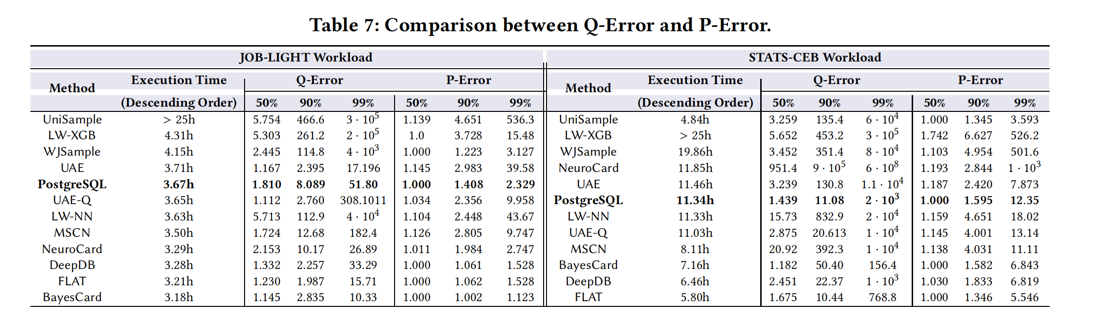
Q-Error VS P-Error
P-Error is more highly correlated to the query execution time than Q-Error.

