Slide 1




Virtual Consensus in Delos
Mahesh Balakrishnan, Jason Flinn, Chen Shen, Mihir Dharamshi, Ahmed Jafri, Xiao Shi Santosh Ghosh, Hazem Hassan, Aaryaman Sagar, Rhed Shi, Jingming Liu, Filip Gruszczynski Xianan Zhang, Huy Hoang, Ahmed Yossef, Francois Richard, Yee Jiun Song
Facebook, Inc.
OSDI 2020 Jay Lepreau Best Paper

Slide 2
The Facebook Stack
Turtles all the way down…
the data plane
Web
NoSQL
Databases
AI/ML
…
…
the control plane
Config Naming
Scheduler
Sharding
[ Twine, OSDI 2020 ]
fault-tolerant
[ zero-dependency, durable, highly available ]
rich API
[ transactions, range queries, secondary indices ]
control plane storage
Notes:
Fault-tolerance的同时，支持SQL语法

Slide 3

The Need For A New Storage System
why not use an existing system?
???
why not modify an existing system?
hard to change database API (e.g., add TXes to ZooKeeper)
MySQL
database
consensus
rich API
ZippyDB
ZooKeeper
fault-tolerance
hard to change consensus protocol (e.g., MySQL over ZAB)
problem statement circa 2017:
can we build a zero-dependency, fault-tolerant system with a rich API… in months?
Notes:
Mysql支持SQL，但是很难处理fault-tolerance
ZooKeeper有很好的fault-tolerance，但是自身的API又十分受限
难以魔改 如何快速构建一个fault-tolerant而且没有外部依赖的系统

Slide 4


The Delos Storage System
or: “how to build a production-ready storage system in eight months”
database (materialized state)
append checkTail readNext
shared log (consensus)
complex distributed protocol
the shared log is an API for consensus
CORFU (NSDI 2012), Tango (SOSP 2013), Hyder (SIGMOD 2015),
CorfuDB, LogDevice, Scalog (NSDI 2020)…
Notes:
Shared Log: 底层的log对上层的数据库无感知
1. HA 2. consensus

Slide 5




The Delos Storage System: Above The Log
Client
DelosTable
database (materialized state)
DelosRuntime
shared log (consensus)
shared log (consensus)
logical updates: e.g. “put x=5 if x==4”
simple protocols above the log
easy to support new APIs

Slide 6

The Delos Storage System: Below The Log
database (materialized state)
pros:
append checkTail readNext
fast to build/deploy
highly reliable
shared log (consensus)
/log
/log/entry0
/log/entry1
- …
(ZooKeeper shim)

Slide 7
The Delos Storage System: Below The Log
database (materialized state)
pros:
append checkTail readNext
fast to build/deploy
highly reliable
shared log (consensus)
cons:
very inefficient and slow
service dependency
/log
/log/entry0
/log/entry1
- …
(ZooKeeper shim)

Slide 8

How Do We Develop A New Shared Log? (without re-implementing MultiPaxos…)

Slide 9
How Do We Develop A New Shared Log?
(without re-implementing MultiPaxos…)
How Do We Deploy A New Shared Log?
(without service downtime…)
Virtual Consensus!

Slide 10

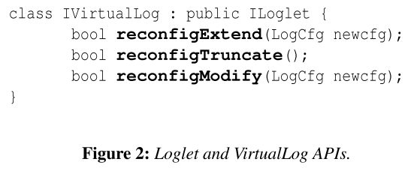
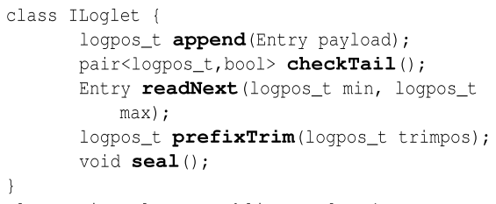

Virtualizing Consensus Via The Virtuallog
append checkTail readNext
MetaStore
[ver 0]
0 ➔ inf : ZKLoglet
VirtualLog
Loglet
append checkTail readNext seal
ZKLoglet
ZooKeeper
Notes:
The reconfigExtend call changes the active segment of the VirtualLog so that new appends are directed to an entirely different Loglet.
Reconfigurations can also modify sealed segments via the reconfigModify call (e.g., to replace failed servers within a sealed Loglet).
The reconfigTruncate call is used to remove the first sealed segment from the chain (e.g., when the VirtualLog’s address space is trimmed).

Slide 11
Virtualizing Consensus Via The Virtuallog
append checkTail readNext
MetaStore
[ver 0]
0 ➔ inf : ZKLoglet
VirtualLog
Loglet
append checkTail readNext seal
ZKLoglet
ZooKeeper
Notes:
Applications can append an entry, receiving back a log position;
call checkTail to obtain the first unwritten position;
call readNext to read the first entry in the passed-in range;
and call prefixTrim to indicate that a prefix of the log can be trimmed.
Virtual log maps logical log to physical log(Loglet), loglet normally contain more than one log servers.

Slide 12
Virtualizing Consensus Via The Virtuallog
append checkTail readNext
MetaStore
[ver 1]
0 ➔ 3: ZKLoglet
3 ➔ inf: LDLoglet
VirtualLog
Loglet
append checkTail readNext seal
ZKLoglet
ZooKeeper

Slide 13

Virtualizing Consensus Via The Virtuallog
append checkTail readNext
MetaStore
[ver 1]
0 ➔ 3: ZKLoglet
3 ➔ inf: LDLoglet
VirtualLog
Loglet
append checkTail readNext seal
ZKLoglet
ZooKeeper
LDLoglet
LogDevice

Slide 14
Virtualizing Consensus Via The Virtuallog
append checkTail readNext
MetaStore
[ver 1]
0 ➔ 3: ZKLoglet
3 ➔ inf: LDLoglet
VirtualLog
Loglet
append checkTail readNext seal
ZKLoglet
ZooKeeper
LDLoglet
LogDevice
we can deploy a new Loglet without downtime!

Slide 15
Difficult To Build A Log That Is Simple, Fast, Fault-tolerant
MetaStore
[ver 0]
0 ➔ inf : Loglet
necessary and sufficient source of fault-tolerant consensus…
VirtualLog
MetaStore
[ver 0]
0 ➔ inf : Loglet
simple, fault-tolerant
the VirtualLog handles all reconfiguration (including leader election); the Loglet provides failure-free ordering
Loglet
Loglet
simple, fast
no fault-tolerant consensus; only fault-tolerant seal
Lamport’s original Paxos with no optimizations
simple, fast
Notes:
构建virtual log时遇到的三个困难 No fault-tolerant consensus means one server is down, the whole loglet is down.
When a loglet becomes unavailable, just switch! All reconfigurations including sealed loglet changing

Slide 16





The Nativeloglet
Delos Runtime (client)
sequencer
LogServer
quorum appends

Slide 17

The Nativeloglet
Delos Runtime (client)
sequencer
LogServer
quorum appends
quorum checkTail

Slide 18

The Nativeloglet
Delos Runtime (client)
LogServer
quorum appends
quorum checkTail
fast local reads

Slide 19

The Nativeloglet
Delos Runtime (client)
sequencer
LogServer
quorum appends
quorum checkTail
fast local reads
fault-tolerant seal
Notes:
如果sequencer挂了，那么就无法进行append, checkTail或者其他操作

Slide 20
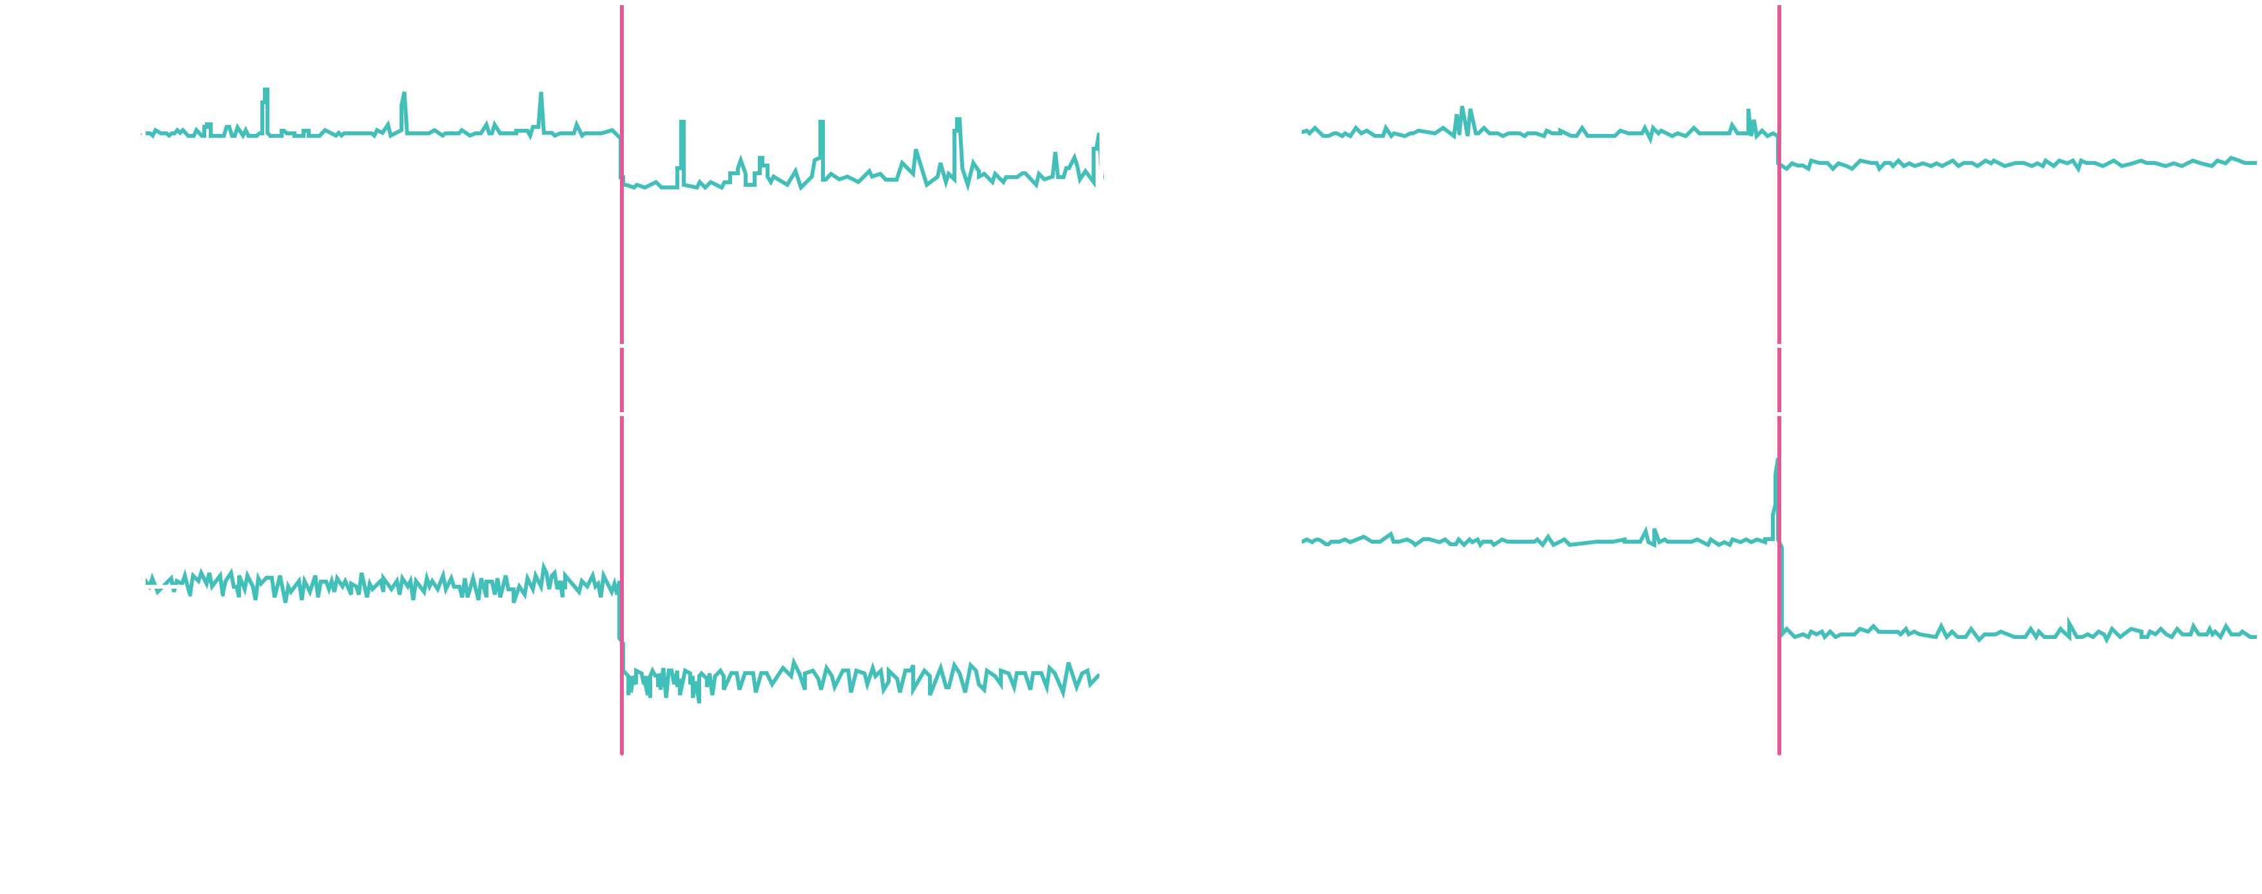
Switching Logs Mid-flight
Notes:
部署NativeLoglet

Slide 21




Deploying Loglets: Converged Vs. Disaggregated
log+DB on each server:
fast local log reads
fate-sharing
separate log and DB:
less I/O contention
independent scaling
converged is preferred in production: the DB wants fate-sharing with the log…

Slide 22
Deploying Loglets: Converged Vs. Disaggregated
log+DB on each server:
separate log and DB:
fast local log reads
fate-sharing
less I/O contention
independent scaling
converged is preferred in production: the DB wants fate-sharing with the log…
(unless its own fate is bad…)

Slide 23
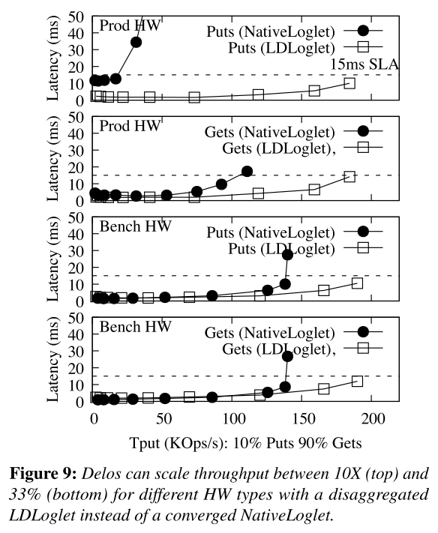
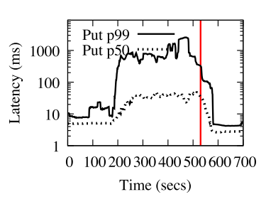
Deploying Loglets: Converged Vs. Disaggregated
log+DB on each server:
separate log and DB:
fast local log reads
fate-sharing
less I/O contention
independent scaling
converged is preferred in production: the DB wants fate-sharing with the log…
(unless its own fate is bad…)
… we can decouple fate on demand by reconfiguring to a disaggregated log
10X
higher throughput via disaggregation
Notes:
Delos can scale throughput by running over a disaggregated Loglet.
In Figure 9, we plot throughput on the x-axis and p99 latency on the y-axis, for the synthetic workload with 90% gets and 10% puts.

Slide 24

Composing Loglets: The Stripedloglet
DelosRuntime

Slide 25
Composing Loglets: The Stripedloglet
DelosRuntime
0
0

Slide 26
Composing Loglets: The Stripedloglet
DelosRuntime
0 1
0
1

Slide 27
Composing Loglets: The Stripedloglet
DelosRuntime
0 1 2
0
1
2

Slide 28
Composing Loglets: The Stripedloglet
DelosRuntime
0 1 2 3
0 3
1
2

Slide 29

Composing Loglets: The Stripedloglet
DelosRuntime
DelosRuntime
0 1 2 3
0 3
1
2

Slide 30
Composing Loglets: The Stripedloglet
DelosRuntime
DelosRuntime
0 1 2 3
6
0 3
6
1
2
Notes:
可以有洞，但必须等前面的都full了才能提交 The StripedLoglet stripes over underlying Loglets. Loglets can be disjoint (sharded acceptors) or have overlapping membership but different sequencers (rotating sequencer)

Slide 31



Composing Loglets: The Stripedloglet
DelosRuntime
DelosRuntime
0 1 2 3
6
0 3
6
1
2
rotating sequencer

Slide 32
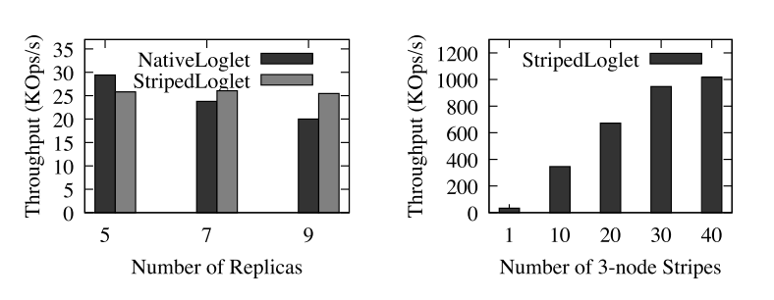
Composing Loglets: The Stripedloglet
DelosRuntime
DelosRuntime
0 1 2 3
6
1M+
1KB appends/s with 30 stripes
0 3
6
1
2
sharded acceptors
Notes:
If we instead use a StripedLoglet over 2 NativeLoglets (each with the same set of LogServers but different sequencers), we rotate the sequencing load across two servers.
As Figure 10 (Middle) shows, Delos+StripedLoglet runs 25% faster than Delos+NativeLoglet with 9 nodes on the benchmark HW.
2 hardware setups for evaluating Delos
production hardware: 5 servers with shared boot SSDs
benchmark hardware: dedicated NVMe SSDs
workload traffic
real production traffic: 425 queries/sec and 150 puts/sec on the Delos Table API. In production, Delos takes local snapshots every 10 minutes and ships them to a backup service every 20 minutes
synthetic workload consisting of single-key puts and gets

Slide 33
Trimming The Virtuallog
ZKLoglet
NativeLoglet

Slide 34
Trimming The Virtuallog
trim cold segments
ZKLoglet
NativeLoglet

Slide 35
Trimming The Virtuallog
trim cold segments
remap cold segments
InfiniteLog ➔ PiT restore
more durability
ZKLoglet
NativeLoglet
BackupLoglet
Notes:
Fine-grained point-in-time restore

Slide 36
Trimming The Virtuallog
trim cold segments
remap cold segments
InfiniteLog ➔ PiT restore
more durability
NativeLoglet
BackupLoglet

Slide 37
Trimming The Virtuallog
trim cold segments
remap cold segments
InfiniteLog ➔ PiT restore
more durability
remap single slots
delete poison pill entries
less durability
NativeLoglet
BackupLoglet

Slide 38
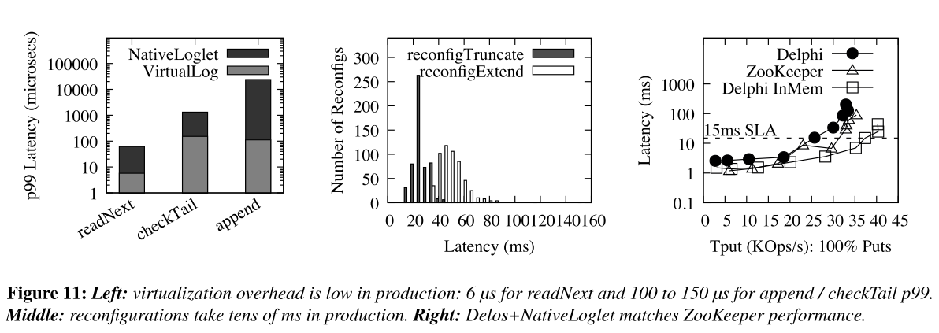
Virtualization Cost
Notes:
Virtualization does not affect peak throughput
Reconfigurations occur within 10s of ms.
Figure 11 (Left) shows the p99 latency of VirtualLog and NativeLoglet operations; this data is measured over a one-hour time period on a production cluster running over the NativeLoglet. In Figure 11 (Middle), we show a histogram of all reconfigurations in a 1-month period on our production clusters.

Slide 39
Delos As A Platform original goal: can we build a zero-dependency, fault-tolerant system with a rich API… in months?
rich API
DelosTable
2 1.8B
years in production TXes per day
fault-tolerant
DelosRuntime
VirtualLog
…in months
ZKLoglet
NativeLoglet
zero-dependency

Slide 40
Delos As A Platform original goal: can we build a zero-dependency, fault-tolerant system with a rich API… in months?
rich API
DelosTable
DelosZK
extensible APIs
2 1.8B
years in production TXes per day
fault-tolerant
DelosRuntime
VirtualLog
…in months
ZKLoglet
NativeLoglet
zero-dependency

Slide 41
Delos As A Platform original goal: can we build a zero-dependency, fault-tolerant system with a rich API… in months?
rich API
DelosTable
DelosZK
extensible APIs
2 1.8B
years in production TXes per day
fault-tolerant
DelosRuntime
common platform
VirtualLog
…in months
ZKLoglet
NativeLoglet
zero-dependency
LDLoglet
extensible Loglets

Slide 42



Conclusion
Delos is a new storage system at the bottom of the Facebook stack
virtualizing consensus allowed us to develop and deploy new protocols
production benefits immediately from new research…
…new research can reach production quickly

Slide 43
thank you!

