Slide 1
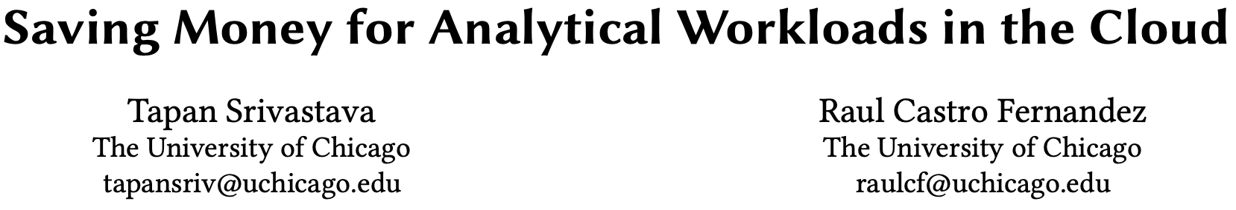

Slide 2
Introduction
While cloud providers offer many tools to tune database performance, there are no mechanisms to directly save money.
AP query category in the cloud:
CPU-bound: group by、aggregate、sort…
IO-bound：table scan、join…
Cloud’ pricing models charge for IO or CPU time.
pay-per-compute. e.g. in AWS Redshift.
pay-per-byte. e.g. in Google BigQuery.

Slide 3
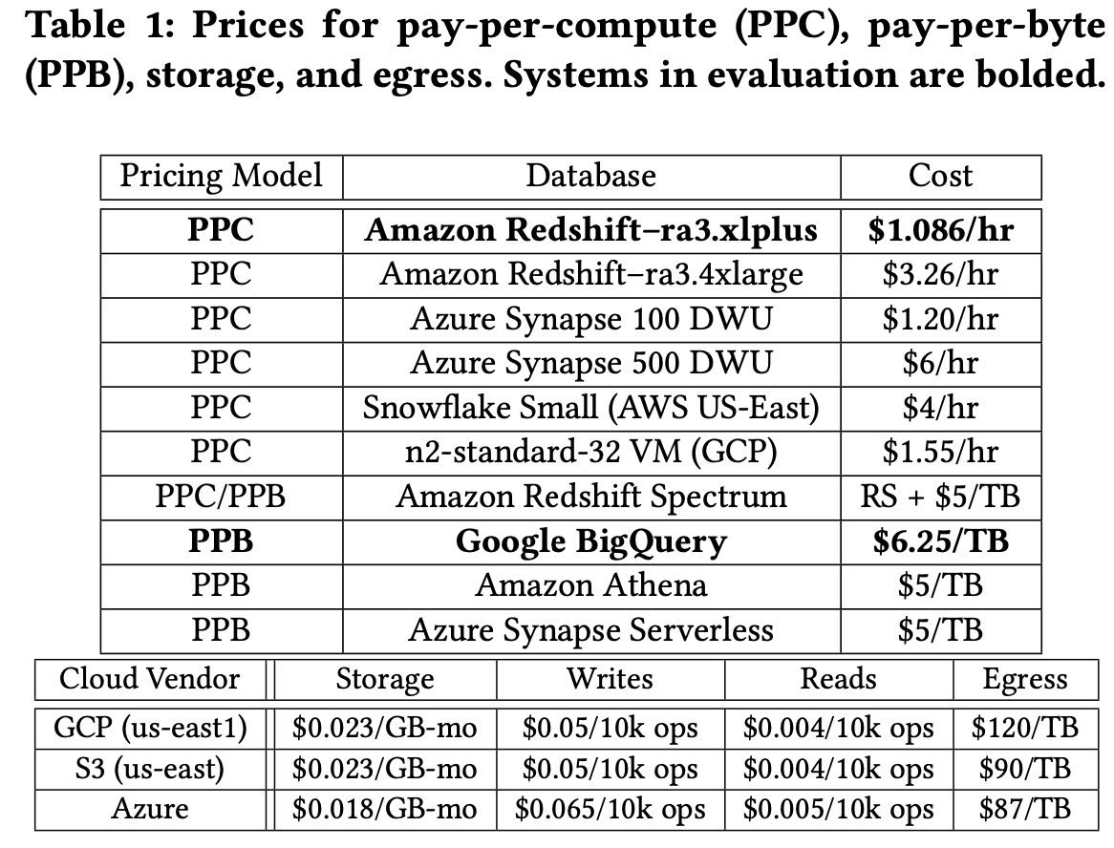
Introduction
Breakdown of Cloud Costs.
Blob Storage cost
Read/Write cost
Loading cost
Egress cost
Query Processing cost

Slide 4
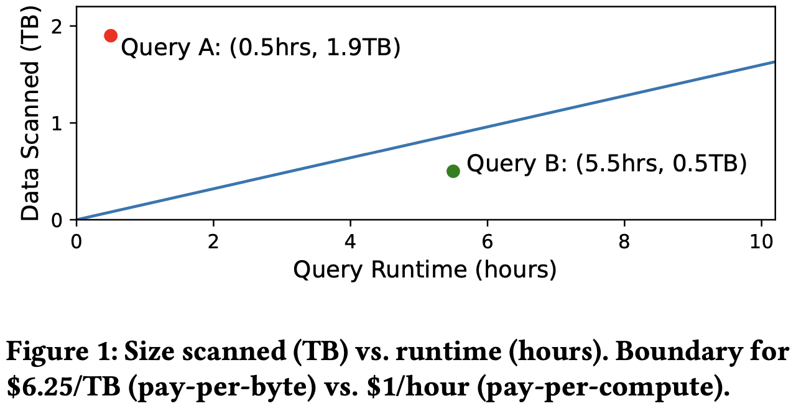
Introduction
CPU-bound queries execute cheaper in pay-per-byte models, vice versa for IO-bound queries.
Implement middleware called Arachne between users and the cloud. Propose two algorithms to exploit money saving opportunities.
Inter-Query Algorithm
Intra-Query Algorithm

Slide 5
Inter-Query Algorithm
Setup
A set of tables 𝑇 , queries 𝑄, and a workload runtime constraint. Initial employs a source execution backend 𝑋_{𝑠}.
Goal
Given a second execution backend 𝑋_{d} , choose a subset of queries 𝑊 ⊆ 𝑄 to execute in 𝑋_{𝑑} to save money without breaking the runtime constraint.

Slide 6
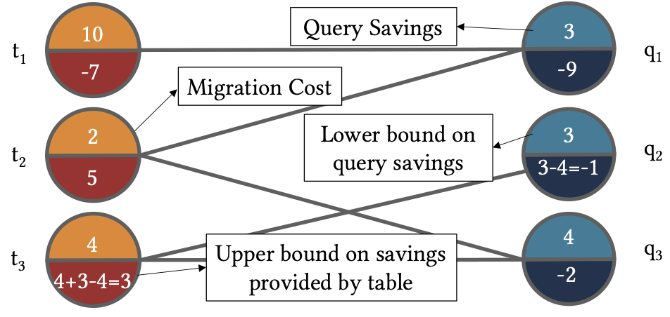
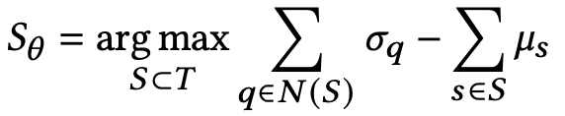
Inter-Query Algorithm
Definition：Bipartite graph 𝐺 = (𝑇,𝑄,𝐸) ，assign weights 𝜎_{𝑞} to each query 𝑞 ∈ 𝑄 and 𝜇_{𝑡} for each table 𝑡 ∈ 𝑇.
𝜎_{𝑞} represents the query savings achieved by moving query 𝑞 to the other execution backend：𝜎_{𝑞} =𝐶_{d} (𝑞)−𝐶_{s} (𝑞)
𝜇_{𝑡} represents the migration costs for a table：𝜇_{𝑡} =𝑒×𝑠(𝑡)+(𝑝_{𝑟𝑒𝑎𝑑} +𝑝_{𝑤𝑟𝑖𝑡𝑒})×(𝑠(𝑡)/𝐾)+𝑝_{𝑏𝑙𝑜𝑏} ×𝑠(𝑡)
Goal：find a subset of tables that
maximizes query savings.

Slide 7
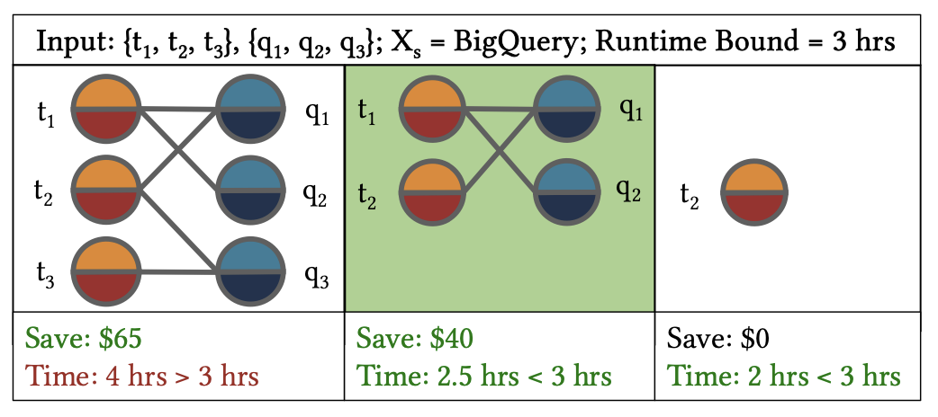
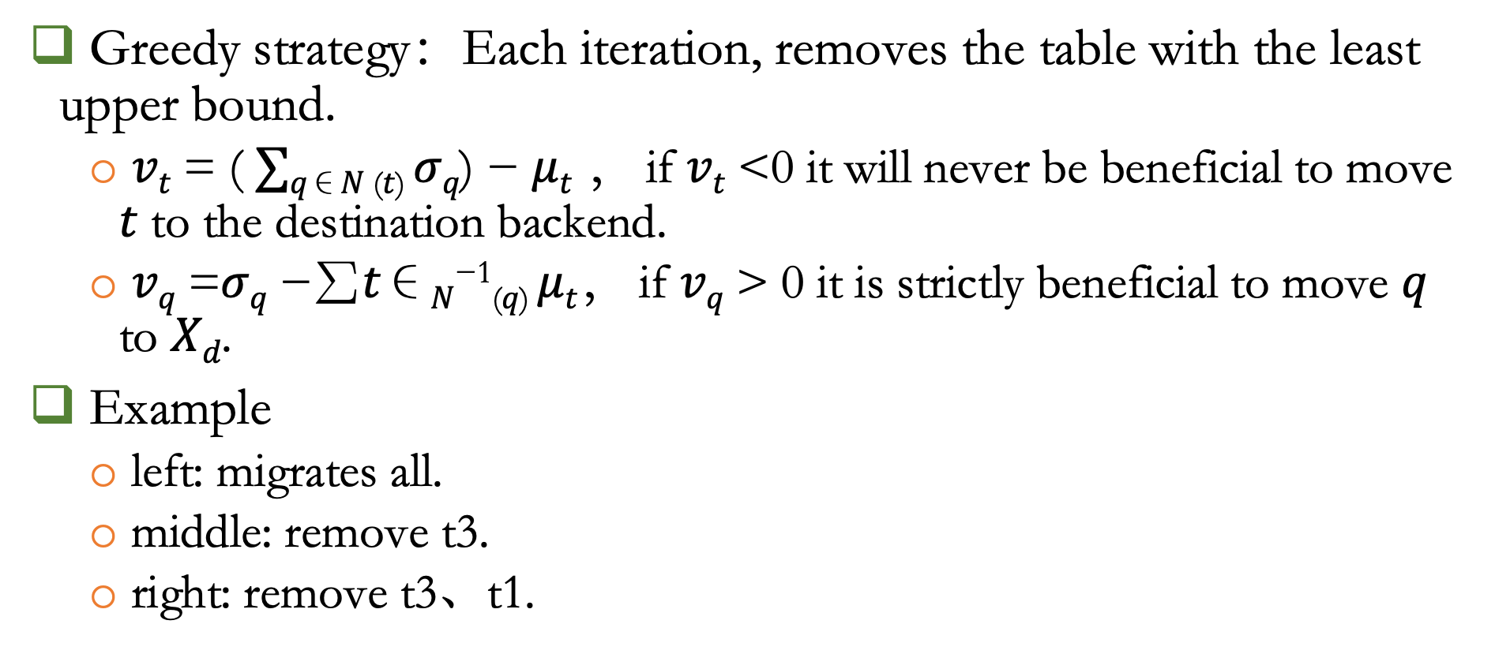
Inter-Query Algorithm
Greedy strategy：Each iteration, removes the table with the least upper bound.
𝑣_{𝑡} = ( $∑$_{𝑞∈𝑁 (𝑡)} 𝜎_{𝑞}) − 𝜇_{𝑡} ， if 𝑣_{𝑡} <0 it will never be beneficial to move 𝑡 to the destination backend.
𝑣_{𝑞} =𝜎_{𝑞} −∑︁𝑡∈_{𝑁}⁻¹_{(𝑞)} 𝜇_{𝑡}， if 𝑣_{𝑞} > 0 it is strictly beneficial to move 𝑞 to 𝑋_{𝑑}.
Example
left: migrates all.
middle: remove t3.
right: remove t3、t1.

Slide 8
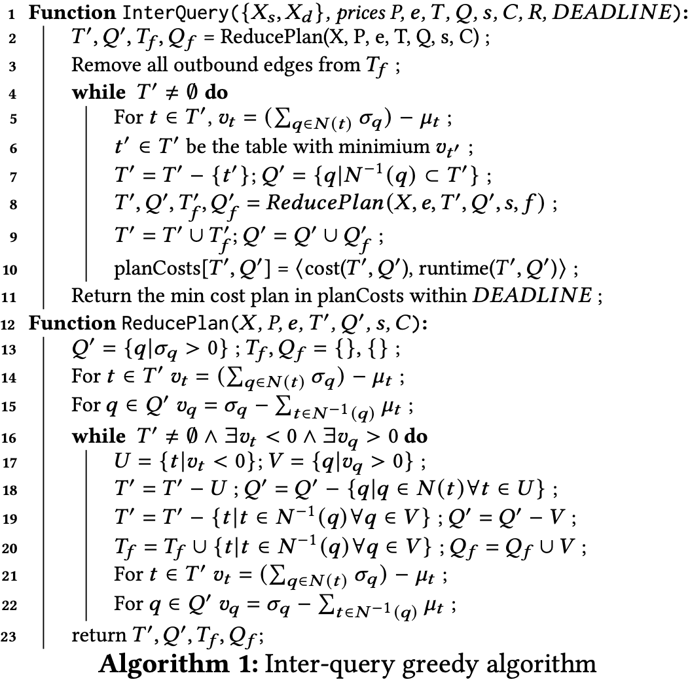
Inter-Query Algorithm
Step1: Invokes ReducePlan(line 2), removes tables with 𝑣_{t} < 0 and migrates queries with 𝑣_{q} > 0 to 𝑋_{d}.
Step2: Greedy iteration.

Slide 9
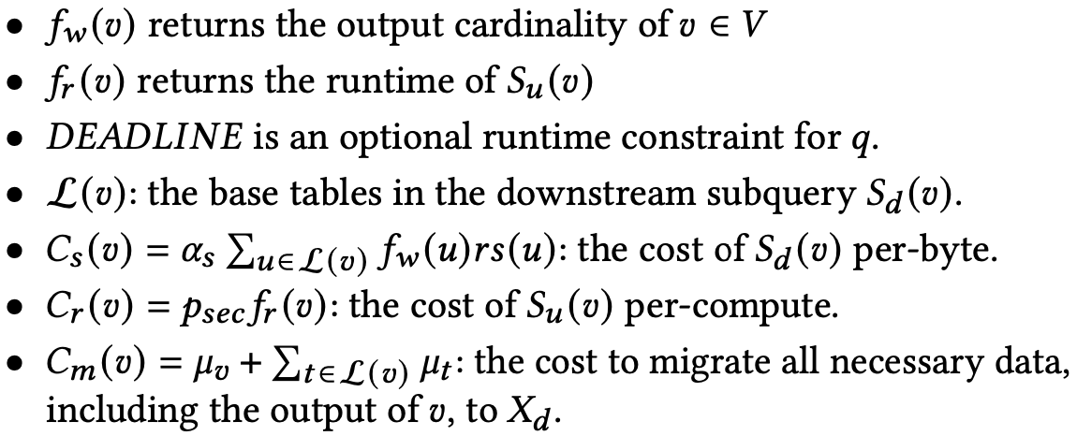

Intra-Query Algorithm
Goal: find a profitable cut of 𝑞 so that one subquery executes in 𝑋_{s} and the other in 𝑋_{d} to save money.
Define: 𝑇 =(𝑉,𝐸) be a query plan，𝜇_{𝑣} for 𝑣 ∈ 𝑉 be the migration cost of the data output from 𝑣，𝑠 be the table size and 𝑟𝑠(𝑣) be the row size for 𝑣，the subgraph upstream of 𝑣 is 𝑆_{u} (𝑣) , the subgraph downstream of 𝑣 is 𝑆_{d} (𝑣) .
find 𝑣 ∈ 𝑉 such that:

Slide 10
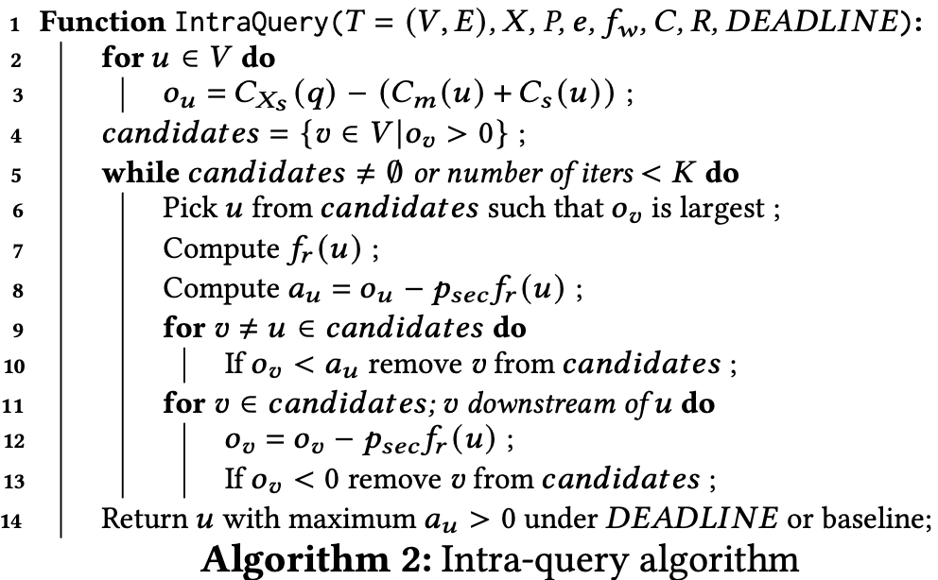
Intra-Query Algorithm
Naively, we could find the optimal execution plan by making a cut at every operator and executing each resulting plan.
Calculating Savings Opportunity
The savings opportunity 𝑜_{𝑣} is the right hand side of 𝑝_{𝑠𝑒𝑐}𝑓_{𝑟}(𝑣) < 𝐶_{𝑋s}(𝑞) − (𝐶_{𝑚}(𝑣) +𝐶_{𝑠}(𝑣))
The algorithm aims to reduce the
number of times it computes 𝑓_{r} .

Slide 11
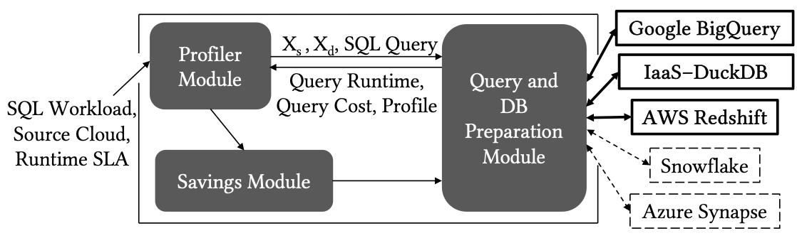
ARACHNE OVERVIEW
Profiler Module
executes each query in each execution backend to obtain runtime, cost, and cardinality information(duckDB).
Saving Module
include inter-query and intra-query algorithm.

Slide 12
Evaluation
Workloads
Resource Balance Workloads：use tpc-ds benchmark to create three workloads.
W-CPU: 46 queries, about 40% of which are CPU-bound.
W-Mixed: 49 queries, about 30% of which are CPU-bound.
W-IO: 46 queries, about 20% of which are CPU-bound.
Read-Heavy Workloads（IO-skew）：create 24 workloads from TPC-DS by removing one table.
LDBC： queries written on the LDBC Social Network Benchmark-Business Intelligence (SNB-BI) dataset.
PaaS Execution Backends
Google BigQuery (pay-per-byte) and AWS Redshift (pay-per-compute)

Slide 13
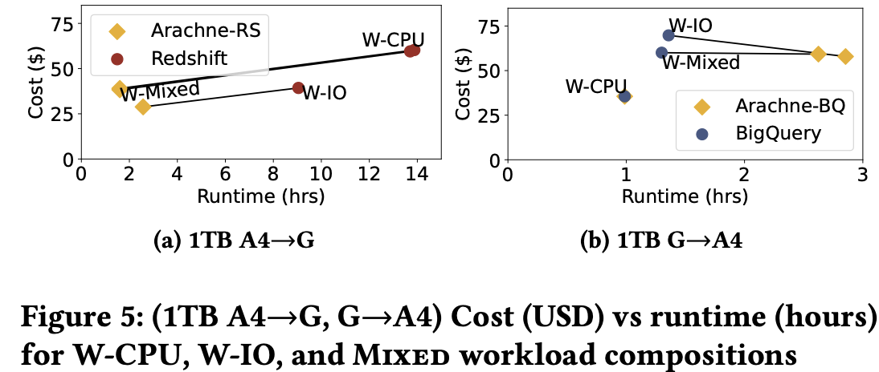
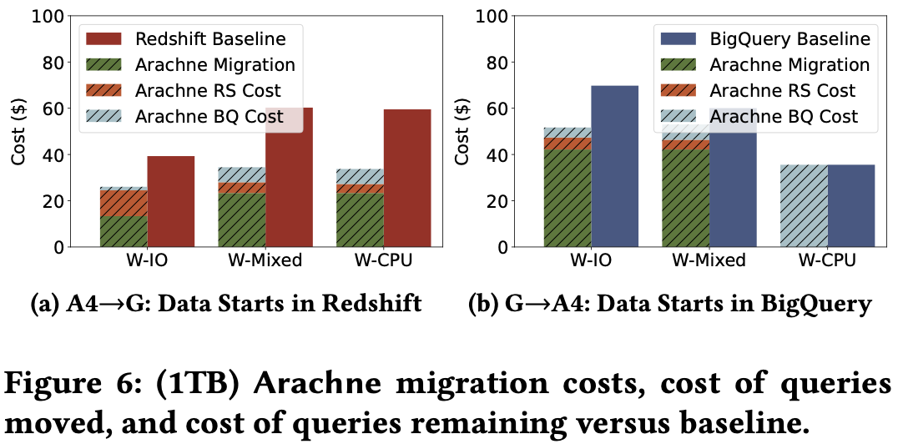
Inter-query Processing
In 5 out of the 6 workloads Arachne finds cheaper plans.
Arachne saves less money for W-IO because there are more IO-bound queries that favor Redshift’s per-second pricing model.
Exorbitant migration costs make up the majority of Arachne’s costs for multi-cloud plans.

Slide 14
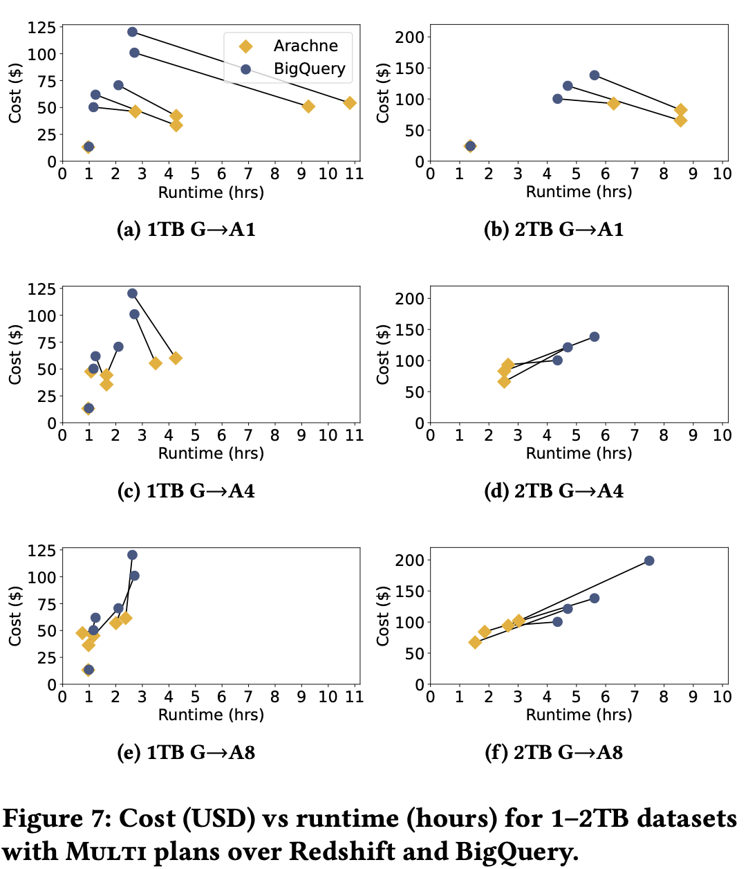
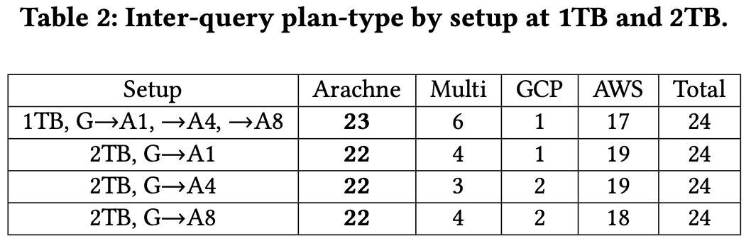
Inter-query Processing
Only 6/144 remain in BigQuery where
the Arachne saves no money.
In larger clusters, Redshift completes
the workloads faster (and cheaper).

Slide 15
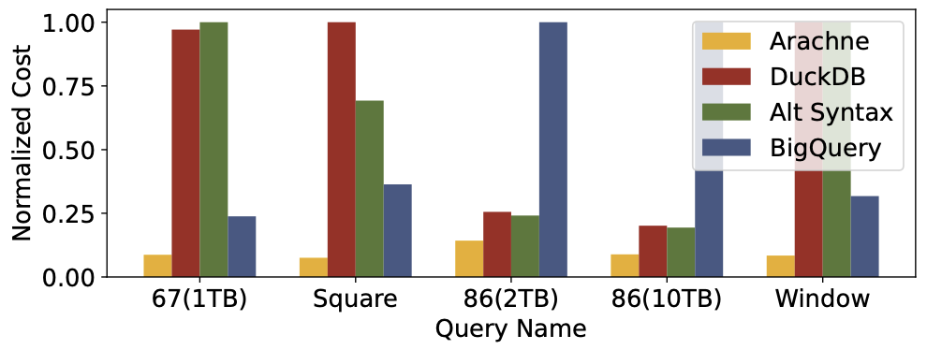
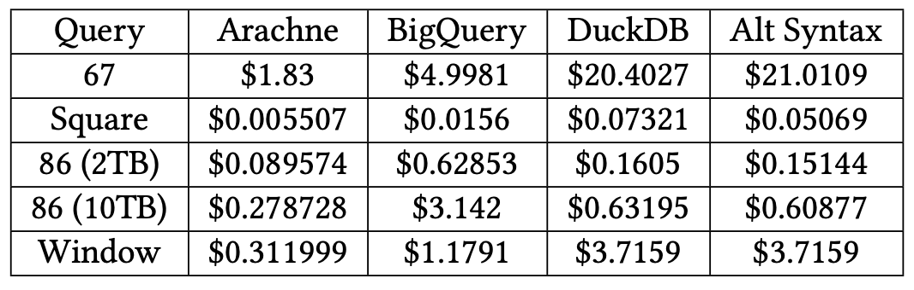
Intra-query Processing
These opportunities are significant but occur less often than O1.
Data starts in BigQuery. Expensive egress fees restrict data movement, so consider intra-query plans between BigQuery (pay-per-byte) and DuckDB (pay-per-compute) on a GCP VM.
Common Characteristics：these queries first join many tables (IO-bound) followed by a window or self-join (CPU-bound).

Slide 16
Conclusion
Presents, exploits, and evaluates two money saving opportunities for cloud analytical workloads.
The key is to schedule queries based on the resources they consume onto beneficial pricing models offered by cloud vendors.
Hope this work will encourage further investigation into multi-cloud savings opportunities.

