Slide 1
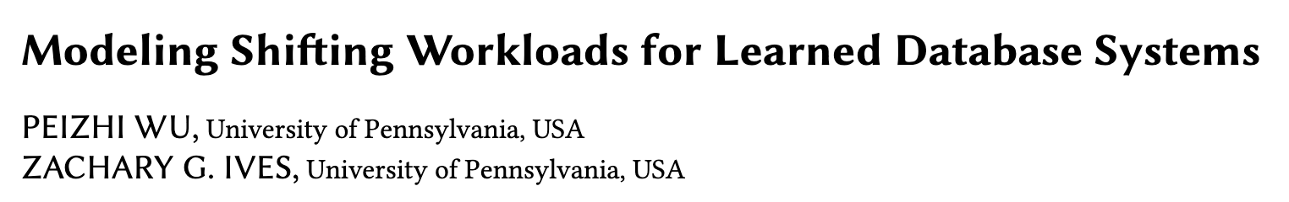

Slide 2
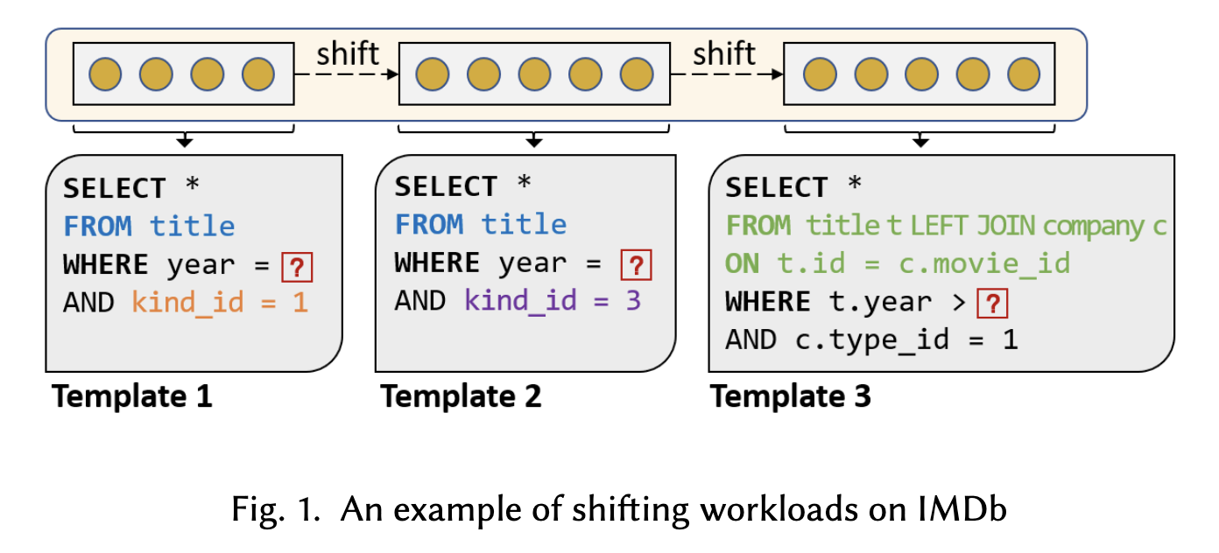
Workload Shift
Most likely, a learned DB component trained on the former two classes would produce poor results on the last queries of Template 3, since the model only learned the information of the two classes of table title.
The key question is when and how best to re-train the model.

Slide 3
Challenges of retraining over shifting workloads
First, the learned DB component is required to learn new information from new queries while retaining the knowledge of previous queries.
Second, it should rapidly react to new information in order to ensure the next query gets an accurate prediction or the best plan.

Slide 4
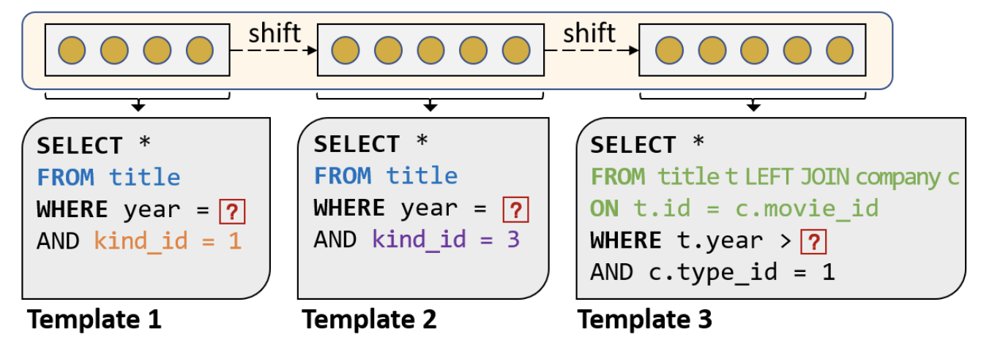
Workload Imbalance
(Definition) Queries of one specific range of query features are significantly fewer than those of the other range of query features.
Again, back to Figure 1, if we increase the number of queries of class 2 to 1K and train an ML model on queries of the former two classes, one would naturally suspect the ML model would degrade for class 1 since the much-more-prevalent class 2 dominates the training set.
Notes:
1条template 1的query和1000条template 2的query一起训练

Slide 5
Three desiderata
Learned DB systems should balance three desiderata:
Long-term memory: The system, even when retrained, should retain the core information obtained from prior queries for producing good-quality query execution plans.
Plasticity: The system should adapt quickly to shifts in the workload and use new information to improve its predictions.
Tolerance to imbalance: When different classes of queries occur with different frequencies, the system should learn accurate models of all of these imbalanced classes.
This paper develops strategies for managing a replay buffer (which stores query instances for future retraining) for achieving the three desiderata. Given a workload-driven machine learning model M for a database component CP of a database system DB, we maintain a small replay buffer that efficiently and effectively models up-to-date workloads to M for retraining.

Slide 6
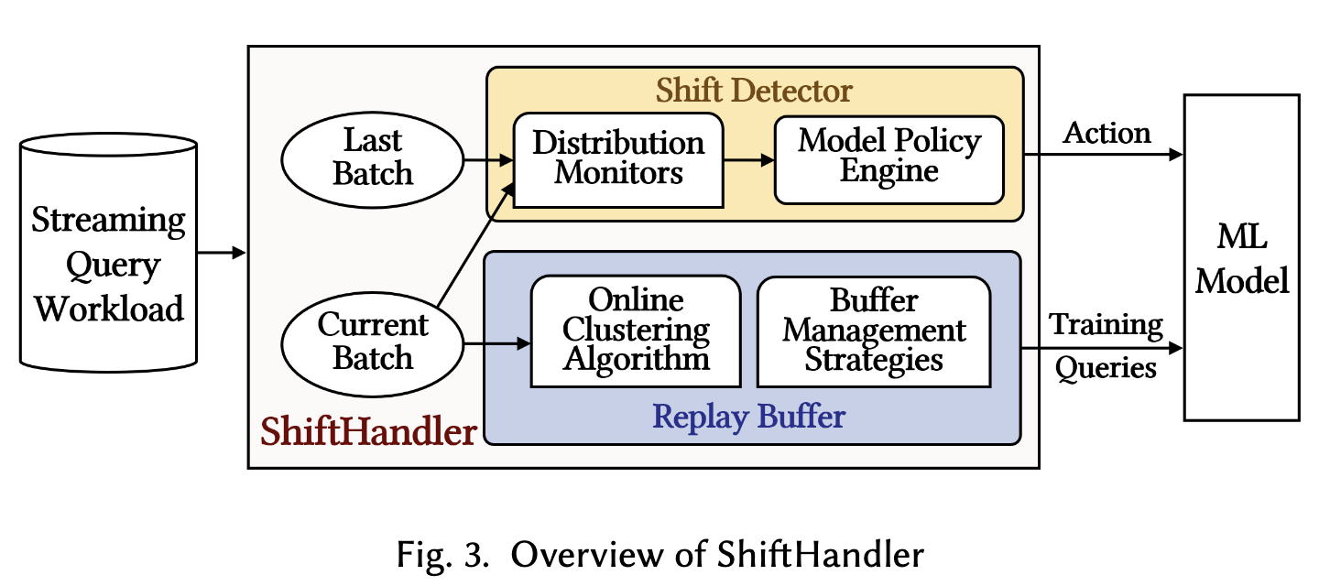
Overview
To address the problems of managing a learned DB component (e.g., cardinality or cost estimator) to shifting workloads, we propose a module that
(1) manages the specific set of training data that will be used for learning, and
(2) determines when to trigger relearning.
We refer to this as the ShiftHandler

Slide 7
Overview
The Shift Detector works on the current query batch and the last query batch. For every 𝑙𝑑 query (𝑙𝑑 can be set by DBA), it detects potential workload shifts between the two batches using the Distribution Monitor. The Model Policy Engine receives the statistics from the distribution monitor and triggers the proper actions.
The Replay Buffer manager with a query limit 𝑚 operates on the current batch of queries, which is shared with the shift detector. It takes the streaming workload as input and maintains a set of representative and useful queries.
Notes:
Shift Detector接受current batch和last batch两个输入，每隔ld个query检测是否出现workload shift。current batch就是上次训练后到来的查询
Policy Engine接受上一个组件的数据，负责触发retraining
Buffer负责存储具有代表性的查询集合，当需要重新训练时就会用到这些查询

Slide 8
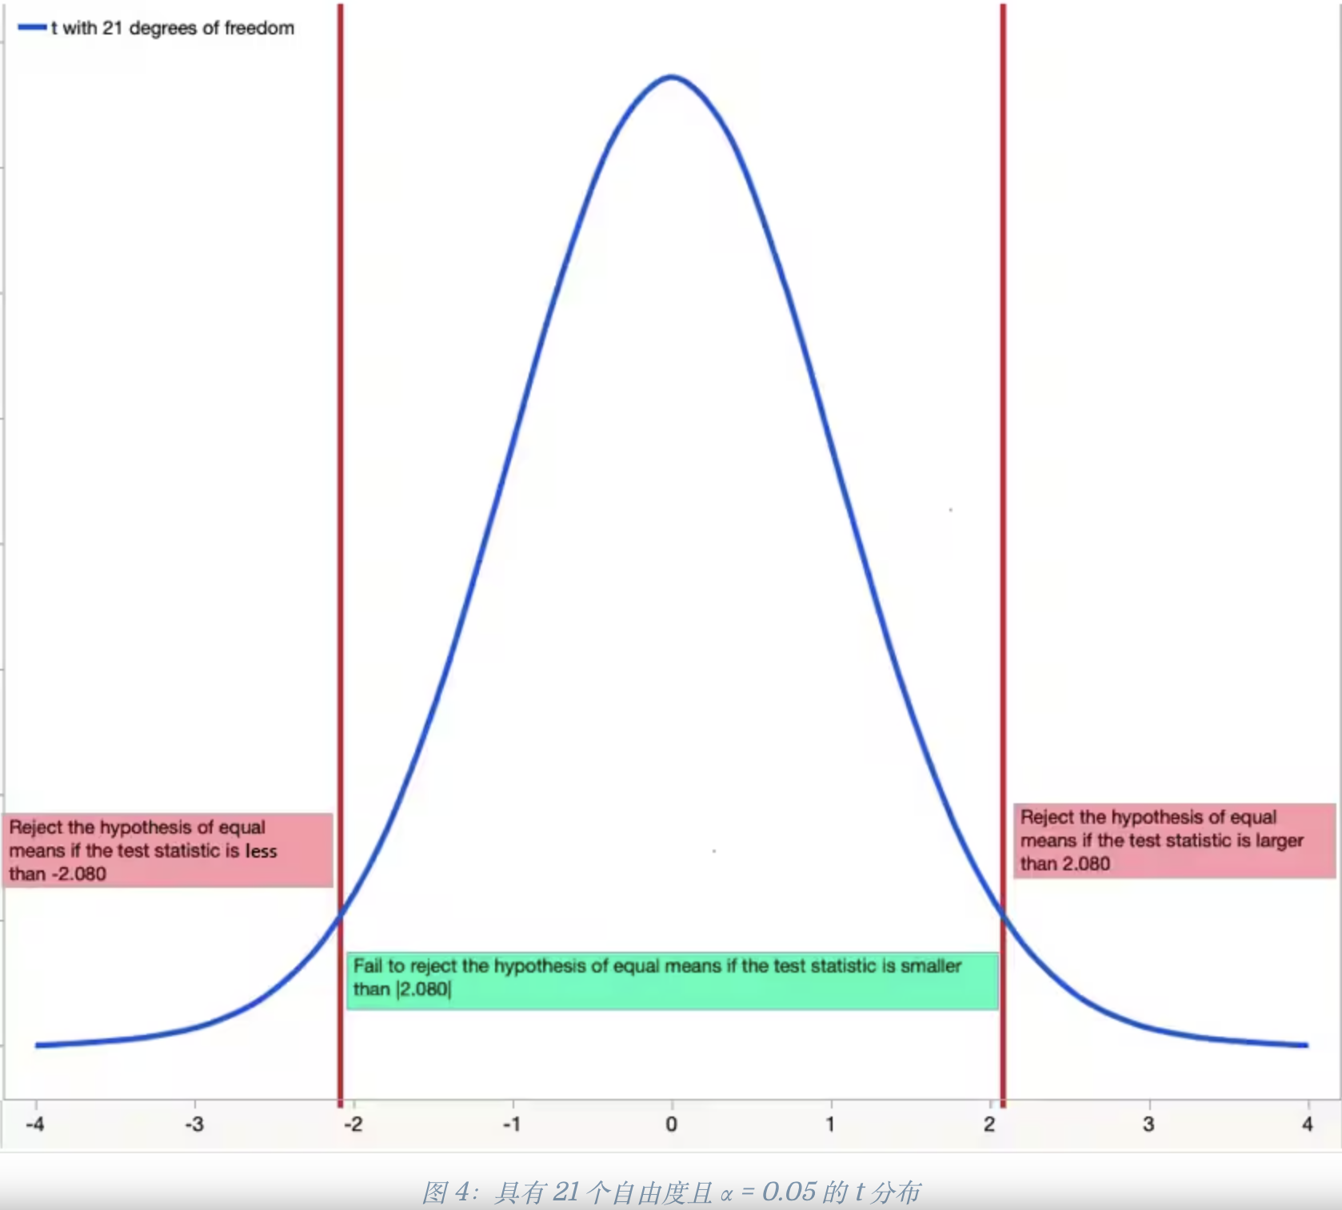
Distribution Monitor
Our distribution monitor operates on query features rather than labels for their empirical performances. The goal of distribution monitoring is essentially comparing the query feature distributions of the current query batch (denoted by 𝑃) and the last query batch (denoted by 𝑄).
In fact, this is a fundamental problem in statistics.
One principled method would be two-sampled tests, which summarizes the differences between two samples (𝑞1 ∼ 𝑃, 𝑞2 ∼ 𝑄) from each distribution into a test statistic. The real-valued test statistic is then used to accept or reject the null hypothesis 𝐻0, i.e., 𝑃 = 𝑄.
Notes:
Distribution Monitor通过比较查询之间的query Feature（而不是label）来检测current batch P和last batch Q之间的差异。（query Feature是具体的机器学习算法决定的）
因为做实验发现query feature的效果比label要好
Two-Sample Testing，即双样本检验，是概率中的一种检验方法，用来判断两个样本是否相似。
q1和q2是从P和Q中采样的两批查询，每批查询通过转化能得到它们的均值、方差等样本数据，假设它们来自同一个数据分布，通过双样本检验，根据样本数据可以根据公式计算出具体的检验量，用这个统计量和标准的t分布或者F分布的标准值对比（需要根据自由度和置信度确定），这些标准值就是边界，如果我的检验量超过这个边界，就要拒绝原假设，因为这说明在当前假设下不可能出现这个检验量（因为检验量出现在低概率区间，随机取值几乎没有这个可能）

Slide 9
Model Policy Engine
The model policy engine controls the actions taken by the ML model based on the statistics it receives from the shift detector.
Possible actions include
periodic training, which triggers for every 𝑙𝑝 query
training for workload shifts
Notes:
定期正常训练
检测到shift就立即重训练

Slide 10
Online Cluster Of Workloads
We aim to design a replay buffer that generates a compact summary for shifting or even imbalanced workloads in this section. A naive approach would be reconstructing the buffer using all previous queries each time. However, this approach would be neither space-efficient; nor time efficient.
Specifically, the replay buffer is supposed to provide the replay queries to the ML model on time whenever retraining is triggered. This could be impossible if the workload is heavy. As a result, the replay buffer needs to be constructed in an online fashion.
A naive method for generating the replay buffer in an online fashion would be reservoir sampling. But it suffers under imbalanced workloads because it may not capture the diversity of a workload.
To capture the feature structure of a workload, clustering would be a natural idea to select the most representative queries in high-dimensional query space.
Notes:
使用所有旧查询训练不可取---》时间空间都效率不高
因为如果有重新练的需求，需要立马提供query，所以没有时间给你反复多轮挑选，必须是online的形式
蓄水池采样的缺点是无法针对imbalance的情况

Slide 11
K-Medoids vs. K-Means
Both problems attempt to minimize the sum of distances (or dissimilarities) between queries and the cluster "center" in which queries are labeled.
The major difference between the two problems lies in selecting "centers". In K-Means, a cluster "center" is the cluster centroid which is the mean of all queries in the cluster and is not necessarily an actual input query. In contrast, the cluster "center" in K-Medoids refers to the medoid, which is a query that belongs to the dataset, calculated by minimizing the sum of pairwise distances between the selected center and the queries in the cluster.

Slide 12
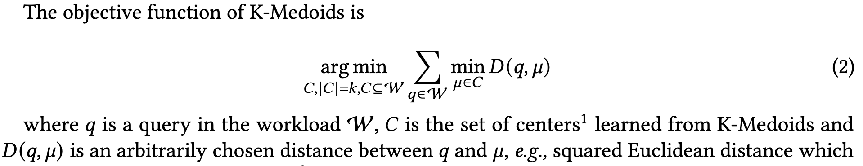
K-Medoids vs. K-Means
We choose K-Medoids for at least three reasons.
First, we do not have actual labels for queries not in the workload since they were not executed.
Second, K-Means is specifically designed for Euclidean distances, whereas K-Medoids supports arbitrary distance measures.
Third, K-Medoids is more robust to outliers because the computation of centers in K-Means can be easily dominated by outliers.
Notes:
对每个q，计算与其距离最近的center的距离D，找到让所有q的D之和最小的若干个center

Slide 13
Challenges of managing replay buffer
No prior knowledge of the number of clusters. Since 1) there is no prior knowledge of the number of clusters and 2) manually setting the cluster number could result in sub-optimal clustering performance, we need to adapt the cluster number from the query workloads.
Accurate online clustering for streaming query workloads. Online clustering methods can only make one pass over the workload: this could lead to sub-optimal results compared to a multi-pass, offline algorithm.
Notes:
第二点：没有办法用EM算法反复迭代聚类

Slide 14
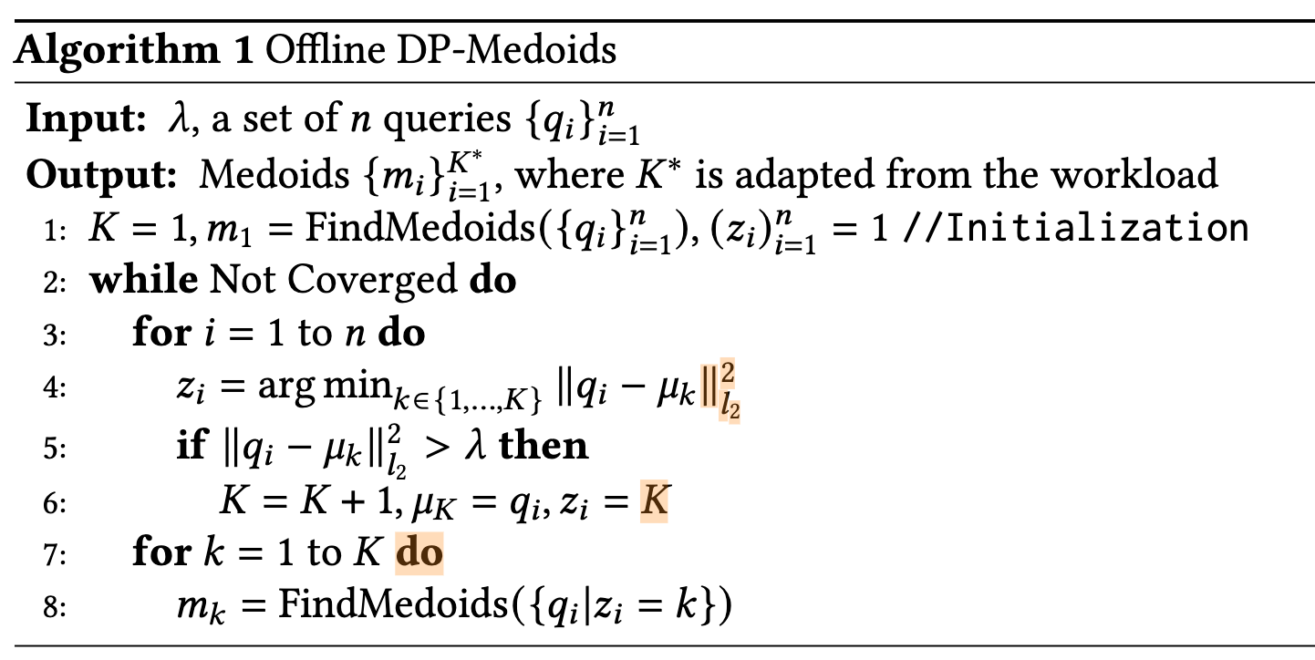
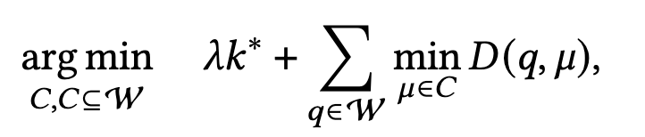
DP-Means and DP-Medoids
DP-Means is the pioneering work that combines the Bayesian non-parametric priors with K-Means, achieving the adaptivity of cluster number for K-Means. It is similar to the origin K-Means, except that if the distance between a query and its nearest cluster center is larger than a threshold 𝜆, a new cluster should be created on the query.
Inspired by DP-Means, we propose the DP-Medoids algorithm. The main difference from DP-Means is, at the end of each iteration, DP-Medoids updates the center of each cluster by FindMedoids(·), which takes a set (cluster) of queries as input and outputs the query that minimizes the sum of pairwise distances between all queries in the cluster to the query as the new center.
the total time complexity is O (𝑛²𝑇 𝐾∗) where
𝑇 is the number of iterations.
objective function for DP-Medoids:
Notes:
DP-Means通过引入lambda阈值来自适应聚类个数
复杂度主要来源于line8，因为findMedoids函数的复杂度是n²(每个点计算一次，一次计算是O(n),总共n次计算才能选出新的聚类中心)

Slide 15
Online DP-Medoids
For offline version of DP-Medoids in ShiftHandler, retraining is computationally expensive for a heavy workload of size 𝑛 since the time complexity is quadratic in 𝑛. One would resort to an online version of DP-Medoids which only makes a single pass of the workload. However, the design of online DP-Medoids must be careful since it should not lose too much performance compared to the optimal one.
Inspired by a few theoretical works on K-Means, we introduce a randomized solution to online DP-Medoids by an approximation-preserving reduction to online facility location. Although the solution may appear strikingly simple, they work surprisingly well.
Notes:
鉴于offline复杂度太高，所以必须采用online的方法
本文采用的方法就是根据facility location问题的online解决模板，提出K-Mediods的解决方法（归约到同一个问题）

Slide 16
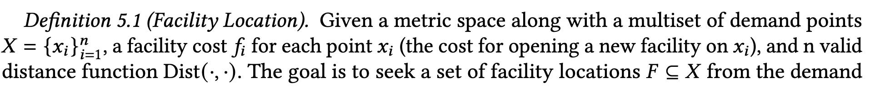
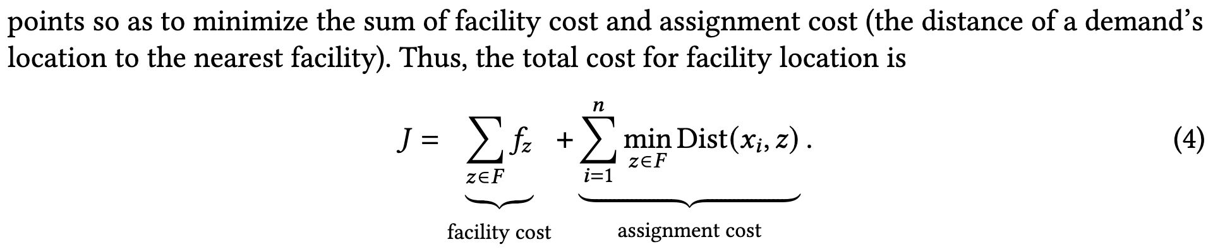
(Online) Facility Location
In Online Facility Location(OFL), the demand points are not known in advance and arrive one at a time. They are irrevocably assigned either to an existing facility or a new facility on it. Note that the total cost for OFL is the same as Equation. 4.
Therefore, we can convert an instance 𝜑DP-Medoids of online DP-Medoids to an instance 𝜑OFL of OFL, apply the solver for 𝜑OFL and recover the solution for 𝜑DP-Medoids simply by an identical mapping.
Notes:
Facility Location的Online场景也是流数据，和本文的场景一模一样，而且损失函数也和offline一样

Slide 17
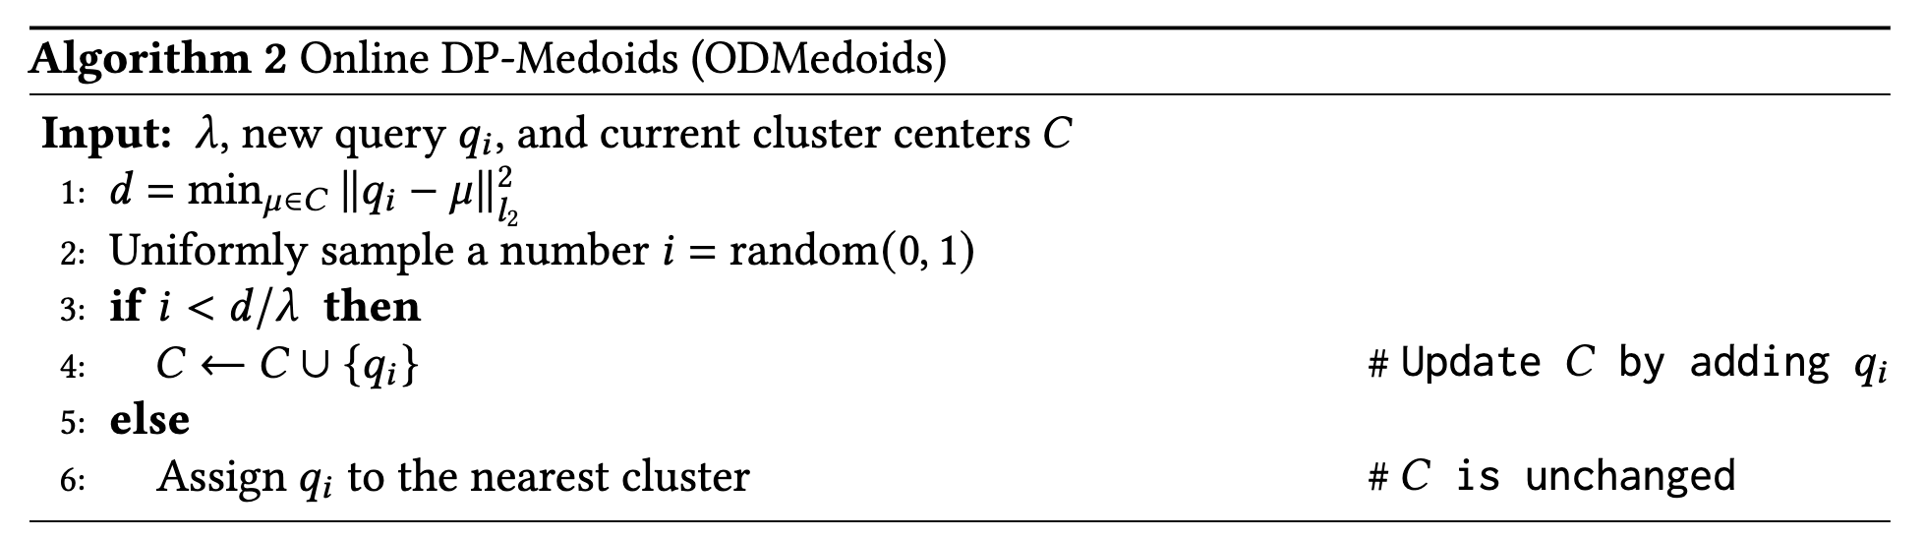
Algorithm for Online DP-Medoids
For each new query 𝑞, it first computes the minimal distance 𝑑 between 𝑞 and all centers in 𝐶 (line 1).
Then with probability 𝑑/𝜆 (𝜆 is cluster penalty parameter), we create a new cluster on 𝑞 (line 3-4).
Otherwise, 𝑞 is labeled with the nearest cluster, and 𝐶 is unchanged (line 5-6).
Note that one consequence of the randomized solution is that even if 𝑑 < 𝜆, the new query 𝑞 is still possible to create a new cluster.
Since ODMedoids does not require retraining from the beginning, the total running time for a new batch is O (𝑛𝐾∗), where 𝑛 is the number of queries in the new batch. which is way more efficient than offline DP-Medoids.

Slide 18
Goals of Buffer Management
Center Priority. Each cluster from ODMedoids represents a querying pattern, in which the center is the most representative query of the cluster.
Diversified Clusters. When dealing with workload imbalance, we have to keep the number of clusters stored in the buffer as much as possible.
Balanced Cluster Sizes. We make the cluster sizes as balanced as possible to further mitigate potential workload imbalance.

Slide 19
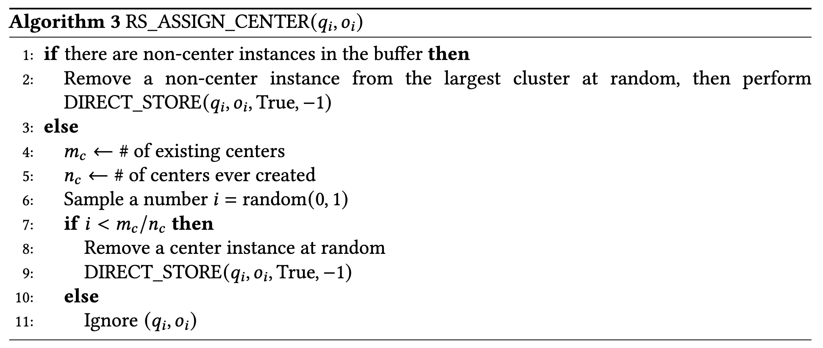
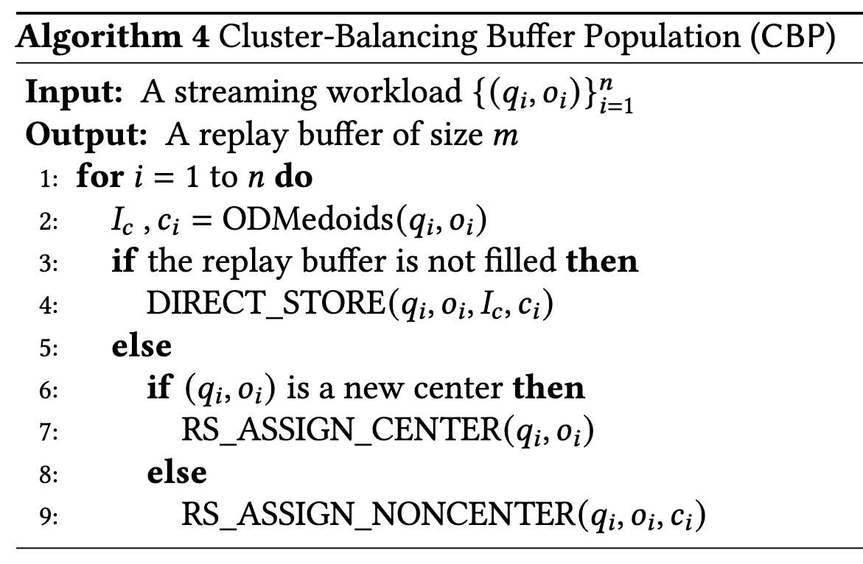
Operations
DIRECT_STORE(𝑞𝑖 , 𝑜𝑖 , 𝐼𝑐 , 𝑐𝑖 ) directly stores (𝑞𝑖, 𝑜𝑖 ) using the return values (𝐼𝑐 , 𝑐𝑖 ) of ODMedoids.
RS_ASSIGN_CENTER(𝑞𝑖, 𝑜𝑖 ) (Algorithm 3) handles the case when the replay buffer is filled, requiring a decision whether to store a new center (𝑞𝑖, 𝑜𝑖 ) or ignores it.
RS_ASSIGN_NONCENTER(𝑞𝑖, 𝑜𝑖, 𝑐𝑖 ) assigns 𝑞𝑖 as a non-center instance to cluster 𝑐𝑖 or ignores it via reservoir sampling, which is similar to the implementation of RS_ASSIGN_CENTER. To enforce that sizes are balanced across clusters if 𝑐𝑖 is not one of the largest clusters, we replace a random non-center instance from the largest cluster with (𝑞𝑖, 𝑜𝑖 ). Otherwise, use the idea of reservoir sampling to replace a random non-center instance in cluster 𝑐𝑖.

Slide 20
Loss-Weighted Buffer Population
Clusters might exhibit different sample complexities. For example, in the context of cardinality estimation where the underlying database instance is skewed, a querying pattern focusing on the skewed portion of data is more likely to require more query samples than the querying pattern that only queries the uniformly distributed data portion.
Therefore, to account for the sample complexity, we utilize the query losses during training as the proxy for the cluster sample complexity.
On a high level, if the queries in a cluster have a large mean training loss, it is likely that the cluster size does not match the actual sample complexity of the cluster. As such, we need to increase the size of the cluster. We call this strategy Loss-Weighted Buffer Population (LWP).

Slide 21
Implementation
We implement this idea by revisiting the Op2 (RS_ASSIGN_CENTER) and Op3 (RS_ASSIGN_NONCENTER) of CBP.
For Op2, if there are only center instances in the buffer, rather than removing centers by reservoir sampling (i.e., uniform sampling), we make the cluster with a higher mean loss have a smaller probability to be removed, which, in essence, is equivalent to increasing the size of the cluster.
for Op3, instead of removing a non-center instance from the largest center, again we consider removing an instance from a cluster with the probability inversely weighted by the cluster mean loss. This way, clusters with sufficient queries (small loss) are more likely to reduce in size, when the buffer is filled.
Benefits
First, LWP is model agnostic, making it compatible with any ML model.
Second, LWP only requires further storing of training losses of queries which can be directly obtained during training without additional computation.

Slide 22
Experiments
Setup
We evaluate ShiftHandler on three core components in learned DB.
Learned Cardinality Estimators. We integrate ShiftHandlerwith MSCN, a well-known learned query-driven cardinality estimator.
Learned Cost Estimators. We integrated ShiftHandlerwith Tree-CNN, which encodes queries on the plan level.
Learned Query Optimizers. We integrate ShiftHandler with a learned bandit query optimizer, Bao.
Baselines
Retraining from the latest 𝑠queries (Latest). For a fair comparison, we set the 𝑠 in Latest to match the size of the current batch plus the query size 𝑚 of the replay buffer
Retraining from all previous queries (ALL)
Buffer population via reservoir sampling (RS) which essentially uniformly samples from the workload
Postgres (PG)
CBP
LWP

Slide 23
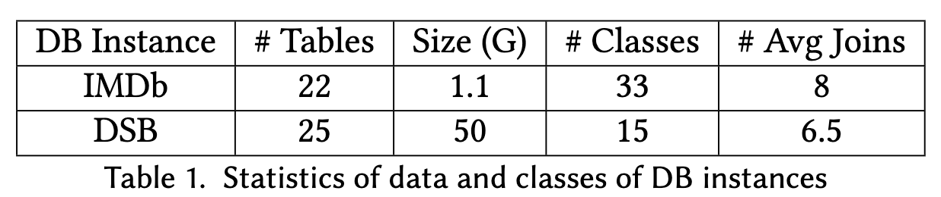
Experiments
Datasets
We consider the full schema of IMDb (21 relations), with the JOB benchmark.
We also use the recently proposed DSB benchmark to conduct the most critical experiment of learned query optimizers. DSB enhances the TPC-DS benchmark with complex data distribution and challenging query classes.
Workload
We simulate two types of workloads as the testbed, shifting workloads as well as shifting and imbalanced (S&I) workloads. Each workload starts with a set of burn-in queries randomly sampled from the query pool, in which the number of queries is balanced across classes for shifting workloads but becomes imbalanced for S&I workloads.
The replay buffer limit 𝑚 is set to 3% ∼ 5% of the entire workload size. For CBP and LWP, 𝜆 in ODMedoids is chosen from {0.01, 0.1, 1, 10, 100}.

Slide 24
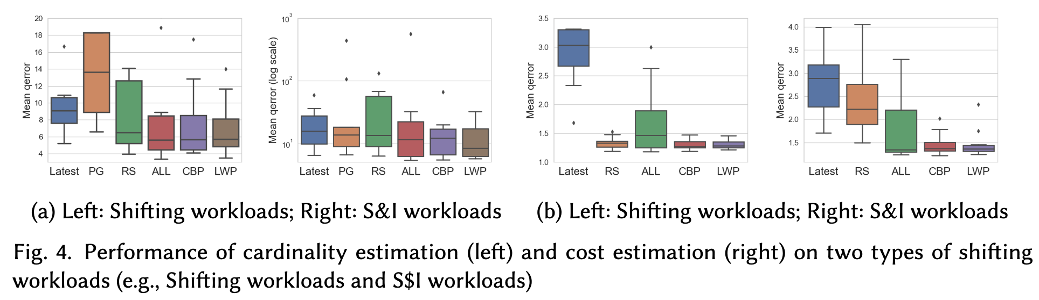
Performance and Findings
F1. Learned database systems could suffer from workload shifts without a carefully designed replay buffer for retraining, which could be exacerbated by workload imbalance.
Notes:
Latest和RS这两个没有Buffer设计的方案在两种负载中基本都是表现最差的

Slide 25
Performance and Findings
F2. Even neglecting retraining efficiency, retraining from all previous queries does not necessarily achieve the best model performance.
Notes:
图4b中ALL的表现非常差，文章猜测可能是训练过拟合导致

Slide 26
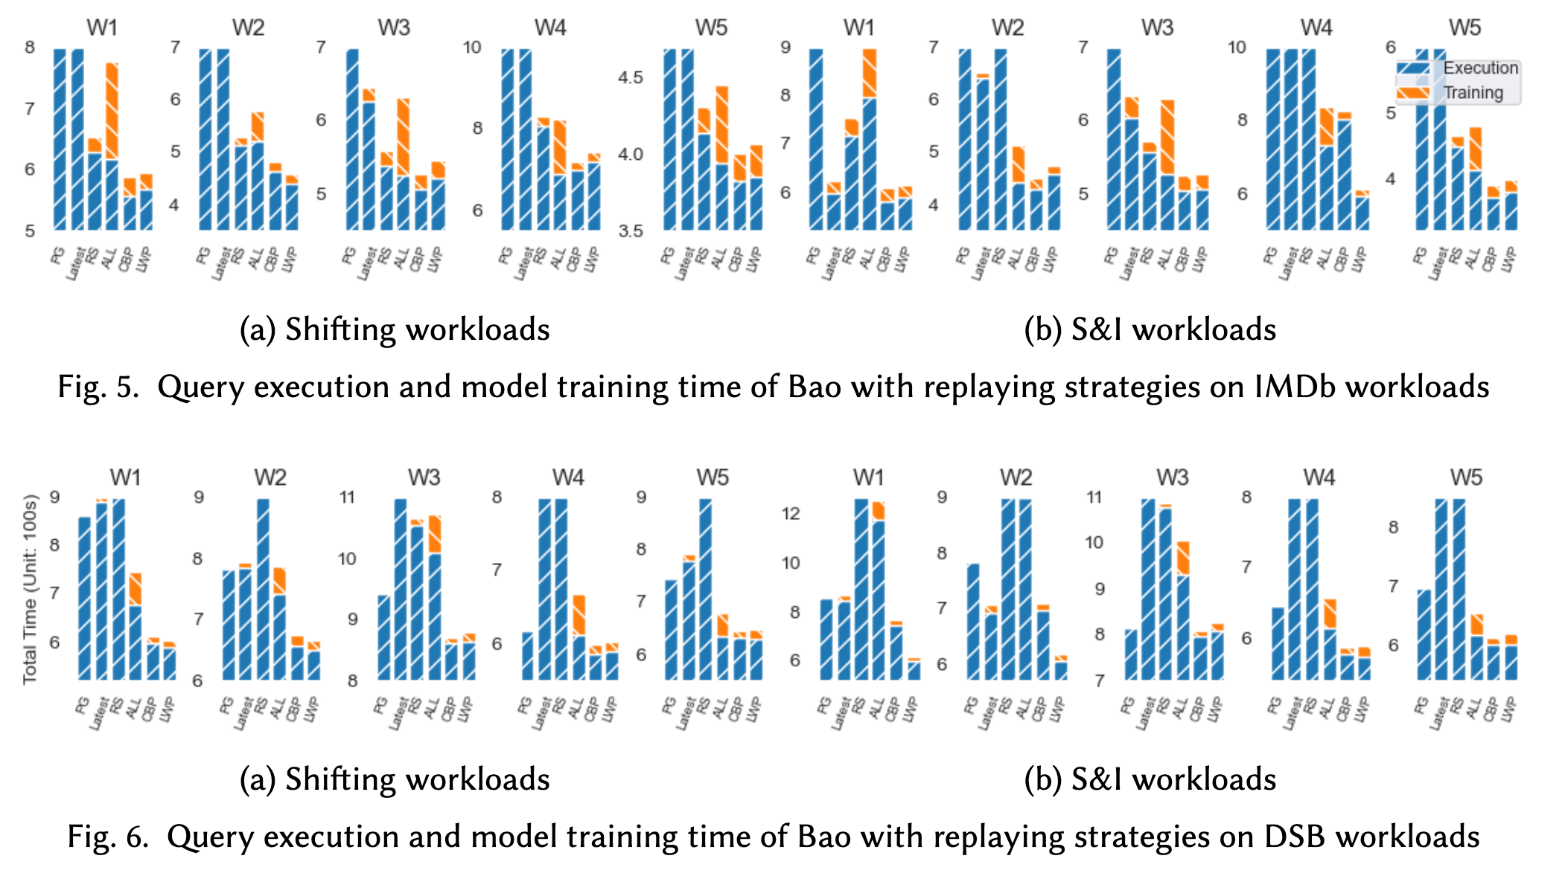
Performance and Findings
F3. CBP can mitigate the effect of workload shifts on learned database systems with minimal retraining overhead.
F4. CBP is more robust to workload imbalance compared to baselines.
F5. LWP is more robust to outliers than CBP.
Notes:
F3结论一个来自于前面那张图，另一个在上图中即使不考虑训练时间与ALL相比，CBP的查询执行时间也比它快
best trade-off between performance and training overhead for workload shifts
F4的意思是在S&I负载上CBP相对于RS的优化效果（比在Shift负载上）更明显，在两个图也都有体现

Slide 27
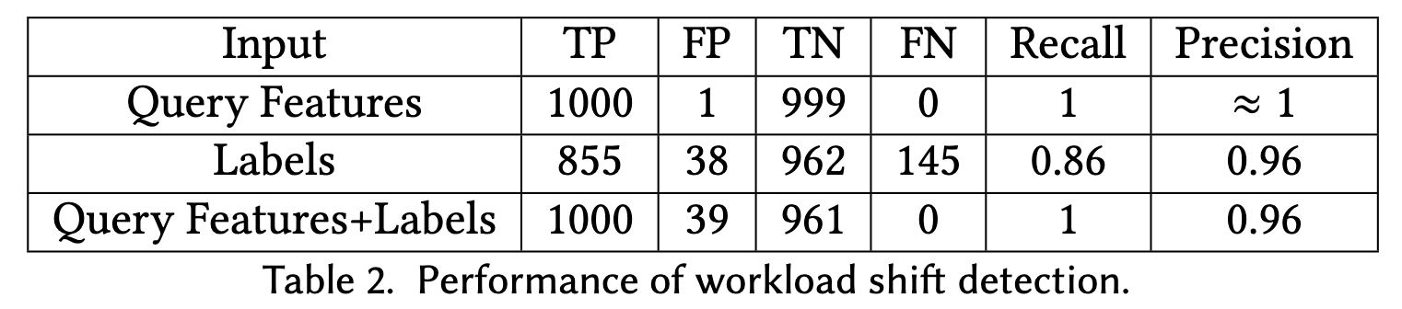
Accuracy of Shift Detection
We observe that query features are more critical than labels in detecting workload shifts in learned DB systems.
Thus we recommend using query features.

Slide 28
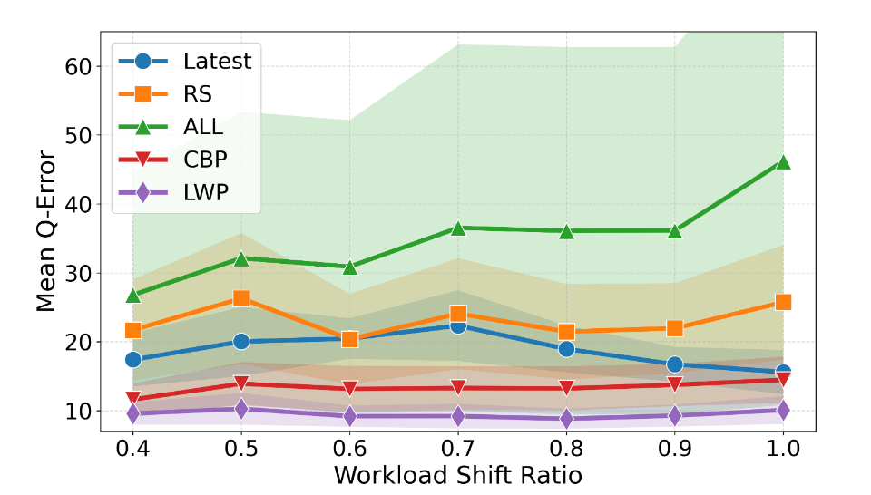
Varying the Workload Shift Ratio
For the replay buffer, we observe that CBP and LWP exceed baselines and LWP outperforms CBP under different 𝑟 . Thus we conclude that our major scientific findings still hold with varying workload shift ratios.

Slide 29
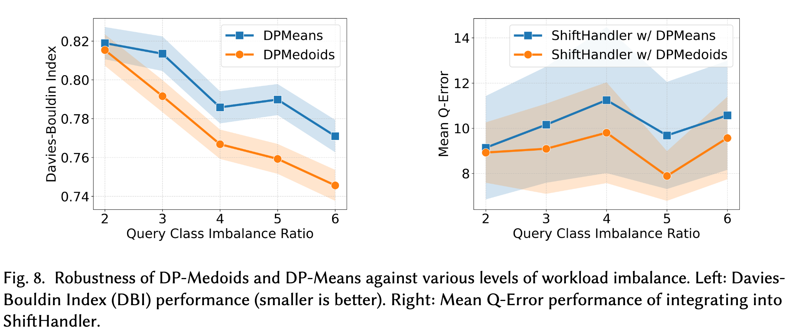
DP-Medoids vs. DP-Means

