Slide 1

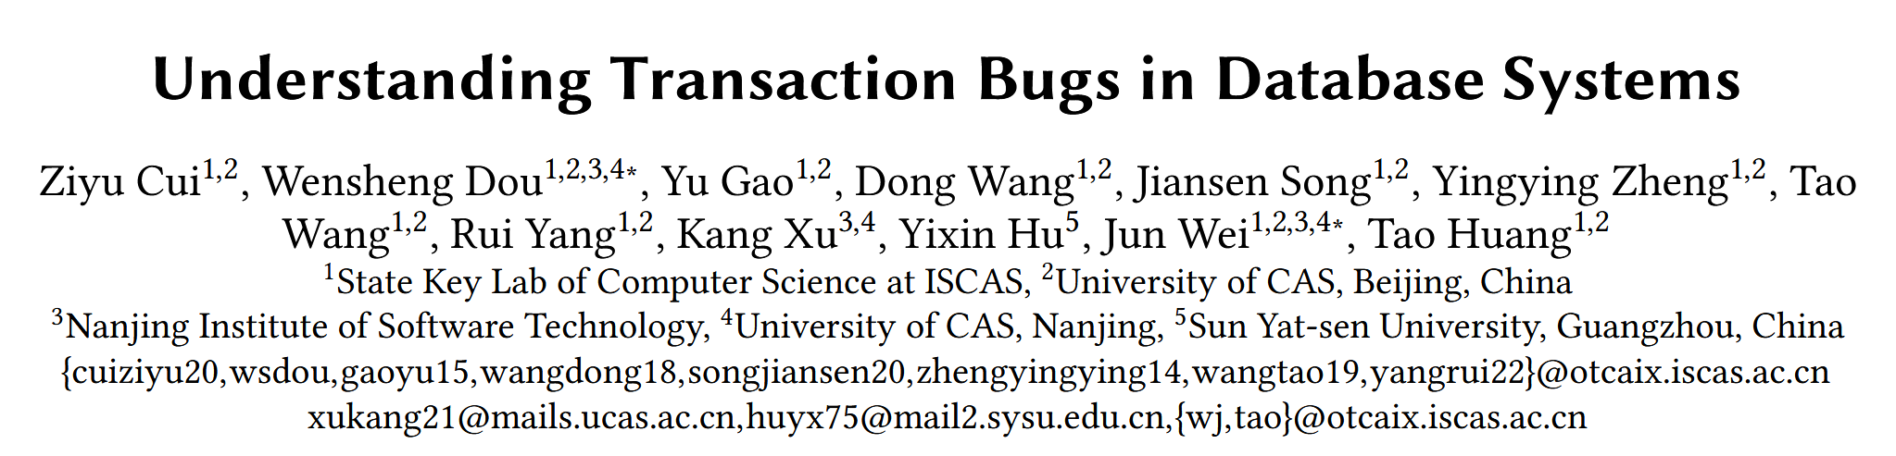

Slide 2
INTRODUCTION
BACKGROUND
Transaction bugs(TXBugs) can cause DBMSs to violate their transaction semantics, e.g., ACID (Atomicity, Consistency, Isolation, and Durability).
TXBugs can cause severe consequences in DBMSs, and easily go unnoticed by DBMS developers.
About 1/3 TXBugs can result in incorrect query results, database states and DBMS states.

Slide 3
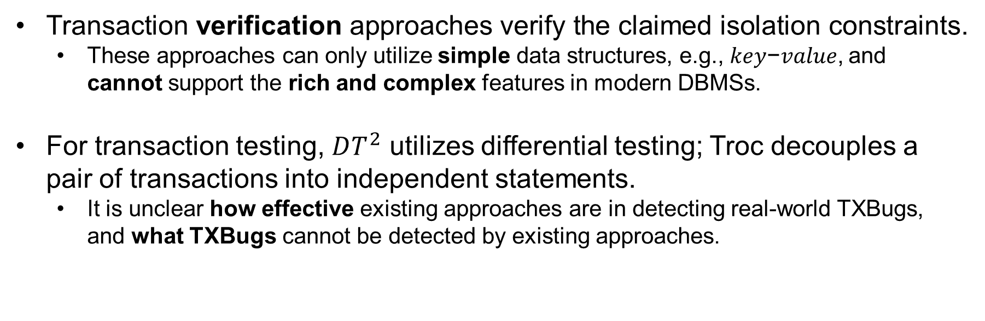
INTRODUCTION
BACKGROUND
Transaction verification approaches verify the claimed isolation constraints.
These approaches can only utilize simple data structures, e.g., 𝑘𝑒𝑦−𝑣𝑎𝑙𝑢𝑒, and cannot support the rich and complex features in modern DBMSs.
For transaction testing, $DT^{2}$ utilizes differential testing; Troc decouples a pair of transactions into independent statements.
It is unclear how effective existing approaches are in detecting real-world TXBugs, and what TXBugs cannot be detected by existing approaches.

Slide 4
INTRODUCTION
RESEARCH QUESTION
Bug manifestation: How do TXBugs manifest themselves? How are TXBugs triggered?
Root cause: What are root causes for TXBugs?
Bug impact: What impacts do TXBugs have? Can they lead to silent failures?
Bug fixing: How are TXBugs fixed?
Detection capability of existing approaches: How effectively can existing approaches detect TXBugs?

Slide 5
CONTRIBUTION
We present the first empirical study on transaction bugs in real-world DBMSs from five aspects, i.e., bug manifestations, root causes, bug impacts, bug fixing, and detection capability of existing approaches.
Our 140 documented transaction bugs can serve as a bug benchmark for future work on combating transaction bugs in DBMSs.

Slide 6
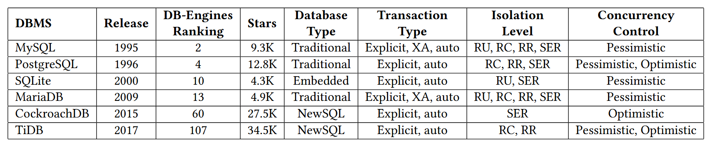
METHODOLOGY
TARGET DBMSs
TRANSACTION TYPE
Explicit transaction: Transactions start with BEGIN and end with COMMIT/ROLLBACK.
XA transaction: XA transactions are used for processing distributed transactions in MySQL and MariaDB.
Auto transaction: Single statement is implicitly executed as an independent transaction with autocommit.

Slide 7
METHODOLOGY
Collecting TXBUGs
We collect TXBugs from these DBMSs’ issue repositories.
Long period, e.g. 27 years for MySQL.
Large amount, e.g., 109,580 issues in MySQL, and 13,716 issues in TiDB.
We apply some filtering rules to identify relevant issues.
Confirmed by DBMS developers in the last 5 years.
Contained the following keywords, i.e., “transaction”, “abort”, “commit”, “isolation level”, and their variations.
We manually inspect the bug description and developer comments for each retrieved issue(7775).
We only keep TXBugs that we can completely understand(140).

Slide 8
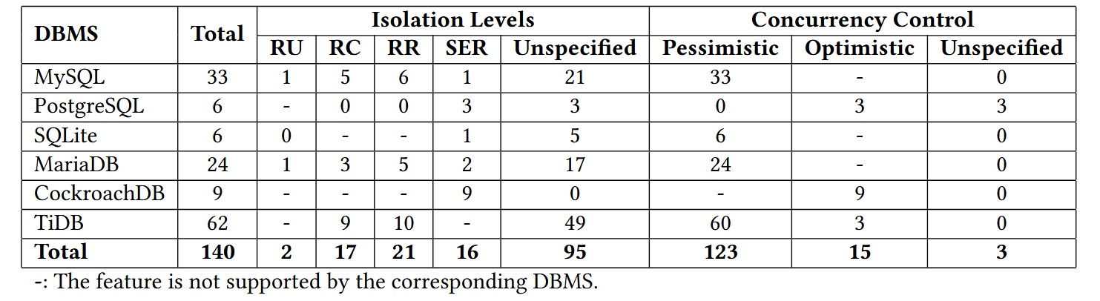
METHODOLOGY
Collecting TXBUGs
All our studied TXBugs have been independently investigated and discussed by at least three authors.
We look through the patches to fix TXBugs or compare the code between fix and old DBMS version.

Slide 9
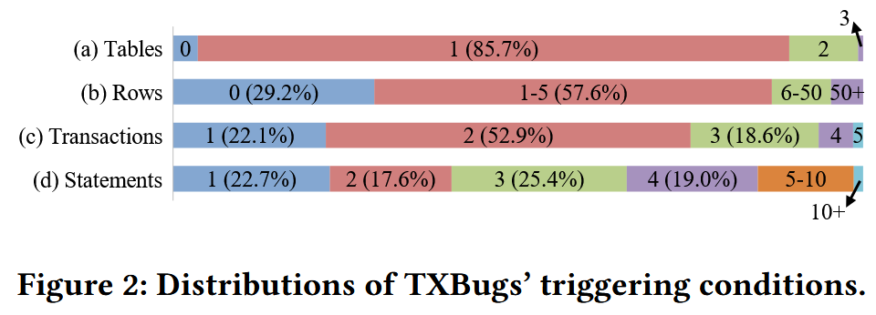
BUG MANIFESTATION
Initialization
Most (89.3%) TXBugs require no more than one initial table, and all TXBugs require at most three initial tables.
Most (86.8%) initial tables in TXBugs contain a small amount of data, i.e., no more than 5 rows of data.
Most (71.4%) TXBugs have specific requirements for database properties, e.g., key constraints, column constraints, partition configurations, and virtual tables.

Slide 10
BUG MANIFESTATION
Database properties
86 (61.4%) TXBugs require key constraints (e.g., primary key, unique key, and foreign key).
26 (18.6%) TXBugs require index settings and 46 (32.9%) TXBugs require column constraints(e.g., NOT NULL, DEFAULT NULL and AUTO_INCREMENT).
15 (10.7%) TXBugs require encoding, and 9 (6.4%) TXBugs require partition.

Slide 11
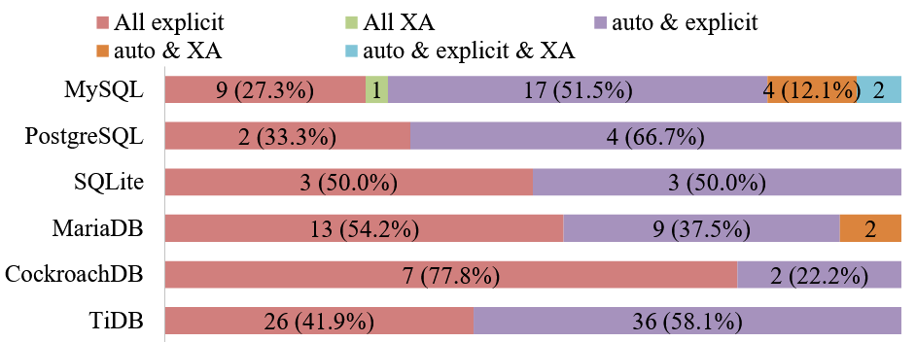
BUG MANIFESTATION
Transactions
Almost all (93.6%) TXBugs require no more than three transactions, and no more than five transactions can trigger all our studied TXBugs.
More than half (56.4%) of TXBugs require multiple types of transactions.

Slide 12
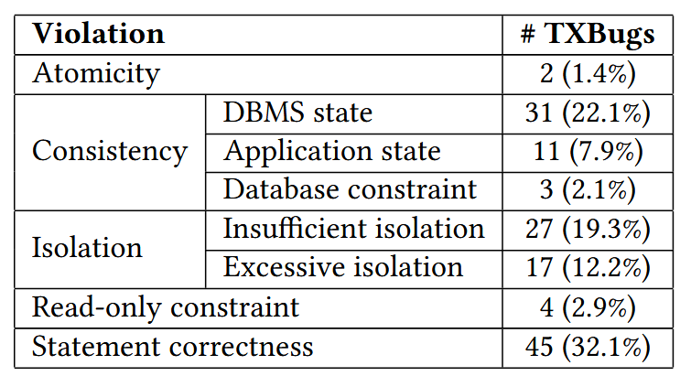
BUG MANIFESTATION
Bug Determinism
132 (94.3%) TXBugs can be triggered deterministically.
Root Cause
Notes:
Atomicity：原子性，例如更新仅部分成功
DBMS state：数据库系统内部状态不一致
Application state：执行结果和操作的逻辑不一致
Database constraint：违反数据库构建时定义的状态
Insufficient isolation：比宣称的级别更弱
Excessive isolation：额外的锁阻塞
Read-only constraint：只读事务中实现了写请求
Statement correctness violations：其他的

Slide 13
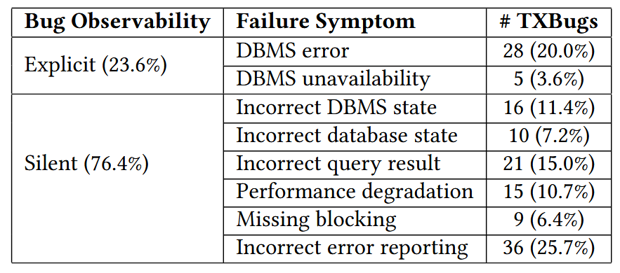
BUG MANIFESTATION
Failure Symptoms
Most (76.4%) TXBugs lead to silent failures.
Two thirds (62.9%) of TXBugs have critical or major priorities.

Slide 14
BUG MANIFESTATION
Bug Fixing
83 (59.3%) TXBugs have been fixed by DBMS developers. On average, fixing a TXBug involves:
5 patches;
5 files;
150 lines of code change;
102 days.
57 (40.7%) TXBugs have not been fixed yet, whose average durations are 360(TiDB)-1046(PG) days.
hard to diagnose root causes;
cannot figure out their correct transaction semantics;
cannot figure out their fixing solutions.

Slide 15
EXISTING APPROACHES
Transaction Verification
Most TXBugs(97.2%) cannot satisfy transaction verification approaches’ conditions.
different database structures from 𝑘𝑒𝑦−𝑣𝑎𝑙𝑢𝑒;
complex operations other than 𝑟𝑒𝑎𝑑 (𝑘𝑒𝑦) and 𝑤𝑟𝑖𝑡𝑒 (𝑘𝑒𝑦, 𝑣𝑎𝑙𝑢𝑒);
failure out of the transaction execution history.
We find that only 52 TXBugs satisfy DT2’s preconditions, and can be detected by DT2.
Only 25 TXBugs satisfy Troc’ preconditions, and can be detected by Troc.
Transaction Testing

Slide 16
LESSONS LEARNED
Test Case
more types of TXBugs, e.g., atomicity and read-only constraint violations
various SQL features instead of only key-value structure
large numbers of transactions and data should be inefficient.
Test Oracle
precise transaction semantics for performance degradation, DBMS errors, statement correctness violations

Slide 17
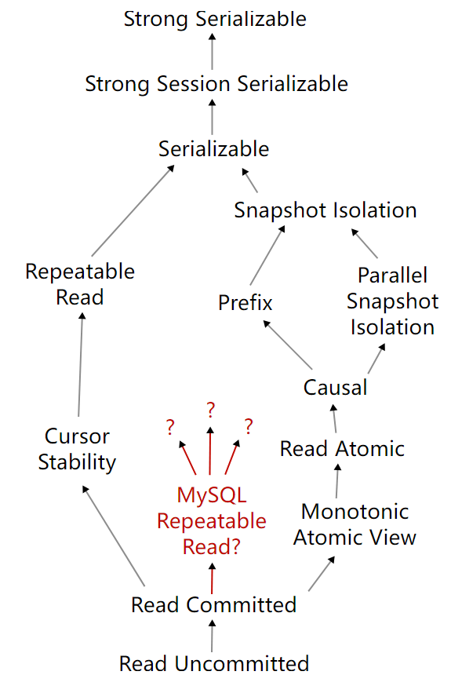
LESSONS LEARNED
Test Verification
new transaction verification techniques to record and analyze complex transactions’ execution history
Transaction Semantics
a clear and unified specification for transaction semantics
TXBug Diagnosis
new approaches on automatically detecting duplicate TXBug reports
[1] https://jepsen.io/analyses/mysql-8.0.34

