Slide 1



Slide 2
INTRODUCTION
BACKGROUND
Large-scale storage systems are susceptible to various failures.
The fail-slow failures have been receiving an increasing amount of attention.
In fail-slow failures, a software or hardware component (while functioning) delivers lower-than-expected performance.

Slide 3
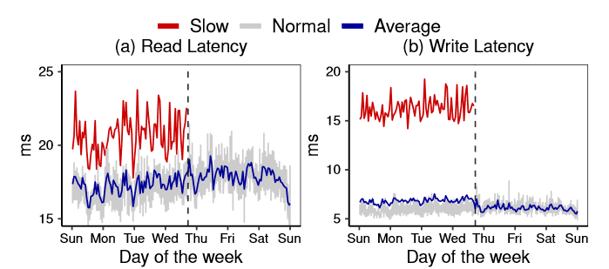
IMPACT OF FAIL-SLOW FAILURES
While the fail-slow drive shows much higher read/write latency than the mean of all the drives, its other metrics, such as IOPS, remain normal.

Slide 4
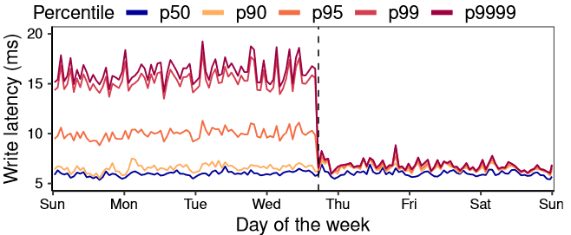
IMPACT OF FAIL-SLOW FAILURES
The load balancer prefers not to allocate writes to the victim node due to its abnormally high retry rate caused by high tail latencies.

Slide 5
INTRODUCTION
LIMITATION OF CURRENT WORK
They are impractical and inefficient for large-scale deployment in our production cloud environment.
These techniques require source code access or software modification.
Existing techniques can only detect fail-slow failures at the node level.

Slide 6
CONTRIBUTION
share our lessons on detecting fail-slow failures in largescale data centers from three unsuccessful attempts.
propose the design of PERSEUS, a non-intrusive, fine-grained and general fail-slow detection framework.
assemble a large-scale fail-slow dataset and build a fail-slow test benchmark.
provide an in-depth root cause analysis of fail-slow failures from the perspective of various factors.

Slide 7
DESIGN
GOALS
Non-intrusive: rely on external performance statistics (e.g., drive latency) for detection.
Fine-grained: expect the framework to pinpoint the culprit.
Accurate: avoid unnecessary diagnosis on false positives.
General: can be deployed on both SSD and HDD clusters and quickly applied to different services with minor adjustments.

Slide 8
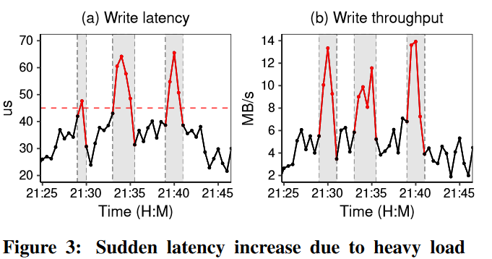
UNSUCCESSFUL ATTEMPTS
THRESHOLD FILTERING
We can set up a hard threshold on drive latency to identify fail-slow drives based on the Service Level Objectives (SLOs).
Hard to have a suitable threshold for detection.

Slide 9
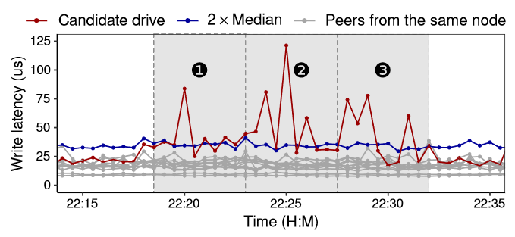
UNSUCCESSFUL ATTEMPTS
PEER EVALUATION
We can identify the fail-slow drive by comparing the performance between drives from the same node.
Require more empirical parameters than threshold filtering, such as the slowdown degree and the monitoring window span.

Slide 10
UNSUCCESSFUL ATTEMPTS
IASO-BASED MODEL
The design principle of IASO is to leverage software timeouts and convert them into informative metrics to benchmark fail-slow.
IASO requires code changes (i.e., intrusive monitoring) to insert or modify certain code snippets of the running instances.
IASO is node-level detection, whereas our goal is device-level.
The IASO-based model delivers rather unsatisfactory performance on our assembled benchmark, with a precision rate of only 0.48.

Slide 11
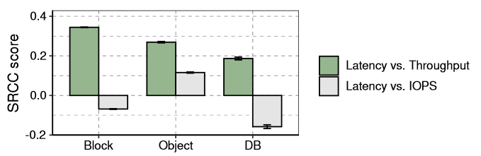
GUIDELINES
METRICS
We mostly focused on the write performance.
Among the verified fail-slow cases, more than half of them only have a notable influence on writes.
Fail-slow failures have more severe impacts on writes.
WORKLOAD PRESSURE
We decide to use throughput for modeling the workload pressure.

Slide 12
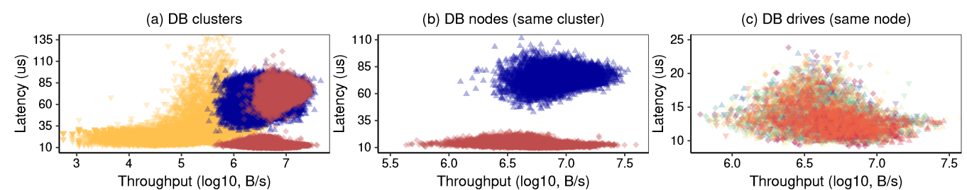
GUIDELINES
ADAPTIVE THRESHOLDS
We decide to use the node-wise samples to build the latency-vs-throughput distribution.
We can use regression models on such distribution to define a statistically normal drive and subsequently use its upper bound as the adaptive thresholds for various environments.

Slide 13
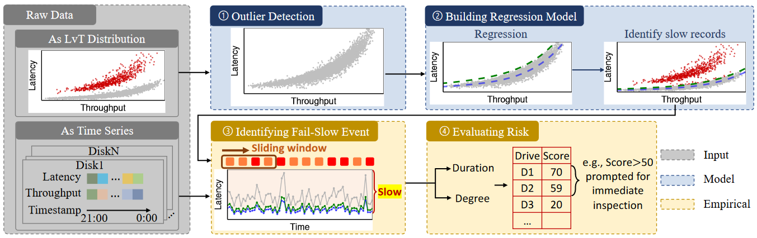
DESIGN
WORKFLOW

Slide 14
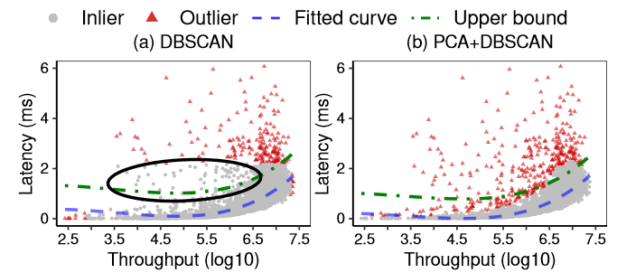
DESIGN
OUTLIER DETECTION
DBSCAN groups points whose distances between points is smaller than a minimum value.
We leverage PCA to penalize the outliers perpendicular to the skewed direction to reduce mislabeling.
Notes:
Throughput 和latency强关联，所以要用PCA突出在偏移方向上的特征

Slide 15
DESIGN
REGRESSION MODEL
Polynomial regression is preferable as it handles nonlinearity while retaining model parsimony.
Advanced models (e.g., kernel regression) are unnecessary as the latency-vs-throughput mapping is primarily monotonic.

Slide 16
DESIGN
IDENTIFYING FAIL-SLOW EVENT
We can calculate a prediction upper bound by regression model to distinguish the slow entries.
Slowdown Ratio (SR) is obtained from dividing drive latency by the upper bound.

Slide 17
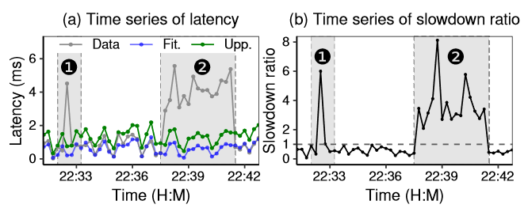
DESIGN
IDENTIFYING FAIL-SLOW EVENT
Within a fixed length sliding window, a certain proportion of SR series with a median SR value exceeding the threshold(e.g. 1) will be detected as a fail-slow event.

Slide 18
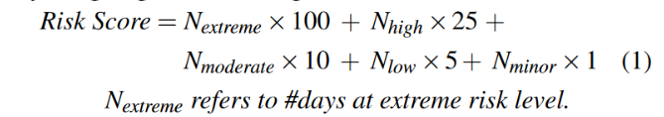
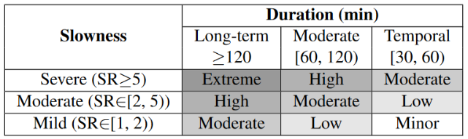
DESIGN
RISK SCORE
To examine fail-slow, a per-drive risk score is calculated by assigning different weights to risk levels:

Slide 19
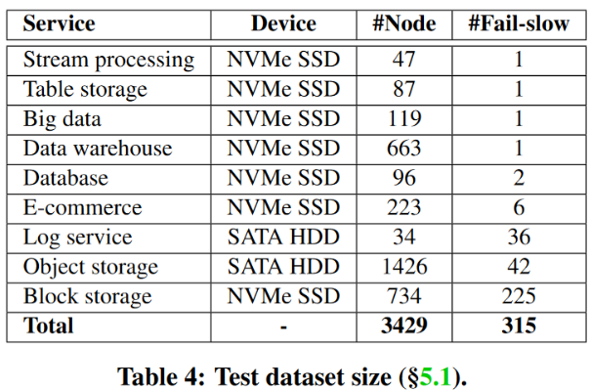
EVALUATION
DATASET
Our dataset includes 886 million operational traces of 15 consecutive days from 41K drives and 25 clusters.
Notes:
Rocks-db lsm
Leanstore update in place

Slide 20
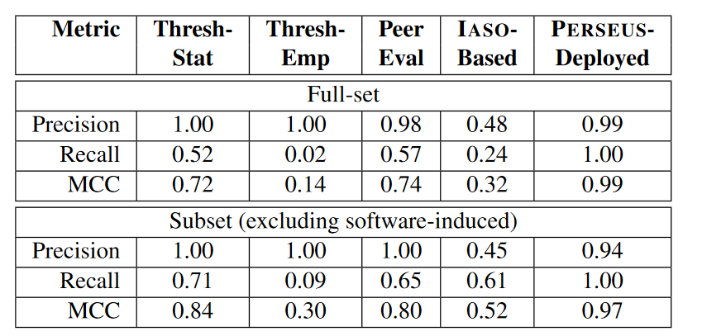
EVALUATION
RESULT
Strict thresholds will miss mild fail-slow. (Threshold-based/Peer-evaluation)
IASO heavily relies on software timeouts which can not be simply replaced with other metrics; its algorithm is designed for node-level detection.(IASO-based)
Notes:
Rocks-db lsm
Leanstore update in place

Slide 21
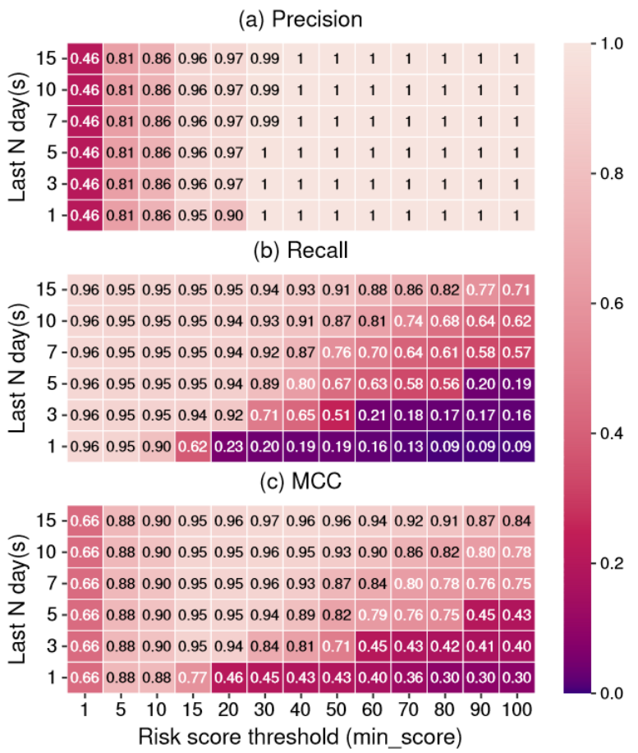
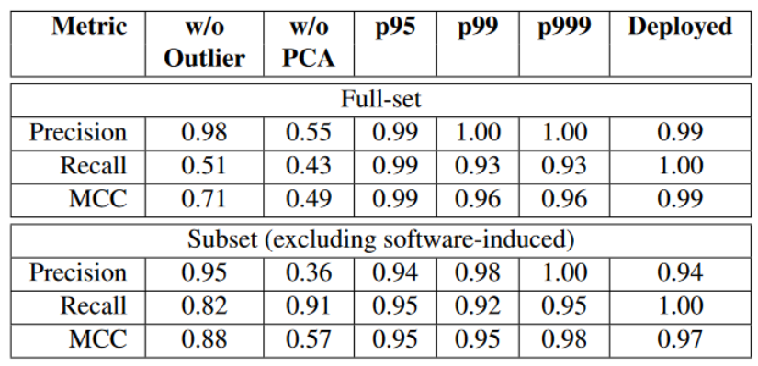
EVALUATION
RESULT
What leads to a low recall:
lack of data pre-processing(outlier/PCA)
strict upper bound
high risk score
Notes:
Rocks-db lsm
Leanstore update in place

Slide 22
LIMITATION
Multiple fail-slow occurrences: PERSEUS leverages an important precondition that fail-slow failures should be rare in the field.
Generalizability: Drives have the same configuration, and multiple levels of load balancing assure that the workload on each drive is similar within the same node.
Comprehensiveness: It is possible that some fail-slow failures could only be triggered during a particular time window or under heavier workloads.

