Slide 1



VLDB 2024
Detecting Metadata-Related Logic Bugs in Database Systems via
Raw Database Construction
https://github.com/tcse-iscas/radar

Slide 2
Database Metadata Effects
Describes the organization of data in a database
A column c1 with TINIINT data only store numeric values between -128 and 127
NOT NULL constraint means the NULL values cannot be stored in c1
UNIQUE constraint means c1 is not allowed to store duplicate numeric values
Optimize query evaluation
For a SQL “SELECT c1 FROM t1 where ISNULL(c1)”, it can return false directly
Use Index to avoid unnecessary data accesses

Slide 3
What is metaBug？
MetaBugs refers to metadata-related logic bugs
It can cause a DBMS to silently compute an incorrect result for a given query and can easily go unnoticed by DBMS developers
Difficulty
Lack effective strategies to specifically test metadata-related optimizations
Lack effective test oracles to judge whether the metadata-related optimization in a DBMS behaves correctly for a given query

Slide 4
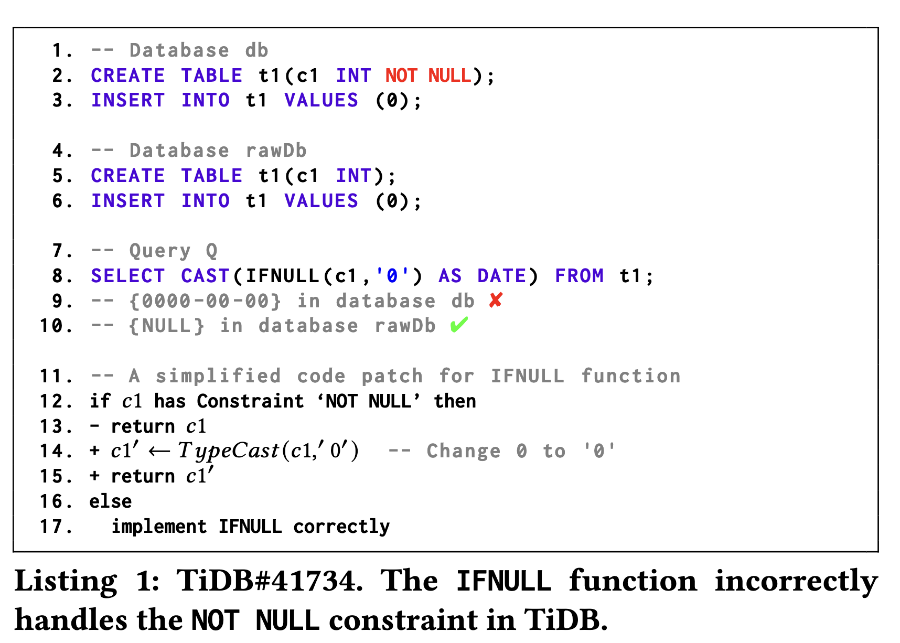
A Simple Example

Slide 5
Basic Methodology
It first randomly generate a database 𝑑𝑏 that contains some metadata
Then, it construct a raw database 𝑟𝑎𝑤𝐷𝑏, which has the same data with 𝑑𝑏, but does not contain the metadata in 𝑑𝑏
Given a query 𝑄, it execute it on 𝑑𝑏 and 𝑟𝑎𝑤𝐷𝑏, respectively, and then compare their returned query results
Any inconsistency in their returned query results indicates a 𝑚𝑒𝑡𝑎𝐵𝑢𝑔 in the target DBMS

Slide 6
Contribution
It proposes Radar, a general and effective testing approach to detect metadata-related logic bugs in DBMSs. It solves the test oracle problem by comparing the query results on databases that contain the same data but with different metadata
It proposes a metadata-oriented testing optimization strategy to improve Radar’s testing efficiency, which can test databases with diverse metadata and discover unique bugs quickly
It implements Radar and evaluate it on five widely-used DBMSs. It has found 42 bugs in these DBMSs, of which 38 have been confirmed as unique and new bugs

Slide 7
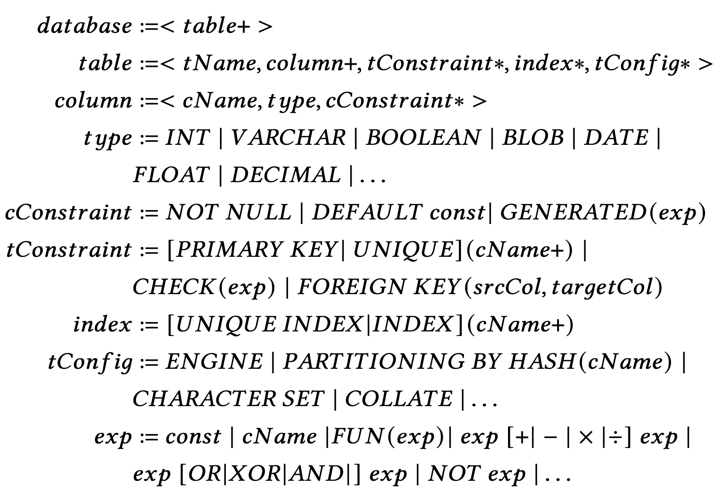
Database Metadata Classfication
Data types
Column constraints
Table constraints (tConstraint)
Index
Table configurations (tConfig)

Slide 8
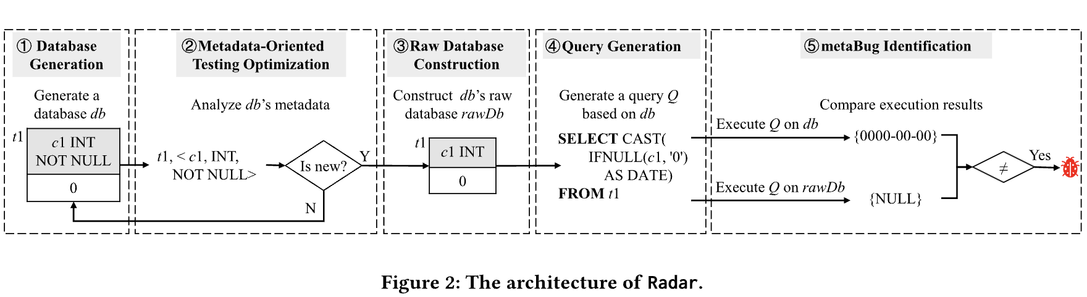
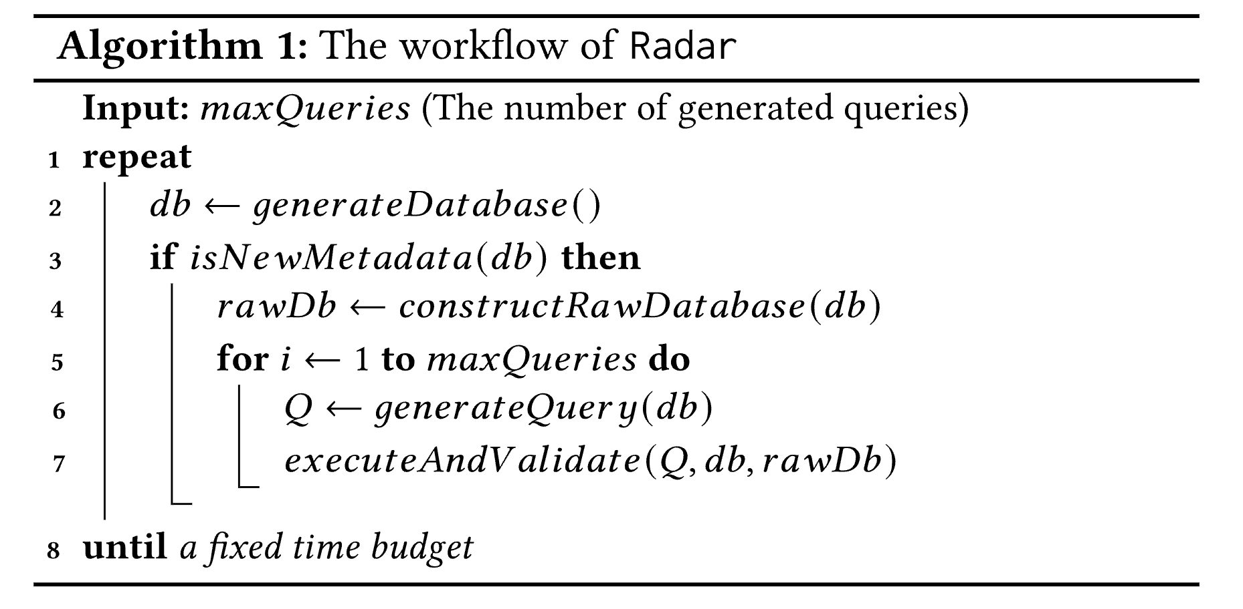
Architecture

Slide 9
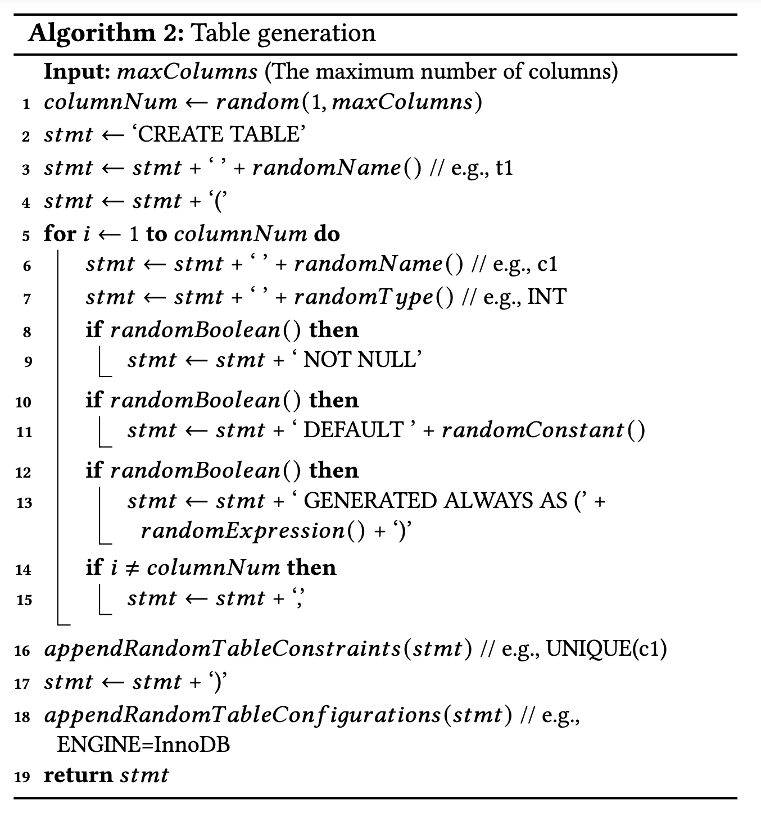
Database Generation
Step1: Generate a table with a random name and a random number of columns
Step2: Each column has a random name, a random data type and some random column constraints
Step3: Randomly add some table constraints/configurations
Step4: Randomly build some indexes, and FOREIGN KEY constraints
Step5: Populate random data into each table
Note: 𝑚𝑎𝑥𝑇𝑎𝑏𝑙𝑒𝑠, 𝑚𝑎𝑥𝐶𝑜𝑙𝑢𝑚𝑛𝑠, 𝑚𝑎𝑥𝑅𝑜𝑤𝑠, 𝑚𝑎𝑥𝐼𝑛𝑑𝑒𝑥𝑒𝑠 and 𝑚𝑎𝑥𝐹𝑜𝑟𝑒𝑖𝑔𝑛𝐾𝑒𝑦𝑠 are all configurable.

Slide 10
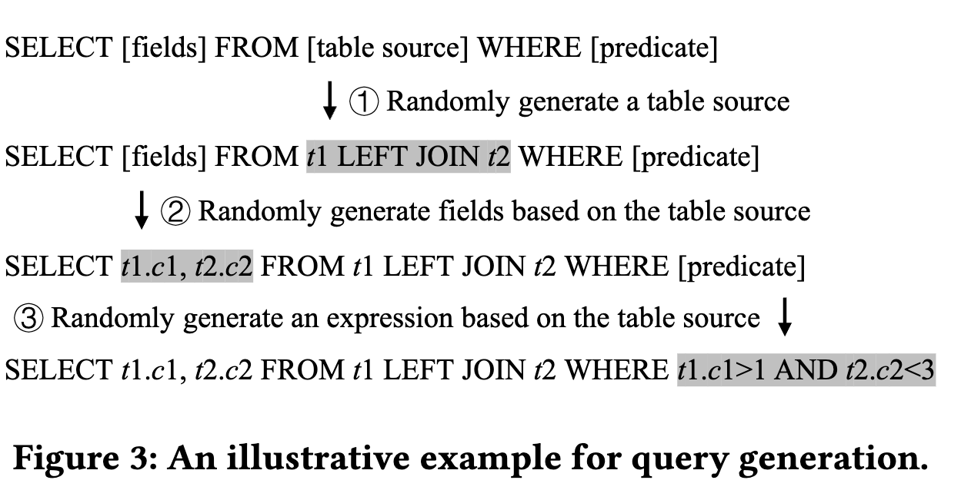
Query Generation

Slide 11
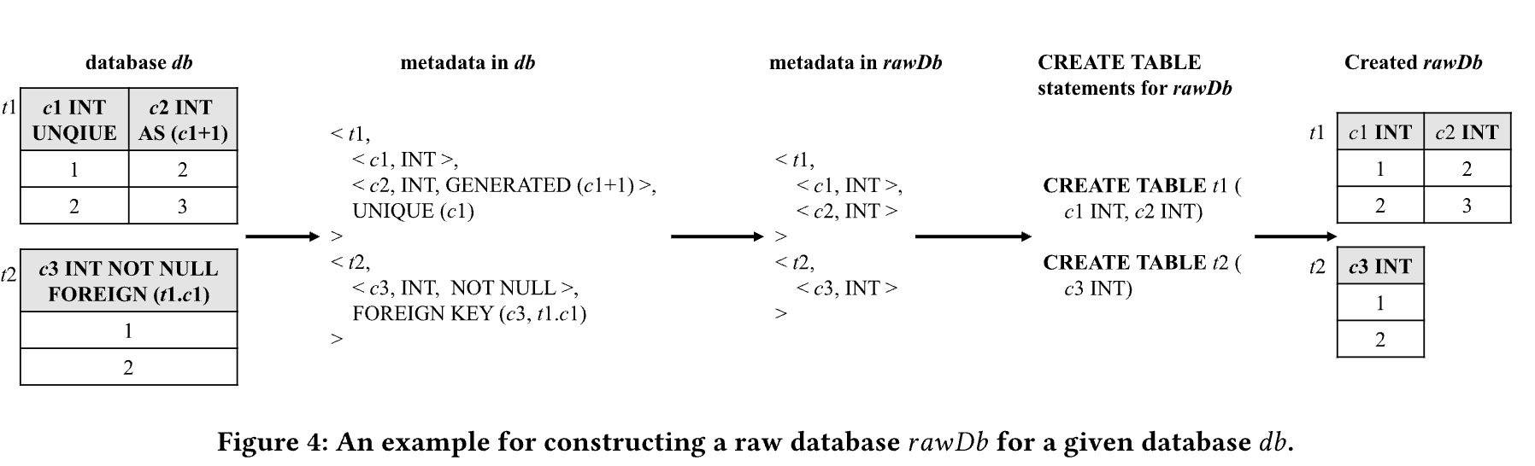
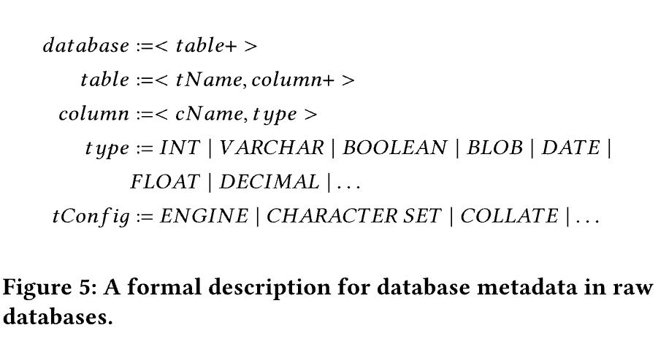
Raw Database Generation

Slide 12
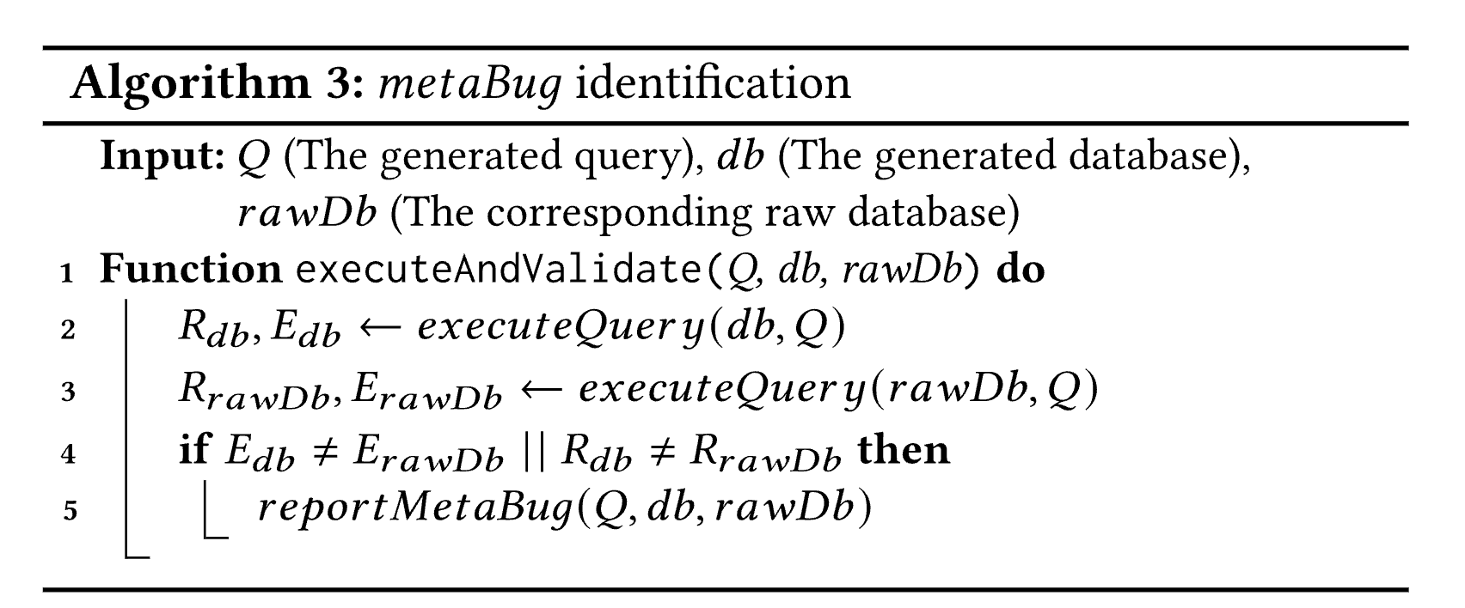
metaBug Identification

Slide 13
Metadata-Oriented Testing Optimization
Motivation: Random database generation can generate many databases with the same or similar database metadata, i.e., triggering duplicate metaBugs
Solution: Extracting abstract database metadata

Slide 14
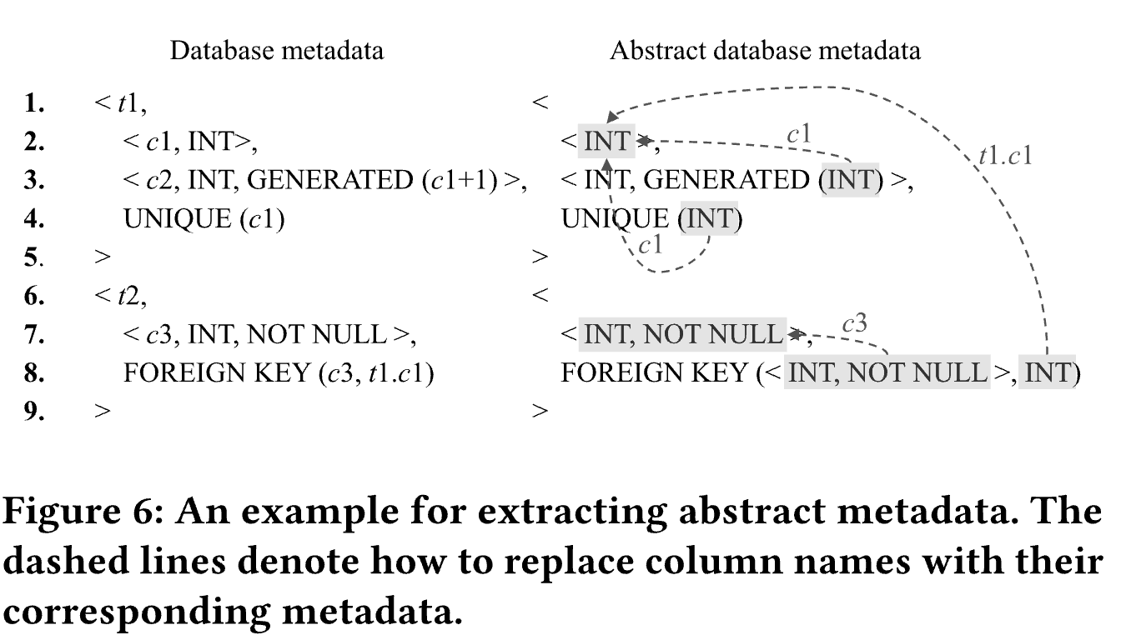
Extracting Abstract Database Metadata

Slide 15
Experiment
Database and query generation: SQLancer in JAVA
Target DBMS: MySQL 8.0.32, SQLite 3.41.0, MariaDB 11.0.3, CockroachDB 22.2.5, and TiDB 6.6.0
Experimental infrastructure: perform their experiments on a machine with 8 CPU cores and 32GB RAM
Experimental process: It run Radar on each target DBMS for 24 hours, and then stop Radar to analyze the generated bug reports and submit the detected unique bug reports to DBMS developers. After processing all the generated bug reports, we start a new testing round.

Slide 16
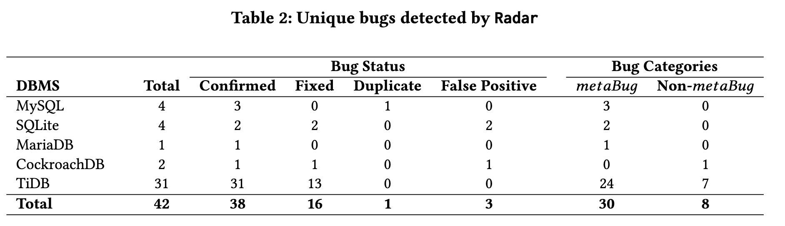
Unique Bugs

Slide 17
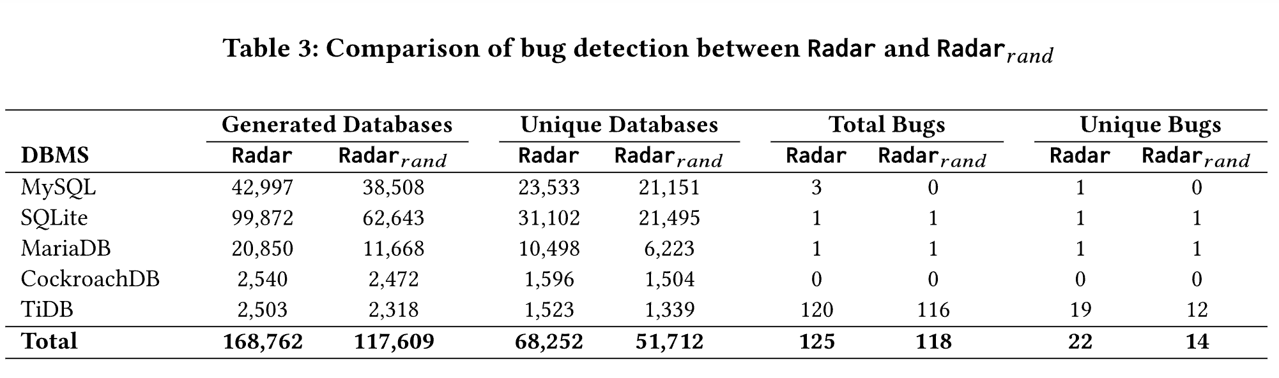
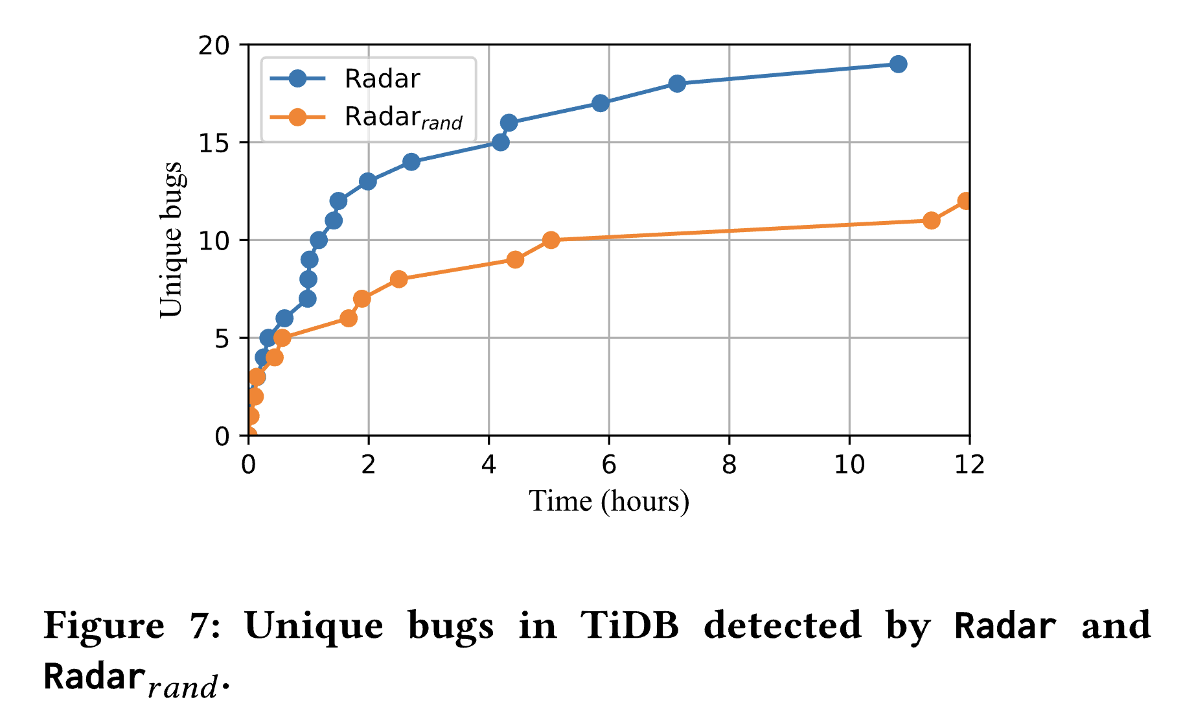
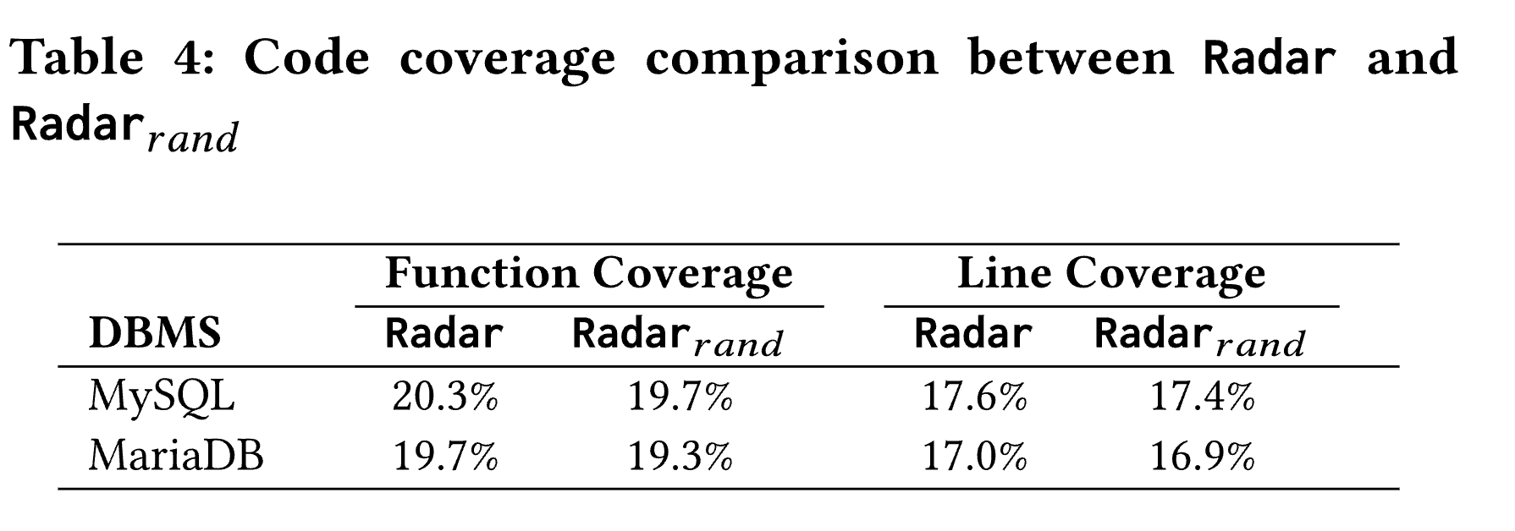
Test Efficiency

Slide 18
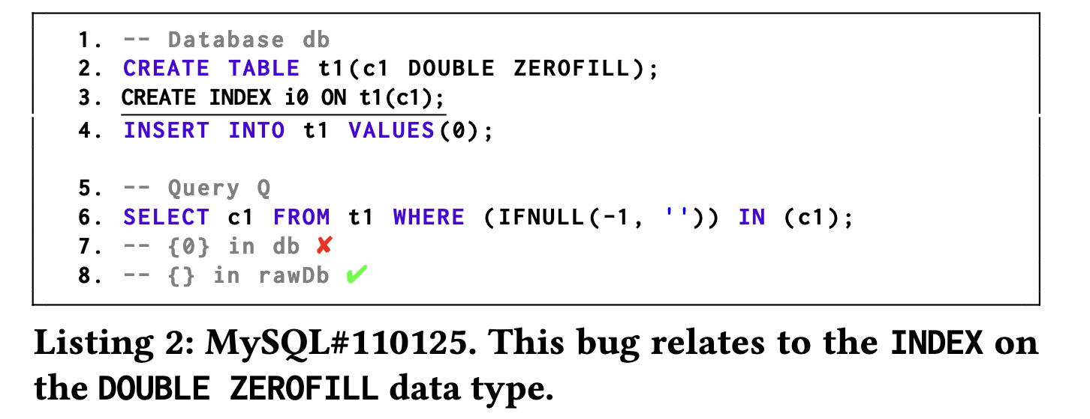
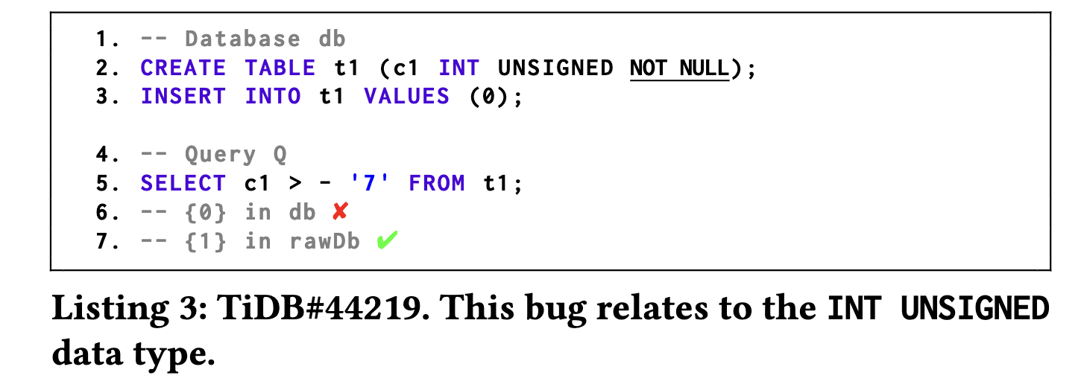
Case Study
Notes:
如果是空，就返回后一个，否则返回自己

Slide 19
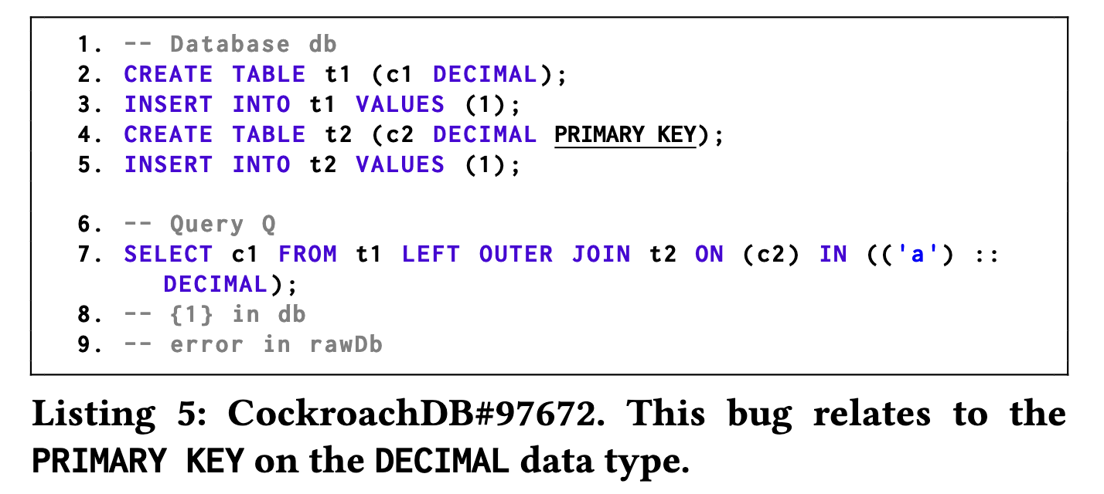
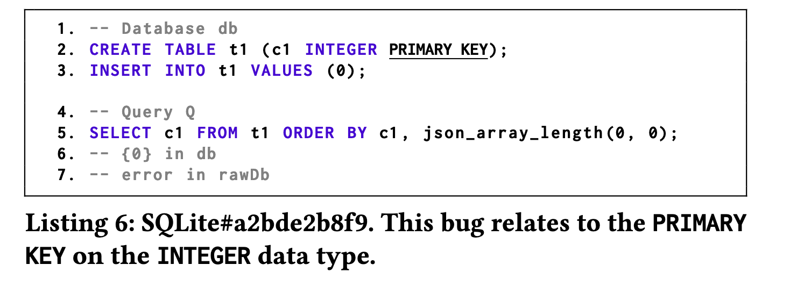
False Positives

Slide 20
Limitations
Radar may miss some bugs due to the following reasons
First, random database and query generation may cause Radar to miss some bugs
Second, Radar cannot detect bugs that occur in both the generated database and its corresponding raw database
Third, Radar cannot detect bugs that are caused by nondeterministic functions, database-related functions and index hints, since Radar does not support them during query generation

Slide 21
Thank You Guys!

